Slide 1

Windows Server 2022 Overview
Week 3

Slide 2

Objectives
2.1 Getting Started with Windows server
2.2 Introducing Windows server 2022
2.3 Installing Windows server 2022
2.4 Post Installation task on windows server 2022

Slide 3
2.1 Getting Started with Windows server
2.1.1 Understanding what a server does
Server is a computer that is meant to be a dedicated service provider,
Client is a computer that requests services.
Client/server network : network that is made up of dedicated servers and clients.
Plan your server for future growth

Slide 4
2.1 Getting Started with Windows server
2.1.2 Understanding the server roles
A server role is a primary duty that a server performs:
Some of the more common server roles include:
File services Email Server
Print services Database Server
Web services
Remote Access
Application Server

Slide 5
2.1 Getting Started with Windows server
2.1.2 Selecting Server Hardware
Primary Subsystem that makes the server hardware:
Processor
Memory
Storage
Network
Notes:
https://www.amazon.com/dp/B085RK7ZWV?tag=rswebsols-20&linkCode=osi&th=1

Slide 6
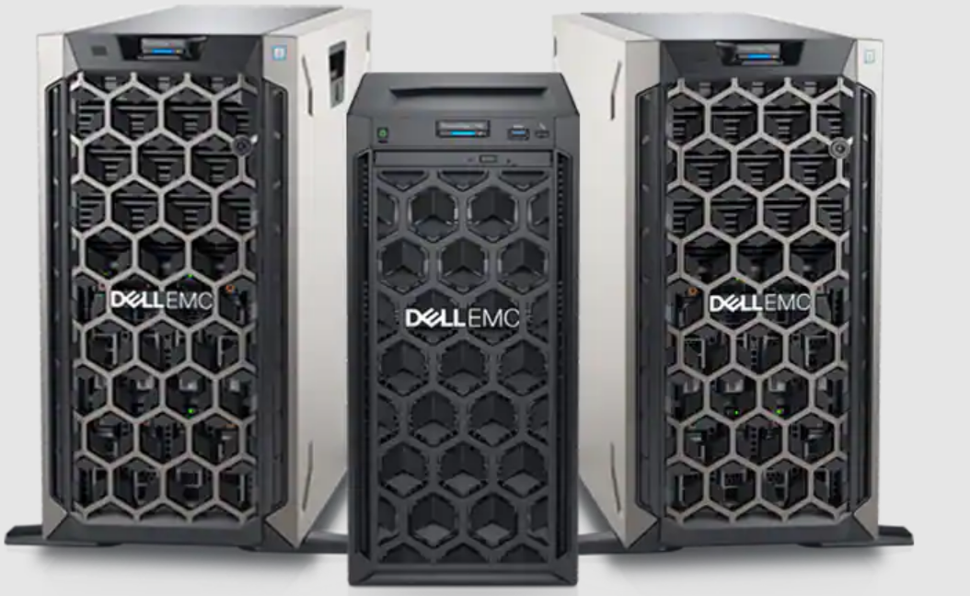
2.1 Getting Started with Windows server
2.1.2 Types of Server
Tower Server
Standalone, upright cabinet, also known as a chassis configuration
Notes:
https://www.amazon.com/dp/B085RK7ZWV?tag=rswebsols-20&linkCode=osi&th=1

Slide 7
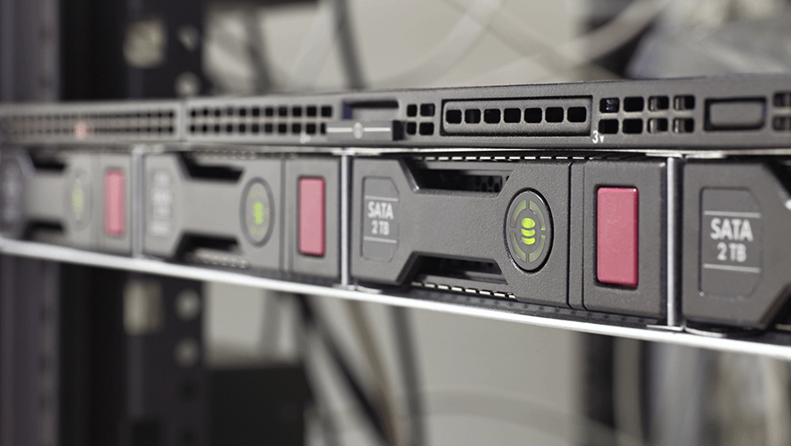
2.1 Getting Started with Windows server
2.1.2 Types of Server
Rack Server
Mounted on a server rack in a data center.
Plays an all-around computing role in the data
center, supporting a multitude of workloads.
Notes:
https://www.amazon.com/dp/B085RK7ZWV?tag=rswebsols-20&linkCode=osi&th=1

Slide 8
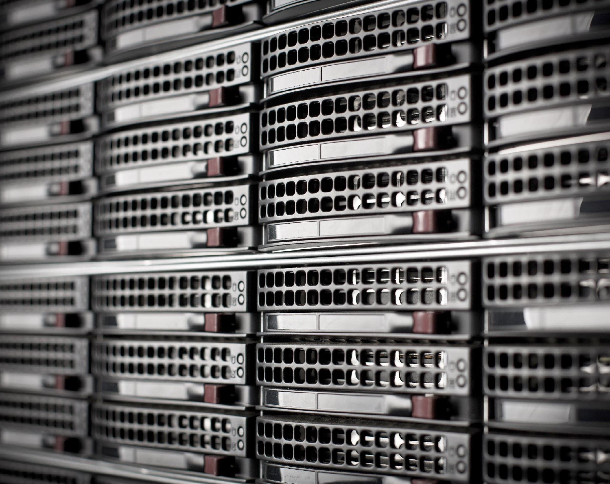
2.1 Getting Started with Windows server
2.1.2 Types of Server
Blade Server
Compact device that houses multiple thin, modular circuit boards called server blades.
Each blade contains a single server, which is often assigned to one application.
Notes:
https://www.amazon.com/dp/B085RK7ZWV?tag=rswebsols-20&linkCode=osi&th=1

Slide 9
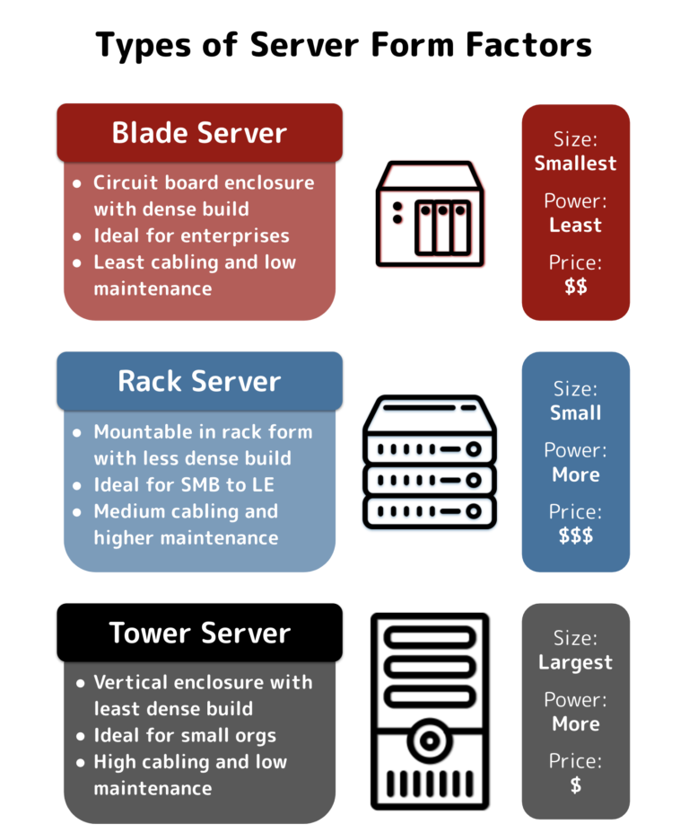
2.1 Getting Started with Windows server
2.1.2 Types of Server
Notes:
https://www.amazon.com/dp/B085RK7ZWV?tag=rswebsols-20&linkCode=osi&th=1

Slide 10
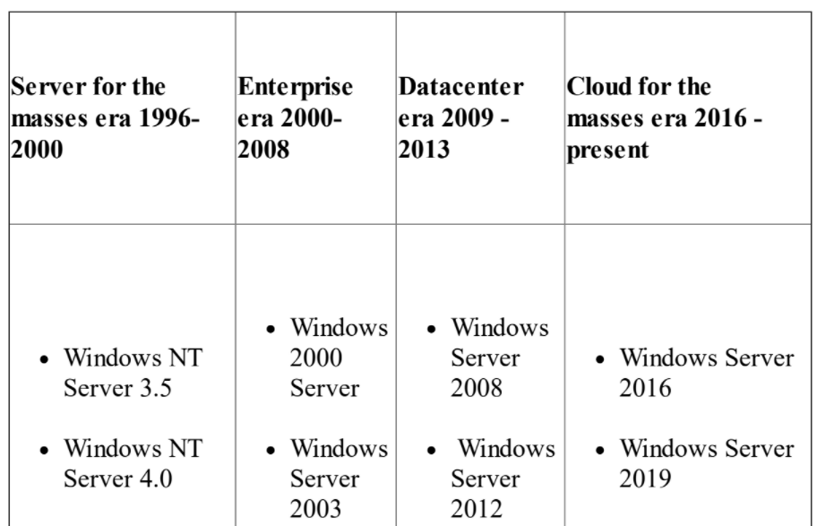
2.1 Getting Started with Windows server
Understanding windows server
Windows Server is the server's operating system developed by Microsoft as part of the Windows NT family of operating systems.
Notes:
https://www.amazon.com/dp/B085RK7ZWV?tag=rswebsols-20&linkCode=osi&th=1

Slide 11
2.2 Introducing Windows Server 2022
Latest version of windows server operating system
Windows Server 2022 Datacenter Edition is the most comprehensive edition designed for enterprises that own highly virtualized data-centers or act as cloud providers.
Windows Server 2022 Standard Edition is the full-featured edition designed for medium-sized businesses that own servers on-premises.
Windows Server 2022 Datacenter: Azure Edition this is intended only for running in the Microsoft cloud.
Notes:
https://www.amazon.com/dp/B085RK7ZWV?tag=rswebsols-20&linkCode=osi&th=1

Slide 12
2.2 Introducing Windows Server 2022
Windows server 2019 vs Windows server 2022
New windows Admin center
Upgraded Hyper-V Manager
Enhanced Security
Hybrid Cloud Capabilities
Notes:
https://www.amazon.com/dp/B085RK7ZWV?tag=rswebsols-20&linkCode=osi&th=1

Slide 13
2.2 Introducing Windows Server 2022
Recommended Hardware Requirement for Windows server 2022
2 GHz 64-bit processor
Compatible with x64 instruction set
32 GB for Server with Desktop Experience installation option
256 GB SSD, 1 TB HDD
An ethernet adapter capable of at least 1 gigabit per second throughput
Compliant with the PCI Express architecture specification.
Graphics device and monitor capable of Super VGA (1024 x 768) or higher-resolution
Notes:
https://www.amazon.com/dp/B085RK7ZWV?tag=rswebsols-20&linkCode=osi&th=1

Slide 14
2.3 Installing Windows server 2022
Understanding Partition Schemes:
Master Boot Record (MBR):
This is an old partition scheme known today as a legacy boot option.
Operates on a 512-byte disk sector
Maximum of four primary partitions, or three primary partitions and
one extended partition. An extended partition can have up to 26 logical
partitions
Support disks up to 2 TB
Notes:
https://www.amazon.com/dp/B085RK7ZWV?tag=rswebsols-20&linkCode=osi&th=1

Slide 15
2.3 Installing Windows server 2022
Understanding Partition Schemes:
GUID Partition Table (GPT): New partition scheme that overcomes the limitations of the MBR
Operates on a 512-byte and up disk sector, most common 4096 byte
Part of the Unified Extensible Firmware Interface (UEFI)
Standard that replaces the old basic input/output system (BIOS) to
Support modern hardware.
Support disks up to 18 EB and 128 partitions
Notes:
https://www.amazon.com/dp/B085RK7ZWV?tag=rswebsols-20&linkCode=osi&th=1

Slide 16

2.3 Installing Windows server 2022
Boot Options:
Optical Installation Media
USB Drive
Network Boot
Notes:
https://www.amazon.com/dp/B085RK7ZWV?tag=rswebsols-20&linkCode=osi&th=1

Slide 17
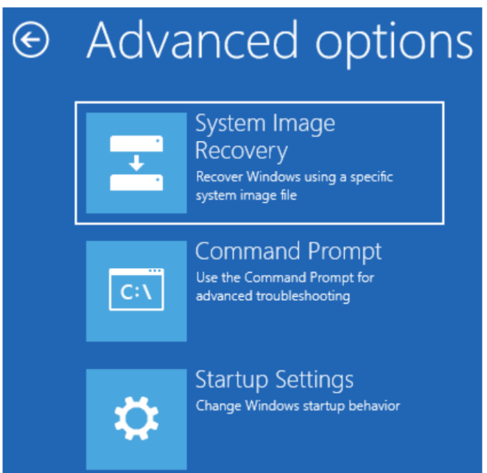
2.3 Installing Windows server 2022
Accessing Advanced Startup Options
1.Click the Start button.
2. Select Settings from the Start menu.
3. In Windows | Settings, select Update & Security.
4. Select Recovery from the navigation menu on the left side of the screen.
5. Click the Restart now button and then click on Continue:
Notes:
https://www.amazon.com/dp/B085RK7ZWV?tag=rswebsols-20&linkCode=osi&th=1

Slide 18
2.3 Installing Windows server 2022
Various Windows Server 2022 Installation Methods:
Clean installation
Installation over a network using WDS
Unattended installation
In-place upgrade
Migration
Notes:
https://www.amazon.com/dp/B085RK7ZWV?tag=rswebsols-20&linkCode=osi&th=1

Slide 19

2.3 Installing Windows server 2022
Performing Clean Installation:
Turn on your computer, depending on the selected boot option, and wait for the boot prompt on the screen. The message on the screen requires user confirmation to boot the system from a DVD, USB flash drive, or network boot.
The installation files are loaded in RAM,
Notes:
https://www.amazon.com/dp/B085RK7ZWV?tag=rswebsols-20&linkCode=osi&th=1

Slide 20
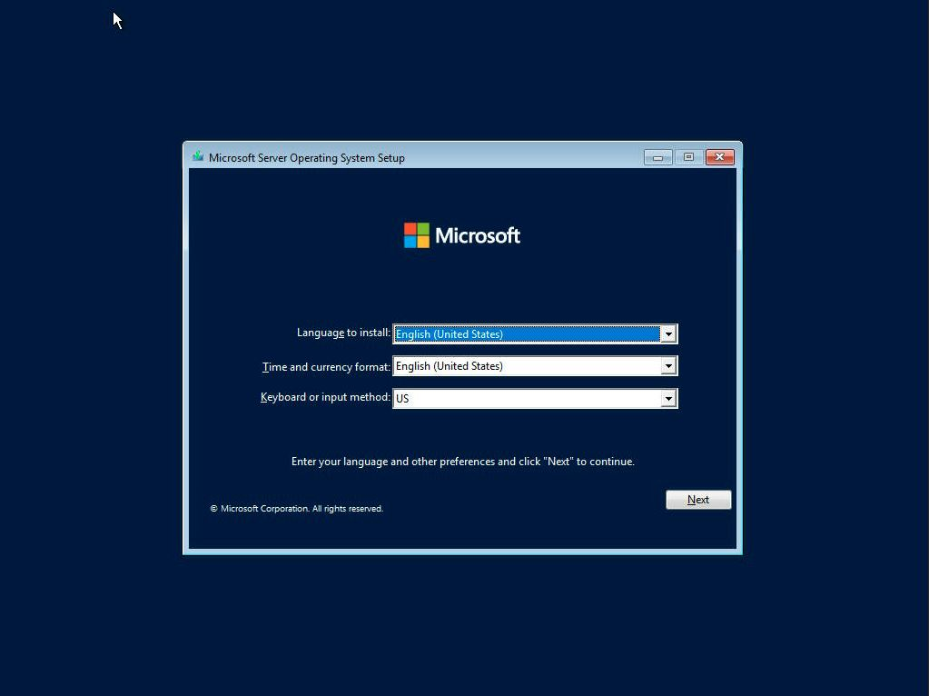
2.3 Installing Windows server 2022
Performing Clean Installation:
3. Enter your Languages and Preferences
Notes:
https://www.amazon.com/dp/B085RK7ZWV?tag=rswebsols-20&linkCode=osi&th=1

Slide 21
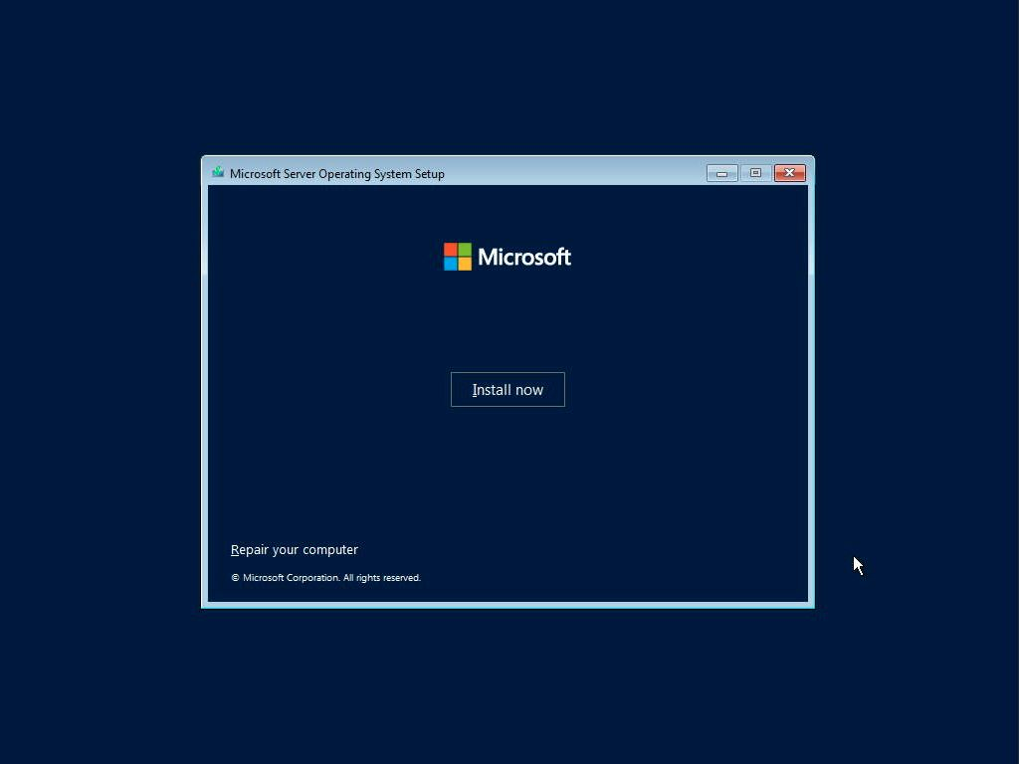
2.3 Installing Windows server 2022
Performing Clean Installation:
4. Click Install
Notes:
https://www.amazon.com/dp/B085RK7ZWV?tag=rswebsols-20&linkCode=osi&th=1

Slide 22
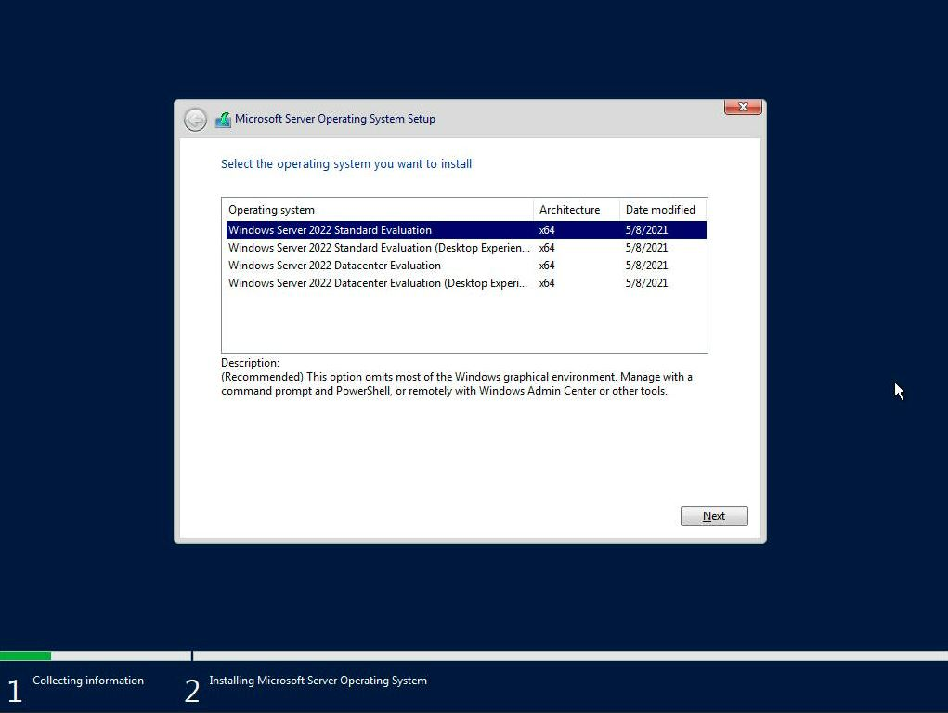
2.3 Installing Windows server 2022
Performing Clean Installation:
5. Select Windows Server 2019 Datacenter (Desktop Experience) and then click Next
Notes:
https://www.amazon.com/dp/B085RK7ZWV?tag=rswebsols-20&linkCode=osi&th=1

Slide 23
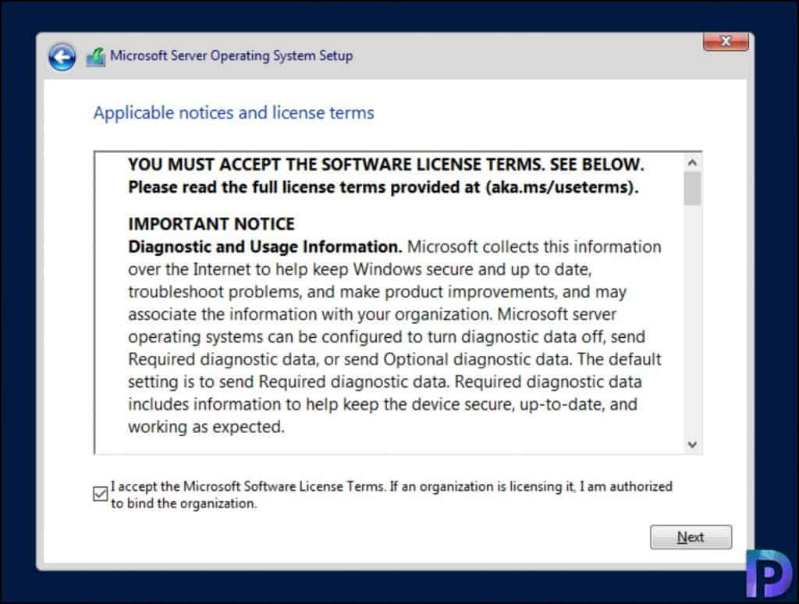
2.3 Installing Windows server 2022
Performing Clean Installation:
6. Take your time to read the license terms. When done, check I accept the license terms and then click Next,
Notes:
https://www.amazon.com/dp/B085RK7ZWV?tag=rswebsols-20&linkCode=osi&th=1

Slide 24
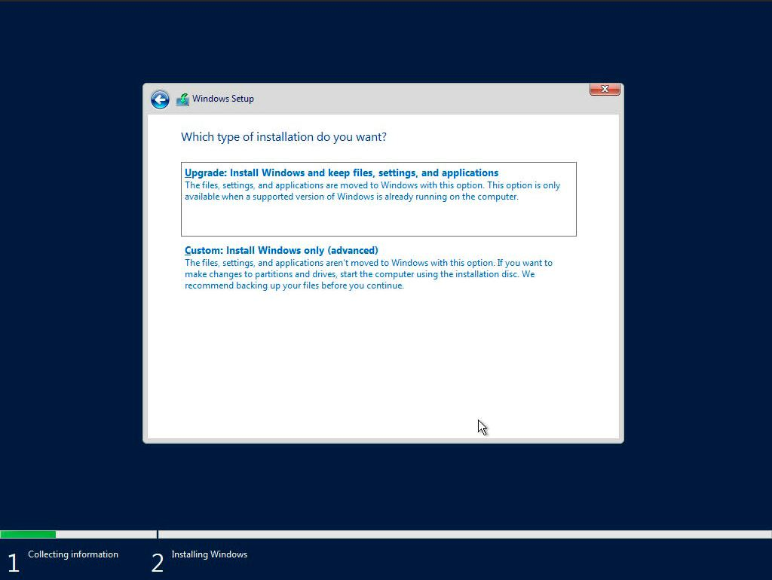
2.3 Installing Windows server 2022
Performing Clean Installation:
7. Select Custom: Install Windows only (advanced), as shown in Figure
Notes:
https://www.amazon.com/dp/B085RK7ZWV?tag=rswebsols-20&linkCode=osi&th=1

Slide 25
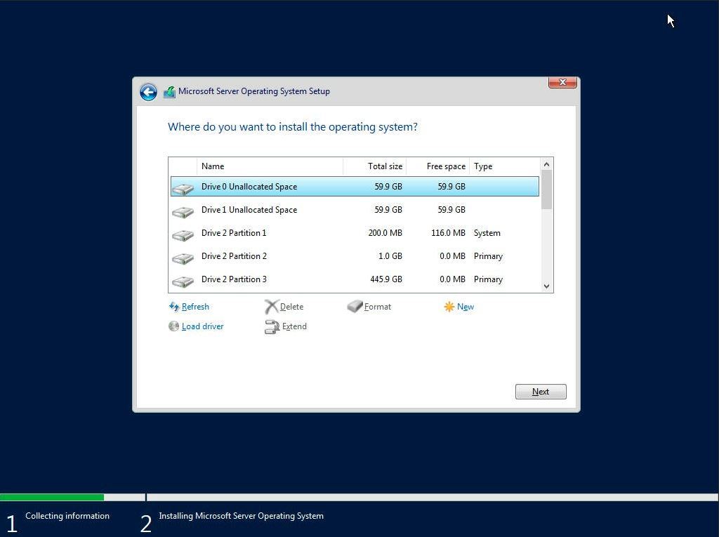
2.3 Installing Windows server 2022
Performing Clean Installation:
8. After preparing the drive, select the partition where you want to install
Windows Server 2022
Notes:
https://www.amazon.com/dp/B085RK7ZWV?tag=rswebsols-20&linkCode=osi&th=1

Slide 26
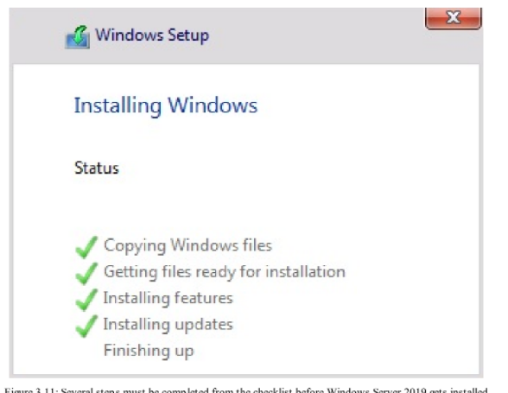
2.3 Installing Windows server 2022
Performing Clean Installation:
9. Windows Setup is installing Windows Server 2022
Notes:
https://www.amazon.com/dp/B085RK7ZWV?tag=rswebsols-20&linkCode=osi&th=1

Slide 27
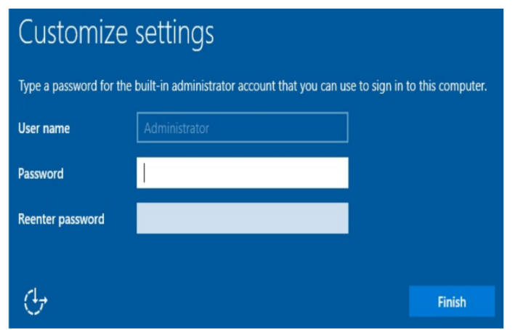
2.3 Installing Windows server 2022
Performing Clean Installation:
10. After getting the devices ready and performing a few restarts, set up the administrator password
Notes:
https://www.amazon.com/dp/B085RK7ZWV?tag=rswebsols-20&linkCode=osi&th=1

Slide 28
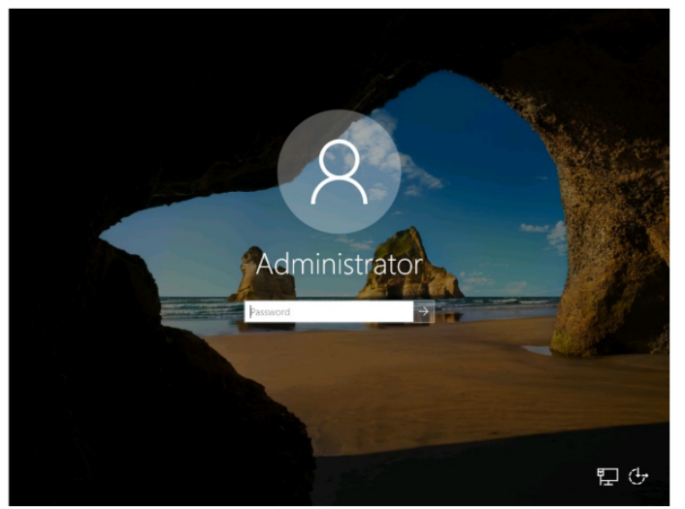
2.3 Installing Windows server 2022
Performing Clean Installation:
11. Congratulations! You have successfully installed Windows Server 2022.
Notes:
https://www.amazon.com/dp/B085RK7ZWV?tag=rswebsols-20&linkCode=osi&th=1

Slide 29
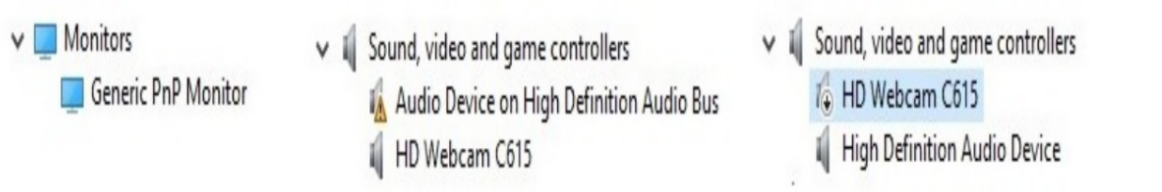
2.4 Post Installation task on windows server 2022
Understanding the devices and device drivers
Device Manager is used to manage device drivers
Status of Device Manager:
Generic
A black exclamation point inside a yellow triangle
A downward black arrow
Notes:
https://www.amazon.com/dp/B085RK7ZWV?tag=rswebsols-20&linkCode=osi&th=1

Slide 30
A device driver is a computer program that operates or controls a particular type of device that is attached to a computer.
A driver provides a software interface to hardware devices, enabling operating systems and other computer programs to access hardware functions without needing to know precise details about the hardware being used.
A driver communicates with the device through the computer bus or communications subsystem to which the hardware connects.
The main purpose of device drivers is to provide abstraction by acting as a translator between a hardware device and the applications or operating systems that use it.

Slide 31
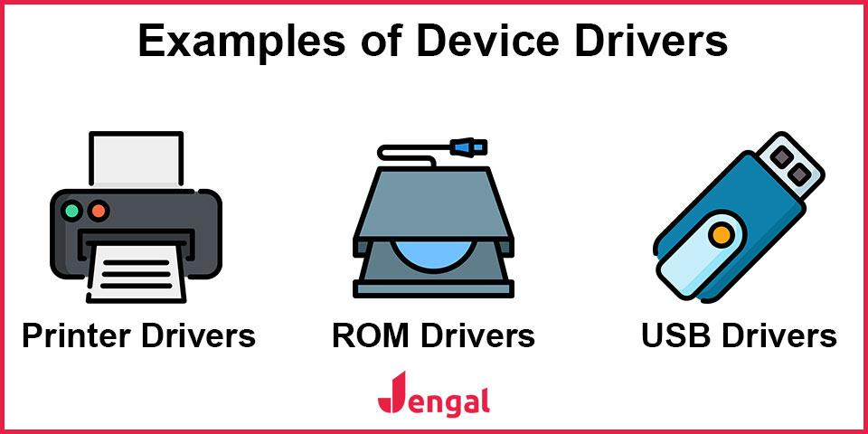

Slide 32
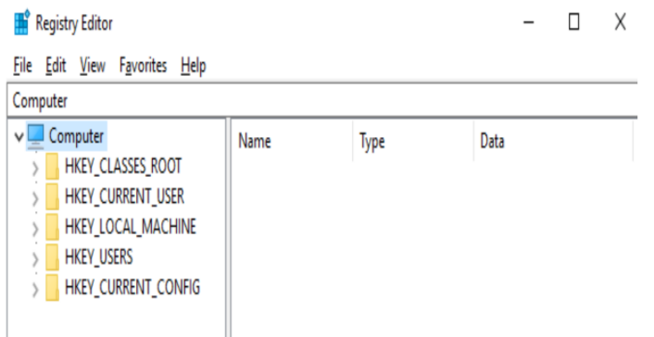
2.4 Post Installation task on windows server 2022
Understanding the windows server registry
Windows Registry is a hierarchical database that stores the hardware/software configuration and system security information.
HKEY_CLASSES_ROOT:
HKEY_CURRENT_USER:.
HKEY_LOCAL_MACHINE:
HKEY_USERS:
HKEY_CURRENT_CONFIG:
Notes:
https://www.amazon.com/dp/B085RK7ZWV?tag=rswebsols-20&linkCode=osi&th=1

Slide 33
Most intimidating part of your computer.
Windows registry is a centralized, hierarchical database that manages resources and stores configuration settings for applications on the Windows OS.
Command: regedit
regedit is windows registry editor, a graphical tool that lets you view and monitor the system’s registry and edit if necessary.
regedit lets you make root level or administrative level changes to your computer and the configuration settings of applications.
Be careful while using it.

Slide 34
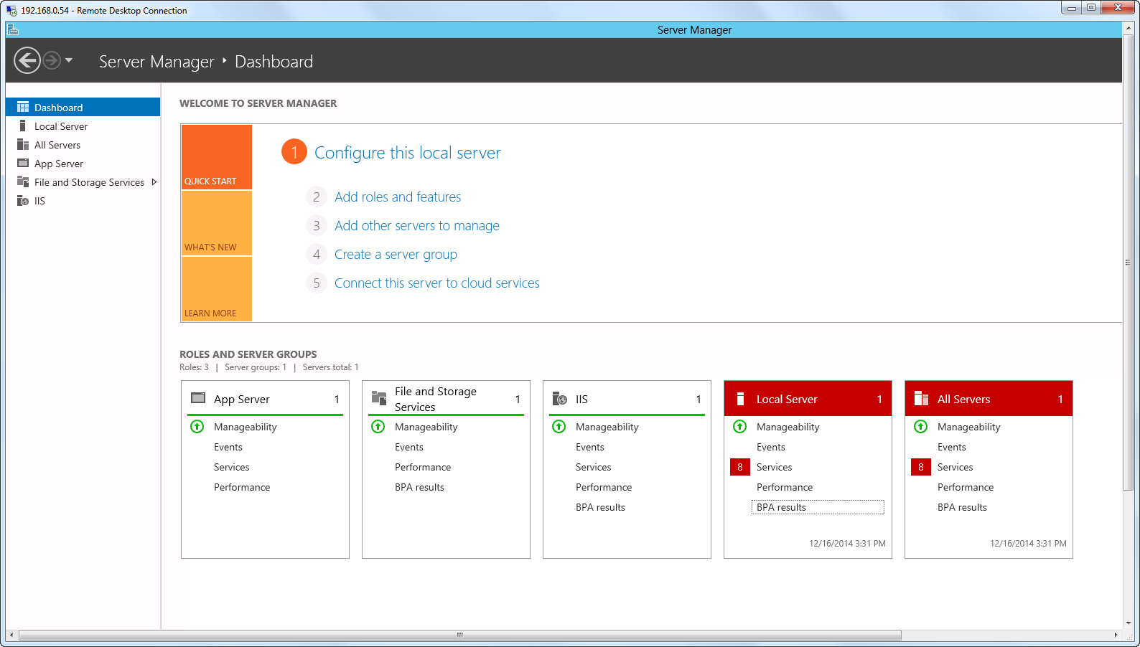
2.4 Post Installation task on windows server 2022
Using Server Manager in Desktop Experience
Notes:
https://www.amazon.com/dp/B085RK7ZWV?tag=rswebsols-20&linkCode=osi&th=1

Slide 35
2.4 Post Installation task on windows server 2022
Understanding Windows Server initial configuration using server manager
Changing the server name,
Joining a domain (this depends on the role of the server),
Enabling Remote Desktop,
Setting up a static IP address,
Changing the time zone,
Activating Windows Server 2022,
Turning off Internet Explorer (IE) enhanced security, and checking for updates.
Notes:
https://www.amazon.com/dp/B085RK7ZWV?tag=rswebsols-20&linkCode=osi&th=1

Slide 36
Thank You

