Slide 1

Overview of Network OS Services
Week 4

Slide 2

Agenda
Network OS Services
Remote Administration and Access Services
Directory Services
Other NOS Services

Slide 3
4.1 Network/NOS Services

Slide 4
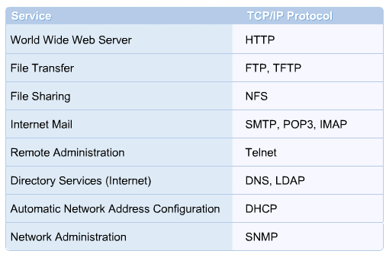
4.1 An Introduction to Network/NOS Services
Networking Operating Systems are designed to provide network services to clients and peers.
Network services include the World Wide Web (WWW), file sharing, mail exchange, directory services, remote management, and print services.
Most popular network services rely on the TCP/IP suite of protocols.

Slide 5
4.2 Remote Administration and Access Services

Slide 6
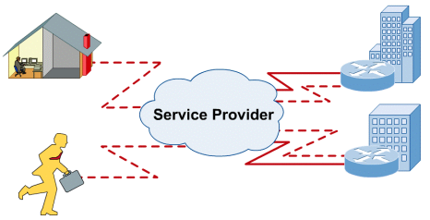
4.2 Remote Administration and Access Services
4.2.1 Remote Access
With a remote access connection, employees can access the corporate remote access server and log in to the network with their regular user account.
Employees can then use all the resources that would be available from the office desktop computer.

Slide 7
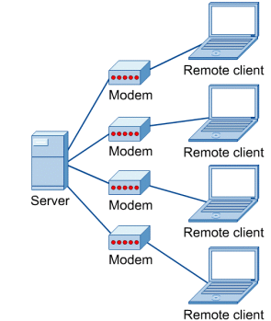
4.2 Remote Administration and Access Services
4.2.2 Telecommuting
Telecommuting is attractive to employees because it saves travel time and other costs associated with working in an office.
Telecommuting tools such as email, phone, chat and video apps

Slide 8
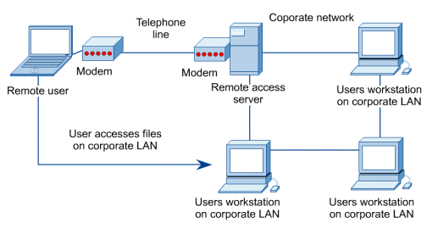
4.2 Remote Administration and Access Services
4.2.3 Mobile Users
It can be difficult or impossible to store all the files needed on a laptop or notebook computer.
It is a security threat as well because the laptop and its contents could be physically stolen or broken.
A better solution is for mobile users to dial in to the company LAN.

Slide 9
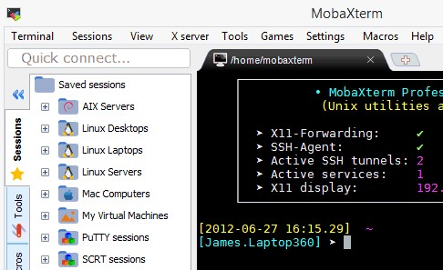
4.2 Remote Administration and Access Services
4.2.4 Terminal Emulation Services
Terminal emulation is the process of accessing a remote system via a local computer terminal.
The local terminal runs software that emulates, the look of the remote system terminal.
The local user can type commands and execute programs on the remote system.

Slide 10


Slide 11
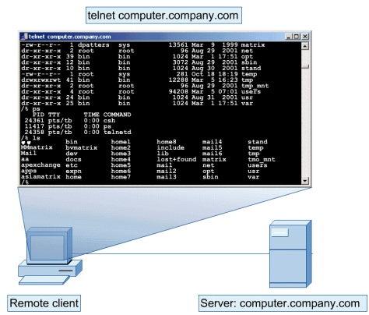
4.2 Remote Administration and Access Services
4.2.5 Telnet Services
Telnet is the main Internet protocol for creating a connection with a remote machine.
It gives the user the opportunity to be on one computer system and do work on another.
But Telnet protocol has the following security considerations:
- Hacking
- Password guessing
- Denial of Service (DoS) attacks
- Packet sniffing (viewable text data)

Slide 12
4.3 Directory Services

Slide 13
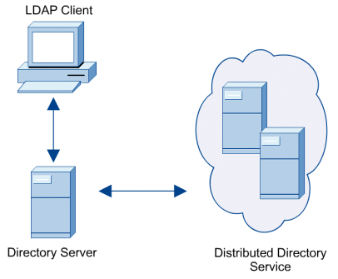
4.3 What is Directory Services?
An IT infrastructure for storing and mapping of resource information that are accessed frequently on daily basis.
It is a centralized storage, so that we can access it across the globe.
It is relatively faster
Eg: Employee profile records, DNS Servers

Slide 14
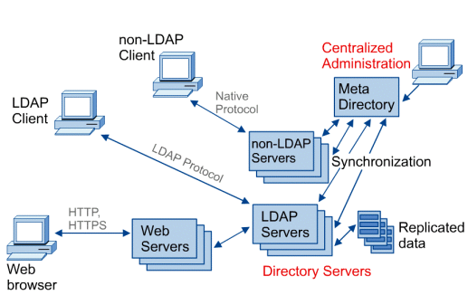
4.3 Directory Services
4.3.1 Directory Service Standards
To operate within a NOS, different directory services need to have a common method of naming and referencing objects.
X.500 defines the Electronic Directory Service (EDS) standards.
Lightweight Directory Access Protocol (LDAP)

Slide 15
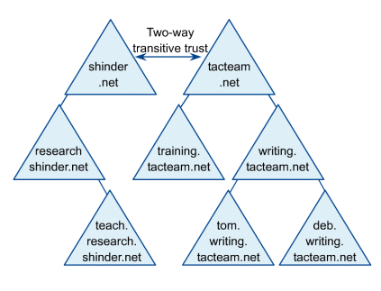
4.3.2 Windows 20xx Active Directory
The logical structure of the Active Directory is based on units called Domains.
In Windows, networks can have multiple domains, organized into domain trees.
These trees can be joined to other trees to form forests.
Active Directory uses Organizational Units (OUs) to organize resources within domains.

Slide 16
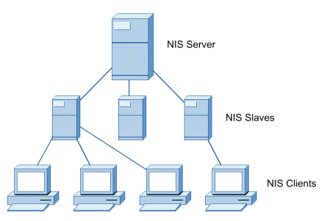
4.3 Directory Services
4.3.3 Network Information Service (NIS)
Linux uses its own version of Directory Services called the Network Information Service (NIS).
The network consists of the NIS server, slaves, and clients.
The NIS Servers is where the NIS database is created and maintained. The NIS databases are copied to all the NIS slave servers.

Slide 17
4.4 Other NOS Services

Slide 18
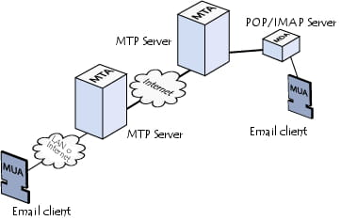
4.4 Other NOS Services
4.4.1 Mail
Virtually all mail services rely on TCP/IP
Mail services are comprised of a combination of the following components:
- Mail Transfer Agent (MTA)
- Mail Delivery Agent (MDA)
- Mail User Agent (MUA)

Slide 19
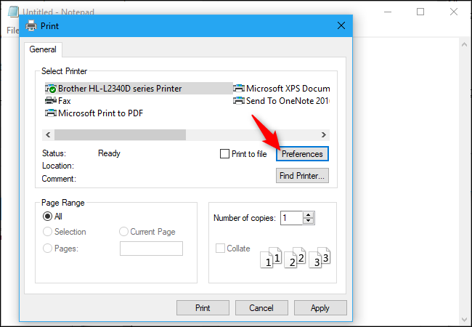
4.4 Other NOS Services
4.4.2 Printing
When a user decides to print in a networked printing environment, the job is sent to the appropriate queue for the selected printer.
Print queues stack the incoming print jobs and service them using a "First In, First Out" (FIFO) order.
It is placed at the end of the list of waiting jobs and is printed after all other previous jobs before it.

Slide 20
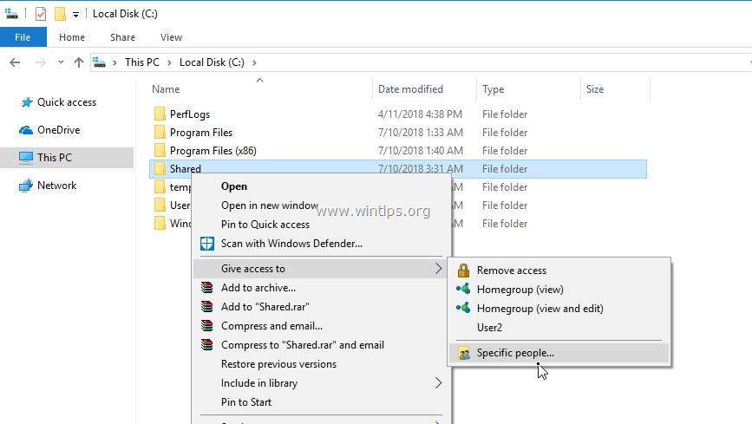
4.4 Other NOS Services
4.4.3 File Sharing
File sharing is often done using the File Transfer Protocol (FTP) within a home or office network.
Peer-to-peer networking is popular among home users, but the technology has yet to be deployed as a widespread business solution.
Peer-to-peer protocols work without a central server.

Slide 21
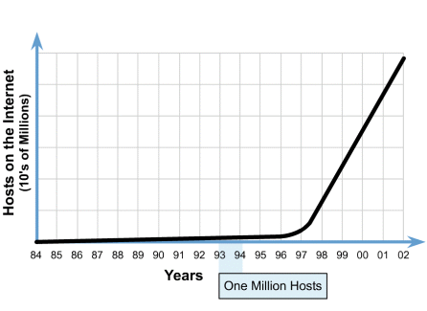
4.4 Other NOS Services
4.4.4 Internet
The World Wide Web is now the most visible network service.
In less than a decade, the internet has become a global network of information, commerce, education, and entertainment.

Slide 22


Slide 23
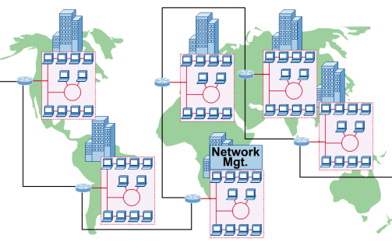
4.4 Other NOS Services
4.4.5 Intranet
Intranets use the same technology used by the Internet, including HTTP over TCP/IP, web servers, and web clients.
The difference between an intranet and the Internet is that intranets do not allow public access to private servers.
This is typically accomplished by using an Internet firewall.

Slide 24
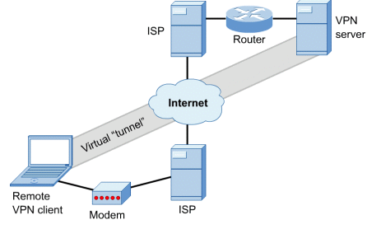
4.4 Other NOS Services
4.4.6 Extranet
Extranets are configured to allow employees and customers to access the private network over the Internet.
To prevent unauthorized access to the private network, extranet designers must use a technology such as virtual private networking.
VPNs rely on encryption software, usernames, and passwords to ensure that communication occurs privately, and only among authorized users.

Slide 25
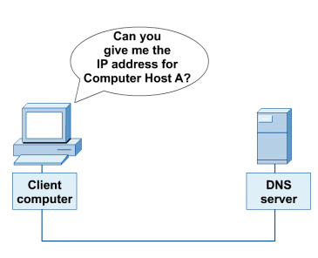
4.4 Other NOS Services
4.4.7 Domain Name Service (DNS)
The DNS protocol allows clients to make requests to DNS servers in the network for the translation of names to IP addresses.
The Internet name that the DNS resolves to the IP address is also called the Hostname.

Slide 26
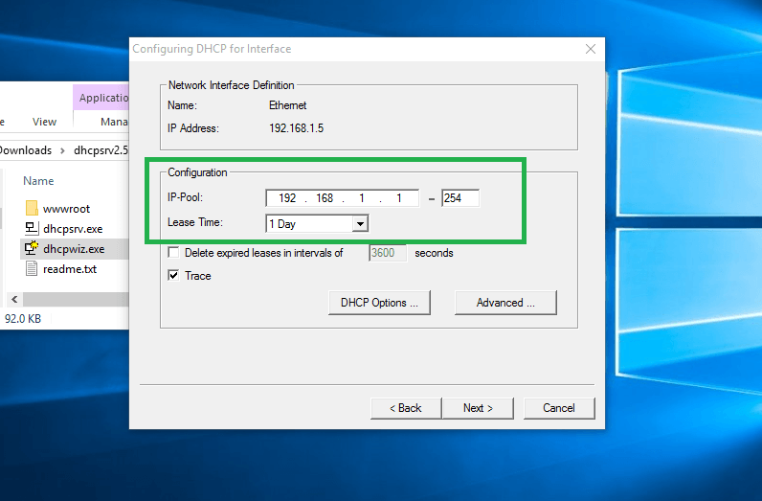
4.4 Other NOS Services
4.4.8 Dynamic Host Configuration Protocol (DHCP)
Dynamic Host Configuration Protocol (DHCP) enables computers on an IP network to receive network configurations from the DHCP server.
These servers have no information about the individual computers until information is requested.
DHCP also allows for recovery and the ability to automatically renew network IP addresses through a leasing mechanism.
This mechanism allocates an IP address for a specific time period, releases it and then assigns a new IP address.

Slide 27

Conclusion
Network OS Services
Remote Administration and Access Services
Directory Services
Other NOS Services

Slide 28
Thank You

