Slide 1
Lecture 7
CT5052 -Network Operating Systems
Unix Command Utilities

Slide 2
Overview
Revision
Pathname
Copy,Move and Replace
Permission Modification

Slide 3
Creation of a file:
There are two methods to create a file:
The ‘cat’ utility.
The ‘touch’ command.

Slide 4
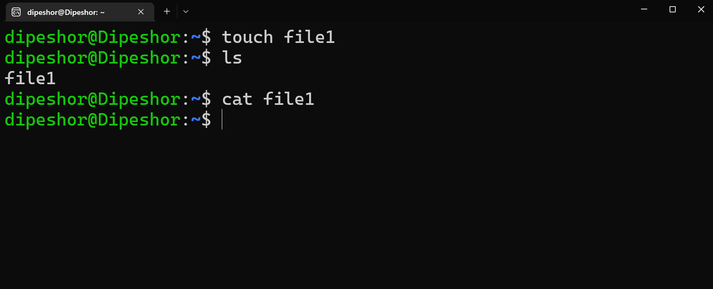
Displaying the contents of a Text file:
The cat utility displays the contents of a text file.

Slide 5
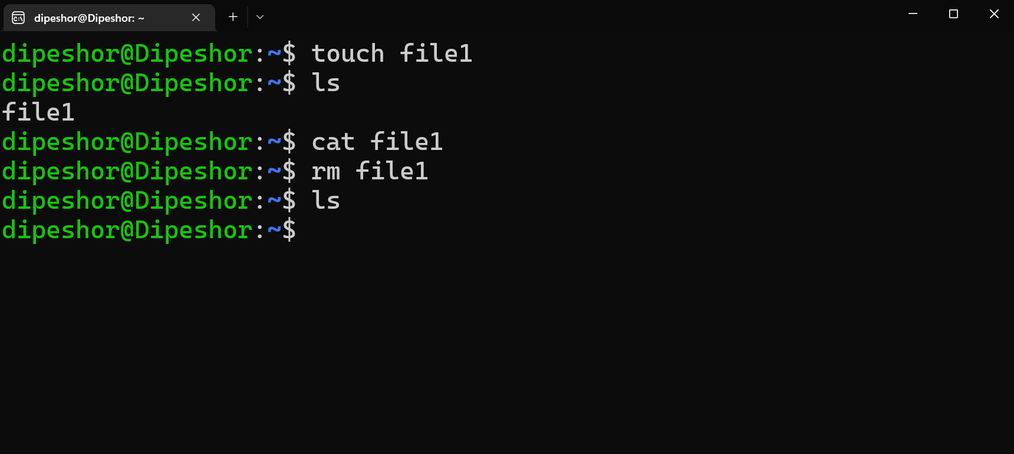
Deleting a file:
The ‘rm’ (remove) command is used to delete a file.

Slide 6
Deleting a directory/folder:
The ‘rmdir’ (remove directory) is used to delete a directory.
We cannot delete the working directory or a directory that contains files. If you need to delete a directory with files in it, first delete the files (using rm) and then delete the directory.
$ rmdir /home/samin/folder1
If we need to delete a directory that contains files or other sub-directories than we can also use a recursive function. With the rm command you can use the ‘-r’ option which is the recursive option. This option remove directories and their contents recursively.
$ rm –r /home/samin/folder2

Slide 7
Relative Pathname
A relative pathnames traces a path from the working directory to a file.
Any pathname that does not begin with the root directory (/) is a relative pathname.
Relative pathnames can describe a path through many directories.
Samin could have created the Nepal directory more easily using a relative pathname:
$ pwd
/home/dipeshor
$ mkdir Nepal
The pathname used in this example is a simple filename.

Slide 8
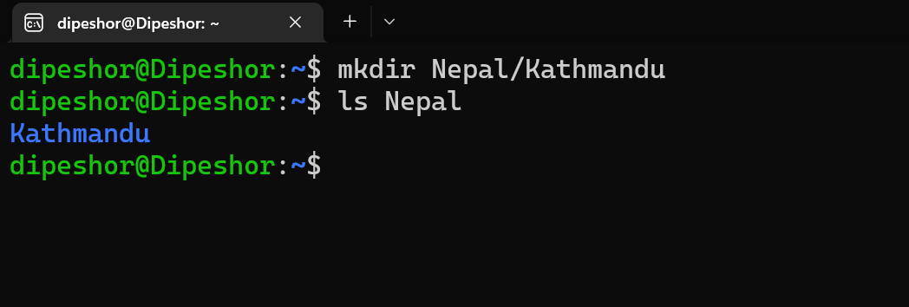
Relative Pathname: Example
If we need to create a directory named “Kathmandu” inside the Nepal directory, we can use the relative pathname something like this:
$ pwd
/home/dipeshor
$ mkdir Nepal/Kathmandu

Slide 9
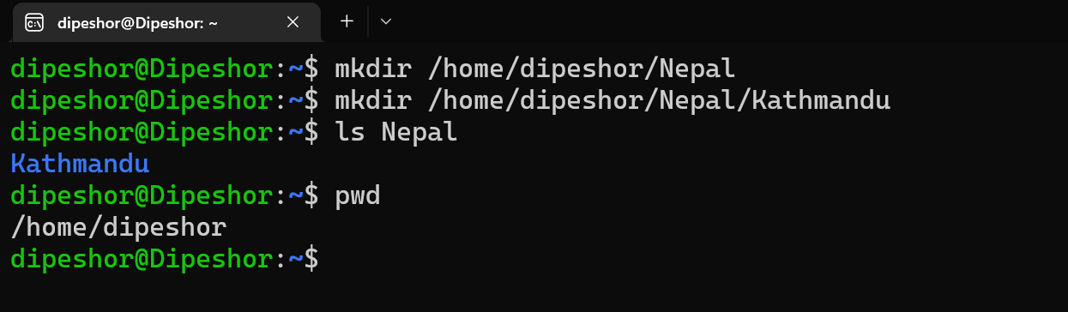
Absolute Pathname:
Any pathname that begins with the root directory (/) is a Absolute pathname.
If we need to create a directory named “Pokhara” inside the Nepal directory, we can use the absolute pathname something like this:
$ pwd
/home/dipeshor
$ mkdir /home/dipeshor/Nepal/Pokhara

Slide 10
Copy, Move and Rename:
The ‘cp’ command is used to copy files and directories from one directory to another, as path determines.
Command: cp file1 [Directory Path]
Command: cp -r folder1 [Directory Path]

Slide 11
Copy, Move and Rename: (Continue)
The ‘mv’ command is used to move files and directories from one working directory to another, as path determines.
The ‘mv’ command is also used to rename files and directory.
Command: mv file1 [Directory Path] [Here, the file1 will move to another directory]
Command: mv file1 [Directory Path]/file2 [Here, the file1 will move to another directory with different filename as file2]
Command: mv file1 file2 [Here, the file1 will rename to file2]

Slide 12
Access Permission:
Three types of users can access a file:
the owner of the file (owner) - user,
a member of a group to which the owner belongs (group),
and everyone else (other).
A user can attempt to access an ordinary file in three ways – by trying to read from, write to, or execute it.
Three types of users, each able to access a file in three ways, equal a total of nine possible ways to access an ordinary file.

Slide 13
Access Permission:
The owner of a file can try to: read from the file
write to the file
execute the file
A member of the owner’s group can try to: read from the file
write to the file
execute the file
Anyone else can try to: read from the file
write to the file
execute the file

Slide 14
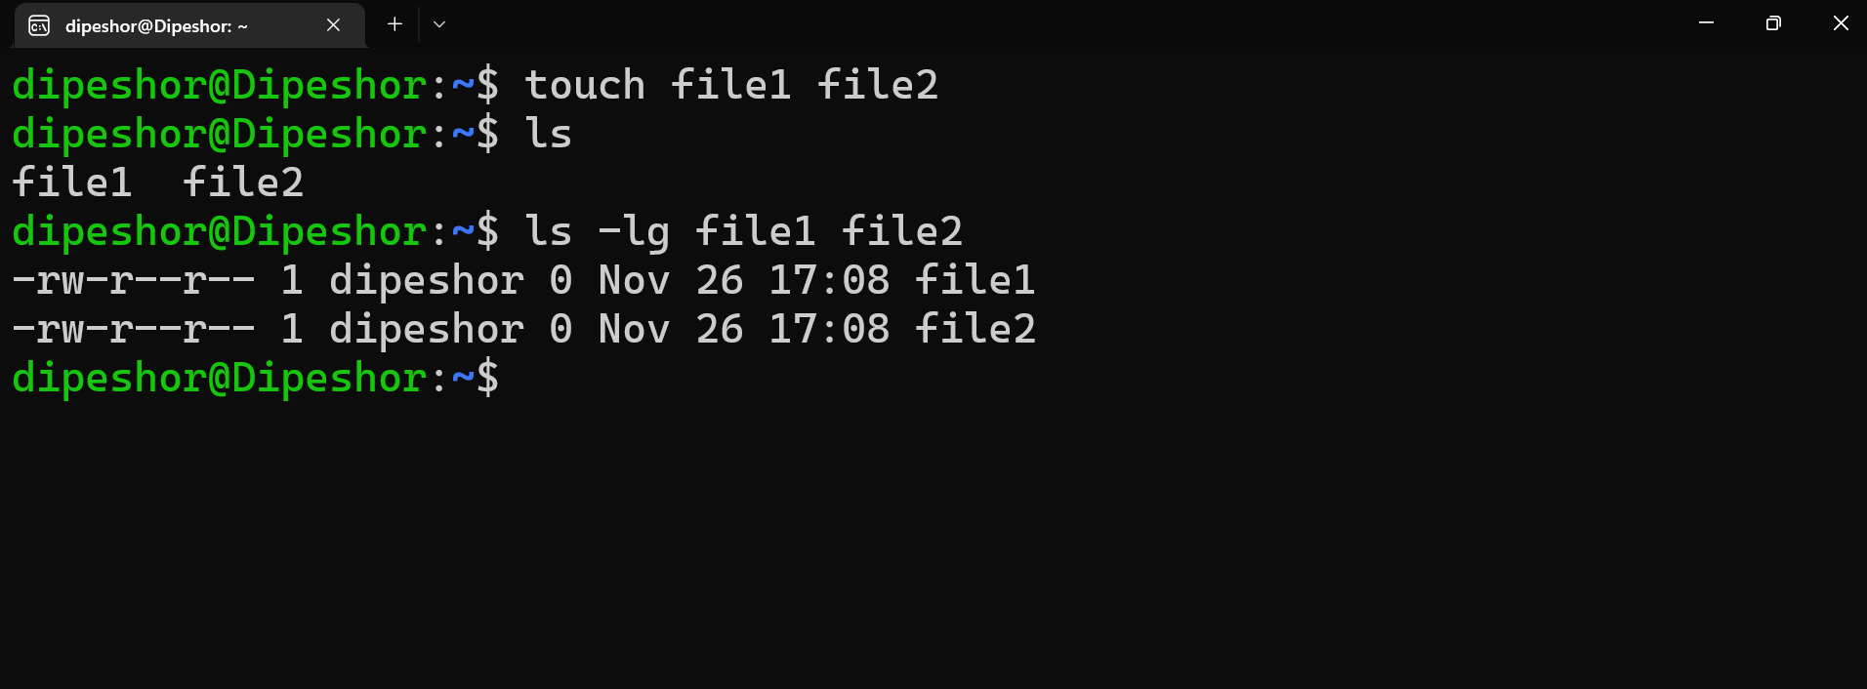
The ‘ls’ utility with the –l and –g options
When you call ls with the –l (long) option and the name of a file, ls displays a line of information about the file.
When called with –g (group) it displays information about the group the file belongs to.

Slide 15
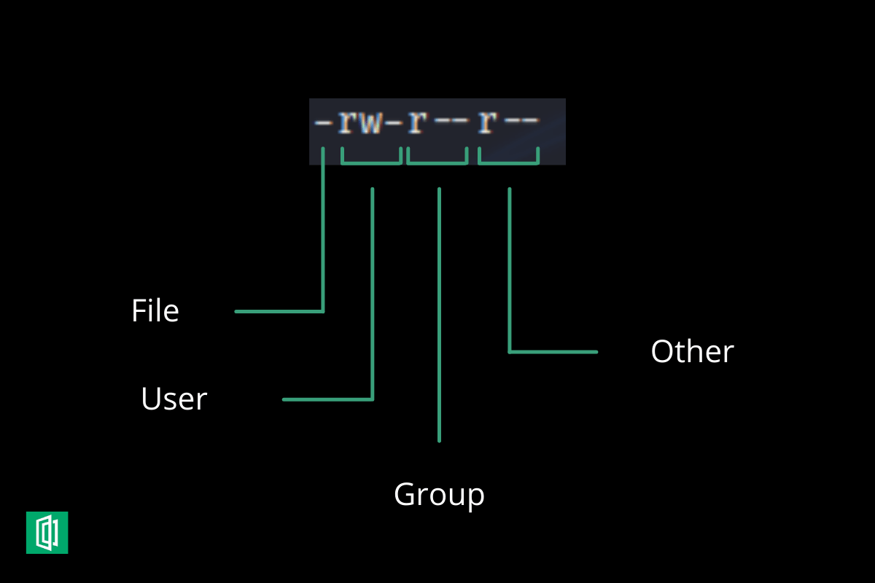
Utility (Contd.)

Slide 16
Use of the ‘chmod’ command
The ‘chmod’ command is used to give read, write and execute permissions to the files and folders on the basis of user, group and others.
Symbolic Permission Notation:
So, let’s create a file named file1 and set its permissions.
User: The user can read, write and execute it.
Group: The group members can read and execute it.
Others: Others may read it.
Command: chmod u=rwx,g=rx,o=r file1

Slide 17
Use of the ‘chmod’ command
Octal Number Permissions:
Command: chmod 754 file1
Here, the digits 7, 5 and 4 each individually represent the permissions for user, group, and others.
The digits 7, 5 and 4 are the combination of the numbers 4, 2, 1 and 0.
4 stands for “read”,
2 stands for “write”,
1 stands for “execute”, and
0 stands for “no permission.”

Slide 18
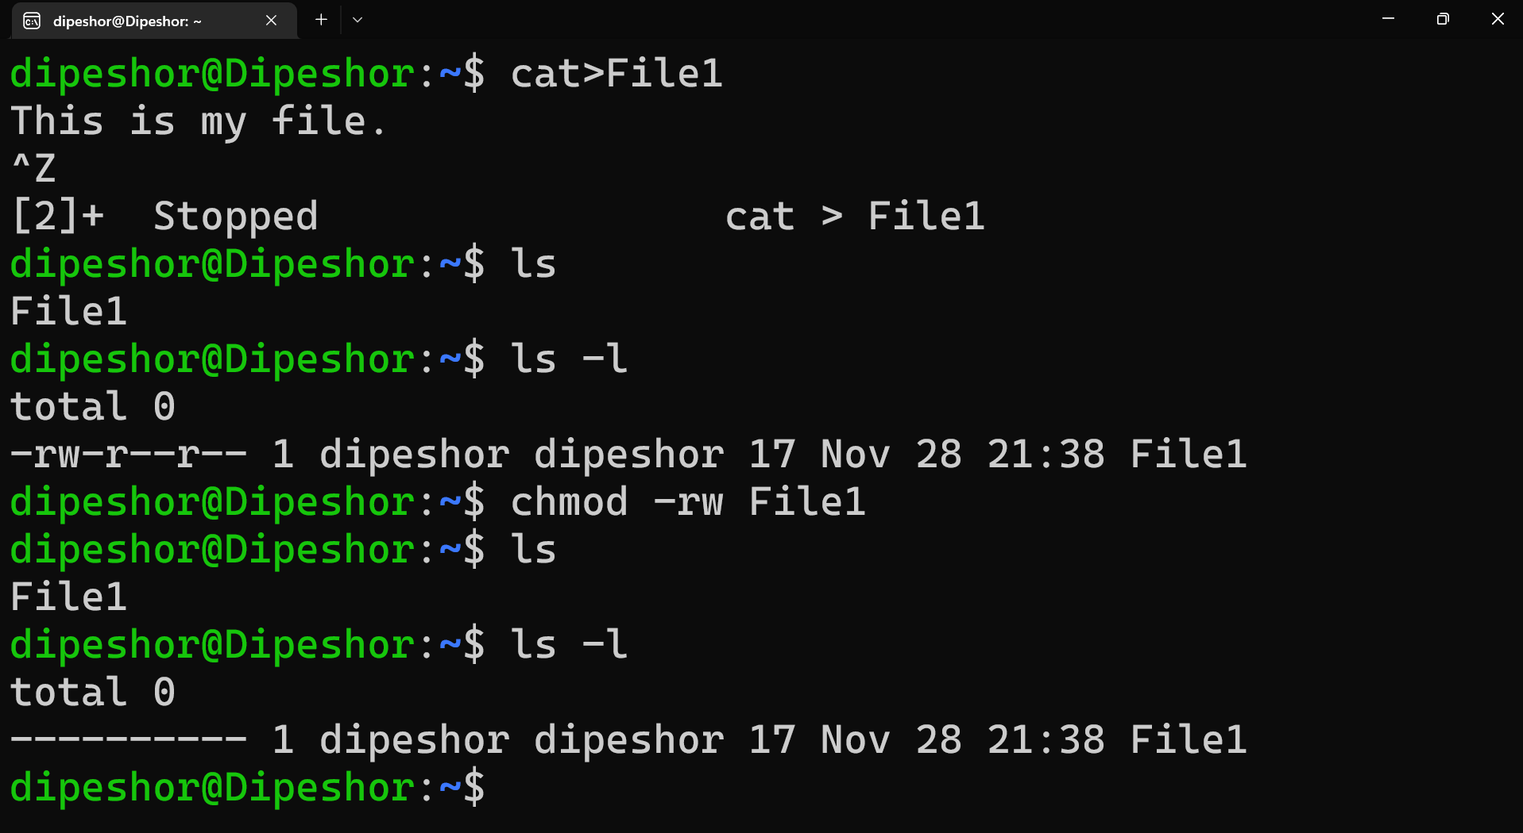
chmod (example)

Slide 19
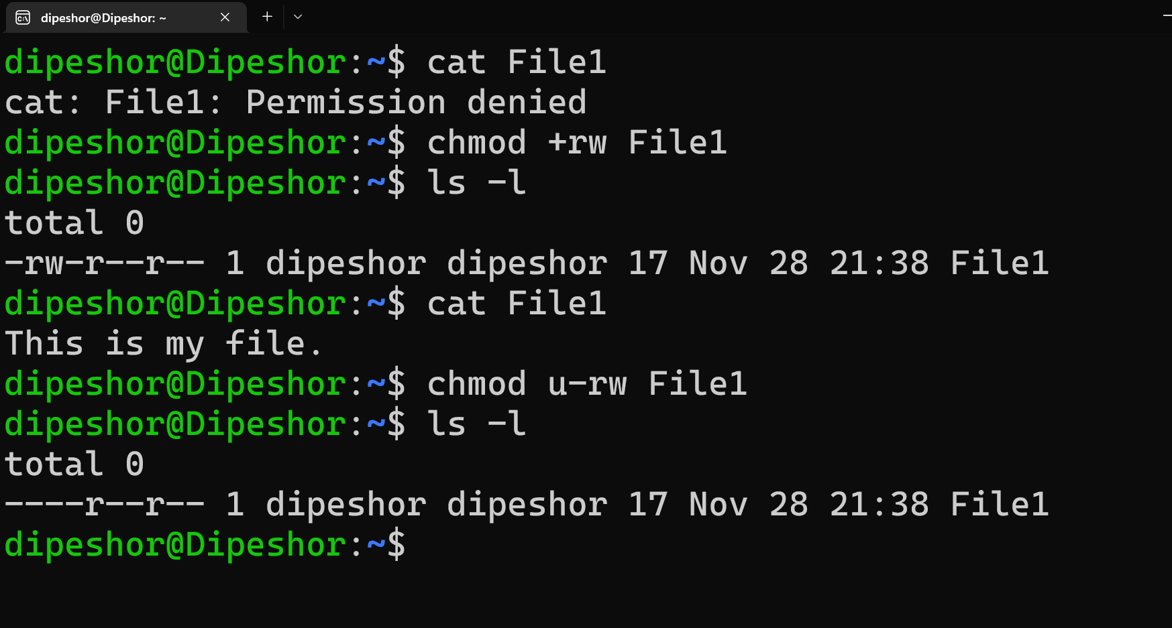
chmod (contd.)

Slide 20
Thank You!!
Any Questions?

