Slide 1

Network Operating System Fundamentals
Week 1

Slide 2
About Me
Mr. Dipeshor Silwal (Module Leader)
Msc(IT) Data Analytics, Islington College (London Metropolitan University)
FYP Networking Coordinator
FYP Supervisor
More than 6 Years at Islington College
QC at My Second Teacher

Slide 3
What your module is ?
Semester long Module
15 Weeks
Study of Network Operating systems (Windows / Linux Servers)
Operations of Network Operating systems
Virtualizations
Understand security and troubleshooting inside Network Operating System

Slide 4
Aims of the module
To understand the importance of Network operating systems (NOS)
To explain the operation of Network operating systems, and their benefits
To describe hardware requirements for the effective operation of NOS

Slide 5
Aims of the module (contd..)
To compare some of the most commonly available NOS, and their abilities and limitations
To understand the concept of virtualization and its application in modern server environments
To understand server documentation, security and trouble shooting

Slide 6
Module learning outcomes
LO1. Understand how the modern Network operating systems work, and the interrelation between hardware and software;
LO2. Explain the function and structure of modern Network operating systems;
LO3. Identify the compare the most widely used Network operating system
LO4. Use preventive maintenance to solve security upgrading issues in responsible and professional manner;
LO5. Implement hardware and software troubleshooting techniques, and record and present the technical findings critically and effectively

Slide 7
Syllabus
Introduction to NOS, NOS clients
Basic network design
Microsoft (Windows Servers)
Create users/profiles.
Patching securing
Active directory design

Slide 8
Syllabus
Domain controller function IIs
Linux installation /samba / apache
Linux Create users/profiles controlling services.
NOS Server Hardware and software
Server Virtualisation
Network administration role and best practises server security
Troubleshooting

Slide 9

Assessments
Unseen Theory Exam (Written , 50%)
Practical Test (Logbook and practical test, 40%)
Progress Test (MCQ, 10 %)

Slide 10
Text Books
IT Essentials II: Network Operating Systems Companion Guide (Cisco Networking Academy Program) (Cisco Networking Academy Program Series) ISBN-10: 1587130971
CompTIA Network+ Certification All-in-One Exam Guide, Seventh Edition (Exam N10-007) ISBN-10: 1260122387

Slide 11

Objectives
1.1 Operating System Basics
1.2 Network Operating System Overview

Slide 12
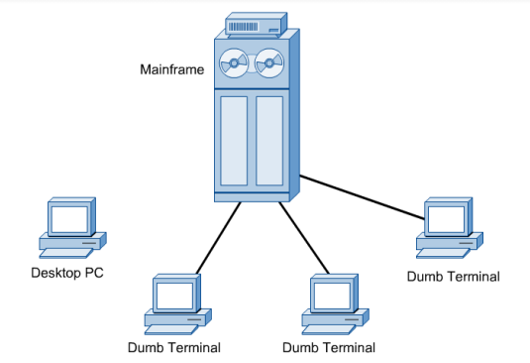
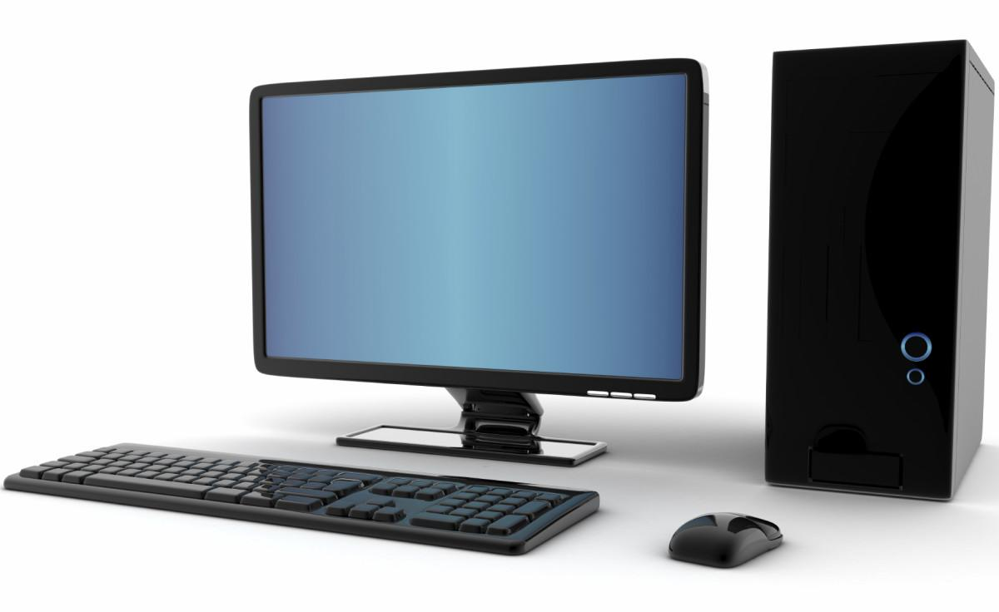
1.1 Operating System Basics
1.1.1 Overview of PC Operating System
Desktop microcomputers first become popular and widespread in the early 1980s.
Productivity of desktop computers was limited by their inability to share information easily with other system.

Slide 13
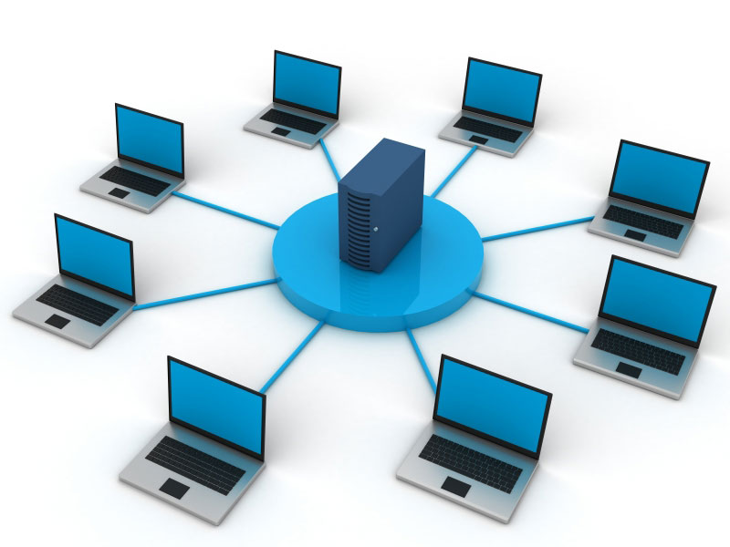
1.1 Operating System Basics
1.1.2 PCs and Computer Network
Companies installed local-area networks (LANs) to connect desktop PCs so that the PCs could share data and peripherals, such as printers.
Network operating system (NOS) requires more computing muscle than the desktop counterparts.

Slide 14
1.1 Operating System Basics
1.1.2 PCs and Computer Network
A new breed of PCs was pressed into service as network servers.
These computers ran a NOS and became the focal point of the PC-based LAN.

Slide 15
1.1 Operating System Basics
1.1.2 PCs and Computer Network
Web browsing, electronic mail (e-mail), and other Internet-related applications are now the focus of home computing.
To provide these Internet technologies, companies such as Microsoft have retooled their desktop operating systems.
The desktop OS now includes many of the features and services that were once reserved for the NOS.

Slide 16
1.1 Operating System Basics
1.1.3 Kernel
Kernel is the most common term for the core of the operating system.
It is a small piece of code that is loaded into memory when the computer boots.
This computer code contains instructions that allow the kernel to manage hardware devices, memory allocation, system processes, and other programs.

Slide 17
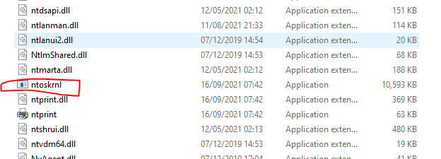
1.1 Operating System Basics
1.1.3 Kernel

Slide 18
1.1 Operating System Basics
1.1.4 User Interface
Component of the OS that the user interacts with.
The UI is like an interpreter, translating user keystrokes, mouse clicks, or other input for the appropriate programs.
Allows the user to manipulate software using visual objects such as windows, pull-down menus, pointers, and icons.

Slide 19
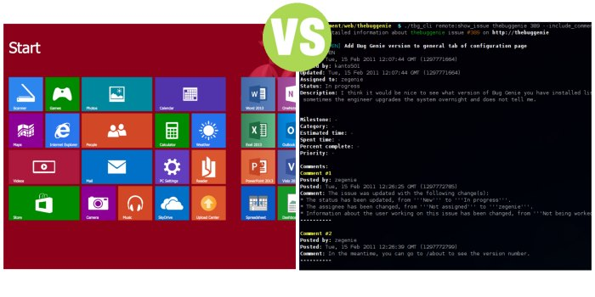
1.1 Operating System Basics
1.1.4 User Interface

Slide 20
1.1 Operating System Basics
1.1.5 File System
The file system provides the directory structure that organizes
the user's operating system, application, configuration, and data files.
File Allocation Table, 32-bit (FAT32) – A file system that can support partition sizes up to 2 TB or 2,048 GB.
New Technology File System (NTFS) – A file system that can support partition sizes up to 16 Exabytes, in theory.

Slide 21
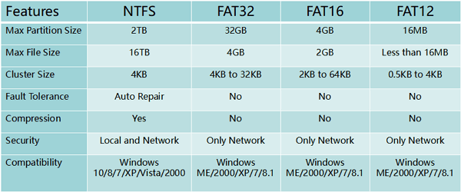
1.1 Operating System Basics
1.1.5 File System

Slide 22
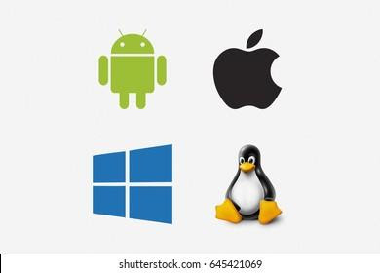
1.1 Operating System Basics
1.1.6 Common Desktop Operating System
Microsoft Windows
one of the most popular operating systems today.
Example: Windows 11, Window 10 , so forth.
Apple Mac OS
Apple computers are proprietary and use an operating system called Mac OS.
Current versions of Mac OS are now based on a customized version of UNIX.

Slide 23
1.1 Operating System Basics
1.1.6 Common Desktop Operating System
UNIX/Linux
UNIX, which was introduced in the late 1960s, is one of the oldest operating systems.
There are many different versions of UNIX, example Linux.
Linux was developed by Linus Torvalds in 1991, and it is designed as an open-source operating system.
Open-source programs allow the source code to be distributed and changed by anyone as a free download or from developers at a much lower cost than other operating systems.

Slide 24
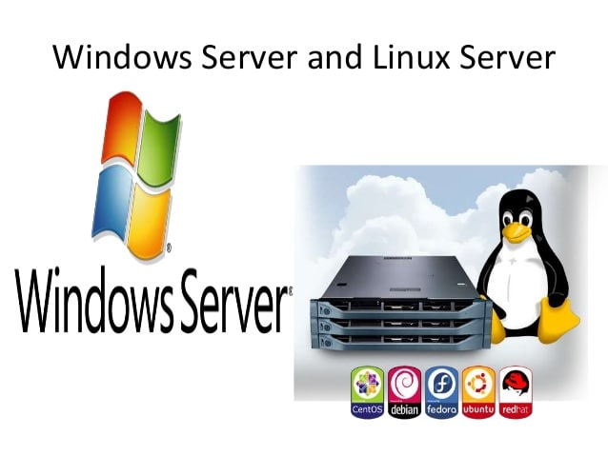
1.2 Network Operating System Overview
1.2.1 Common Network Operating System
Network OS - corporate environment
Supports multiple users
Runs multi-user applications
Is robust
Provides increased security compared to desktop operating systems
Built-in networking components and network services, multiuser capability, and sophisticated file security and file sharing technologies
Examples:
Microsoft Windows: Windows Server 2022, and Windows Server 2019
Linux: Red Hat, Fedora, CentOS and so forth.

Slide 25
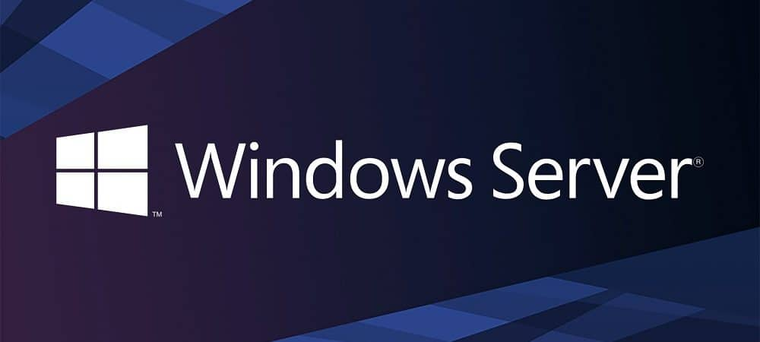
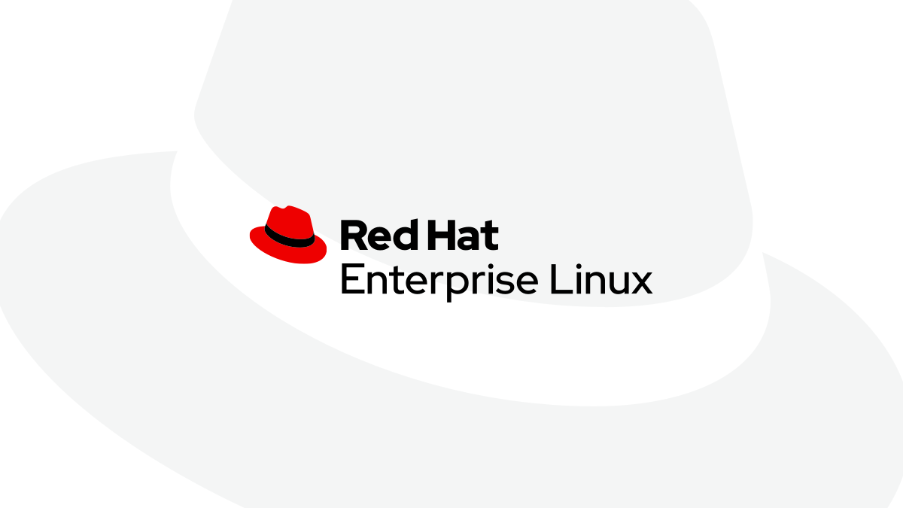
1.2 Network Operating System Overview
1.2.1 windows vs Linux NOS Comparison
Windows has been marketed as a user-friendly, graphical interface (GUI), desktop operating system.
The roots of Linux begin with UNIX and with that modular design made Linux a very popular choice among system administrators to run their servers.

Slide 26
1.2 Network Operating System Overview
1.2.2 windows vs Linux NOS Differences
Text-mode interface functionality
Cost
Obtaining the OS
Available application software
Obtaining application software
Virus vulnerability
Security features
Supporting multiple users

Slide 27
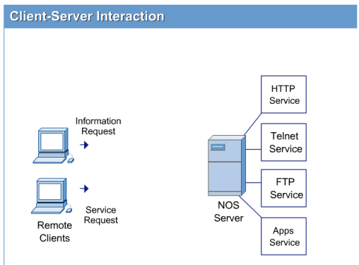
1.2 Network Operating System Overview
1.2.3 The Client-Server Model
Most network applications, including Internet-related applications such as the World Wide Web (WWW) and e-mail, are built around a client/server relationship.
A server offers network services, such as e-mail to other programs called clients.
Once enabled, a server program waits to receive requests from client programs. If a legitimate request is received, the server responds by sending the appropriate information back to the client.

Slide 28
1.2 Network Operating System Overview
1.2.3 The Client-Server Model
Any computer can act as a server as long as it is connected to the network and is configured with the appropriate software.
Most organizations put all of their key network services on high-end computers called servers running NOSs optimized for servicing remote clients.

Slide 29
1.2 Network Operating System Overview
1.2.4 Evaluating Customer resources and Requirements
One of the first things that must be taken into consideration when buying or building a new computer are the requirements that are needed to allow the system to efficiently provide the service.
Determining the customer resources will also help decide on what type of system to build or buy for the customer.

Slide 30
1.2 Network Operating System Overview
1.2.4 Evaluating Customer resources and Requirements
A Linux workstation is a system that is typically a standalone computer consisting of one monitor, keyboard, and mouse.
Most often a workstation will be configured with a network connection as well.

Slide 31
1.2 Network Operating System Overview
1.2.4 Evaluating Customer resources and Requirements
Servers really have no need to the user-oriented features like large monitors, speakers or sound card.
They need to consist of things like reliable and fault tolerant hard disks.
For this reason, servers will have large, high-performance hard disks such as Small Computer System Interface (SCSI) disks or solid-state drive (SSDs)

Slide 32
1.2 Network Operating System Overview
1.2.4 Evaluating Customer resources and Requirements
Determining the customers resources is an important step in evaluating the requirements that are needed but also that will be available.
These can include things like existing hardware, budgetary constraints, and having the proper expertise available.
Linux provides and excellent means for reusing existing hardware and extending the life of old and otherwise unusable systems.
Linux has the ability to run without a GUI that can use up all the system resources.
One way to deal with budget constraints is to decide the proper hardware that is needed and what the user will need to accomplish the job.

Slide 33
Thank You

