Slide 1

Overview of Network Operating System II
Week 5

Slide 2

Objectives
5.1 Recap
5.2 Characteristics of a Network Operating System
5.2 Windows
5.3 Linux
5.4 Determining Software Requirements

Slide 3
5.1 Characteristics of a Network Operating System

Slide 4
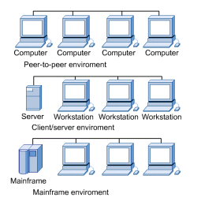
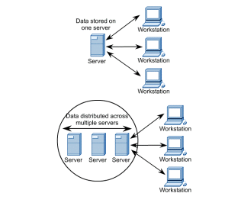
5.1 Characteristics of a Network Operating System
5.1.1 Overview of NOS Characteristics
Network operating systems (NOSs) distribute their functions over a number of networked computers.
It then adds functions that allow access to shared resources by a number of users concurrently.
Client systems contain specialized software that allows them to request shared resources that are controlled by server systems responding to a client request.

Slide 5
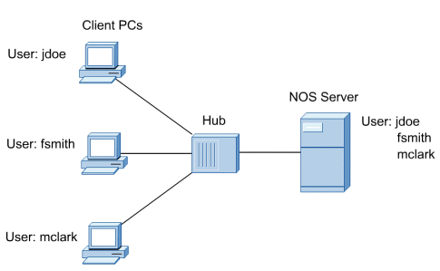
5.1 Characteristics of a Network Operating System
5.1.2 Differences Between PC and a NOS
The NOS enhances the reach of the client PC by making remote services available as extensions of the local native operating system.
Although a number of users may have accounts on a PC, only a single account is active on the system at any given time.
NOS supports multiple user accounts at the same time and enables concurrent access to shared resources by multiple clients.

Slide 6
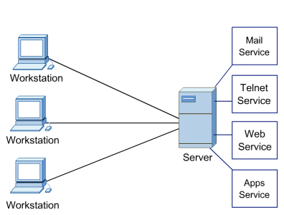
5.1 Characteristics of a Network Operating System
5.1.3 Multi User, Multitasking, and Multiprocessor Systems
A NOS server is a multitasking system. Internally, the OS must be capable of executing multiple tasks or processes at the same time.
Some systems are equipped with more than one processor, called multiprocessing systems.
They are capable of executing multiple tasks in parallel by assigning each task to a different processor.
The aggregate amount of work that the server can perform in a given time is greatly enhanced in multiprocessor systems.

Slide 7
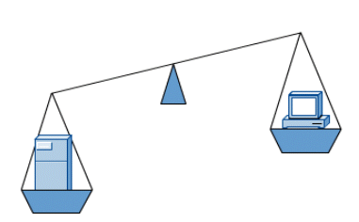
5.1 Characteristics of a Network Operating System
5.1.4 NOS Server Hardware
NOS servers are large systems with additional memory to support multiple tasks that are all active, or resident, in memory at the same time.
Additional disk space is also required on servers to hold shared files and to function as an extension to the internal memory on the system.
Because a NOS depends on the continuous operation of its servers, the extra hardware components justify the additional expense.

Slide 8
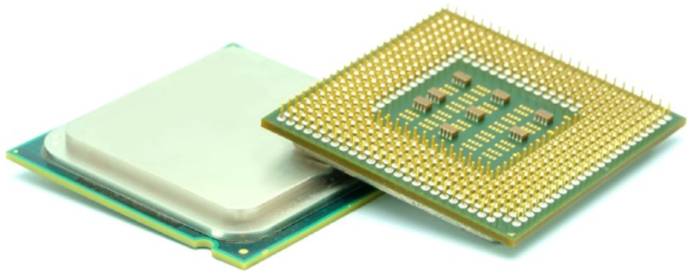
5.1 Characteristics of a Network Operating System
5.1.5 CPU Architectures
A program is a sequence of stored instructions, and a CPU executes these instructions by following a specific instruction set.
There are two distinct types of instruction sets that CPUs may use:
Reduced Instruction Set Computer (RISC) - This architecture uses a relatively small set of instructions. RISC chips are designed to execute these instructions very rapidly.
Complex Instruction Set Computer (CISC) - This architecture uses a broad set of instructions, resulting in fewer steps per operation.

Slide 9
5.1 Characteristics of a Network Operating System
5.1.6 Enhancing CPU Operation
Intel processors use Hyper-Threading to enhance the performance of some of their CPUs.
With Hyper-Threading, multiple pieces of code (threads) are executed simultaneously in the CPU so a single CPU performs as though there are two CPUs.
AMD processors use HyperTransport to enhance CPU performance.
HyperTransport is a high-speed connection between the CPU and the Northbridge chip.
The power of a CPU is measured by the speed and the amount of data that it can process.
The speed of a CPU is rated in cycles per second, such as millions of cycles per second, called megahertz (MHz), or billions of cycles per second, called gigahertz (GHz).
The amount of data that a CPU can process at one time depends on the size of the front side bus (FSB).

Slide 10
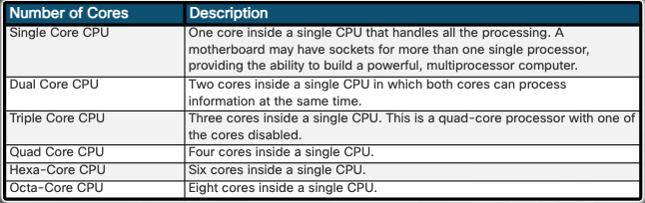
5.1 Characteristics of a Network Operating System
5.1.7 Multicore Processors
Integrating the processors on the same chip creates a very fast connection between them. Multicore processors execute instructions more quickly than single-core processors. Instructions can be distributed to all the processors at the same time. RAM is shared between the processors because the cores reside on the same chip.

Slide 11
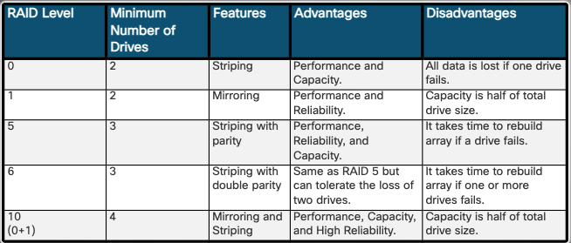
5.1 Characteristics of a Network Operating System
5.1.8 RAID Concepts
Storage devices can be grouped and managed to create large storage volumes with redundancy. To do so, computers can implement redundant array of independent disks (RAID) technology.
Higher levels of RAID, such as RAID 5, 6, or 10 use striping and parity in combination to provide speed and to create large volumes. The figure shows the details about the RAID levels. RAID levels higher than 10 combine lower RAID levels. For example. RAID 10 combines RAID 1 and RAID 0 functionalities.

Slide 12
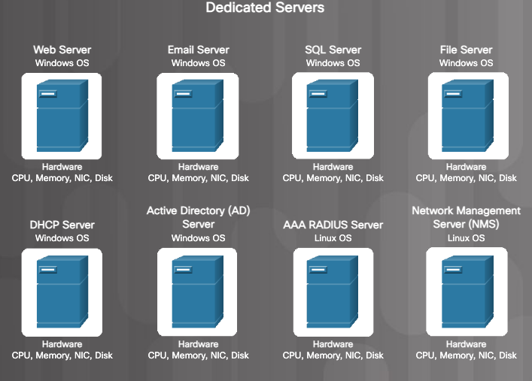
5.1 Characteristics of a Network Operating System
5.1.9 Cloud Computing and Virtualization
Virtualization enables a single computer to host multiple independent virtual computers that share the host computer hardware.
Without virtualization, cloud computing, as it is most-widely implemented, would not be possible.
Traditionally, organizations delivered applications and services to their users using powerful dedicated servers.
Problems with the traditional server deployment approach include:
- Wasted resources
- Single-point of failure
- Server sprawl

Slide 13
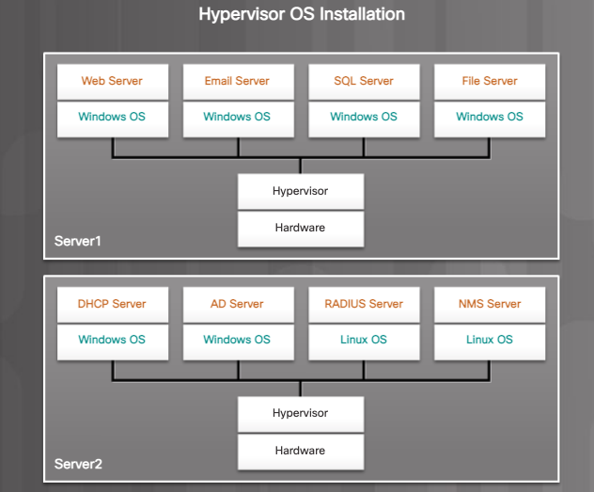
5.1 Characteristics of a Network Operating System
5.1.9 Cloud Computing and Virtualization
A special program called the hypervisor is used to manage the computer resources and various VMs. It provides VMs access to all of the hardware of the physical machine such as CPUs, memory, disk controllers, and NICs. Each of these VMs runs a complete and separate operating system.
With virtualization, enterprises can now consolidate the number of servers. It is not uncommon for 100 physical servers to be consolidated as virtual machines on top of 10 physical servers using hypervisors.

Slide 14
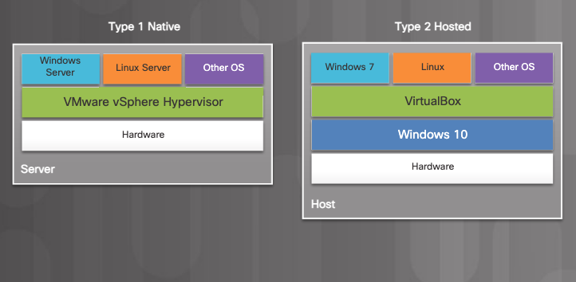
5.1 Characteristics of a Network Operating System
5.1.9 Cloud Computing and Virtualization
The hypervisor, also called the Virtual Machine Manager (VMM), is the brain of virtualization. There are two types of hypervisors:
Type 1 (native) hypervisor – Also called bare-metal hypervisor and typically used with server virtualization.
Type 2 (hosted) hypervisor – This is hosted by an OS and is commonly used with client-side virtualization.

Slide 15
5.1 Characteristics of a Network Operating System
5.1.9 Cloud Computing and Virtualization
All virtual machines share the following basic system requirements:
Processor support – Processors from Intel and AMD, were specifically designed to support virtualization. Processors with multiple cores are recommended as the additional cores increase speed and responsiveness when running multiple VMs and cores can be dedicated to specific VMs.
Memory support – You need enough RAM for each virtual OS.
Storage - Each active VM will require storage space. Therefore, large and fast drives are recommended.
Network Requirements – Network connection requirements depend on the type of VM. To connect a VM uses a virtual network adapter that simulates the real host adapter. In certain setups a dedicated NIC is provided exclusively to the VM.

Slide 16
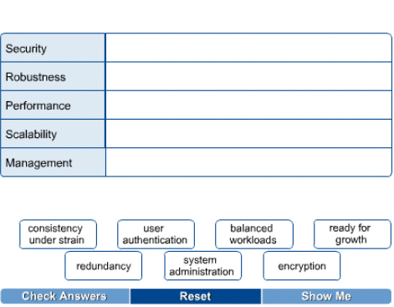
5.1 Characteristics of a Network Operating System
5.1.10 Choosing a NOS
The main features to consider when selecting a NOS include:
- Performance
- Management and monitoring tools
- Security
- Scalability
- Robustness/fault tolerance

Slide 17
5.1 Characteristics of a Network Operating System
5.1.11 Types of Network Operating System
It is important to know the basics about popular NOS families.
Many networks now include more than one server type, and knowing how to get these diverse systems to interoperate is an important skill for a network administrator.
Operating systems on the network have their own language.
Different NOS vendors use the same terms in different ways.

Slide 18
5.2 Windows

Slide 19
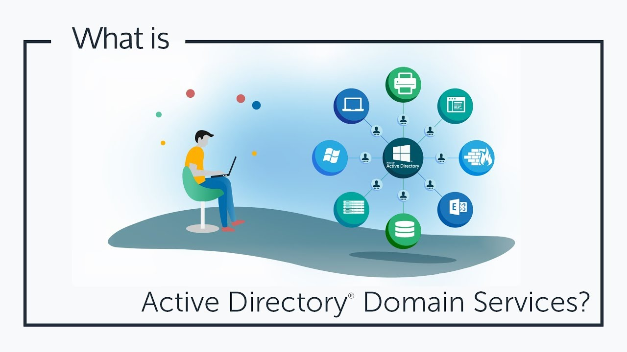
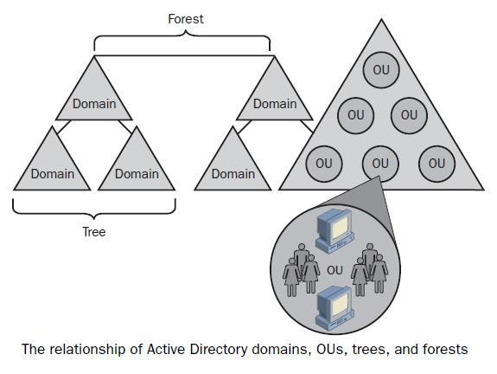
5.2 Windows
5.2.1 Windows Terminology
Windows server-based networks that run Windows Server are based on the concept of the domain and Active Directory.
A domain is a group of computers and users that serves as a boundary of administrative authority.

Slide 20
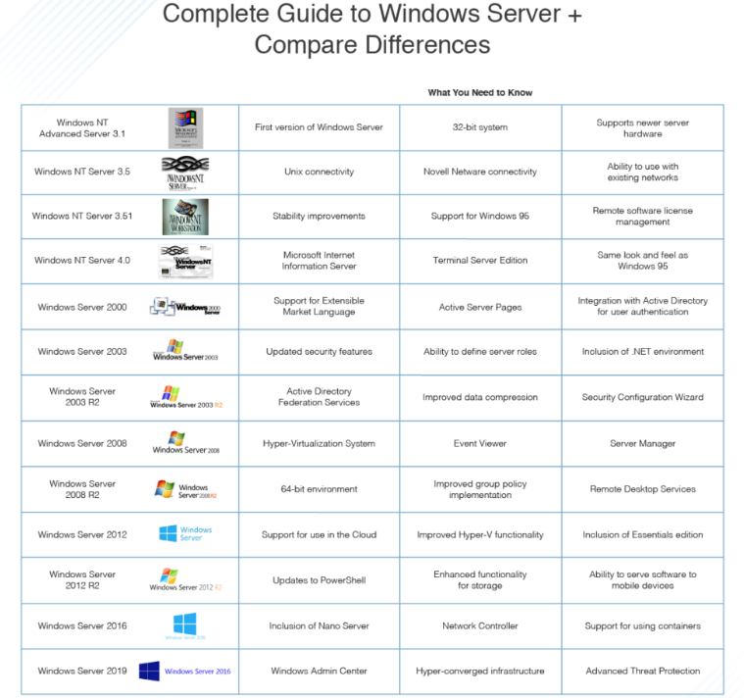
5.2.2 Windows 20XX Family of OS

Slide 21
5.3 Linux

Slide 22
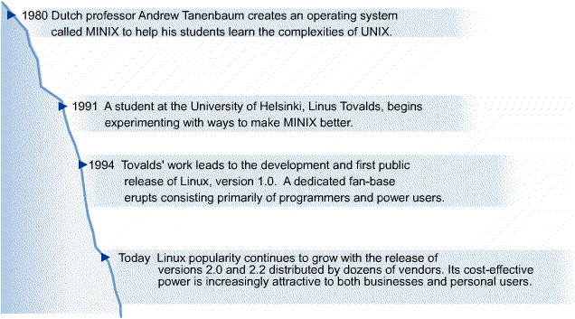
5.3 Linux
5.3.1 History of Linux
Linux is an operating system similar to UNIX. It runs on many different computers and was first released in 1991.
Linux is portable, which means versions can be found running on name brand or clone PCs.
Linux offers from other versions of UNIX. many features adopted

Slide 23
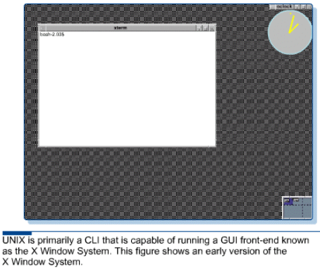
5.3 Linux
5.3.2 What is UNIX?
The UNIX NOS was developed in 1969, and it has evolved into many varieties.
The source code is opened, that is, available at no cost to anyone who wants to modify it.
It is written in C programming language so businesses, academic institutions, and even individuals can develop their own versions.
There are hundreds of different versions of UNIX.

Slide 24
5.3 Linux
5.3.3 Linux Operating System
Linux is sometimes referred to as "UNIX Lite", and it is designed to run on Intel-compatible PCs.
However, Linux will run on other machines as well.
Linux brings the advantages of UNIX to home and small business computers.
The following are a few of the most popular types:
- Ubuntu Server
- Red Hat Enterprise Linux Linux Mandrake
- SUSE Linux Enterprise Server Debian GNU/Linux
- CentOS

Slide 25
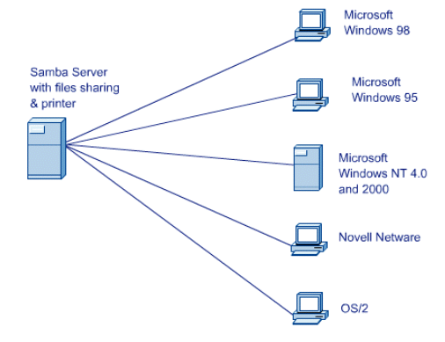
5.3 Linux
5.3.4 Linux Clients
Windows clients can access Linux servers without client software if the UNIX servers run Samba, which is a program that uses the Server Message Block (SMB) application layer protocol.
Windows computers use SMB for file access across the network.
Samba permits them to see the Linux file system.
https://www.youtube.com/watch?v=UhvuApzNZOU

Slide 26
5.4 Determining Software Requirements

Slide 27
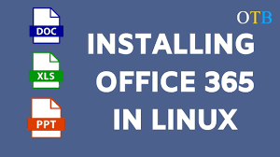


5.4 Determining Software Requirements
5.4.1 Workstation Software and Programs
The X Window System is what comprises the Linux GUI environment.
FreeOffice 2021 and LibreOffice are the top two office suites capable of running on Linux.
There also But also cloud driven solutions that you can use if you are connected to the internet like Google Docs, or MsOffice365 if you are that determined.

Slide 28
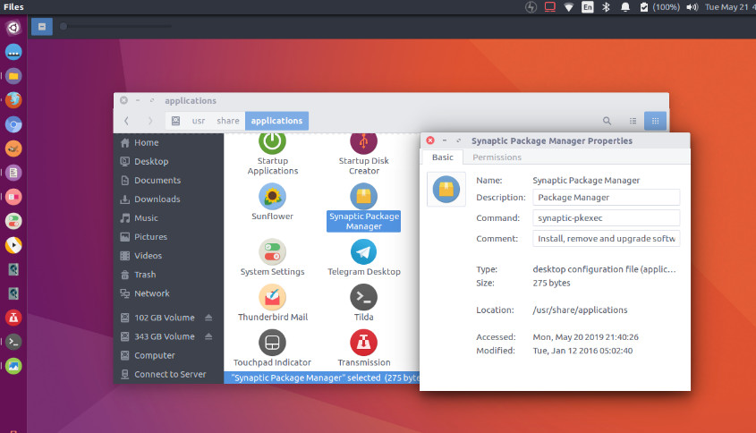
5.4 Determining Software Requirements
5.4.1 Workstation Software and Programs
Some of the popular audio and visual programs available for Linux include tools for viewing and editing graphics like XV and GIMP.

Slide 29
5.4 Determining Software Requirements
5.4.2 Server Software and Programs
A popular use of a Linux system is a web server.
Web server software uses Hypertext Transfer Protocol (HTTP) to deliver files to users that request them, using a web browser from their workstation.
A Mail Server is a system that is configured with the proper programs and services that enable handling the exchange of e-mail sent from one client to another.
The Linux operating system provides file server either in a Linux environment or in a cross-platform environment consisting of Windows, Macintosh, UNIX, or OS/2 workstation.

Slide 30
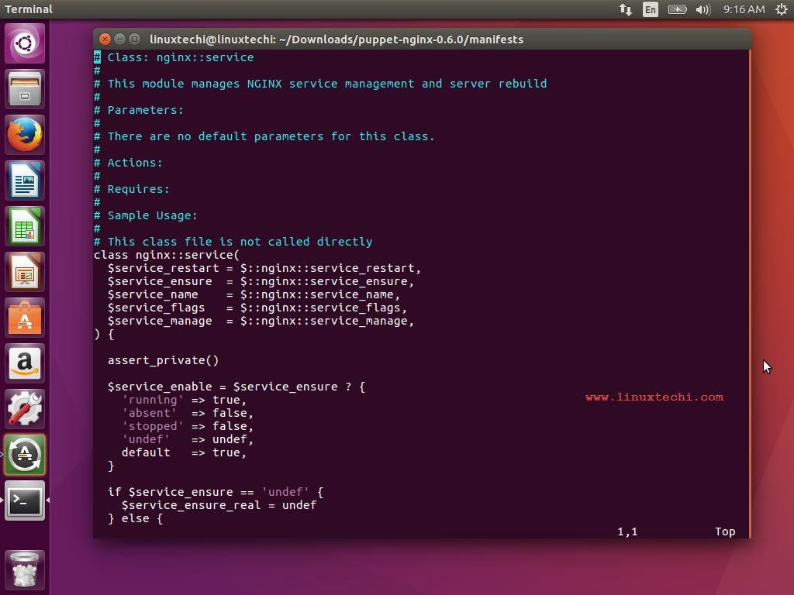
5.4 Determining Software Requirements
5.4.2 Additional Software and Programs
There are some programs and software that are essential to add to a Linux system regardless of whether it is configured as a workstation or a server.
Text editors are essential for performing any type of maintenance tasks that a user or an administrator may need to do.
Some examples of text editors available in Linux are vi, jed, pico, or Emacs.

Slide 31
5.4 Determining Software Requirements
5.4.2 Additional Software and Programs
Programming tools are helpful Linux servers as well to specific users at workstations if they are programmers.
These programming tools are also referred to as compilers or interpreters.
A complier converts the program source code, which is written by the programmer into binary form the computer can read.
Common scripting languages include Javascript, Python, and Perl.
Every Linux system relies on a library called the C library (libc). Linux systems rely on the C library for the routines that are necessary for C programs to run in Linux.

Slide 32
5.4 Determining Software Requirements
5.4.3 Verifying Software Compatibility
When installing a package, the first step should be to always check and make sure that the operating system supports the package.
Generally, any Linux software and package can be installed on any UNIX-like operating system.
Check CPU requirements, library requirements, and development tools.

Slide 33

Conclusion
5.1 Characteristics of a Network Operating System
5.2 Windows
5.3 Linux
5.4 Determining Software Requirements

Slide 34
Any Questions??

Slide 35
Thank You

