Slide 1

CT5052 Network Operating Systems
Getting Started UNIX
The UNIX File System
Some UNIX Commands
Notes:
Lecture 1/1
CS2026N Operating Systems 2006/7 (1)
B.Cogan

Slide 2
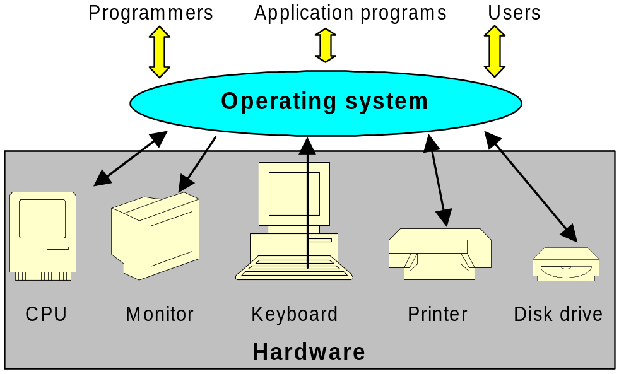
What is an Operating System?

Slide 3
What is an Operating System?
An operating system is a control program for a computer.
It has two main functions:
■ to allocate computer resources and schedule tasks;
■ to provide interfaces to the user.
It performs many sub-functions almost simultaneously.
It schedules tasks so that the central processor is working on only one task at a given moment.

Slide 4
The UNIX Operating System
UNIX is the name of a family of computer
operating systems and their family of
related utility programs.

Slide 5
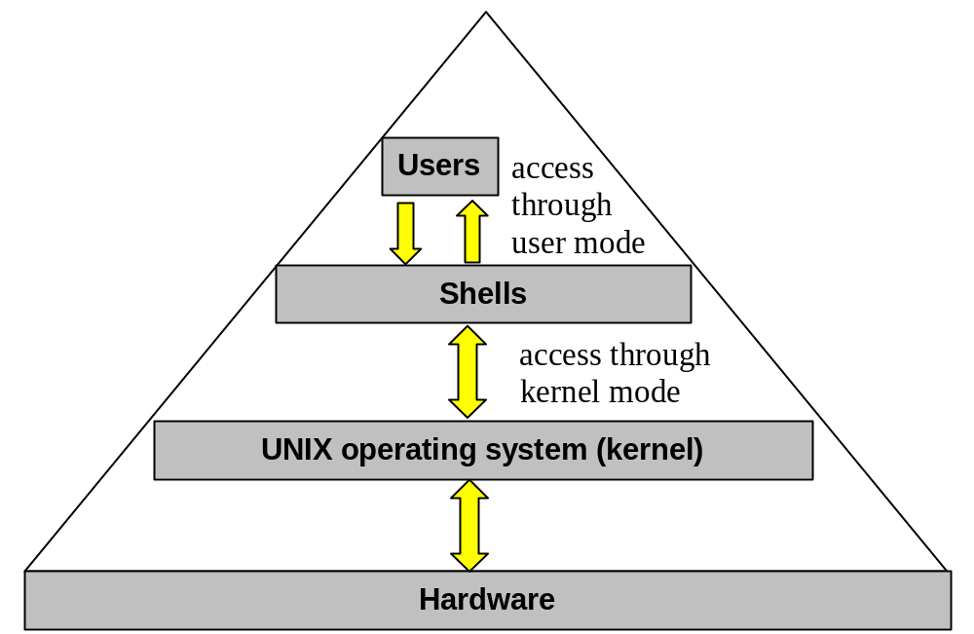
Layers of an UNIX system

Slide 6
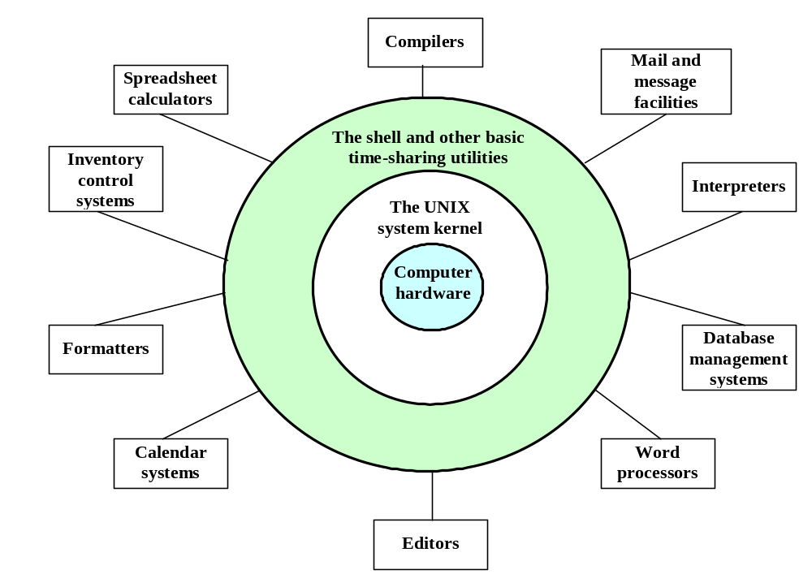
Overview of the UNIX System

Slide 7
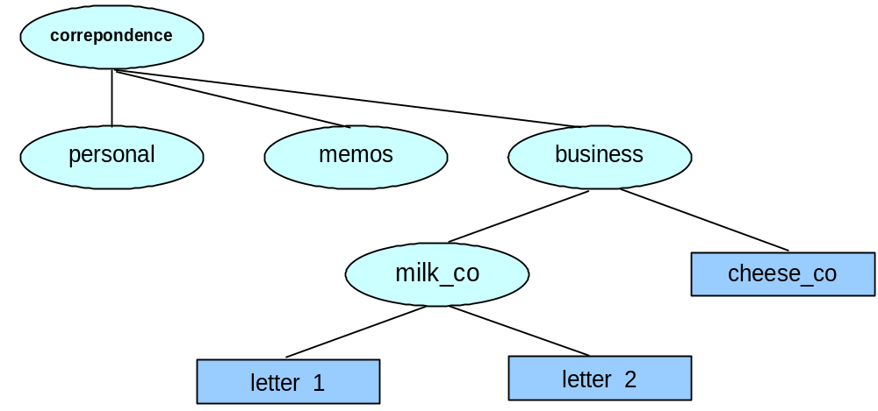
The UNIX File System
(hierarchical file structure)
A hierarchical structure frequently takes the shape of a tree.
In a UNIX system, each user starts with one directory.
Typically, each subdirectory is dedicated to a single subject.
Notes:
Lecture 1/1
CS2026N Operating Systems 2006/7 (1)
B.Cogan

Slide 8
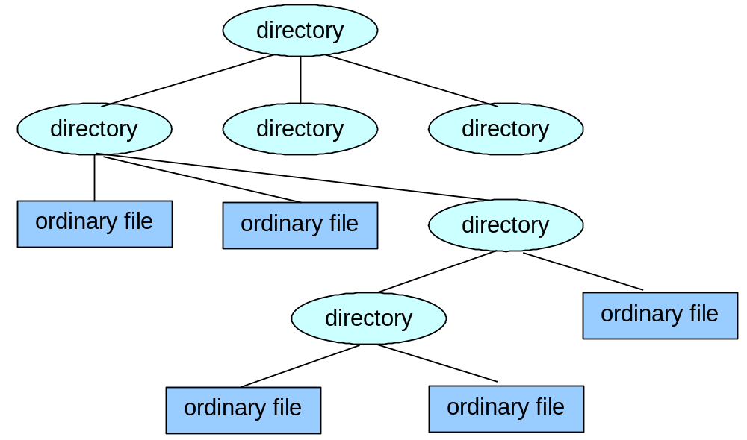
Directory and Files
· Files are at the ends of paths.
· Directory files, or directories, are the points that other paths can branch off from.
· Directories directly connected by a path are called parents (closer to the root) and children (farther from the root).

Slide 9
Filenames
Every file has a filename.
You will avoid confusion if you choose characters from the following list:
  uppercase letters (A-Z)
  lowercase letters (a-z)
  numbers (0-9)
  underscore (_)
  period (.)
  comma (,)
The only exception is the root directory, which is always named / .

Slide 10
Filename Extensions
· Filename extensions help to describe the contents of the file.
· A filename extension is the part of a filename following an embedded period.
· It makes filenames easy to understand.
· You can use several periods within the same filename (for example, notes.30.09.2003).
Filename
Meaning of Filename Extension
compute.c
A C programming language source file
computer.o
The object code for the program
computer
The same program as an executable file
memo.0410
A text file

Slide 11
Invisible Filenames
A filename beginning with a period is called an invisible filename because the ls command without options does not normally display it.
The command ls –a displays all filenames, even invisible ones.
Startup files are usually invisible.
Two special invisible entries, a single and double period (. and ..), appear in every directory.

Slide 12
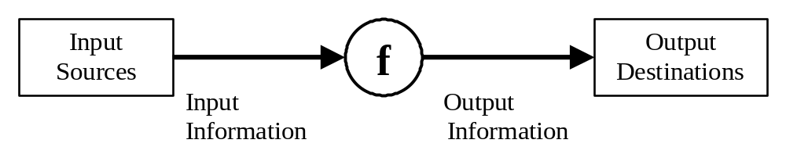
UNIX Command
· The basis of all UNIX interactions is the command.
· A command given by you forces your computer (system) to do what you want.
· A UNIX command is an action request given to the UNIX shell for execution.
· It may be entered at a console or included in executable files to form scripts.

Slide 13
Command Syntax
· Commands are entered at the shell prompt (for example, the Korn shell $ prompt).
· The command format is:
$ verb [options] [arguments]
· The brackets indicate that the options and arguments are optional.
· The verb is the command name.
· The option modifies how the action is applied.
· The argument provides additional information to the command.

Slide 14
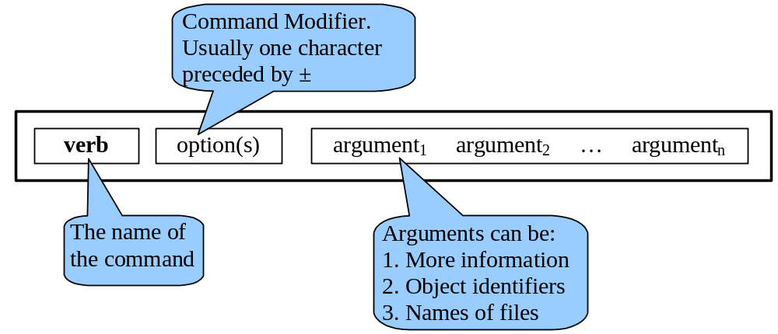
Command Syntax (contd…)
· You must know, for each command, what are the options and what are the arguments.
· The general format or syntax of a command may be represented graphically like this:

Slide 15
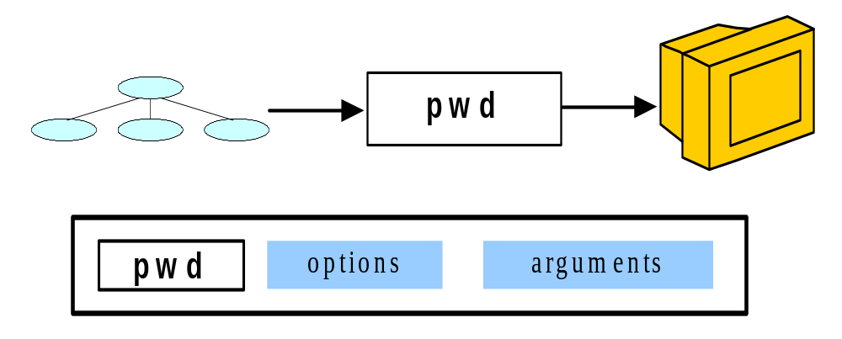
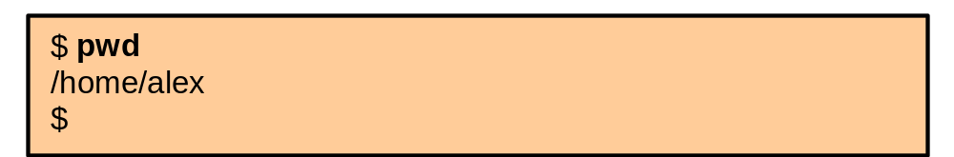
Example: Command Without Options and Arguments
· The command used to determine the current directory is print working directory (pwd).
· It has no options and no arguments.
· When executed, it prints the absolute pathname for the current directory.

Slide 16
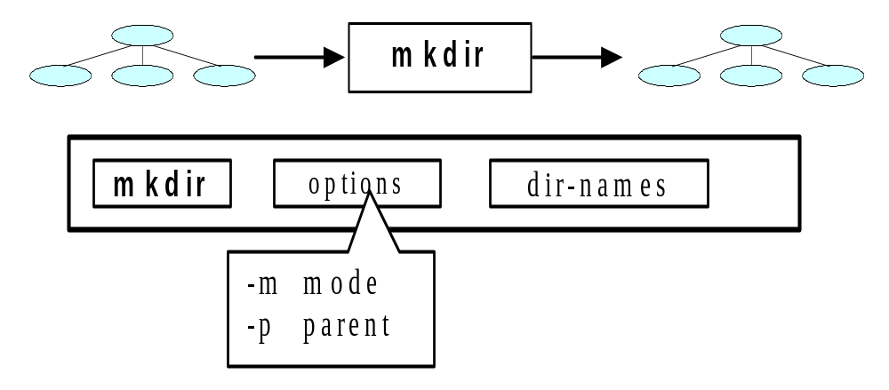
Example: Command With Options and Arguments
· To create a new directory, you use the make directory (mkdir) command.
· It has two options: permission mode and parent directory (try man mkdir).

Slide 17
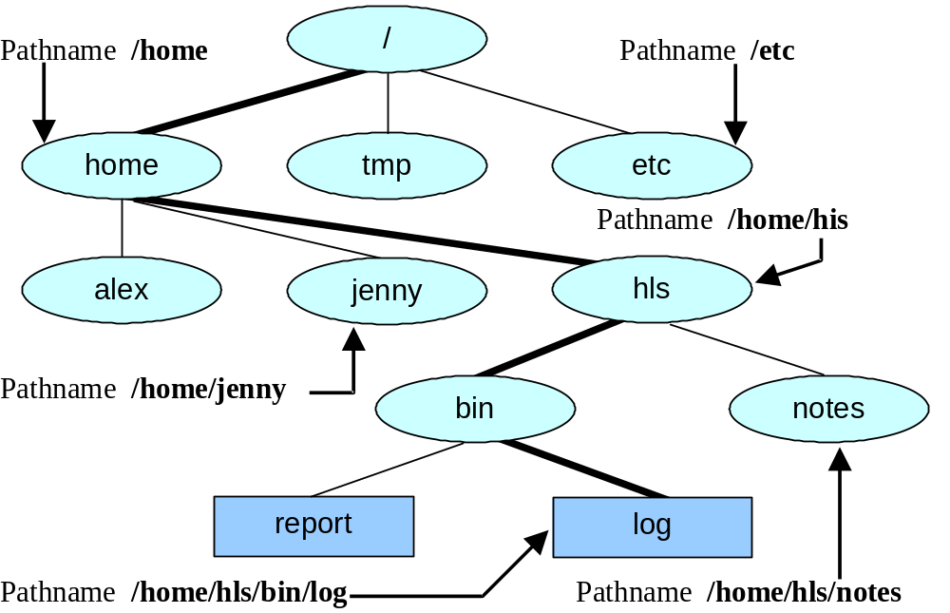
Absolute Pathnames
Every file has a pathname.
You can build the pathname of a file by tracing a path from the root directory, through all the intermediate directories, to the file.
This path of filenames is called an absolute pathname.

Slide 18
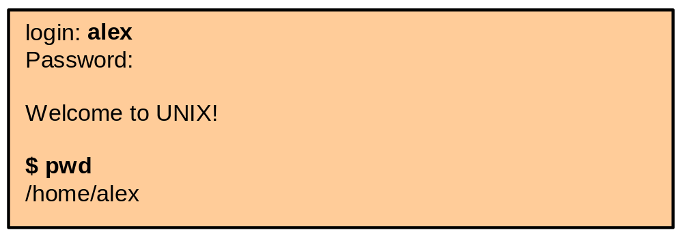
The Working Directory
The directory you are associated with, or are working in, is called the working directory, or the current directory.
The pwd (print working directory) utility displays its pathname.
To access a file in the working directory, you do not need a pathname – just a simple filename.
To access a file in another directory you must use a pathname.

Slide 19
Your Home Directory
When you first log in on a UNIX system, the working directory is you home directory.
To display the absolute pathname of your home directory, use pwd just after you log in.

Slide 20
Startup Files
· An important file in your home directory is a startup file. It gives the operating system specific information about you as a user.
· Either you or the system administrator can put a startup file, containing shell commands, in your home directory.
· The shell executes the commands in this file each time you log in.
· With the Bourne shell and the Korn shell, the filename must be .profile.
· Because the startup files have invisible filenames, you must use ls –a command to see these files in your home directory.
· You can put your own commands in your startup files.

Slide 21
Creating a Directory
The mkdir utility creates a directory. It does not change your association with the working directory.
The argument you use with mkdir becomes the pathname of the new directory.

Slide 22
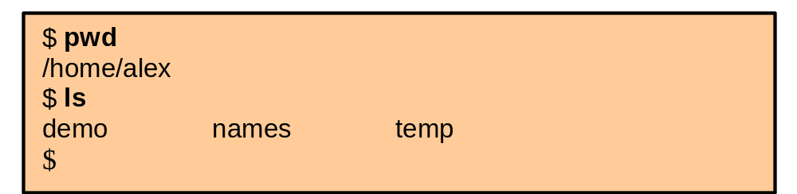
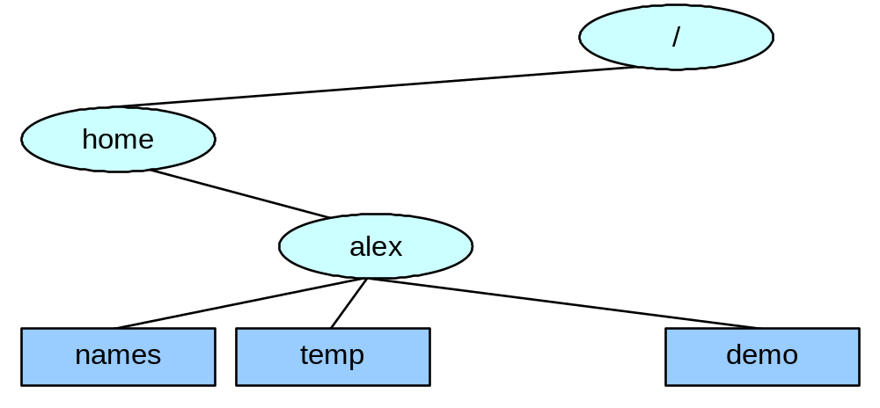
Creating a Directory: Example I

Slide 23
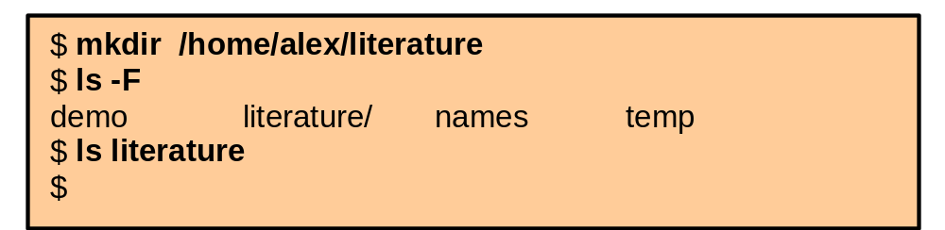
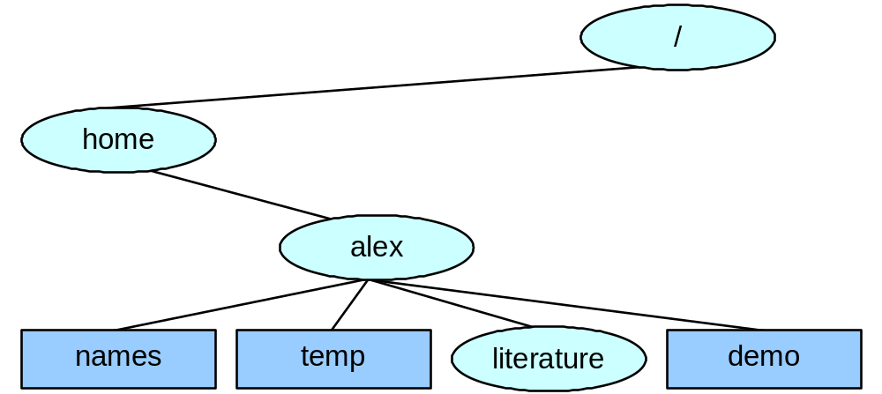
Creating a Directory: Example II
· If there are no files in the directory, ls does not list anything.

Slide 24
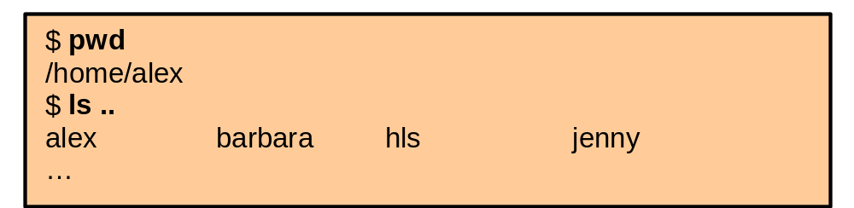
The . and .. Directory Entries
· The mkdir utility automatically puts two entries in every directory.
· The . is synonymous with the pathname of the working directory and can be used in its place. You can think of . as being a shortcut version of the current directory. If you are in "/home/max" then "." (by itself or followed by a '/') is equivalent to "/home/max"
· The .. is synonymous with the pathname of the parent of the working directory, a shortcut version of the directory above.

Slide 25
Thank You!!
Any Questions?

