Slide 1
類神經網路期末報告
D10115015張宗銓
D10415004賴家民

Slide 2
The Description of our NN
4 layers of fully connected NN
Using MSE as loss function
Choosing Adam(Adaptive Moment Estimation) as our optimizer
Using dropout method to prevent overfitting

Slide 3
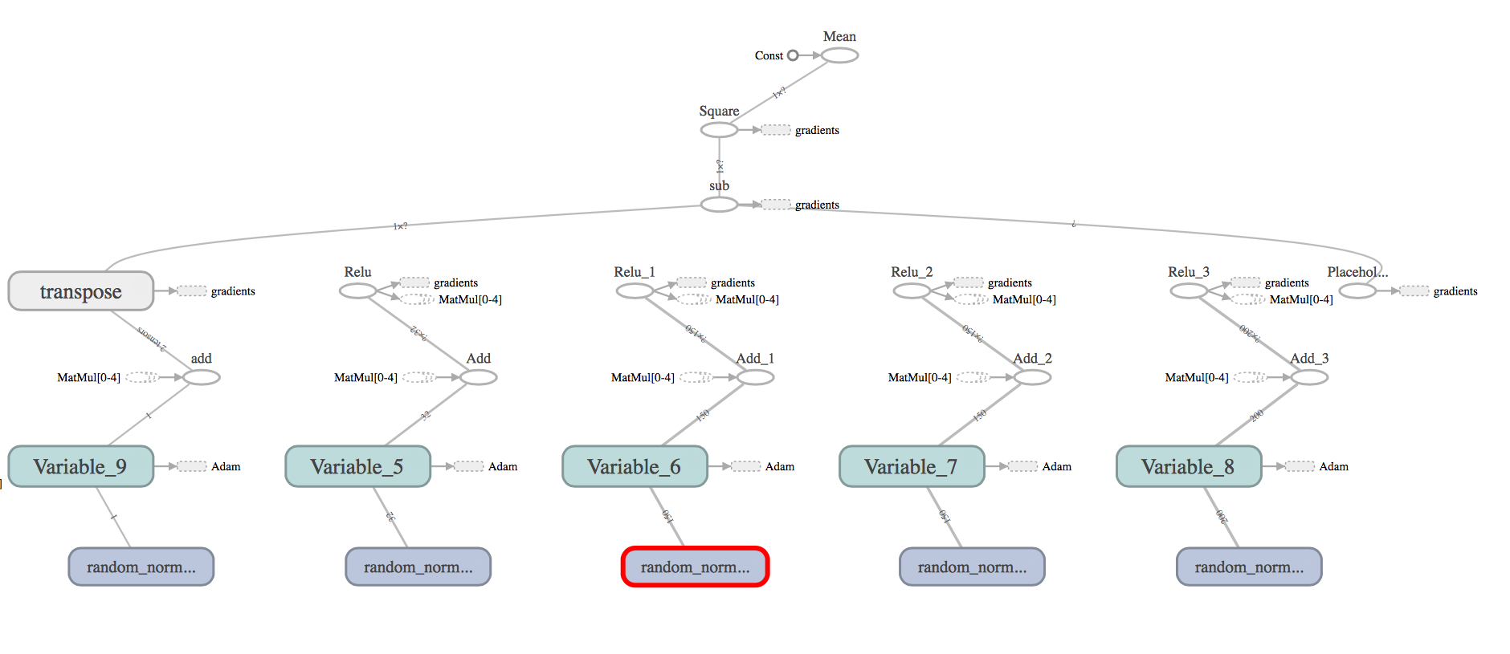
Using TensorBoard to Visualize Graph

Slide 4
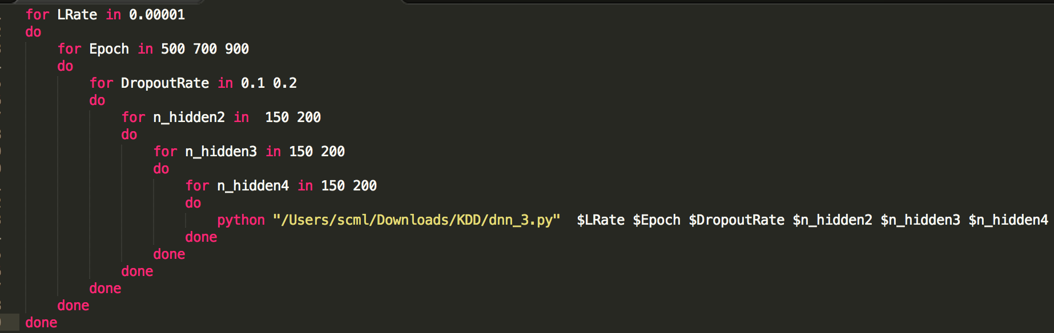
Tuning the NN parameter
Learning Rate
Training Epoch
Dropout Rate
Numbers of Neuro of hidden2
Numbers of Neuro of hidden3
Numbers of Neuro of hidden4

Slide 5
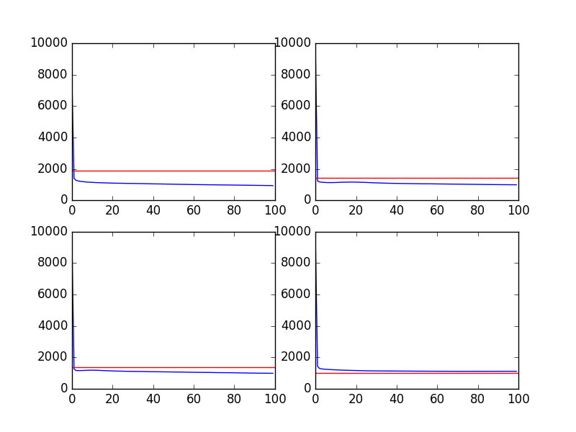
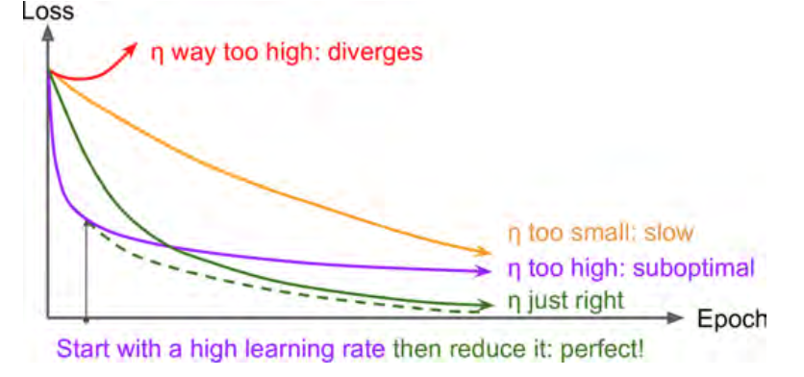
First round of tuning
Learning Rate: 0.001
Training Epoch: 100
Dropout Rate: 0.3
Numbers of Neuro of hidden2: 200
Numbers of Neuro of hidden3 :200
Numbers of Neuro of hidden4 :200

Slide 6
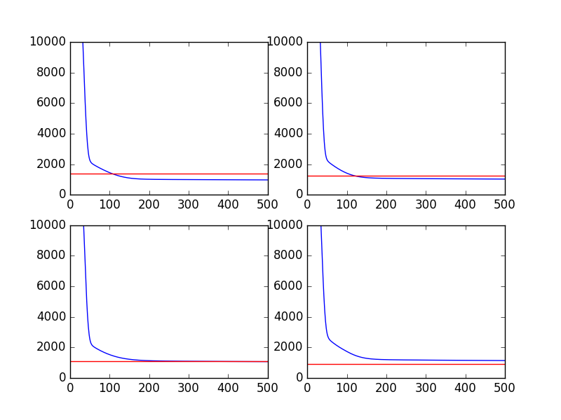
Tuning after the decrease the learning rate
The curves of loss becomes better.
Learning Rate: 0.0001
Training Epoch: 500
Dropout Rate: 0.3
Numbers of Neuro of hidden2: 200
Numbers of Neuro of hidden3 :200
Numbers of Neuro of hidden4 :200

Slide 7
