Slide 1
Final Reports
KDD 2017
M10507305 陳弘明
M10507307 黃健傑
M10515026 鄒濬安

Slide 2
Outline
Task1
Approach
Result
Problem
Task2
Approach
Result
Problem
Improvement

Slide 3
Task1
Approach

Slide 4
Task1 approach
Pre-process data
Select features
Develop models
Decision Tree
Multilayer Perceptron
Tune model hyperparameter
MAPE evaluate

Slide 5

Pre-process data
Data split
Average time in 20 minutes
Merge weather
Use week day as feature
 | intersection_id | tollgate_id | pressure | sea_pressure | wind_direction | wind_speed | temperature | rel_humidity | precipitation | hour | week | minute | travel_time
0 | 1 | 2 | 1000.9 | 1005.8 | 219 | 3.3 | 27.5 | 81 | 0 | 0 | 2 | 20 | 58.05
1 | 1 | 2 | 1000.9 | 1005.8 | 219 | 3.3 | 27.5 | 81 | 0 | 1 | 2 | 20 | 56.87
2 | 1 | 2 | 1000.9 | 1005.8 | 219 | 3.3 | 27.5 | 81 | 0 | 1 | 2 | 40 | 77.74
3 | 1 | 2 | 1000.9 | 1005.8 | 219 | 3.3 | 27.5 | 81 | 0 | 2 | 2 | 20 | 42.64
4 | 1 | 2 | 1000.9 | 1005.8 | 219 | 3.3 | 27.5 | 81 | 0 | 2 | 2 | 40 | 40.17333333
18 | 1 | 2 | 1000.5 | 1005.3 | 212 | 3.8 | 31.7 | 65 | 0 | 3 | 2 | 20 | 41.92
19 | 1 | 2 | 1000.5 | 1005.3 | 212 | 3.8 | 31.7 | 65 | 0 | 3 | 2 | 40 | 39.43
20 | 1 | 2 | 1000.5 | 1005.3 | 212 | 3.8 | 31.7 | 65 | 0 | 4 | 2 | 0 | 48.13
21 | 1 | 2 | 1000.5 | 1005.3 | 212 | 3.8 | 31.7 | 65 | 0 | 4 | 2 | 20 | 62.10666667
22 | 1 | 2 | 1000.5 | 1005.3 | 212 | 3.8 | 31.7 | 65 | 0 | 4 | 2 | 40 | 46.115
23 | 1 | 2 | 1000.5 | 1005.3 | 212 | 3.8 | 31.7 | 65 | 0 | 5 | 2 | 0 | 49.556

Slide 6


Slide 7
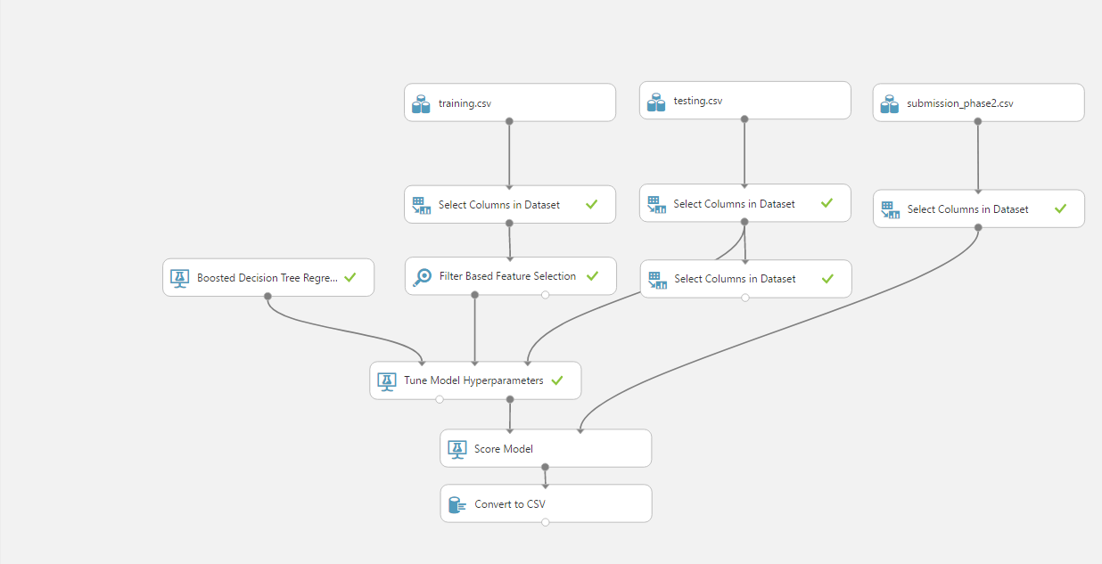
Develop models

Slide 8
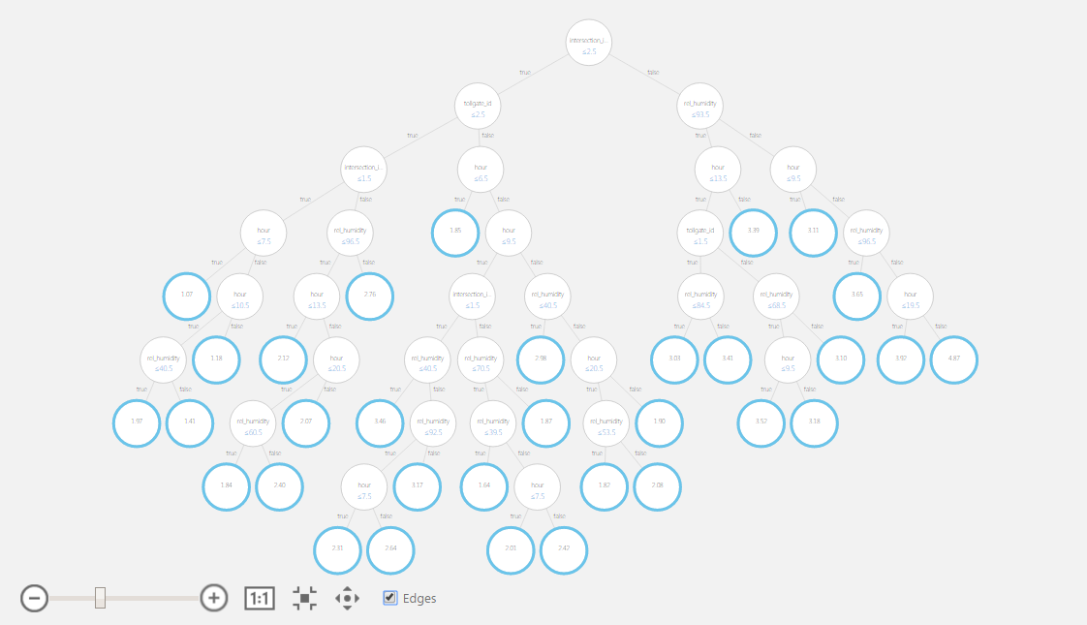
Boosted Decision Tree

Slide 9




Preprocessing :
Training : + +

Slide 10
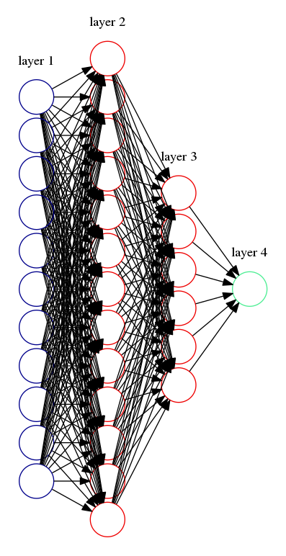

Network model
intersection_id
tollgate_id
pressure
sea_pressure
wind_direction
wind_speed
travel_time
temperature
rel_humidity
hour
week
minute

Slide 11
Develop model
Architecture
Hidden layer1 13 neurons
Hidden layer2 6 neurons
Activation function
ReLu
Loss function
Mean squared error
Optimizer
Adam (lr=0.001, beta_1=0.9, beta_2=0.999, epsilon=1e-08, decay=0.0)
Compile model
Fit model
Epochs=50

Slide 12
Visualization of algorithms

Slide 13
Result

Slide 14
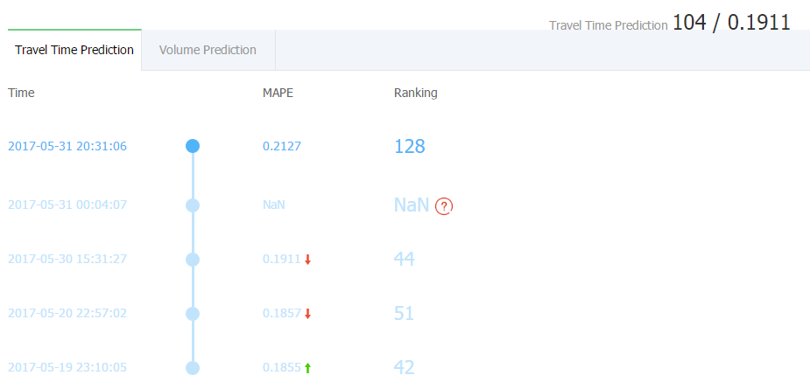
Task 1

Slide 15
Problem

Slide 16
Problem
How to solve the problem of overfitting?
Regularization
Early stop
Drop out
Missing data.
Interpolation
Error rate.

Slide 17
Task2
Approach

Slide 18
Task2 approach
Pre-process data
Select features
Develop models
Multi-layer Perceptron
MAPE evaluate

Slide 19


Slide 20
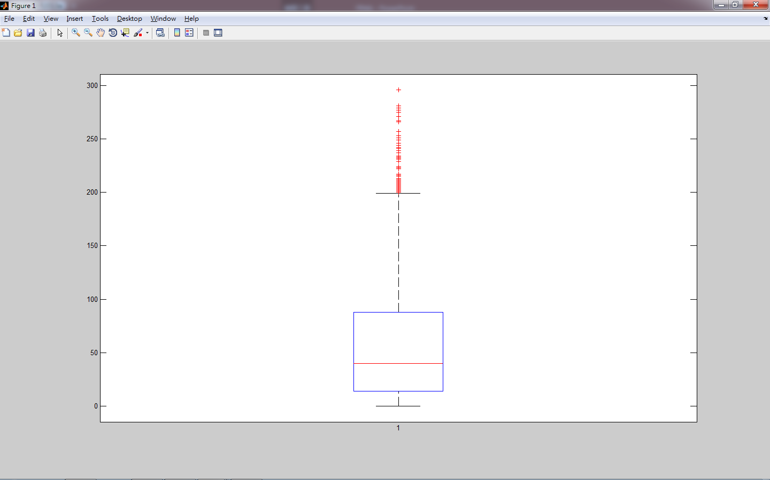
Remove outliners
OUTLIER：200~
Q1：14
Q3：88
MEAN：53.9598
Median：40

Slide 21
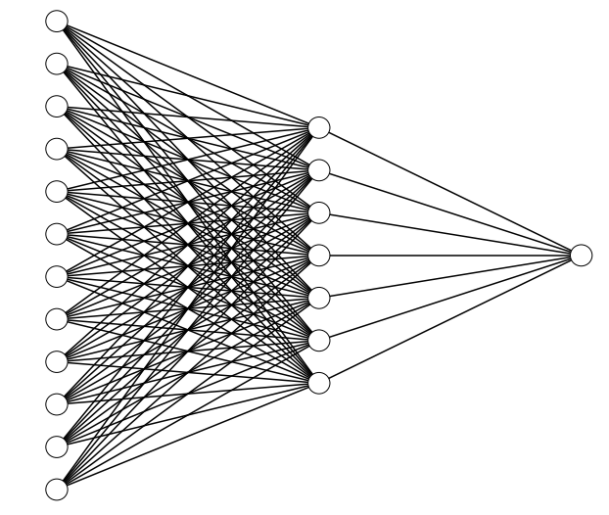
Network Architecture
intersection_id
tollgate_id
pressure
sea_pressure
wind_direction
wind_speed
Volume
temperature
rel_humidity
hour
week
minute
precipitation

Slide 22
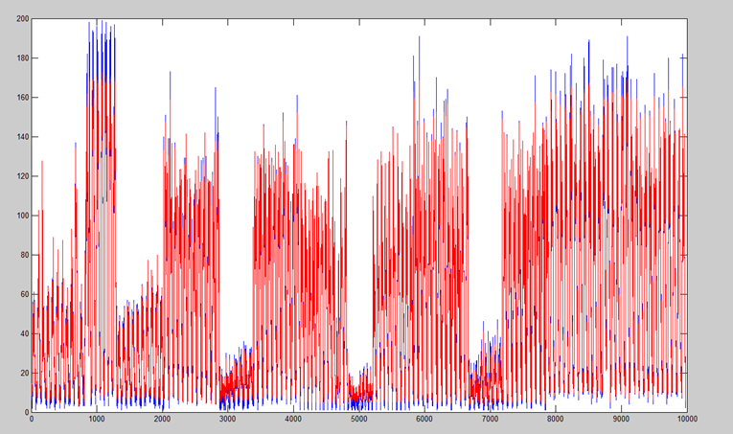
Training Result

Slide 23
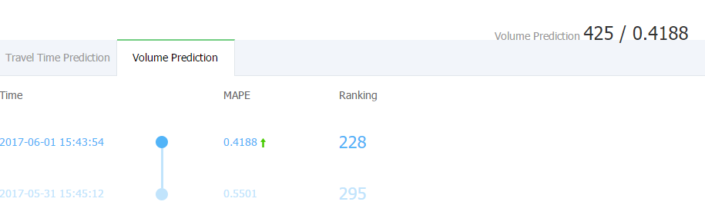
Result

Slide 24
Future Work

Slide 25
Improvement
Define Volume and delta Volume : very high , high, median , low, very low.
Use previous delta volume to predict next 20 minutes.
採用 XGBoost

Slide 26
XGBoost
XGBoost 可以避免 overfitting。
Cross Validation 效果不錯。
在 Task2 中 MLP 做出來的效果並不如人意（根據最佳的 mape 也將近約 1 ~ 2 左右），下一頁有實際 Cross Validation 的結果比較。

Slide 27
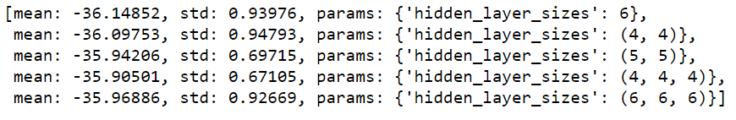
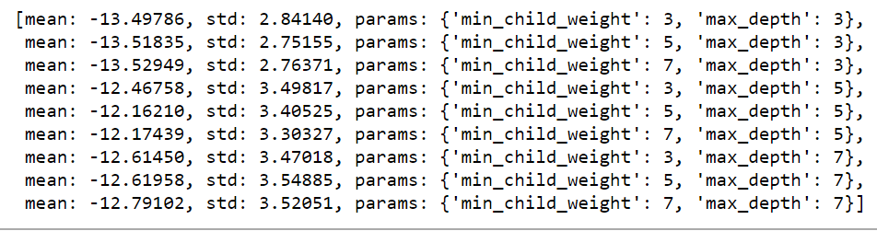
MAE for MLP & XGBoost
MLP
XGB

Slide 28
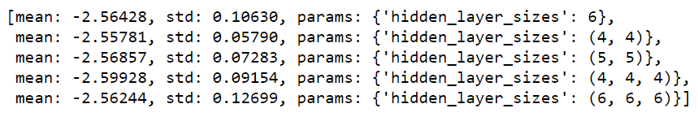
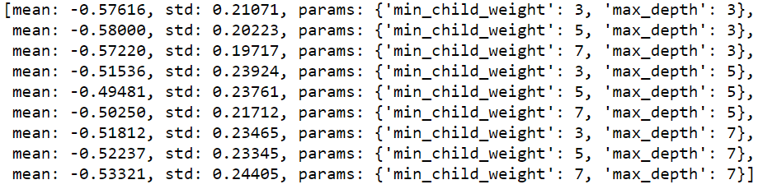
MAPE for MLP & XGBoost
MLP
XGB

