Slide 1
任清宇 2024.11.21
指令遵循的软约束优化

Slide 2
指令遵循的软约束优化
Motivation
软约束难以遵循
软约束是指不具有明确规则或硬性限制的约束。由于软约束不像硬约束那样具有明确的“对”或“错”的判断标准，大模型在生成内容时很难完全满足这些约束。
例如，“回答需在专业性和通俗易懂之间平衡”这样的软约束可能难以被严格执行，因为模型需要在语义模糊区域进行判断。
软约束是否遵循大模型判断不准，即使是GPT-4
对于软约束的遵循情况，判断通常需要结合上下文和复杂的语义分析。即使是像GPT-4这样的高级模型，在判断时也可能出现偏差或误判。
约束数量的增多代表学习难度增大，偏好判断难度增大
当约束数量增加时，大模型需要在更多的条件之间寻找平衡，这无疑会加大模型学习和生成内容的复杂性。

Slide 3
指令遵循的软约束优化
Method
构造数据
通过DPO对比增强软约束遵循
通过LLM as a judge对偏好数据重排，提升数据质量
训练优化
通过课程学习，由易到难逐步增强约束遵循能力
按照约束数量从小到大排序
Eg. {"prompt": "Please change the meaning of the following question by changing as few words as possible. Create different questions with the same output format (i.e., if the given question has a yes/no answer, so should yours, etc.). Incorporate a Specific Theme: Ensure the story aligns with a particular genre or theme, such as mystery, fantasy, or science fiction.Specify a Role: Assume the role of a tour guide explaining details about wildlife in the national park.Ensure each changed question includes at least one historical or factual detail related to the domain.The letter i must appear less than 6 times in the reply. ", "instruction_id_list": ["detectable_format:multiple_sections", "style:open_ended", "situation:role_play", "detectable_content:open_ended", "keywords:letter_frequency"]}
构造的软约束示例

Slide 4
指令遵循的软约束优化
Results 训练后的模型在IFEval、FollowBench各个具体类别上的效果均有所提升。
IFEval | strict |  | loose
model | prompt-level | inst-level | prompt-level | inst-level
Llama-3-8B-Instruct | 67.47% | 76.14% | 72.83% | 80.94%
Ours-Llama-3-8B-Instruct_{dpo} | 76.34% | 83.33% | 79.85% | 85.97%
Ours-Llama-3-8B-Instruct_{judger} | 77.26% | 83.81% | 80.78% | 86.69%
Our-Llama3-8B-Instruct_{judger+course} | 79.11% | 85.73% | 83.18% | 88.61%
Todo:
1.另一个sft
2. Mistral
3.偏好实验
4.Dpo各个阶段

Slide 5
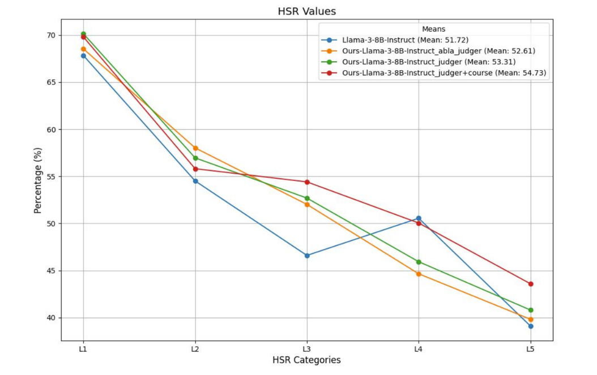
FollowBench

Slide 6
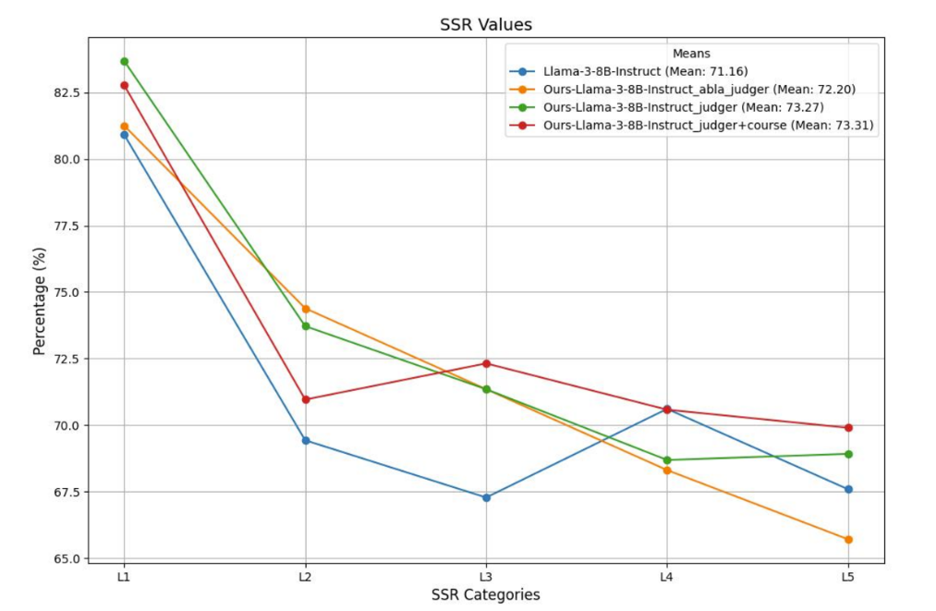
FollowBench

