Slide 1
HUFS IOT TERM PROJECT
AI-Based Threat Sound Detection
IoT Security System
Real-time Threat Sound Detection for Smart Surveillance
Taehyun Jang , Yuna Ko

Slide 2
Part 1. Problem Definition & Core Objectives
The Gap & Opportunity
Visual Blind Spots
Cost Barrier
Our Solution
Camera-based security has inevitable detection gaps
Commercial solutions like Axis are prohibitively expensive
Low-cost microphone sensors + Edge-AI
for a comprehensive audio security layer
4 Core Objectives
Lightweight
Edge-AI
Real-time Detection
Parallel Control
Remote Alerts
Simultaneous buzzer, LED, and camera activation.
Instant mobile push alerts
TFLite on Raspberry Pi,
with no server dependency
Frame-level analysis for
glass breaks and screams

Slide 3








DATA FLOW ARCHITECTURE
System Architecture
Input
AI Engine
Decision
Lavalier USB Mic | 16kHz Mono
| Real-time Streaming
YAMNet Feature Extractor | TFLite Classifier (259KB) | Max-pooling Inference
Glass / Scream / Normal
Actions
Buzzer
LED
Capture
Log
Notify

Slide 4
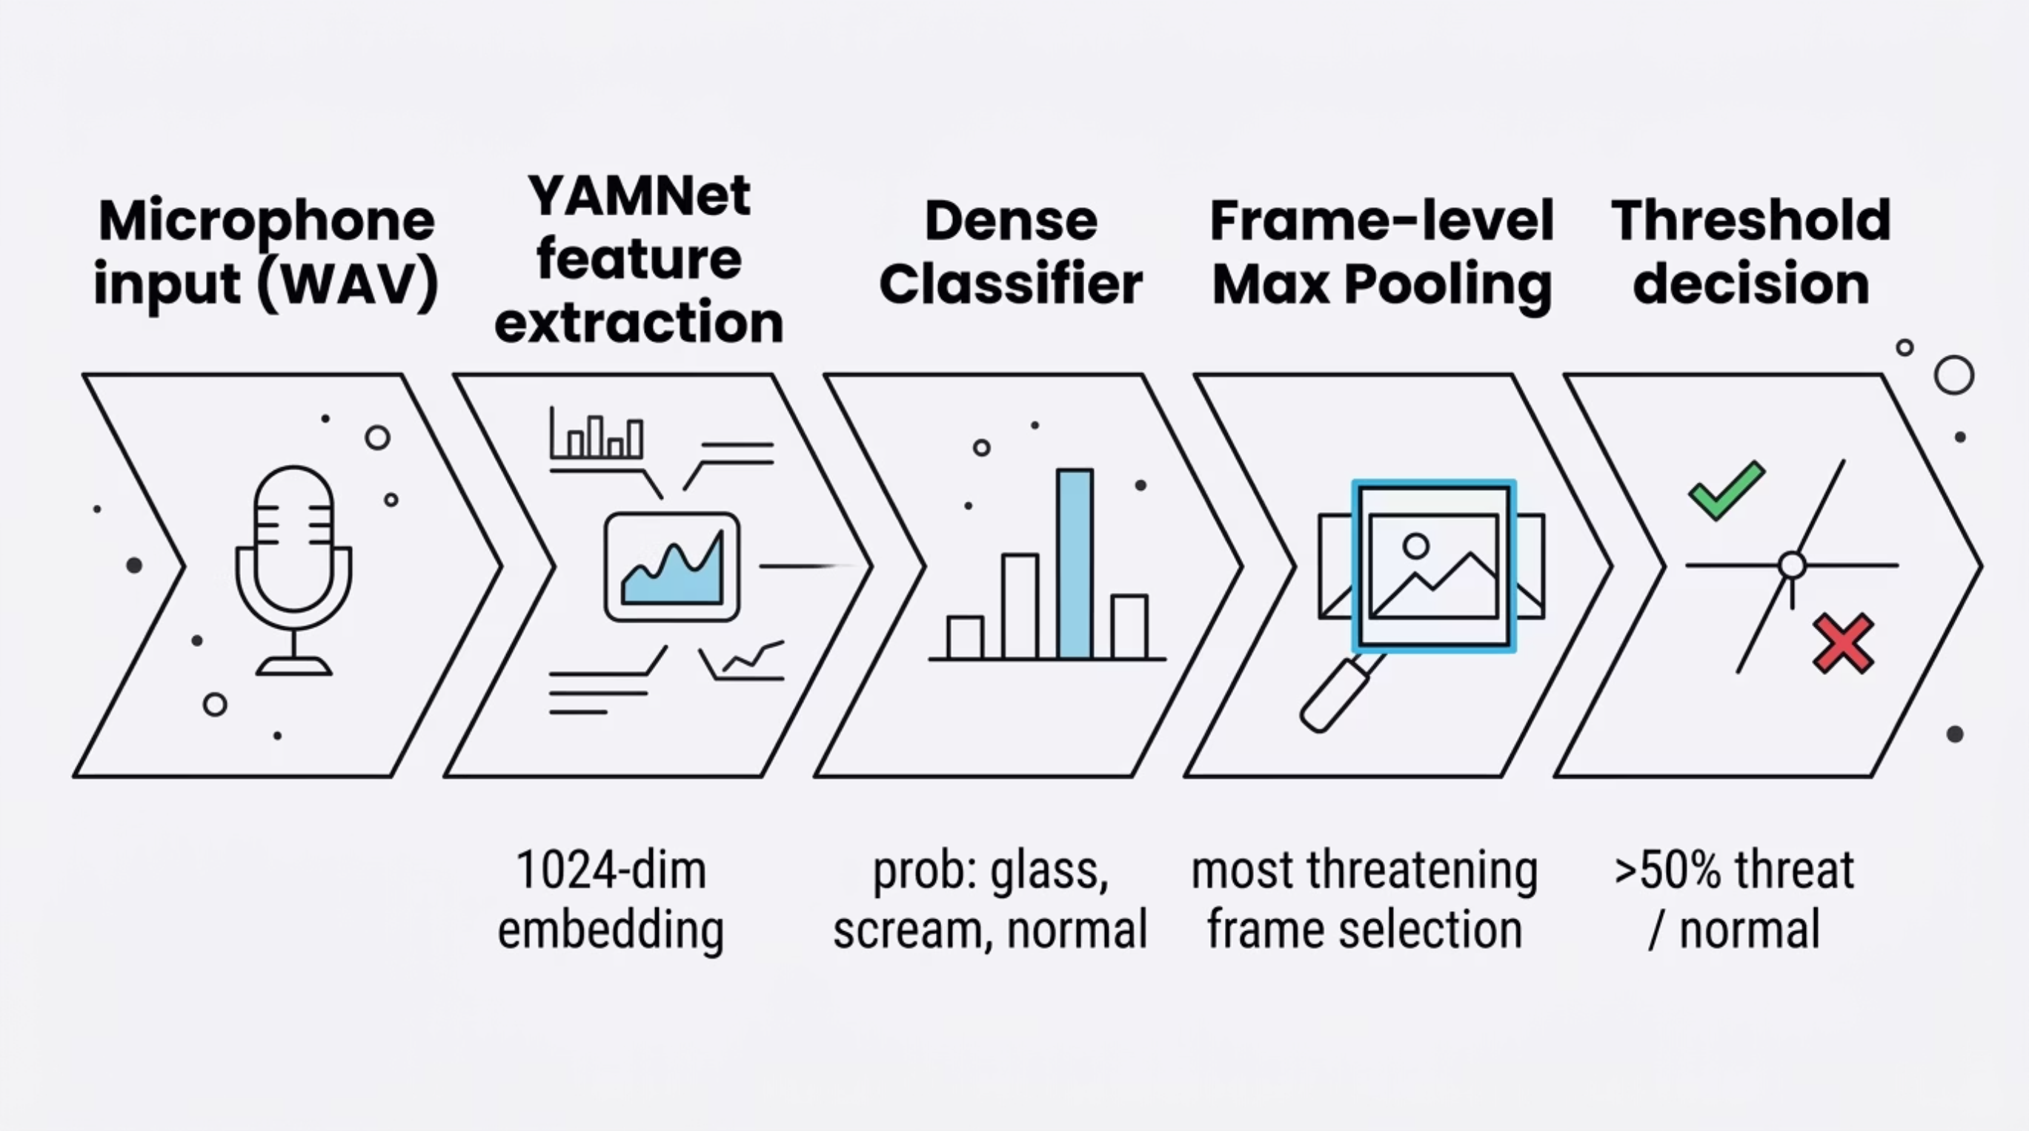
PROCESS FLOW
Overall System Pipeline

Slide 5

AI ENGINE DETAILS
YAMNet & Detection Logic
Mean vs. Max Pooling: A Core Discovery
❌ Original Approach: Mean Pooling
# Original: Averaging all frames -> short sounds get buried
mean_probs = all_probs.mean(axis=0)
# Example: glass break detection at 35.5% (misclassified as normal)
✅ Improved Approach: Max Pooling
# Improved: Max value per frame -> short sounds detected
threat_probs = all_probs[:, [0, 2]] # glass + scream classes
max_frame = np.argmax(threat_probs)
# Example: glass break detection at 99.1% (accurately detected)

Slide 6
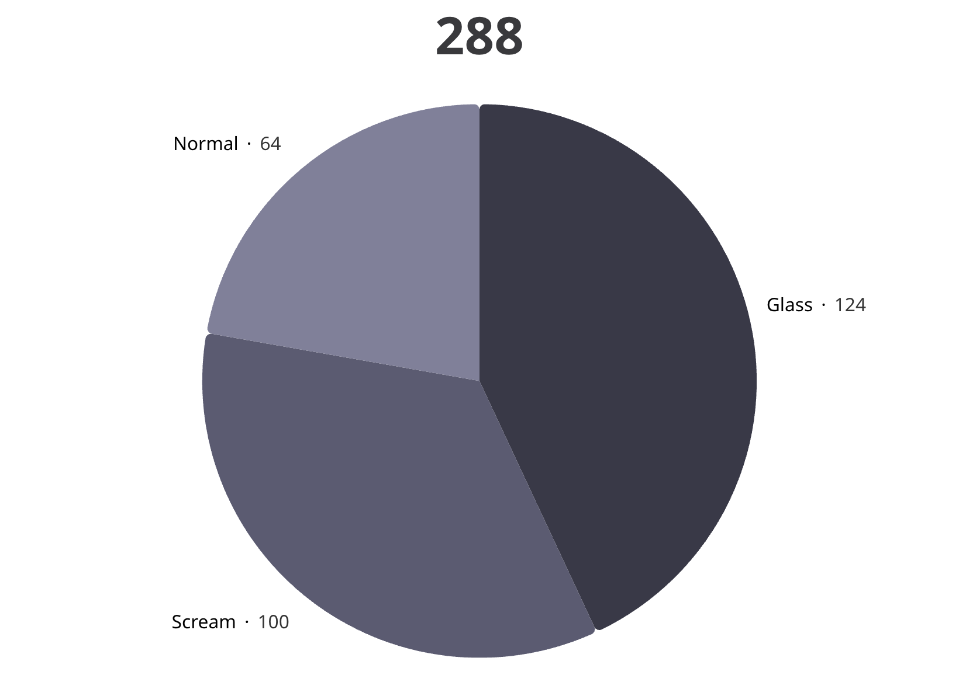
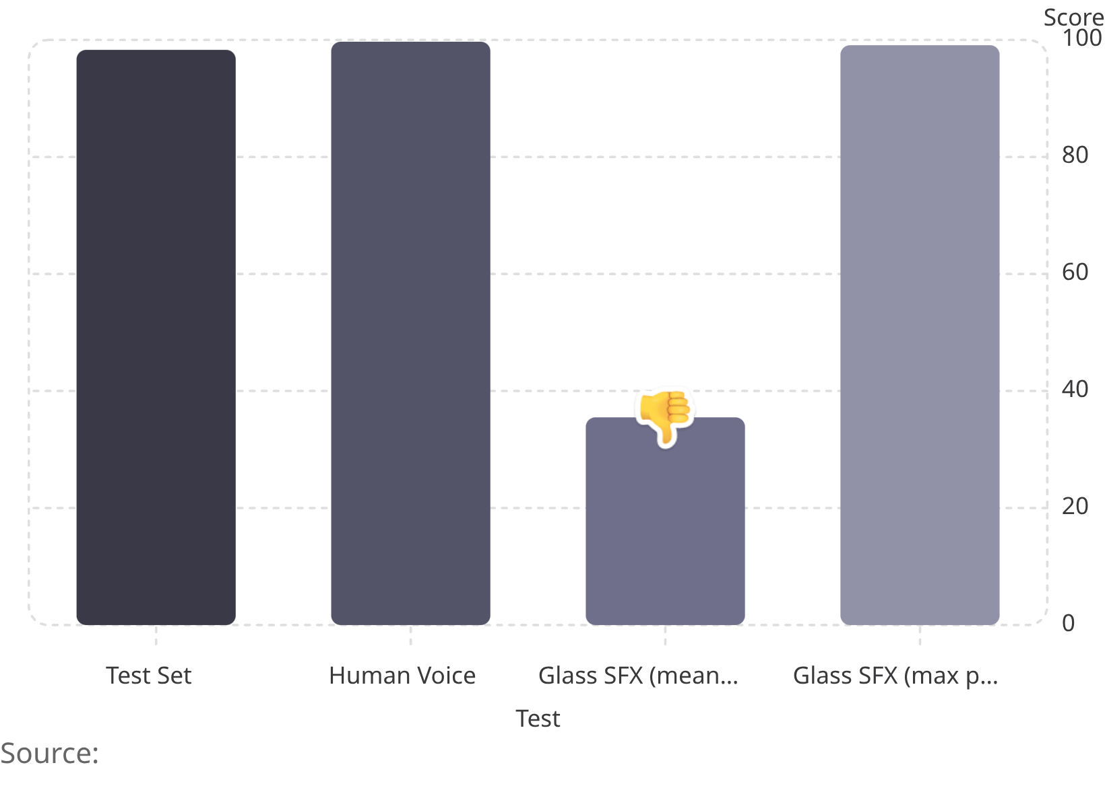
Dataset & Results
Frame max-pooling raised glass confidence from 35.5% → 99.1% on a test clip

Slide 7
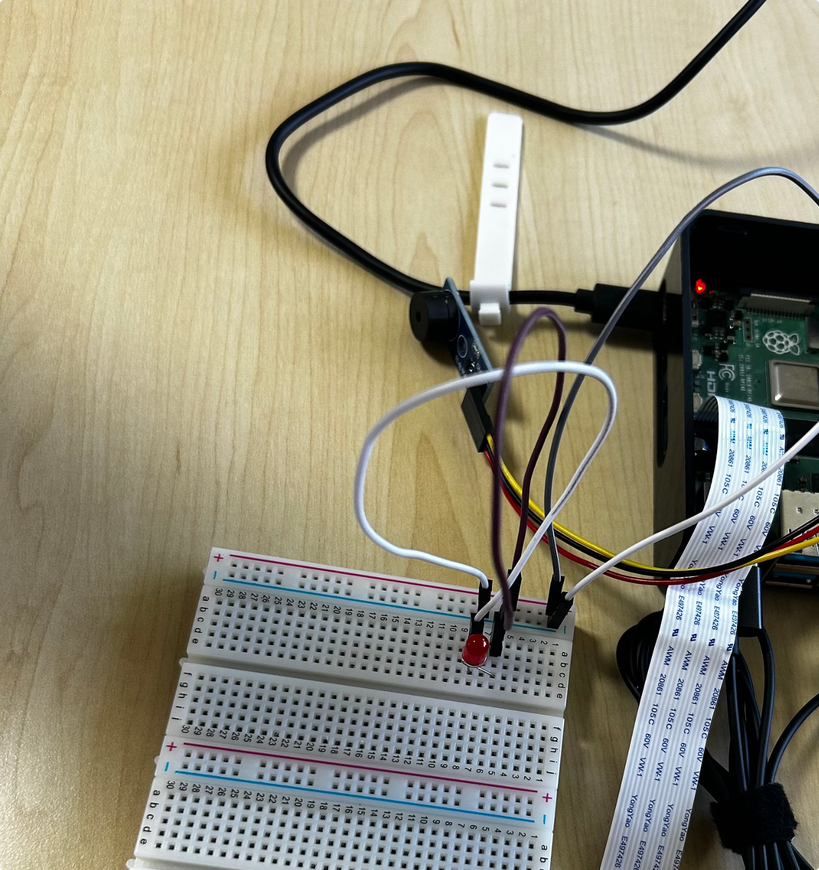
Progress Completed ✓
Hardware Setup
Lavalier mic + Raspberry Pi connected, Pi Camera V2.1 verified
Dataset Built
3 classes, 288 samples collected and labeled
Model Trained & Lightweight
YAMNet classifier trained; TFLite compressed from 795KB → 259KB
Pipeline Ready
Inference pipeline implemented, tested, and automated

Slide 8
Key Challenges
🔍 Domain Mismatch
🛑 False Positive Minimization
Acoustic gap between training data and real microphone input characteristics.
Distinguishing threats from clapping, footsteps, and TV noise.
⏱️ Real-time Latency
📉 Data Scarcity
Minimizing inference delay on Raspberry Pi's limited CPU
via TFLite.
Normal only 22% — audio augmentation to expand training.

Slide 9
Roadmap to Final Demo
Week 1
1
Real-time streaming detection implementation
2
Week 2
Hardware integration — buzzer, LED, LCD, camera capture & logging
Week 3
3
Telegram bot notification integration
4
Week 4
Full system integration test & demo video
June 22
5
Final presentation + live demonstration

Slide 10
Thank You
Questions & Discussion Welcome
🔗 GitHub Repository
github.com/happy124210/2026-HUFS-IoT
📜 Reference
J. F. Gemmeke, D. P. W. Ellis, D. Freedman, A. Jansen, W. Lawrence, R. C. Moore, M. Plakal, and M. Ritter, "Audio Set: An ontology and human-labeled dataset for audio events," in Proc. IEEE ICASSP, 2017, pp. 776–780. doi: 10.1109/ICASSP.2017.7952261
D. S. Park, W. Chan, Y. Zhang, C.-C. Chiu, B. Zoph, E. D. Cubuk, and Q. V. Le, "SpecAugment: A simple data augmentation method for automatic speech recognition," in Proc. Interspeech, 2019, pp. 2613–2617. doi: 10.21437/Interspeech.2019-2680
Google, "YAMNet," TensorFlow Model Garden. [Online]. Available: github.com/tensorflow/models/tree/master/research/audioset/yamnet TensorFlow, "TensorFlow Lite: On-device machine learning." [Online]. Available: tensorflow.org/lite

