Slide 1
Dual Microphone Respiratory Sound Assessment with Adaptive Noise Cancellation and Machine Learning
Asmi Jain (230906092)
Sonali Pandit (230906514)
Susmrithi Rishi (230906050)
School of Electrical Engineering
Manipal Institute of Technology, Manipal, India.
Guide
R Srividya
Associate Professor
School of Electrical Engineering
Manipal Institute of Technology,
MAHE, Manipal, India.

Slide 2
Presentation Outline
Introduction
Literature Review
Objectives
Methodology (Experiments / Simulations)
Results & Discussion
Future Work
Conclusion

Slide 3
Introduction
Breathing produces airflow sounds that are normal, crackle, wheeze or crackle with wheeze.
Analysis quality depends on microphone placement, noise handling, features and the classifier.
Background noise, class imbalance and device variation limit current systems (Rocha et al., 2019; Yu et al., 2025).
Aim: one workflow joining dual-microphone capture, adaptive noise cancellation and machine learning. The output is an acoustic pattern, not a diagnosis.

Slide 4
Literature Review
ICBHI database: 920 recordings, 126 patients; reported scores depend on the split protocol (Rocha et al., 2019; Yu et al., 2025).
Adaptive cancellation needs a reference correlated with the noise (Widrow et al., 1975; Haykin, 2014).
Adaptive suppression helps lung auscultation in noisy clinics (Emmanouilidou et al., 2015).
Recurrent networks suit lung-sound sequences (Perna & Tagarelli, 2019); device variation needs correction (Nguyen & Pernkopf, 2022).

Slide 5
Objectives
Acquire synchronised chest and ambient-reference signals with an ESP32-S3.
Apply and assess LMS/NLMS noise cancellation while keeping the raw recordings.
Build patient-separated ICBHI partitions and compare features and models.
Report class-sensitive metrics, not accuracy alone.
Fix a hardware-to-model preprocessing contract for laptop inference.

Slide 6
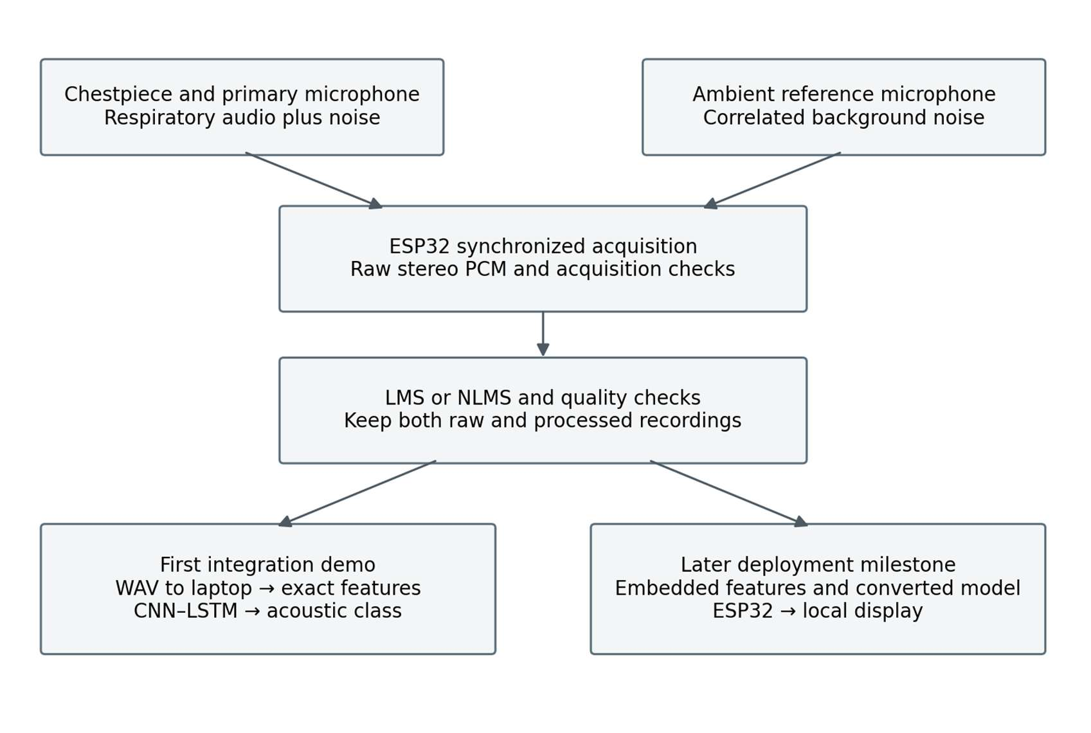
Methodology
Chest-coupled and ambient INMP441 microphones share one I²S line on an ESP32-S3.
Capture at 16 kHz, then resample to 4 kHz for the model.
NLMS: e[n] = d[n] − wᵀx[n]; raw and processed audio are both kept.
Simulation: a 64-tap NLMS raised SNR from 5.00 to 6.42 dB on synthetic noise (not a hardware result).

Slide 7
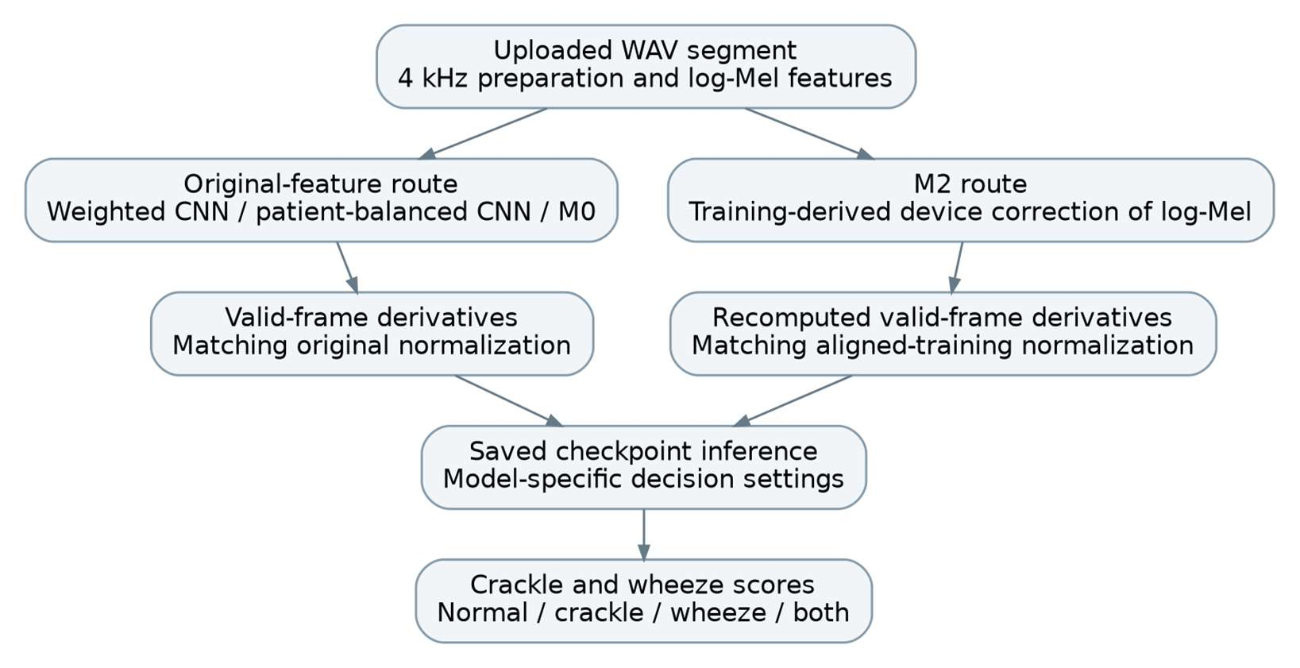
Methodology (Machine Learning)
ICBHI after patient separation: 907 recordings, 6,781 cycles (train 3,376 / validation 649 / test 2,756).
Features: 4 kHz audio, 64 Mel bands; log-Mel + Δ + ΔΔ give a 64 × 157 × 3 input.
CNN–LSTM, 107,906 parameters; crackle and wheeze outputs with thresholds 0.45 and 0.60.
Weighted loss with patient-balanced weights; early stopping.

Slide 8
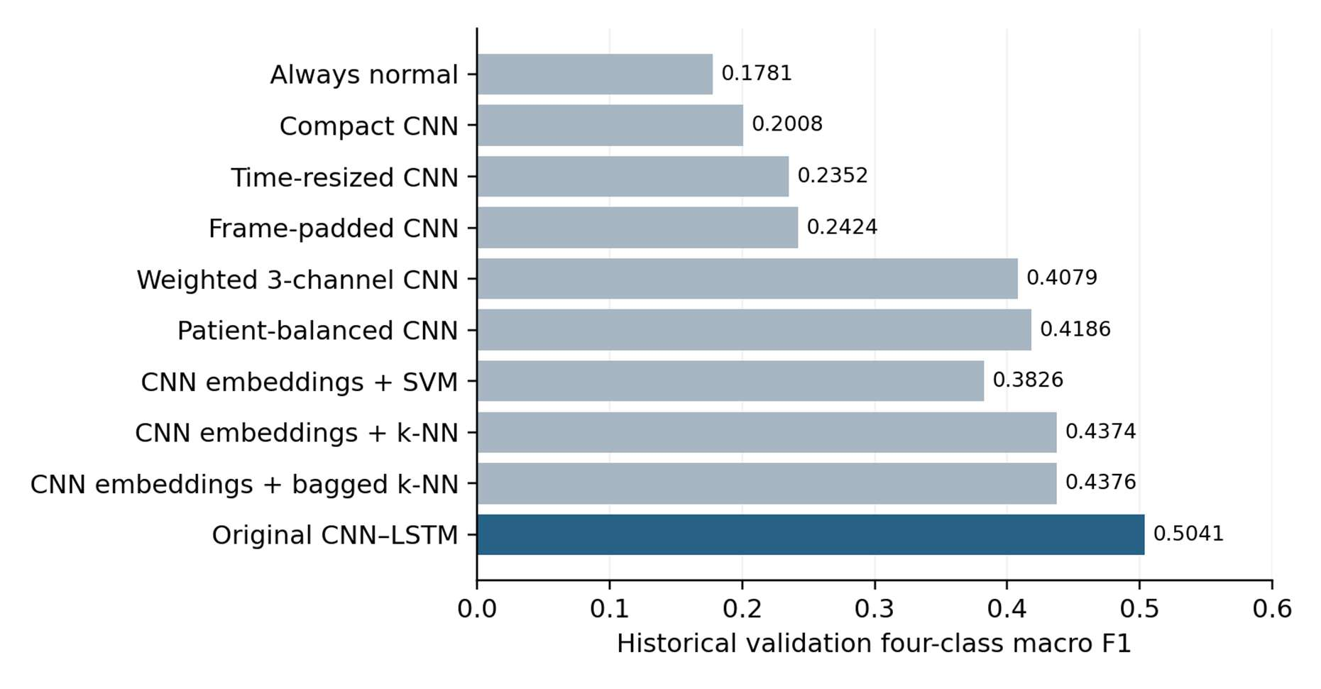
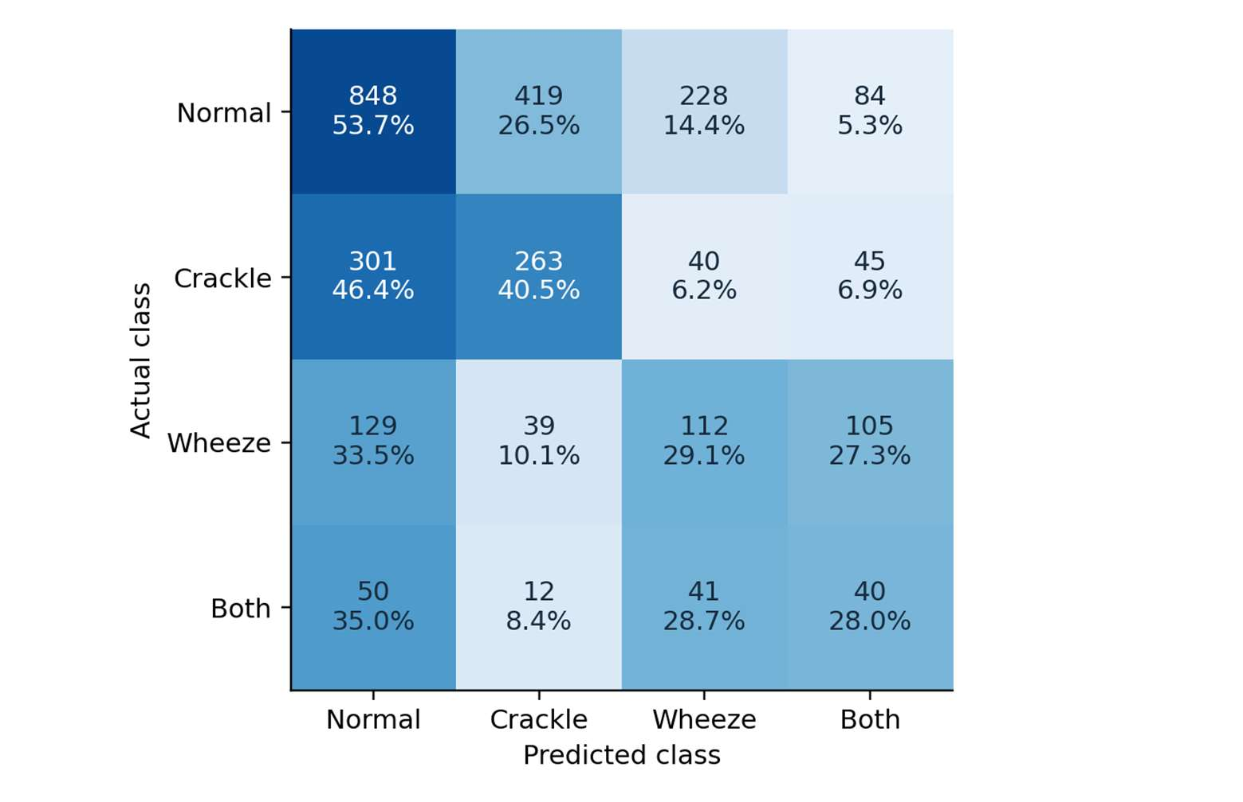
Results & Discussion
CNN–LSTM gave the highest validation macro F1 (0.5041).
Test: 45.83% accuracy, macro F1 0.3584, ICBHI-style score 0.4448.
Wheeze separates better (test AUC 0.7276) than crackle (0.5885).
Historical M0 → M2 (validation, not reproduced): wheeze AUC 0.8497 → 0.9013; gains vary by device.
Prototype assembled; four-model dashboard runs on WAV files.

Slide 9
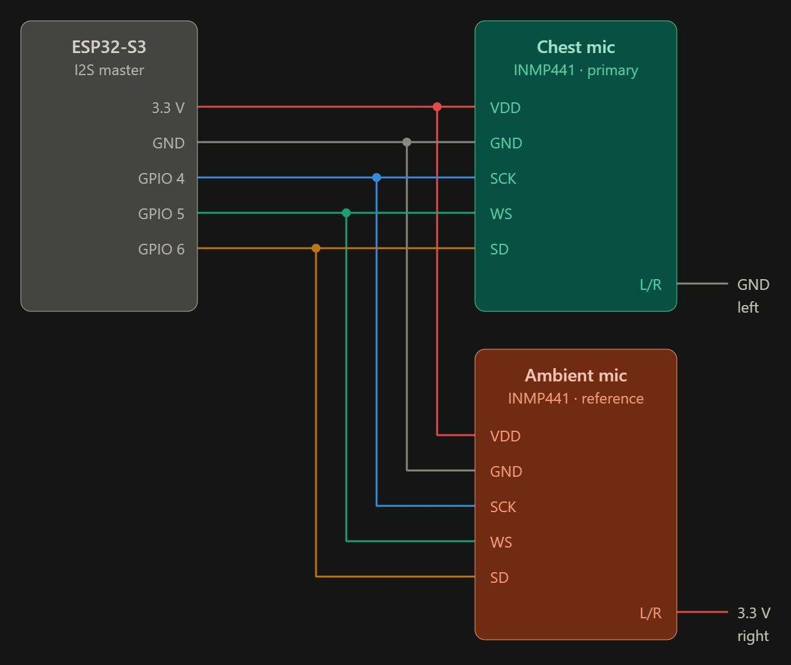
Future Work
Hardware: Validate NLMS on real dual-channel recordings; measure SNR gain and check crackles and wheezes are preserved.
Hardware: Add quality gating (clipping, silence, motion), microSD storage, and measure latency, memory and power.
ML: Improve crackle detection with crackle-specific models and device-balanced, patient-grouped evaluation.
ML: Quantise the model and test on-device inference on the ESP32-S3; use a smaller CNN if memory requires.
Integration: Pass hardware recordings through the saved pipeline and confirm preprocessing parity.

Slide 10
Conclusion
Integrated workflow: dual-microphone front end, NLMS concept, CNN–LSTM and a four-model laptop dashboard.
Baseline: 45.83% test accuracy, macro F1 0.3584; weak crackle discrimination limits reliability.
Hardware is assembled, but acquisition and cancellation are not yet validated; no noise-cancellation gain is claimed.
The output is an experimental acoustic pattern, not a clinical diagnosis.

Slide 11
Reference
Emmanouilidou, D., McCollum, E. D., Park, D. E., & Elhilali, M. (2015). Adaptive noise suppression of pediatric lung auscultations with real applications to noisy clinical settings in developing countries. IEEE Transactions on Biomedical Engineering, 62(9), 2279–2288. https://doi.org/10.1109/TBME.2015.2422773
Haykin, S. (2014). Adaptive filter theory (5th ed.). Pearson.
Nguyen, T., & Pernkopf, F. (2022). Lung sound classification using co-tuning and stochastic normalization. IEEE Transactions on Biomedical Engineering, 69(9), 2872–2882. https://doi.org/10.1109/TBME.2022.3156293
Perna, D., & Tagarelli, A. (2019). Deep auscultation: Predicting respiratory anomalies and diseases via recurrent neural networks. IEEE CBMS. arXiv:1907.05708
Rocha, B. M., et al. (2019). An open access database for the evaluation of respiratory sound classification algorithms. Physiological Measurement, 40(3), 035001. https://doi.org/10.1088/1361-6579/ab03ea
Widrow, B., et al. (1975). Adaptive noise cancelling: Principles and applications. Proceedings of the IEEE, 63(12), 1692–1716. https://doi.org/10.1109/PROC.1975.10036
Yu, S., Yu, J., Chen, L., Zhu, B., Liang, X., Xie, Y., & Sun, Q. (2025). Advances and challenges in respiratory sound analysis: A technique review based on the ICBHI2017 database. Electronics, 14(14), 2794. https://doi.org/10.3390/electronics14142794

Slide 12
Acknowledgements
Internal Guide: R Srividya, Associate Professor
Department of Electrical and Electronics Engineering, Manipal Institute of Technology
We thank the Director, Dean, project coordinators, laboratory in charge, and the faculty and staff of the School of Electrical Engineering.
We acknowledge the ICBHI database authors and the open-source tool developers.

