Slide 1
Nature

Slide 2
Contents
Introduction
Importance of Nature
Destruction of Nature
How we can protect Nature
Conclusion

Slide 3
Introduction
What is Nature?
It refers to living plants and animals,
geological processes, Whether and physics,
Such as matter and energy.
Importance of Nature:
There was no nature we wouldn’t be alive. Especially trees,
they give us oxygen To live and breathe.

Slide 4
Destruction of Nature
Cutting down trees means less water can held on
land causing floods, land slide and soil erosion.
Plastic takes over 400 years to decompose.
Industrial and Chemical wastes degrade the water
quality and purity.
Vehicle emissions, fuel oils and natural gas to heat homes.
These are the primary sources of human-made pollutions.

Slide 5
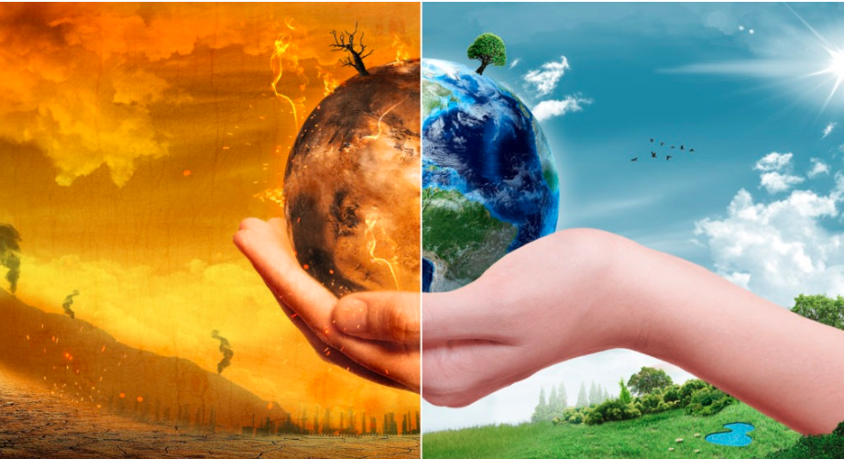
How we can protect Nature
We must plant more and more trees
Throw plastic garbage in the dustbins
Using emission free vehicles
To avoid waste follow these three things
Reduce
Reuse
Recycle

Slide 6
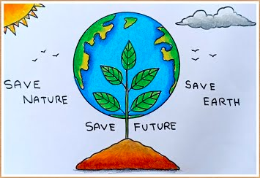
Conclusion
We know that certain environmental conditions like
air, water and food are essential for man survival.
Healthy environment is essential for a Healthy society.
Care and love the Earth because it is our home…

