Slide 1
7-20-2026
M0 reuse foundation: PE-internal KV reuse (S6a) — prefill warm-start lands, and both kernels are measured on real WSE-3 for the first time
Le Xu
·
20 July 2026

Slide 2
Roadmap — and where we are
North star — tiered KV cache management (in-PE → idle-PE → off-chip) plus a policy control plane, under a hard on-chip SRAM budget.
M0 Reuse foundation — preserve and key-retrieve KV across consecutive requests. ◀ WE ARE HERE
M1 Single-card in-place reuse — skip prefill on a prefix hit; requests-per-bank capacity curve.
M2 force-decode vs ship-to-prefill — an A/B cost model, validated on a multi-turn trace.
M3 Idle-PE second tier — park KV on free PEs and reload it; quantify the real cost.
M4 Off-chip retained pool + eviction — and lift the ~512-token single-pass prefill cap.
M5 Unified control plane — one min-waste policy across all tiers, ablatable and explainable.
M6 Scenario evaluation — an agentic workload, plus an area/power-equivalent GPU comparison.

Slide 3
This week — M0 / S6a
S6a-decode ✓ done earlier and re-confirmed: decode keeps KV across requests instead of discarding it; output matches the reference to the noise floor.
S6a-prefill ✓ the week's main deliverable: a request can now start from a resident prefix instead of from token 0. Implemented, and verified at full scale.
Along the way we found a hardware-level trap: a fabric transfer whose length is odd never signals completion on WSE-3 — it just hangs, with no compile error. Reproduced in a small standalone test, then fixed by padding the per-request metadata to an even width.
Three correctness bugs in the warm-start path were found and fixed — all three would have produced plausible-looking but wrong output rather than an obvious failure.
First real-scale device runs: 524,288 PEs, 28 layers, 8,192 tokens. Every reuse round is byte-identical to the cold round, so the saving is real, not an accuracy trade.
Performance measured for both kernels — next two slides.
Open: a longer-sequence (16,384-token) sweep is running now; code is not committed yet, pending review.

Slide 4
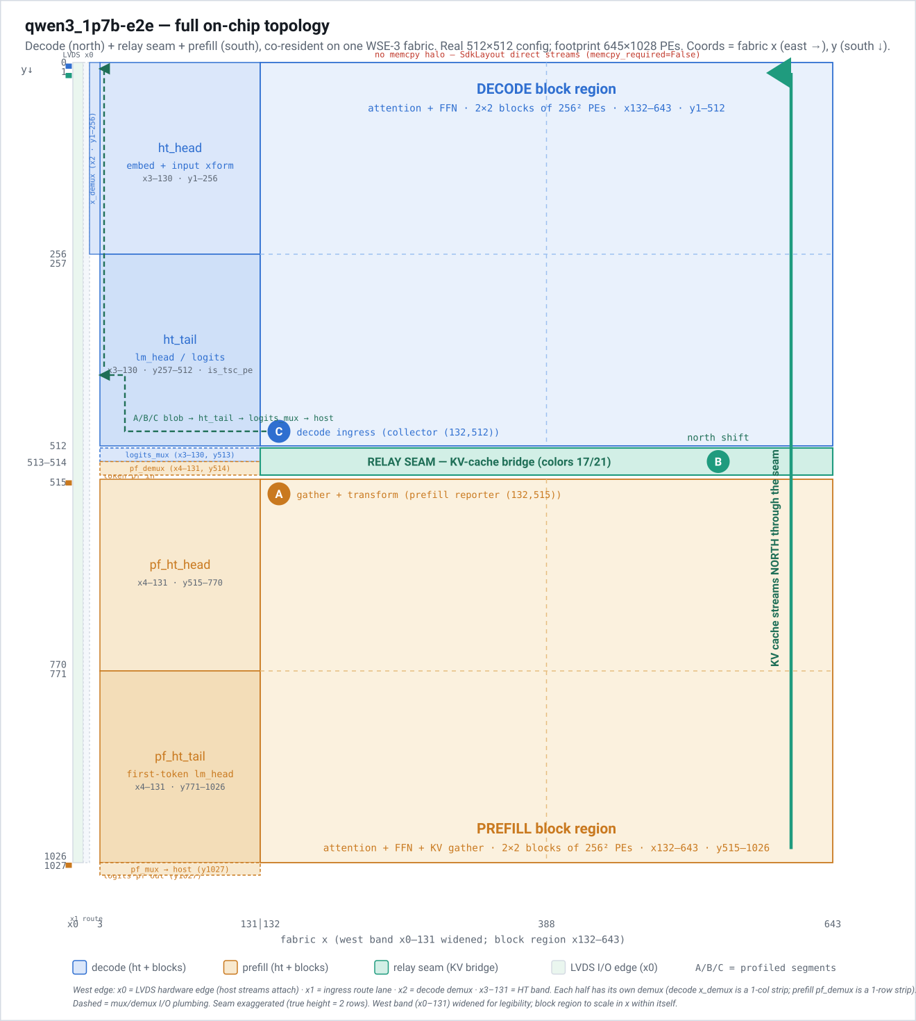
On-chip Floor plan

Slide 5
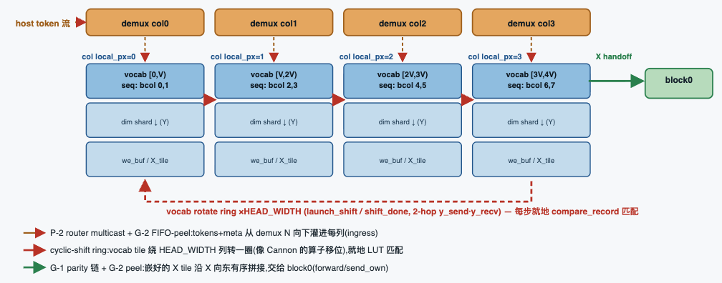
What changed — prefill: start from chunk k, not chunk 0

Slide 6
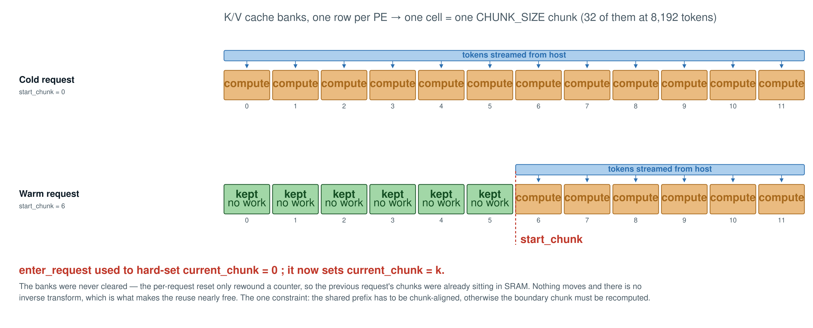
What changed — prefill: start from chunk k, not chunk 0

Slide 7
Prefill — reusing half the prompt saves less than a quarter of the time
PREFIX
SHARE
LATENCY
SAVING
THROUGHPUT
none
0 %
1001.5 ms
—
8,180 tok/s
8 chunks
25 %
924.1 ms
−7.7 %
8,865 tok/s
16 chunks
50 %
773.3 ms
−22.8 %
10,594 tok/s
24 chunks
75 %
549.2 ms
−45.2 %
14,916 tok/s
8,192-token prompt on 524,288 PEs; pure on-device request latency, host work excluded. All reuse rounds byte-identical to the cold round. — Why sub-linear: a chunk's cost grows with how much text precedes it (the last chunk costs about 7× the first), so a reused prefix is always the cheapest part of the request. Planning that assumes “half the prompt cached = half the time saved” will overestimate the win.

Slide 8
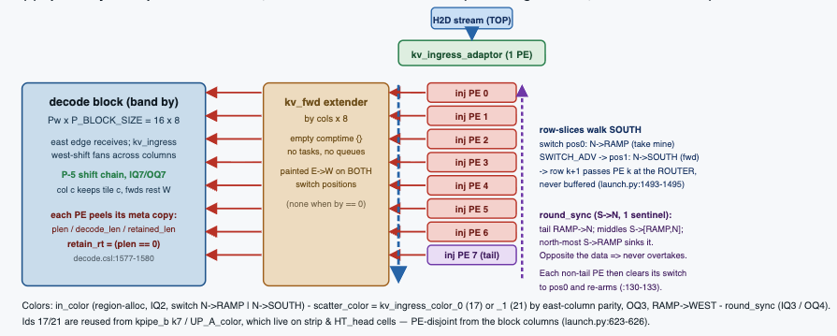
What changed — decode: retain the KV instead of rewinding

Slide 9
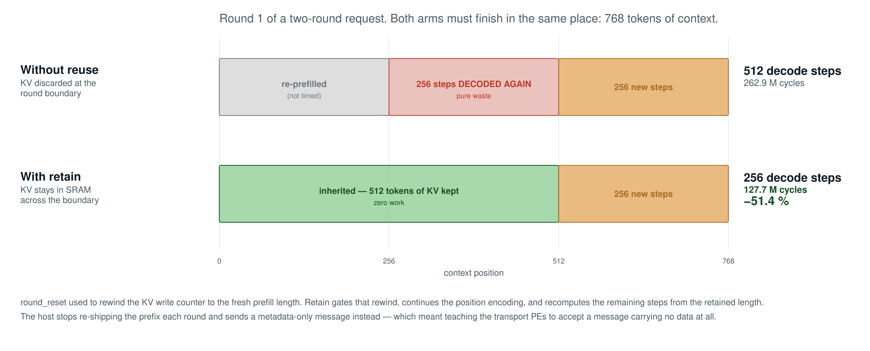
What changed — decode: retain the KV instead of rewinding

Slide 10
Decode — the win is skipping whole steps, not making steps cheaper
MEASURED
ARM
COST
CHANGE
MEANING
Second round
no reuse
262.9 M cycles
—
redoes 512 discarded steps
Second round
retain
127.7 M cycles
−51.4 %
runs only the 256 new steps
Total decode work
both rounds
390.6 → 255.4 M
−34.6 %
as predicted: 768 → 512 steps
Control: equal work
same steps both
126.2 vs 126.2 M
+0.02 %
a retained step is not cheaper
524,288 PEs; cycles at 1.1 GHz; timer starts after KV load, so this is compute only. The control row is the point: retain changes the cost of a decode step by 0.02 %. Its entire value is that steps already taken do not have to be taken again — which is why the comparison has to make the no-reuse arm redo the work it threw away.

Slide 11
How the KV cache crosses from prefill to decode

Slide 12
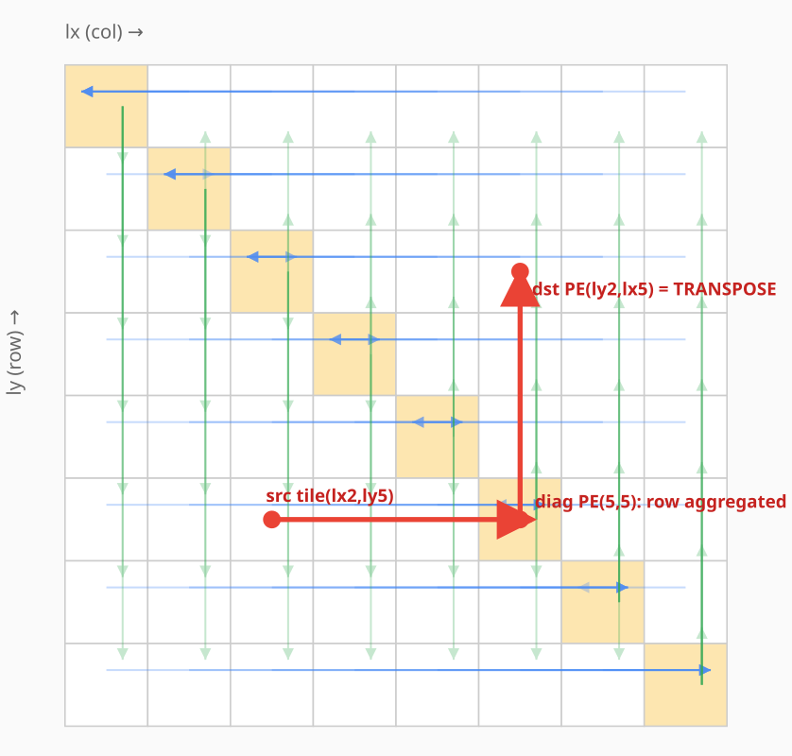
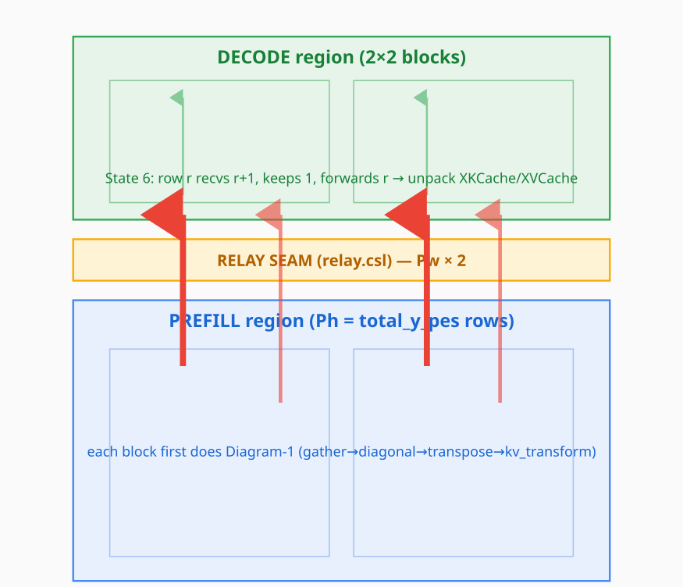
How the KV cache crosses from prefill to decode
1 — inside one prefill block: funnel → diagonal → transpose stage A ≈ 7%
2 — across regions: store-and-forward north into decode stage B ≈ 93%
Prefill and decode hold KV on transposed coordinates — a tile on PE (lx, ly) is expected at (ly, lx). Each row funnels sideways to its diagonal PE, which then emits down its column; the turn at the diagonal is the transpose. A second, in-tile relayout puts the bytes in decode's order, so decode only receives and unpacks.
That is all of stage A — about 7%. The other 93% is stage B: each tile is handed north PE by PE across the full prefill height and the relay seam, once per layer per K/V plane, with no overlap between planes.
KV cache: prefill → decode transfer · WaferEngine on WSE-3 · July 2026

Slide 13
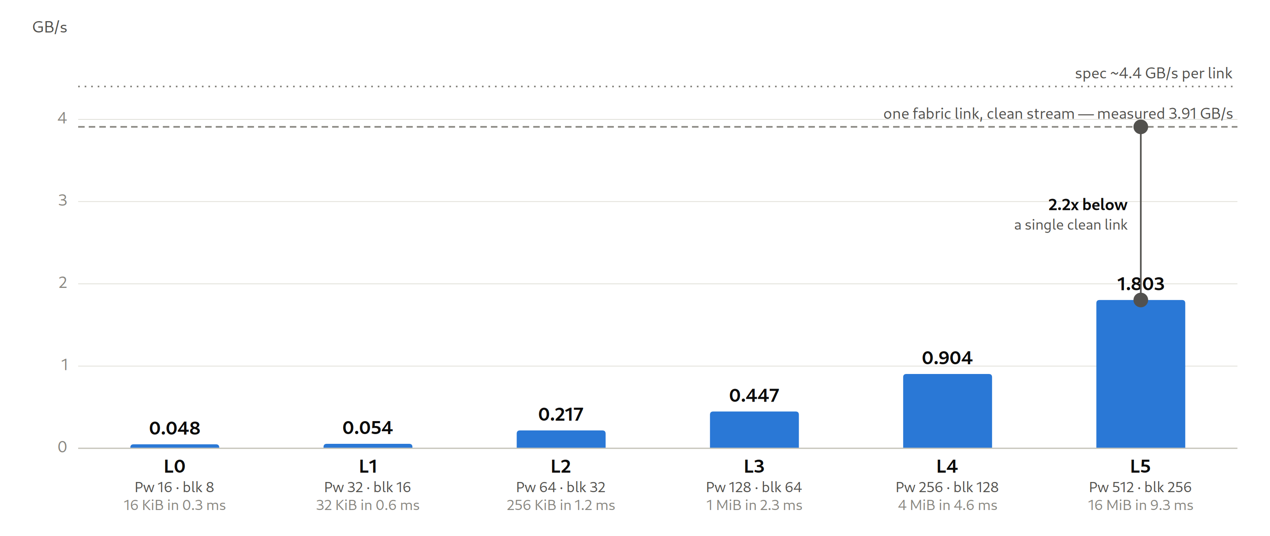
Measured on real silicon — it scales with geometry, but runs far below the wire
Six configurations end to end on the EPCC CS-3, from a 16×16 toy up to the full 512×512 production geometry — no simulator. Effective bandwidth = KV bytes moved ÷ (A+B), timed by on-device counters; it grows almost linearly with geometry, reaching 1.803 GB/s.
The ceiling lines are the point: one fabric link carrying a single clean stream measured 3.91 GB/s on the same machine (0.89× spec). The whole parallel transfer is therefore slower than one clean link and uses ~0.1% of the seam — bound by per-hop latency and by running the planes serially, not by the fabric. Fixes: coalesce the planes into one shift, enlarge the per-hop payload, cut through, route directly.
KV cache: prefill → decode transfer · WaferEngine on WSE-3 · July 2026

