Slide 1
WaferEngine · CS-3
WEEKLY COLLABORATOR DISCUSSION
Both Sides Measured
Where the wafer wins, and what it cannot hold: a 4B GPU baseline, three traces re-cut, and layout C on silicon.
MODEL
RATES
PERIOD
DATE
Qwen3-4B
CS-3 tok/s at 750 MHz as reported — clock TBD
09-07 → 09-13
2026-09-13
Notes:
DRAFT for Le's review. Sources: three sessions — 4b-mini-ppl-debug (layout C), 4b-pp-demo (trace length distributions), 4b-wide-layer (GPU baseline, capacity, interconnect, positioning; Rounds 153–171). Every CS-3 tok/s on these slides is the number the source session reported, converted at 750 MHz; Le's 2026-09-07 rule is 0.85 GHz (multiply by 1.133). Ratios of cycle counts do not move with the clock; ratios against the H100 do. Decision pending.

Slide 2
THIS WEEK IN THREE LINES
Decode leads 4–5×, on the one workload we cannot hold.
Layout C is closed: the kernel is coordination-bound, not FLOP-bound. Both sides measured for the first time.
Notes:
The three verdicts, one per section. (1) from the H100 baseline (4b-wide-layer Round 156). (2) from the trace re-cut (4b-pp-demo) against the analytical ladder (Rounds 153–154). (3) from layout C's single-layer measurement and 4b-wide-layer's phase-TSC profile (4b-mini-ppl-debug, conclusion doc §5b).

Slide 3
01
The workload
Three traces, re-cut per request on 2026-09-12: Claude Code (46,650 de-duplicated calls), Mooncake (39,632 requests), ServeGen (four Alibaba models).

Slide 4
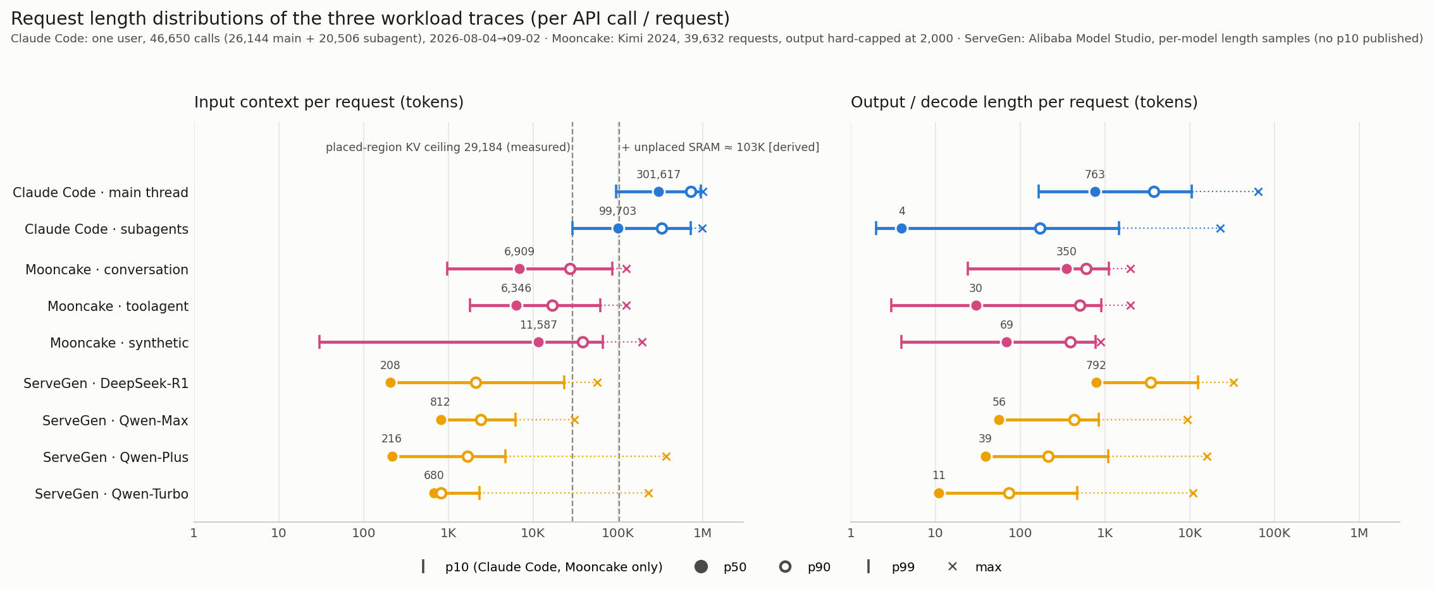
WORKLOAD · REQUEST LENGTHS
Three worlds, not one workload
Per-request input context (left) and output length (right), log scale; p10–p99 bar, p50 filled, p90 open, × max. Dashed lines: 29,184 tokens measured placed-region ceiling, and ≈103K whole-wafer total (derived, not measured). Claude Code: one user, 26,144 main-thread + 20,506 subagent calls, 2026-08-04 → 09-02. Mooncake output is hard-capped at 2,000. ServeGen publishes no p10.
Notes:
Source: analyses/2026-09-12-trace-length-distributions/ (README, plot_length_distributions.py, results/lengths.json). Recomputed from the existing study files: gc-trace steps.csv, mooncake data/*.jsonl, servegen lengths.json. Per-turn Claude Code: decode p50 5.8K / p90 23.5K, new prefill p50 10.9K / p90 254K; per session max context p50 94K / p90 281K / p99 965K. ServeGen R1 reasoning share of output p50 76%; requests with output > 2K are 16% of requests but 57% of decode tokens.

Slide 5
WORKLOAD · WHAT THE DISTRIBUTIONS SAY
Only the agentic harness produces the case where not even one request fits
Claude Code: huge input (p50 100–300K), medium output (a few K to ~20K per turn)
Mooncake: input a few K, output a few hundred — p99 input 62–85K
ServeGen R1: input a few hundred, output a few thousand — p99 input ≤ 23K
Every non-agentic trace has p99 input inside the measured 29,184-token ceiling
The whole-wafer total (≈103K, derived) holds tens of such sessions — and a fraction of one Claude Code request
So 'grow one request' vs 'park many requests' has no workload-independent answer
Notes:
4b-pp-demo's conclusion for the on-chip KV debate. The 103K figure is 29K placed + ≈74K unplaced SRAM, derived not measured. Supporting measured numbers from the 09-03/09-05 captures (not new): 99% of Claude Code calls have a successor re-reading ≥95% of their KV within 10–18 s; not keeping it costs a median 13.9 s reload = 61% of the next call's latency; decode-stream concurrency p50 = 1 in both traces.

Slide 6
WORKLOAD · CLAUDE CODE, SPLIT BY CALLER
Subagent calls are a different shape, not a smaller copy
Tokens per call; p10 / p50 / p90 / p99 unless noted.
MAIN THREAD (26,144 CALLS)
SUBAGENTS (20,506 CALLS)
Input context
95K / 302K / 719K / 955K
29K / 100K / 326K / 726K
First call of a session, context p50
51.5K
18.6K
Output (p10 / p50 / p90 / p99 / max)
166 / 763 / 3.8K / 10.6K / 64K
2 / 4 / 170 / 1.5K / 22.8K
Calls with output ≤ 5 tokens (≤ 50)
0.2% (1.1%)
58% (70%)
Notes:
Source: 4b-pp-demo, memory/inbox/2026-09-12-trace-length-distributions-and-subagent-vs-main.md. Subagent input is 3× smaller but still 10^5-scale — it does not fit 29K either. Output is essentially one tool call with no visible reasoning. Behaviour rows (output share of traffic, intra-turn gap, calls per session, output by model) are in the appendix.

Slide 7
WORKLOAD · CONSEQUENCE
The decode budget lives on the main thread; subagents are prefill-dominated fan-out
Subagents are 44% of all calls, with output p50 of 4 tokens
Main-thread output is 11.6% of that class's token traffic; subagents 1.5%
Correction to last week: the 'median context 309K' was the main-thread number
Including subagent calls, the per-call median is 197K — the figure used from here on
Notes:
4b-pp-demo. The 309K appeared in the 09-04/09-05 captures and last week's deck; it is not wrong, it is the main-thread-only cut. 197K is the all-calls median and is the number 4b-wide-layer's capacity and PD-split analyses use.

Slide 8
02
The GPU baseline
SGLang 0.5.19 on one H100 80GB, vanilla, every cell measured. Same model on both sides for the first time.

Slide 9
BASELINE · MEASURED BOTH SIDES
The wafer leads single-stream decode by 4–5× and trails prefill by 7×
Qwen3-4B. CS-3 rates as reported by the source session (750 MHz); clock convention pending.
CS-3
H100 80GB
LEAD
Decode, bs = 1 @ 4K
~1,000 tok/s (1.0 ms)
213 tok/s (4.70 ms)
CS-3 4.7×
Decode, bs = 1 @ ~30K
653 tok/s
162 tok/s
CS-3 4.0×
Context slope
21.5 ns/token
48.9 ns/token
CS-3 2.3× shallower
Decode, batched
~2,100 tok/s
4,684 tok/s (bs 32 @ 1K)
H100 2.2×
Prefill, native
9.3–9.8K tok/s
66.5–70.4K tok/s
H100 ~7×
Max context, one request
29K
~524K
H100 18×
Notes:
Source: docs/reports/2026-09-13-sglang-qwen3-4b-h100-baseline.md and 4b-wide-layer Round 156. CS-3 column: decode cycles/step = 681K + 16.1 × context, converted at 750 MHz by the source session. At 0.85 GHz the CS-3 rates rise by 1.133 and the leads become ~5.4× / 4.5× / 2.6× shallower; the batched and prefill deficits shrink to ~2.0× and ~6×. Le to decide which clock the deck uses. Finding 10 (prefill behind) goes from extrapolated to measured.

Slide 10
BASELINE · WHAT IT SETTLES
Our only measured advantage applies exclusively to the workload we cannot hold
Confirmed: prefill is ~7× behind — finding 10 is now measured, not extrapolated
Killed: the 'fast recompute engine for short-context multi-tenant traffic' claim
Even the analytical thin-stage forced prefill (31–43K tok/s) is 1.6–2.2× slower than the H100's measured native prefill
There is no prefill-side wedge anywhere on the roadmap
Median agentic turn at short context: CS-3 6.9 s vs H100 28 s
At the real 197K context: H100 ~75 s, CS-3 cannot hold it at all
Notes:
4b-wide-layer Round 156. The single-stream decode lead (4.0–4.7×) grows with context — and the workload with long context is the one that does not fit.

Slide 11
03
The capacity case
Every rung of the on-chip ladder against the traces, then the two ways around it: more wafers, or a link.

Slide 12
CAPACITY · THE LADDER AGAINST THE TRACES
No rung reaches the agent harness; the workloads it reaches also fit in 80 GB of HBM
Ceilings are analytical except today's, which is measured. Trace percentiles: Claude Code p50 197K, Mooncake p99 85K, ServeGen p99 23K.
RUNG
CEILING
BASIS
CLAUDE CODE P50
MOONCAKE · SERVEGEN P99
Today
29,184
measured
no
no · yes
Fusion
~17.6K
derived
no
no · no
Split
~26K
derived
no
no · yes
Near pool
95K
derived
no
yes · yes
Far pool (every lever)
167K
derived
no — below the median
yes · yes
fp8 + far pool + chunked scoring
≈225K
derived
yes — ~55% of calls
yes · yes
Notes:
4b-wide-layer Rounds 153–154. The far pool at 167K is the score-buffer wall, not a storage limit: fp8 storage alone allows ≈225K, and chunked scoring (lever C3, owned by the 4b-chunked-softmax session) removes the wall. The yes/no columns compare each ceiling against the quoted trace percentile; they are my reading of the numbers the session gave, not a table the session produced.

Slide 13
CAPACITY · IN ONE SENTENCE
Capacity cannot reach the workload that wants it; the workloads it reaches do not need it.
The reopener is the score-buffer wall: fp8 storage plus chunked scoring would clear the 197K median for ~55% of agent calls — all derived.
Notes:
4b-wide-layer Round 153. The sentence is the session's; the reopener is Round 154's.

Slide 14
CAPACITY · BUYING IT WITH WAFERS
Multi-card does not rescue capacity: it halves the one thing we lead
Measured: 175 µs per wafer per token at today's layout
29K → 197K needs ≈ 6 extra wafers, i.e. +1.01 ms per token (derived)
Decode goes from 1.05 to 2.06 ms per token: 954 → 485 tok/s
A negative-sum trade in the one dimension where the wafer is ahead
Notes:
4b-wide-layer Round 156/157. The 175 µs is measured; the extension is arithmetic. tok/s at 750 MHz as reported.

Slide 15
CAPACITY · KV OVER A LINK
Per token, attention reads the whole KV — it cannot cross a link
Card-to-card interconnect at 1.2 Tbit/s (150 GB/s), per Le; not measured in this project. Whole decode step on the wafer is 1.0 ms.
CONTEXT
KV
OVER THE 150 GB/S LINK
H100 FROM ITS OWN HBM
29K
4.01 GB
26.7 ms / token
1.20 ms
197K
27.1 GB
180 ms / token
8.08 ms
Notes:
4b-wide-layer Round 159. Fitting 29K of KV into half a token budget needs ≈8 TB/s — the link is 53× short — and the H100 reads the same KV 22× faster from HBM. This is a bandwidth-class fact, not an engineering gap. The earlier 171 µs crossing figure was the public API and is retracted (see Corrections).

Slide 16
CAPACITY · WHAT THE LINK DOES BUY
KV must live where the attention compute is; the link carries activations, and AFD is a weights-side solution
Activations: 5 KB per layer, 34 ns of wire — pure latency
36 layers × 6–10 µs round trip = 0.22–0.36 ms per token: affordable
So attention–FFN disaggregation is viable on the real interconnect
But it removes FFN weight traffic: worth 57.3% at 4K, only 15.0% at 197K
A dense 4B on an 80 GB GPU is AFD's worst case — which is why NVIDIA keeps attention + KV together
Notes:
4b-wide-layer Round 159. The 6–10 µs round trip is Le's interconnect figure plus turnaround, unmeasured here. AFD = Attention–FFN Disaggregation, NVIDIA's split in which the GPU holds prefill and decode attention plus the whole KV and the LPX side does FFN/MoE.

Slide 17
04
The prefix × decode spectrum
Four configurations across eleven workload scenarios, derived from each machine's measured rates. Per-request wall time.

Slide 18
SPECTRUM · SCENARIOS THAT FIT (1 OF 2)
PD-split wins every scenario that fits: the GPU prefills, the wafer decodes
ms per request. PD-split = GPU prefill → link → CS-3 decode. Derived from measured rates; link at 0.98 µs per prefix token (unmeasured).
SCENARIO (PREFIX / DECODE)
CS-3 ALONE
PD-SPLIT
H100 ALONE
GPU-STREAMED
Qwen-Turbo p50 (680 / 11)
82
21
61
28
ServeGen R1 p50 (208 / 792)
745
726
3,654
888
Long reasoning (208 / 10,000)
9,147
9,128
46,105
11,172
R1 p90 (2,100 / 3,400)
3,462
3,273
16,020
10,290
Qwen-Max p90 (2,400 / 433)
668
453
2,078
1,472
Notes:
4b-wide-layer Round 171. Modelling: CS-3 decode = (681K + 16.1·C) cycles at 750 MHz; H100 decode = 4.60 + 0.0489·C/1K ms (fit to measured 1K–32K); H100 prefill measured, held at the 32K rate beyond 32K (optimistic for H100). GPU-streamed = KV stays on the GPU and the whole cache crosses per token. PD-split's decode side is the wafer, so it keeps the 29K ceiling. Best in every row here is PD-split.

Slide 19
SPECTRUM · SCENARIOS THAT FIT (2 OF 2)
The longer the prefix, the more the 7× prefill deficit costs CS-3 alone
ms per request. Same model as the previous slide.
SCENARIO (PREFIX / DECODE)
CS-3 ALONE
PD-SPLIT
H100 ALONE
GPU-STREAMED
Mooncake conv p50 (6,900 / 350)
1,096
482
1,834
2,850
Mooncake toolagent p90 (17,000 / 507)
2,435
1,012
3,103
9,468
Long-doc classification (27,000 / 20)
2,872
734
796
1,238
Mooncake conv p90 (27,000 / 597)
3,730
1,592
4,212
17,411
Notes:
4b-wide-layer Round 171. PD-split's margin over CS-3 alone: 1.03× at 208 tokens, 1.5× at 2.4K, 2.3× at 6.9K, 2.4× at 17K, 3.9× at 27K. Its weakest win is long-prefix/tiny-decode (classification), where the H100 alone is within 8%.

Slide 20
SPECTRUM · ABOVE THE WALL
Above 29K only the H100 serves — PD-split does not extend the ceiling, because its decode side is the wafer
ms per request. The Claude Code row is a frontier-model workload a 4B never serves; it is here for completeness, not as a target.
SCENARIO (PREFIX / DECODE)
CS-3 ALONE
PD-SPLIT
H100 ALONE
GPU-STREAMED
Mooncake conv p99 (85,000 / 1,100)
no fit
no fit
12,075
97,363
Claude Code median (197,000 / 5,800)
no fit
no fit
88,215
1,158,677
Notes:
4b-wide-layer Round 171 and Round 168. H100 prefill beyond 32K is held at the 32K rate, so these two H100 times are understated. The GPU-streamed column is worse than the H100 alone in every row of the spectrum except the 680-token one, and 8–13× worse above 29K: 'keep KV on the GPU' is dead at every scale.

Slide 21
SPECTRUM · HOW TO READ IT
Prefix length sets the margin over CS-3 alone; decode share sets the margin over the H100
Over CS-3 alone: 1.03× at a 208-token prefix, rising to 3.9× at 27K — PD-split is the prefill fix
Over H100 alone: 5.0× where decode is ~100% of the work, down to 1.08× at 4% — the decode advantage
The 29K wall decides participation; above it the GPU is alone, with or without a wafer
Short-prefix / long-decode (reasoning) is the wafer's home turf: 5× over H100 alone, PD-split barely needed
Long-prefix / short-decode (RAG, summarisation) needs PD-split, and the H100 is competitive
PD-split was ruled out earlier on a 3.2 GB/s H2D measurement; the real link is 62–176× that requirement
Notes:
4b-wide-layer Rounds 169 and 171. The 3.2 GB/s was host-to-wafer memcpy through the public API, a different leg from the card-to-card interconnect.

Slide 22
SPECTRUM · DEPTH VS BREADTH
The same 167K holds zero agentic requests or 803 ServeGen requests
Capacity spent on one request's depth, or on many requests' prefixes. Derived.
CAPACITY
DEPTH: ONE AGENTIC REQUEST
MOONCAKE P50 (6.9K PREFIX)
SERVEGEN R1 P50 (208 PREFIX)
Today, 29K (measured)
14.7% of the 197K median
4 prefixes
139 prefixes
Far pool, 167K (derived)
84.8% — still short
24 prefixes
803 prefixes
Notes:
4b-wide-layer Round 164. The frontier is two-dimensional and only the depth axis has been pushed.

Slide 23
SPECTRUM · RECOMMENDED ORDER
Push breadth first: prefix reuse inside today's 29K, with harvesting as the mechanism
Prefix reuse is startable inside today's 29K, with two independent justifications
Our prefill is 7× slower, so avoiding a re-prefill is worth 7× more to us: 10.9K tokens cost the H100 156 ms and CS-3 1,147 ms
ServeGen traffic is 3.9 : 1 prefill-to-decode by token
Near-pool harvesting is the one rung already priced: 1.17 cycles per word, inside the ≤ 2 gate (simfab microbench)
Then the depth-vs-breadth allocation curve
Do not chase 167K or 225K as a target
Notes:
4b-wide-layer Round 164. The 1.17 cyc/word figure came from the fused-block thread's simfab microbench, which also corrected a 13 cyc/word relay artefact. Two measurements still missing: the width axis (four measured points on height, none on width), and the wafer-edge round trip to a GPU (waits on Cerebras opening the API).

Slide 24
05
Layout C
One decoder layer cut into three thin stages on a single 256×256 block. Implemented through a five-layer group, measured on CS-3, closed on 2026-09-13.

Slide 25
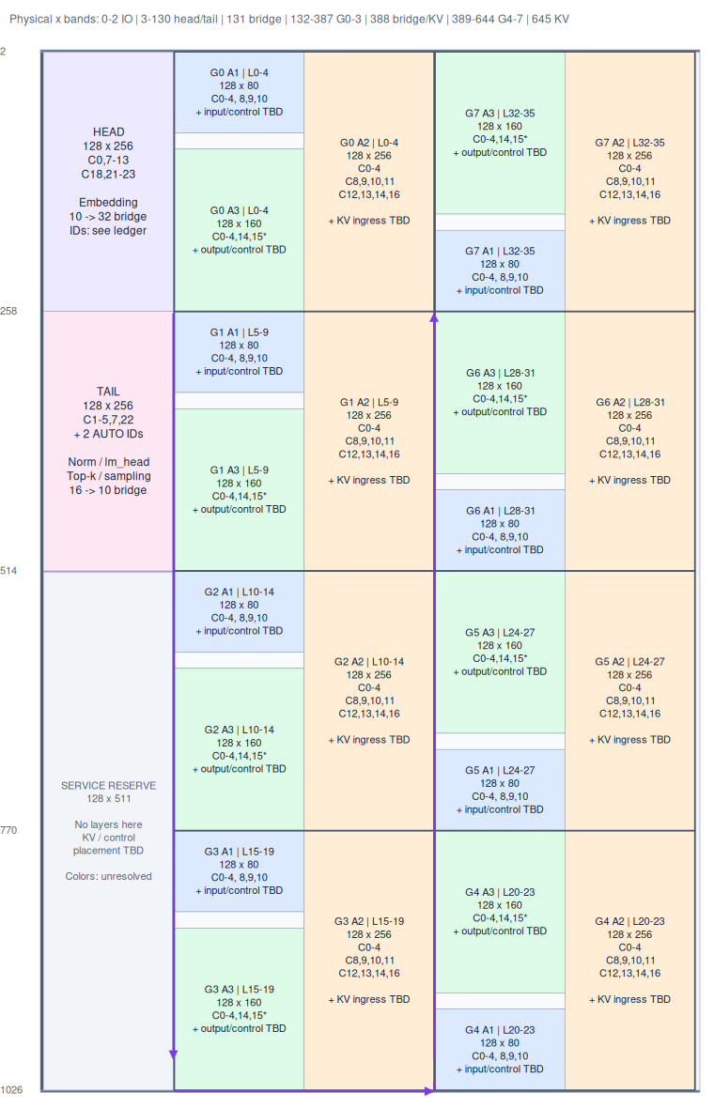
LAYOUT C · PLACEMENT
Eight groups of five layers on a 650 × 1028 footprint, with head and tail on the left
Wafer map only; the colour ledger is in the source figure. Analytical placement from a design and source audit, not a compiled full model.
Notes:
Source: docs/diagrams/2026-09-13-layoutC-color-regions.png (.excalidraw editable). Northbound groups G4–G7 are mirrored proposals with no chip-fit, route, queue or SRAM validation. Purple columns are router-only activation bridges; orange x=645 is the KV feeder reservation.

Slide 26
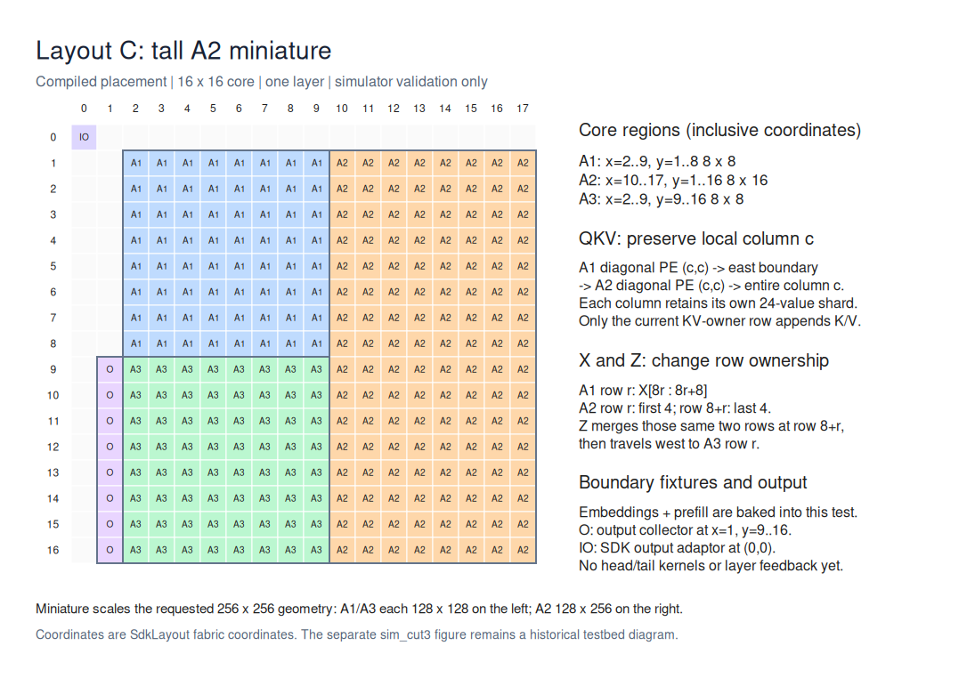
LAYOUT C · ONE GROUP
A1 and A3 share the left half; A2 takes the whole right half
Compiled miniature (16 × 16 core, one layer, simulator validation) with the same shape as the full geometry: A1 128 × 80 (32 hidden per row), spare 128 × 16, A3 128 × 160 (16 per row), A2 128 × 256 (10 per row). 65,536 PEs reserved, 63,488 active.
Notes:
Source: docs/diagrams/2026-09-10-layoutC-tall-a2.png; geometry source of truth is docs/reports/2026-09-13-layoutC-implementation-handoff.md §3. Why the row shards are 32/10/16 and which tensor axis each stage shards: the hidden-reshard and weight-axes figures in the appendix.

Slide 27
LAYOUT C · MEASURED
3.7–3.9× the original's single-layer latency in half the PEs
Raw CS-3 device cycles, batch 1, BF16, one layer. Serialized latency, not pipelined throughput; synthetic weights.
INITIAL KV
ORIGINAL ATTN + FFN (131,072 PE)
LAYOUT C A1 + A2 + A3 (65,536 PE)
RATIO
1,280
26,377 cycles
102,511 cycles
3.886×
5,120
28,000 cycles
104,330 cycles
3.726×
Notes:
Source: docs/reports/2026-09-13-layoutC-single-layer-performance.md (+ evidence JSON). Three independent jobs per cell, 33 tokens each, first 4 dropped, median of 29 then median across jobs. All 1,013,760 output elements exact against each geometry's own operation-order oracle. Common boundary: START enqueue → all output rows complete on one collector PE; empty cost 8,231 cycles, not subtracted. Context sensitivity is tiny on both sides: +0.42 / +0.47 cycles per KV position. The bar chart is in the appendix.

Slide 28
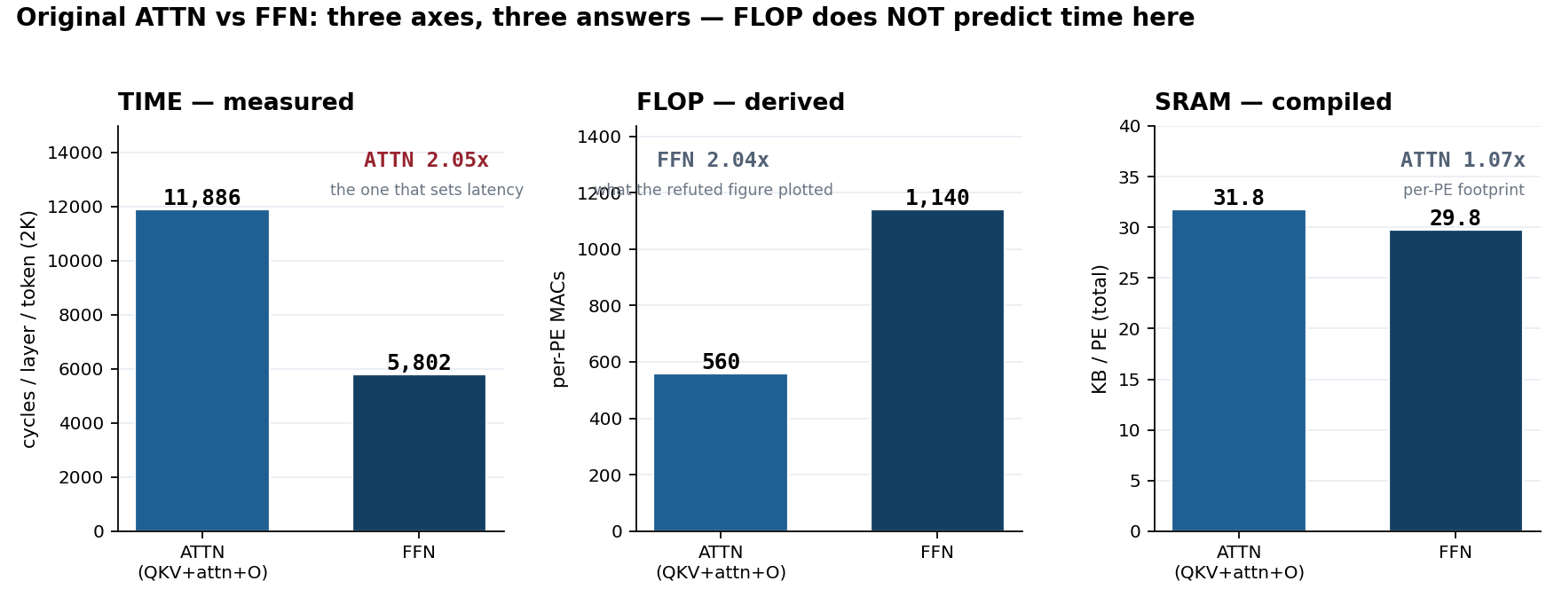
LAYOUT C · WHY
FLOP does not predict time here: FFN has 2× the MACs, ATTN takes 2× the time
The original ATTN and FFN blocks on three axes. TIME is 4b-wide-layer's phase-TSC profile (per layer per token, 2K, full 256 × 256 square); FLOP is derived MACs per PE; SRAM is the compiled per-PE total. ATTN also grows with context (T_attn / T_ffn → ~2.7 at 8K); FFN is flat.
Notes:
Source: docs/reports/2026-09-13-attn-vs-ffn-three-axes.png (footnote cropped for the slide; the FLOP-panel subtitle still collides with the 1200 tick — re-export pending). Numbers: ATTN 560 MACs / 11,886 cycles / 31.75 KB; FFN 1,140 MACs / 5,802 cycles / 29.77 KB. SRAM from demo/qwen3-4b-thin-stage/results/cs3/out_S1B_2K/msize.txt. This replaces the per-PE-work bar chart, which plotted FLOP only and is withdrawn (Corrections).

Slide 29
LAYOUT C · THE EXPLANATION THAT SURVIVED
The kernel is comm- and latency-bound, so a three-way cut pays three coordination costs
The MAC model that named A3 (FFN) as the pacing stage predicted the ratio and got the mechanism backwards — withdrawn
Measured: ATTN paces the original at 2.05× FFN's time, and FFN idles
Per-stage time for A1 / A2 / A3 was never measured; only the combined single-layer numbers exist
Separately measured: ATTN and FFN as independent pipelined stages give 1.47× at 2K and 1.40× at 8K
That result keeps two blocks and overlaps them — the lever layout C gave up
Notes:
4b-mini-ppl-debug's correction plus docs/reports/2026-09-13-layoutC-performance-conclusion.md §5b. Also withdrawn with the MAC model: the '2.65× optimal three-way split' floor and the 0.31× / 0.62× first-order pipelined-throughput figures.

Slide 30
LAYOUT C · WHAT STANDS REGARDLESS
The first five-layer group with on-wafer feedback runs on CS-3, exact
Mini geometry: 5 layers × 33 tokens, 10,560 output elements exact
Full geometry: 5 layers × 2 tokens, 5,120 exact
Full cache probe: 83,886,080 K/V values and every cursor pass; a one-bit-flip negative control fails as it should
Router-only strip transport with the marker / ACK / reset / START protocol validated both directions, with dropped- and duplicated-fragment controls
Two device defects found and fixed on 09-10: A2 RoPE reset overwriting XKCache; cut-chain zero local-layer count
Notes:
Sources: docs/reports/2026-09-13-layoutC-first-group-feedback.md, docs/reports/2026-09-10-layoutC-kv-fix.md. The transport, checker and handoff work carry over to the fused block.

Slide 31
LAYOUT C · DECISION
Closed. Next: one fused 256 × 256 block with attention state on one PE in N
The two-group D17 link is paused (Le, 09-13)
Fused block: FFN + QKV on every PE; attention heavy state on 1-in-N PEs; the rest hold KV and a minimal scan
Gate: compile-only SRAM of the three PE images
First-order expectation: ~1.0× the original's latency in half the area — derived, not measured
Layout C's structural cause — three serial stages sharing one block's area — does not apply to a fused block
Notes:
4b-mini-ppl-debug relaying Le's 09-13 decision. Memory note (layoutc-closed-fused-sparse-attention-next) adds: fusion 1.34× at fixed wafer and SRAM-ahead vs the FFN block; gate = compile-only .text-vs-layer-halving; streaming measured cheap. Those figures were not in the message sent to this deck and are not on the slide.

Slide 32
06
Why the hardware advantage does not come out
A property of this kernel, not of the architecture — the scoping caveat is on the slide.

Slide 33
KERNEL · THE FIXED TERM
87% of per-layer time is independent of how much work each PE does
Least-squares on the measured height ladder: T = 10,398 + 855 × W (W = per-PE work) — halving the area moved time by 1.4%
Per PE per layer: 3,080 bytes in ~17,688 cycles = 0.174 B/cycle against ~27 available, 0.63% utilisation
Mechanism: 10 hidden + 16 attention values per PE, so a QKV matvec is 160 MACs against ~100 cycles of DSD setup; 8–9.6K of the fixed term is collectives
Aggregate: 6,269× the bandwidth converted into 4.7×; 0.045% utilisation against the H100's 59.7%
Scope: Cerebras quotes CS-5 at 10,000 tok/s per user on 31B–120B models — a model 8–30× larger running 10× faster. These are this kernel's numbers, not the architecture's
Their own rates back-solve to 0.24–1.52% of aggregate bandwidth, so the diagnosis (latency-bound) is corroborated; the lever it implies is speculative decoding, not yet pulled
Notes:
4b-wide-layer Rounds 158 and 162. Speculative decoding amortises the fixed term and the KV scan; batching amortises only the first, and our batching measured 2.2×. Unaffected by the caveat: everything trace-based — the three workload shapes, AFD's weights-side nature, MoE sparsity inverting sign, KV not crossing a link.

Slide 34
07
Industry context and positioning
What NVIDIA's LPX and Cerebras's CS-6 say about the boundary, and how to frame the argument.

Slide 35
CONTEXT · TWO PUBLIC DATA POINTS
Both LPX and CS-6 add a DRAM tier; the field is moving from total residency to tiering
NVIDIA Groq 3 LPX: 500 MB compiler-managed SRAM per chip, 128 GB rack-wide, 96 C2C links = 2.5 TB/s per chip, plus 256 GB + 128 GB DRAM
LPX does FFN / MoE; the GPUs hold prefill and decode attention and the whole KV — attention–FFN disaggregation with compile-time static allocation
Shared design constant: a full SRAM sweep is ~3.3 µs on LPX and ~2.1 µs on WSE-3
The difference is the boundary: LPX made the chip edge part of the compiler's schedule; Cerebras has no edge inside a wafer
Cerebras CS-6 (Hot Chips 2026) adds 3D-stacked DRAM — the tier CS-3 lacks. Roadmap, no capacity or bandwidth numbers published
If KV moved there the thresholds are 4.0 TB/s at 29K, 27.1 TB/s at 197K (8.1× HBM), 84.6 TB/s at p90 — derived
Notes:
4b-wide-layer Rounds 158 and 162, from the NVIDIA blog and the Cerebras Hot Chips 2026 post. LPX also uses a plesiosynchronous protocol aligning hundreds of chips as one system.

Slide 36
POSITIONING · A PROPOSAL, NOT A DECISION — NEITHER OPTION IS MARKED
From capacity to residency
On-chip capacity → performance
The residency frontier
—
167K far pool < 197K median
—
Which state must be resident
—
Numbers are this kernel's, not the architecture's
—
Weights tierable; KV not (53×)
—
Per-PE distribution binds, not totals
—
CS-6 and LPX both add DRAM
Notes:
4b-wide-layer Rounds 163–164. Not marked recommended because Le has not decided. Rounds 166–167 (Le: 'weights and KV are not different; a fixed system prompt is weights') refine the taxonomy row and were not relayed to this deck — pending Le.

Slide 37
POSITIONING · THE RESIDENCY FRONTIER IN THREE LAYERS
Taxonomy is AFD's table; placement is the measured, novel part; method is what survived this week
Taxonomy: dense weights tierable; MoE experts must be tiered; KV not tierable (53× short); activations trivially tierable
Placement: inside the resident tier, per-PE distribution binds, not aggregate capacity — halving width halves the ceiling, fusion doubles it, at identical totals
Per-PE footprint is not weight-dominated: 24.8 of the ATTN block's 31.8 KB is code, buffers and KV machinery
Method: across ~12 contested claims this week, the single predictor of survival was whether the measurement carried a control; the failure mode recurred twelve times
CS-3 is the extremal no-tier point, so every residency decision is forced into the open and measurable
Notes:
4b-wide-layer Rounds 163–164, expanded from the compare slide.

Slide 38
DECIDE
What the room needs to settle
Convention
Clock for every tok/s: 750 MHz as reported, or 0.85 GHz per the 09-07 rule
Fused block
Go / no-go criteria for the compile-only SRAM gate
Workstream
Prefix reuse inside today's 29K, with near-pool harvesting as the mechanism
Measure
The width axis — four points on height, none on width
Measure
Wafer-edge round trip to a GPU — waits on Cerebras opening the API
Framing
Adopt the residency frontier, or keep capacity
Notes:
The first item changes numbers on four slides (baseline, multi-card, and the three spectrum tables); nothing else on the deck depends on it. Items 4–5 are the two measurements 4b-wide-layer names as missing.

Slide 39
C
Corrections
Three things said earlier — one last week, two this week — that the measurements overturned.

Slide 40
CORRECTION · LAYOUT C EXPLANATION
The per-PE MAC breakdown is withdrawn: it predicted the 3.7× and named the pacing stage backwards
As sent: original ATTN 560 / FFN 1,140 MACs per PE; layout C A1 / A2 / A3 = 1,536 / 640 / 3,648, 'explaining 88–92% of the ratio'
Measured (4b-wide-layer phase-TSC): ATTN takes 2.05× FFN's time — the kernel is comm- and latency-bound, not FLOP-bound
Withdrawn with it: the per-PE-work bar chart, the 2.65× three-way floor, the 0.31× / 0.62× throughput figures, and 'enlarge FFN to 512 × 256'
The 3.7–3.9× measurement itself stands; struck sections are kept struck in the conclusion doc so they are not re-derived
Notes:
4b-mini-ppl-debug, second message; docs/reports/2026-09-13-layoutC-performance-conclusion.md §5 (struck) and §5b (corrected).

Slide 41
CORRECTION · THE INTERCONNECT
The 171 µs crossing was the public API, not the fabric
Le: the card-to-card interconnect is 3–5 µs at 1.2 Tbit/s (150 GB/s); the public Cerebras API does not expose it
The 171 µs was measured through that API — 43× worse than the silicon
Withdrawn: Rounds 157–158's 'the boundary is a wall, AFD is dead at bs = 1'
Survives: KV cannot cross a link (53× short); the link carries activations, so AFD is viable — on the weights side
Revived: PD-split, which had been ruled out on a 3.2 GB/s host-to-wafer measurement of a different leg
Notes:
4b-wide-layer Round 159 and Round 169.

Slide 42
CORRECTION · LAST WEEK'S MEDIAN
The 'median context 309K' was the main-thread number; over all calls it is 197K
Subagent calls are 44% of the Claude Code trace and were not in the 09-04 / 09-05 cut
Main thread p50 302K; subagents p50 100K; all calls p50 197K
Every capacity and spectrum figure this week uses 197K
The verdict does not change: 197K is still 6.8× the measured ceiling and above the far pool
Notes:
4b-pp-demo. Pending Le: Round 167 ('a fixed system prompt is weights') and Round 168 ('a 4B never serves the Claude Code model; applying Round 35's caveat changes the verdict') were not relayed to this deck and may belong here.

Slide 43
A
Appendix
The full tables behind the talk, one per slide.

Slide 44
APPENDIX · REQUEST LENGTHS (1 OF 3)
Claude Code per call: p10 / p50 / p90 / p99 / max, tokens
TRACE
N
INPUT CONTEXT
OUTPUT
Claude Code · main thread
26,144
95K / 302K / 719K / 955K / 1.0M
166 / 763 / 3.8K / 10.6K / 64K
Claude Code · subagents
20,506
29K / 100K / 326K / 726K / 991K
2 / 4 / 170 / 1.5K / 22.8K
Claude Code · all calls
46,650
47K / 197K / 616K / 930K / 1.0M
2 / 243 / 2.5K / 8.7K / 64K
Notes:
analyses/2026-09-12-trace-length-distributions/results/lengths.json. Per turn (4,032 turns): decode p50 5.8K / p90 23.5K; new prefill p50 10.9K / p90 254K. Per session (1,057): max context p50 94K / p90 281K / p99 965K.

Slide 45
APPENDIX · REQUEST LENGTHS (2 OF 3)
Mooncake per request: p10 / p50 / p90 / p99 / max, tokens
Output is hard-capped at 2,000.
TRACE
N
INPUT CONTEXT
OUTPUT
Mooncake · conversation
12,031
964 / 6.9K / 27K / 85K / 126K
24 / 350 / 597 / 1.1K / 2,000 (cap)
Mooncake · toolagent
23,608
1.8K / 6.3K / 17K / 62K / 126K
3 / 30 / 507 / 897 / 2,000 (cap)
Mooncake · synthetic
3,993
30 / 11.6K / 39K / 66K / 191K
4 / 69 / 389 / 768 / 893
Notes:
analyses/2026-09-12-trace-length-distributions/results/lengths.json, from analyses/2026-09-03-mooncake-trace-study/data/*.jsonl.

Slide 46
APPENDIX · REQUEST LENGTHS (3 OF 3)
ServeGen per request: p50 / p90 / p99 / max, tokens
ServeGen publishes mean / p50 / p90 / p99 / max only — no p10, no raw rows.
MODEL
INPUT CONTEXT
OUTPUT
ServeGen · DeepSeek-R1
208 / 2.1K / 23K / 57K
792 / 3.4K / 12.6K / 32.8K
ServeGen · Qwen-Max
812 / 2.4K / 6.2K / 31K
56 / 433 / 840 / 9.3K
ServeGen · Qwen-Plus
216 / 1.7K / 4.7K / 372K
39 / 213 / 1.1K / 16K
ServeGen · Qwen-Turbo
680 / 813 / 2.3K / 229K
11 / 73 / 467 / 10.9K
Notes:
analyses/2026-09-05-servegen-trace-study/results/lengths.json. R1: reasoning share of output p50 76%; requests with output > 2K are 16% of requests but 57% of decode tokens.

Slide 47
APPENDIX · CLAUDE CODE BY CALLER
Main thread vs subagents: behaviour
MAIN THREAD
SUBAGENTS
Output share of the class's token traffic
11.6%
1.5%
Intra-turn gap p50
14.9 s
8.3 s
Calls per session p50 / p90
21 / 267
15 / 46
Output p50 by model
Opus 4.8 837 · Opus 5 673 · Fable 5 501 · Fable 5.1 1,145
Opus 4.8 3 · Opus 5 3 · Sonnet 5 3 · Haiku 4.5 1 (p90 4) · Fable 5 74
Notes:
4b-pp-demo; agent-memory memory/inbox/2026-09-12-trace-length-distributions-and-subagent-vs-main.md.

Slide 48
APPENDIX · ATTN VS FFN, THE NUMBERS
Three axes for the original blocks at 2K
BLOCK
PER-PE MACS (DERIVED)
PER-LAYER TIME (MEASURED CS-3)
PER-PE SRAM (COMPILED)
Original ATTN (QKV + attn + O)
560
11,886 cycles
31.75 KB
Original FFN
1,140
5,802 cycles
29.77 KB
Notes:
TIME: 4b-wide-layer phase-TSC profile. SRAM: demo/qwen3-4b-thin-stage/results/cs3/out_S1B_2K/msize.txt. MACs: 4b-mini-ppl-debug's derivation. FLOP says FFN 2.04×; TIME says ATTN 2.05×; SRAM says ATTN 1.07×.

Slide 49
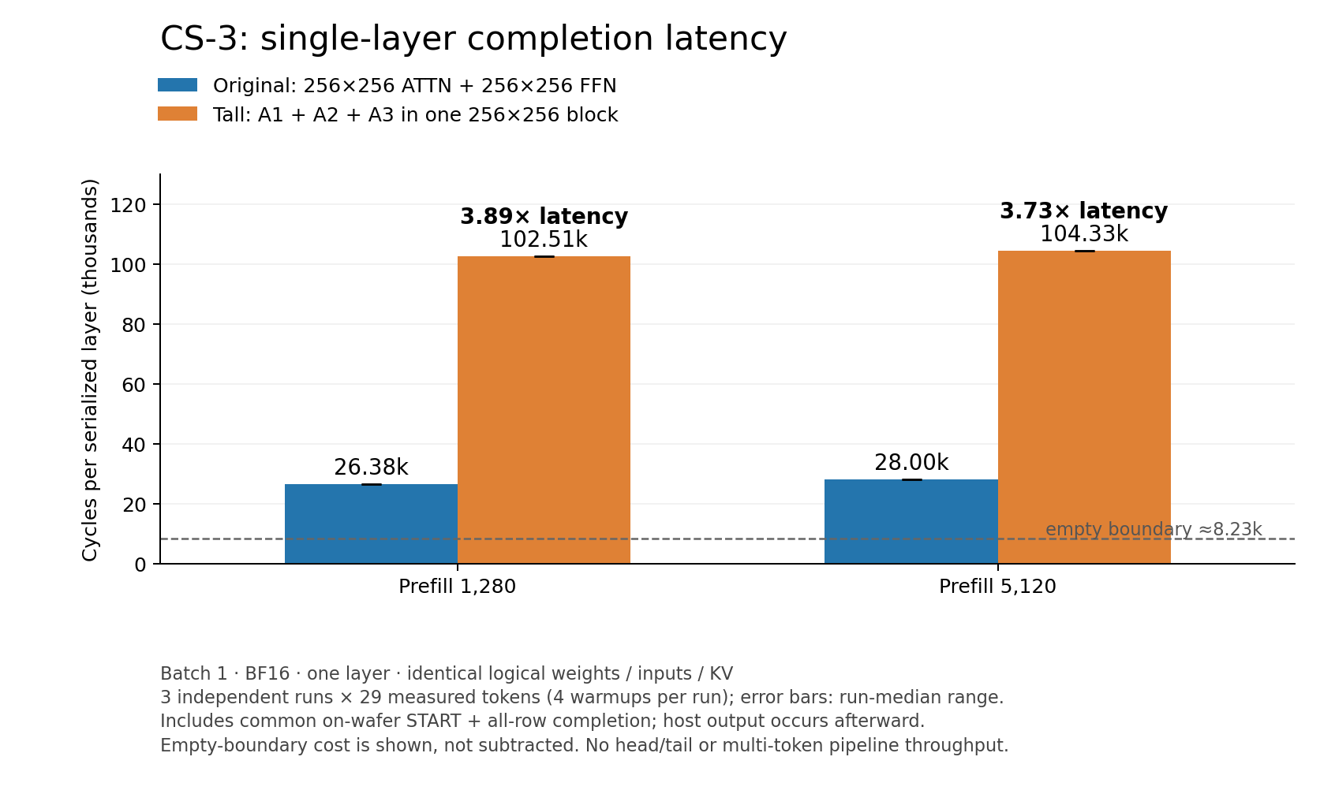
APPENDIX · LAYOUT C MEASUREMENT
Single-layer completion latency, original vs layout C
Cycles per serialized layer at two initial KV lengths. Three independent runs × 29 measured tokens; error bars are the run-median range. The dashed line is the empty-boundary cost (≈8.23K), shown but not subtracted.
Notes:
docs/reports/2026-09-13-layoutC-single-layer-performance.png.

Slide 50
APPENDIX · LAYOUT C GEOMETRY
One group on a 256 × 256 block
Columns × rows; source of truth is the implementation handoff §3.
STAGE
COLUMNS × ROWS
VALUES PER ROW
PES
A1 (QKV)
128 × 80
hidden 32
10,240
Spare
128 × 16
—
2,048
A3 (FFN)
128 × 160
16
20,480
A2 (attention + O)
128 × 256
10
32,768
Notes:
docs/reports/2026-09-13-layoutC-implementation-handoff.md §3. 65,536 PEs reserved, 63,488 active. PE counts are columns × rows from the stated geometry.

Slide 51
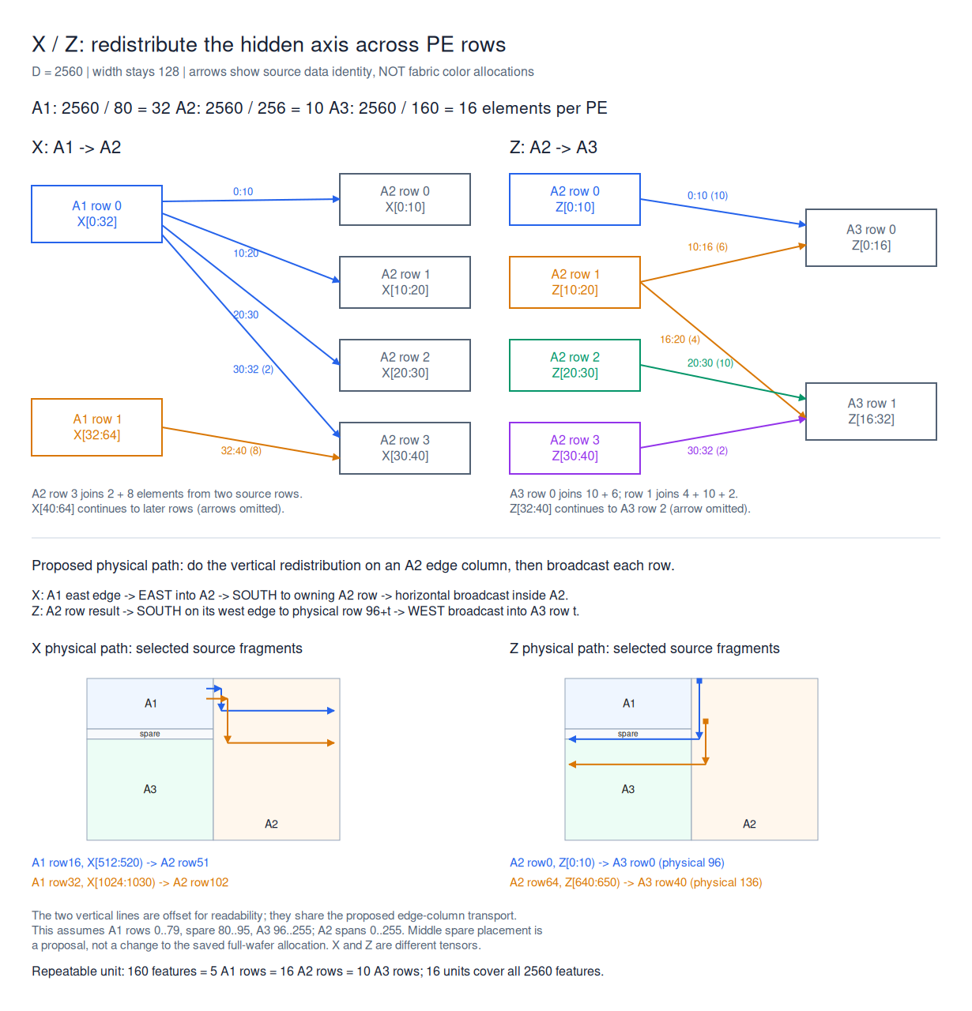
APPENDIX · LAYOUT C SHARDING
Why the row shards are 32 / 10 / 16
How the hidden dimension is re-sharded between stages.
Notes:
docs/diagrams/2026-09-10-layoutC-hidden-reshard.png.

Slide 52
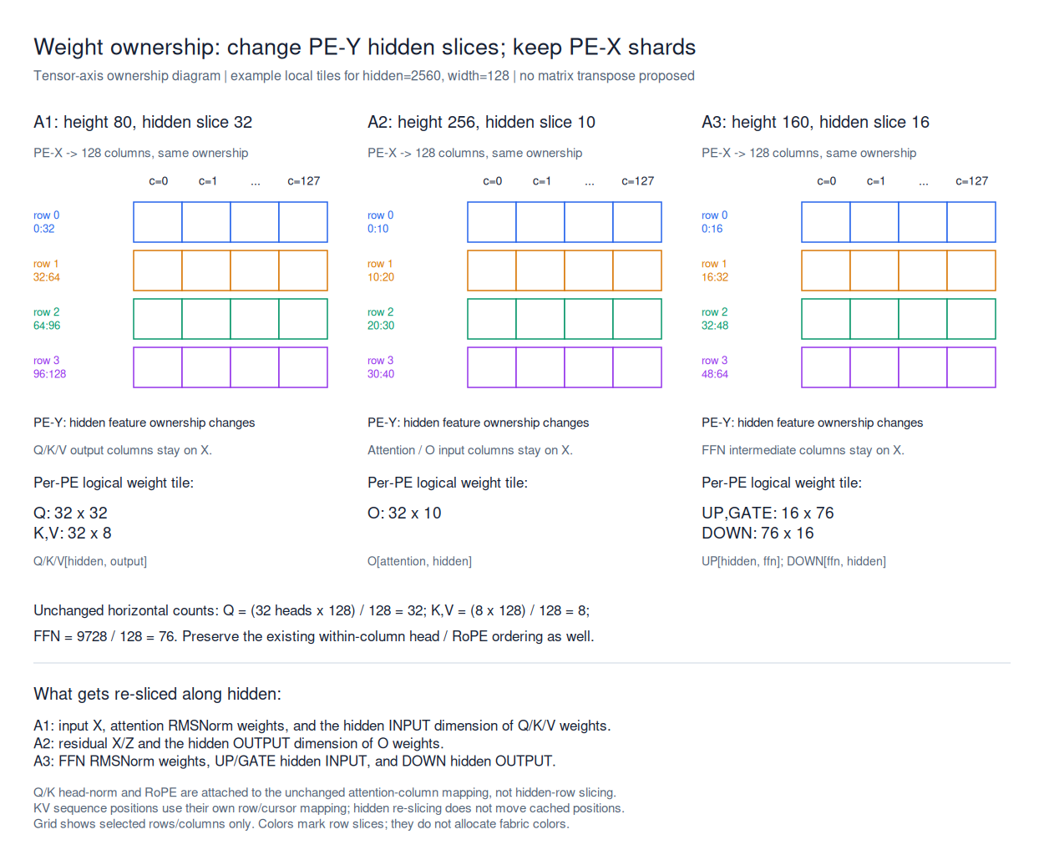
APPENDIX · LAYOUT C SHARDING
Which tensor axis each stage shards
Weight axes per stage.
Notes:
docs/diagrams/2026-09-10-layoutC-weight-axes.png.

Slide 53
APPENDIX · IF KV MOVED TO A DRAM TIER
Bandwidth a DRAM tier would need to hold the KV scan at today's step time
Derived from the whole-KV-per-token read; CS-6 has published no numbers.
CONTEXT
THRESHOLD
VS H100 HBM
29K
4.0 TB/s
1.2×
197K (Claude Code median)
27.1 TB/s
8.1×
616K (Claude Code p90)
84.6 TB/s
25×
Notes:
4b-wide-layer Round 162. The vs-HBM column is 27.1 / 8.1 = 3.35 TB/s as the HBM reference; the 1.2× and 25× are my arithmetic on the session's thresholds — strike if unwanted.

Slide 54
APPENDIX · NVIDIA GROQ 3 LPX
LPX as published
From the NVIDIA blog, as fetched by 4b-wide-layer.
QUANTITY
VALUE
SRAM per chip (compiler-managed)
500 MB; 128 GB rack-wide
On-chip bandwidth
150 TB/s
Chip-to-chip
96 C2C links = 2.5 TB/s per chip; plesiosynchronous
Role in the system
FFN / MoE; GPUs hold attention and the whole KV (AFD)
DRAM
256 GB + 128 GB
Notes:
4b-wide-layer Round 158.

