Slide 1
WaferEngine · CS-3
WEEKLY UPDATE
KV reuse inside one card now works end to end
S6 closes M0's reuse line. Force-decode turns out to be 8.5x cheaper on the wafer, for a reason we had wrong.
OWNER
PERIOD
FOCUS
Le Xu
20 - 26 July 2026
M0 closes Line 1, M1 opens
Notes:
Last week's deck covered S6a on real silicon. This week: force-decode lands, S6 closes, and M1 is planned.

Slide 2
ROADMAP
Where we are
DONE
PARKED
NOW
NEXT
LATER
M0, Line 1
M0, Line 2
M1
M2
M3 - M6
PE-internal KV reuse: retain and force-decode
KV transport, still to build
Several requests resident in one card
Reuse architecture, settled by benchmark
Idle-PE tier, off-chip pool, policy, scenarios
Notes:
M0's transport half stays blocked on the CS-3 cluster being down; M1 runs in simulation and does not wait for it.

Slide 3
PROGRESS
Since last week
Force-decode was re-measured on the wafer and the conclusion reversed: the win is layer overlap, not skipped work.
A forced token costs about 12% of a plain one, roughly 8.5 times cheaper, and that holds across a 15x context range.
S6b merged, which closes S6, so M0's reuse line is complete on a single branch.
Two more device sweeps landed: prefill at a 16,384-token prompt and decode at a 4,096-token context.
M1's slot contract was approved and its first subtask is already built and verified in simulation.
M2 grew from a single cost model into a cluster of coupled architecture questions.
Notes:
The two device sweeps completed on 21 July, one day after last week's deck. The two reversals: the device now gets one slot per lane rather than a single slot number, because eviction victims are not contiguous across lanes; and per-slot lengths stay on the host rather than being counted on the device.

Slide 4
01
What now works
Three mechanisms, one branch.

Slide 5
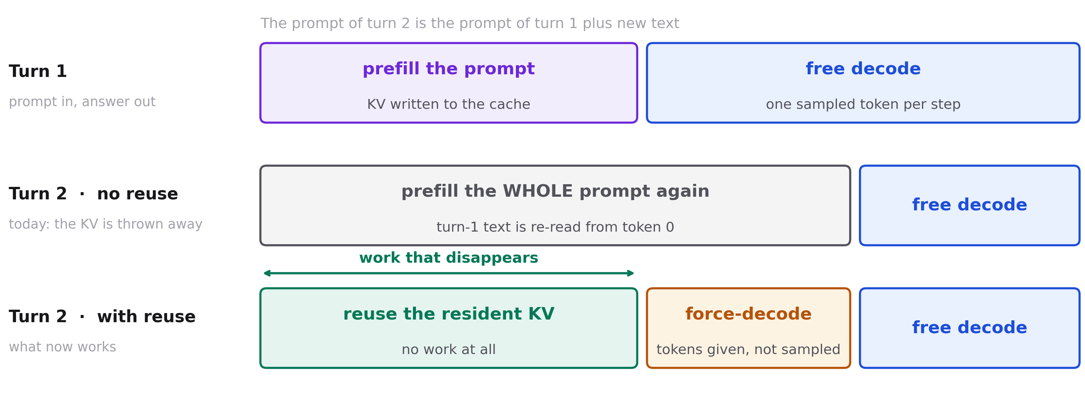
THE IDEA
Reuse what is already there, and force-decode only the new text
Force-decode runs ordinary decode steps, but the host supplies the token instead of the model sampling one, so the sampling work is skipped.
Notes:
The key point: a second turn no longer has to re-read the first turn from token 0.

Slide 6
CAPABILITY
What is supported today
Decode keeps its KV across rounds and extends it, rather than rewinding to zero. Correctness checked in simulation, cost measured on the wafer.
Prefill can start from a resident prefix instead of token 0, and its output is byte-identical to a cold run, both in simulation and on the wafer.
New text can be appended to a kept context by force-decoding it. Correctness checked in simulation; speed now measured on the wafer.
Still one resident request per bank. Holding several at once is exactly what M1 adds.

Slide 7
02
What we measured
Three sweeps on real silicon, and a conclusion we had to reverse.

Slide 8
PREFILL, REAL WSE-3
The reuse fraction dominates; length only nudges it
Time saved by starting from a resident prefix. 524,288 PEs, one run per point.
PREFIX REUSED
8,192-TOKEN PROMPT
16,384-TOKEN PROMPT
DIFFERENCE
none (cold)
1,001 ms
3,145 ms
baseline
25 %
-7.7 %
-7.3 %
-0.5
50 %
-22.8 %
-23.8 %
+1.1
75 %
-45.2 %
-49.8 %
+4.6
Notes:
The 16,384 column completed this week. Every reuse round was byte-identical to the cold round. Saving is sub-linear because a reused prefix is always the cheapest part of the prompt: the last chunk costs about 7x the first.

Slide 9
DECODE, REAL WSE-3
Retain wins by skipping whole steps
-49.3%
second decode round at a 4,096-token context, the point measured this week
-51.4%
-34.6%
+0.02%
Second round
Both rounds together
Equal-work control
1,024-token context
1,024-token context
a retained step is not cheaper
Notes:
The control row is the point: when both arms run the same number of steps, retain is 0.02% slower. Its whole value is that steps already taken are not taken again. So the saving tracks the fraction of decode steps skipped, not the sequence length.

Slide 10
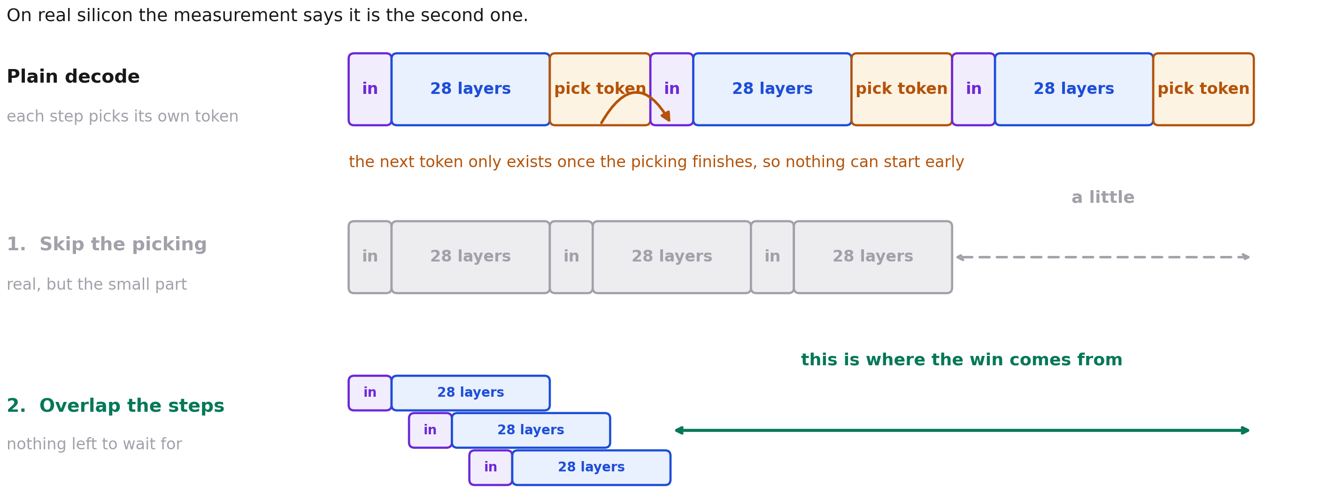
HOW IT WORKS
Two reasons a forced step could be cheaper
A plain step cannot start until the one before it has picked its token. Supplying the token removes that stage, and removes the wait along with it.
Notes:
Both effects are real, but they are not the same size. The next slide shows the measurement that separates them.

Slide 11
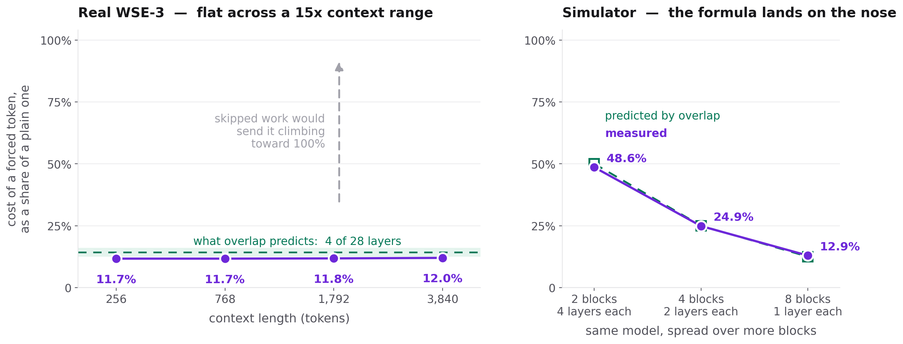
FORCE-DECODE, REAL WSE-3
The win is layer overlap, and the formula predicts it
A forced token costs about 12% of a plain one, roughly 8.5 times cheaper. 524,288 PEs, 28 layers over 8 blocks, vocabulary 151,936. Device runs are timing-only.
Notes:
Left: if the saving were skipped work, the ratio would climb toward 100% as the context grows and attention dwarfs the skipped stage. It does not move. Right: holding the model fixed and spreading it over more blocks tracks the predicted ratio at all three points.

Slide 12
FINDING
We had this backwards a week ago
Last week we said the saving was skipped work. That is now falsified, not narrowed: on the wafer it is layer overlap.
The old test could not have decided it. Once forced steps run open-loop, both explanations predict a straight line.
The magnitudes never fitted either. The skipped stage is about 5% of a step, yet the saving was about 71%.
The size of the win is set by how the layers are spread across the block pipeline, not by vocabulary as we had predicted.
It also explains the old 28%: seven layers at two per block gives 28.6%, which is what we had measured.
A stale divisor made absolute per-token figures about five times too low. Ratios hold, but throughput baselines need re-checking.

Slide 13
03
M1, and what to decide
Several requests in one card, and the architecture questions behind it.

Slide 14
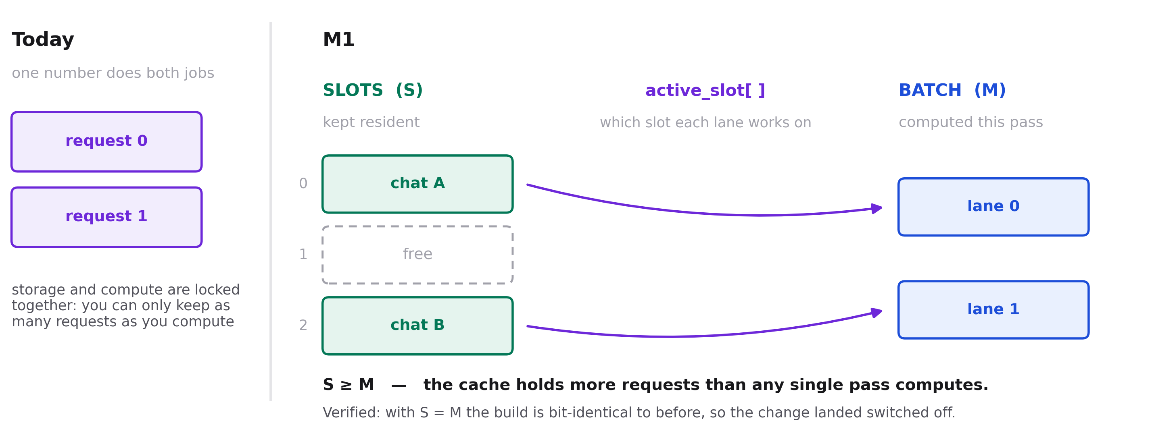
M1 CONTRACT
One number becomes two: capacity and compute
Slots size the cache, batch sizes the compute. The device is told one new thing, which slot each lane is on; everything else stays on the host.
Notes:
Batch is a scheduling subset of the slots, not a storage axis. A slot-by-batch grid would over-allocate.

Slide 15
M1 PLAN
Six subtasks, the first two now done
STEP
WHAT IT DELIVERS
STATUS
NOTE
S0
Slot addressing and metadata contract
done
Reviewed and approved, 26 July
S1
Multi-slot cache, inert
done
Bit-identical on both gates, in simulation
S2
Retain and extend across a changing active set
on track
Next: per-slot lengths on the host
S3
Hit detection, eviction, miss handling
planned
A miss rebuilds by force-decoding
S4
Requests-per-bank capacity curve
planned
Needs a geometry near the SRAM budget
S5
End-to-end verification
planned
Against a teacher-forced reference
Notes:
S1 passed two gates in simulation: bit-identical to the pre-change build over 48 records, and bit-identical again with four slots and the active set mapped to slots 3 and 0, with the unused slots still exactly zero. Capacity is not exercised at this geometry. The code is still uncommitted in the working tree.

Slide 16
TO DISCUSS
The M2 questions
WHY TOGETHER
One architecture, not four separate calls
FOUR COUPLED QUESTIONS
01
Does the control plane live on the host, or distributed across the compute PEs?
These choices constrain each other. Paging's page table is exactly the per-PE mapping a distributed control plane would need, so picking one nearly picks the other. M1 commits to the simplest working defaults, fixed slots with control on the host and the cache in decode, and M2 tests each against a small benchmark rather than settling it by argument.
02
Fixed-size slots, or paging for copy-free prefix sharing?
03
On a hit, continue in decode, or ship the KV back to prefill?
04
Does the cache live in decode or in prefill?
Notes:
Paging would chop the attention inner loop into roughly 16 short pieces at 256 tokens and 16-token pages, which is why M1 does not start there.

Slide 17
ALSO TO DISCUSS
Open routing calls
The cluster was available all along, so the standing assumption that it was down was stale. Does M0's transport work restart now?
Device runs are timing-only, with no correctness gate at device scale. When do we add one?
A forced token at 56 to 67 microseconds looks faster than our recorded prefill rate. A like-for-like run would settle force-decode against ship-to-prefill.
Continuous batching: M1 builds the substrate, but running requests concurrently needs ingress, egress and a scheduler reworked. Which milestone owns it?
Ragged batch, meaning lanes at different sequence positions. M1 declined it, but continuous batching needs it.
Do we run the control-plane comparison inside M1, or on a branch forked after M1-S2?

Slide 18
NEXT STEPS
What happens next
Le Xu
Commit the S1 working tree, which is the one thing holding up S2.
Le Xu
Build S2: per-slot lengths on the host, across a changing active set.
Team
Decide which of the M2 questions gets a benchmark first.

Slide 19
WaferEngine · CS-3
Questions?
Plan in ROADMAP.md, current state in PROGRESS.md, detail in milestones/M1-intra-pe-reuse.md.
lxu5398@gmail.com

