Slide 1
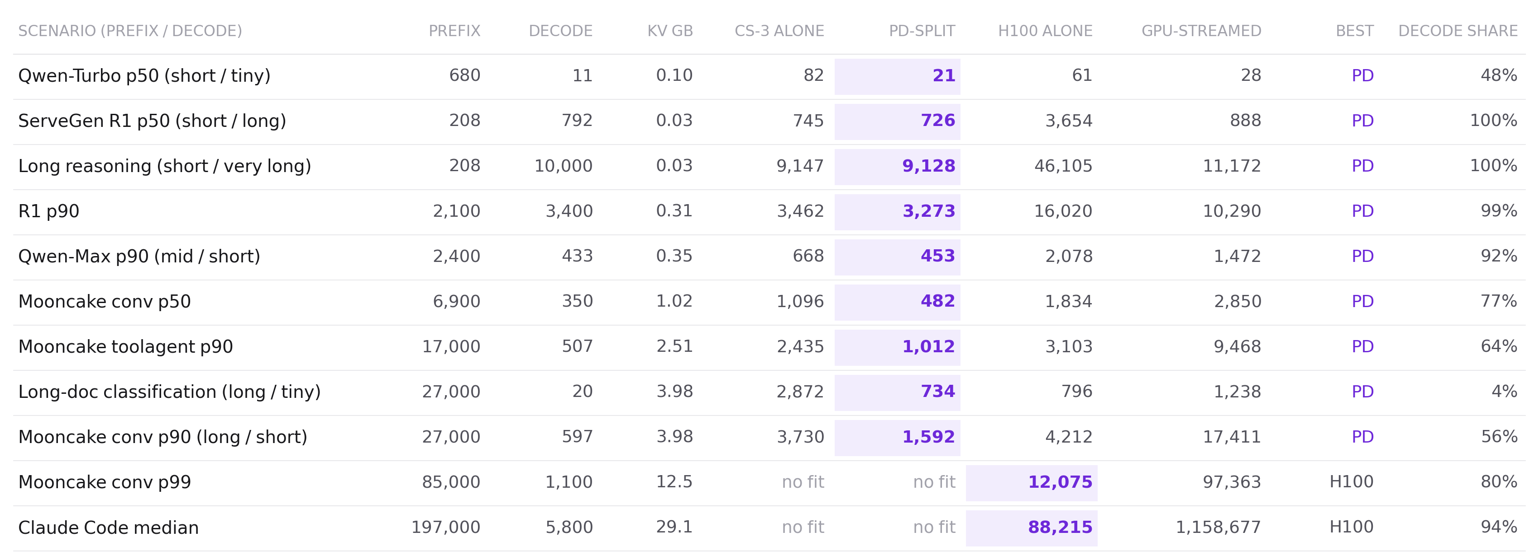
PREFIX × DECODE · FOUR CONFIGURATIONS, ELEVEN SCENARIOS
PD-split wins wherever it fits; above 29K, H100 only
ms per request, derived from measured rates; link 1.2 Tbit/s unmeasured. PD-split decodes on the wafer, so it keeps the 29K ceiling.
Notes:
Source: 4b-wide-layer Round 171. Modelling: CS-3 decode = (681K + 16.1·C) cycles at 750 MHz; H100 decode = 4.60 + 0.0489·C/1K ms (fit to measured 1K–32K); H100 prefill measured, held at the 32K rate beyond 32K (optimistic for H100); link 0.98 µs per prefix token (Le's 1.2 Tbit/s, unmeasured; API not open). GPU-streamed = KV stays on the GPU and the whole cache crosses per token. The Claude Code row is a frontier-model workload a 4B never serves (Round 168) — for completeness, not a target. Rendered by figures/render_pd_table.py.

