Slide 1
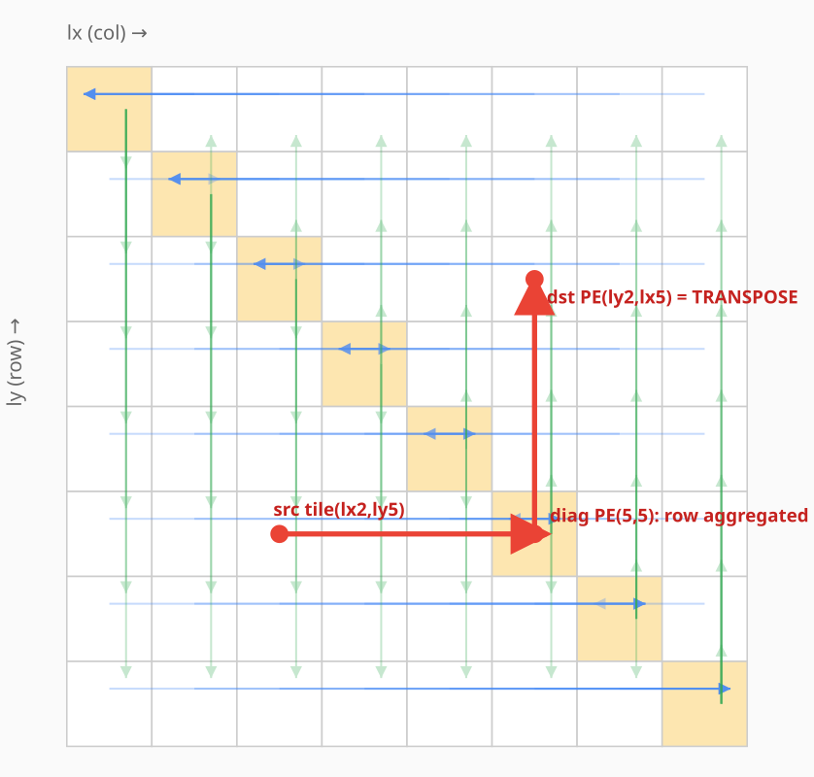
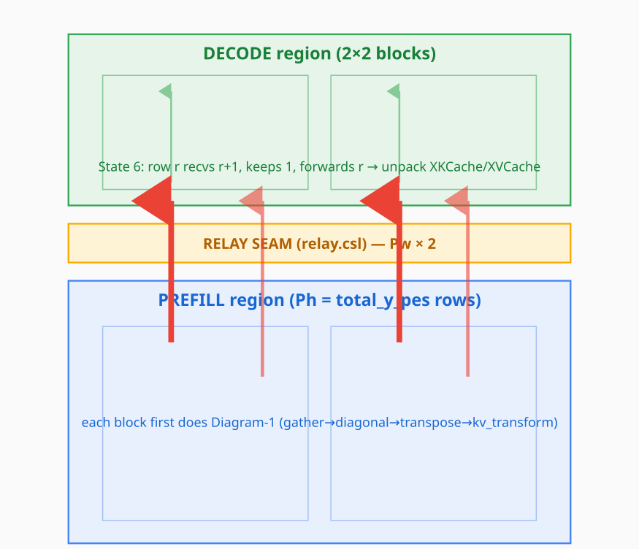
How the KV cache crosses from prefill to decode
1 — inside one prefill block: funnel → diagonal → transpose stage A ≈ 7%
2 — across regions: store-and-forward north into decode stage B ≈ 93%
Prefill and decode hold KV on transposed coordinates — a tile on PE (lx, ly) is expected at (ly, lx). Each row funnels sideways to its diagonal PE, which then emits down its column; the turn at the diagonal is the transpose. A second, in-tile relayout puts the bytes in decode's order, so decode only receives and unpacks.
That is all of stage A — about 7%. The other 93% is stage B: each tile is handed north PE by PE across the full prefill height and the relay seam, once per layer per K/V plane, with no overlap between planes.
KV cache: prefill → decode transfer · WaferEngine on WSE-3 · July 2026

Slide 2
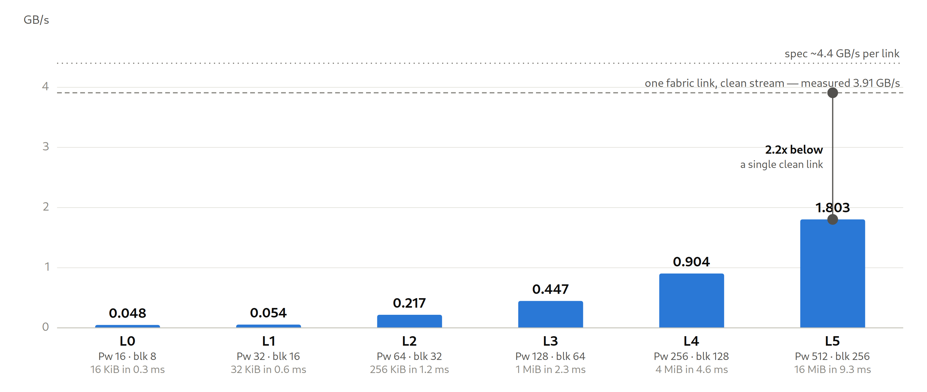
Measured on real silicon — it scales with geometry, but runs far below the wire
Six configurations end to end on the EPCC CS-3, from a 16×16 toy up to the full 512×512 production geometry — no simulator. Effective bandwidth = KV bytes moved ÷ (A+B), timed by on-device counters; it grows almost linearly with geometry, reaching 1.803 GB/s.
The ceiling lines are the point: one fabric link carrying a single clean stream measured 3.91 GB/s on the same machine (0.89× spec). The whole parallel transfer is therefore slower than one clean link and uses ~0.1% of the seam — bound by per-hop latency and by running the planes serially, not by the fabric. Fixes: coalesce the planes into one shift, enlarge the per-hop payload, cut through, route directly.
KV cache: prefill → decode transfer · WaferEngine on WSE-3 · July 2026

