Slide 1
WaferEngine · CS-3
WEEKLY COLLABORATOR DISCUSSION
In-PE KV Reuse
Measured benefits, execution constraints, and an on-wafer secondary KV tier.
MODEL
EVIDENCE
SCOPE
DATE
Qwen3-1.7B
Real CS-3 TSC
M1 reuse + M3 exploration
2026-08-11
Notes:
Discussion deck: focus on the serving behavior, measured effects, and architecture questions rather than host implementation details.

Slide 2
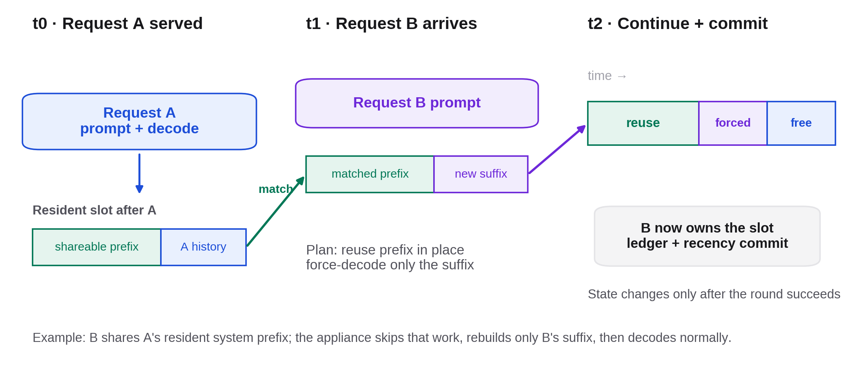
WHAT HAS BEEN ENABLED · SERVING EXAMPLE
A later request can reuse KV left by an earlier request
One slot across three time steps: match the resident prefix, force only the new suffix, then continue normal decode and commit the new resident history.
Notes:
The example is content-prefix reuse: Request B may have a new sequence ID. Green is already resident, violet is forced input, blue is normal free decode.

Slide 3
CURRENT FEATURE SURFACE
Resident KV is now a serving resource, not a one-request scratchpad
ROUND BEHAVIOR
Reuse, rebuild, or replace
ENABLED SCENARIOS
01
Hit — reuse in place; exact retains one seed, prefix forces only prompt[start:]
The host chooses a one-to-one resident slot assignment for the batch. The appliance starts from a shared safe prefix, receives no host KV payload on this path, and extends the slot with real prompt and sampled tokens.
02
Miss — start at zero and rebuild the prompt by force-decode
03
Pressure — use an empty slot, otherwise replace one whole slot by LRU
Notes:
Success-only state update matters operationally, but keep the slide at the serving-contract level. Equal-length lanes and one common start are still required.

Slide 4
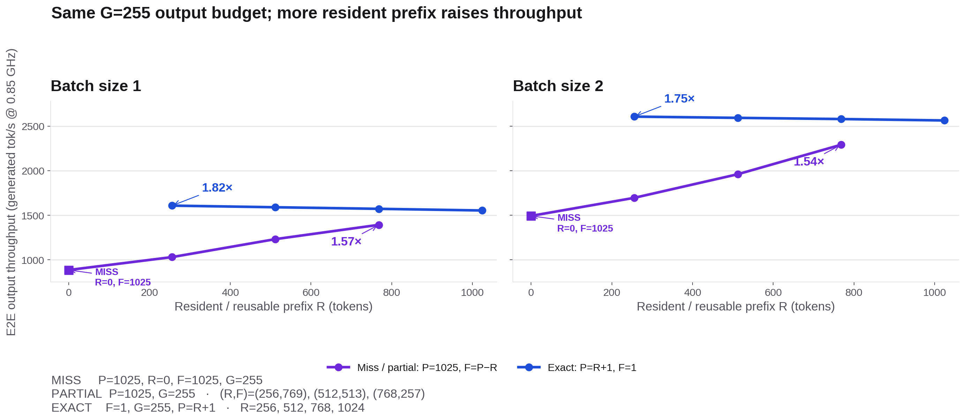
EXPERIMENT A · REUSE LENGTH × BATCH
More reusable prefix translates into higher output throughput
Throughput = batch×255 generated tokens / median round TSC at 0.85 GHz. Purple keeps P=1025 and reduces F as R grows; blue uses an exact resident prefix with P=R+1 and F=1.
Notes:
Experiment A setting:
real Qwen3-1.7B on one CS-3/WSE-3; Pw512×Ph1024; 2×4 blocks; P_BLOCK_SIZE=256; 28 layers; dim=2048; 16 attention heads / 8 KV heads; vocab=151936;
three device repetitions per point;
median raw TSC converted at 0.85 GHz.
G=255 free-decode/generated tokens per lane for every point.
Miss: P/R/F/G=1025/0/1025/255. Partial: P=1025,G=255 with R/F=256/769,512/513,768/257. Exact: F=1,G=255,P=R+1 with R/P=256/257,512/513,768/769,1024/1025. Throughput numerator is batch×G, so partial and exact are compared on the same generated-output budget. bsz 3–4 reached the ht_tail PE-memory compile boundary and produced no TSC.

Slide 5
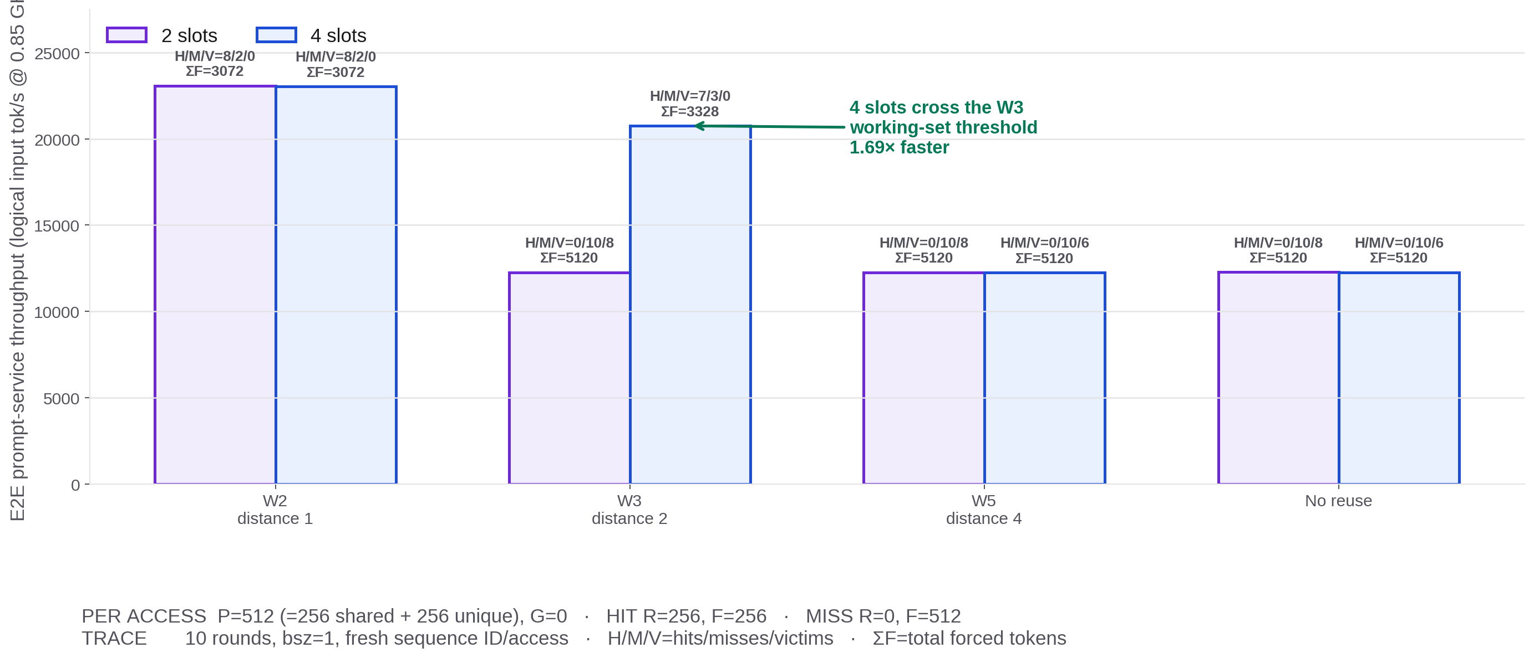
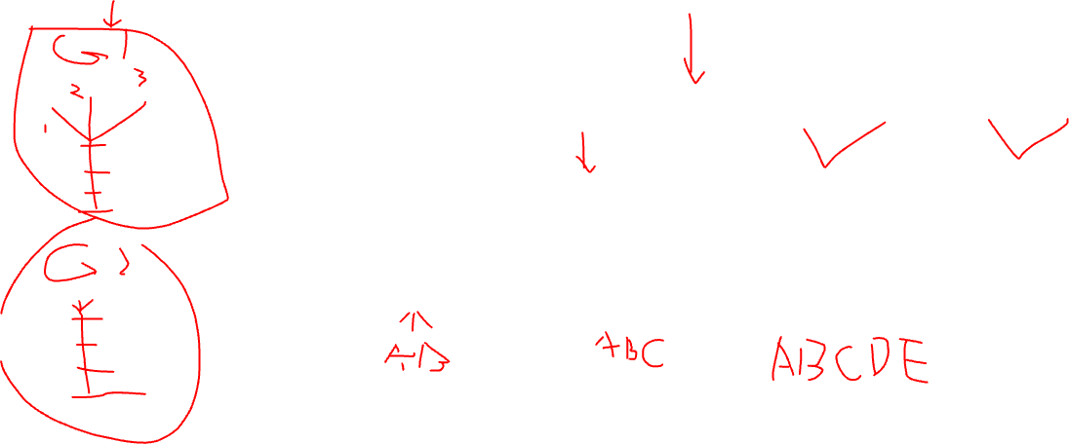
EXPERIMENT B · SYNTHETIC LOCALITY × SLOTS
More slots help only when they cross the working-set threshold
Throughput = 10×512 logical prompt tokens / cumulative device TSC at 0.85 GHz. This is a G=0 pure KV-rebuild trace, so generated-output throughput would be zero by construction.
Notes:
Experiment B setting: real Qwen3-1.7B on one CS-3/WSE-3; Pw512×Ph1024; 2×4 blocks; P_BLOCK_SIZE=256; 28 layers; dim=2048; 16 attention heads / 8 KV heads; vocab=151936; bsz=1; ten rounds;
fresh sequence ID per access;
P=512 tokens composed of a 256-token shared prefix plus 256 unique tokens;
G=0.
On a content-prefix hit, R=256 and F=256;
on a miss, R=0 and F=512.
W2/W3/W5 mean reuse distances 1/2/4;
slot counts are 2 and 4. Because G=0, the plotted metric is logical prompt-token throughput, not generated-output throughput. W3 thrashes with 2 slots but achieves 7 hits/3 misses with 4 slots; W5 exceeds both capacities.

Slide 6
LIMITATION
Matching works; divergent execution is still missing.
Today every lane in a round is forced onto one common safe start, even when its reusable prefix is longer.
Notes:
This is why the current implementation is still a toy serving setting despite using the full model for the microbenchmarks.

Slide 7
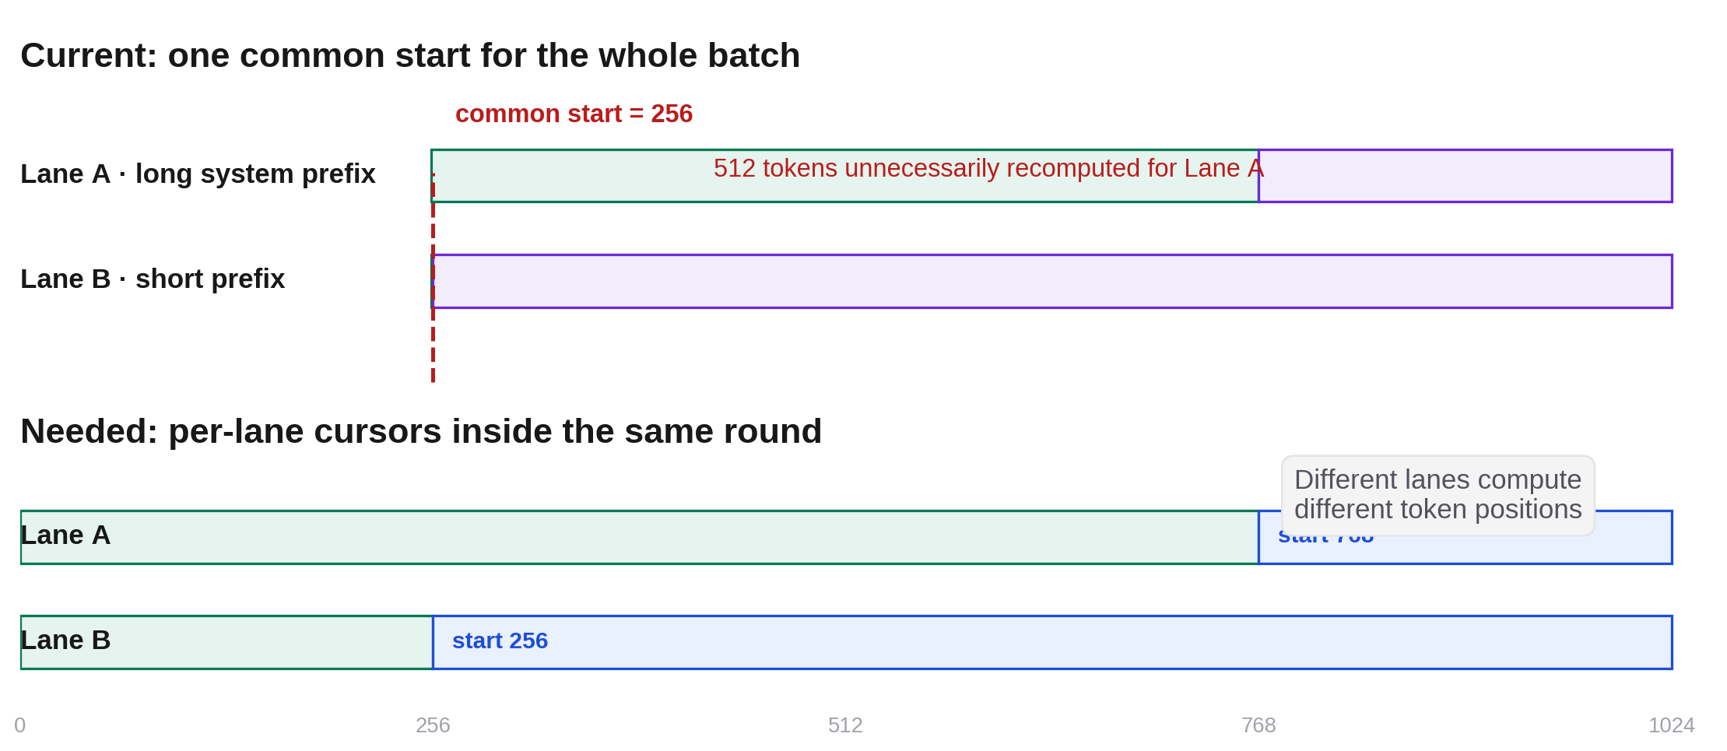
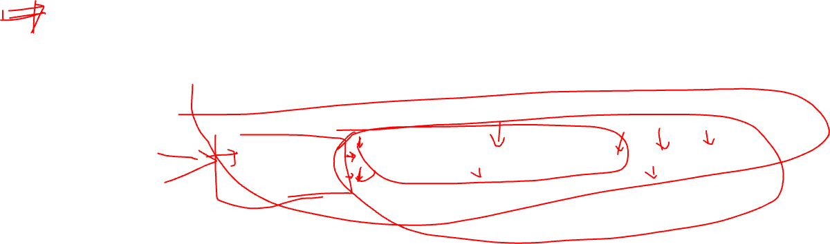
LIMITATION A · RAGGED EXECUTION
One shared start is unfair to requests with long reusable prefixes
Example: Lane A can reuse 768 tokens and Lane B only 256. The current batch starts both at 256; ragged execution would let the same PE block compute different token positions per lane.
Notes:
This resembles the kernel contract required by continuous batching: per-lane cursor, active mask, forced length and completion state. It may materially change the gain for long system prompts.

Slide 8
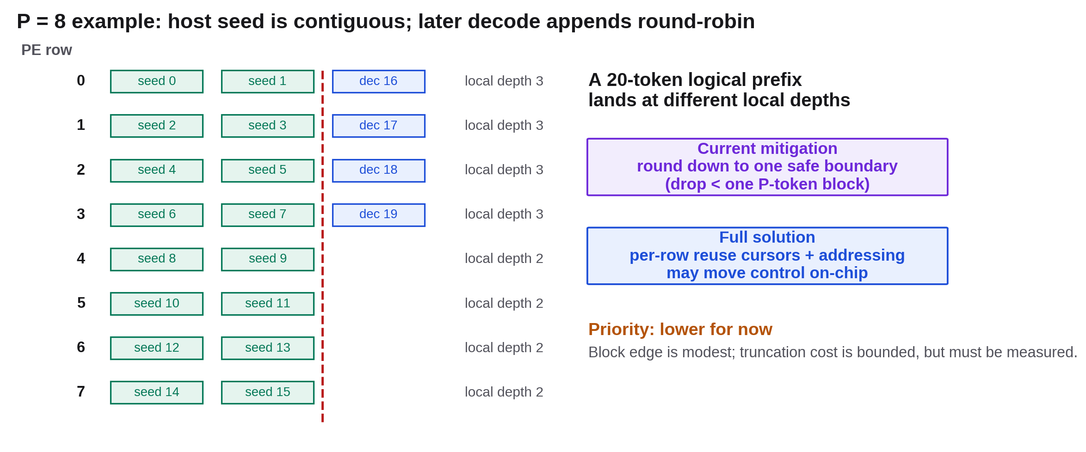
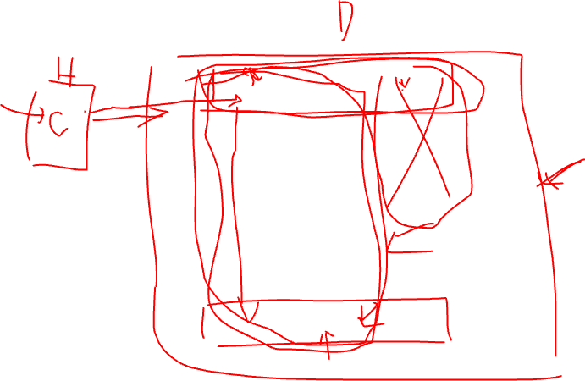
LIMITATION B · PER-ROW KV LAYOUT
Seed and decode KV can produce different local reuse depths
After a contiguous host seed and round-robin decode appends, one logical prefix can end at different local indices across PE rows. The current safe mitigation truncates to a shared boundary.
Notes:
The mitigation loses less than one P-token block. Because the block edge is moderate, this is lower priority than ragged execution. A full solution may require per-row cursors and more on-chip addressing/control.

Slide 9
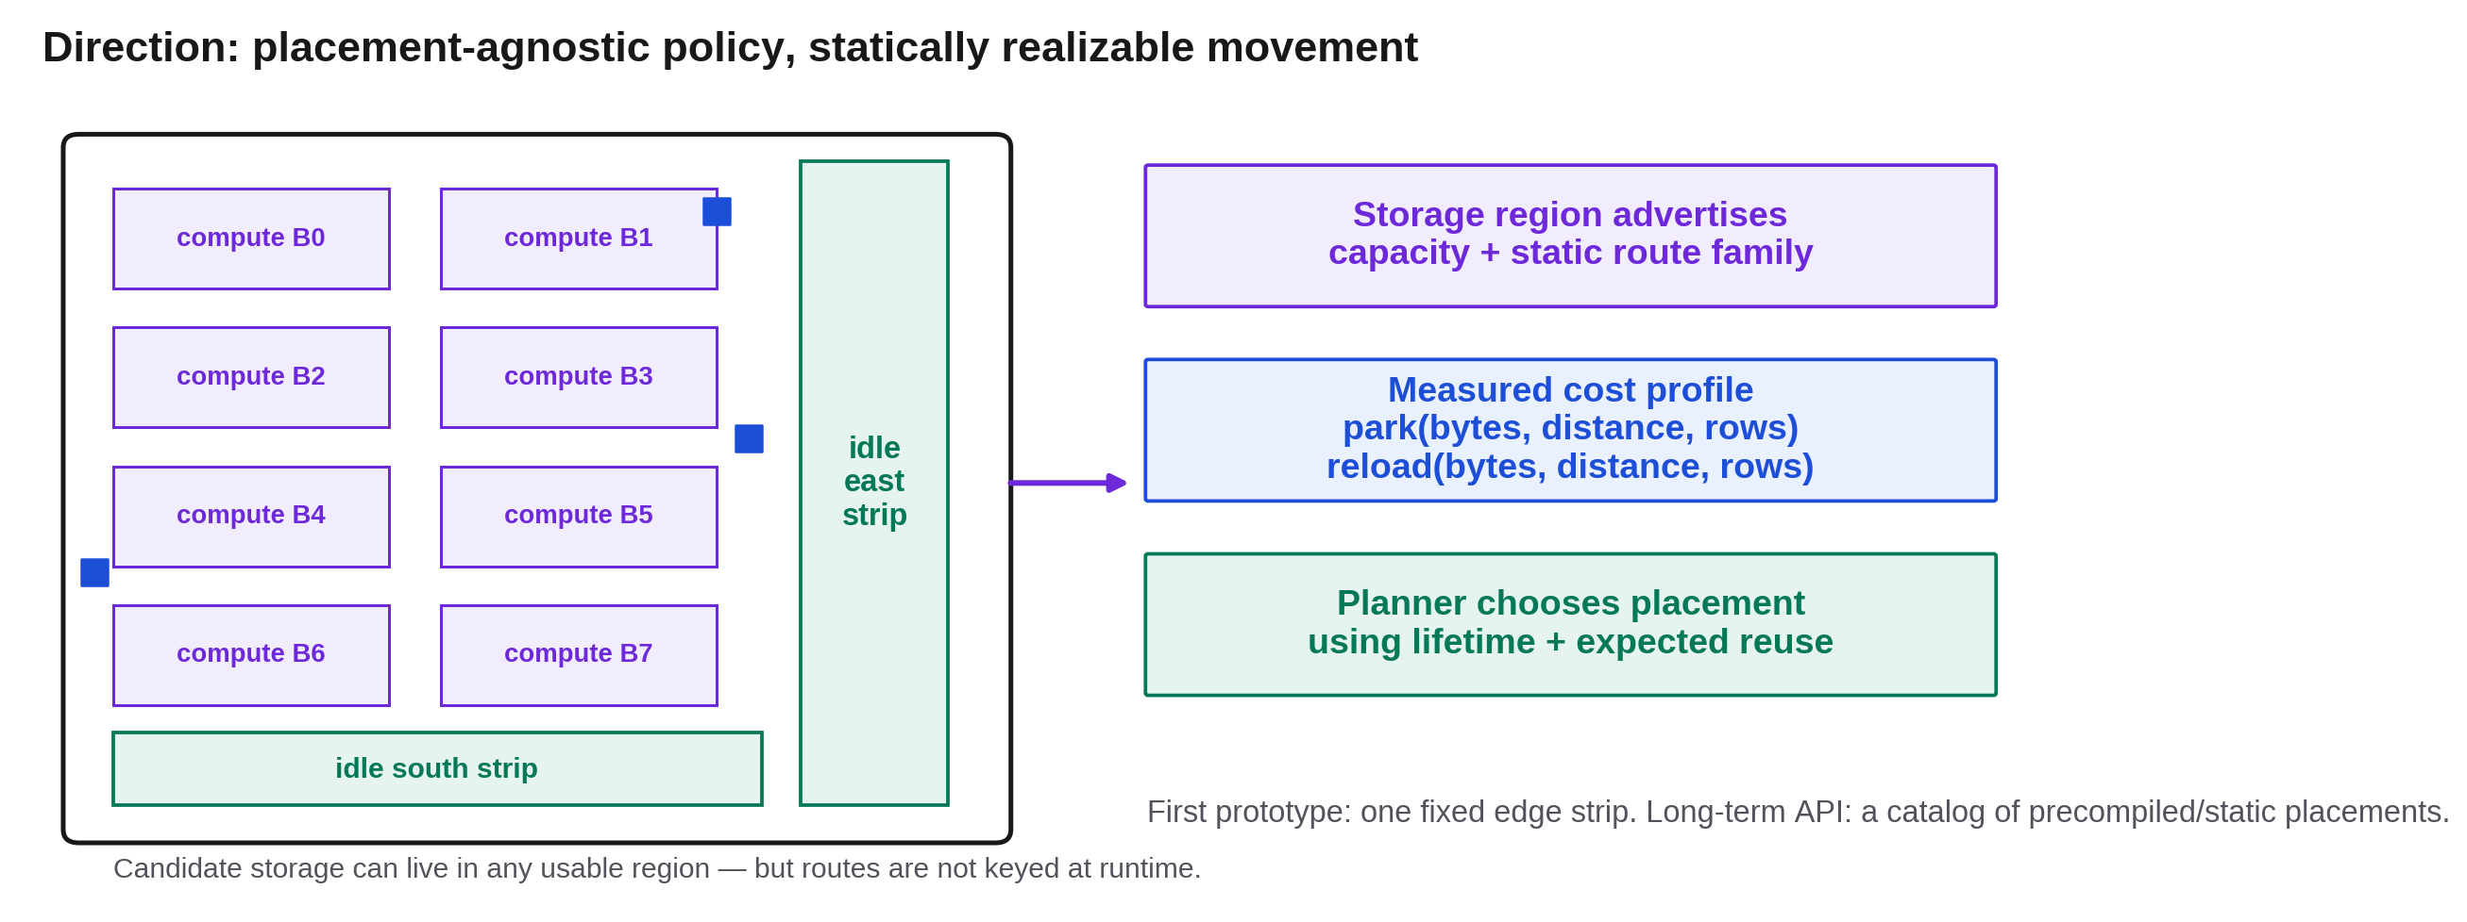
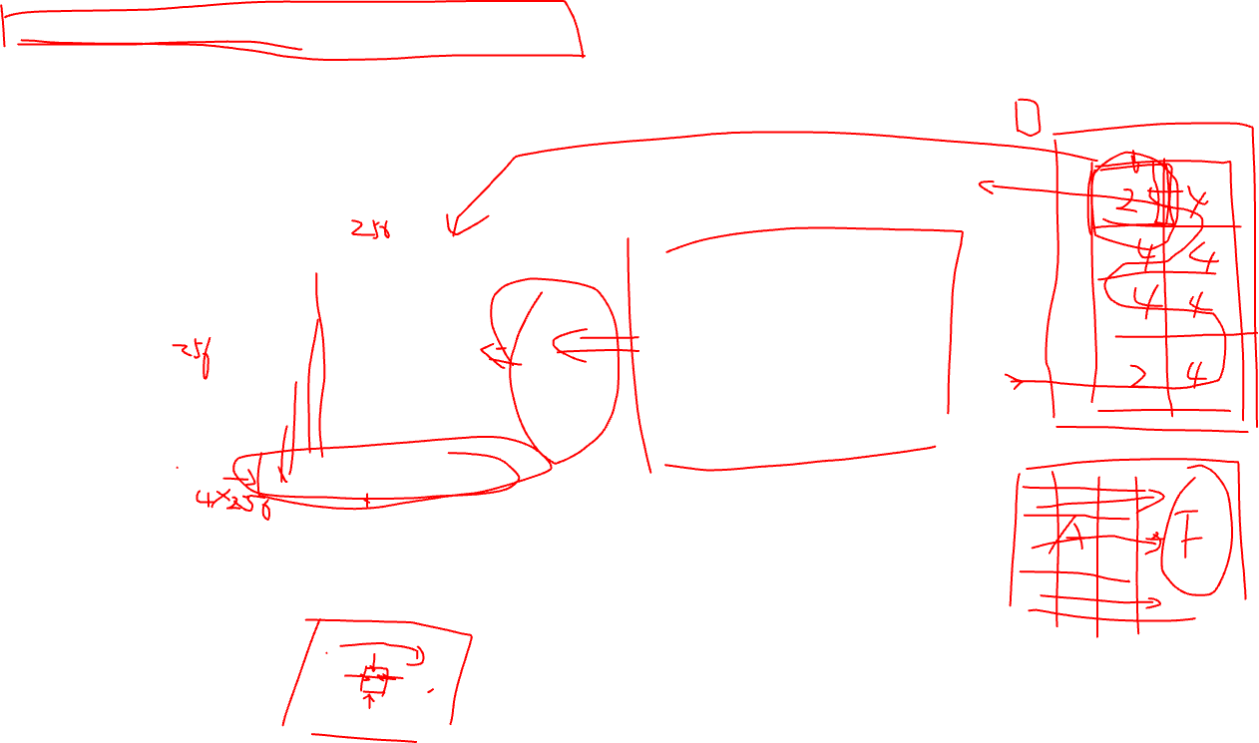
M3 INITIAL EXPLORATION · PLACEMENT CONTRACT
Support flexible placement through measured, static movement profiles
Logical placement can be general, but WSE routes are not keyed by request ID. Each usable storage region should expose capacity plus measured park/reload curves for a precompiled route family.
Notes:
The planner remains placement-agnostic. The fabric mechanism must still be static/count-exact or serialized through a known mux; arbitrary runtime destinations are not directly supported.

Slide 10
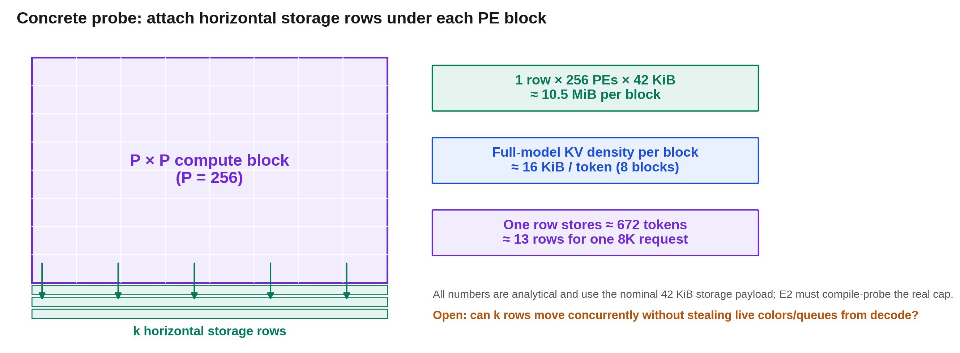
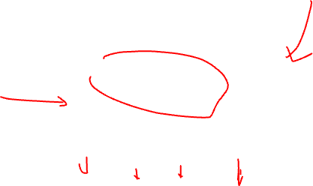
M3 CONCRETE CANDIDATE · EDGE-ATTACHED STORAGE
A horizontal storage strip gives a simple first mechanism—and a clear capacity bill
Nominal analytical sizing: 42 KiB payload per storage PE and 128 KiB/token across the eight-block model. One 1×256 strip stores about 672 tokens per block; an 8K request needs about 13 rows.
Notes:
This placement can use vertical gather/scatter and avoid the serpentine inter-block direction at the conceptual level, but color/queue coexistence must be audited. The 42 KiB payload is not yet compile-probed for this storage kernel.

Slide 11
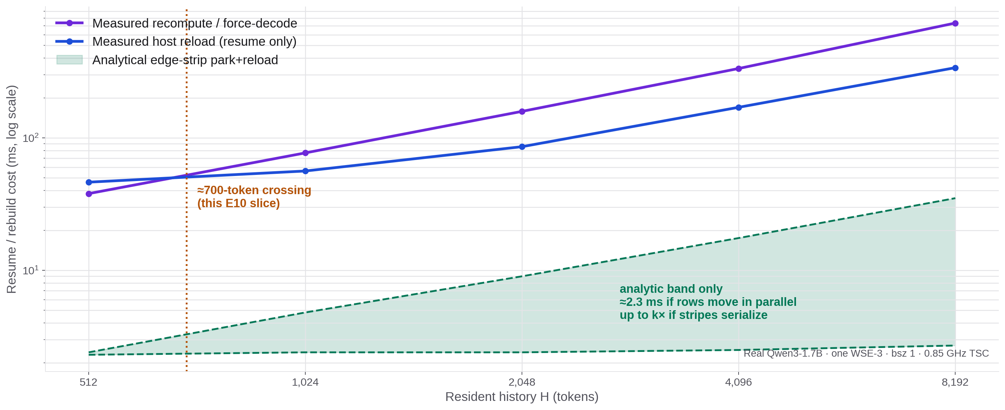
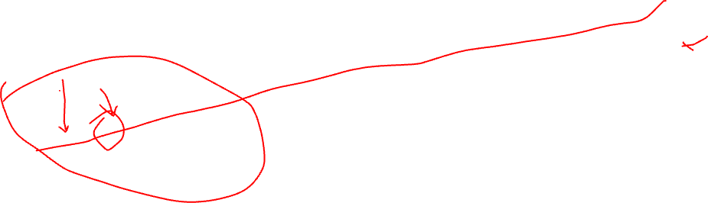
M3 COST MODEL · REAL CS-3 ANCHORS + ANALYTICAL CANDIDATE
At full CS-3 scale, measured host reload crosses recompute
Real Qwen3-1.7B, one WSE-3, Pw512×Ph1024, 2×4 blocks, bsz 1. This E10 resume-only slice crosses near 700 tokens; the green edge-strip band remains analytical.
Notes:
This is one measured boundary slice, not a universal policy threshold. Full-target reload shifts with S, H and L_new; a true eviction decision must also add decode-to-host D2H and resume probability. E1 must measure the green band.

Slide 12
QUESTIONS FOR COLLABORATORS
What should we resolve next?
Ragged
Prioritize per-lane starts; choose the long-prefix success workload.
Row layout
Measure bounded reuse loss before moving per-row addressing on-chip.
M3-E1
Sweep park/reload by payload, distance, active rows and direction.
Placement + policy
Prototype one profiled edge strip; let measured cost drive eviction.
Notes:
No decision is implied on arbitrary distributed storage versus a fixed strip. The immediate ask is whether the profile abstraction and edge-strip first probe are the right decomposition.

