Slide 1
WaferEngine · CS-3
WEEKLY COLLABORATOR DISCUSSION
Where a Wafer Fits in Agentic Inference
96% of an agentic call's context is KV the decoder has already seen. What it costs to put that back in front of the scan decides everything else.
MODEL
RATES
SCOPE
DATE
Qwen3-4B
Device-measured, 0.85 GHz
Fits · doesn't · not yet
2026-09-06
Notes:
Framing for the room: this is not a progress report, it is an argument about where a wafer belongs in agentic serving. Three verdicts — where it fits, where it does not, and where it should fit but cannot yet. Cycles are the measurement and are frequency-independent; every tok/s is converted at 0.85 GHz per Le's convention, which is what the launcher prints and what his other material uses. Ratios -- decoder vs native prefill, rung vs rung -- are ratios of cycle counts and do not move with the clock. No GPU comparison appears on any slide: every H200 number we have is an external figure for a 9B from the MeshRT paper, and no 4B GPU curve has been measured.

Slide 2
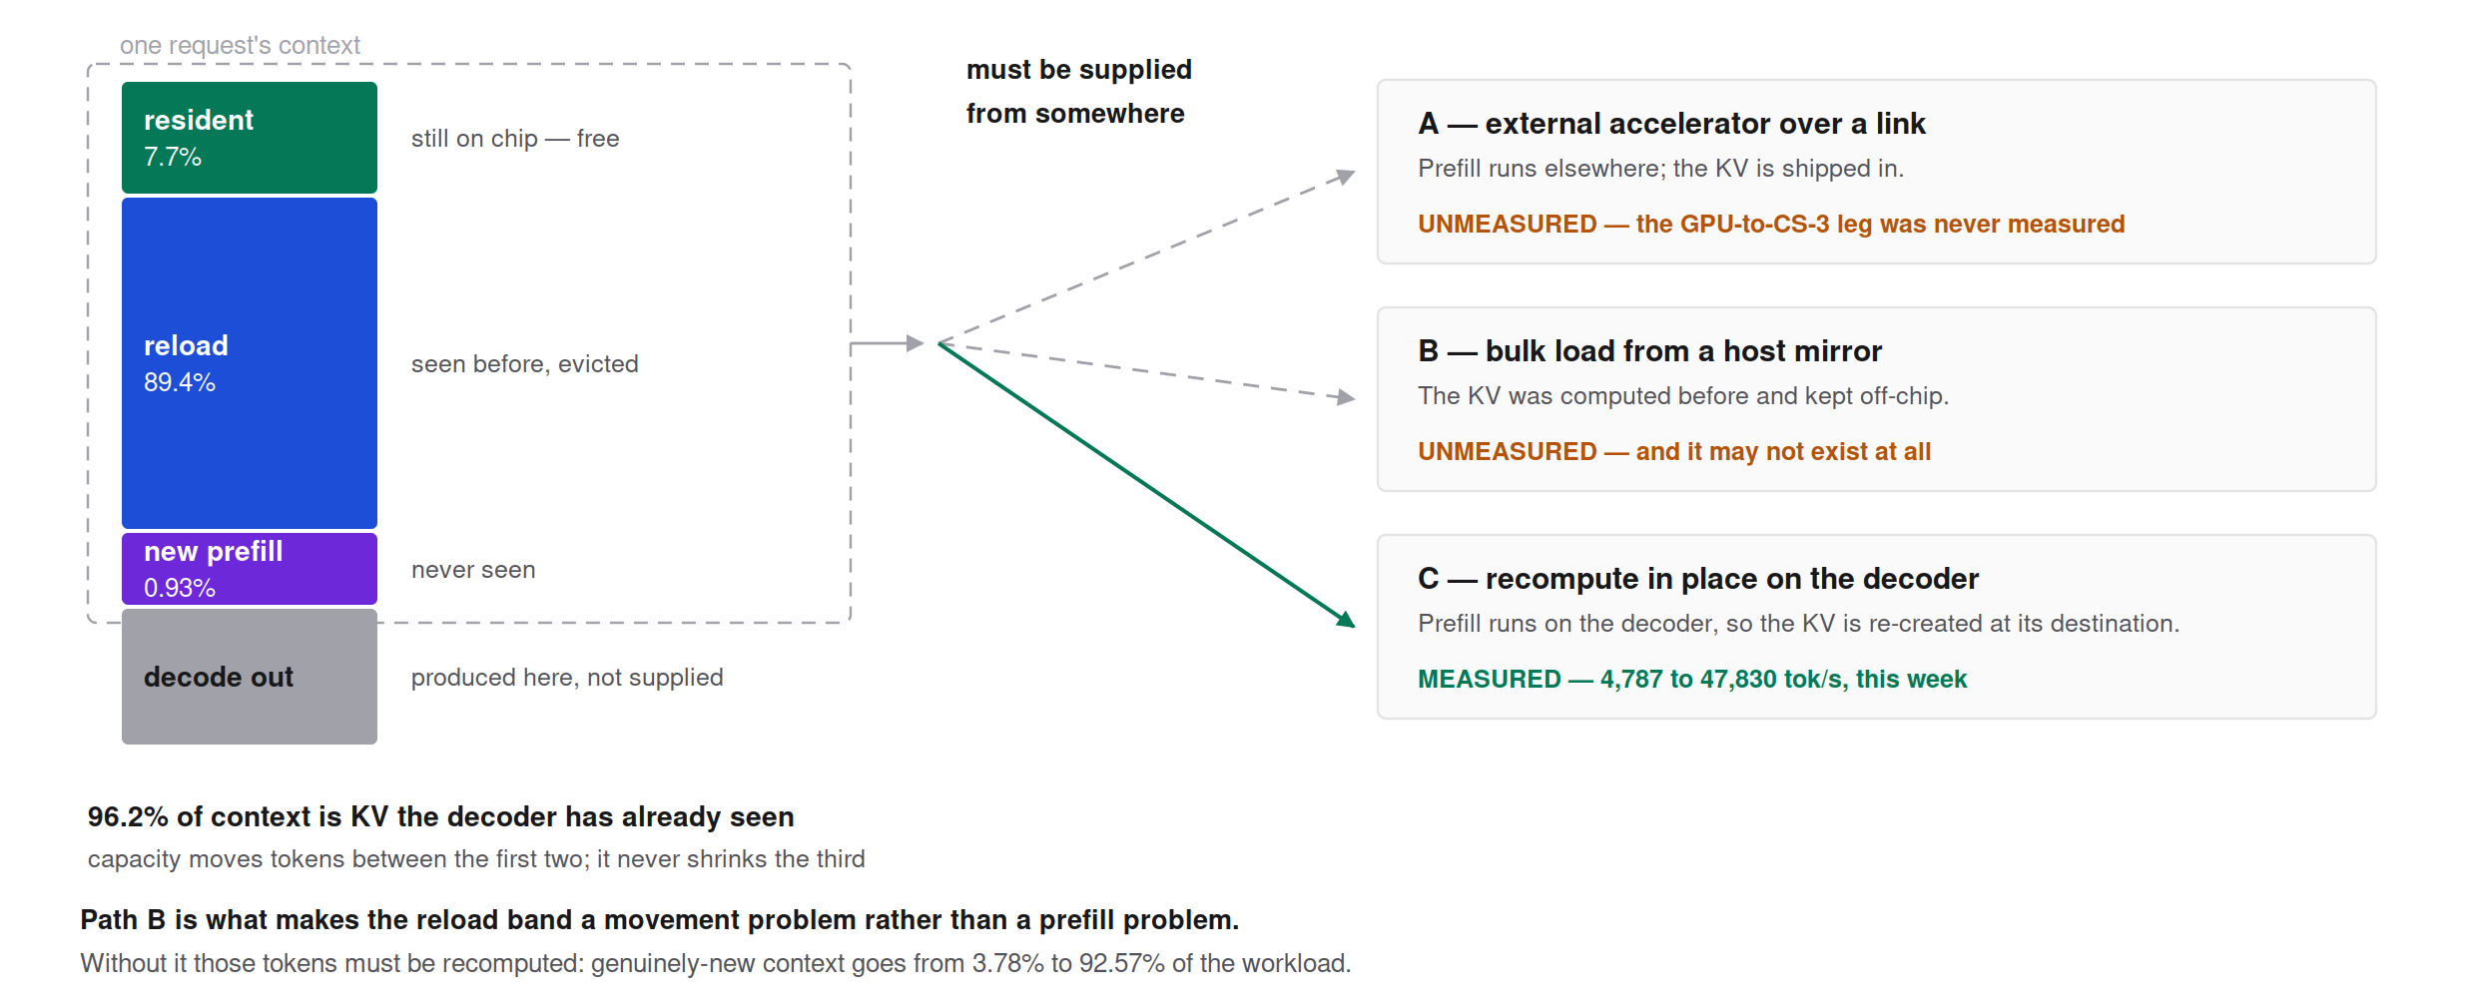
FRAME · WHERE A CALL'S KV COMES FROM
Four kinds of token, and only three ways to supply them
Evicted prefix needs movement only, not recomputation. Only context the decoder has never seen must actually be prefilled — and those two cost an order of magnitude apart, so collapsing them hides the answer.
Notes:
This is the frame the whole deck rests on, and it came out of Le's observation that evicted KV only needs reload, never recompute. The supply paths matter because they are priced by different hardware: category 2 by bandwidth, category 3 by prefill throughput, category 1 by on-chip capacity alone. Prefill on this chip happens on the decoder, so 'recompute in place' means re-creating the KV at the destination and skipping the link entirely — which is why a short new increment can be cheaper to recreate than to ship.

Slide 3
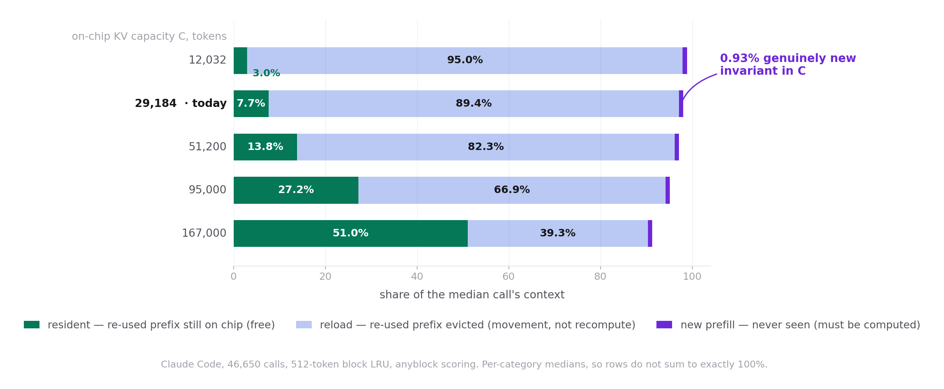
MEASURED · THE AGENTIC TRACE
Only 0.9% of an agentic call is context the decoder has never seen
At today's 29,184-token ceiling the median call is 28,672 tokens resident, 165,376 re-used but evicted, and 1,820 genuinely new. Capacity trades the evicted band for the resident one and never touches the third.
Notes:
Method: analyses/2026-09-06-kv-four-way-decomposition/, new files, source studies untouched. Scoring uses the anyblock rule — every resident block counts wherever it sits — because the leading-contiguous-run rule that percall_latency.py uses breaks on this trace: its median context exceeds every capacity on the grid and LRU evicts the head first, so the leading run terminates at block 0 and median resident reads 0, which is not physically true. Under leading at C=29,184 the row is 0 / 186,880 / 1,820. Context medians: 196,590 over all 46,650 calls including sidechains; 301,617 main-thread only (n=26,144), which is the figure Round 27 quotes as 309K. Cross-check: gc_curve_partial.csv's avoided_per_step brackets the C=29,184 to 51,200 shift at +12,185 to +18,770; this method gives +14,637, inside the bracket.

Slide 4
THE PIVOT · ONE UNMEASURED FACT
Whether a host KV mirror exists changes the workload by 24×
Same trace, same replay, one assumption changed. Claude Code at today's 29,184-token capacity.
QUANTITY
WITH A HOST MIRROR
WITHOUT A MIRROR
Median per-call new prefill
1,820 tok
175,704 tok
Context tokens genuinely new
3.78%
92.57%
What the bottleneck becomes
Moving seen KV back
Recomputing seen KV
What a faster prefiller touches
3.78% of tokens
The whole workload
Is that path measured?
No — the link was never measured
Yes — 4,787 to 47,830 tok/s
Notes:
This is the single most sensitive quantity in the decomposition — nothing else moves by anything like 24×. The reload category exists only if every block ever computed remains retrievable from a host-side mirror. Collapse category 2 into category 3 and the agentic workload stops being a movement problem and becomes a prefill problem, at which point this week's 5.7x is the dominant lever rather than a marginal one. The honest position for the room: we do not know which world we are in, because the GPU-box to CS-3 leg has never been measured (Round 21 records the access problem). The only bandwidth we have measured is host-to-wafer memcpy at 3.2 GB/s against a 12.5 GB/s design rate, which is a different leg. Figure caption: Same trace, same replay, one assumption changed.

Slide 5
WORKLOAD · THE TRACES DISAGREE EXACTLY WHERE IT MATTERS
Whether decoded KV re-enters context is a platform choice, not a law
TRACE
IS DECODED KV RE-USED?
CONSEQUENCE FOR ON-CHIP KV
Claude Code — agentic, one user, one month
~0% — thinking is stripped before the next call
Long decode consumes context and produces almost nothing keepable
ServeGen — reasoning, multi-tenant, Feb 2025
83.4% of turn pairs re-send the full previous output, reasoning included
Decoded KV is worth keeping; the 29K and 51K rungs matter there
Mooncake — chat and tool-agent, 2024
No thinking at all; output capped at 2,000 tokens
Informs the input side only — prefix sharing and arrival gaps
Notes:
This is the crux for whether the capacity work pays, and the three traces give opposite answers. It is a property of the serving platform — whether the harness strips reasoning before re-sending — not of the model or the hardware. Claude Code: keeping decode-produced KV is worth 0.003 to 0.13 s per call, essentially nothing. ServeGen: reuse length p50 7,498 tokens, 82% token-weighted. Caveat to state if asked: the Claude Code trace is one user, one harness, one month — it represents the newest usage shape but cannot represent user diversity, arrivals, provider concurrency, or cross-user prefix sharing.

Slide 6
FITS · WHERE THE WAFER EARNS ITS PLACE
Three conditions — and the third is a property of the model, not the chip
CONDITION
EVIDENCE
CLASS
Decode is at least ~5% of newly prefilled tokens
Claude Code median turn sits at 63%
measured (trace)
The user waits per turn, with a large reasoning budget
5,838 decode tokens per turn, 75% hidden reasoning
measured (trace)
The decoder doubles as the prefiller
4.29–4.53× the native prefill kernel at 2K, 1.91–2.02× at 8K
measured (device)
But thinking length follows the model class
The shape evidence is frontier-model; a 4B's own agentic trace does not exist
Le's reading
Notes:
The 5% threshold is derived from prefill and decode rates on both engines, so it moves if the GPU side is re-measured — and Le expects a real 4B GPU measurement to come in 2-3x faster than the 9B paper figures we currently substitute, which would raise the threshold and eat into the 63% margin. State that when the row is read. The fourth row is Le's inference, not the report's: Round 35 argues the 300K context depth is a frontier-model artefact that does not transfer to a 4B deployment, but it never extends the same argument to thinking length. That extension is what makes the model ladder two slides on necessary rather than optional. Native prefill at 0.85 GHz is 10,545-11,143 tok/s; the 4.29-4.53x and 1.91-2.02x are cycle ratios and do not move with the clock.

Slide 7
DOESN'T · WHERE THE CASE FAILS, ON OUR OWN NUMBERS
Five ways the wafer loses
SITUATION
WHAT HAPPENS
No extended thinking in the turn
Parity — the per-turn advantage disappears entirely
Large new prefill, little decode
About 8× slower: first turn, repository dump, big tool output
Throughput per dollar
The GPU keeps a 15–60× margin under every lever set (modelled)
Multi-tenant aggregation
Decode-stream concurrency p50 = 1; filling S stages needs about 12·S in-turn users
Two wafers on chat-shaped traffic
Both Mooncake traces come out net negative at every prefill rate
Notes:
Row 1 is the load-bearing caveat of the whole deck: without extended thinking the same turn is 4.3 s on CS-3 against 4.5 s on an H200 — and that H200 figure is the optimistic-for-us one, since it is a 9B paper number standing in for an unmeasured 4B. If the GPU is 2-3x faster than that substitute, row 1 becomes a loss, not a tie. Row 3's per-dollar verdict is a modelled first cut: a bytes-bound GPU model at 80% of 4.8 TB/s, measured CS-3 step laws, assumed list prices. Row 4 is measured on both traces and is an operator-scale fact, not a single-box one: about 50 in-turn users to fill 4 stages, about 700 to fill 54.

Slide 8
FITS · THE MODEL LADDER
Meeting the fit condition needs a bigger model — which needs more wafers
MODEL
WAFERS
RESIDENT CONTEXT
AGENTIC FIT
Qwen3-4B bf16
1
32K — 29,184 measured
Tool use; weak on SWE
Qwen3-8B bf16
1
24K
—
Qwen3.5-9B, dense / 3:1 hybrid
2
62K / 247K
Agentic-tuned
GPT-OSS-20B MXFP4
4
863K
Codex-class; reasoning-effort knob
Qwen3-235B-A22B bf16
12
39K — only 3K per wafer
Weight-minimum: the wrong deployment
Notes:
From the capacity rule of Round 36: resident KV = eta x (N x 44 GB - weights) / KV per token, with eta ~ 0.13 calibrated on two independent anchors — the 4B's measured 29,184 ceiling and MeshRT's GPT-OSS-20B 900K kernel on four wafers. Every column but the 4B's measured 29,184 is analytical. Two readings for the room. First, architecture dominates size: sliding-window and hybrid-linear models hold 5-10x more context per wafer than dense GQA, so a bigger model does not mean less context per wafer — GPT-OSS-20B holds 216K per wafer against the 4B's 32K. Second, every wafer beyond the weight minimum adds about 40K tokens for dense Qwen, 235K for GPT-OSS-20B. The 235B row is the counter-example: a weight-minimum deployment has almost no KV room.

Slide 9
NOT YET · THE CAPACITY QUESTION, ASKED CORRECTLY
"Does the whole request fit" is the wrong test
Capacity trades evicted KV for resident KV; it never reduces what must be prefilled.
ON-CHIP KV CAPACITY
RESIDENT
RELOAD
NEW PREFILL
12,032
2.96%
94.96%
0.93%
29,184 — today, measured
7.65%
89.44%
0.93%
51,200
13.83%
82.35%
0.93%
95,000
27.25%
66.92%
0.93%
167,000
51.04%
39.27%
0.93%
Notes:
The whole-request-fits criterion — which produced the familiar '29K covers 0.04% of calls' — asks whether an entire 300K context fits and counts a call as zero otherwise. That is the wrong question for a workload where 98.3% of a call is re-sent prefix and the median new increment is 1.5K tokens. Asked correctly, capacity moves real tokens: 29,184 to 51,200 moves a mean 14,637 tokens per call out of reload and into resident. The invariant last column is structural, not noise: a block counts as never-seen exactly once in the replay regardless of pool size. This is also why the multi-wafer net benefit two slides on hangs entirely on the mirror question. Figure caption: Claude Code, median per-call shares of context, anyblock scoring.

Slide 10
NOT YET → MEASURED · THIS WEEK'S THROUGHPUT WORK
Four stage granularities on silicon: 5.7×, paid for in context
One wafer, single request, forced prefill at 2K. Cycles measured, tok/s at 0.85 GHz. Context caps are the pre-stride-lift i8 caps — see notes.
LAYOUT
STAGES
CYCLES/TOKEN
TOK/S
CONTEXT CAP
A — 4 rows × 256², 9 layers per block
8
101,670
8,360
29,184
L = 4 — 9 rows × 256×128
18
48,872
17,392
16,256
L = 2 — 18 rows × 256×64
36
27,348
31,081
8,128
L = 1 — 36 rows × 256×32
72
17,771
47,830
4,064
Notes:
Each rung was predicted from a one-layer height rig before it ran, and the predictions held to 0.5-1.0%: L=4 measured 0.995x of prediction, L=2 1.001x, L=1 1.010x. The mechanism behind the flat region: at 256 rows the kernel is issue-bound, not compute-bound — each PE holds only 10 of 2,560 hidden dimensions, so every DSD operation's fixed setup dominates the work it does, and halving the rows doubles work per operation without adding operations. Stated plainly: at 2K the current layout uses 65,536 PEs to do work that 32,768 PEs do in the same time. Le's reading, which the numbers back: the tok/s x context product is near-constant at about 220M, so thinning L converts context into stages rather than creating throughput. It is a benchmark axis, not a deployment axis. The sustainable axis is splitting operations, because within a layer only the scan holds KV. The context caps in this table are the i8-stride caps that were in force when these ran. Round 118 has since compiled and pinned the post-lift ceilings on every rung: L=1 12,032 (2.96x), L=2 18,176 (2.24x), L=4 24,832 (1.53x), and A unchanged -- A was always SRAM-bound, not stride-bound, so the lift buys it nothing, which is now compiled rather than inferred. ANOMALY to know before quoting A: in the current tree A does not compile at 29,184, and the unpatched snapshot fails identically, so A's footprint grew somewhere in the B-prime lineage between the tree that measured 29,184 and this one. Not yet investigated (Round 118).

Slide 11
NOT YET → MEASURED · THE CONTEXT CEILING
Ten lines removed the field that was capping context
A memory descriptor's stride is a signed 8-bit field, so context was capped at 127 × the block's rows. Ten lines replace that one strided K-cache write with four scalar stores: 1,000 device records byte-identical, +0.05% cycles.
RUNG
OLD STRIDE CAP
COMPILED CEILING
LIFT
L = 1 — 32 rows, 1 layer
4,064
12,032
2.96×
L = 2 — 64 rows, 2 layers
8,128
18,176
2.24×
L = 4 — 128 rows, 4 layers
16,256
24,832
1.53×
A — 256 rows, 9 layers
32,512
26,112
none — SRAM-bound
Notes:
Which ceiling binds depends on the rung: a thin block has few rows, so 127 x rows bites first and the rung is stride-bound; A has 256 rows, so its stride cap is 32,512 while SRAM only reaches 26,112 -- A was always SRAM-bound and the lift buys it nothing. That was a model prediction in Round 114 and is now compiled fact (Round 118). Gates: 1,000 device records byte-identical on both the free and forced paths, reusing the original forced request verbatim; and a negative control that is the convincing part -- at kv_len_per_pe = 136 the UNPATCHED tree refuses to compile, naming the line ('integer value 136 cannot be coerced to type i8'), while the patched tree runs. That is the cap being removed rather than merely survived. Slope validated at 16 x (L+2) bytes per position across a nine-fold range in layers per block, within half a percent on three rungs. ANOMALY worth stating if A comes up: A does not compile at 29,184 in this tree, and the unpatched snapshot fails identically with 'ran out of PE memory for data (.bss)' -- so it is not the lift; A's footprint grew somewhere in the B-prime lineage between the tree that measured 29,184 and this one. 26,112 is this tree's number, 29,184 is the historical measurement, and they are not the same code. Also available and not taken: decoupling prefill capacity from context capacity is a twenty-line launcher change worth +17% context at L=1 (12,032 -> 14,080), at the price that the artefact stops accepting arbitrary prefill lengths (Round 117).

Slide 12
NOT YET → MEASURED · SRAM RETURNED TO THE BUDGET
Boot-only routing code moved to the host: 5.6 KB back on every compute PE
comm_mod.init derived the routes once at boot, then stayed resident for the whole run. The host now computes them per PE and ships 68 B.
REGION
BASELINE
ROUTE TABLE
FREED
Decode ATTN — 4 × 65,536 PE
39,328 B
34,080 B
−5,248 B
Decode FFN — 4 × 65,536 PE
34,944 B
30,272 B
−4,672 B
ATTN role image, .text
22,892 B
17,660 B
−5,232 B
FFN role image, .text
11,316 B
6,640 B
−4,676 B
HT head / HT tail
27,360 / 45,584 B
unchanged
0
Compile-only context ceiling
23,040 tok
30,464 tok
1.32×
Notes:
Appliance-compiled per-PE maxima of a 49,152 B bank; every PE within a region is identical. Not paged, not overlaid, not deleted -- recomputed on the host and shipped as data. Gates in order: a simulator self-check ran both derivations side by side and 0 of 1,024 role PEs disagreed on any of the 34 table entries; oracle and re-arm passed over 3 rounds; on the device all 4,096 steps of top-20 values, indices and sampled ids are md5-identical to baseline. Steady-state cost +0.007% on one run each -- noise; the real support is that only boot-path code changed. Two things to keep off this slide: the 30,464 ceiling is a compile-sweep link ceiling that has never been executed (the shipped config is still 8,192), and the separate shared-reduce change is NOT free (-1,136 B more but +0.39% per token), so 'pure SRAM saving' means the route table alone. Not landed -- working copy, Le commits. Provenance: wsjob-rcbpvpt6cay6aomhuujnx9 baseline / wsjob-amzrrqt78wnfxoxy9blpyq route table.

Slide 13
NOT YET · HOW THE CUT CHANGES THE RATE
Side by side against stacked, across the layers-per-block ladder
One wafer, one request, forced prefill at 2K, equal wafer area (589,824 PEs). Cycles measured; tok/s converted at 0.85 GHz.
LAYOUT
STAGES
CYCLES/TOKEN
TOK/S
CONTEXT CAP
Side by side, H = 256 — today's A
8
101,670
8,360
29,184
Side by side, H = 128 — L = 4
18
48,872
17,392
16,256
Side by side, H = 64 — L = 2
36
27,348
31,081
8,128
Side by side, H = 32 — L = 1
72
17,771
47,830
4,064
Stacked 2 lanes, ATTN 128 | FFN 64
24
≈ 36,602
≈ 23,223
16,256
Stacked 2 lanes, ATTN 96 | FFN 32
36
≈ 26,042
≈ 32,639
12,192
Stacked 2 lanes, ATTN 32 | FFN 32
72
≈ 18,238
≈ 46,606
4,064
Notes:
The four side-by-side rows are device-measured; every stacked row is a projection that applies the measured 4.1% hop premium and the measured height ladder to a three-layer rig. Read it by context, not by throughput: at the same 16,256 ceiling stacking is worth 1.34x; at about 27,000 tok/s (0.85 GHz) stacking buys 1.5x the context at slightly better throughput; at equal heights it buys nothing and costs the hop. Omitted deliberately: stacked ONE lane at ATTN 128 | FFN 64 is ~73,203 cycles/token -- the trap, since a single stacked column is half the wafer's width. Two assumptions carry the stacked rows: flat per-layer time for multi-layer stacked bands, and a lane-to-lane riser cheaper than the period. Slide 10 is the measured ladder alone; this is what stacking does to it. The context caps in this table are the i8-stride caps that were in force when these ran. Round 118 has since compiled and pinned the post-lift ceilings on every rung: L=1 12,032 (2.96x), L=2 18,176 (2.24x), L=4 24,832 (1.53x), and A unchanged -- A was always SRAM-bound, not stride-bound, so the lift buys it nothing, which is now compiled rather than inferred. ANOMALY to know before quoting A: in the current tree A does not compile at 29,184, and the unpatched snapshot fails identically, so A's footprint grew somewhere in the B-prime lineage between the tree that measured 29,184 and this one. Not yet investigated (Round 118).

Slide 14
NOT YET · TWO WAFERS
The two-wafer experiment, and where the 344 µs per token goes
Qwen3-4B split by layer across two CS-3s, bsz 1, byte-exact over 4,096 steps. Each token crosses the boundary twice.
LEG
PER TOKEN
NOTE
SDK direct-stream H2D + D2H, both wafers
≈ 250 µs
≈ 125 µs per wafer
On-wafer host-facing gather / fan-out columns
≈ 45 µs
set by hop count, not bytes
Host work — embedding copy 13.3, enqueue 5.3
19 µs
per token
RDMA wire and wait
14 µs
RTT alone is 11.0 µs
Attributed total
328 of 344 µs
closes at 99.2%
One wafer → two wafers
1,036.2 → 1,380.2 µs
+33%, n = 3, sd 0.38%
Notes:
Wafer A holds layers 0-17, wafer B layers 18-35 plus the HT tail; the hidden state crosses A to B and the sampled token id crosses back. The headline is the composition: roughly 70% of a crossing is the SDK's per-call host-to-wafer stream latency and 3% is the network, so a faster interconnect does not fix it. Two independent confirmations: isolated on a passthrough ring the SDK round trip is ~160 us and flat from 8 B to 10 KB, unmoved by blocking vs spin, io_buffer_size or pinned io_loc; and running the whole thing over TCP instead of RDMA costs 18 us on a 1,380 us step while still byte-exact, even though the RDMA RTT (11.0 us) is three times faster than TCP's (31.9 us). Corrections to carry: about 170 us per crossing (the n=3 mean is 172; the report's 171 and 175 are n=2 and n=1), and the scaling rule is 170*N, not 170*(N-1), because the decode loop is closed -- the sampled token must return to the wafer holding the embedding. Round 34's '+16% step' is superseded: it priced one crossing where the layout makes two. Never measured: two-wafer capacity, N>2, bsz>1 to amortise the crossing, and cross-wafer prefill.

Slide 15
DECIDE
What would move the argument
Measure first
The GPU-to-CS-3 link, and a 4B GPU curve. Both unmeasured
Design call
Is a host KV mirror part of the deployment? It moves the workload 24×
Kernel
Cut (iii): 1.71× at 24,384 context, blocked on the A1 stall
Layout
The second stacked lane: 1.34×, needs the multi-lane serpentine
Capacity
Stream KV out of idle FFN SRAM: 36,800 tokens stranded today
Workload
A same-model agentic trace on a 4B-class model
Notes:
The A1 stall in one line if asked: cut (ii) is functionally correct on the device — oracle gate passes with zero defects over 1,000 steps — but stalls 151.5K cycles on five of every six tokens against 8.1K of real work, localised to A1's first half, with the queue-7 rebind theory falsified by a controlled job. One bug blocks the operation-cut branch; the layout branch went around it. Le's standing rule stopped further device debugging pending a joint session. On the streaming prize: the FFN block's compiled SRAM is 27.8 KB of 48 per PE and does not grow with context, so 20.2 KB per PE idles across 262,144 PEs — about 5.42 GB, more KV capacity than the entire on-chip context we serve today. It is stranded because the scan reads the whole KV every step, so parked KV needs rate-matched streaming, not just placement. A peer session is already on that problem.

Slide 16
A
Appendix
Every experimental result in the session report — one slide each, figure or table, with the question it answered.

Slide 17
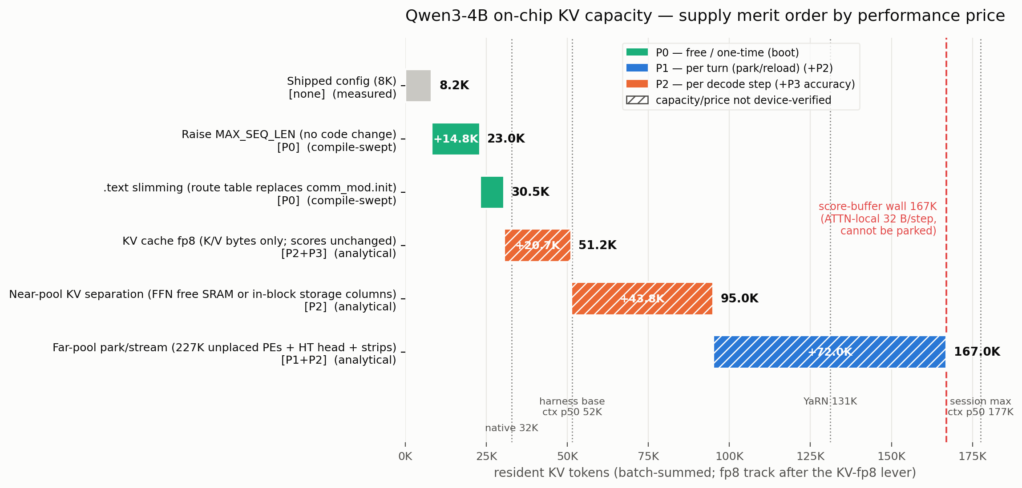
APPENDIX · F1
SRAM levers are not comparable by size — they are ranked by when the price is paid
A merit order of the KV-capacity levers: x is resident KV tokens, each block is a lever in price order, colour is when the cost is paid (P0 boot, P1 per turn, P2 per decode step, P3 accuracy), hatching means not device-verified, and the red line is the 167K score-buffer wall. Produced from machine-readable price cards written for the SRAM-performance exchange methodology. It settled that there is no single formula: prices in different currencies are comparable only under a stated workload profile. Analytical, built on compiled constants.
Notes:
Round 5. Sources: analyses/2026-09-02-sram-perf-exchange/ (levers.json) and docs/design/2026-09-02-sram-performance-exchange-methodology.md. No device job. Caveats the report attaches: unpriced levers stay hatched and are never assumed free; capacities are re-derived after every composition change; the per-step price of the near pool (95K) and far pool (167K) has never been measured. The 167K wall itself is the per-slot 32 B of softmax scratch that cannot be parked (Round 4).

Slide 18
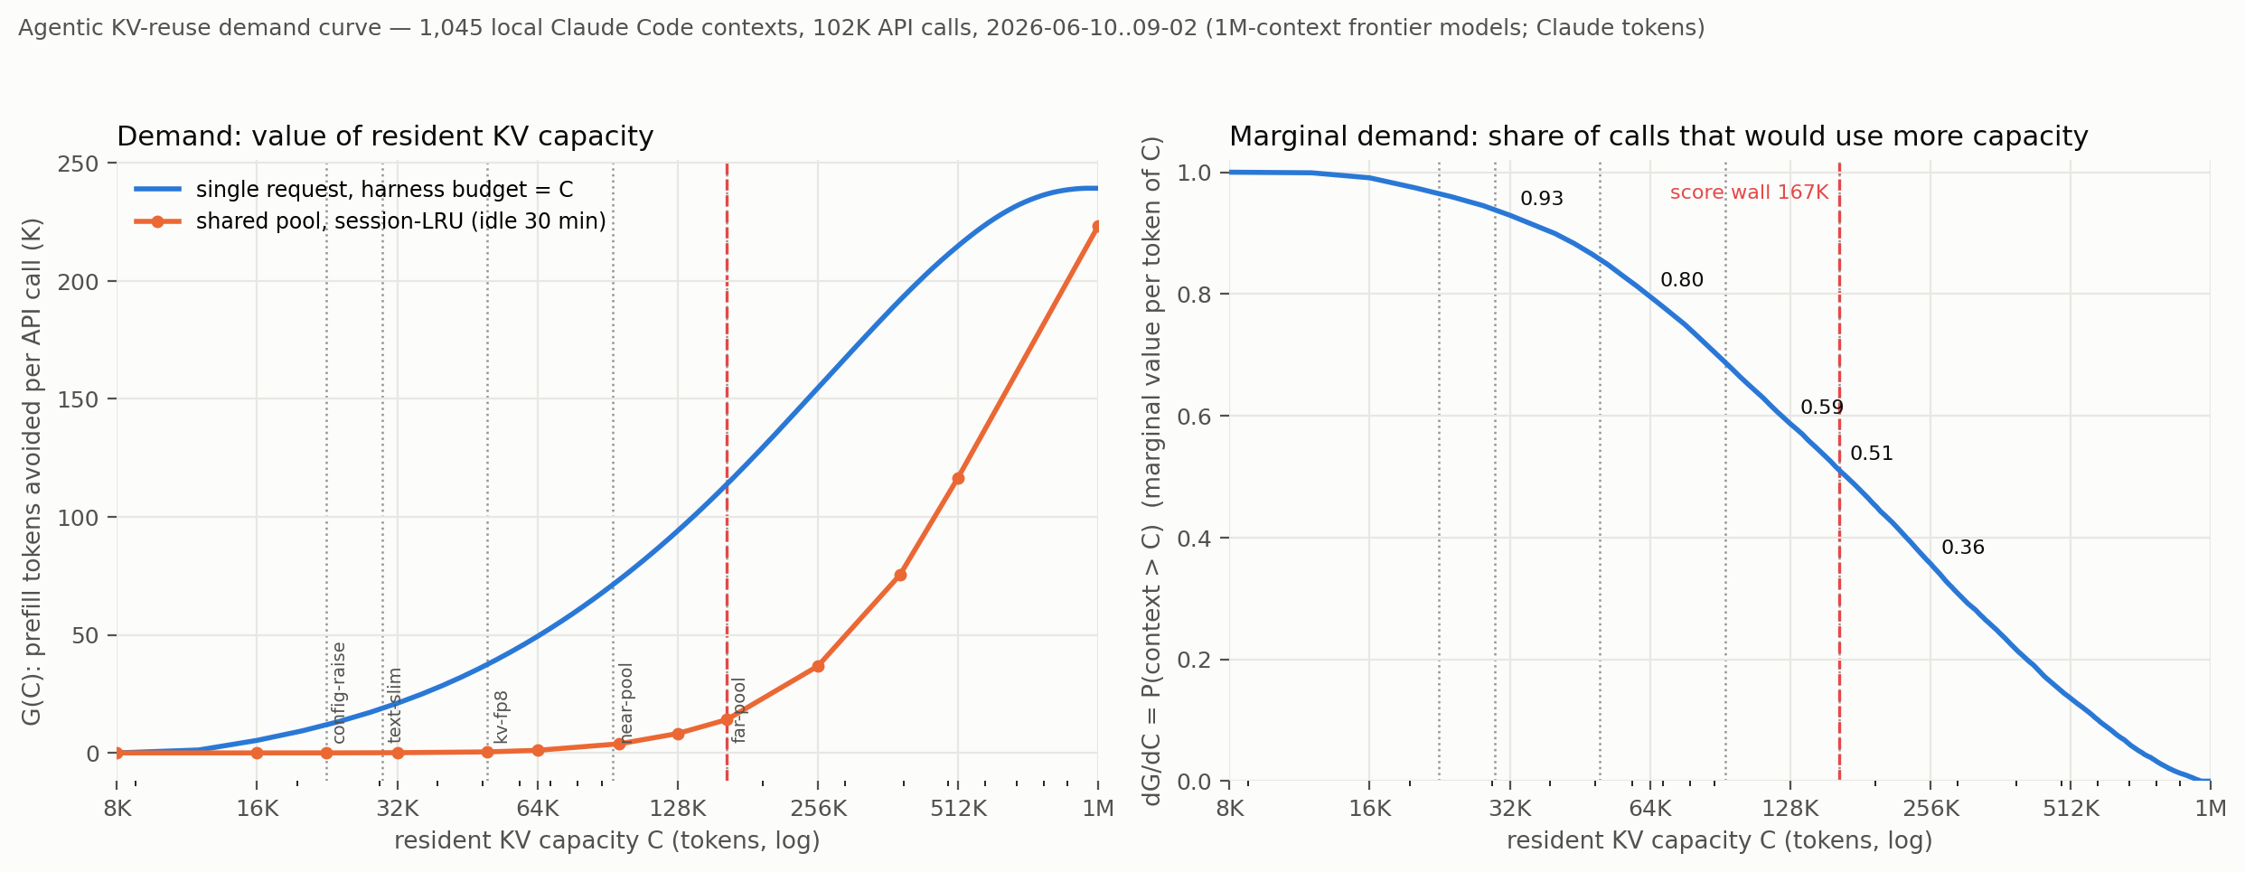
APPENDIX · F2
The first demand curve was wrong: calling an over-capacity session infeasible collapsed the shared-pool line
Version 1 of G(C), the prefill tokens avoided per call as a function of resident KV capacity C, replayed on 1,048 local Claude Code contexts. Its shared-pool line collapses below 256K, which is an artifact of declaring any session larger than C infeasible rather than a property of the workload. Kept for the record only; F3 is the corrected curve. Measured trace replay with an analytical residency model.
Notes:
Round 7; Le's correction. File lives in agent-memory (assets/2026-09-02-gc-demand-curve.png), not the repo. Two reasons not to quote numbers off it: the infeasibility rule, and the fact that the underlying trace was later found to contain 58,581 duplicate rows (Round 28). F3 is both re-ruled and regenerated.

Slide 19
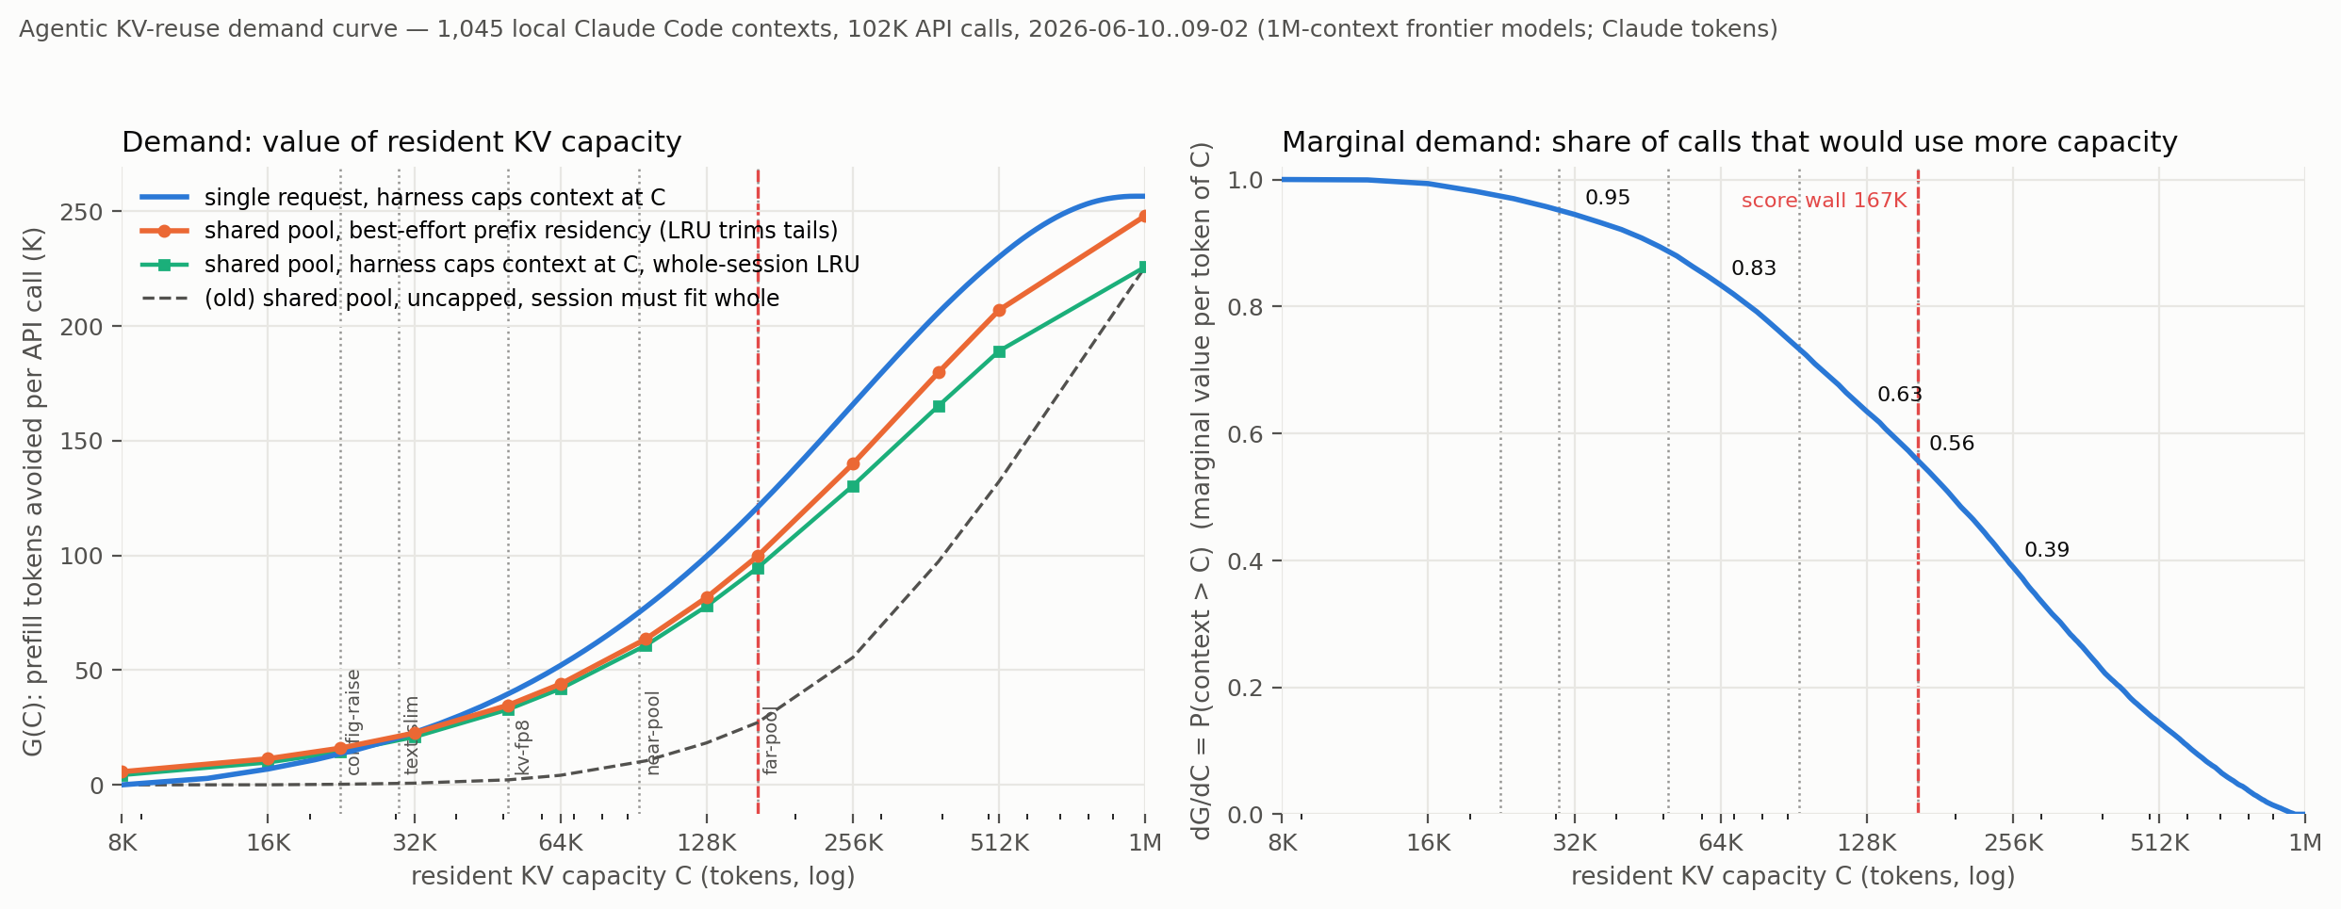
APPENDIX · F3
How much prefill a resident-KV capacity actually avoids, and what the next rung is worth
Version 2 replaces the infeasibility rule with best-effort prefix residency: an LRU trims tails and any missing prefix is recomputed, which lands the shared-pool line within 15-20% of the single-request curve. The marginal value of capacity is dG/dC = P(context > C) — 0.93 at 32K, 0.80 at 64K, 0.51 at 167K. Measured trace replay of 46,650 de-duplicated API calls.
Notes:
Round 7, regenerated after the Round 28 de-duplication. Script and data in analyses/2026-09-02-gc-trace-study/. Caveats: Claude tokenizer, one power user, one harness, one month; and per Round 35 these are frontier-model context depths (median 302K per call), so read the deep rungs as an upper bound on what a 4B deployment would need.

Slide 20
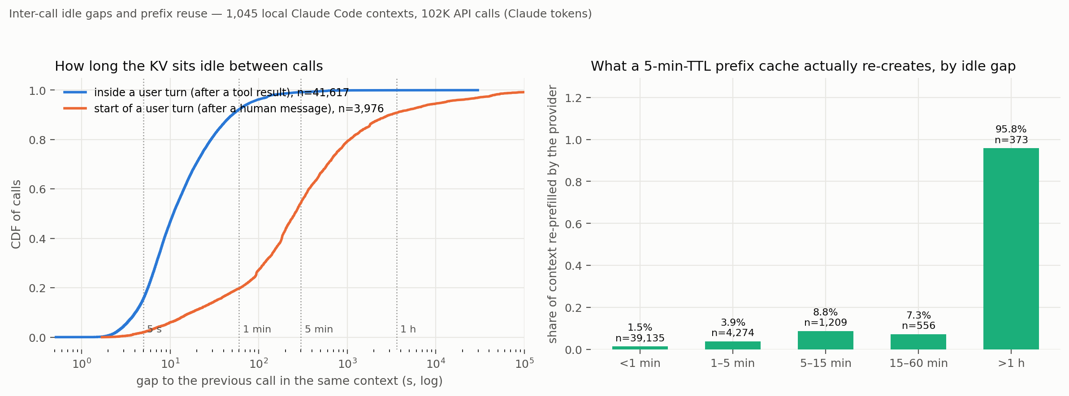
APPENDIX · F4
The provider keeps KV about an hour, and intra-turn gaps are 10.9 s — keeping across a turn is unconditionally right
Idle-gap distributions inside a turn and at turn starts, next to the share of context the provider re-created as a function of gap length. It re-created 3.7% of context for gaps under five minutes and 95.9% beyond an hour. Measured directly from the usage fields of 46,650 de-duplicated Claude Code API calls.
Notes:
Round 7, regenerated after Round 28 (the intra-turn gap p50 moved from 3.3 s to 10.9 s when duplicate streamed records were removed — which makes keeping more clearly right, not less). analyses/2026-09-02-gc-trace-study/. What it cannot price: turn-boundary contention, which needs a multi-tenant trace this study does not have.

Slide 21
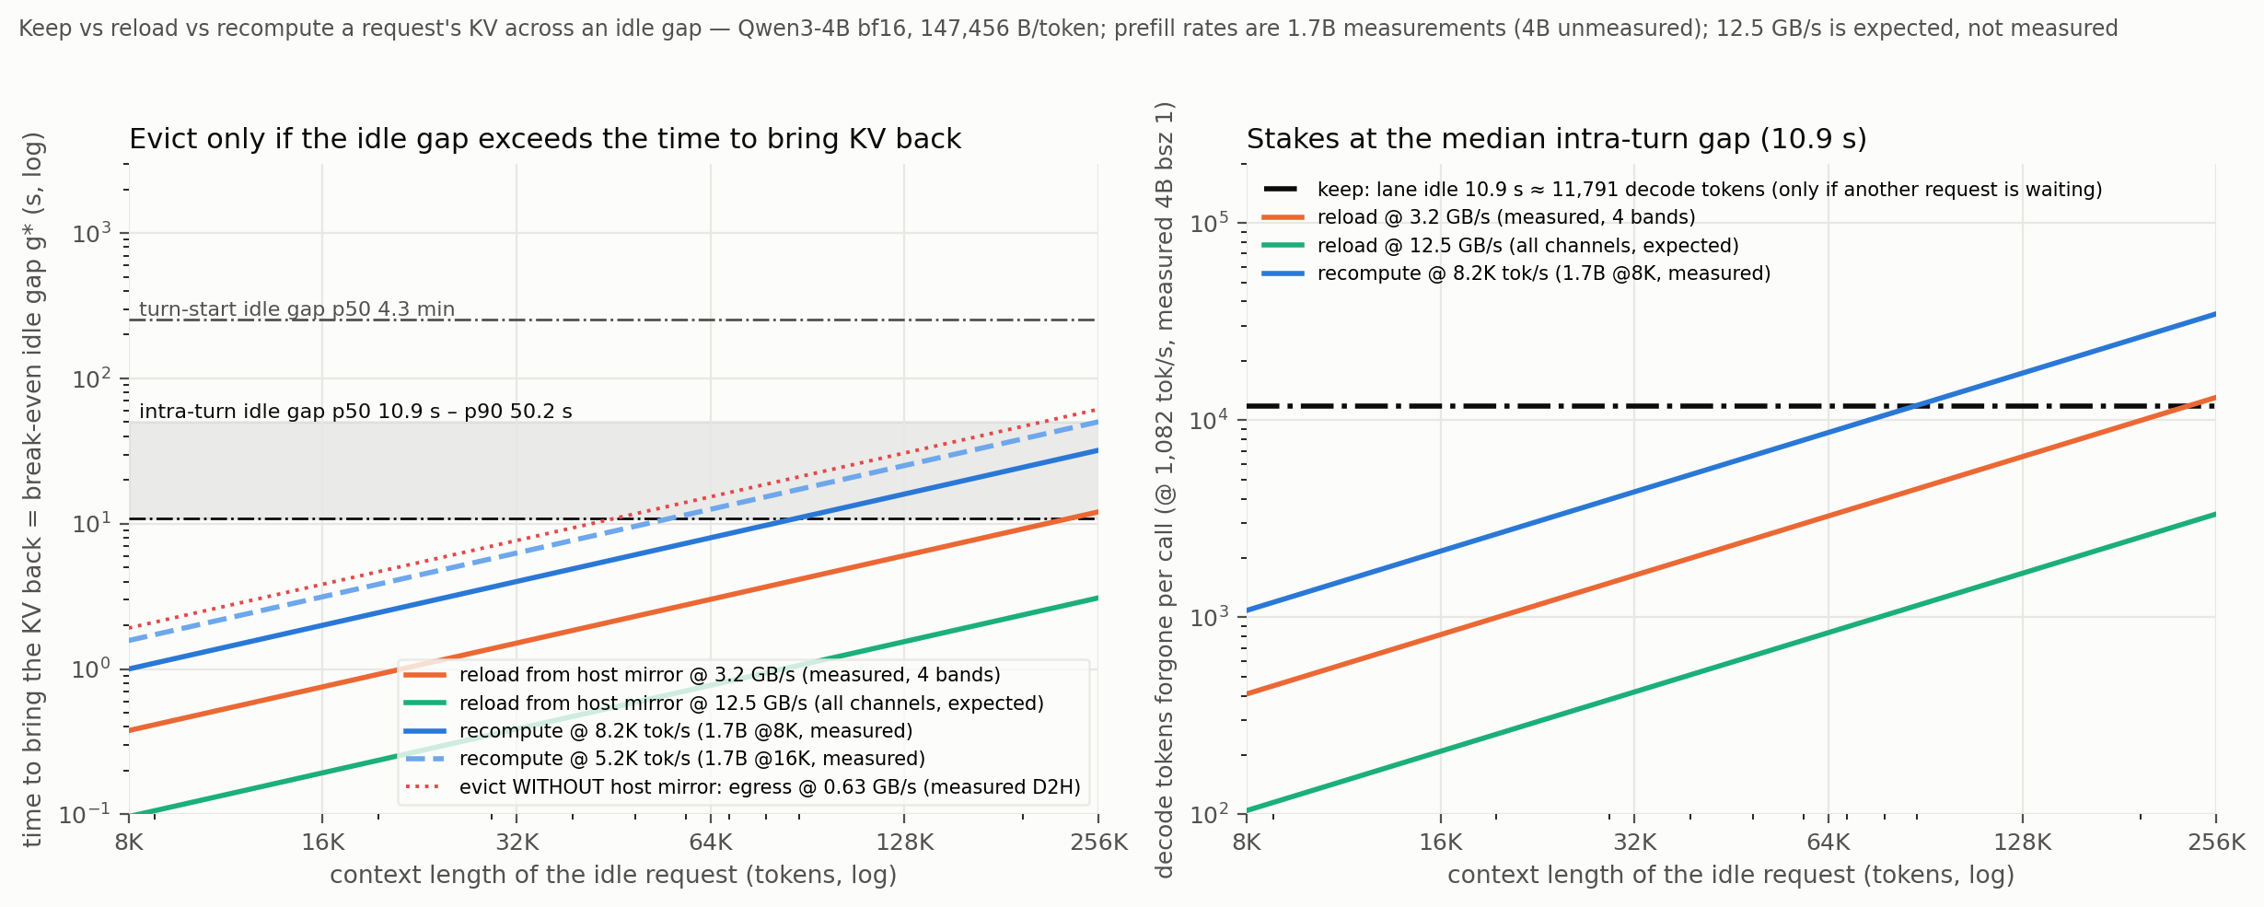
APPENDIX · F5
Recompute is never the right recovery above ~25K tokens; without a host mirror, eviction is the most expensive option
Break-even idle gap for the three recoveries — keep, reload, recompute — against context length. With a host mirror at the 12.5 GB/s design rate, reloading any context up to 256K takes less than the median intra-turn gap; without one, the measured 1.37-1.44 GB/s egress makes eviction the worst option. Decode tok/s cancels in keep-versus-reload: it sets the stakes, not the crossover. Measured gaps and measured link rates, modelled economics.
Notes:
Round 7. Link rates: host-to-wafer 3.2 GB/s and wafer-to-host 1.37-1.44 GB/s are measured; 12.5 GB/s is the design rate. The GPU-box to CS-3 leg has never been measured (Round 21 records the access problem), so the mirror's existence is the single unmeasured fact behind this figure.

Slide 22
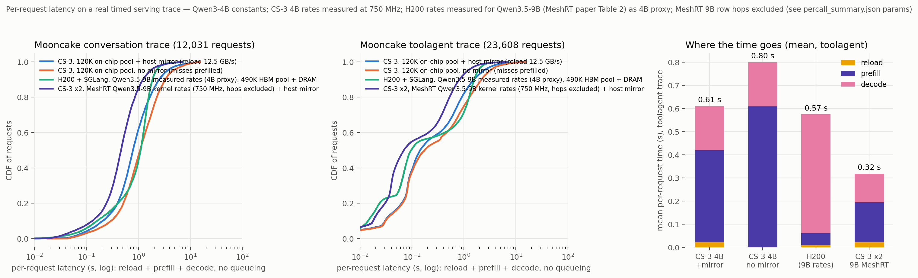
APPENDIX · F6
On a real serving trace the pool size is invisible — and with measured GPU rates one 4B wafer no longer wins per request
Per-request latency on the Mooncake FAST'25 conversation and toolagent traces under a 512-token block-LRU prefix cache. Cache hit rate is flat from 32K to 1M tokens and only reaches its infinite-cache value at 16-64M. The first pass had CS-3 about 2x faster per request; revised with measured H200 rates it loses on prefill-heavy requests, because the GPU's 8x faster prefill outweighs the wafer's faster decode. Measured trace, modelled single-stream latency.
Notes:
Rounds 8 and 11; analyses/2026-09-03-mooncake-trace-study/. Two caveats to say out loud: every GPU number here is an external H200 figure for a 9B from the MeshRT paper — no 4B GPU curve has ever been measured — and the CS-3 side of the model was computed at 750 MHz, so CS-3 latencies fall by 1/1.133 at 0.85 GHz while the GPU column does not move. Per-point cycle counts are not recoverable from the plotted latencies.

Slide 23
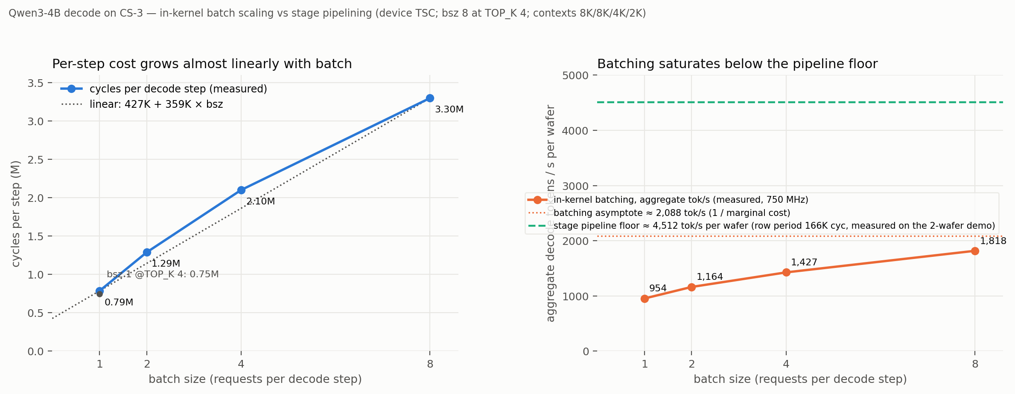
APPENDIX · F7
Batching alone saturates the wafer at ~2,370 tok/s; pipelining requests across stages is the better multiplier
Measured decode cycles per step at batch 1, 2, 4 and 8 on CS-3, fitted as 427K + 359K x bsz, plotted against the two-wafer demo's pipelined per-wafer period of 166K cycles. Because the batch-independent part is only ~0.43M cycles, in-kernel batching asymptotes at 0.85e9/359K = ~2,370 tok/s per wafer, while stage pipelining reaches ~5,120. Measured on-device TSC.
Notes:
Round 9. Jobs: wsjob-ety497nzzyactz9mnp8exh, wsjob-kehrtcp6jwvpdmkrhzqnsp, wsjob-ypfwbalxthvu6ckbzf7yuk, wsjob-jtyqqnkrmamhczfjwu3gto. The batch runs needed two experiment-only edits (SiLU scratch moved out of the D-cache; tail logits partials restructured) which live only in analyses/2026-09-03-cs3-4b-prefill-bsz/bsz_experiment.patch — the tracked kernel trees were never modified. Batch 16 does not link. The figure's tok/s axis was drawn at 750 MHz; multiply by 1.133.

Slide 24
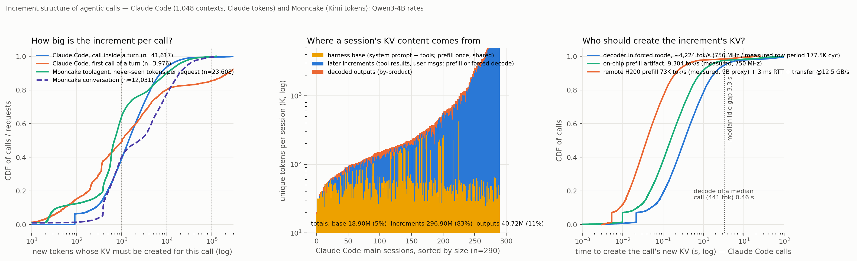
APPENDIX · F8
KV is 90-95% prefill-origin: the decoder's own output is a tenth of unique context, and tool results are the bulk
The increment structure of agentic calls — new tokens per call, what those tokens are, and where a session's unique context comes from. Decode by-products are 10% of unique context in Claude Code sessions and 4-5% in Mooncake; the harness base prefix is 2% of unique content but 27% of re-sent volume. Measured from trace usage fields.
Notes:
Round 11; regenerated after the Round 28 de-duplication, so read increments as p50 1.5K per call and p50 10.9K per turn (the pre-dedup figures were 1.9K and 24.7K). analyses/2026-09-02-gc-trace-study/. Attribution of the increment into tool results versus user text is harness-only information and exists for no other trace.

Slide 25
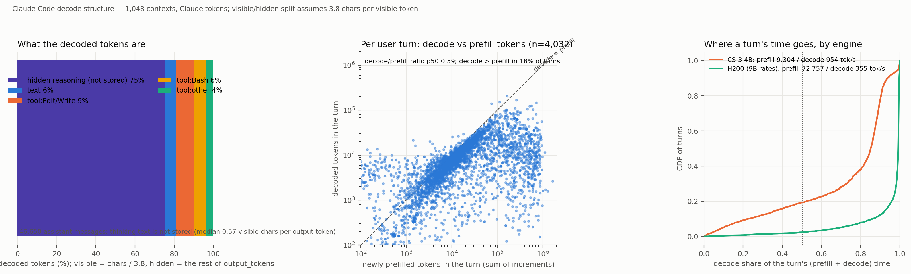
APPENDIX · F9
Three quarters of what an agentic model decodes is hidden reasoning — that is what makes the per-turn decode budget
Per-turn decode against per-turn prefill, and an attribution of decoded tokens: hidden reasoning 75%, visible text 5.9%, Edit/Write tool inputs 9.1%, Bash 6.0%, other tools 3.9%. Per turn the median is 5,838 decoded tokens against 10,917 newly prefilled, yet the turn is decode-bound in time on both engines because decode is 10-200x slower per token. Measured token counts; the visible/hidden split is estimated.
Notes:
Rounds 14 and 28 (regenerated post-dedup; the pre-dedup figures were 14.4K decode tokens per turn and an 89% hidden share). The hidden share rests on an assumed 3.8 characters per visible token, so it is +/-10 points, not exact. A reasoning-light agent would have a per-turn decode budget an order of magnitude smaller, which is the whole premise of the decode-heavy case.

Slide 26
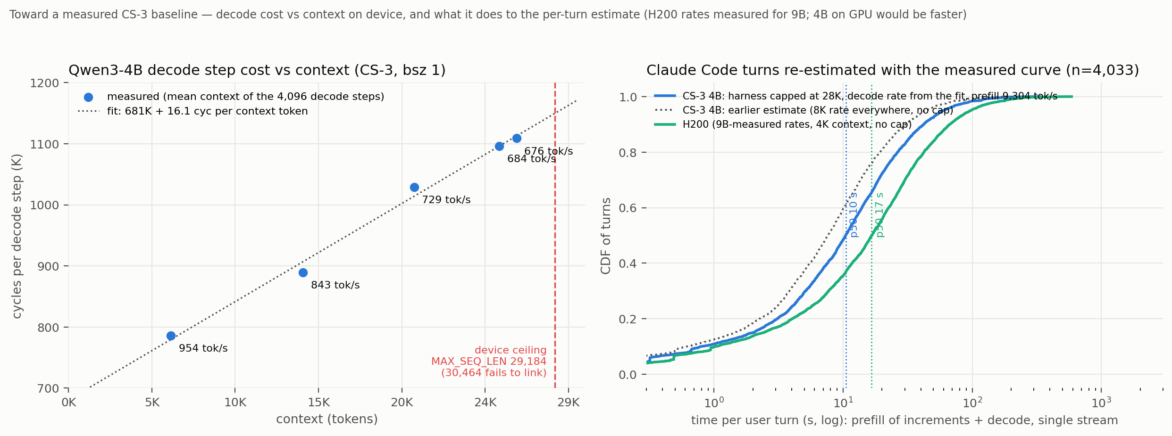
APPENDIX · F10
Decode cost is linear in context — 681K cycles plus 16.1 per context token — and the device ceiling is 29,184
Five device runs of the unmodified route-table 4B decode tree at batch 1 with host-ingested prefixes, 4,096 decode steps each, sweeping MAX_SEQ_LEN from 8,192 to 29,184. From 8K to 29K the step slows 41%; at the ceiling a step is 1,109,064 cycles = 766 tok/s at 0.85 GHz. The next setting, 30,464, fails to link on the appliance. Measured on-device TSC.
Notes:
Round 16; analyses/2026-09-04-4b-context-sweep/. Jobs: wsjob-amzrrqt78wnfxoxy9blpyq (8K reference), wsjob-ef9m7k5abo3xmpxkx2ox7q, wsjob-ldhubkgfqptdu82pg3l3vi, wsjob-pkugixotaderkrvmydmsui, wsjob-5faj77vfj547buzddc4mvb, plus wsjob-bja2eqjp3zgiv469n7tnbp for the link failure. The figure's tok/s axis is at 750 MHz (954/843/729/684/676); at 0.85 GHz they are 1,082/956/826/776/766. Later caveat: 29,184 was measured on an earlier tree — the current B-prime lineage compiles A only to 26,112, and the unpatched control fails identically, so the lineage added footprint somewhere (Round 118).

Slide 27
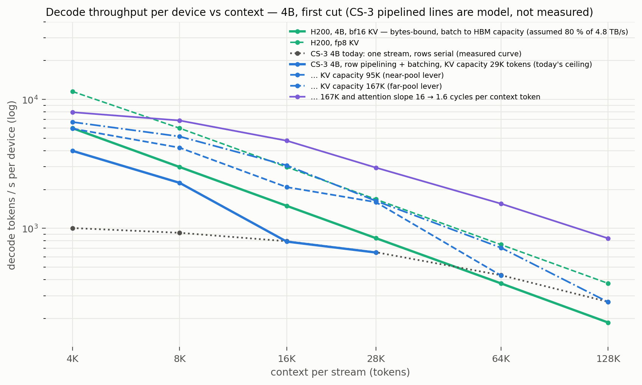
APPENDIX · F11
Both engines fall as 1/context — and per dollar the GPU keeps a 15-60x margin under every lever set
Modelled decode throughput per device against context. The GPU side is bytes-bound (weights plus every stream's KV per step, batched to HBM capacity at 80% of 4.8 TB/s); the CS-3 side uses the measured step laws with row pipelining and batching assumed, and caps the number of streams by on-chip KV capacity. Per device the wafer ends between 0.8x (today) and 3.5x (every lever) an H200. Modelled on measured inputs, not measured.
Notes:
Round 24; analyses/2026-09-04-throughput-vs-context/. First cut only; the verdict it supports is that serving price is not where a 4B on CS-3 wins, and that its value stays per-turn latency at large reasoning budgets. Caveats: every GPU number is an external 9B figure, no 4B GPU curve exists, and the CS-3 columns were computed at 750 MHz (multiply by 1.133 at 0.85 GHz) while the GPU columns do not move. Per-point cycle counts are not recoverable from the plotted rates.

Slide 28
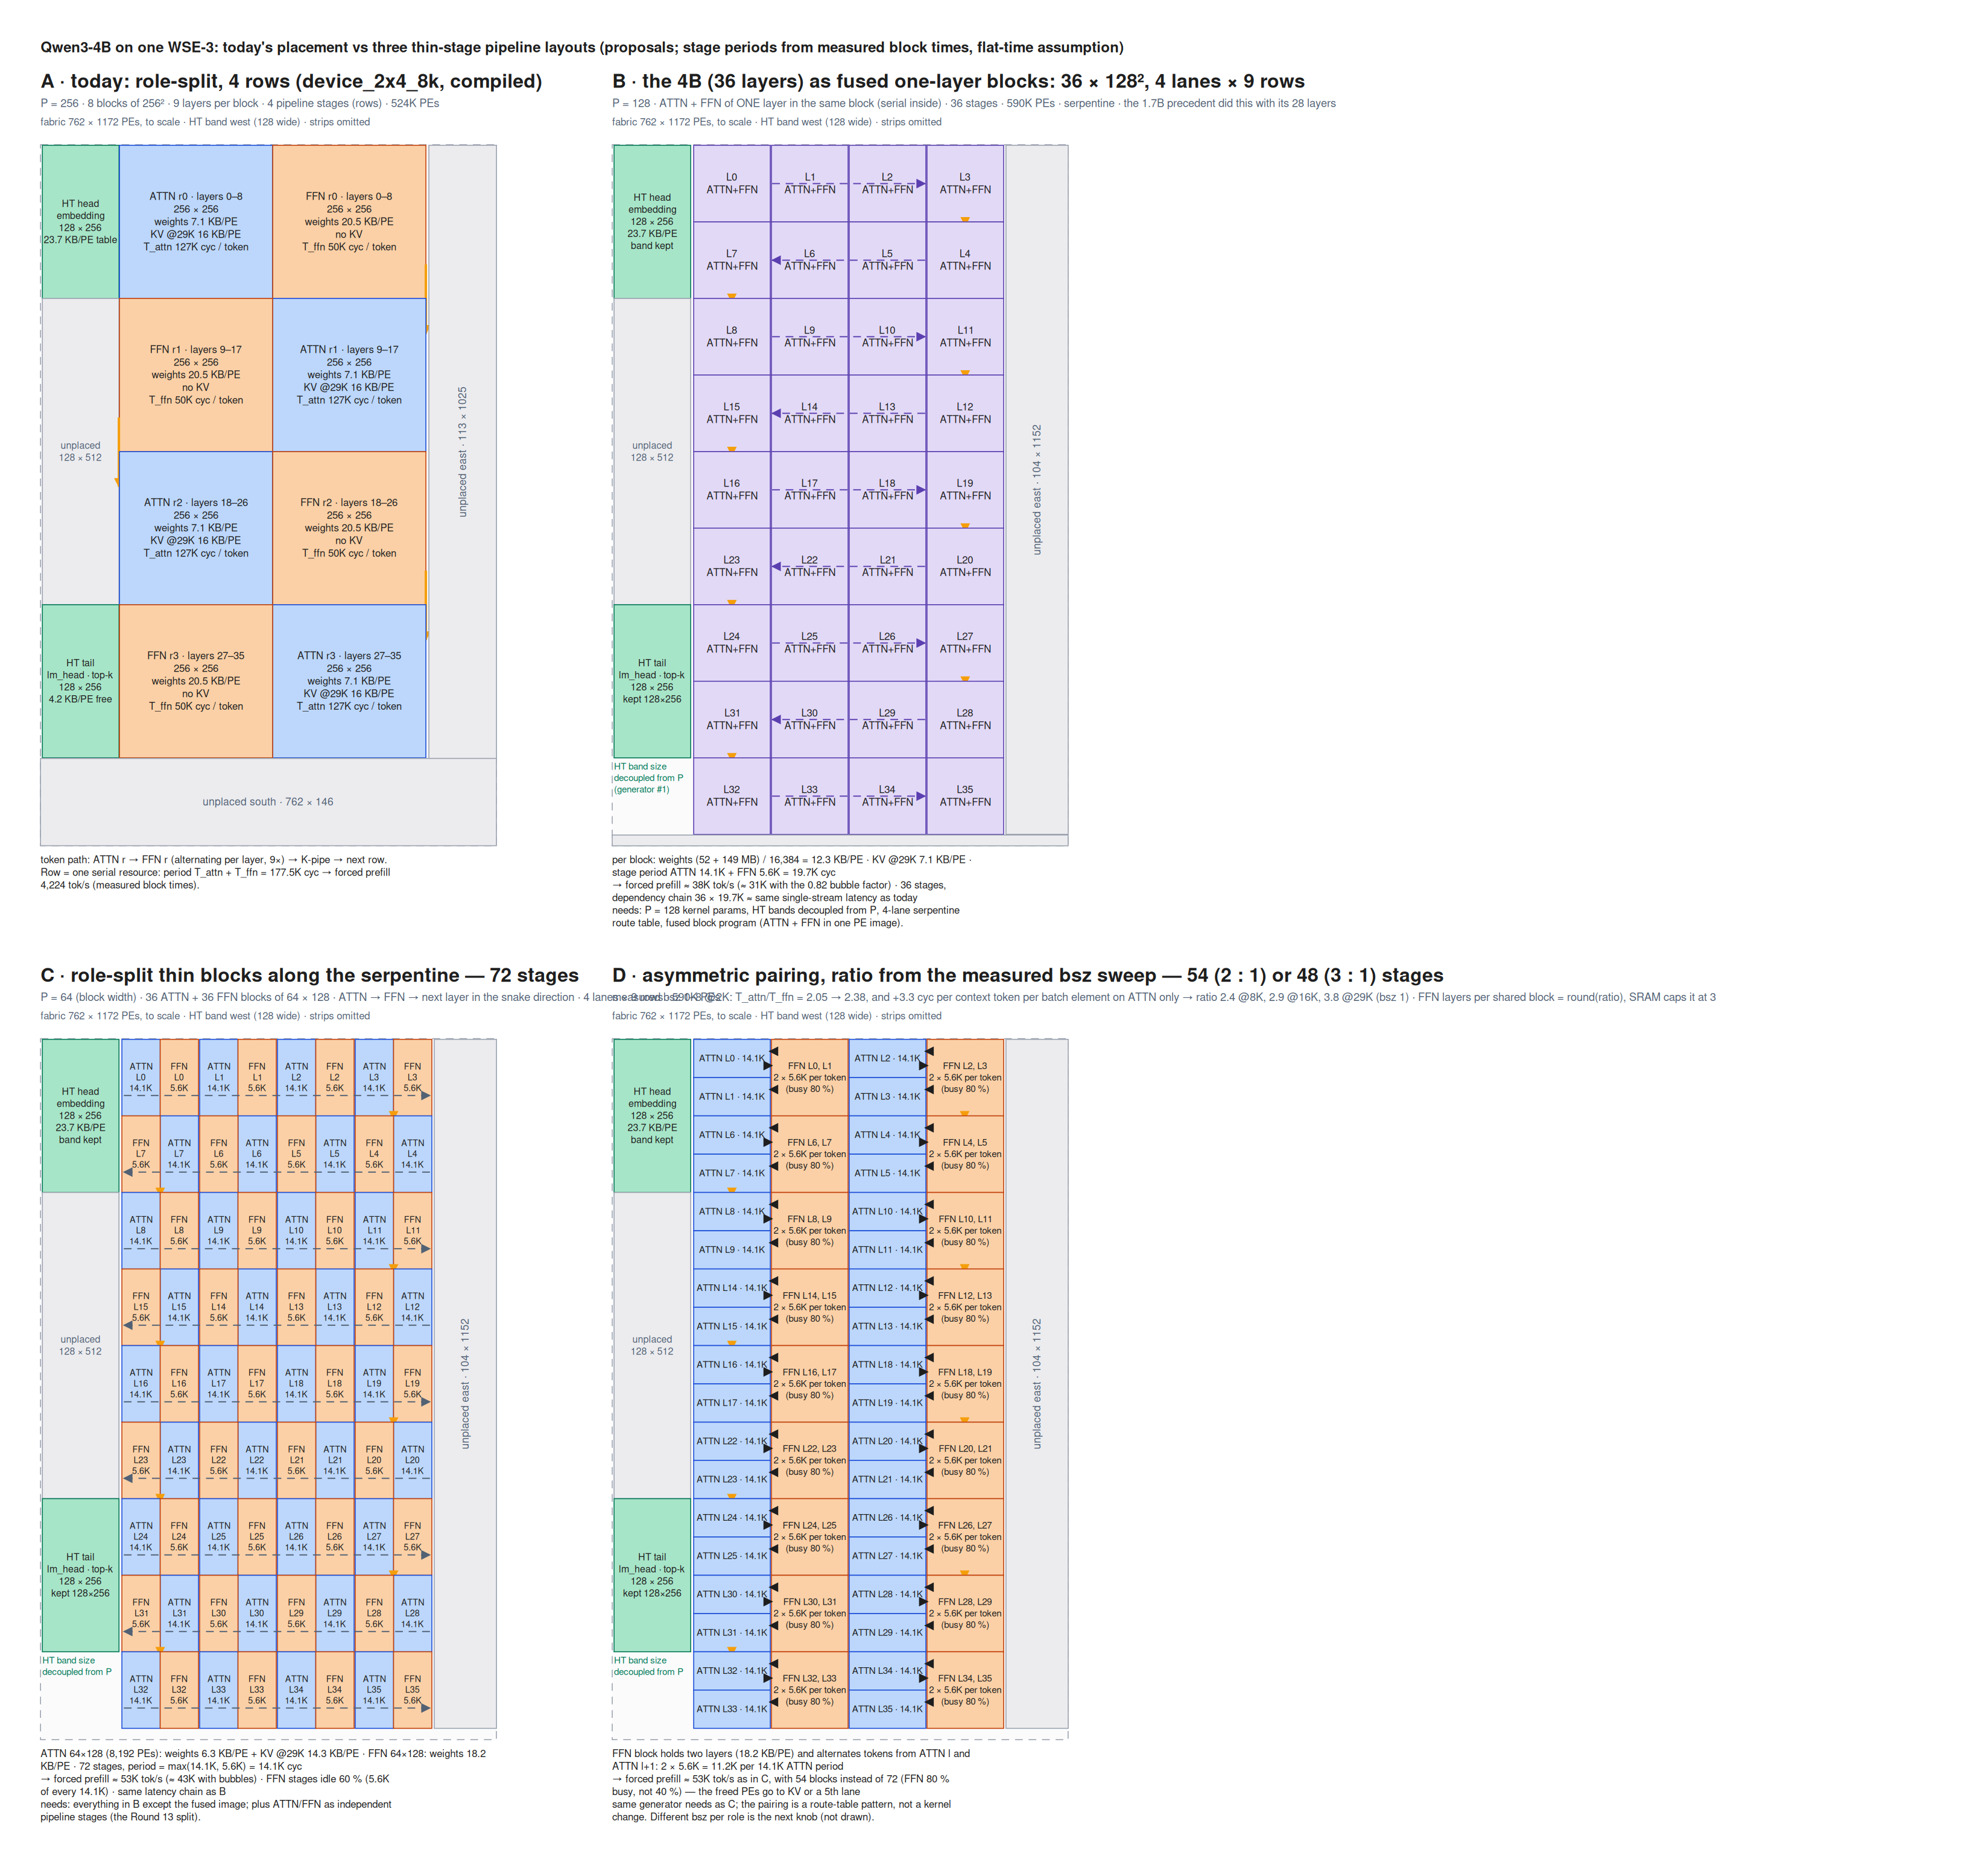
APPENDIX · F12
Four ways to cut the model into pipeline stages — and the three that were never built
On-chip layouts: A is today's four rows of 256-square blocks with nine layers each; B fuses ATTN and FFN into one-layer 128-square blocks (36 stages); C splits the roles into thin 128x64 blocks (72 stages); D pairs one two-layer FFN block with two ATTN blocks (54 stages). The B/C/D throughputs on this figure are analytical, resting on the assumption that per-layer time stays flat as a block shrinks. Design figure.
Notes:
Rounds 24-26. Only A was measured when this was drawn. B, C and D were never built: the ladder that was actually built and measured is the height ladder (A, L=4, L=2, L=1 on 256-wide blocks of falling height, Rounds 77-86). Do not carry the label 'L = 4 is P = 128 on one lane' — 128-square blocks are the L = 2 rung, and only one lane of 256-wide blocks fits the fabric (Rounds 63, 77). Layout B's context ceiling was hand accounting and was never compiled; the fused 4B image has never been assembled.

Slide 29
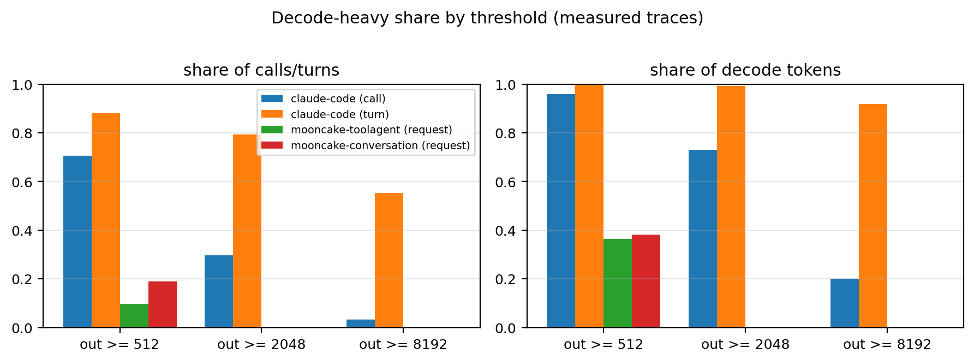
APPENDIX · F13
71% of agentic calls decode at least 512 tokens, and those calls carry 96% of all decode tokens
Decode-heavy classes by output tokens, per call and per turn, on both traces. Calls above 8K output are only 3.1% of calls but 55% of turns and 92% of per-turn decode tokens. Mooncake has no request above 2K output at all. Measured on 32,378 de-duplicated Claude Code main-thread calls and 35,639 Mooncake requests.
Notes:
Round 27, subagent decoder-lever-value; analyses/2026-09-05-decoder-lever-value/ and docs/analysis/2026-09-05-decoder-only-lever-value.md. Caveat the report attaches: Mooncake's two traces share one synthesized long-output sample, so decode-length conditioning there is approximate.

Slide 30
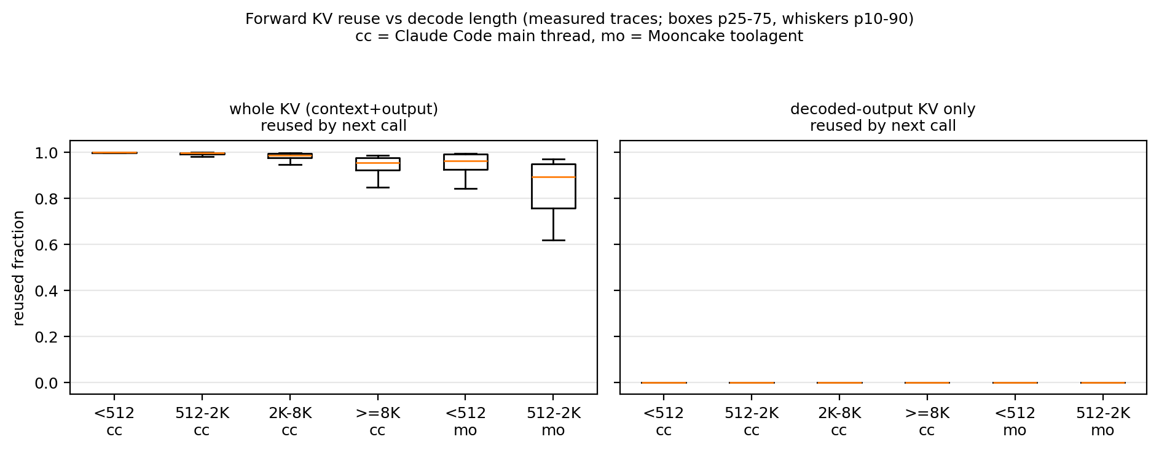
APPENDIX · F14
A decode-heavy call's KV is re-read: 99% of calls have a successor re-reading at least 95% of it
Forward KV reuse by the next call, conditioned on decode length. The median reuse fraction is 0.999 for calls under 512 output tokens and still 0.954 for calls above 8K, with a median gap of 10-18 s. On Mooncake only 37% of decode-heavy requests ever get a next turn, at a median gap of 159 s. Measured trace replay.
Notes:
Round 27. This is the half of Le's worry that turned out wrong — decode-heavy calls do have reusable KV on the agentic trace. The half that was right is F15: what is reused is the input context, never the decode's own product. Multi-tenant odds are much poorer, which is the Mooncake row.

Slide 31
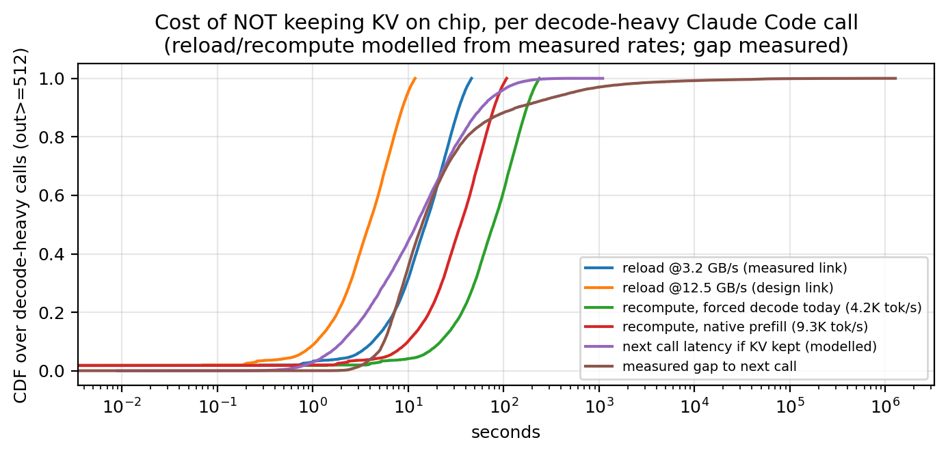
APPENDIX · F15
Not keeping the context costs a median 13.9 s reload — 61% of the next call's latency
Value of keeping KV on chip per call: reload time avoided, recompute time avoided, and the idle gap it has to fit inside. At the measured 3.2 GB/s link a median reload is 13.9 s and 49% of reloads exceed the gap; at the 12.5 GB/s design link it is 3.6 s and 28%. Keeping the decode's own output KV is worth only 0.003-0.13 s per call, because thinking is stripped before the next call. Measured reuse and gaps, modelled at measured link rates.
Notes:
Round 27. The comparison assumes reload at the full link rate with no overlap, and applies the visible-output share uniformly. The recompute alternative is priced at the forced-prefill rates of the time; with the rates now measured (up to 47,831 tok/s at L = 1) recompute is a much stronger substitute for keeping than this figure shows.

Slide 32
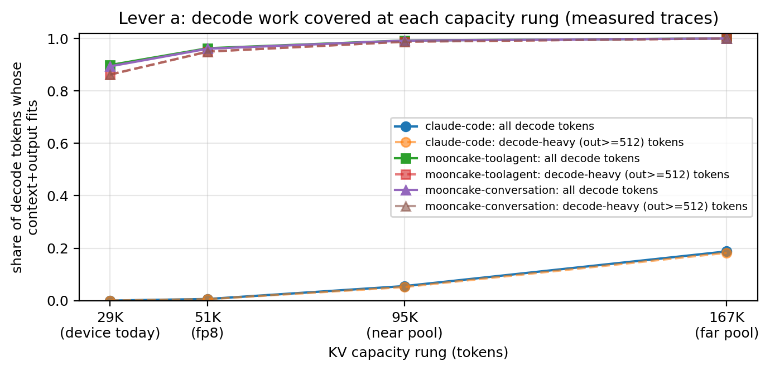
APPENDIX · F16
Today's 29K fits 0.04% of agentic calls; even the 167K far pool covers only 19% of decode tokens
Share of decode work covered at each KV-capacity rung — 29K measured on device, 51K with fp8 KV, 95K near pool, 167K far pool. The median agentic call context is 309K tokens (p90 715K), so capacity is binding and still about 2x short of the median. For Mooncake-class traffic the picture inverts: 90% of decode work already fits 29K. Measured contexts against analytical capacity rungs.
Notes:
Round 27. Round 35's caveat travels with this figure: the 300K+ contexts exist because the harness was driving frontier Claude models, and a 4B-class deployment would carry a leaner base prompt and compact far earlier — so read these coverage shares as an upper bound on what a 4B needs, and ServeGen (F20) as the closer proxy.

Slide 33
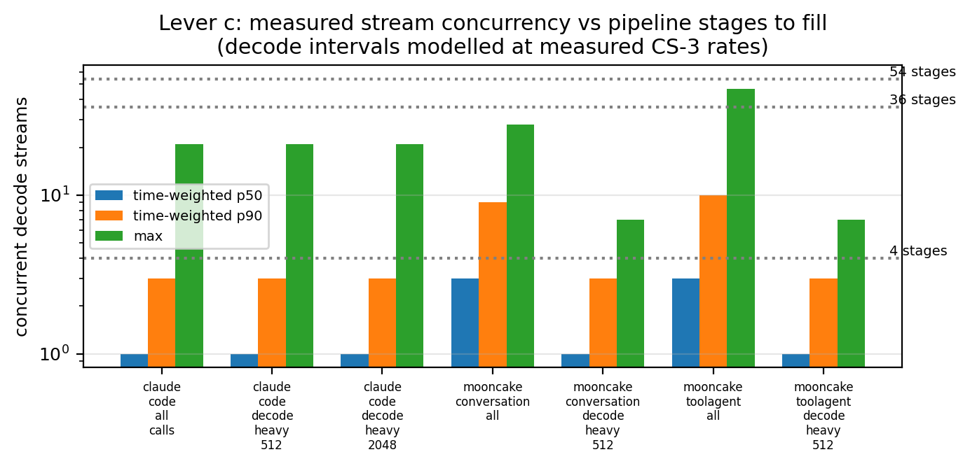
APPENDIX · F17
Decode-stream concurrency is 1 at the median on both traces — filling 36 or 54 stages is an operator question
Concurrency of decode-heavy streams over time against the pipeline stage counts under consideration (4, 36, 54). Four stages fill in bursts; 36 and 54 never fill on either trace, with a maximum of 7 concurrent decode-heavy streams on Mooncake. Measured from trace timestamps.
Notes:
Round 27. The follow-on arithmetic (Round 29) is the useful part: at a 1% per-session duty cycle, filling S decode-heavy stages needs roughly 12 x S users mid-turn — about 50 users for 4 stages and 700 for 54. That is an operator-scale number, never a single box, and it is why pipelining is filed as a multi-tenant question rather than a lever this trace can price.

Slide 34
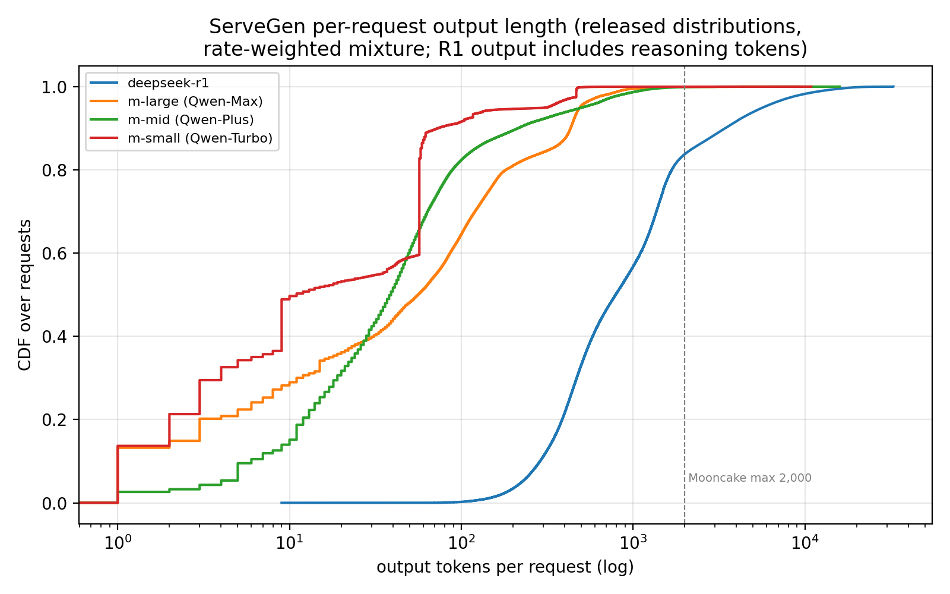
APPENDIX · F18
A multi-tenant reasoning platform's per-request output is almost exactly an agentic per-call output
Output-length CDFs from the ServeGen release (Alibaba Cloud Model Studio production, NSDI'26), DeepSeek-R1 including reasoning tokens against the language models. R1's per-request output is p50 792, p90 3,432, max 32,768, with a bimodal reason ratio (0.38 / 0.9, mean 0.70) — statistically the same shape as Claude Code's p50 763 per call. Measured on the released distributions.
Notes:
Round 31, subagent servegen-trace-study; analyses/2026-09-05-servegen-trace-study/ with provenance.txt (clone commit d70c8b2d) and the field-semantics quotes that settle whether output length includes reasoning. Caveat: the five model-level datasets are fitted per-client marginals only — no per-request records and no joint input/output distribution — and length mixtures are rate-weighted over released client windows, which are a subset of production.

Slide 35
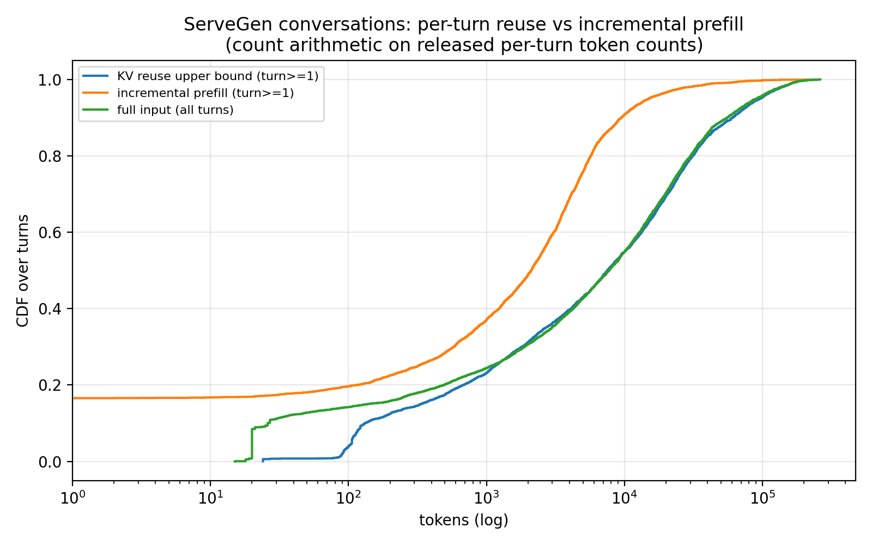
APPENDIX · F19
This platform re-sends the reasoning: 83.4% of turn pairs grow by at least the previous full output
Per-turn reuse length and incremental prefill across 1,616 ServeGen conversations (5,720 turns, a 24-hour window in February 2025), computed by count arithmetic on input and output token counts without any harness information. Reuse is p50 7,498 tokens (82% token-weighted) and the incremental prefill is p50 2,107. The 83.4% result is the opposite of Claude Code, where thinking is stripped and only ~5% of decoded tokens re-enter context. Measured, with reuse as an upper bound.
Notes:
Round 31. Reuse is an upper bound under a verbatim-history assumption (13.6% of pairs are partial, 3% shrink). The 1,616 conversations are an unstated selection of 57,205 and their model is unstated. Token units are each source model's tokenizer and were not rescaled. This is a platform choice, not a law — which is exactly why it decides whether decoded KV is worth keeping.

Slide 36
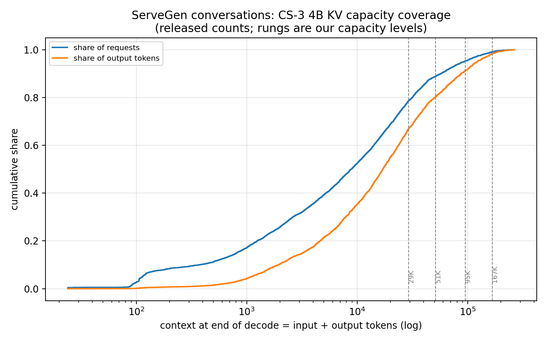
APPENDIX · F20
For multi-tenant reasoning traffic 29K already covers two thirds of the decode work
Share of ServeGen requests and of output tokens that fit each KV-capacity rung. 29K holds 78% of requests and 67% of output tokens; 167K holds 99% and 98%. Context sits where Mooncake's does (input p50 7.7K) rather than at Claude Code's 300K, so the 29K and 51K rungs are far more useful on multi-tenant reasoning traffic than on our own trace. Measured on the released conversation file.
Notes:
Round 31. The headline the report draws from F18 plus F20: reasoning-era traffic is decode-heavy but not deep-context, and this platform keeps the reasoning in context, which makes decoded KV reusable there in a way it is not on the agentic trace. Concurrency on the released 16 req/s slice is derived by Little's law, not measured, and ignores queueing and burstiness.

Slide 37
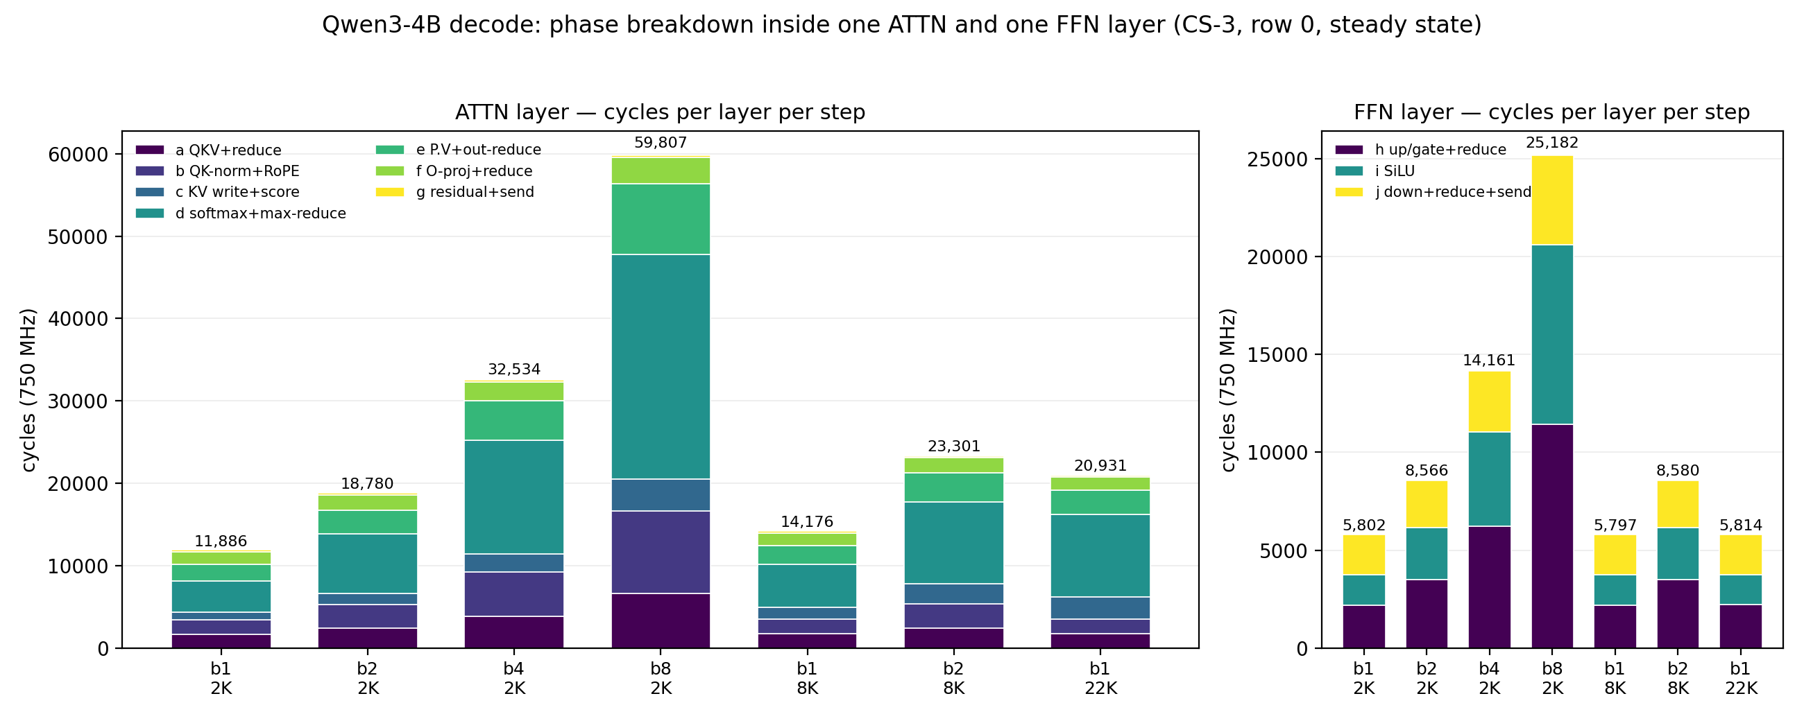
APPENDIX · F21
Softmax is the largest phase everywhere and carries 69% of the whole context slope
Phase-level breakdown inside one ATTN and one FFN layer against batch and context, stamped by an on-device TSC probe on today's 256-square blocks across seven configurations. Softmax carries 0.303 of the 0.439 cycles per context token per layer and 49% of the batch slope; the three KV-walking phases together give 15.8 cycles per context token per step over 36 layers, independently reproducing the context sweep's 16.07. The FFN layer is flat in context (5,802 / 5,797 / 5,814 cycles at 2K / 8K / 23K). Measured device TSC.
Notes:
Round 45, subagent 4b-block-tsc; analyses/2026-09-05-4b-phase-tsc/ with phase-tsc.patch and the stage-cut table. All four byte-identity gates pass against existing unprobed references; probe overhead +0.02% to +0.11%; sum of phases equals layer busy on every run. Caveats: 29K could not be probed at all (the ATTN PE has 960 B free with no probe), so the long-context point is 23K; only row 0 is instrumented; the SiLU phase is measured out of the D-cache and reads about 10% high.

Slide 38
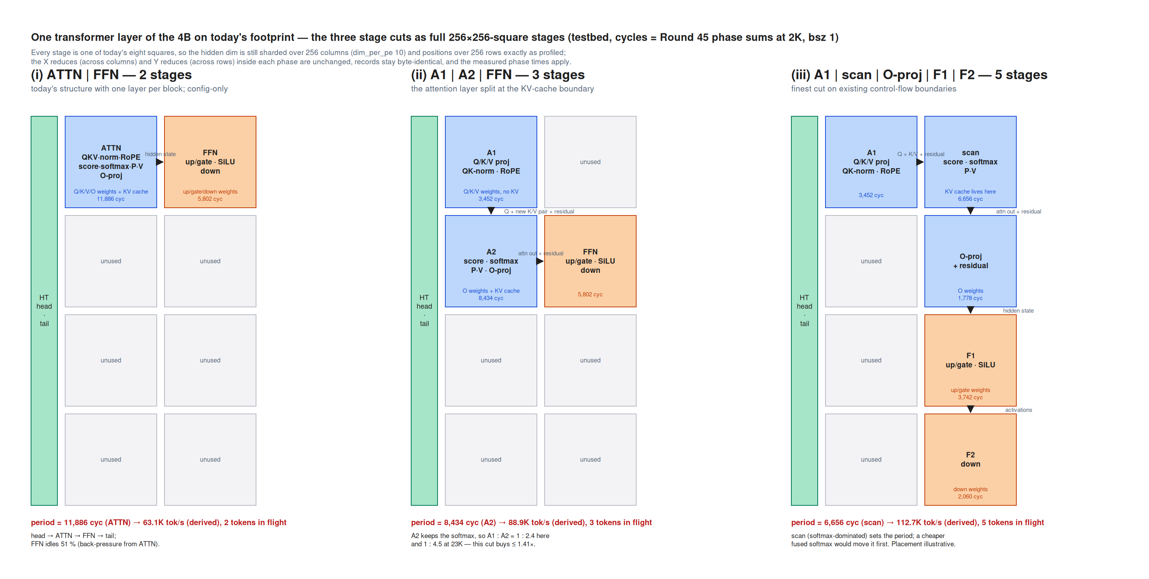
APPENDIX · F22
The three ways to cut a layer into stages: which phases go to which stage
The one-layer testbed's three cuts drawn as full 256-square blocks on today's footprint, with the real hand-offs and the periods derived from the measured phase sums: cut (i) ATTN | FFN (2 stages), cut (ii) A1 | A2 | FFN (3), cut (iii) A1 | scan | O-proj | F1 | F2 (5). Topology sketch; the derived periods come from measured phases, the areas do not mean anything.
Notes:
Round 46. Read this as 'which phases go to which stage', never as the area each stage gets — Le's Round 47 correction was that a full square per stage gives cut (iii) five squares and cut (i) two for the same computation, which is not a comparison. The decision metric is tokens/s per PE at equal area, which is what the B-prime equal-area testbed was built for.

Slide 39
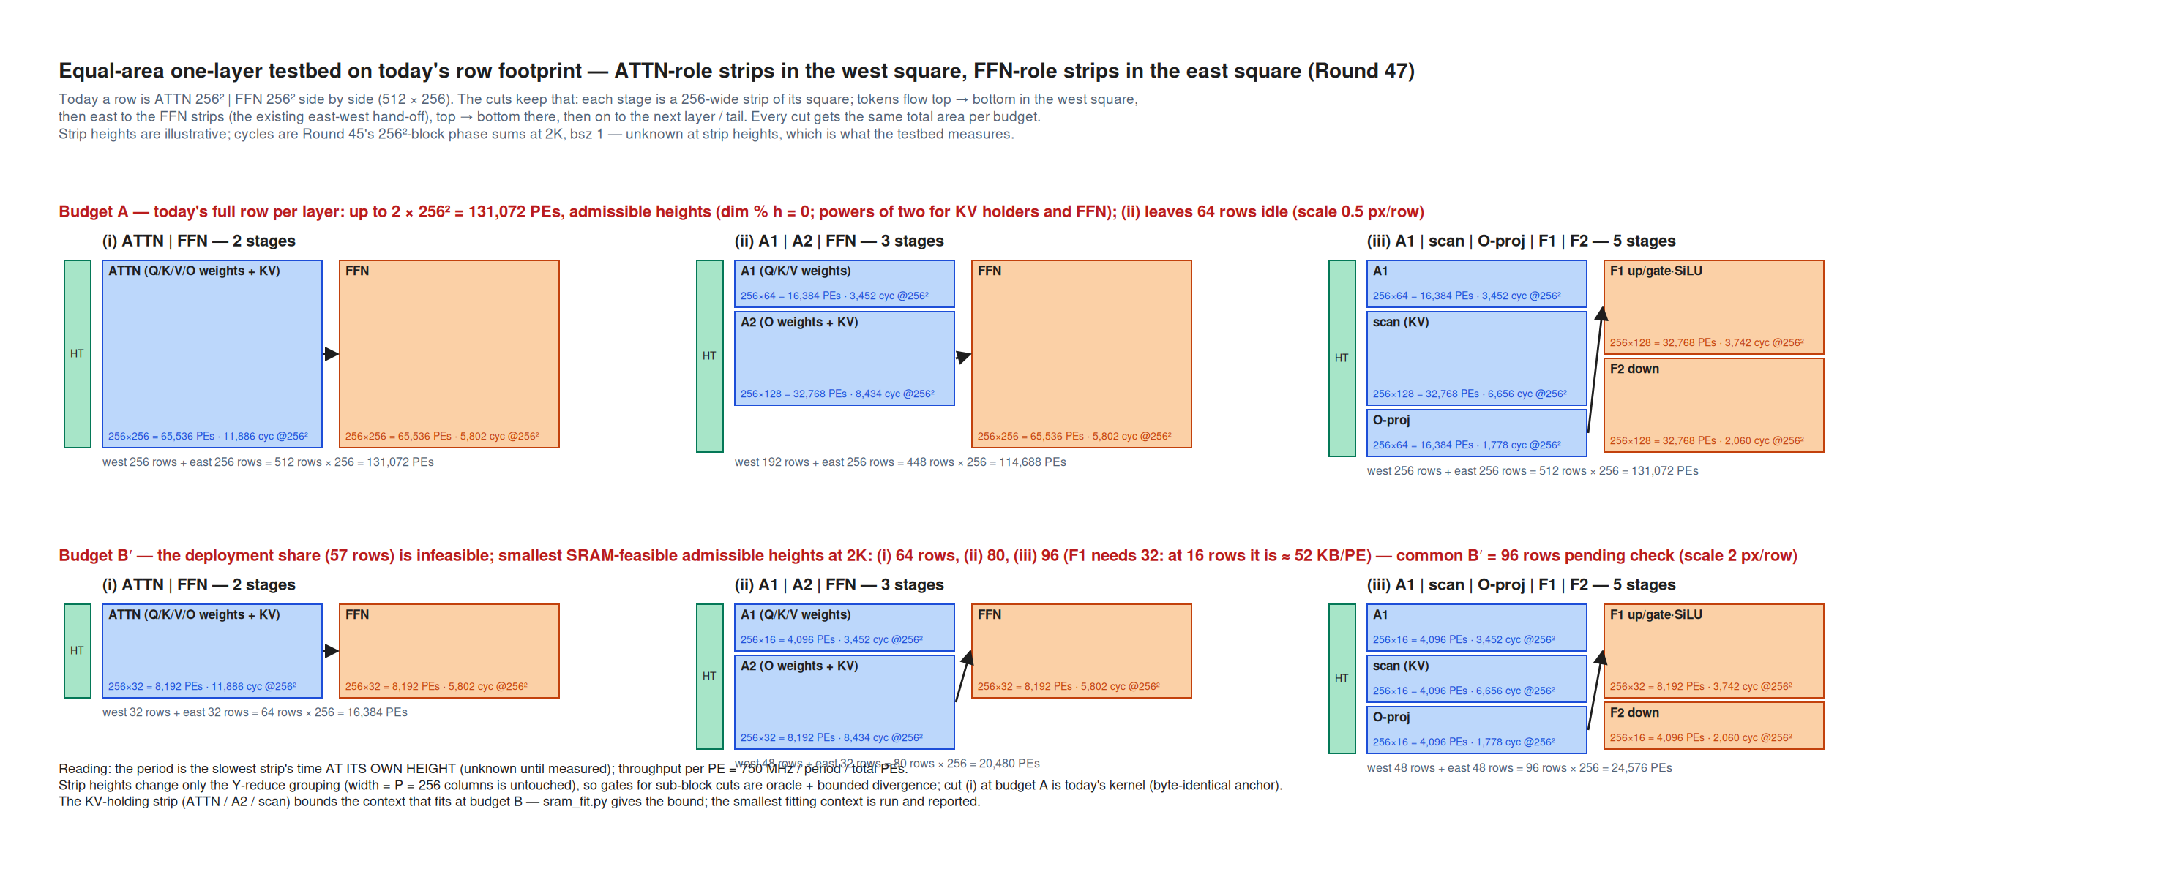
APPENDIX · F23
Comparing cuts needs equal active area — and the strip heights drawn here were wrong in five of six setups
The equal-area testbed on today's side-by-side row, attention-role strips west and FFN-role strips east, with each cut drawn at budget A (a full row) and budget B (a layer's real deployment share, about 57 rows). The heights in this drawing are illustrative and Round 52 checked all six setups: only A-(i) is feasible as drawn. Every other setup violates height admissibility (a strip needs dim % h = 0, and KV holders and FFN strips need a power of two) or overflows SRAM. Design figure, superseded in detail.
Notes:
Rounds 47 and 52. Superseded further by compiled numbers (Round 59): height 16 does not compile at all because the K-cache DSD stride is a signed 8-bit field capping positions per PE at 127, and cut (i) at 32 | 32 = 64 rows is SRAM-clean by compiled fact. Budget B at 57 rows is infeasible for every cut. Keep the figure for the framing — equal area, strips of a row — and do not read the heights off it.

Slide 40
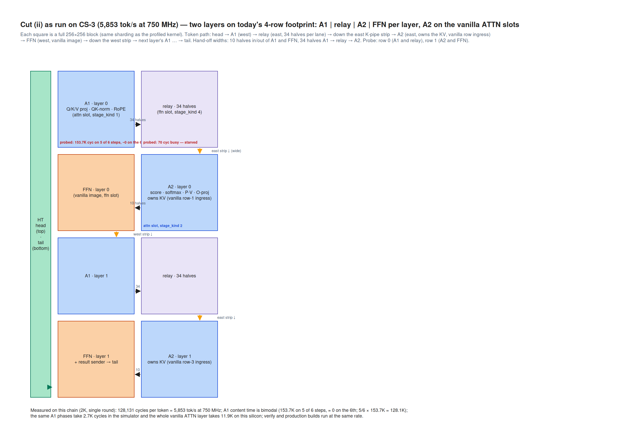
APPENDIX · F24
The chain that actually ran on silicon for cut (ii) — and where the A1 stall showed up
Cut (ii) as run on CS-3: today's four-row, two-square footprint with two layers laid out as A1 -> relay -> A2 -> FFN, the probe on row 0 and row 1. Faithful to the run's own placement plan. On device the chain is functionally correct — the restated oracle gate passes with zero defects over 1,000 steps — but it runs at 128,131 cycles per token against a derived 8,434, because A1 stalls on five of every six steps. Measured on device.
Notes:
Rounds 55-56. Baseline job wsjob-j33adkcfd8trw5xofupqwa; attribution job C2Q_2K; per-stage compiled SRAM A1 15.6 KB, relay 7.0, A2 14.9, FFN 11.8 of 48. Do not carry the queue-7 boot-rebind explanation: it was falsified by a controlled job that bound queue 7 at compile time and changed 128,131 to 128,139. The one step in six where the stall skips runs at 8,368 cycles, within 0.8% of the derived 8,434 — the pipeline is right and only the stall stands between it and 100K tok/s.

Slide 41
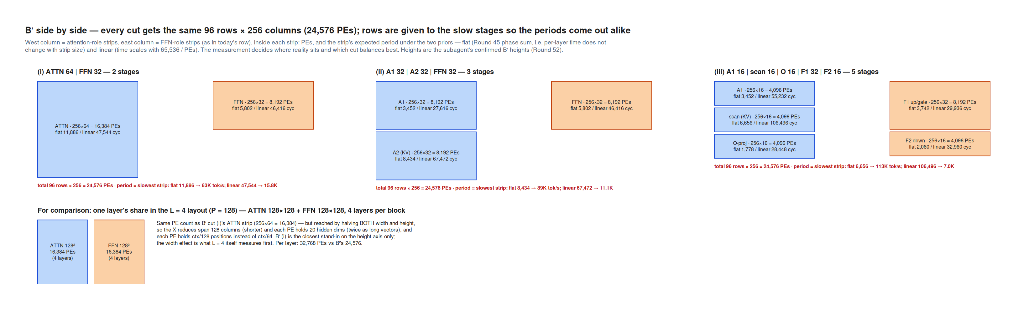
APPENDIX · F25
The equal-area testbed as drawn — superseded before it ever ran
The three cuts side by side at a common 96-row budget with strip heights chosen to balance the stages under the linear prior, plus a 128-square pair drawn for comparison. Round 63 superseded the comparison pair: a 128-square block is a quarter of today's block and is therefore the L = 2 rung, while the equal-area L = 4 is 256 wide by 128 tall. The 96-row budget itself was then overtaken by compiled SRAM. Design figure, superseded.
Notes:
Round 57, superseded by Round 63 (the rung labelling) and Round 59 (compiled heights: 32 | 32 = 64 rows fits with 16-20 KB/PE to spare; height 16 does not compile). Kept because it is the clearest picture of what 'equal area, heights as the balancing knob' means. The FFN activation model behind these heights was also wrong — the FFN's inner dimension is width-sharded, not Y-sharded (Round 58).

Slide 42
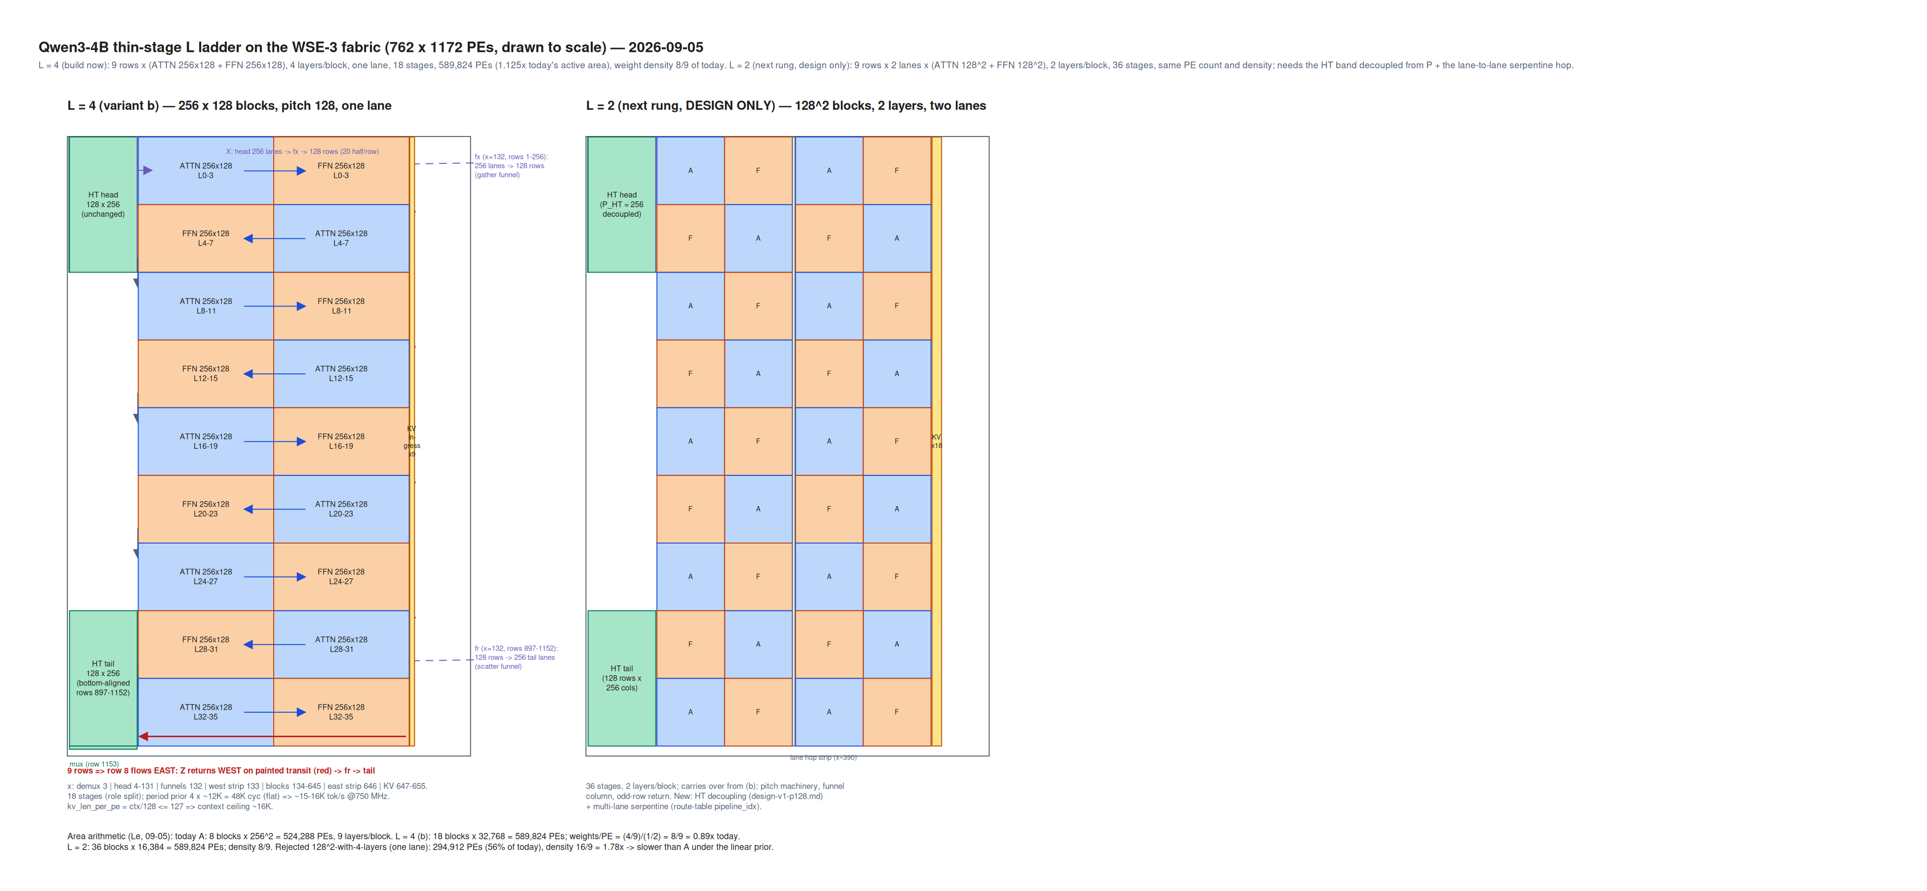
APPENDIX · F26
The thin-stage layouts drawn to fabric scale: L = 4 on one lane, and the two-lane rung that stayed on paper
Left panel: L = 4 as nine rows of ATTN 256x128 plus FFN 256x128 on one lane, with the funnel column and the odd-row result return — this is the layout that was built, gated and measured at 48,872 cycles per token. Right panel: an L = 2 design at 128-square blocks on two lanes, 36 stages, which needs the HT band decoupled from P and a multi-lane serpentine and was never built. Design figure for a measured layout.
Notes:
Round 68, subagent 4b-l4-p128; demo/qwen3-4b-thin-stage/l4/. Three generator changes were needed for the left panel: row pitch = H_ROWS instead of 256, the funnels moved to a dedicated one-wide column, and an odd row count with a westward result return. Note the L = 2 rung that was actually built and measured is not this drawing — it is the one-lane 256x64 geometry (Round 84), which needed neither of the two-lane changes.

Slide 43
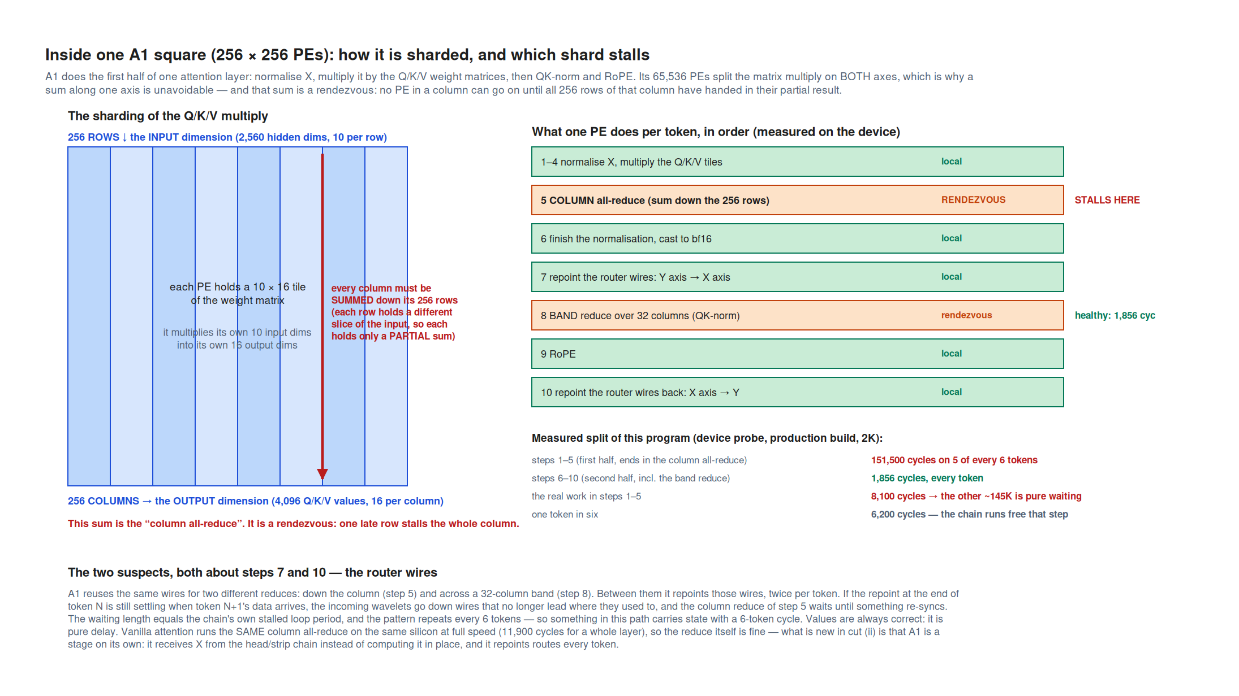
APPENDIX · F27
Why A1 stalls: a 256-row column rendezvous where one late row stops the whole column
Inside one A1 square: the Q/K/V weight matrix is sharded on both axes — the input dimension down the 256 rows, the output dimension across the 256 columns — so every PE ends with a partial result and the column all-reduce is a rendezvous. The device probe split A1's per-token program in two and localised the stall to the first half (RMSNorm, the three matvecs, the column all-reduce): 151,500 cycles on five of every six tokens against 8,100 cycles of real work, while the second half is steady at 1,856. Measured device probe.
Notes:
Rounds 62, 87. Values are always correct — this is delay, not error. Ruled out with the job that ruled it out: the queue-7 raw rebind and its one-wavelet-skew variant (C2Q_2K, compile-time binding, 128,139 vs 128,131), a hardware timeout (none exists in the SDK), A1's second half, the tail, buffer gating and transport widths. Still standing: the axis-3 to axis-0 route repaint at the end of the previous step racing the next step's column reduce, or another wait with a six-token period in the Y-reduce path. Unresolved; stall work was stopped by Le's rule.

Slide 44
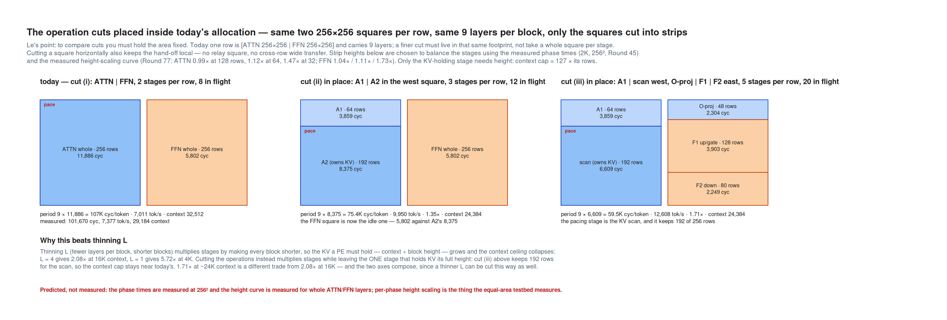
APPENDIX · F28
The operation cuts belong inside today's allocation, not one square per stage
The same two 256x256 squares per row and the same nine layers per block as today, with the squares cut into horizontal strips whose heights balance the stages: today's cut (i), then cut (ii) in place, then cut (iii) in place. Predicted periods use the measured 256-square phase times and the measured height-scaling curve — cut (ii) 1.35x and cut (iii) 1.71x today. Predicted, not measured; neither in-place cut was built.
Notes:
Round 89, answering Le's objection that a stage-per-square arrangement invents new inter-block data paths (the relay square, the wide cross-row transfer and the K-pipe hops exist only because A1 and A2 were put in different squares — and the A1 stall lives in that machinery). An in-place split needs none of it: the hand-off between two strips is a short local hop, and the sub-height strip generator it needs is built and silicon-proven.

Slide 45
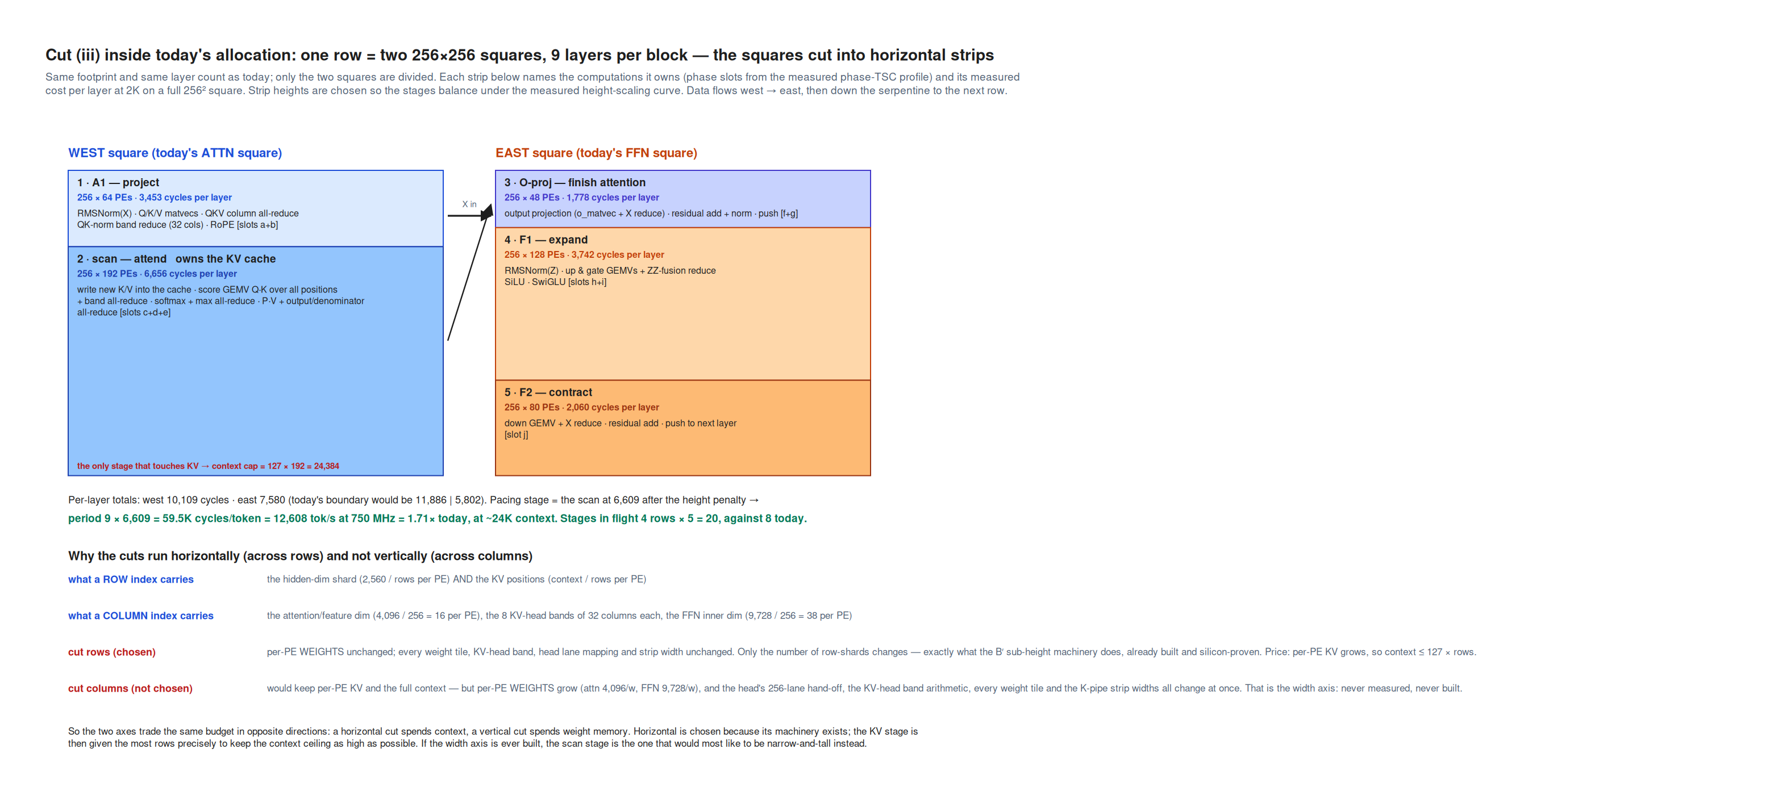
APPENDIX · F29
Cut (iii) in place: five stages, and only one of them touches the KV cache
The five stages as horizontal strips of today's two squares, each labelled with the computations it owns and its measured per-layer cost, plus why the cuts run across rows rather than columns. A1 sits at 256x64 and the scan at 256x192 in the west square; O-proj, F1 and F2 share the east square. The scan paces at 6,609 cycles after its height penalty, giving 59.5K cycles per token = 14,286 tok/s at 0.85 GHz, 1.71x today, at a context ceiling of 24,384. Predicted from measured phases; never built.
Notes:
Round 90. The structural point is that stage 2 (the scan) is the only stage that touches the KV cache, so only its geometry has to respect the context ceiling — which is why splitting operations is a sustainable axis and thinning L is not. Cutting rows spends context (KV positions live on the rows); cutting columns would spend weight memory and change the head's lane mapping, every weight tile and the strip widths at once. The width axis has never been built or measured.

Slide 46
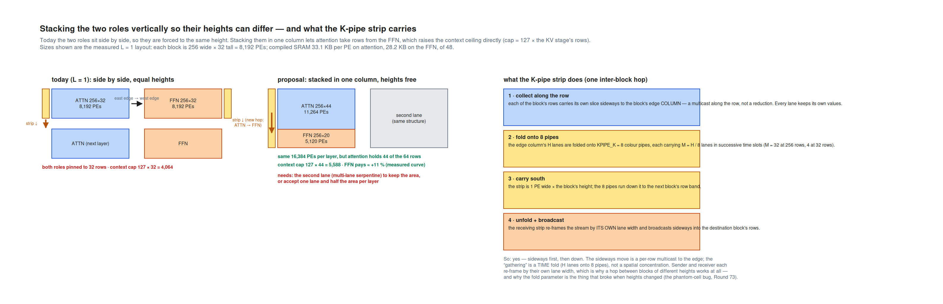
APPENDIX · F30
Stacking the two roles vertically so their heights can differ, and what the K-pipe strip carries
Today's side-by-side L = 1 row against the stacked proposal, plus the four steps of the inter-row K-pipe: collect along each row to the edge column, fold the lanes onto eight colour pipes as a time fold, carry south down a one-PE-wide strip, then unfold and broadcast into the next block. Sender and receiver re-frame independently, which is what makes a hop between blocks of different heights possible at all. Stacking was then built and measured: 12,202 cycles per token on a three-layer rig, with attention's own compute unchanged at -1.3%.
Notes:
Rounds 93, 97, 104; demo/qwen3-4b-thin-stage/vstack/. The implementation came out smaller than the six-change spec: the strip machinery needed no change, and the K-pipe fold moving from cyclic to block is what removes the height-to-height reshard entirely (and is byte-identical at equal heights, controlled in Round 105). One-lane stacking is a loss because it uses half the columns; the second lane is what converts it.

Slide 47
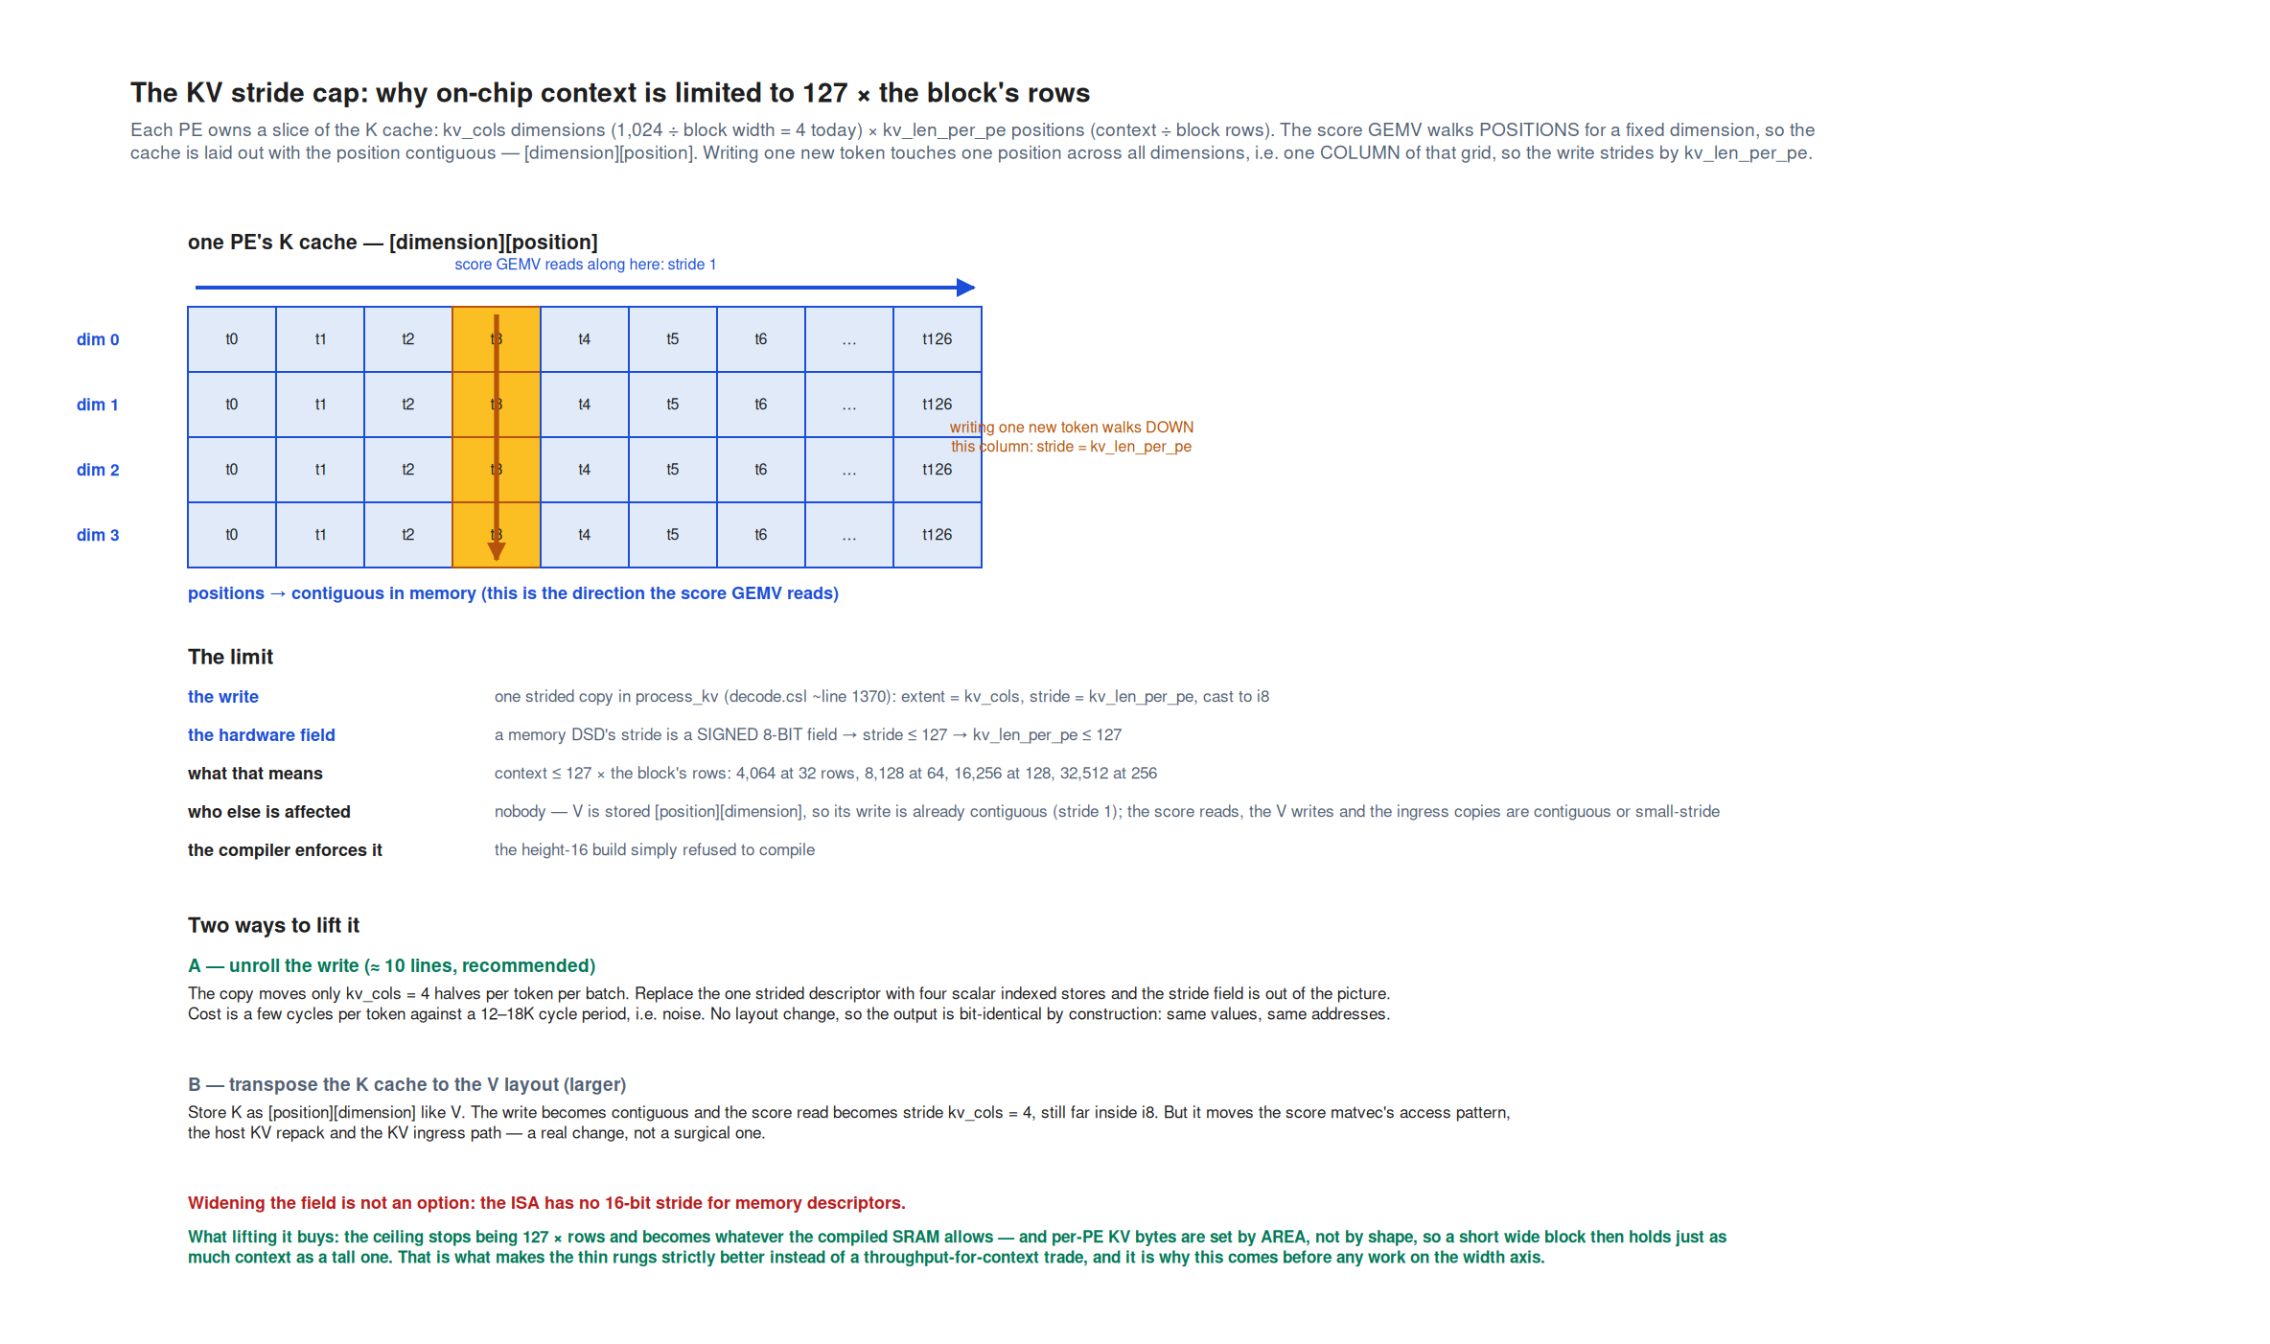
APPENDIX · F31
One 8-bit stride field capped on-chip context at 127 positions per row — and ten lines removed it
One PE's K cache laid out as [dimension][position]: the score GEMV walks every position for a fixed dimension, so positions must be contiguous, which makes the write of one new token a strided copy with stride = positions per PE. A memory descriptor's stride is a signed 8-bit hardware field, so positions per PE is capped at 127 and context at 127 x block rows. Option A unrolls the write into four scalar stores; option B transposes the cache to the V layout. Option A was implemented and gated byte-identical on 1,000 device records.
Notes:
Rounds 78, 95, 96, 108, 111-115. Verified against csl/language/dsds.md, which types a memory DSD's stride as i8 and mem4d_dsd strides as tuples of i8 — no descriptor form escapes the field, and there is no 16-bit stride to widen to. The V write is contiguous and untouched. Correction to carry: there was never a launcher check enforcing 127; the cap was the CSL cast alone, which is why a height-16 build failed at compile time rather than at config time.

Slide 48
APPENDIX · ROUND 9
Prefill measures 10,544-11,143 tok/s; in-kernel batching saturates at ~2,370
First CS-3 measurements of the 4B: native prefill at two chunk sizes, and decode at batch 1 through 8. A selection of 5 of 7 measured points — bsz 2 (1,289,187 cyc/step) and bsz 4 (2,102,119) are omitted and both sit on the fitted line. Measured on-device TSC; tok/s converted at 0.85 GHz.
RUN
CYCLES
TOK/S @0.85 GHZ
P1 — prefill, 1 x 8,192 tokens
76,282 / token
11,143
P2 — prefill, 4 x 2,048 tokens
80,615 / token
10,544
Decode, bsz 1 (TOP_K 20)
785,826 / step
1,082
Decode, bsz 8
3,300,460 / step
2,061
Fitted law 427K + 359K x bsz
359K per element
~2,370 asymptote
Notes:
Round 9. Prefill jobs wsjob-eptcyqjparjjjombvqiozp (P1) and wsjob-gbgvnij9crj7srrlc5nyce (P2, byte-identical KV across rounds). Decode batch jobs wsjob-ety497nzzyactz9mnp8exh, wsjob-kehrtcp6jwvpdmkrhzqnsp, wsjob-ypfwbalxthvu6ckbzf7yuk, wsjob-jtyqqnkrmamhczfjwu3gto. The first batch attempt failed to compile (FFN SiLU scratch overflows the 512 B D-cache window; HT-tail logits partials overflow the tail PE) — wsjob-3bqgsljf25cvxguqjccqo6, wsjob-puluwcakbvtzlcqkcz5jyg. Batch 16 does not link. Patch: analyses/2026-09-03-cs3-4b-prefill-bsz/bsz_experiment.patch; the tracked kernel trees were never modified. Because the batch-independent part is only ~0.43M cycles, in-kernel batching cannot pass ~2,370 tok/s — which is what made stage pipelining the interesting direction.

Slide 49
APPENDIX · ROUND 12
Per-layer time barely moves with region size — the smallest region that links is the fastest
MeshRT Qwen3.5-9B layer_block benchmark on CS-3 at batch 1 and 4K context, eight regions, 12 device jobs. A selection of 5 of the 8 measured regions: 128x512 (+1.1%), 256x512 (+5.3%) and 512x256 (+17%) are omitted, and 16,384-PE regions do not link at all. Measured device TSC.
REGION (W X H)
PES
FULL CYC/STEP
VS 256-SQUARE
128 x 256
32,768
15,647
-0.3%
256 x 128
32,768
15,718
+6.6%
256 x 256 (published)
65,536
14,719
0
512 x 128
65,536
16,923
+20%
512 x 512
262,144
17,787
+22%
Notes:
Round 12, subagent meshrt-9b-region-profile; analyses/2026-09-04-meshrt-9b-region-profile/README.md carries every wsjob id. Commit 288fe8ae; reproduces the published 256-square numbers to 0.0001%; negative gate — illegal meshes are rejected by the generator's divisibility checks. Width is the expensive axis (the hidden tile and KV are sharded along X in MeshRT, so a wider mesh lengthens the chains a batch-1 decode is latency-bound on); height is nearly free. The floor on stage size is per-PE SRAM, not time. 512-square is slower than 256-square at batch 1 but wins 37% at batch 16. A small TSC probe also split the layer: mixer/attention 69-77%, FFN 23-31%, with a ~1,450-cycle per-step floor at every region size. This is the flat-time evidence every later thin-stage prediction leaned on — and it is a 9B kernel, not the 4B.

Slide 50
APPENDIX · ROUND 13
A block row is one serial resource: ATTN and FFN alternate per layer, so they cannot hold different tokens
One PE per block stamps its own TSC at the per-layer boundaries; bursts leave through new routing-only collector streams, so no existing data path is touched. Row 0, steady state over the last 512 of 4,096 steps at about 8K context. Measured device TSC.
QUANTITY (ROW 0)
CYCLES
WHAT IT MEANS
T_attn — 9 ATTN layers
127,301
14,145 per layer, 72% of a layer
T_ffn — 9 FFN layers
50,238
5,582 per layer
Waits: ATTN on FFN / FFN on ATTN
44,981 / 113,313
The roles alternate every layer
Row-0 step period
808,995
Row busy only 21.9% of the step
T_attn + T_ffn = row period
177,539
4,788 tok/s forced, at 0.85 GHz
Notes:
Round 13, subagent 4b-block-tsc; analyses/2026-09-04-4b-block-tsc/README.md. Job wsjob-tp5yqatuwy2mfzoubusxnc, configs device_2x4_8k + device_prefill4k. Gates: token records byte-identical to the 09-02 run, per-token TSC -0.058%, and a negative control (stamping before the work) that collapses the block time and is rejected by the checker. The 6,677 tok/s that 0.85e9 / max(T_attn, T_ffn) would give needs ATTN and FFN as independent pipeline stages — a kernel change, not a layout change — and that was later built and measured (Round 39). Cross-check: the eight stamped blocks sum to 87.8% of the row period; the 12.2% residual is the HT head, HT tail and inter-row K-pipe, which were not stamped.

Slide 51
APPENDIX · ROUND 16
Decode cost is linear in context, and the device ceiling is 29,184 — the next setting will not link
Five device runs of the unmodified route-table decode tree at batch 1 with host-ingested prefixes, 4,096 decode steps each. The fit over the five points is 681K + 16.1 cycles per context token per step; the sixth setting tried, 30,464, fails to link on the appliance. Measured on-device TSC.
MAX_SEQ_LEN
CONTEXT DURING DECODE
CYCLES/STEP
TOK/S @0.85 GHZ
8,192 (reference)
4K -> 8K
785,826
1,082
16,384
12K -> 16K
889,547
956
23,040
18.7K -> 22.8K
1,029,112
826
28,160
23.8K -> 27.9K
1,096,070
776
29,184
24.8K -> 28.9K
1,109,064
766
Notes:
Round 16; analyses/2026-09-04-4b-context-sweep/. Jobs in row order: wsjob-amzrrqt78wnfxoxy9blpyq (09-02), wsjob-ef9m7k5abo3xmpxkx2ox7q, wsjob-ldhubkgfqptdu82pg3l3vi, wsjob-pkugixotaderkrvmydmsui, wsjob-5faj77vfj547buzddc4mvb, wsjob-bja2eqjp3zgiv469n7tnbp. The device ceiling is 29,184 and not the locally compiled 30,464 because the appliance compiler adds a few hundred bytes of .text — the 30,464 figure is a link ceiling that was never executed. 16 cycles per context token is 15x the MeshRT 20B long-context kernel's 1.1, which Round 17 traced to instruction structure and KV layout, not hardware. Later caveat (Round 118): 29,184 was measured on an earlier tree; A compiles only to 26,112 in the current lineage and the unpatched control fails identically.

Slide 52
APPENDIX · ROUND 26
The ATTN:FFN ratio never inverts — ATTN grows faster with batch and is the only role that grows with context
Block-TSC probe rerun at batch 1, 2, 4 and 8 with context held equal at 2K, five device jobs, tokens byte-identical to unprobed runs. Fits: T_attn = 45.2K + 61.7K x b, T_ffn = 27.2K + 24.9K x b per nine-layer row. Measured device TSC; rates at 0.85 GHz.
BSZ
T_ATTN
T_FFN
RATIO
ROWS-AS-STAGES TOK/S
1
106,645
51,964
2.05
5,358
2
168,577
77,056
2.19
6,919
4
292,757
127,240
2.30
8,093
8
538,793
226,604
2.38
8,882
Notes:
Round 26, subagent 4b-block-tsc; analyses/2026-09-04-4b-block-tsc-bsz/. The FFN's 2.85x MAC count does not show: both blocks are issue-bound, ATTN grows at 6.9K cycles per layer per batch element against the FFN's 2.8K, and context adds 3.3 cycles per context token per batch element to ATTN only (FFN is flat). Ratio reaches 2.4 at (1, 8K), 2.9 at (1, 16K), 3.8 at (1, 29K). Balancing rule for the D pairing: FFN layers per shared block = round(ratio), capped at 3 by SRAM. With ATTN and FFN as independent stages the same sweep predicts 7,968 tok/s at bsz 1 and 12,617 at bsz 8 — but per Le's Round 72 correction those batch figures are multi-request aggregates and say nothing about a single request's serving rate.

Slide 53
APPENDIX · ROUND 27
Capacity is binding, keeping KV pays per hit, and pipelining is an operator question
The decoder-only lever evaluation's verdict, from replaying 32,378 de-duplicated Claude Code calls and 35,639 Mooncake requests against measured CS-3 rates and modelled keep/reload/recompute economics.
LEVER
WORK IT TOUCHES
VALUE PER HIT
VERDICT
a — capacity 29K -> 167K
Agentic decode tokens 0.01% -> 19%; Mooncake 90% -> 100%
Precondition for lever b
Binding; ~2x short of the median agentic context
b — keep KV across calls
99% of agentic calls, >=95% reused in 10-18 s; 37% of Mooncake
13.9 s = 61% of next-call latency; decoded-KV part <=0.13 s
High per hit, gated by a; fast recompute substitutes
c — pipelining / batching
Concurrency p50 1 on both traces, max 7-47
Fills 4 stages in bursts; 36 or 54 never on-trace
Multi-tenant / operator question only
Notes:
Round 27, subagent decoder-lever-value; docs/analysis/2026-09-05-decoder-only-lever-value.md and analyses/2026-09-05-decoder-lever-value/. Figures F13-F17 are this study's five panels. Assumptions that carry the verdict, as the report states them: the 4B step law is applied beyond the 29K it was measured on; reload happens at the full link rate with no overlap; the visible-output share is applied uniformly; and the 54-stage recompute rate was analytical at the time. The measured L-ladder rates (up to 47,831 tok/s) have since made the recompute substitute much stronger than this table assumes.

Slide 54
APPENDIX · ROUND 28
58,581 of ~105K trace rows were duplicates — the agentic decode budget is 5.8K tokens per turn, not 14.4K
One API call is logged as several assistant records, one per streamed content block, each repeating the same message id and usage. A selection of 5 of the 13 corrected quantities; also corrected were calls per turn (~19 -> ~12) and per-turn new prefill (24,691 -> 10,917). Every CS-3 measurement and every ratio was unaffected.
QUANTITY
BEFORE
AFTER
Claude Code API calls
102,517
46,650
Intra-turn gap p50 / p90
3.3 s / 22 s
10.9 s / 50 s
Per-turn decode tokens p50 / p90
14,373 / 66,685
5,838 / 23,546
Hidden-reasoning share of decode
89%
75%
Median turn on CS-3 (29K curve)
26.0 s
10.5 s
Notes:
Round 28. Fixed in extract_claude_code_traces.py (keep the first record per message id) and decode_breakdown.py (merge a call's blocks before attributing tokens); all downstream results regenerated, pre-correction results kept in results/pre-dedup-2026-09-04/. Figures F3, F4, F5, F8, F9 and F10 are the regenerated versions. What survives unchanged: the G(C) supply/demand picture, the keep-versus-park logic (a 10.9 s gap makes keeping more clearly right than 3.3 s did), the 5% decode threshold, and every CS-3 measurement. What changes in the narrative: the per-turn decode budget of an agentic user is about 6K tokens, not 14K, so the decode-heavy argument stands on a smaller base.

Slide 55
APPENDIX · ROUND 31
Multi-tenant reasoning traffic is decode-heavy but not deep-context
Three-way comparison of the traces the argument rests on. A selection of 5 of 7 axes: incremental prefill (p50 2,107 / 1.5K / new input dominates) and idle gaps (inter-turn 308 s / intra-turn 10.9 s / 3.0 s) are omitted. Measured on each release; ServeGen reuse is an upper bound and its concurrency is derived.
AXIS
SERVEGEN R1
CLAUDE CODE
MOONCAKE
Per-request output
p50 792, p90 3,432
p50 763 per call; 5.8K per turn
p50 350, max 2,000
Reuse length
p50 7,498 (upper bound)
context p50 ~302K, 98% re-sent
37-57% block reuse
Output re-enters next input
Yes — 83% fully
~5% — thinking stripped
0% (toolagent)
Fits 29K / 167K
78% / 99% of requests
0.04% / 19% of decode tokens
~90% fits 29K
Decode-stream concurrency
26 mean / 68 peak (derived)
1 user
3.4-6.7 req/s arrivals
Notes:
Round 31, subagent servegen-trace-study; docs/analysis/2026-09-05-servegen-reasoning-workload-first-pass.md and analyses/2026-09-05-servegen-trace-study/ (provenance.txt, clone commit d70c8b2d). Raw data stays outside the repo. Headline: a ServeGen R1 request's output is statistically almost the same as a Claude Code per-call output, but its context sits where Mooncake's does, so the 29K and 51K rungs are far more useful there than on our own trace — and that platform keeps the reasoning in context, which makes decoded KV reusable there. Caveats: reuse assumes verbatim history (13.6% of pairs partial, 3% shrink); the 1,616 conversations are an unstated selection of 57,205 and their model is unstated; concurrency comes from Little's law on a released 16 req/s slice and ignores queueing.

Slide 56
APPENDIX · ROUND 34
Two wafers of today's layout do not move the needle — only two wafers with the far-pool levers reach half the calls
Capacity rungs against how much of the agentic workload each covers. Capacity figures are measured (29K) or analytical (the rest); coverage is measured on the de-duplicated Claude Code trace.
KV CAPACITY
WHAT IT IS
CALLS THAT FIT
DECODE TOKENS
29,184
Today, measured on device
0.1%
0.0%
53-58K
Two wafers, today's layer split
3.0%
1.3%
95K
Near-pool lever
10.0%
6.5%
167K
Far-pool lever (score wall)
24.5%
21.6%
334K
Two wafers x far pool
54.7%
52.0%
Notes:
Round 34. The two 'prefill lengths' this answers are different things: the increment a call prefills is small (p50 1.5K per call, 10.9K per turn), while the resident context the decode needs is large (p50 302K). So 29K is adequate for the increment and an order of magnitude short of the context. Round 35's reframing travels with this table: the 300K contexts are a frontier-model artefact, a 4B harness would be leaner and compact earlier, and on that reading 29K is roughly the operating point rather than 10x short. For ServeGen R1 and Mooncake, 29K already covers 78% and ~90%. Also struck in Round 34: a second wafer cannot be a KV farm — there is no direct wafer-to-wafer link, so a KV pool on another wafer is host DRAM with an extra hop.

Slide 57
APPENDIX · ROUND 36
For dense-attention models the per-wafer resident context stays 24-32K whatever the model size
Resident KV capacity = eta x (N x 44 GB - weights) / KV bytes per token, with eta ~ 0.13 calibrated on two independent measured anchors. A selection of 5 of 8 rows: Qwen3-8B (24K), Qwen3-30B-A3B (94K on 3 wafers) and GPT-OSS-120B (1.0M on 8 wafers) are omitted. Analytical, on measured anchors.
MODEL
WAFERS
KV/TOKEN
TODAY (ETA 0.13)
PER WAFER
Qwen3-4B bf16
1
144 KB
32K (measured 29K)
32K
Qwen3.5-9B, dense attention
2
144 KB
62K
31K
Qwen3.5-9B, 3:1 hybrid (GDN)
2
36 KB
247K
123K
GPT-OSS-20B MXFP4
4
24 KB
863K (kernel: 900K)
216K
Qwen3-235B-A22B bf16
12
188 KB
39K
3K
Notes:
Round 36; analyses/2026-09-05-kv-capacity-scaling/. Eta is the share of post-weight SRAM the kernel actually turns into KV, calibrated on two anchors that agree: the 4B's measured one-wafer ceiling (29,184 x 147 KB = 4.3 GB of 36 GB left, 0.12) and MeshRT's GPT-OSS-20B 900K kernel on four wafers (22 GB of 163 GB, 0.135). Three readings: adding wafers only for weights buys no depth (every wafer beyond the weight minimum adds ~40K tokens for dense Qwen); architecture dominates the ladder, with sliding-window and hybrid models holding 5-10x more context per wafer; and a model that just fits its weight minimum has almost no KV room. Caveats: eta is a two-point calibration, not a fit; KV bytes per token are from published architectures (Qwen3.5-9B's hybrid structure must be verified per checkpoint); pool levers multiply every row by 3-5x but are not shown feasible for MeshRT layouts.

Slide 58
APPENDIX · ROUND 37
Forced prefill runs at exactly one token per row period — there is no pipelining penalty at four stages
Forced mode implemented as a runtime flag plus a baked token list on the HT head; the same compiled image serves both modes. Four device jobs, about 16 minutes of CS-3 time, all gates pass. Measured on-device TSC; rates at 0.85 GHz.
CONTEXT
FREE (SERIAL)
FORCED
CYCLES/TOKEN
MEASURED / PREDICTED
2K
1,263 tok/s
5,674 tok/s
149,811
1.044
8K
1,081 tok/s
5,108 tok/s
166,407
1.032
Notes:
Round 37, subagent 4b-thin-stage-forced; demo/qwen3-4b-thin-stage/ (step1-forced-design.md, step1-README.md, step1-forced.patch, results/step1_results.json). Jobs wsjob-d46iukzpnbdb2jp3obmum3 and wsjob-f4pbfv3uetmpyzcf87gi2y (2K), wsjob-9t9d8hgzjxhdnt2vzzufrx and wsjob-9sdgqjhg5nin2udesnjrcz (8K), all exit 0. The 1.7B pipeline's 0.82 bubble discount does not apply here: inter-row hops and the head's embedding gather hide inside the ATTN-bound row period. The small surplus over prediction is the one legal cross-token overlap the row allows; removing it gives 1.007 and 0.998. Gates: sim forced-vs-free byte-identical, sim negative control diverges at exactly the expected step, device forced records byte-identical to same-tree free references at both contexts, and the free reference byte-identical back to the 09-02 pristine run.

Slide 59
APPENDIX · ROUNDS 39, 44
ATTN and FFN as independent stages: 8,360 tok/s at 2K, byte-identical, 1.47x the four-stage rate
Eight stages, two tokens per row, period = T_attn. The verify build computes top-k every step for the byte gate; the production build runs the logits once per round and streams the head's tokens. Production equals verify to within 0.03%, so the tail was not binding at eight stages. Measured on-device TSC; rates at 0.85 GHz.
BUILD
CONTEXT
CYCLES/TOKEN
TOK/S @0.85 GHZ
GATE
Verify (tail computes top-k)
2K
101,723
8,356
Byte-identical to free
Production (tail skips logits)
2K
101,670
8,360
Final record equal
Verify
8K
118,550
7,170
Byte-identical to free
Production
8K
118,554
7,170
Final record equal
Notes:
Rounds 39 and 44, subagent 4b-thin-stage-forced. Jobs wsjob-lhgcurbqytb7crgetkhbwk and wsjob-dpgl8fsv9fmdhutvkbqp92 (Round 39); wsjob-3ef5h5eql38sxxfe2zazre, wsjob-krjgzzijgtatakhqm9v5gn, wsjob-vdexixxz6bdsvfmvequom3, wsjob-u2yb3psg6yfakcqmycywjb (Round 44). The 4 -> 8 gain is T_row / T_attn = 1.47 at 2K and 1.40 at 8K, exactly the ATTN-bound period the batch sweep predicted; the FFN stage idles 51% to 63% of every period, which is what layout D's pairing or FFN-at-batch-b would recover. Round 38's corruption on the first attempt was a latent race in the HT tail (the top-k X-merge repaints shared reduce colours, which is safe at 150K-cycle spacing but not at 12K), fixed with a Y-phase admission gate. Two device-only lessons recorded: a raw-int colour parameter leaves the router entry disabled, and runtime repaints argued race-free by causality are unsafe at device scale.

Slide 60
APPENDIX · ROUND 45
Where a layer's cycles go: softmax dominates and grows fastest with both context and batch
Phase-TSC probe on today's 256-square blocks, seven device runs, all four byte-identity gates pass. Columns are a selection from the full ten-phase table (see F21); rows are 5 of the 7 runs — bsz 2 at 2K (softmax 7,185) and bsz 4 at 2K (13,784) are omitted. Measured device TSC, cycles per layer per step, row 0.
RUN (BSZ, CONTEXT)
SOFTMAX
ATTN LAYER
FFN LAYER
SOFTMAX SHARE
bsz 1, 2K
3,808
11,886
5,802
32%
bsz 8, 2K
27,241
59,807
25,182
46%
bsz 1, 8K
5,211
14,176
5,797
37%
bsz 2, 8K
9,938
23,301
8,580
43%
bsz 1, 23K
9,984
20,931
5,814
48%
Notes:
Round 45, subagent 4b-block-tsc; analyses/2026-09-05-4b-phase-tsc/ with phase-tsc.patch and results/phase_tsc.json. Softmax carries 69% of the context slope (0.303 of 0.439 cycles per context token per layer; score 20%, P.V 11%, every other phase zero) and 49% of the ATTN batch slope. The three KV-walking phases give 15.8 cycles per context token per step over 36 layers, independently reproducing the context sweep's 16.07. FFN is flat in context. A1 | A2 is not near-even: 3,452 against 8,434 at 2K (1 : 2.4), 1 : 4.5 at 23K, because A2 keeps the softmax. Caveats: 29K could not be probed (960 B free on the ATTN PE), only row 0 is instrumented, and the SiLU phase runs out of D-cache and reads ~10% high.

Slide 61
APPENDIX · ROUND 45
Cutting a layer five ways would raise the stage rate 1.3-1.8x — derived from measured phases, not measured
Each cut's pacing stage is the longest contiguous run of measured phase slots; throughput is 0.85e9 divided by that. Derived, under three assumptions the one-layer testbed exists to replace: each cut stage becomes its own PE region, per-phase time is unchanged, hand-offs are free, and there are enough PEs.
RUN
ATTN+FFN (2/LAYER)
A1 | A2 | FFN (3)
5-WAY CUT
bsz 1, 2K
11,886 cyc -> 71.5K tok/s
8,434 -> 100.8K
6,656 -> 127.7K
bsz 8, 2K
59,807 -> 14.2K x b
43,171 -> 19.7K
39,740 -> 21.4K
bsz 1, 8K
14,176 -> 60.0K
10,669 -> 79.7K
8,894 -> 95.6K
bsz 2, 8K
23,301 -> 36.5K x b
17,974 -> 47.3K
15,929 -> 53.4K
bsz 1, 23K
20,931 -> 40.6K
17,445 -> 48.7K
15,659 -> 54.3K
Notes:
Round 45. The five-way cut is A1 | scan | O-proj+residual | FFN up/gate | FFN down = 180 stages for the whole model — the finest cut whose boundaries are already real control-flow boundaries, needing no numerical restructuring. Rates at 0.85 GHz; 'x b' marks multi-request batch rates, which per Round 72 say nothing about a single request. Chunking the scan saturates at k = 2 because its fixed collective cost binds. The subagent's own recommendation was that the highest-payoff move is not a cut but a cheaper softmax — which Round 49 then tested and found the obvious fusion makes things worse. Caveats: 256-square block times, which transfer to smaller blocks only under the flat-time assumption; at 180 stages the per-layer blocks would be 3-4K PEs each, where the SRAM accounting has not been done, so this is a period statement and not a fit statement.

Slide 62
APPENDIX · ROUND 48
At full block size the phase-sum model predicts the measured stage period to 0.2%
Cut (i) — ATTN | FFN with one layer per block on today's full squares — needed no kernel change: at one layer per block the serial kernel is already a two-stage pipeline. Six device jobs, all gates pass, verify records byte-identical to same-tree free references. Measured on-device TSC; rates at 0.85 GHz.
CONTEXT
CYCLES/TOKEN
TOK/S @0.85 GHZ
DERIVED
MEASURED / DERIVED
2K
11,866
71,633
11,886 cyc
1.002
8K
13,705
62,021
14,176 cyc
1.034
Notes:
Round 48, subagent 4b-thin-stage-forced; demo/qwen3-4b-thin-stage/one-layer-cuts/cut1-README.md and results/cut1_results.json. Hand-off overhead is within noise (ATTN stage busy 11,492 against a period of 12,053 at 2K); the A-multicast hand-off and the head feed hide completely, and the head keeps up at this rate. The 8K row's 1.034 is a TSC-window context-average effect through the softmax slope. Bonus result: the full HT tail was isolated as a stage for the first time at 35.8K cycles per token at TOP_K 4 and about 120-126K at TOP_K 20 — which is exactly what the production tail-skip buys, since no stage period below those numbers could otherwise show. This is a rig, not a model: one layer on half the wafer.

Slide 63
APPENDIX · ROUND 49
Exact softmax fusion is byte-identical and 8-14% slower — the lever is DSD overhead, not fusion
Folding the sum and cast passes into the exp pass removes exactly what it targets and loses two to three times that inside the exp loop. Ten device jobs, all gates pass; every exact variant is byte-identical on device. Measured device TSC, softmax cycles per layer per step.
CONFIG
BASELINE
FUSED (A2)
CHANGE
2K, bsz 1
4,103
4,581
+11.7%
8K, bsz 1
5,502
5,958
+8.3%
23K, bsz 1
10,246
11,030
+7.6%
23K, bsz 1, variant (c)
10,246
10,781
+5.2%
2K, bsz 8
29,342
33,360
+13.7%
Notes:
Round 49, subagent 4b-block-tsc; analyses/2026-09-05-4b-softmax-fusion/ (anatomy.md written before any code, softmax-fusion-a.patch, results/{anatomy,timing}.json, gates.txt). Every exact variant is byte-identical on device at all four configs, including 23K where a slot spans two tiles — the only case that changes the reduction decomposition. The fusion removes the sum (1,152 -> 24) and cast (170 -> 13) at 23K and loses more inside the exp loop; the slopes get worse too. Variant (c) shows the mechanism from the other side: removing three @set_dsd_length per tile and inlining the slot function recovers about half the loss without touching arithmetic. So the real levers are fewer and longer DSD operations, the ~2,000 cycles per layer of fixed collective cost, and a cheaper exp kernel. Caveat: (c)'s guards also fuse, so it measures fusion plus de-overhead, not de-overhead alone. The online/flash variant (b) was never built.

Slide 64
APPENDIX · ROUND 59
Compiled numbers, not tables: height 16 does not compile, and height 32 fits with 16-20 KB per PE to spare
Real-geometry compile-only builds of the 2K cut (i) geometry at heights 16 and 32 with cs-readelf memory reports, run after Le's rule that only compiled SRAM numbers count. Compiled (link-time), per PE of a 48 KB bank, uniform within regions.
REGION
KB/PE AT HEIGHT 32
HEADROOM
ATTN strip (256 x 32)
32.2
15.8 KB
FFN strip (256 x 32)
27.8
20.2 KB
HT tail (binding region)
42.8
5.2 KB
HT head
27.3
20.7 KB
Inter-row strips
4.0
44 KB
Notes:
Round 59. Height 16 is rejected by the compiler outright: the KV-cache DSD stride is a signed 8-bit field, so positions per PE caps at 127, and a 16-row strip at 2K context would hold 128 — a kernel constraint no hand table had, surfaced only by compiling. That gives a hard floor of 32 rows at 2K and 128 rows at 8K for any KV-holding stage. This is the round that established the working rule for the rest of the program: never hand-derive per-PE SRAM, and ship every runnable deployment with its compiled breakdown next to its wsjob id. The earlier sram_fit.py tables (Rounds 33, 52, 53) were downgraded to first screens, and their FFN activation model was wrong besides — the FFN's inner dimension is width-sharded, not Y-sharded.

Slide 65
APPENDIX · ROUND 62
The stall is in A1's first half — the fused QKV column all-reduce, not the queue-7 band broadcast
A split probe on the compile-time-queue-7 tree, one device job, two minutes. Binding queue 7 at compile time changed 128,131 cycles per token to 128,139, so the raw-rebind theory is dead. Measured device probe; the six-step cycle is intact (four slow steps, one at 6.2K, one at 143.2K).
A1 HALF
WHAT IT DOES
SLOW STEPS
FAST STEP
First
RMSNorm, Q/K/V matvecs, QKV column all-reduce (256 rows)
151.5K cycles (median)
6.2K
Second
QK-norm band reduce (32 cols) + RoPE, on queue 7
1,856 cycles
1,856
Notes:
Round 62, job C2Q_2K. True A1 content cost is 8,100 cycles, so about 145,000 of the 151,500 is pure waiting, and the wait sits at the rendezvous. What remains standing: the axis-3 to axis-0 route repaint at the end of the previous step racing the next step's column reduce, or another wait with a six-token period in the Y-delivery/reduce path. It must be specific to the A1 image or its timing environment, because vanilla attention runs the same collective at full speed on the same silicon (11,900 cycles for a whole layer). Also refuted: a hardware timeout — no such mechanism exists in the SDK, and the 153.7K quantum is within 2.5% of this kernel family's own stalled loop period. Stall work stopped here per Le's rule; the plain-language brief is in one-layer-cuts/cut2-status.md.

Slide 66
APPENDIX · ROUND 63
A 128-square block is a quarter of today's block, so it is the L = 2 rung — the equal-area L = 4 is 256 wide by 128 tall
Le's catch: L = 4 keeps 4 of today's 9 layers per block (4/9 of the weights), but a 128-square block is 1/4 of a 256-square one. Those do not match. Fabric use, omitted below: today 4 rows of 256; both L = 4 variants 9 x 128 = 1,154 rows, the square one using only ~400 of 762 columns. Analytical correction.
QUANTITY
TODAY (A)
128-SQUARE, ONE LANE
256 X 128
PEs per block
65,536
16,384 (1/4)
32,768 (1/2)
Layers per block
9
4
4
Weight density per PE
1x
1.78x
0.89x
Active PEs total
524,288
294,912 (56%)
589,824 (1.13x)
Period if per-layer time is flat
107K cycles
~48K
~48K
Notes:
Round 63. The single-lane 128-square build is a cheap probe of the flat-versus-linear question at 128-row height, but as a deployment it idles 44% of the wafer. The equal-area L = 4 is cheaper to build than the square: it is exactly the B-prime sub-height generator at H = 128 with four layers per block and nine rows, so P_BLOCK_SIZE stays 256 and the HT band needs no decoupling from P. Its flatness even has direct evidence — the MeshRT 9B sweep measured a 128x256 region at -0.3% per layer. Corollary Le drew immediately: 128-square blocks carry about two layers, so they are the L = 2 rung, needing both the HT decoupling and a multi-lane serpentine. Do not carry the label 'L = 4 is P = 128 on one lane'.

Slide 67
APPENDIX · ROUND 75
At 32 rows a layer costs 1.48x the full-square time with one eighth of the PEs — 5.4x better than the linear prior
The first sub-height geometry ever to run on silicon: cut (i) at ATTN 32 rows | FFN 32 rows, one layer, 256-wide strips, 16,384 PEs total, 2K context. The identical geometry had wedged before the phantom-cell fix. Measured on-device TSC; rates at 0.85 GHz.
RUN
BUILD
CYCLES/TOKEN
TOK/S @0.85 GHZ
RB32_free
Free reference
—
1,000 tokens in 3 min
B1V_2K
Verify (full tail every step)
35,847
23,712 — tail-limited
B1P_2K
Production
17,589
48,326
Notes:
Round 75, jobs 18-20 of 20. Per-strip busy from the row-0 probe on the production build: ATTN 32-row 17,520 cycles (sets the period), FFN 32-row 13,768 (about 21% headroom). Gates: deterministic, on-chip top-k invariants hold on all 1,000 steps, and the numpy-oracle bounded-divergence verdict followed as an addendum (zero defects). Compiled SRAM in out_B1V_2K/msize.txt and out_B1P_2K/msize.txt, appliance compile. The linear prior said ATTN at 32 rows would cost 8 x 11,886 = 95K cycles; measured 17.5K. As a power law between the two points, T scales as PEs^-alpha with alpha about 0.19 for ATTN and 0.41 for FFN. Throughput per allocated PE goes from 0.482 on the full-square rig to 2.60 here. This geometry only ran at all because Round 73 found phantom strip cells beyond the active height overwriting host-painted transit routes.

Slide 68
APPENDIX · ROUND 77
Halving a block's rows from 256 to 128 costs 3.5%, to 32 costs 48% — while per-PE efficiency rises 5.4x
The height ladder, four points, one layer per block, 2K context, 256-wide strips, production builds, free references clean at every height. Nine minutes of wall time for four jobs. Measured on-device TSC.
ATTN | FFN ROWS
PES
CYCLES/TOKEN
ATTN BUSY
TOK/S PER PE
256 | 256 (full square)
131,072
11,866
11,886
0.482
128 | 128
65,536
12,278
11,720
0.932
64 | 64
32,768
13,658
13,296
1.68
32 | 32
16,384
17,589
17,520
2.60
Notes:
Round 77, jobs 21-24. ATTN paces at every height. The FFN busy figures of the non-pacing strip include back-pressure wait, so they are upper bounds on the FFN's own cost. This is the measured answer to the flat-versus-linear question that every earlier thin-stage prediction depended on: neither, and much closer to flat. Correction landed in the same round: two lanes of 256-wide blocks do not fit — a lane is ATTN + FFN = 512 columns plus HT band and strips, about 660 of 762 — so only one lane of 256-wide blocks exists, and on that lane layers per block = H/32. Context caps at each rung (127 x H, before the stride lift) fall linearly: 32,512 / 16,256 / 8,128 / 4,064.

Slide 69
APPENDIX · ROUND 77
Every thin geometry is numerically sound: zero defects across 3,000 compared steps
The oracle gate for the height ladder. Byte-identity is impossible at sub-height because a strip's height changes the order in which column-wise reductions add partial sums, so the gate is: unordered top-k id set against an independent numpy implementation, with any differing member inside 3 bf16 ulp of the oracle's own k-th value, plus bounded value drift and determinism. Measured against a locally computed oracle.
HEIGHT
STEPS
ID SET IDENTICAL
WITHIN 3 ULP
DEFECTS
32 rows
1,000
138
862
0
64 rows
1,000
139
861
0
128 rows
1,000
139
861
0
Notes:
Round 77 addendum, run in-session after the subagents ran out of credits. Max relative drift 0.0047 against a 5e-2 bound. The three verdicts being near-identical is itself informative: the divergence is the model's own near-tie churn (its top logits pack within about 2 ulp), not a height-dependent numerical effect. Do not confuse this with the weak 'oracle overlap 1.000' diagnostic reported for the L = 4 and L = 2 minis — that oracle ran its own argmax chain, so the overlap measured sampling divergence rather than model error (Rounds 99, 100). The strong evidence for those layouts is the byte-identity chain: forced reproduces free, determinism across runs, bit-identical re-arm, and the production final record bitwise equal to the free reference's last step.

Slide 70
APPENDIX · ROUNDS 81, 82
L = 4 measured on the wafer: 2.08x today at 2K and 1.91x at 8K, with the flat-per-layer prior holding to 0.5%
The first full-model thin-stage deployment on silicon: 9 rows of ATTN 256x128 plus FFN 256x128, 4 layers per block, 18 stages, one lane, odd-row serpentine, funnel column. Production forced prefill. Measured on-device TSC; rates at 0.85 GHz.
CONTEXT
CYCLES/TOKEN
TOK/S @0.85 GHZ
VS A
PER-LAYER ATTN / FFN
2K
48,872
17,392
2.08x
13,018 / 6,024
8K
62,198
13,666
1.91x
17,665 / 6,027
Notes:
Rounds 81-82, subagent 4b-l4-p128; demo/qwen3-4b-thin-stage/l4/. Jobs wsjob-mpxy5ilsmz35mmbxwtfvba (L4F_2K), wsjob-2ajwwpp4wqbivmwfdzsrfa (L4P_2K), wsjob-dkfhxgqn5q5huyneetpx3h (L4F_8K), wsjob-2txoxftwlnocoeqyeg65j9 (L4P_8K); appliance compiles wsjob-lrgvjhemkezd5h3mzqcx6f and wsjob-ftfwkwp9nshx5tphpascqt with msize. The B-prime ladder predicted 4 x 12,278 = 49,112 cycles; measured 48,872, i.e. 0.995x. Gate: the production final record's args and vals are bitwise identical to the free reference's last step (the sampled id differs only by PRNG stream position, per the production contract); free reference 1,000/1,000 steps. Per-layer time stays near flat when the block halves in height with four layers banked (+9.9% ATTN, +4.3% FFN), which answers the multi-layer weight-bank question: no penalty is visible at the pipeline level. Compiled per-PE SRAM at 8K: ATTN 35.7 KB, FFN 27.8, head 27.4, tail 44.8 (binding). Context slope 2K -> 8K is 2.2 cycles per context token, against vanilla A's 2.8.

Slide 71
APPENDIX · ROUND 84
L = 2 lands within 0.1% of the ladder prediction: 27,348 cycles per token, 3.72x today
One lane, 256x64 blocks, 2 layers per block, 18 rows, 36 stages — the same tree at H_ROWS = 64 with an even row count, so no odd-row return. Measured on-device TSC; rates at 0.85 GHz.
RUN
WSJOB
RESULT
Ladder prediction (2 x 13,658)
—
27,316 cycles/token
L2F_2K free reference
wsjob-anlkis2hlrjgrl3dkvumjg
1,000/1,000 steps; 852,657 cyc/token autoregressive
L2P_2K production forced
wsjob-y6j5dsywfuoutq7yrsequv
27,348 cyc/token = 31,081 tok/s
Notes:
Round 84, run by the main session after both subagents hit usage credits one step from the device. Measured / predicted = 1.001. Gate PASS, checked on the pulled records: the production final record's topk_args and topk_vals are bitwise identical to the free reference's last step, only the sampled id differs by PRNG stream position. Compile job L2C_2K wsjob-xtdmieztfmyv82dd4mukcp with msize: HT tail 43.4 KB (binding, unchanged vanilla), block role A 32.0, role B 27.9, head 27.3, funnels 11.2 and 10.0, strips ~4.3. Two independent rungs now confirm that the deployable period is the block's one-layer time times the layers per block, with no multi-layer or extra-stage penalty. The row-0 probe's ATTN window (17,132) exceeds the 64-row ladder point by 29% while the token period matches to 0.1% — the extra is inter-stage waiting in a 36-stage free run, not work.

Slide 72
APPENDIX · ROUND 85
The whole ladder fits: even 72 stages leaves 15 KB per PE spare — the constraint is context, not SRAM
Settled by compiling it rather than arguing from arithmetic. Compiled per-PE maxima by fabric region, of a 48 KB bank, from CS-3 compile jobs. Inter-row strips, omitted below, are 4.3 KB/PE at every rung. Compiled (link-time), appliance toolchain.
REGION
L = 1
L = 2
L = 4
HT tail (binding, unchanged vanilla)
43.4
43.4
43.4
Block role A (ATTN)
33.1
32.0
31.2
Block role B (FFN)
28.2
27.9
27.8
HT head
27.3
27.3
27.3
Funnels
10.9 / 10.0
11.2 / 10.0
~10.5
Notes:
Round 85; L1C_2K wsjob-q57sbtxnbco3tdj3nsxfsr, exit 0, about 2 minutes. The ATTN block grows only about 0.6 KB per halving of height (31.2 -> 32.0 -> 33.1 from L = 4 to L = 1), because weights and KV per PE are set by total active area — the same 589,824 PEs at every rung — and only the per-token buffers move. Geometry is unchanged too: 36 x 32 = 1,152 rows, exactly what L = 4 (9 x 128) and L = 2 (18 x 64) use on the same lane; only the KV staircase widens from 18 to 36 columns. The constraint on L = 1 at the time was the i8 KV stride: 127 x 32 = 4,064 tokens. That is what made the ten-line stride lift the highest-value next change, and it converted L = 1 from a 4K-context curiosity into a real rung (ceiling 12,032 after the lift).

Slide 73
APPENDIX · ROUND 86
Four rungs measured on silicon: the L axis does not create throughput, it converts context into stages
The deployable L ladder, one wafer, single request, forced prefill, 2K context, all four rungs measured on the device. Context caps are the pre-stride-lift figures (127 x block rows); after the lift they become compiled SRAM and stop halving. Measured on-device TSC; rates at 0.85 GHz.
LAYOUT
STAGES
CYCLES/TOKEN
TOK/S @0.85 GHZ
CONTEXT CAP (PRE-LIFT)
A: 4 rows x 256-square, 9 layers
8
101,670
8,360
29,184
L = 4: 9 rows x 256 x 128
18
48,872
17,392
16,256
L = 2: 18 rows x 256 x 64
36
27,348
31,081
8,128
L = 1: 36 rows x 256 x 32
72
17,771
47,831
4,064
Notes:
Round 86; L1F_2K wsjob-dtgodgumspm3uepbkh8x9z and L1P_2K wsjob-gmxdh9vcsu8xwuyimxkowe close the ladder (measured / predicted from the 32|32 rig = 1.010). Gate PASS on every rung: the production final record's topk_args and topk_vals bitwise identical to the free reference's last step. Le's reading, and the mechanism behind it: for a fixed context the KV a PE holds is context divided by block height, so halving the height doubles per-PE KV — which is why the context column collapses linearly and the tok/s x context product barely moves (215M / 249M / 223M / 172M). Thinning L is a benchmark axis, not a deployment axis. The sustainable axis is splitting the operations, because within a layer only the score/scan step holds KV, so cut (iii) can multiply stages while leaving the KV-holding stage its own geometry.

Slide 74
APPENDIX · ROUND 89
Cut (iii) in place is worth 1.71x at nearly today's context ceiling; cut (ii) only 1.35x
The operation cuts placed inside today's allocation — one row is still two 256-square blocks carrying nine layers, cut into horizontal strips whose heights balance the stages. Predicted, from measured 256-square phase times and the measured height-scaling curve. Neither in-place cut was built.
LAYOUT
STRIPS (WEST | EAST)
PACING STAGE
TOK/S @0.85 GHZ
CONTEXT CAP
Today, cut (i)
ATTN 256 | FFN 256
ATTN 11,886
8,360 measured
29,184 measured
Cut (ii) in place
A1 64, A2 192 | FFN 256
A2 8,375
11,273 predicted
24,384
Cut (iii) in place
A1 64, scan 192 | O 48, F1 128, F2 80
scan 6,609
14,286 predicted
24,384
Notes:
Round 89, answering Le's objection that the cuts must live inside today's allocation rather than take a square each. Two things the table makes obvious: cut (ii) is worth only 1.35x because A2 keeps the softmax and the whole KV walk, so no way of dividing the ATTN square's rows makes the halves even; and cut (iii) pays because it moves the O-projection out of the KV stage and rebalances across both squares. This is also the axis that keeps context — only the scan holds KV, so only it needs height. Predicted, not measured: the phase times are measured at 256-square and the height curve is measured for whole ATTN/FFN layers, but per-phase height scaling is exactly what was never measured. The in-place cuts need the sub-height strip machinery, which is built and silicon-proven; the A1 stall must be understood or avoided by construction first.

Slide 75
APPENDIX · ROUND 90
Only one of cut (iii)'s five stages touches the KV cache — which is why this axis keeps context
The five partitions and their computations. Every boundary is a contiguous run of measured phase slots from the phase-TSC profile, so no numerical restructuring is needed. Cycles per layer are measured on a full 256-square block at 2K, batch 1.
STAGE
WHAT IT OWNS
PHASES
CYCLES/LAYER
A1 — project
RMSNorm; Q/K/V matvecs; column all-reduce; QK-norm; RoPE
a + b
3,453
scan — attend (holds KV)
K/V write; score GEMV; softmax; P.V — all with their reduces
c + d + e
6,656
O-proj — finish attention
Output projection + X reduce; residual add and norm
f + g
1,778
F1 — expand
RMSNorm of Z; up/gate GEMVs + reduce; SiLU; SwiGLU
h + i
3,742
F2 — contract
Down GEMV + X reduce; residual; push to next layer
j
2,060
Notes:
Round 90. The scan is the only stage that touches the KV cache, which is the structural fact making this axis worth taking: only stage 2's geometry has to respect the context ceiling. Placed in today's footprint (F29), A1 and the scan take the west square (10,109 cycles of work) and O-proj, F1 and F2 the east (7,580), so the west carries more and shifting that balance would need the width axis. Why the cuts run across rows: a row index carries the hidden-dimension shard and the KV positions, a column index carries the attention/feature dimension, the eight KV-head bands and the FFN inner dimension — so a horizontal cut spends context and a vertical cut spends weight memory. Horizontal was chosen because its machinery exists.

Slide 76
APPENDIX · ROUND 92
The FFN gives up half its rows for 4.3% and is never the pacing stage at any height
From the B-prime height ladder, which measured FFN strips at 256, 128, 64 and 32 rows alongside ATTN. The FFN is also completely context-independent (5,802 / 5,797 / 5,814 cycles at 2K / 8K / 23K), so none of this changes with sequence length. Measured on-device TSC, cycles per layer.
FFN ROWS
CYCLES/LAYER
VS FULL SQUARE
ATTN AT SAME HEIGHT
256
5,802
—
11,886
128
6,051
+4.3%
11,720
64
6,429
+10.8%
13,296
32
10,037
+73%
17,520
Notes:
Round 92, answering Le's question of whether shrinking the FFN was ever measured. It was, and the FFN still finishes in about half the ATTN stage's time at every height. This is what makes vertical role stacking the robust version of 'spend area on context': attention area is only free to give up at short context (halving rows is -1.4% at 2K but +34% at 8K, because the per-PE KV walk is context divided by rows), whereas FFN area is free to give up at any context. So the right move is not to shrink compute uniformly and store more; it is to take from the FFN and give to attention.

Slide 77
APPENDIX · ROUND 92
20.2 KB per PE sits idle in every FFN square — more capacity than the entire context we serve today
The FFN block's compiled SRAM is 27.8 KB of 48 per PE and does not grow with context (identical at 2K and 8K). Compiled SRAM (measured) plus arithmetic; the capacity is real but stranded without a streaming mechanism.
QUANTITY
VALUE
Idle FFN SRAM (262,144 PEs x 20.2 KB)
5.42 GB
KV for the whole model, per token
144 KB
Tokens of KV that idle SRAM could hold
~36,800
Today's measured on-chip context
29,184 (4.30 GB)
Notes:
Round 92, Le's storage-PE idea. The catch, stated precisely: the scan stage reads the whole KV every step, so KV parked on FFN PEs is only useful if it can be delivered at the rate the scan consumes it — that is the streamed-ingress / chunked-score lever (backlog C2, C3), not a placement change. Parking it without that lever strands it. Three variants separate cleanly: shrink FFN rows and give them to attention is buildable now (vertical stacking, and it raises the context cap directly); change the block aspect at fixed area needs the width axis, which is not built; and idle FFN SRAM as a KV store is the real prize but is gated on the streaming lever, which the peer session 4b-layout-kv-stream owns.

Slide 78
APPENDIX · ROUND 98
Compiled: at 128 attention rows the context ceiling really is the stride field, not SRAM
Appliance compile of the vertical-stack real config — one block column, six bands alternating ATTN 256x128 and FFN 256x64, three layers, 216,200 PEs. Compile job wsjob-fbzg6xly3yqk3lom4buuob, 12.6 s, cslc 1.13.2. West and east strips, omitted below, are 4.2 KB/PE. Compiled per-PE maxima of a 48 KB bank.
REGION
KB/PE OF 48
PES
HT tail (unchanged, binding)
43.4
32,768
HT head (unchanged)
27.3
32,768
ATTN band, 256 x 128, one layer
25.5
32,768 each
FFN band, 256 x 64, one layer
19.4
16,384 each
Funnels (scatter / gather)
11.2 / 10.2
256 each
Notes:
Round 98, subagent 4b-vstack-opus. The number that makes the point: the attention band's KV is only 256 bytes per PE at 2K here (one layer, four KV columns, sixteen cache slots), so taking that band to the i8 stride ceiling of 127 slots per PE — a 16,256-token context — adds under 2 KB per PE and lands the band around 27 KB of 48. The FFN rows that attention absorbed are what bought it. That is the vertical-stacking thesis confirmed on compiled numbers, and it sharpened the case for the stride lift: remove that one 8-bit field and this geometry has roughly 20 KB per PE of headroom left to spend on context. Beyond buildability, this compile also confirmed the appliance toolchain accepts the new CSL including the raw-bit-pattern round header, which until then had only run on the local 2.10 toolchain.

Slide 79
APPENDIX · ROUND 104
Standing a block in a column of its own costs its compute nothing — stacking's whole price is one strip hop
Vertical role stacking on silicon: one block column, six bands alternating ATTN 256x128 and FFN 256x64, 576 rows, one lane, three layers, 2K context. Production forced, block-TSC probe. Measured on-device TSC.
QUANTITY
MEASURED
HEIGHT-LADDER POINT
DELTA
Attention stage's own work, 256 x 128
11,568
11,720
-1.3%
Token period
12,202
pacing stage 11,720
+4.1%
FFN stage, 256 x 64
7,312
6,429
+13.7%
Rig throughput at 0.85 GHz
69,661 tok/s
—
rig, not a deployment
Notes:
Round 104, subagent 4b-vstack-opus; demo/qwen3-4b-thin-stage/vstack/status.md. Jobs VSF_2K wsjob-2p9ugtzgnk4cak6dtlt9qv (free reference, 1,000/1,000 steps, both probe streams drained) and VSP_2K wsjob-p2cjfcwwtsuf9xwy9vveb7 (production; final-record top-k args and values bitwise equal to the free reference's last step). The 482-cycle period premium is the mechanism's whole price: stacking replaces attention's cheap intra-row multicast with a full K-pipe strip hop, and the FFN's +13.7% is the same hop from the other side. It does not bind — the FFN still finishes in under two thirds of the pacing stage. Cost: 3 of 6 device jobs, one of them wedged on a probe bug (a probe lane must never be the collector row's westmost cell) and cancelled with no data. Provenance note: the device numbers were produced by the tree before an inert route install was reverted; the equivalence was settled by a byte-for-byte records comparison at mini scale rather than by spending another device job.

Slide 80
APPENDIX · ROUND 110
Side by side, measured: the L ladder trades context for throughput at a near-constant product (1 of 2)
Equal wafer area (589,824 PEs), one wafer, one request, 2K context, forced prefill. All four rows measured on the device. Context caps are the pre-stride-lift figures (127 x block rows). The stacked projections are on the next slide.
LAYOUT
STAGES
CYCLES/TOKEN
TOK/S @0.85 GHZ
CONTEXT CAP
Side by side, H = 256 (A)
8
101,670
8,360
29,184
Side by side, H = 128 (L = 4)
18
48,872
17,392
16,256
Side by side, H = 64 (L = 2)
36
27,348
31,081
8,128
Side by side, H = 32 (L = 1)
72
17,771
47,831
4,064
Notes:
Round 110. This is the measured half of the comparison; the projected half is the next slide. Read the pair by context, not by throughput: at the same context ceiling stacking wins 1.34x on throughput, at roughly the same throughput it wins 1.5x on context, and at equal heights it buys nothing and costs 4.1%. Side by side forces the two roles to the same height because they share a row band, so it is structurally obliged to give the FFN rows it does not need.

Slide 81
APPENDIX · ROUND 110
Stacked two lanes, projected: 1.34x at equal context, and nothing at equal heights (2 of 2)
The same equal-area comparison for stacked layouts. These rows are projections, not measurements: they apply the measured 4.1% hop premium to the measured height ladder. A one-lane stacked row is omitted deliberately — it uses half the columns (~73,203 cycles, ~11,612 tok/s) and is the trap the design note warned about.
LAYOUT
STAGES
CYCLES/TOKEN
TOK/S @0.85 GHZ
CONTEXT CAP
Stacked 2 lanes, ATTN 128 | FFN 64
24
~36,606
~23,220
16,256
Stacked 2 lanes, ATTN 96 | FFN 32
36
~26,042
~32,640
12,192
Stacked 2 lanes, ATTN 32 | FFN 32
72
~18,238
~46,606
4,064
Notes:
Round 110. Stacking is worth exactly the asymmetry it can exploit: its whole value is that the FFN has measured headroom (it finishes in about half attention's time and gives up half its rows for 4.3%), and only a stacked layout can spend it. Two assumptions carry every row here and are stated rather than buried: flat per-layer time for multi-layer stacked bands (validated for side-by-side blocks at L = 4, never for stacked ones), and a lane-to-lane return riser cheaper than the period. The ATTN 96 row additionally interpolates the height ladder at 96 rows, which was never measured. The second lane needs the multi-lane serpentine, the one generator piece nobody has built.

Slide 82
APPENDIX · ROUNDS 113, 115
The stride cap is removed: 1,000 device records byte-identical, +0.05% cost, ceiling 4,064 -> 12,032
The one strided K-cache descriptor becomes four scalar stores — same values, same addresses, so byte-identity holds by construction. The ceiling is compiled SRAM and is pinned, not bracketed. A selection of 5 of 6 sweep points: 11,776 (368 positions, 47.3 KB) is omitted. Compiled sweep plus a device byte-identity gate.
MAX_SEQ_LEN
POSITIONS/PE
RESULT
ATTN ROLE A
2,048
64
fits (byte-identity point)
33.1 KB
4,096
128
fits — past the old 127 cap
36.1 KB
8,192
256
fits
42.1 KB
12,032
376
fits — the pinned ceiling
47.7 KB
12,064
377
ran out of PE memory for data
—
Notes:
Rounds 111-115, subagent 4b-stride-lift; demo/qwen3-4b-thin-stage/stride-lift/status.md, stride-lift.patch. Device byte-identity gate in its strong form: S1F_2K wsjob-efevuvs9bqmjs3n6pldxfv against L1F_2K wsjob-dtgodgumspm3uepbkh8x9z, and S1P_2K wsjob-jtr9nucul5bkzrdplegypm against L1P_2K wsjob-gmxdh9vcsu8xwuyimxkowe, reusing the original forced request verbatim — all three record arrays byte-identical on both paths, 1,000 records each. Cost 17,780.0 cycles/token against 17,771.4, +0.05%. The negative control is the convincing artefact: at 136 positions per PE the unpatched tree refuses to compile with 'integer value 136 cannot be coerced to type i8' on the .stride line, and the patched tree runs. Correction to carry: there was never a launcher check enforcing the cap — a grep for 127 in the launchers finds nothing — it was the CSL cast alone. Measured slope 47.9 bytes per position per PE, not the 32 B estimated.

Slide 83
APPENDIX · ROUND 116
L = 1 stays above native prefill across its whole context range — 4.3x at 1.5K, still 1.4x at 11.5K
The throughput-versus-context curve after the stride lift: 36 rows of 256x32, 72 stages, production forced, each point's prefill sized to its context and 1,000 decode steps, so each point is a mean over a context window rather than a single depth. Fit: cycles/token = 12,225 + 3.626 x context, R-squared 0.99999. Measured on-device TSC.
MEAN CONTEXT
CYCLES/TOKEN
TOK/S @0.85 GHZ
VS NATIVE PREFILL
1,524
17,780.0
47,807
4.29-4.53x
3,572
25,177.6
33,760
3.03-3.20x
7,668
39,949.5
21,277
1.91-2.02x
11,508
54,000.3
15,741
1.41-1.49x
Notes:
Round 116. Residuals +29, +1, -79, +48 cycles. A 12,225-cycle fixed floor plus 3.63 cycles per context token; throughput falls 3.04x from 2K to the ceiling. The 4K point sits just past the old 4,064 cap, so everything to the right of it is ground the unpatched kernel could not reach at all. The probe confirms where the slope lives: ATTN busy rises 3.608 cycles per context token against the token period's 3.626 (agreement to 0.5%), while the FFN busy floor is flat at every context. Two limitations carried forward: the block-TSC probe has its own lower ceiling (probed builds fail to link at 10,240 and above), so the 12K point has no per-stage breakdown, and the host-level TSC that gives its cycles/token is unaffected. Native prefill for the ratio is 10,544-11,143 tok/s at 0.85 GHz. Cost across the whole stride-lift program: 8 device jobs and 63 compile-only jobs, none cancelled.

Slide 84
APPENDIX · ROUND 117
Every byte of the per-position cost is now named — and one of the five buffers is a free 17% of context
A grep for kv_len_per_pe in an array's declared size yields exactly five allocations; the earlier accounting counted three. The five total 48 B per position, against 47.9 measured. Only K and V scale with layers, at 16 B per position per layer; the other three total exactly 32 B and are layer-independent. Compiled and measured at L = 1.
BUFFER
B/POSITION/PE AT L = 1
SCALES WITH LAYERS?
XKCache_tile
8
yes
XVCache_tile
8
yes
score_f32
16
no
score (a bf16 copy)
8
no
kv_ingress_buf (staging)
8
no
Notes:
Round 117, subagent 4b-stride-lift; compile-only, no device cost. This turns the Round 114 model from fitted into structural: per-PE context bytes = 16 x (context / rows) x (L + 2), where the '+2' is now three named buffers rather than a fitted constant. The measured 47.9 rather than a flat 48 is the ingress buffer's minus-one, a fixed four-position credit. One of the two newly named buffers is a free lever: kv_ingress_buf is staging, not state, and the launcher hardwires its size to kv_len_per_pe - 1 so one artefact accepts any prefill up to the full context. Capping prefill capacity at 2,048 takes L = 1's ceiling from 12,032 to 14,080 and the slope from 48 to 40 B per position — +17% context for a twenty-line launcher change, with both ceilings pinned on the grid. The trade: the artefact then rejects a longer prefill at config time. Carried as prefill-cap.patch, deliberately not inside stride-lift.patch, because the stride lift is a pure capability gain with byte-identical output and this trades generality for capacity. The lever is worth 8 of 48 bytes at L = 1 but only 8 of 176 at A.

Slide 85
APPENDIX · ROUND 118
The stride lift is worth 2.96x at L = 1 and nothing at A — A was always SRAM-bound, not stride-bound
All four rungs compiled and pinned: the listed ceiling compiles and the next admissible value on that rung's grid does not. The per-position slope test passes across a nine-fold range in layers per block. Compiled (link-time), compile-only jobs.
RUNG
OLD I8 CAP
COMPILED CEILING
LIFT
B/POSITION MEASURED
L = 1 (32 rows, 1 layer)
4,064
12,032
2.96x
47.9 (model 48)
L = 2 (64 rows, 2 layers)
8,128
18,176
2.24x
64.2 (model 64)
L = 4 (128 rows, 4 layers)
16,256
24,832
1.53x
96.0 (model 96)
A (256 rows, 9 layers)
32,512
26,112
none
180 (model 176)
Notes:
Round 118, compile-only. A is confirmed SRAM-bound rather than stride-bound — its ceiling is below its old stride cap, so lifting the stride buys A exactly zero, and that prediction survived falsification rather than being assumed. The absolute ceilings the model predicted ran 4-5% low one-sidedly, and the cause is identified as an over-generous linker margin (1.0 KB assumed where about 0.3 was needed), not the model: re-running with 0.3 KB gives figures within 1%. One anomaly, flagged rather than buried: A does not compile at 29,184 in this tree even though 29,184 is where A was originally measured, and the unpatched control fails identically with the same .bss overflow — so A's footprint grew somewhere in the B-prime lineage. Anyone quoting either A number should first find where. Control log BASE_A29k.log sits beside the patched job's. These compiled ceilings replace the Round 114 model numbers.

Slide 86
APPENDIX · ROUNDS 112, 119
The decoder passed the prefill kernel at L = 4 and is 4.3-4.5x past it at L = 1
Native prefill has not changed all session; everything on the other side of the comparison has. A selection of 5 of 7 configurations: rows-as-stages (4 stages, 177,539 cyc, 4,788 tok/s) and the projected stacked two-lane layout (~36,606 cyc) are omitted. Cycles measured; tok/s at 0.85 GHz.
CONFIGURATION
STAGES
CYCLES/TOKEN
TOK/S @0.85 GHZ
VS NATIVE PREFILL
Native prefill kernel
—
76,282 / 80,615
11,143 / 10,544
1x
Forced decode, ATTN | FFN split
8
101,670
8,360
0.75-0.79x
L = 4, 256 x 128 blocks
18
48,872
17,392
1.56-1.65x
L = 2, 256 x 64 blocks
36
27,348
31,081
2.79-2.95x
L = 1, 256 x 32 blocks
72
17,771
47,831
4.29-4.54x
Notes:
Rounds 112 and 119. Native prefill jobs wsjob-eptcyqjparjjjombvqiozp (P1, 1 x 8,192) and wsjob-gbgvnij9crj7srrlc5nyce (P2, 4 x 2,048); the two cycle figures in the first row are per token for those two chunk sizes. Every row is measured on device and byte-identical or oracle-gated. Round 20 concluded that only a re-layout to many small stages would make the decoder a faster prefiller than the prefill kernel — that re-layout now exists and is measured at every rung. Two things to keep beside the number: the comparison is at 2K context, where L = 1's own ceiling was 4,064 tokens before the stride lift (a prefiller that cannot hold the sequence it is prefilling is not a prefiller, which is exactly why the stride work mattered), and native prefill was measured at 8,192 and 2,048 chunks, so it is the honest baseline for chunked prefill rather than for one long sequence. On the clock: cycles are the measurement, the launcher has been printing at 0.85 GHz all along, and every ratio here is a cycle ratio that does not move.

