Slide 1
WaferEngine · CS-3
M2 STUDY · WEEKLY MEETING
KV Resume on WSE-3
Measured costs of recompute, reload, and resident-prefix prefill.
MODEL
DEVICE
TSC
SCOPE
Qwen3-1.7B
WSE-3
0.85 GHz
Resume latency
Notes:
The question is not which lane is universally best. It is which cost dominates under a specific resume state and implementation.

Slide 2
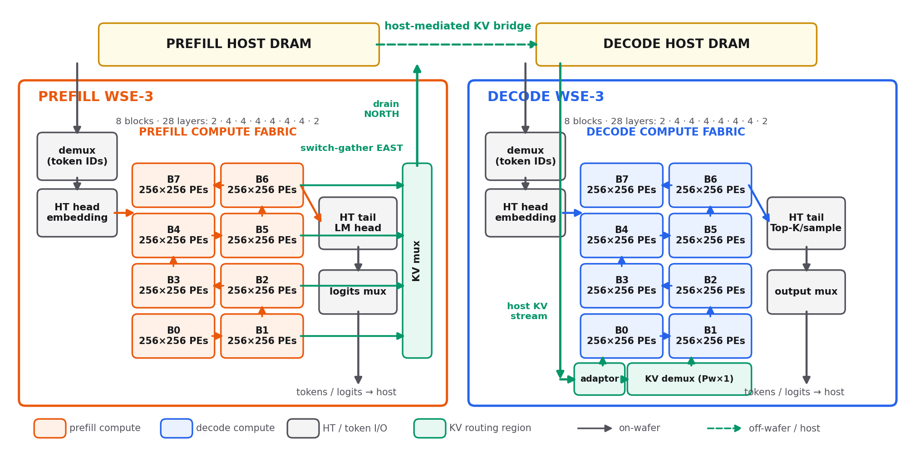
EXPERIMENT IMPLEMENTATION · LOGICAL ON-CHIP LAYOUT
Experiment topology: prefill card → hosts → decode card
Each kernel uses a 2×4 serpentine pipeline of 256×256-PE blocks. Prefill gathers KV east into kv_mux and drains north; decode accepts the host KV stream through adaptor + kv_demux and shifts column slices north into the fabric.
Notes:
This is the logical topology used by the measured pdSeparate implementation, not a to-scale wafer map. The cards do not share an on-wafer relay seam: KV crosses through their separate host memories. The layer slices across B0…B7 are 2,4,4,4,4,4,4,2.

Slide 3
EXPERIMENT IMPLEMENTATION · LOGICAL ON-CHIP LAYOUT
Experiment topology: prefill card → hosts → decode card
Prefill
Decode
A Recompute
…
+
+
…
Force/Free decode
Host DRAM
t1
t2
t3
Host DRAM
Prefill
Decode
B Reload
…
+
+
…
Host DRAM
Host DRAM
Prefill
Decode
C Prefill
+
…
+
+
…
t1
t2
t3
Host DRAM
Host DRAM
Each kernel uses a 2×4 serpentine pipeline of 256×256-PE blocks. Prefill gathers KV east into kv_mux and drains north; decode accepts the host KV stream through adaptor + kv_demux and shifts column slices north into the fabric.
Notes:
This is the logical topology used by the measured pdSeparate implementation, not a to-scale wafer map. The cards do not share an on-wafer relay seam: KV crosses through their separate host memories. The layer slices across B0…B7 are 2,4,4,4,4,4,4,2.

Slide 4
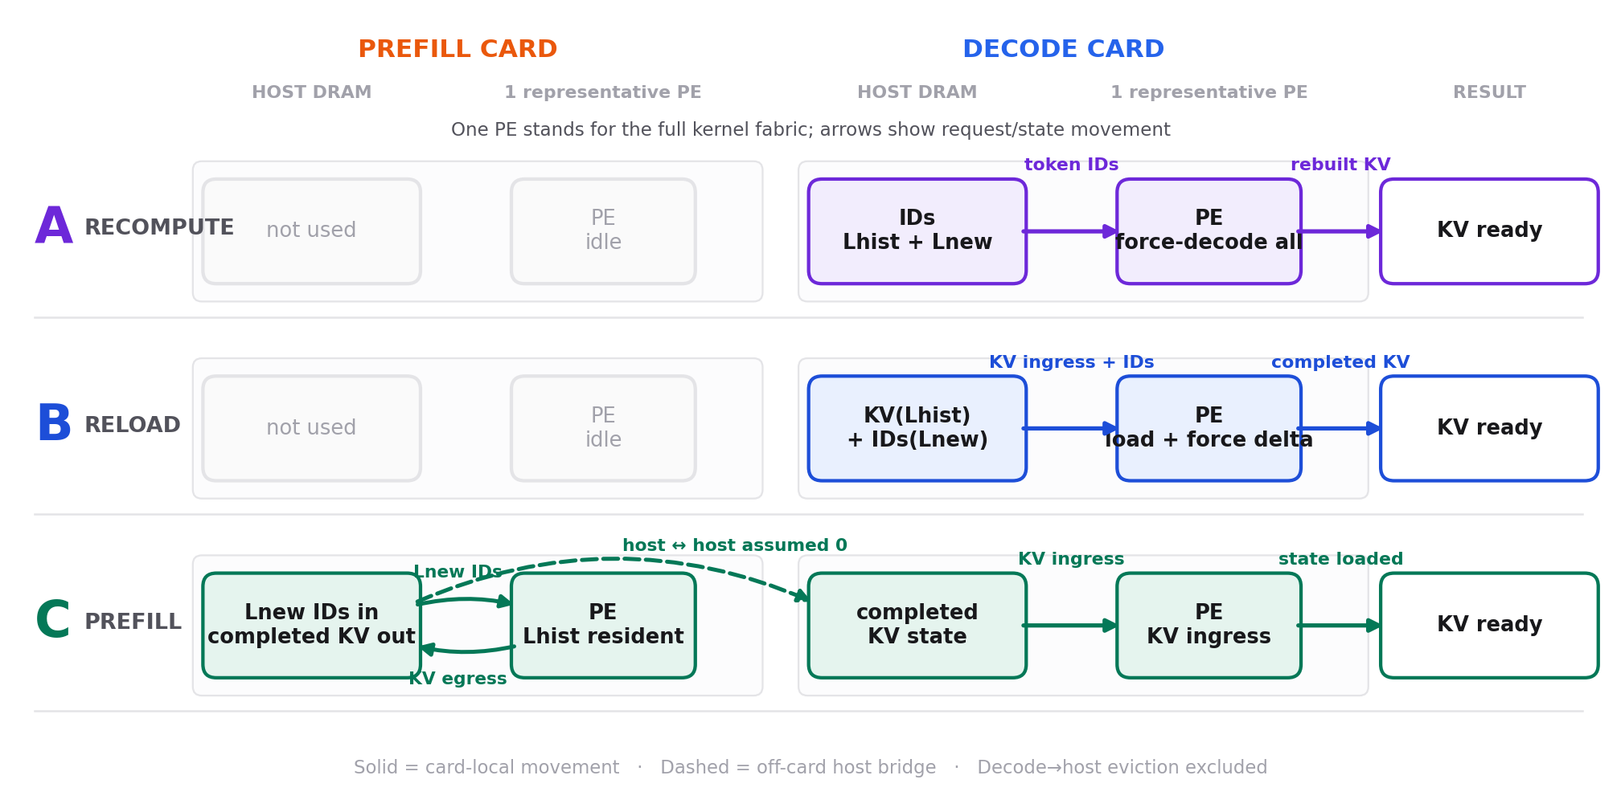
THREE RESUME APPROACHES
Three request paths on the same simplified topology
A sends token IDs to decode and rebuilds all KV; B reloads persisted history KV and computes only Lnew; C extends resident KV on prefill, then transfers the completed state through both hosts.
Notes:
One PE represents the complete 2×4 kernel fabric from slide 2. Each row uses one prefill card and one decode card with separate host memory. The dashed host-to-host leg in C is assumed zero in the current latency model.

Slide 5
QUESTION AND ASSUMPTIONS
Three ways to resume an evicted request
SESSION STATE
History, delta, generation
RESUME LANES
01
A — force-decode Lhist + Lnew in decode; no reload
PD separation: prefill and decode each occupy one WSE card with separate host DRAM. Lhist KV is assumed persisted; Lnew has no KV. We time resume only—decode→host eviction and host-to-host latency are excluded.
02
B — reload Lhist KV; force-decode only Lnew
03
C — prefill Lnew over resident Lhist; transfer the completed KV state to decode
Notes:
Lane B assumes the history was already persisted. E13, the decode egress half, is not implemented, so this is not yet a round-trip eviction policy.

Slide 6
IMPLEMENTATIONS AND MEASUREMENT CONTRACT
The experiments do not all exercise the same kernel path
EVIDENCE
KERNEL / PATH
SWEEP
QUALIFICATION
E5
pdSeparate decode KV ingress adaptor/injector
P=256…8192
Direct device TSC
E9
2×4 force-decode pipeline; 28 layers
P=256; F=1…20224
Direct device TSC
E14
Same force-decode model config
4 prefixes × 6 F
n=1; 24/24 pass
E10/D
Reload path + post-ingress force decode
H=512…8192
Two direct totals
E12a
S6a resident-prefix prefill, e0a19fc
Two 8192-context cases
Screening; not exact pdSeparate
E6
Prefill transpose + switch-gather egress
1…32 chunks
Not inverse-equivalent to E5
Notes:
All reported device spans use the 0.85 GHz TSC conversion. Failed EPCC 502 repeats and a run without a downloaded hash-verified evidence bundle are excluded.

Slide 7
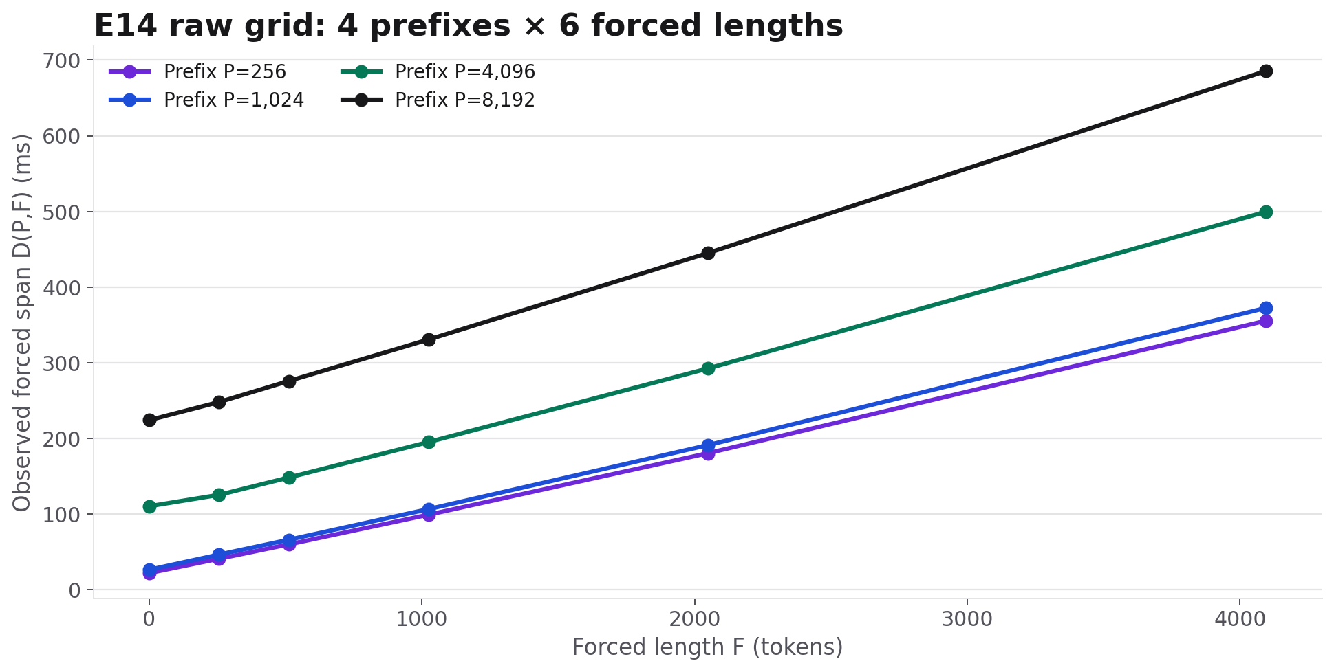
LANE A · EXPERIMENT
All 24 force-decode spans across prefix × forced length
RAW — P={256,1024,4096,8192}, F={1,256,512,1024,2048,4096}; real Qwen3-1.7B on WSE-3, n=1.
Notes:
The large separation at small F is visible before any offset subtraction or regression.

Slide 8
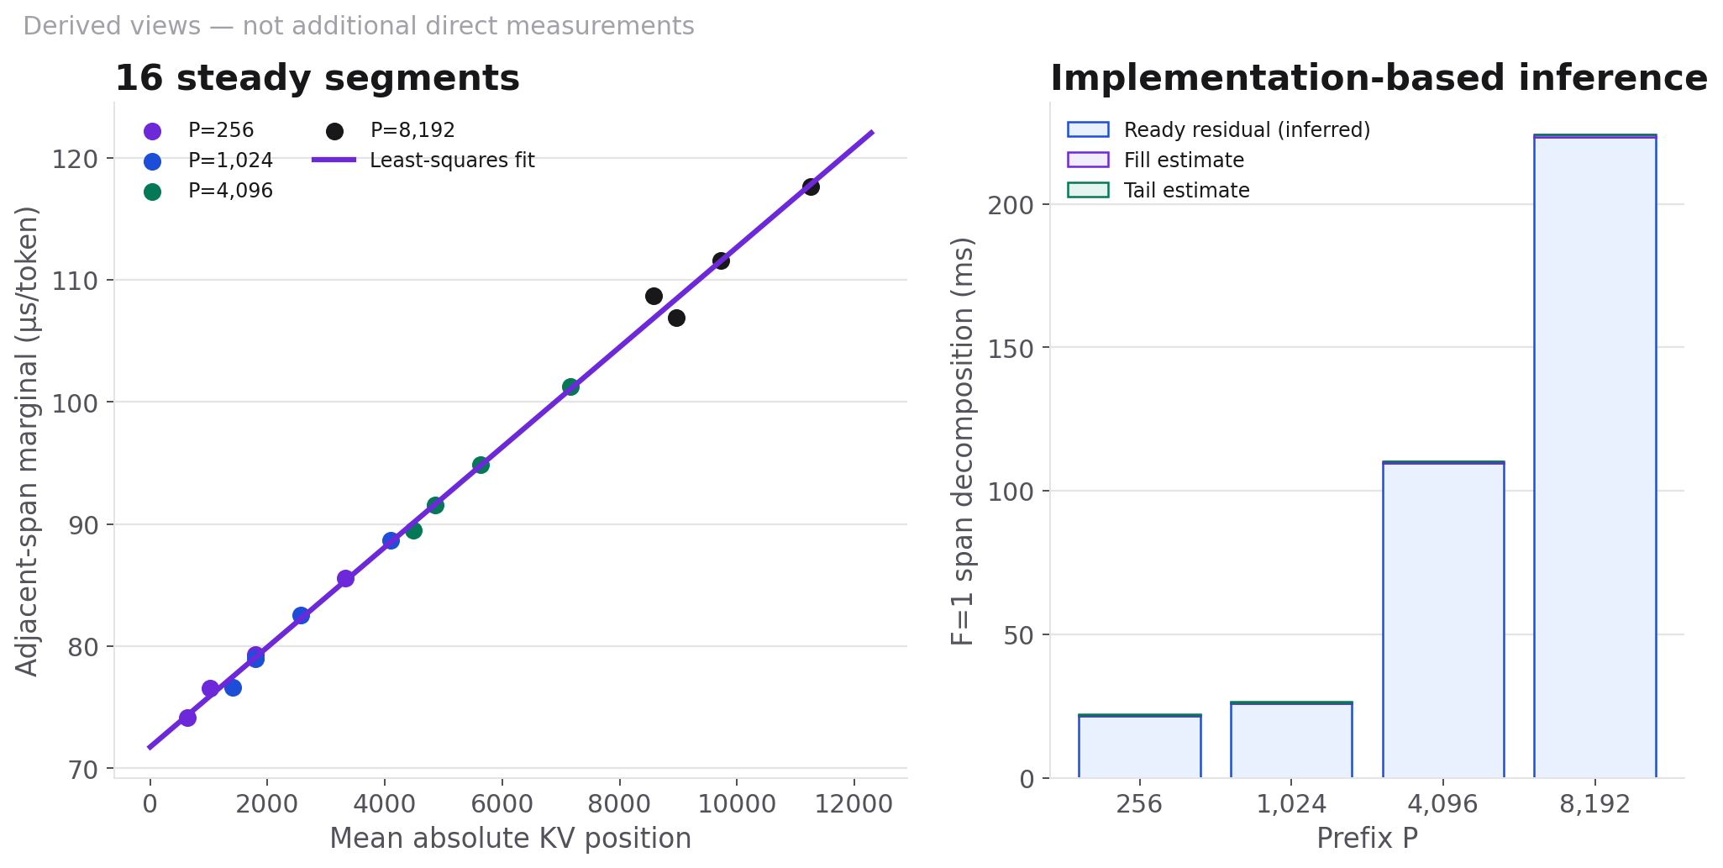
LANE A · PERFORMANCE MODEL
Startup anchor + position-dependent intervals
D(P,F)=D(P,256)+Σ II(q), where 16 steady segments give II(q)=71.745 µs+4.093 ns·q. Ready/fill/tail are inferred.
Notes:
The source-level timer starts after a locally-ready west-edge sender emits [N,F], before HT_tail receives first Z. It is not an all-PE readiness barrier. Exact attribution needs a first-Z timestamp.

Slide 9
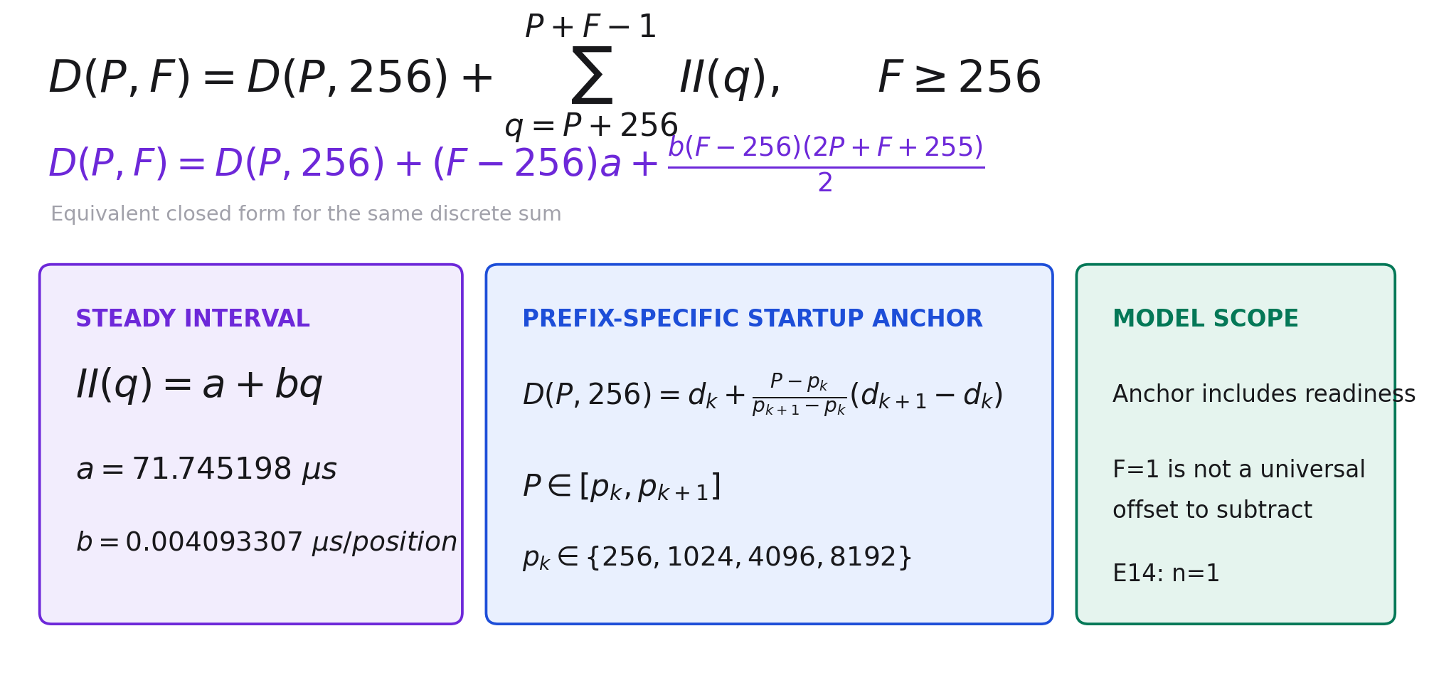
LANE A MODEL
Complete force-decode equations
P – Prefix length, F – Force decode length, q – token position in the sequencce
The discrete sum and closed form are equivalent. D(P,256) is interpolated between measured prefix anchors; F=1 is not subtracted as a universal offset.
Notes:
The closed form follows from summing q from P+256 through P+F−1: there are F−256 terms and their sum is (F−256)(2P+F+255)/2.

Slide 10
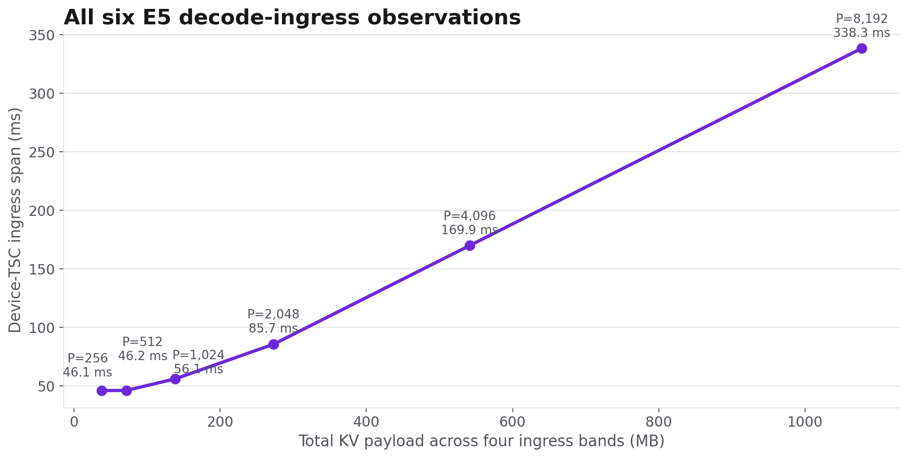
LANE B · EXPERIMENT
Decode KV ingress: six raw measurements
RAW — six device-TSC observations on the pdSeparate ingress path, spanning the floor, knee, and byte-dominated region.
Notes:
Do not compare this bandwidth directly with E6 prefill egress: E6 performs a transpose and switch-gather in addition to moving bytes.

Slide 11
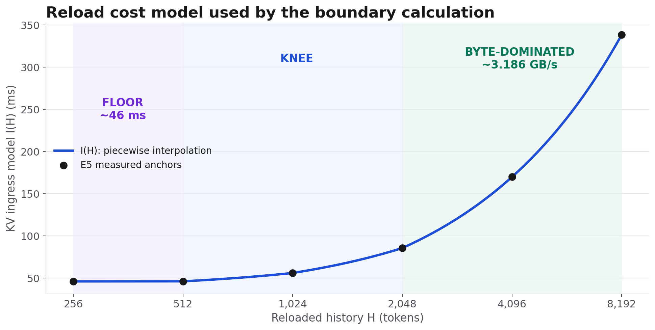
LANE B · PERFORMANCE MODEL
Reload = floor + payload term
I(H) uses piecewise-linear interpolation of the six E5 anchors; the saturated region approaches 3.186 GB/s aggregate.
Notes:
The A/B boundary calculation uses the measured-anchor interpolation, not a single bandwidth number across the whole payload range.

Slide 12
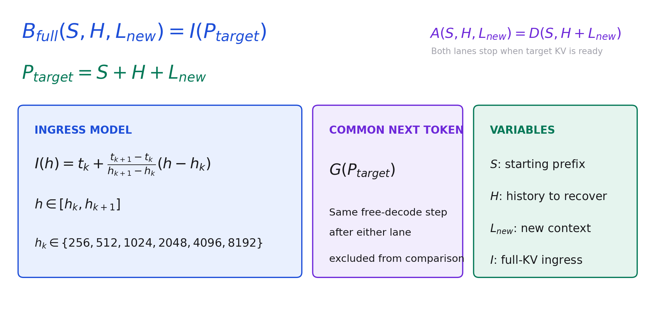
LANE B MODEL
Lane B reload equations
Lane B reloads the complete target KV: B=I(S+H+Lnew). The next free-decode token is common to both lanes and excluded.
Notes:
I(h) is piecewise-linear interpolation over the six E5 anchors. Under the current Lane B contract, host memory already holds the complete target KV, so Lane B has no force-decode term. The older E10 delta-reload fixture is a different mechanism and must not be substituted here.

Slide 13
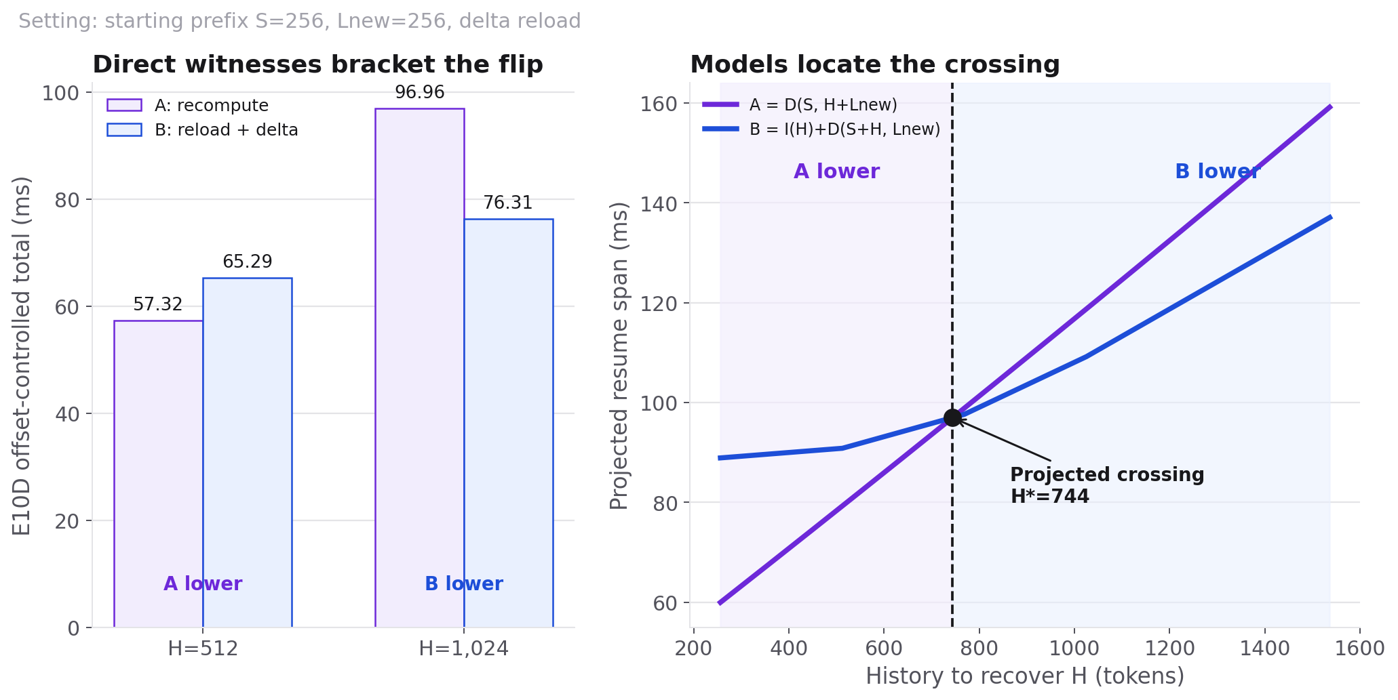
LANE A VS LANE B
The measured flip and the projected crossing
Left: E10D offset-controlled totals. Right: E14+E5 observed-span projection gives H*=744 (S=256, Lnew=256, delta reload); compare winner/crossing, not absolute y-values.
Notes:
The left panel is the E10D offset-controlled direct comparison. The right panel is the newer E14 observed-span model, so the absolute y-values should not be overlaid; the robust shared conclusion is the winner flip and a crossing between the two direct witnesses. Other starting prefixes and full-context reload move the projected boundary.

Slide 14
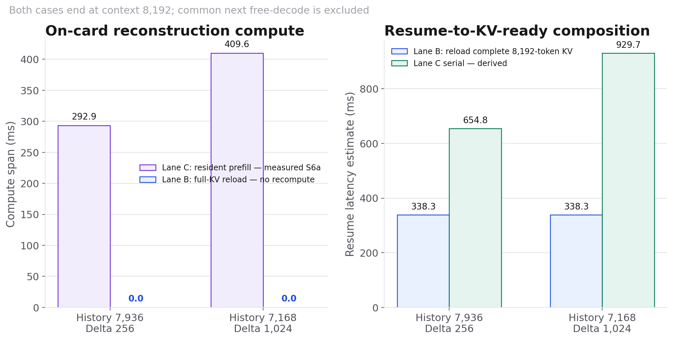
E12A · SCREENING OBSERVATIONS
Two resident-prefix prefill cases at total context 8,192
Lane B: full-KV reload = 338.266 ms in both cases; forced delta and common free-decode excluded.
Notes:
Lane B reloads the complete target KV and resumes with normal free decode. Lane C remains a screening composition based on direct S6a prefill compute plus E5/E6 transport evidence; exact pdSeparate lacks START_CHUNKS.

Slide 15
MILESTONE CURSOR
Finish M2, then resume M1 from S2
M2 · CLOSE
Reconcile Lane B; close E14/E11 and conditional E13; keep E12 gated.
M1 · S2 NEXT
Track per-slot valid_len and verify retention as active slots change.
M1 · S3
Implement prefix hits, skip-prefill, LRU replace, miss rebuild, and truncation.
M1 · S4
Measure requests per bank near the SRAM limit and addressing overhead.
M1 · S5
Verify full/partial hits, misses, and eviction end to end against the oracle.
Notes:
M2 is condensed into one closeout line. The authoritative M1 milestone marks S0 and S1 complete; its remaining dependency chain is S2 to S3 to S4 to S5. The partial-hit open question is resolved by the S3 take-over default, while exact SRAM sizing is part of S4.

Slide 16
WHAT THE EVIDENCE SUPPORTS
A conditional policy, with explicit gaps
STATEMENT
EVIDENCE STRENGTH
SCOPE / CAVEAT
Ingress has a ~46 ms floor
Direct measured
pdSeparate decode ingress
Forced steady cost grows with position
Measured + fit
16 E14 steady segments
A/B winner flips at 512→1024
Direct measured
Lnew=256 resume setting
Crossing moves with S and reload policy
Model-derived
Direct witnesses pending
Current Lane C loses
Screening
S6a path; exact port pending
Full eviction round trip favors B
Unknown
Decode egress E13 missing
Notes:
The safe conclusion is a workload- and implementation-dependent segmented policy, not a universal 700-token rule.

Slide 17
NEXT MEASUREMENTS
Only run experiments that can change the decision
E14
Add a same-PE first-Z timestamp; separate readiness from first-token fill.
E14
Sweep F={1,16,32,64,128,256}, alternate order, and obtain n=2.
E10
Directly witness S=1024 and S=4096 boundary neighborhoods.
E12a
Port to exact pdSeparate only if final confirmation is required.
E13
Decide whether full eviction round-trip latency is required for the policy claim.
Notes:
E12b prefill ingress is gated: transport work alone cannot remove the measured S6a compute floor.

