Slide 1
WaferEngine · CS-3
M2 STUDY · WEEKLY MEETING
KV Resume on WSE-3
Measured costs of recompute, reload, and resident-prefix prefill.
MODEL
DEVICE
TSC
SCOPE
Qwen3-1.7B
WSE-3
0.85 GHz
Resume latency
Notes:
The question is not which lane is universally best. It is which cost dominates under a specific resume state and implementation.

Slide 2
QUESTION AND ASSUMPTIONS
Three ways to resume an evicted request
SESSION STATE
History, delta, generation
RESUME LANES
01
A — force-decode Lhist + Lnew in decode; no reload
PD separation: prefill and decode each occupy one WSE card with separate host DRAM. Lhist KV is assumed persisted; Lnew has no KV. We time resume only—decode→host eviction and host-to-host latency are excluded.
02
B — reload Lhist KV; force-decode only Lnew
03
C — prefill Lnew over resident Lhist; transfer the completed KV state to decode
Notes:
Lane B assumes the history was already persisted. E13, the decode egress half, is not implemented, so this is not yet a round-trip eviction policy.

Slide 3
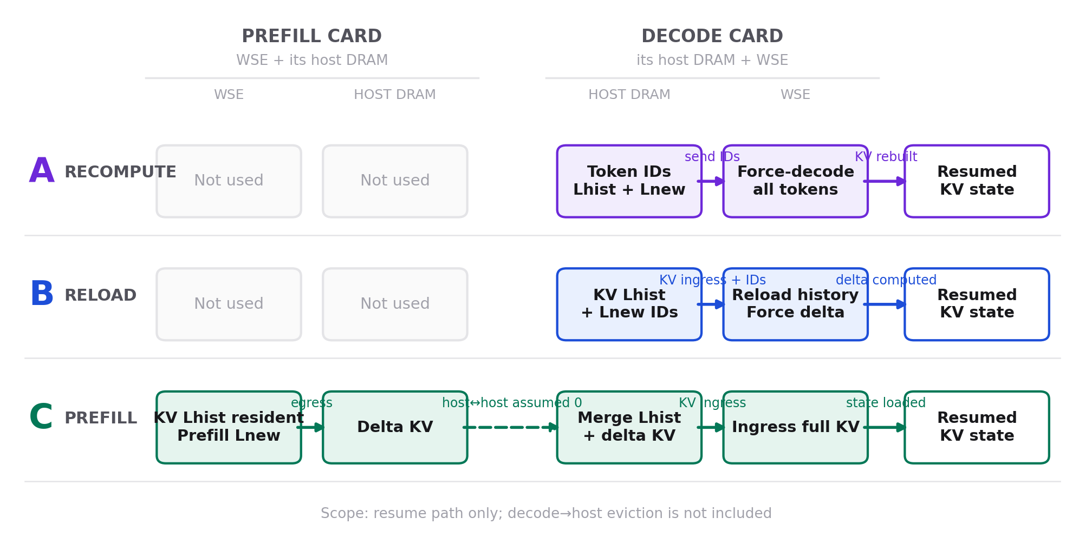
THREE RESUME APPROACHES
How the three resume lanes move state
A recomputes on decode; B reloads history then computes the delta; C computes the delta on prefill and transfers KV through the two hosts.
Notes:
Each row uses the same physical assumption: one prefill card and one decode card, each with its own host memory. The dashed host-to-host leg in C is assumed zero in the current latency model.

Slide 4
IMPLEMENTATIONS AND MEASUREMENT CONTRACT
The experiments do not all exercise the same kernel path
EVIDENCE
KERNEL / PATH
SWEEP
QUALIFICATION
E5
pdSeparate decode KV ingress adaptor/injector
P=256…8192
Direct device TSC
E9
2×4 force-decode pipeline; 28 layers
P=256; F=1…20224
Direct device TSC
E14
Same force-decode model config
4 prefixes × 6 F
n=1; 24/24 pass
E10/D
Reload path + post-ingress force decode
H=512…8192
Two direct totals
E12a
S6a resident-prefix prefill, e0a19fc
Two 8192-context cases
Screening; not exact pdSeparate
E6
Prefill transpose + switch-gather egress
1…32 chunks
Not inverse-equivalent to E5
Notes:
All reported device spans use the 0.85 GHz TSC conversion. Failed EPCC 502 repeats and a run without a downloaded hash-verified evidence bundle are excluded.

Slide 5
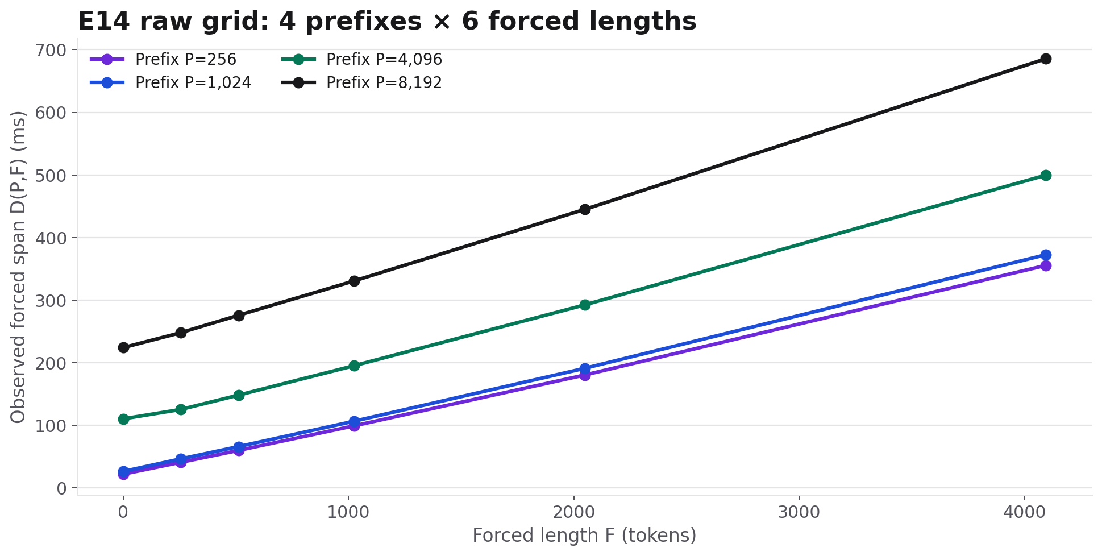
LANE A · EXPERIMENT
All 24 force-decode spans across prefix × forced length
RAW — P={256,1024,4096,8192}, F={1,256,512,1024,2048,4096}; real Qwen3-1.7B on WSE-3, n=1.
Notes:
The large separation at small F is visible before any offset subtraction or regression.

Slide 6
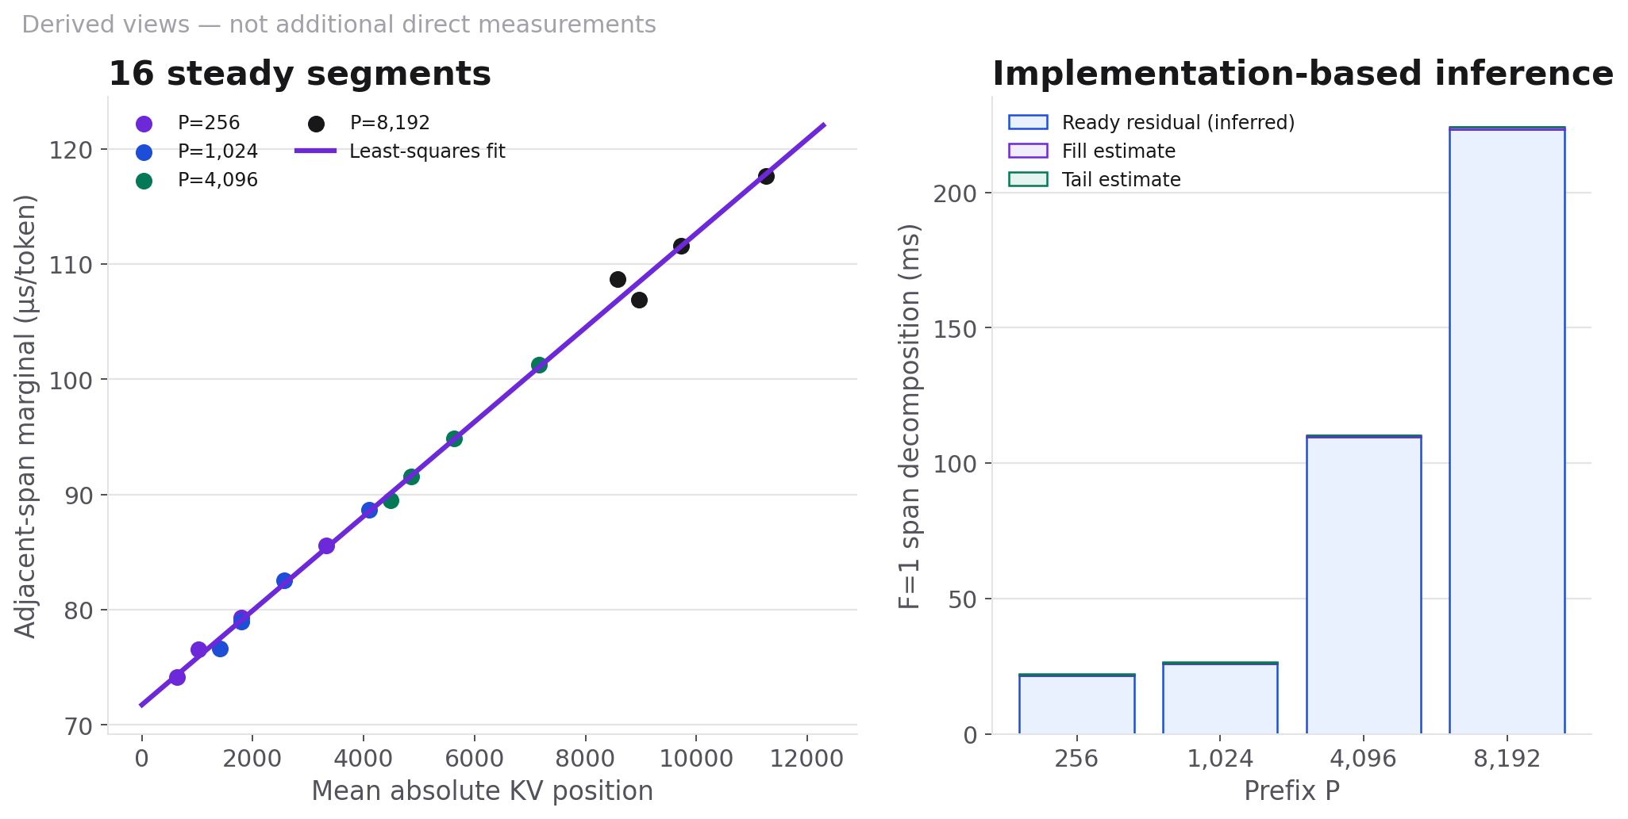
LANE A · PERFORMANCE MODEL
Startup anchor + position-dependent intervals
D(P,F)=D(P,256)+Σ II(q), where 16 steady segments give II(q)=71.745 µs+4.093 ns·q. Ready/fill/tail are inferred.
Notes:
The source-level timer starts after a locally-ready west-edge sender emits [N,F], before HT_tail receives first Z. It is not an all-PE readiness barrier. Exact attribution needs a first-Z timestamp.

Slide 7
LANE A MODEL
How Lane A cost is calculated
COST EQUATION
D(P,F)
WHAT ENTERS THE MODEL
01
D(P,256) absorbs prefix-dependent startup and pre-first-token readiness
For F≥256, start from the measured prefix-specific anchor D(P,256), then add one steady completion interval for each additional forced token.
02
II(q)=71.745 µs+4.093 ns·q is fit from 16 adjacent-span differences beginning at F≥256
03
D(P,F)=D(P,256)+Σ[q=P+256…P+F−1] II(q)
04
Startup anchors are interpolated only across measured prefix values
Notes:
F=1 is not subtracted as a universal offset. The model deliberately leaves readiness inside D(P,256) until a first-Z timestamp separates it from first-token fill.

Slide 8
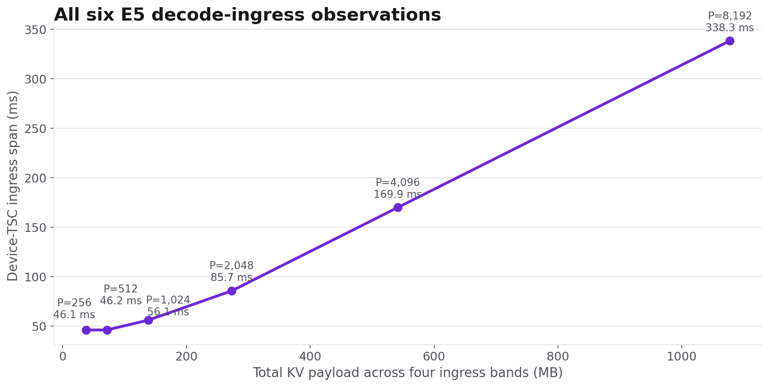
LANE B · EXPERIMENT
Decode KV ingress: six raw measurements
RAW — six device-TSC observations on the pdSeparate ingress path, spanning the floor, knee, and byte-dominated region.
Notes:
Do not compare this bandwidth directly with E6 prefill egress: E6 performs a transpose and switch-gather in addition to moving bytes.

Slide 9
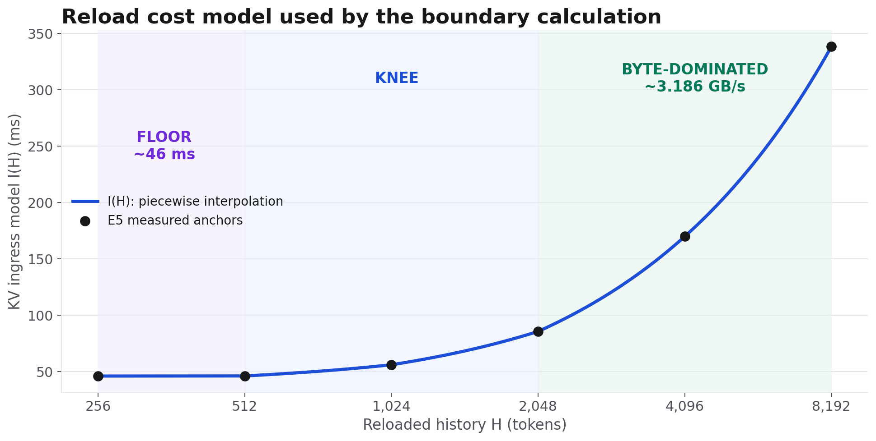
LANE B · PERFORMANCE MODEL
Reload = floor + payload term
I(H) uses piecewise-linear interpolation of the six E5 anchors; the saturated region approaches 3.186 GB/s aggregate.
Notes:
The A/B boundary calculation uses the measured-anchor interpolation, not a single bandwidth number across the whole payload range.

Slide 10
LANE B MODEL
How Lane B cost is calculated
COST EQUATION
B(S,H,Lnew)
WHAT ENTERS THE MODEL
01
I(H): interpolate the six E5 ingress anchors
B = I(H)+D(S+H,Lnew): reload H history tokens, then force-decode Lnew at absolute position S+H.
02
This preserves the ~46 ms floor, knee, and byte-dominated region
03
D(S+H,Lnew): reuse the Lane A startup + steady-II model
04
Full-context reload replaces I(H) with I(S+H)
Notes:
E10 validates that the real reload path reproduces E5 and that post-ingress forced-token cost matches E9 to 0.97–1.00 across H=512…8192. Host-to-host latency and decode→host eviction remain excluded.

Slide 11
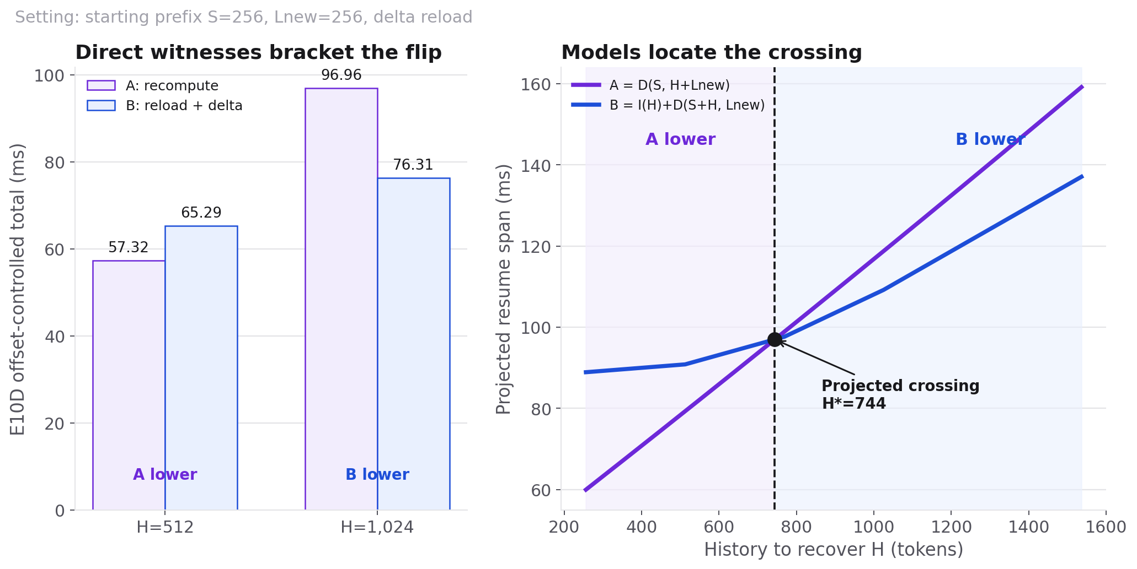
LANE A VS LANE B
The measured flip and the projected crossing
Left: E10D offset-controlled totals. Right: E14+E5 observed-span projection gives H*=744 (S=256, Lnew=256, delta reload); compare winner/crossing, not absolute y-values.
Notes:
The left panel is the E10D offset-controlled direct comparison. The right panel is the newer E14 observed-span model, so the absolute y-values should not be overlaid; the robust shared conclusion is the winner flip and a crossing between the two direct witnesses. Other starting prefixes and full-context reload move the projected boundary.

Slide 12
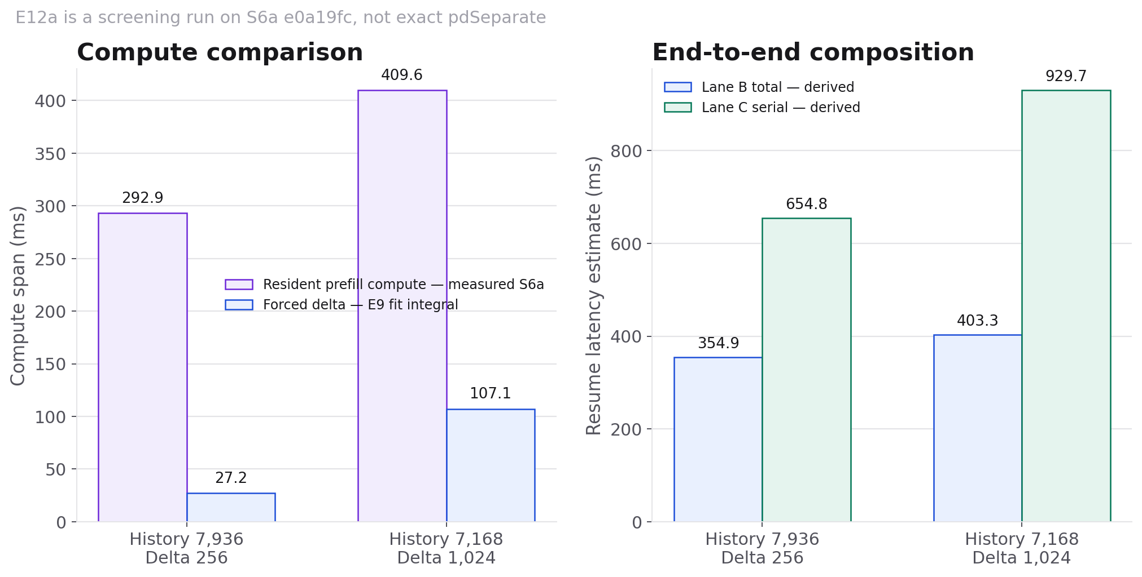
E12A · SCREENING OBSERVATIONS
Two resident-prefix prefill cases at total context 8,192
MEASURED + DERIVED — direct S6a prefill compute at total context 8,192; forced and lane totals combine E9/E5/E6 evidence.
Notes:
The two resident-prefix compute measurements were byte-identical across cold/warm and warm/warm checks. Exact pdSeparate lacks START_CHUNKS, so this is a validated screening result, not the final pdSeparate benchmark.

Slide 13
WHAT THE EVIDENCE SUPPORTS
A conditional policy, with explicit gaps
STATEMENT
EVIDENCE STRENGTH
SCOPE / CAVEAT
Ingress has a ~46 ms floor
Direct measured
pdSeparate decode ingress
Forced steady cost grows with position
Measured + fit
16 E14 steady segments
A/B winner flips at 512→1024
Direct measured
Lnew=256 resume setting
Crossing moves with S and reload policy
Model-derived
Direct witnesses pending
Current Lane C loses
Screening
S6a path; exact port pending
Full eviction round trip favors B
Unknown
Decode egress E13 missing
Notes:
The safe conclusion is a workload- and implementation-dependent segmented policy, not a universal 700-token rule.

Slide 14
NEXT MEASUREMENTS
Only run experiments that can change the decision
E14
Add a same-PE first-Z timestamp; separate readiness from first-token fill.
E14
Sweep F={1,16,32,64,128,256}, alternate order, and obtain n=2.
E10
Directly witness S=1024 and S=4096 boundary neighborhoods.
E12a
Port to exact pdSeparate only if final confirmation is required.
E13
Decide whether full eviction round-trip latency is required for the policy claim.
Notes:
E12b prefill ingress is gated: transport work alone cannot remove the measured S6a compute floor.

