Slide 1
WaferEngine · CS-3
WEEKLY COLLABORATOR DISCUSSION
On-Chip KV Offload as a Storage Tier
Two multi-row storage designs measured on real WSE-3; the on-chip tier now sits under both prior resume options.
MODEL
EVIDENCE
SCOPE
DATE
Qwen3-1.7B geometry
81 CS-3 runs, 0-cycle spread
M3 idle-PE tier
2026-08-24
Notes:
This week closes the M3 multi-row storage question with device data: both candidate designs (v4 GO-chain, v5 cascade) ran on real CS-3, both are modeled to <1%, and the combined result upgrades the M2 resume tradeoff from a two-way A/B to a three-tier hierarchy.

Slide 2
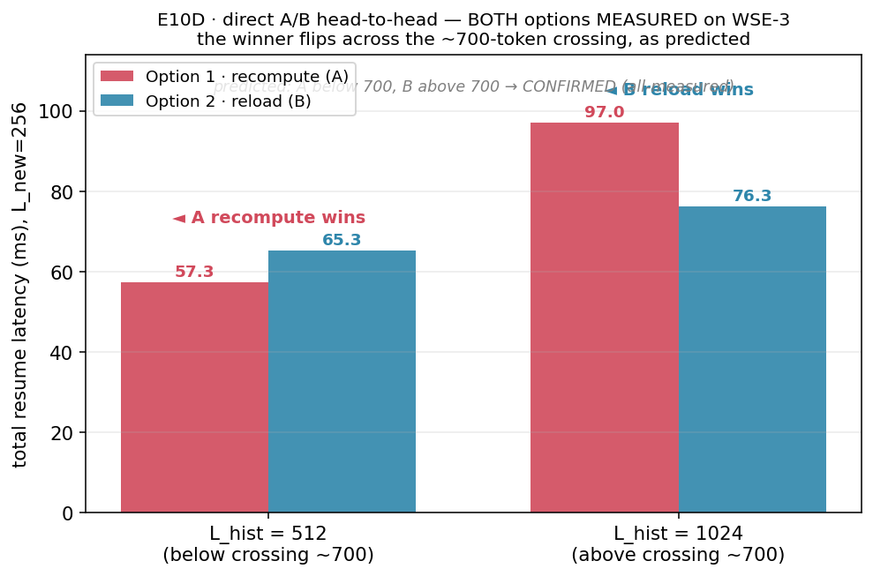
GOAL · WHERE WE ARE IN THE MILESTONES
M2 ended at recompute-vs-host with a 744-token crossing; M3 asks if idle PEs beat both
Last time (M2 E10/E10D, all device-measured): below H*=744 recompute wins, above it host reload wins — but reload rides shared edge IO and the host. M3's question: can idle on-chip PEs hold parked KV as a middle tier? This week: build the multi-row storage strip both candidate ways, measure both end-to-end, and price the tier.
Notes:
Position: M1 in-PE reuse is done (tier 0). M2 priced recompute (A, 77.4 us/token) vs host reload (B, E5 ingress 46-338 ms) and found the crossing at 744 tokens. M3 (idle-PE tier) needs multi-row storage because one storage PE holds ~11K words: L=1024 already needs R=2 rows, L=8192 needs ~12. The single-row protocol was device-proven earlier (51 runs); the open question was HOW to coordinate R rows — and at what cost.

Slide 3
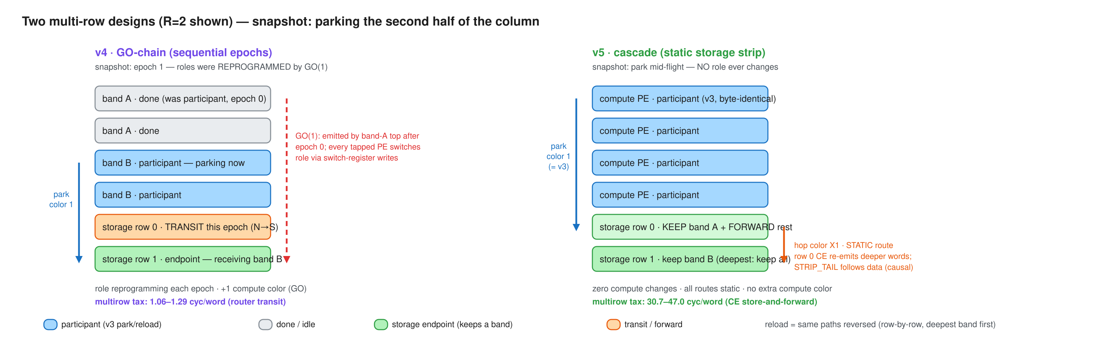
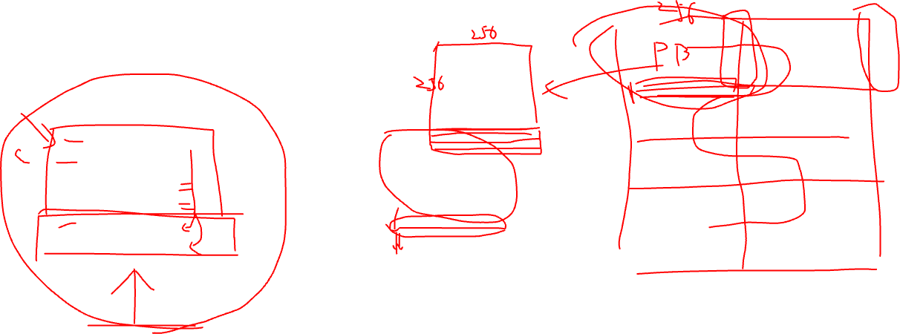
IMPLEMENTATION · TWO COORDINATION DESIGNS
v4 reprograms compute roles per epoch; v5 keeps compute byte-identical and cascades inside the strip
Both share the proven single-row protocol on one borrowed color. v4: bands park in sequential epochs, chained fully on-chip by a GO color; every tapped PE rewrites its switch positions per epoch. v5: row 0 keeps the nearest band and store-and-forwards deeper words on static per-hop colors; a STRIP_TAIL word rides behind the data as the causal end-of-stream. Reload returns over the same paths reversed.
Notes:
v4 needed direct switch-position byte writes (the tile_config library writes the wrong tx bit for RAMP - register-dump proven; byte = in_sel<<5|out_bits, S->RAMP=0x50). First-ever v4 silicon this week: GO chain, role reprogramming, and the byte writes all work at 256 PEs. v5's compute column is cmp-verified byte-identical to the single-row demo; every strip route is static so cross-color ordering hazards are impossible by construction. Editable source: docs/diagrams/m3-multirow-v4-vs-v5.excalidraw.

Slide 4
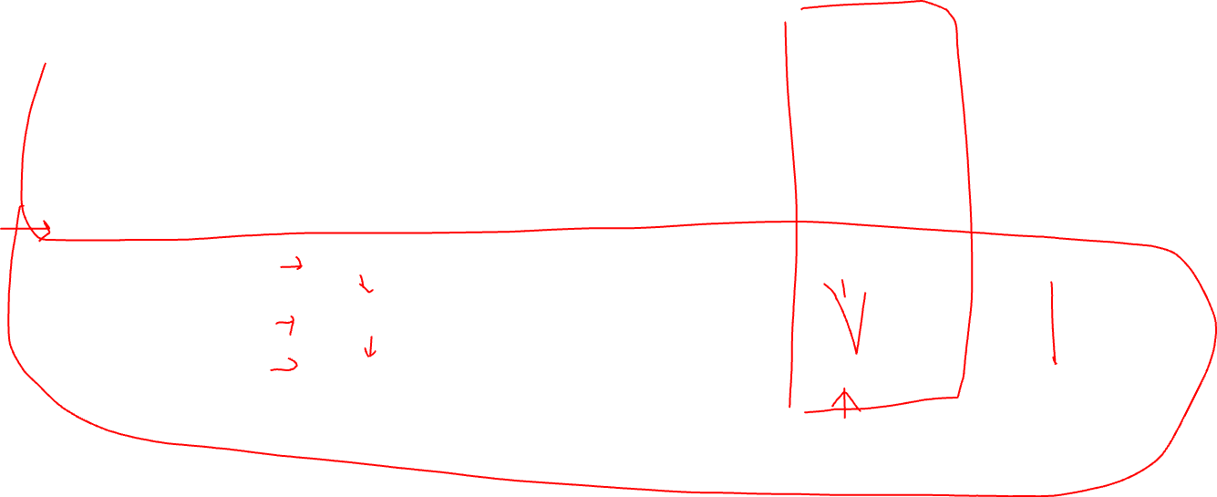
CAPACITY · NOMINAL 42 KIB/STORAGE PE = 672 KV-TOKEN EQUIVALENTS PER 1×256 ROW/BLOCK
Each row adds 672-token capacity; v4 wins every multi-row setting
KV MOVED
ROWS · CAPACITY
V3 SINGLE-ROW
V4 GO-CHAIN
V5 CASCADE
task · 1,024 tok
1 · 672 tok (under)
1,388,470
1,535,920
1,420,244
task · 1,024 tok
2 · 1,344 tok (fits)
—
1,544,946
1,675,327
task · 1,024 tok
4 · 2,688 tok (fits)
—
1,550,855
1,812,526
DSD · 8,192 tok
1 · 672 tok (under)
7,350,234
8,542,434
7,482,812
DSD · 8,192 tok
2 · 1,344 tok (under)
—
8,619,349
10,669,498
DSD · 8,192 tok
4 · 2,688 tok (under)
—
8,675,026
12,343,610
Current layout gives ~36 rows per PE block (bottom, 24K tokens) or ~56 rows per PE block (right, 38K tokens)
Notes:
EPCC CS-3, distance=1, n=3 per cell, zero infrastructure failures across 81 runs; every cell reproduced to the cycle. Visible payload labels replace benchmark notation: with compute-column height N=256 and lpb=4, E=64 u32 words/compute PE maps to 1,024 KV tokens and E=512 maps to 8,192. R is the number of 1×256 storage rows. Capacity is nominal analytical sizing, not compile-fit: 42 KiB/storage PE gives 672 KV-token equivalents per row/block, so R=1/2/4 gives 672/1,344/2,688 tokens. The demo verifies movement rather than retaining the full payload; therefore the 8,192-token rows shown are intentionally capacity-undersized measurements (about 13 rows are needed nominally). v4 metric = sum of per-band spans (excludes inter-epoch GO gaps, ~2*bh cycles each). DSD = owner-side bulk fabin-DSD reload receive. v4 wins every measured R>=2 cell; DSD 8,192-token payload at R=4 is 30% faster than v5.

Slide 5
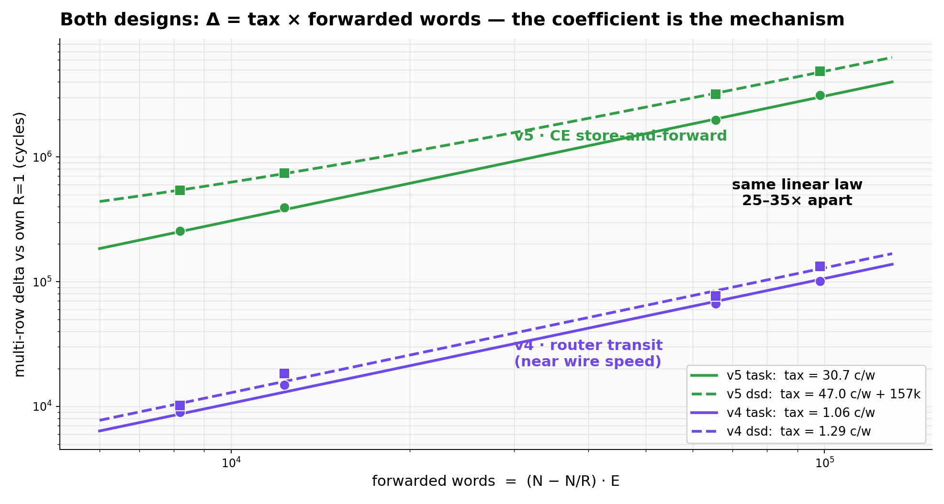
MODEL · ONE LAW, TWO COEFFICIENTS
Both designs obey delta = tax x forwarded words — the tax is the mechanism, 25-35x apart
Delta vs each design's own R=1 baseline collapses on the same axis, fwd_words = (N - N/R)·E. v4's tax is router-level transit (1.06/1.29 cyc/word, near wire speed); v5's is a CE data-task per forwarded word (30.7/47.0). The v5 dsd fit needs one extra constant (~157k cycles): strip rows emit their own block before relaying, which fast owners expose.
Notes:
The preregistered hypotheses were productively falsified: H1 (v5 R=1 reproduces v3 anchors) failed at +0.7-2.3% - the cascade's per-word branches do not compile out, so every implementation carries its own baseline. H2 (v4 overhead = per-epoch constant) failed in form - v4's delta is also per-forwarded-word, just router-priced. H3 (linearity in fwd_words) confirmed for E>=64 in both designs. Fitting: taxes from delta-vs-fwd slopes over (R,E) grid; c_fwd_word=75.4 from four independent park-span decompositions; c_relay_word~28.8 from the dsd identity, cross-checked against task mode to 1.6%.

Slide 6
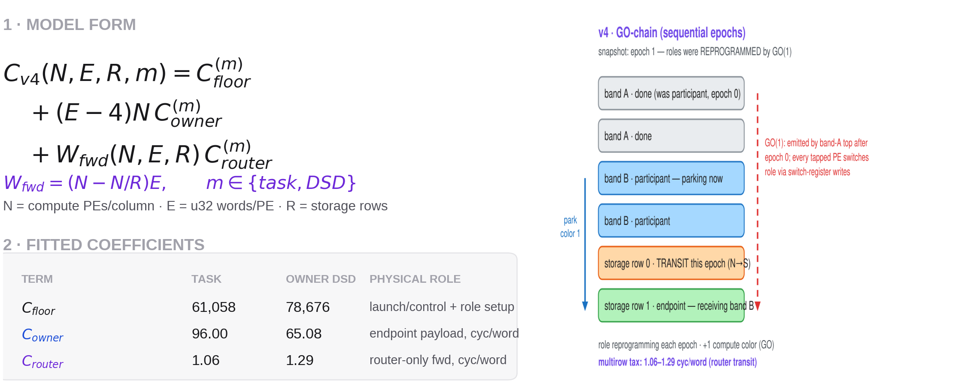
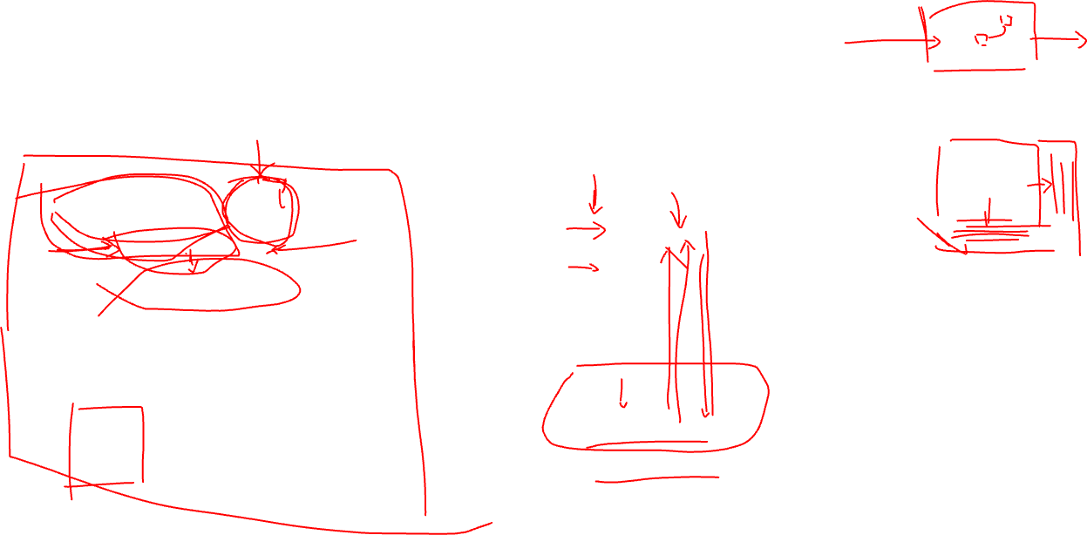
MODEL · V4 GO-CHAIN, MEASURED WINNER FOR R >= 2
v4 cost = endpoint baseline + router-only forwarding
Generic equation first, fitted coefficients second, topology at right. Setting: N=256, E>=64; pairs are task | owner-side bulk-DSD. v4 epoch_sum excludes small inter-epoch GO gaps.
Notes:
各项含义：
C_v4：v4 完成一次 park + reload 的设备原始周期数。使用 epoch_sum，不包含 epoch 之间较小的 GO gap。
N：一个 compute column 中参与 offload 的 owner/compute PE 数。当前 fit 固定为 N=256。
E：每个 compute PE 搬运的 u32 word 数。lpb=4 时：
\[ E=16\lceil L/256\rceil \]
因此 E=64 对应 1,024-token KV，E=512 对应 8,192-token KV。
R：storage row 数量。
m：endpoint receive 实现：
task：每个数据 wavelet 进入 CE task。
owner-DSD：owner 端使用 bulk fabin DSD 接收。
C_base,4：在参考点 E0=4 words/PE 上的 fitted baseline cycle。它包含该参考 payload 和 control/role machinery，不能解释成纯 launch latency。v4 没有测 E=4；这个值是从 v4 自己的 R=1, E=64/512 数据线性外推得到的。
C_owner：超过 E0 后，每增加一个 owner payload word 带来的完整 park+reload endpoint 增量成本：
task：96.00 cycles/owner-word
owner-DSD：65.08 cycles/owner-word
W_fwd：critical path 上绕过最近 storage row、需要继续向更深 storage row 转发的 word 数。它不是整个 strip 上所有 hop-word 数量的总和。
C_router：每个 W_fwd word 产生的额外 router-only multi-row transit 成本：
task：1.06 cycles/forwarded-word
owner-DSD：1.29 cycles/forwarded-word
v4 wins every measured R>=2 cell, so this page intentionally removes v3/v5. Model form: C_v4 = C_floor + (E-4)N*C_owner + W_fwd*C_router, W_fwd=(N-N/R)E. C_floor prices launch/control and role setup. C_owner prices the ordinary endpoint path per payload word: 96.00 task / 65.08 owner-DSD. C_router is the incremental multi-row forwarding tax: 1.06 / 1.29 cycles per forwarded word. The topology crop is derived from docs/diagrams/m3-multirow-v4-vs-v5.excalidraw; it shows the sequential GO epoch and router transit row.

Slide 7
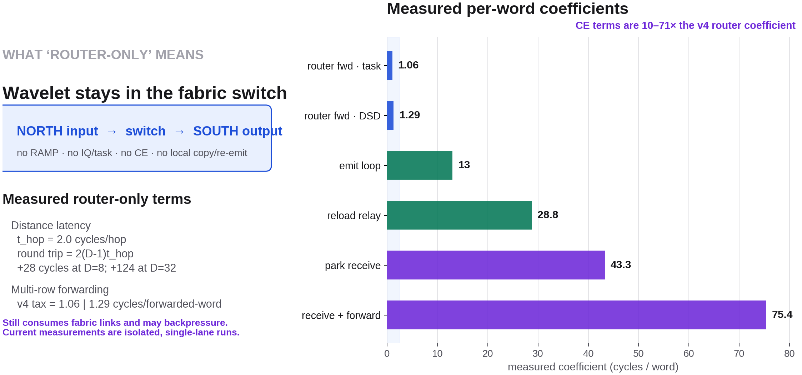
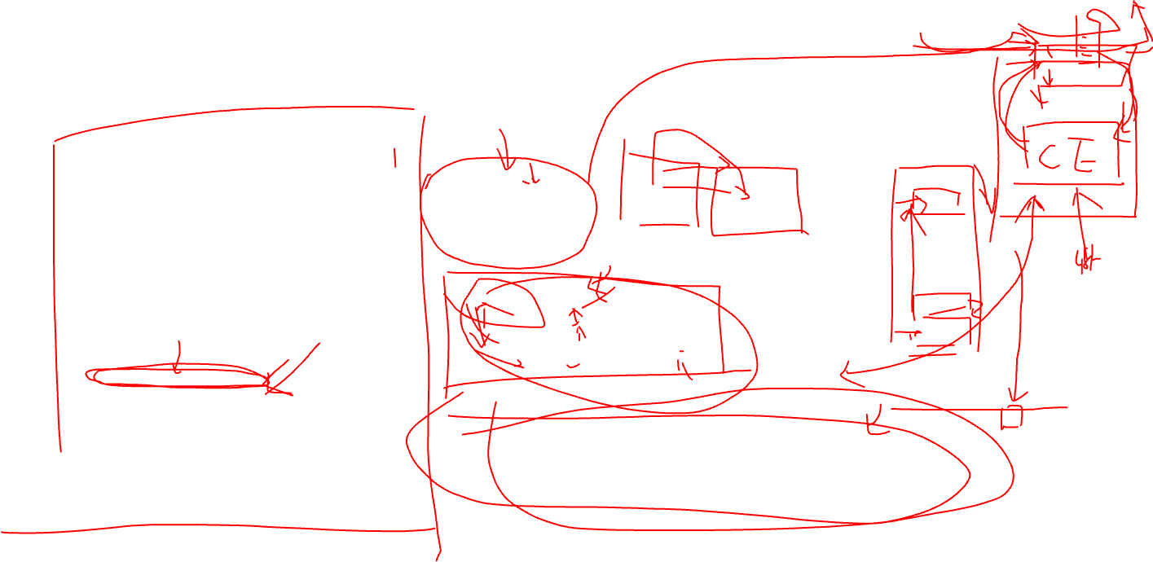
MECHANISM · ROUTER TRANSIT VS CE PROCESSING
The fabric is not binding: CE per-word handling dominates
Router-only means switch-to-switch transit with no RAMP, IQ/task, CE landing, or local copy/re-emit. It still consumes links and can backpressure; current measurements are isolated, single-lane runs.
Notes:
1. router fwd · task = 1.06 cycles/word
定义：v4 GO-chain 在 task endpoint 模式下，每个需要绕过最近 storage row 的 word 所产生的额外 multi-row critical-path 成本。
它通过：
\[ \Delta C_{\text{multirow}} = W_{\text{fwd}} C_{\text{router}} \]
拟合得到，其中：
\[ W_{\text{fwd}}=(N-N/R)E \]
W_fwd 是 critical path 上继续转发到更深 storage row 的 word 数，不是所有 router hop-word 的总和。
这里的 word 只经过 router transit，不进入中间 storage PE 的 CE。
2. router fwd · DSD = 1.29 cycles/word
与上一个 metric 相同，但 reload owner 使用 bulk fabin DSD 接收。
需要注意：router 硬件本身没有因为 DSD 而改变。1.06 与 1.29 的差别来自整个 end-to-end timing、backpressure 和拟合环境不同，不能解释为两种物理 router 速度。
两者共同说明：v4 的 multi-row forwarding 大约只有 1–1.3 cycles/word。
3. emit loop = 13.0 cycles/word
定义：storage PE 在 reload 方向由 CE 执行同步 @mov32 emit loop，将一个 word 注入 fabric 的串行成本。
实验中先把 owner 端接收改成 bulk DSD，移除了约 43.6 cycles/word 的 owner data-task bottleneck。此后 reload marginal 正好降到 13.0 cycles/word，所以这个值是相对干净的 storage emit-loop 测量。
它包含：
CE 执行 emit loop；
构造/推进 output DSD；
将 word 注入 OQ/fabric。
它不代表纯 link bandwidth。
4. reload relay ≈ 28.8 cycles/word
定义：v5 cascade 中，中间 storage row 在 reload 方向接收来自更深 storage row 的 word，并由 CE 将其重新发送给更靠近 compute 的一层所需的增量成本。
路径是：
deeper storage row
↓ fabric
intermediate storage PE
↓ RAMP / IQ
CE receive + relay
↓ OQ / RAMP
shallower row or compute
这个值不是一个独立 TSC span 直接读出来的，而是从 DSD multi-row tax 分解得到：
\[ tax_{dsd} = (c_{fwd}-c_{keep}) + (c_{relay}-c_{emit}) \]
解出来约为 28.8 cycles/word，再用 task-mode 数据交叉验证，误差约 1.6%。因此它属于 device-fit decomposition。
5. park receive = 43.3 cycles/word
定义：单行 v3 park 中，storage endpoint 的 CE 每收到一个 park word，执行 data task 和验证逻辑所需的串行成本。
当前 benchmark 是 verify-not-store，因此这里主要包括：
wavelet 从 RAMP/IQ 激活 data task；
CE 读取 payload；
检查发送顺序、计数和内容；
更新本地接收状态。
它不能直接解释成“SRAM 写入成本”。真正存储 KV 后还需重新测量 local-memory store 的影响。
这个值由 park span 对 N×E 的 scaling 直接拟合得到，约 43.3 cycles/word。
6. receive + forward = 75.4 cycles/word
定义：v5 cascade 的中间 storage PE 在 park 方向收到一个不属于本行的 word 后，执行完整的：
receive
→ identify band/owner
→ validate
→ prepare forwarding
→ CE re-emit to next storage row
它比单纯 park receive 多了一次完整 CE-side forwarding path。
该值从四个独立 row-0 park-span cells 拟合得到：
\[ 75.4\pm0.9\text{ cycles/word} \]
四个 cell 分别约为 74.1/74.5/75.7/75.9，因此是稳定的真实 CS-3 coefficient。
Two measured router-only terms: distance adds t_hop=2.0 cycles per transit hop per direction, so the full-cycle increment is 2(D-1)t_hop; v4 multi-row forwarding adds 1.06/1.29 cycles per forwarded word. CE coefficients are much larger: emit loop 13.0, reload relay about 28.8, park receive 43.3, receive+validate+forward 75.4 cycles/word. The comparison is mechanism-level: t_hop has units cycles/hop and is not plotted beside cycles/word. Pipeline stages combine by the binding maximum, not an unconditional sum. The demo blocks compute at the round boundary, so live concurrent-CE interference remains unmeasured.

Slide 8
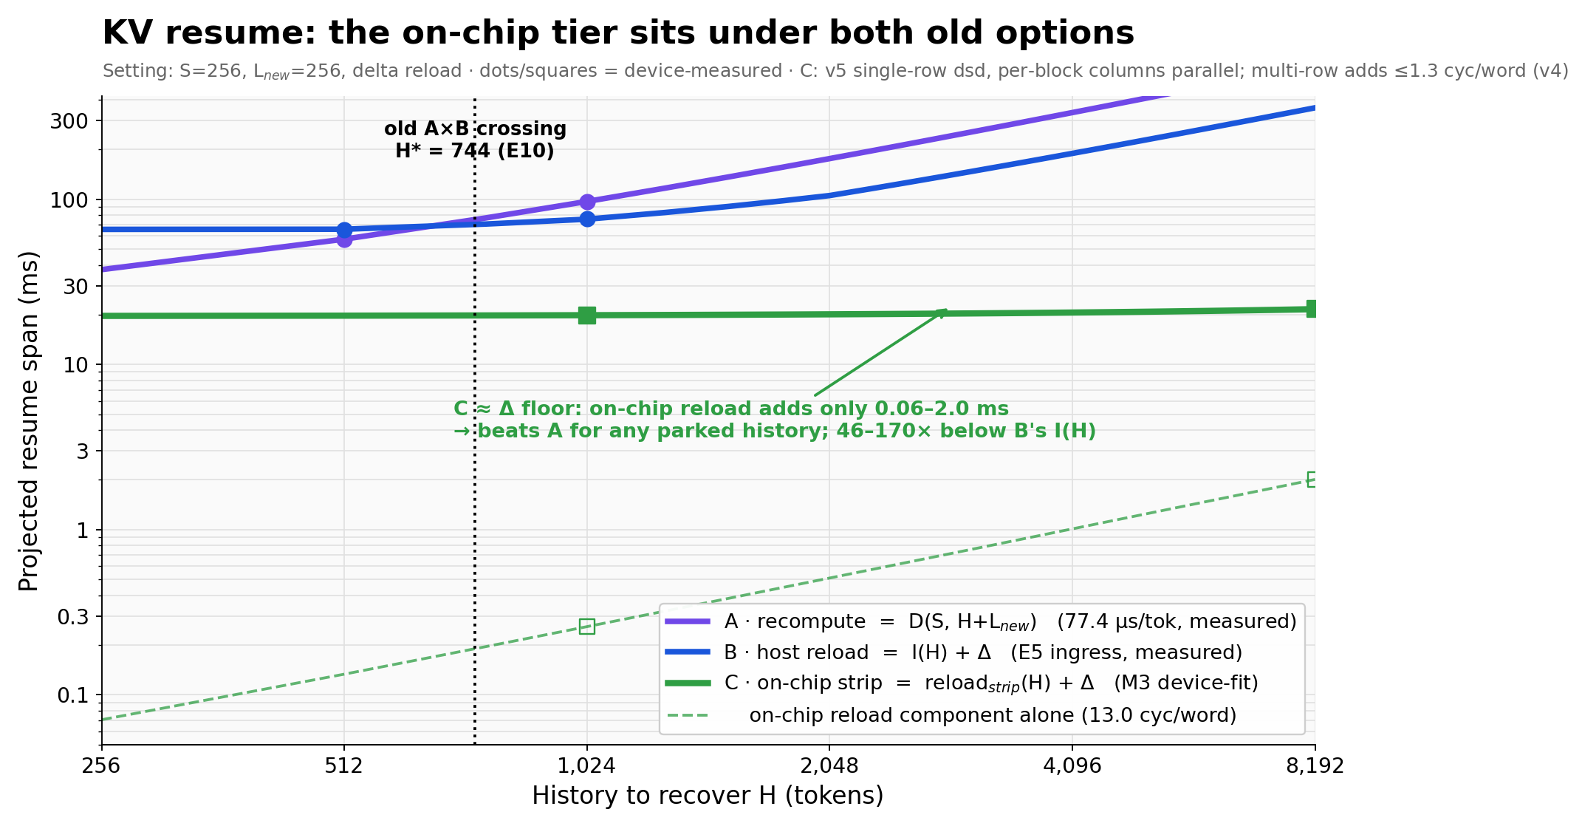
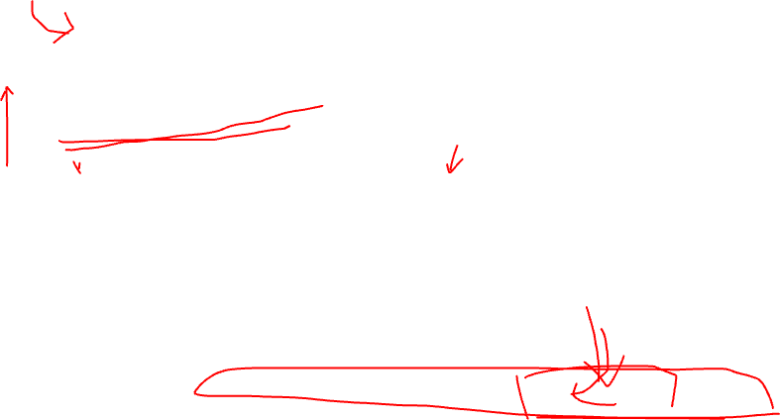
SO WHAT · THE TIER HOLDS
The on-chip tier sits under both old options: resume is now delta-dominated
Same axes and setting as the M2 boundary figure, plus measured tier C: on-chip strip reload adds only 0.06-2.0 ms (13.0 cyc/word), 46-170x below host ingress I(H), flattening resume onto the ~20 ms L_new delta floor. The old 744-token crossing becomes a fallback choice for un-parked history. Next lever for resume latency is the delta/restart path, not the transfer.
Notes:
Tier reading: T0 in-PE resident (free, scarcest SRAM) / T1 on-chip strip (swap ~ L/692 token-equivalents as-built; capacity R x ~11K words per column, columns parallel) / T2 recompute (only for tiny or un-parked history) / T2 DRAM (capacity overflow; shared edge IO, host in the loop). Caveats stated: delta floor is L_new=256 at 77.4 us/token - smaller L_new shrinks it; throughput view still wants the storage-DSD rung; concurrent-decode interference and round-gap fit are the remaining unmeasured items. Open design: a hybrid (v4 router transit + v5 static compute column) would dominate both at ~1.6 baseline + ~1.1 tax.

Slide 9
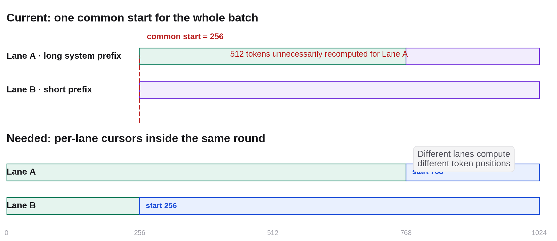
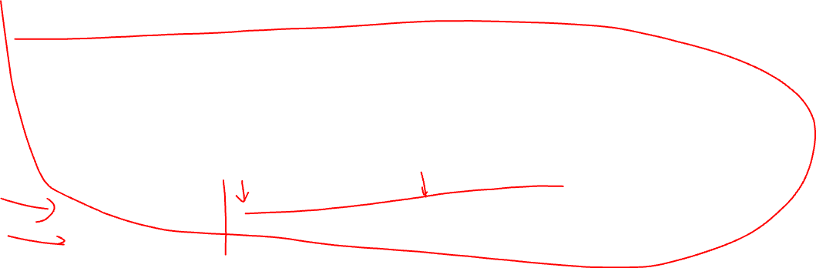
WHY THIS OPTIMIZATION · FOLLOW-UP TO AUG 11
Common-start is correct—but recomputes longer prefix hits
Lane A can reuse 768 tokens while Lane B can reuse only 256. The current batch starts both at 256, so Lane A re-executes 512 already-known token positions.
Notes:
This directly follows the Aug 11 ragged-execution limitation slide. Current common-start assignment is numerically correct; the open question was whether suppressing redundant lane work would shorten the lockstep batch critical path, or only reduce operation count and improve fairness/energy. Source figure: 2026-08-11 weekly collaborator deck, slide 7.

Slide 10
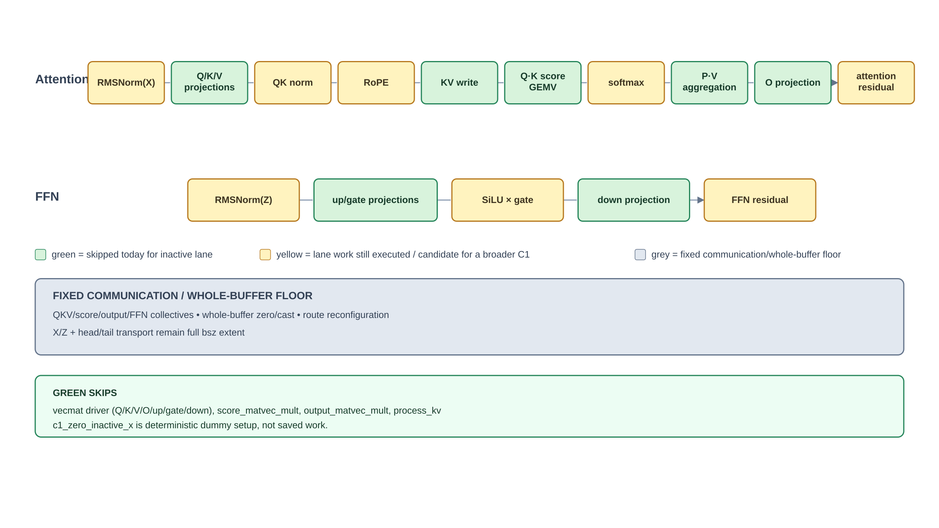
BENCHMARK-ONLY C1-M CHANGE
We skipped lane-sliced compute; the fixed batch floor stayed
Green is predicated while step < Rᵢ − min(R); yellow still executes for the inactive lane; grey remains full-bsz communication or whole-buffer work.
Notes:
Exact implemented skip surface: vecmat_computation_f32 avoids Q/K/V/O/up/gate/down GEMV maps; score_matvec_mult skips Q·K cache traversal; output_matvec_mult skips P·V cache aggregation; process_kv preserves resident KV. c1_zero_inactive_x establishes deterministic dummy state and is not saved work. RMSNorm, QK norm, RoPE, softmax, SiLU/SwiGLU, residuals, whole-buffer zero/cast, every collective, route reconfiguration, X/Z transport and head/tail remain active at fixed extent. One global token position remains; this is C1, not C2 independent progress.

Slide 11
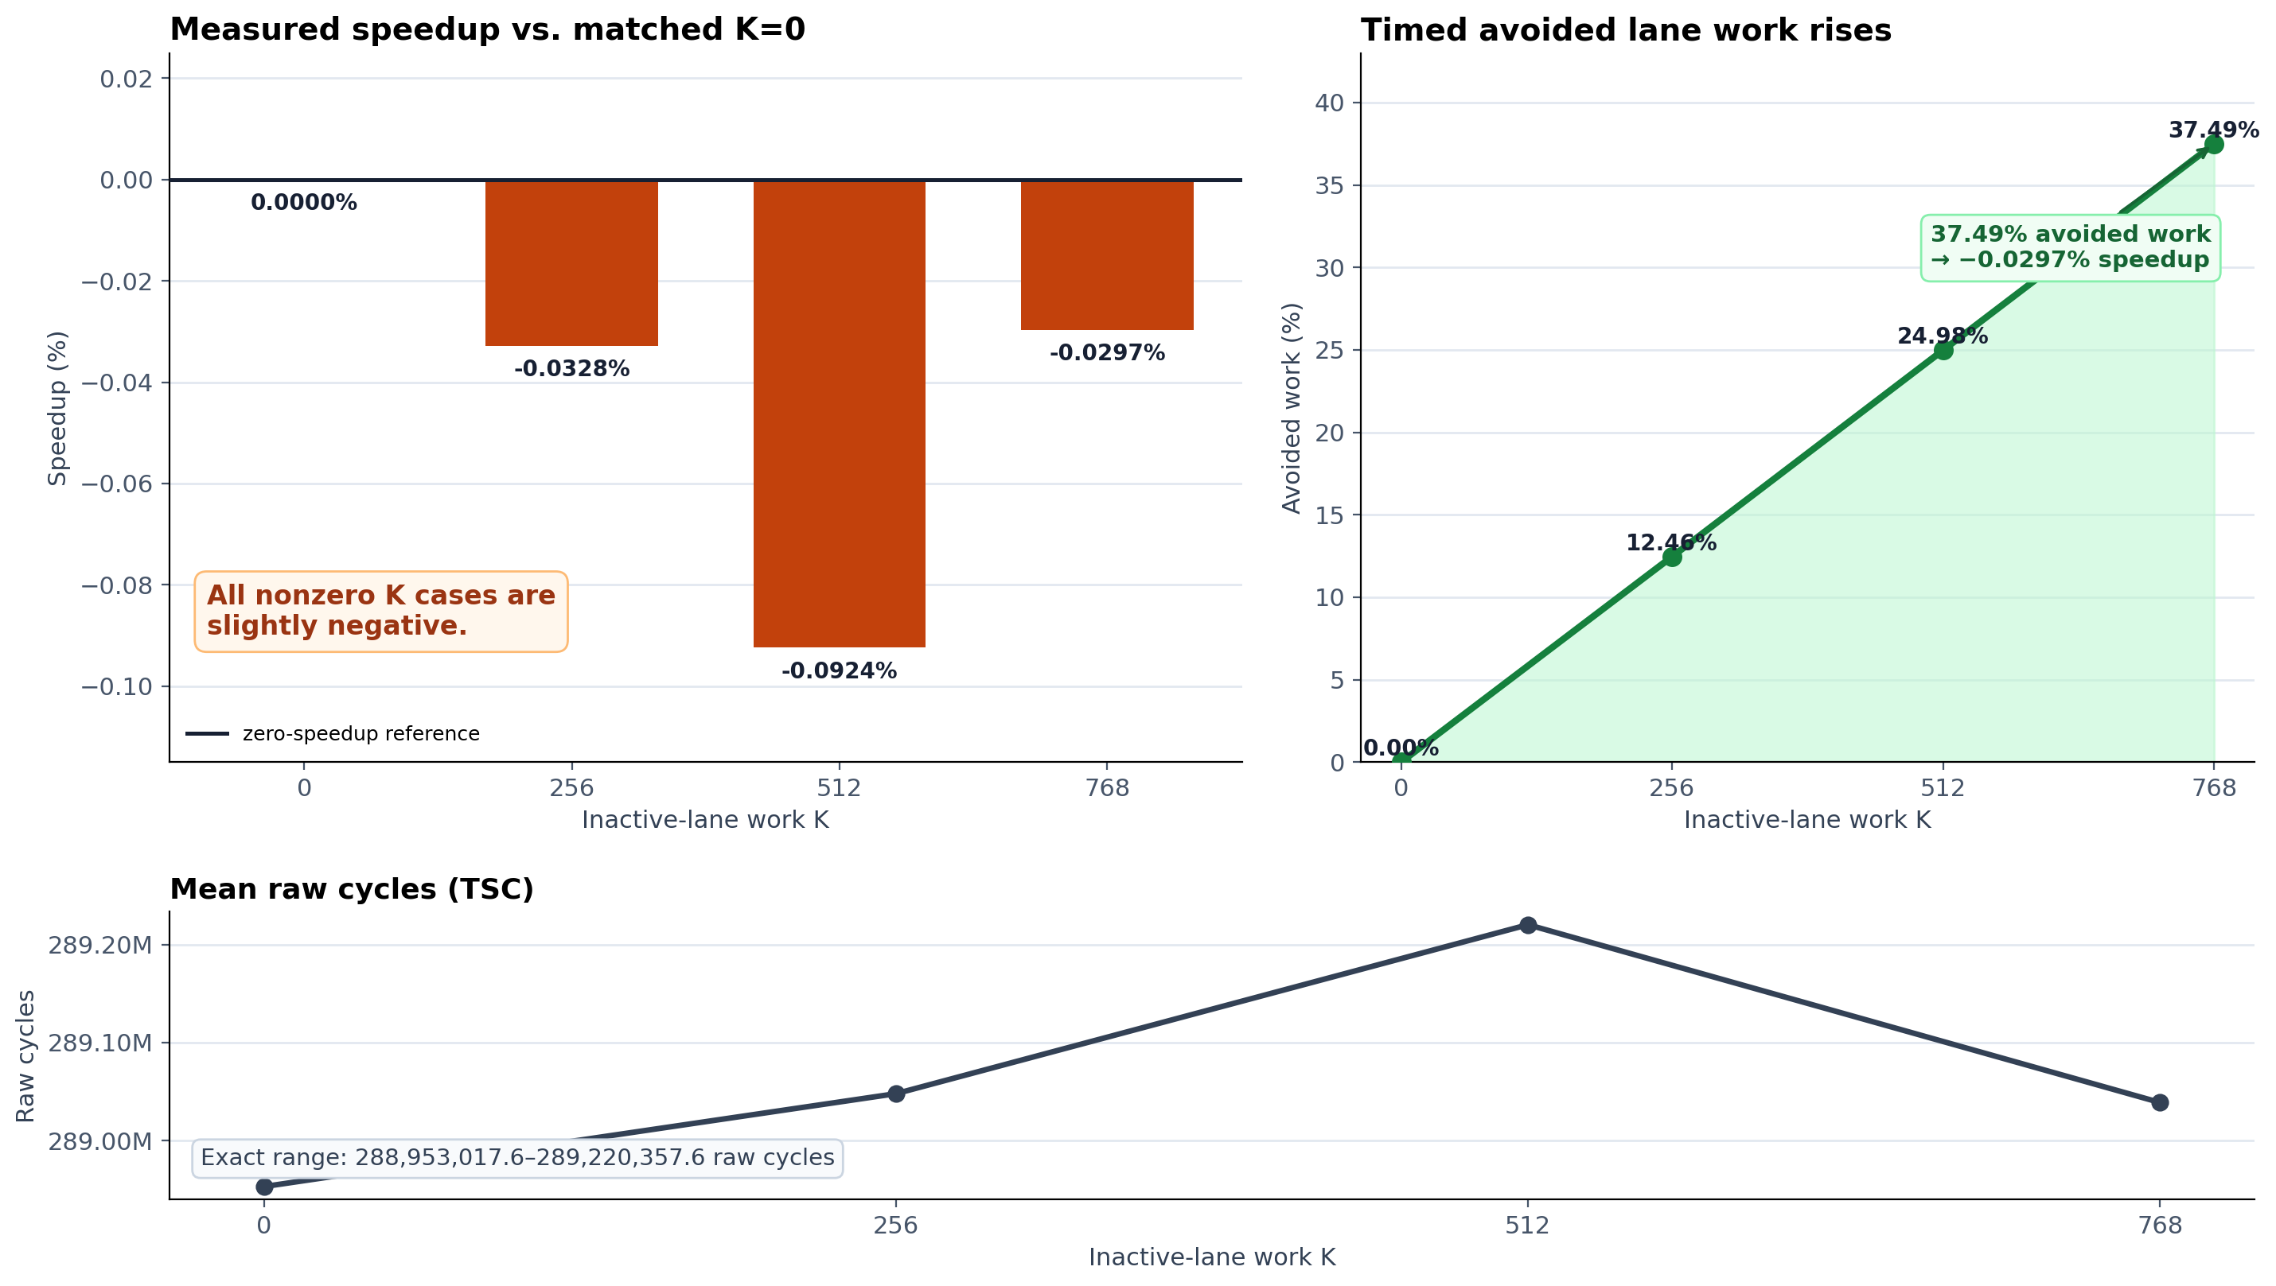
REAL CS-3 RESULT · 20/20 ACCEPTED
37.49% less lane-step work produced no critical-path speedup
Full Qwen3-1.7B, bsz=2, S/N/F/G=256/1024/769/255, five repetitions per case, raw TSC cycles. At K=768, mean speedup is −0.0297%.
Notes:
Construction-matched manual K0 is the only baseline used here. Mean speedups for K=256/512/768 are -0.0328%, -0.0924%, and -0.0297%; the response is non-monotonic and no break-even appears. A descriptive K=768 Welch sensitivity has an approximate +0.106% speedup upper edge, but serial case blocks make it non-universal. The automatic Experiment-A K0 is 12.2363% faster than this manual construction and must not be mixed into the ratio. Decision boundary: NO-GO for C1-M as a throughput mechanism at this point; operation reduction is real, end-to-end throughput/fairness/energy remain separate or unknown.

Slide 12
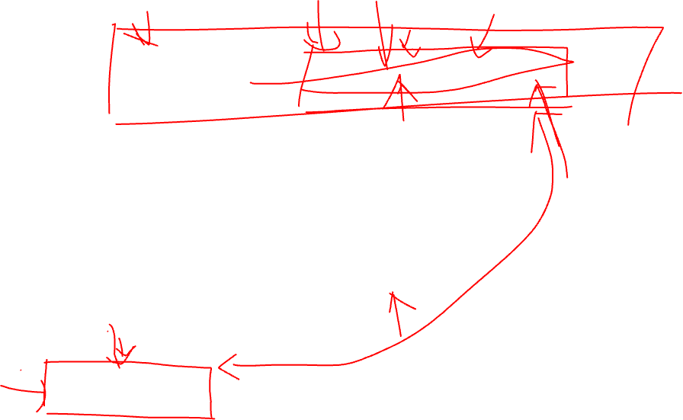
NEXT DECISION
Pin the fixed floor—or move to independent lane progress
A · Profile the C1 fixed floor
B · Design C2 / continuous batching
—
Time or ablate collectives, whole-buffer ops and transport by phase
—
Independent per-lane start, cursor and completion state
—
Identify the single largest remaining critical-path item
—
Price added SRAM, protocol, admission and scheduler complexity
—
Broaden masking only if that removable term can change the <0.1% result
—
Only credit gains that survive a serving-like schedule replay
Notes:
No recommendation is implied yet. Option A is one bounded profiling gate to explain the fixed floor. Option B targets the final mechanism in which a long-hit request can advance without waiting for another lane's missing prefix, but crosses into C2 and O1 continuous-batching scope. The realistic workload projection remains necessary before either path receives a serving-level gain.

