Slide 1
Serving an LLM on a Wafer: a per-PE resource X-ray
qwen3-1.7B on a real Cerebras WSE-3 (CS-3) · memory & fabric-color analysis · 2026-06-28

Slide 2
Why this is hard: no shared memory
• A GPU has one big shared memory (HBM). A Cerebras wafer is ~900,000 tiny cores (PEs), each with its own tiny 48 KB of memory — nothing shared.
• To run an LLM you must REPLICATE the program on every core and SPLIT the weights across them.
• So each core has very little room left for the KV cache (the running context) — which caps the sequence length.
• Two scarce per-core resources: (1) 48 KB SRAM, and (2) 24 'colors' — the fabric communication channels.
• Question: what does ONE core actually hold and use? We built a tool to find out, and ran it on real silicon.

Slide 3
Method: X-ray every PE on real hardware
• Compile each kernel (decode & prefill) on a real CS-3, for the full 762x1172 fabric.
• Read each PE's memory map (cs-readelf) + the compiled binaries, and classify every byte: code / weights / KV cache / activations / system / free.
• Covered all ~329,000 placed PEs — but the result is really PER-ROLE (every PE of the same role is identical), so it's a fast static analysis.
• Also analyzed fabric-COLOR usage per microstep from the kernel source.
• Tool: tools/pe_mem_breakdown/ (28 tests, reconciles to the byte).

Slide 4
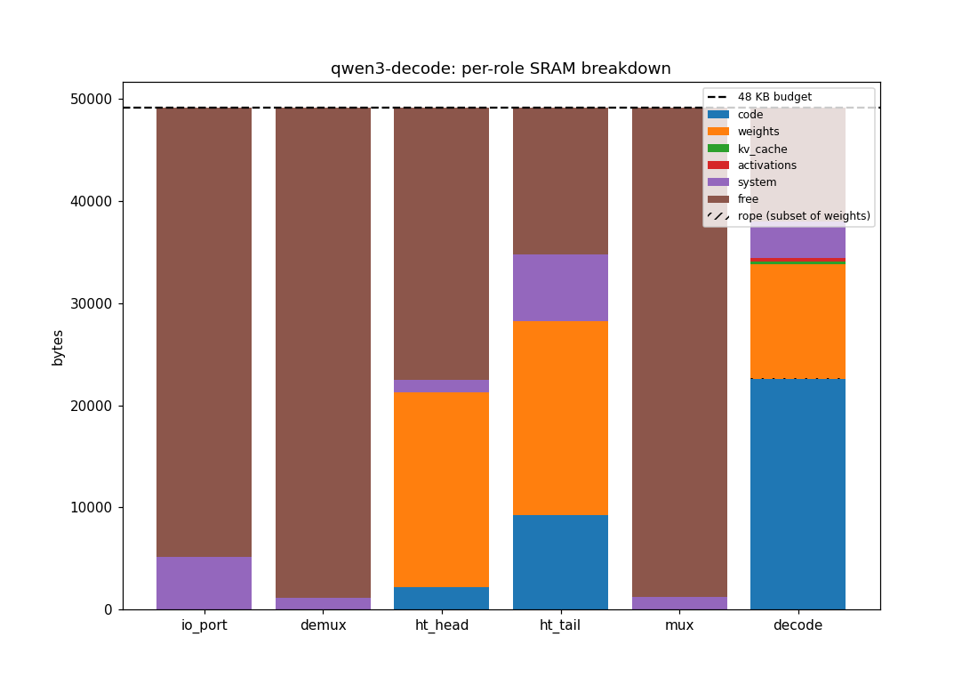
Finding 1: code eats half of every core
• Each compute PE: ~22 KB CODE + ~11 KB weights.
• CODE = the full transformer-layer program, copied onto every one of ~65,000 compute cores.
• KV cache is tiny (<0.3 KB) — it gets only the leftover ~11 KB.
• ht_head/ht_tail cores are weight-bound (embedding / output table).

Slide 5
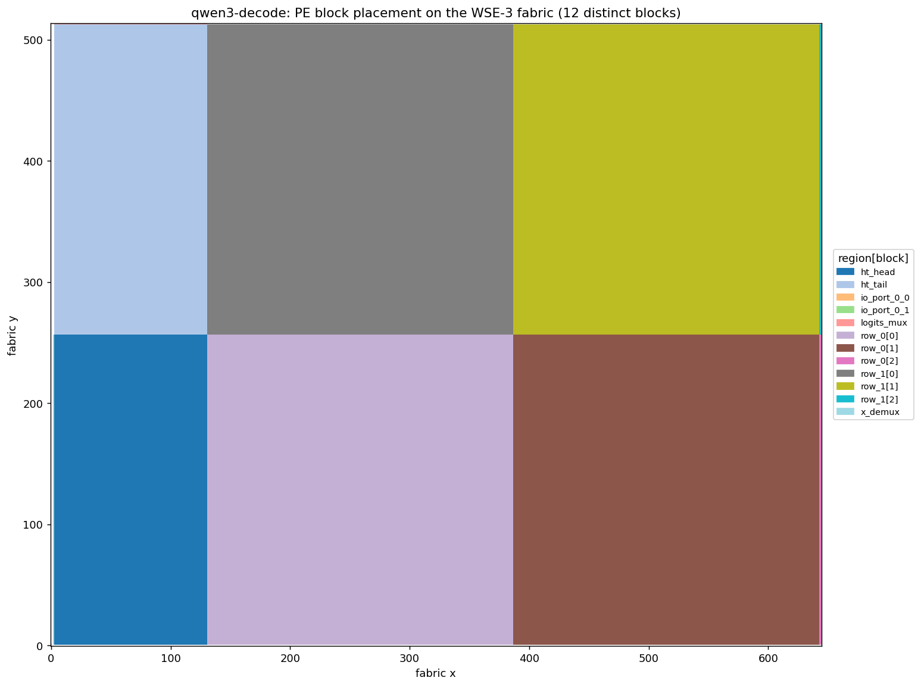
Where the blocks live on the wafer
• The kernel is laid out as functional blocks on the 2-D grid.
• Big area = the 2x2 compute blocks (the transformer layers).
• Thin left band = embedding (ht_head) + output/sampling (ht_tail).
• We can map any metric (code, weights, KV, free...) to its (x,y) coordinate as a heatmap.

Slide 6
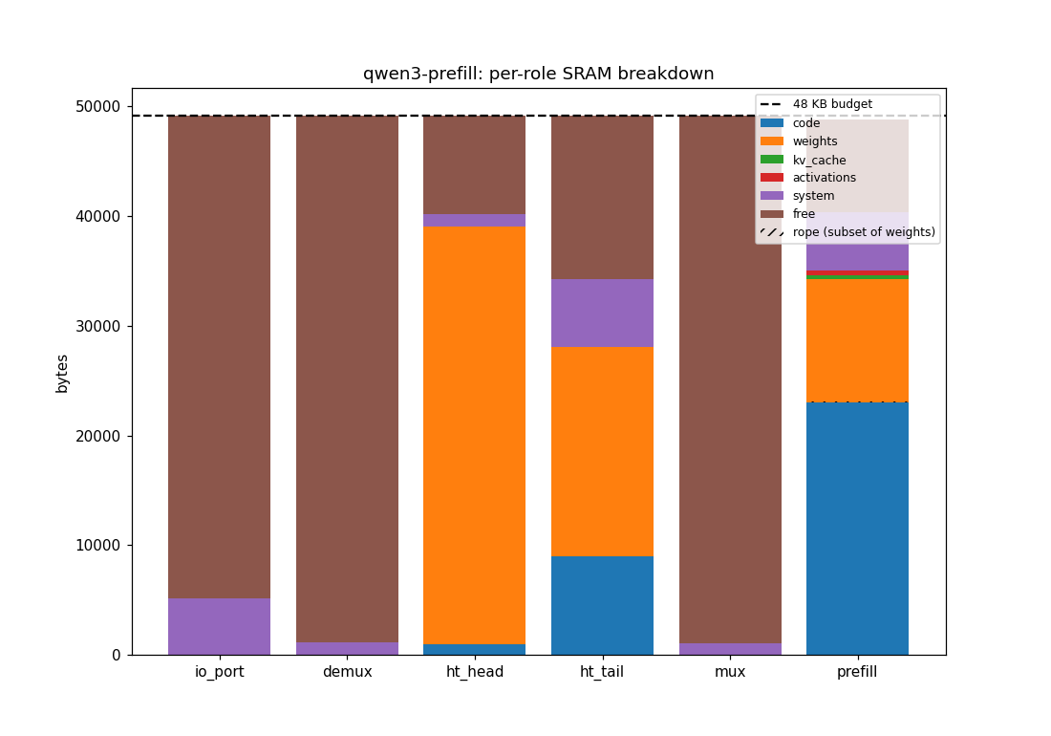
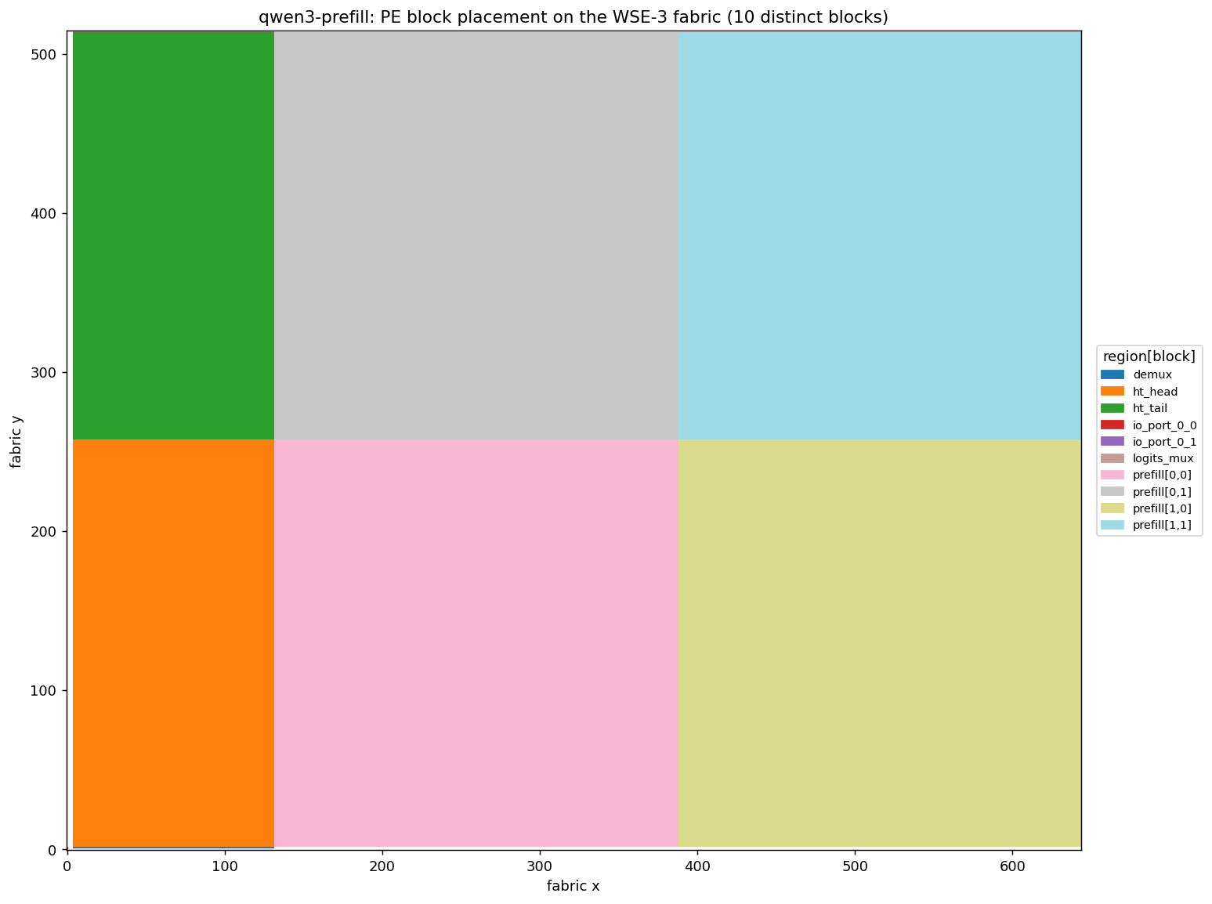
Prefill: memory breakdown + op layout
Per-role SRAM breakdown (48 KB ceiling)
PE block placement: 2x2 prefill blocks + HT band
• Same shape as decode: ~23 KB CODE + ~11 KB weights per compute PE — but runs TIGHTER, ~82% full (~8 KB free vs decode's ~11 KB), because prefill carries the causal attention mask + larger MeshGEMM comm buffers.
• Op layout: ONE prefill region split into 2x2 logical blocks (vs decode's two stacked block-rows); same thin HT band — ht_head embedding (~38 KB, weight-bound) + ht_tail lm_head.
• Same disaggregated-memory tax: the transformer-layer code is replicated on every compute core; KV is the squeezed residual.

Slide 7
Finding 2: max context = 22,784 tokens (44x the default)
• qwen3-1.7B is light, so the leftover ~11 KB is real headroom for KV.
• We swept the sequence length on real hardware (compile + place):
– PASS up to 22,784 tokens; FAILS (out of memory) at 23,040.
– That's 44.5x the shipped default of 512.
• KV costs ~0.44 bytes/token per core; the ~11 KB free fills until the last ~1 KB (needed for placement) is gone.
• Caveat: this is the compile/fit ceiling, for one request (batch size 1).

Slide 8
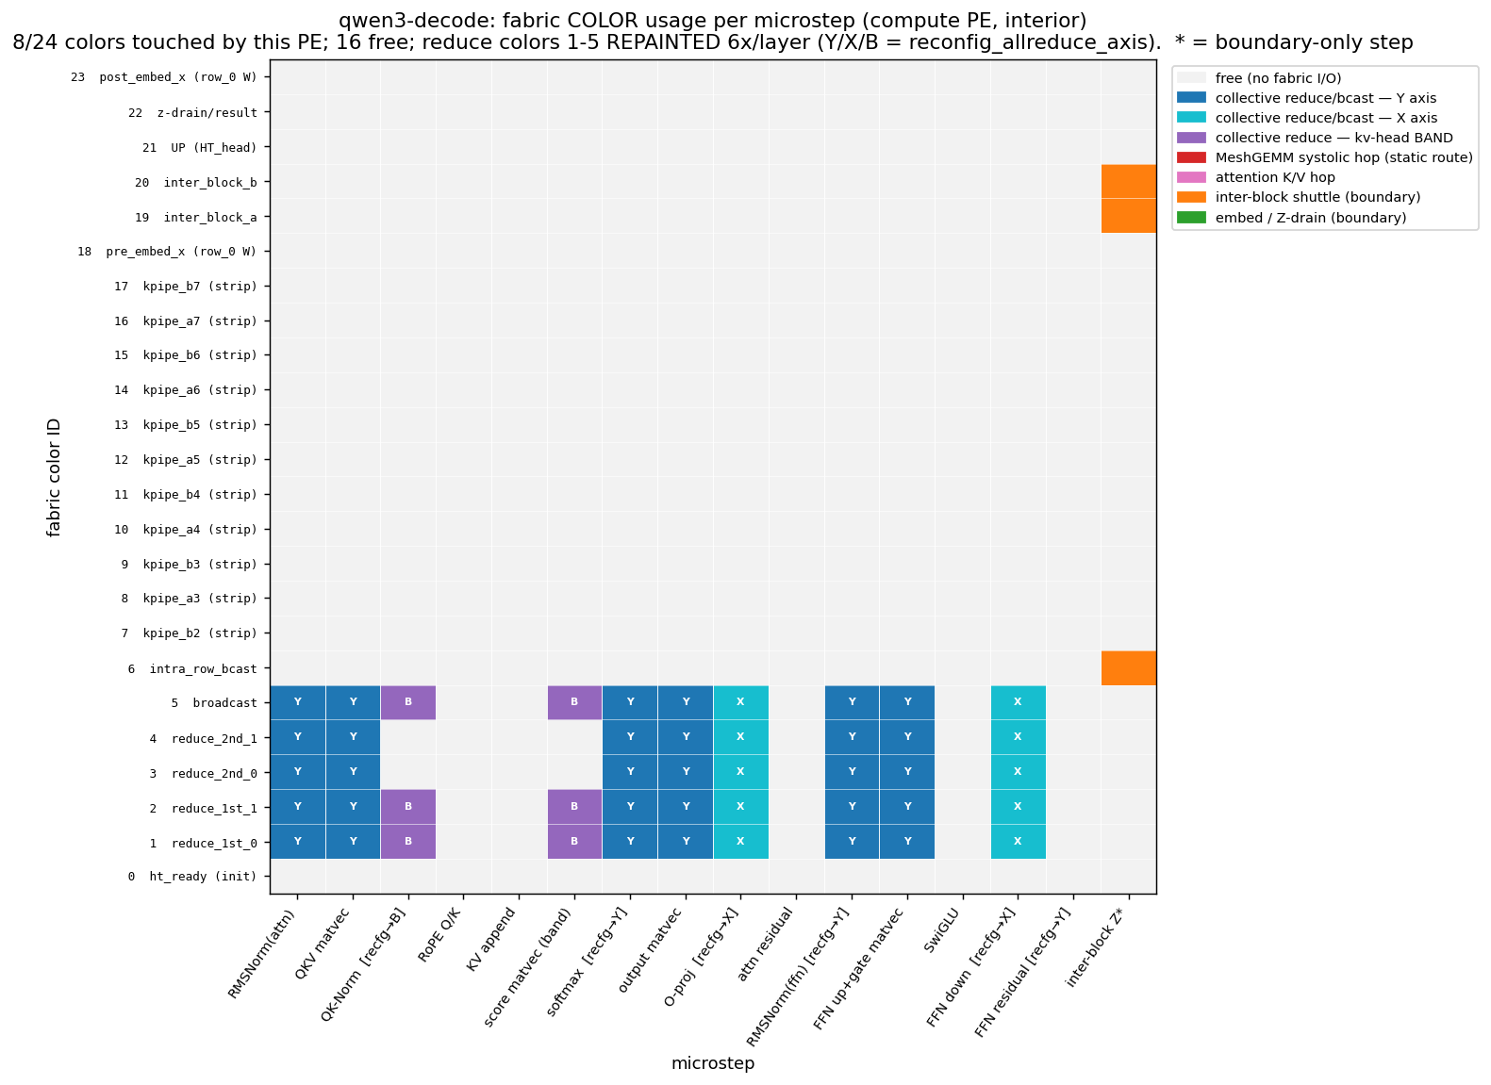
Finding 3: 'colors' are the other scarce resource
• 24 fabric 'colors' = communication channels. We mapped which are used in each microstep.
• DECODE uses only 8/24 on a compute core...
• ...because it REUSES 5 channels, repainting their routes 6x per layer (Y / X / band = the reduce direction).
• Local steps (RoPE, residuals) use no fabric at all.

Slide 9
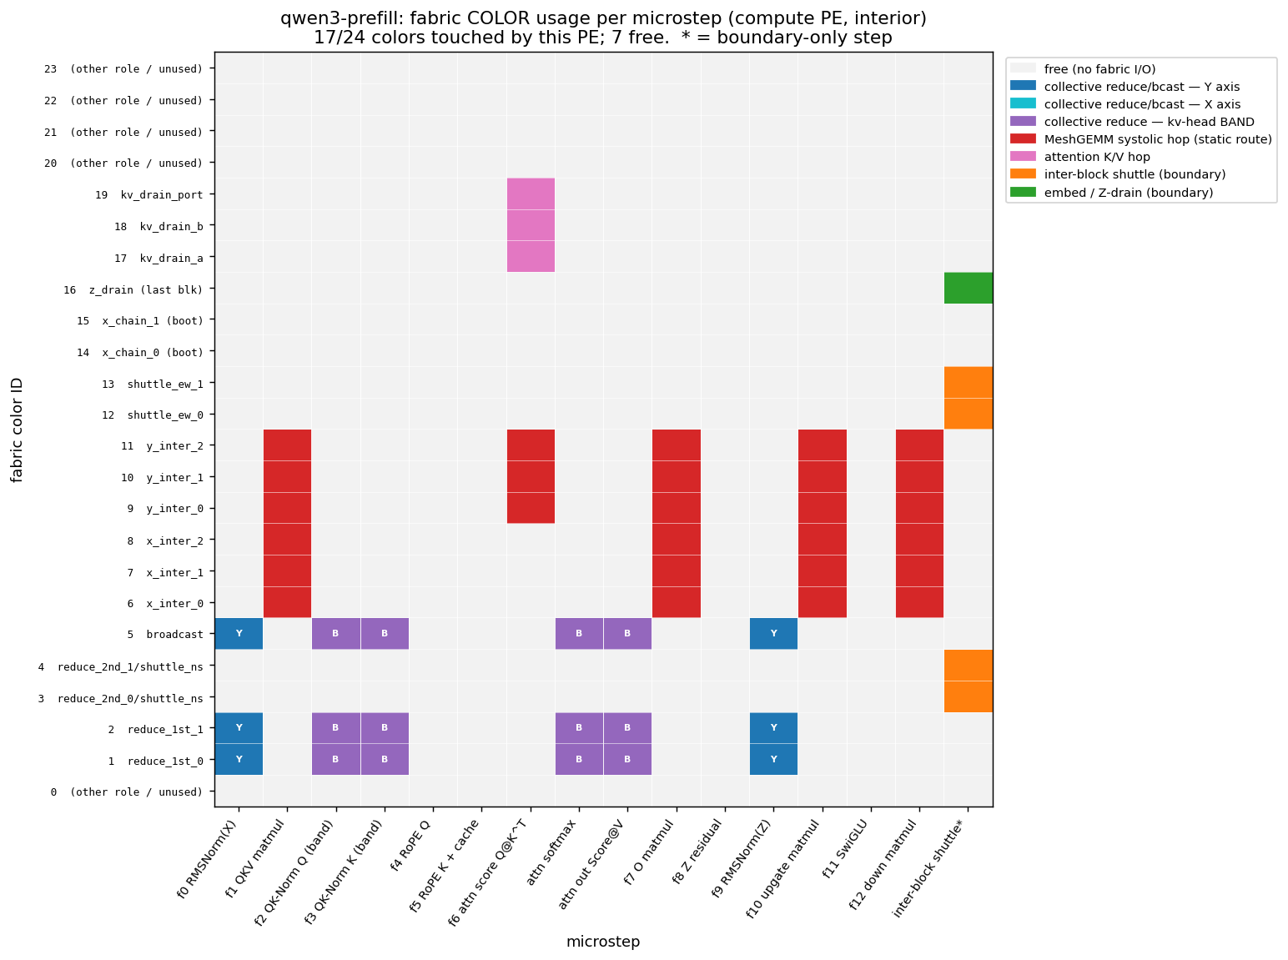
The decode <-> prefill trade-off
• DECODE = color-frugal, reconfiguration-heavy: 8/24 colors; reuses 5 and repaints their routes every step.
• PREFILL = color-hungry, reconfiguration-light: 17/24 colors.
– Its matmuls use a systolic 'MeshGEMM' with 6 dedicated, statically-routed channels (never repainted mid-matmul).
• So the two kernels trade the SAME two resources differently: decode spends route-repaint time to save colors; prefill spends colors to save time.
• Both fit comfortably — neither is color-bound today.
Prefill: 17/24 colors (MeshGEMM-heavy)

Slide 10
Takeaways & where to find everything
Observation
Code/Program binary becomes major resource bottleneck
Shared memory for code/program + dynamic loading
Ship function/compute to parameters
Disaggregated operator placement/True dataflow model
Probably needs storage space (intermediate PEs) to absorb bubbles?
The position of optimize for KV cache needs to be evaluated
Store KV in limited SRAM vs. ultra-fast recompute
Probably still a must if we build a service and support for many requests (needs KV re-use)
Traceable: branch lexu/pe-mem-breakdown (WaferEngine repo).
tool + plots: tools/pe_mem_breakdown/ · results/{decode,prefill}/
key commits: 33ecf27 (heatmaps), 023cf1d (seq-len probe), 0869200 (color map).

