Slide 1
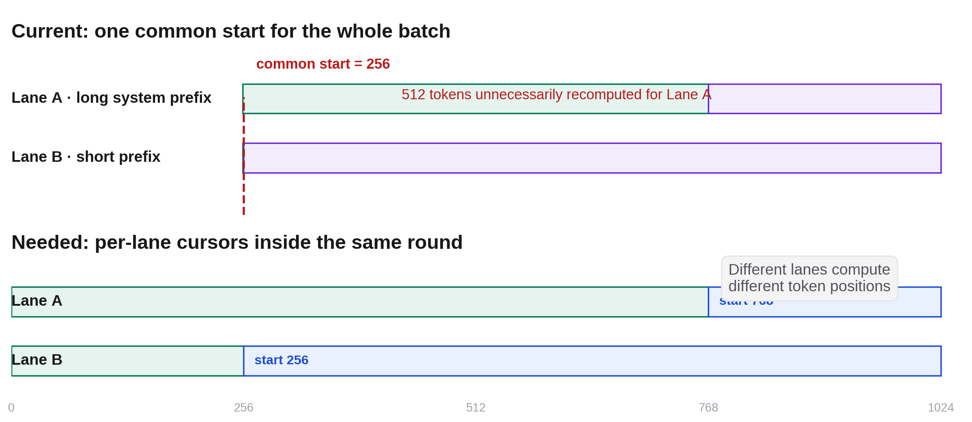
WHY THIS OPTIMIZATION · FOLLOW-UP TO AUG 11
Common-start is correct—but recomputes longer prefix hits
Lane A can reuse 768 tokens while Lane B can reuse only 256. The current batch starts both at 256, so Lane A re-executes 512 already-known token positions.
Notes:
This directly follows last week's ragged-execution limitation slide. Current common-start assignment is numerically correct; the open question was whether suppressing redundant lane work would shorten the lockstep batch critical path, or only reduce operation count and improve fairness/energy. Source figure: 2026-08-11 weekly collaborator deck, slide 7.

Slide 2
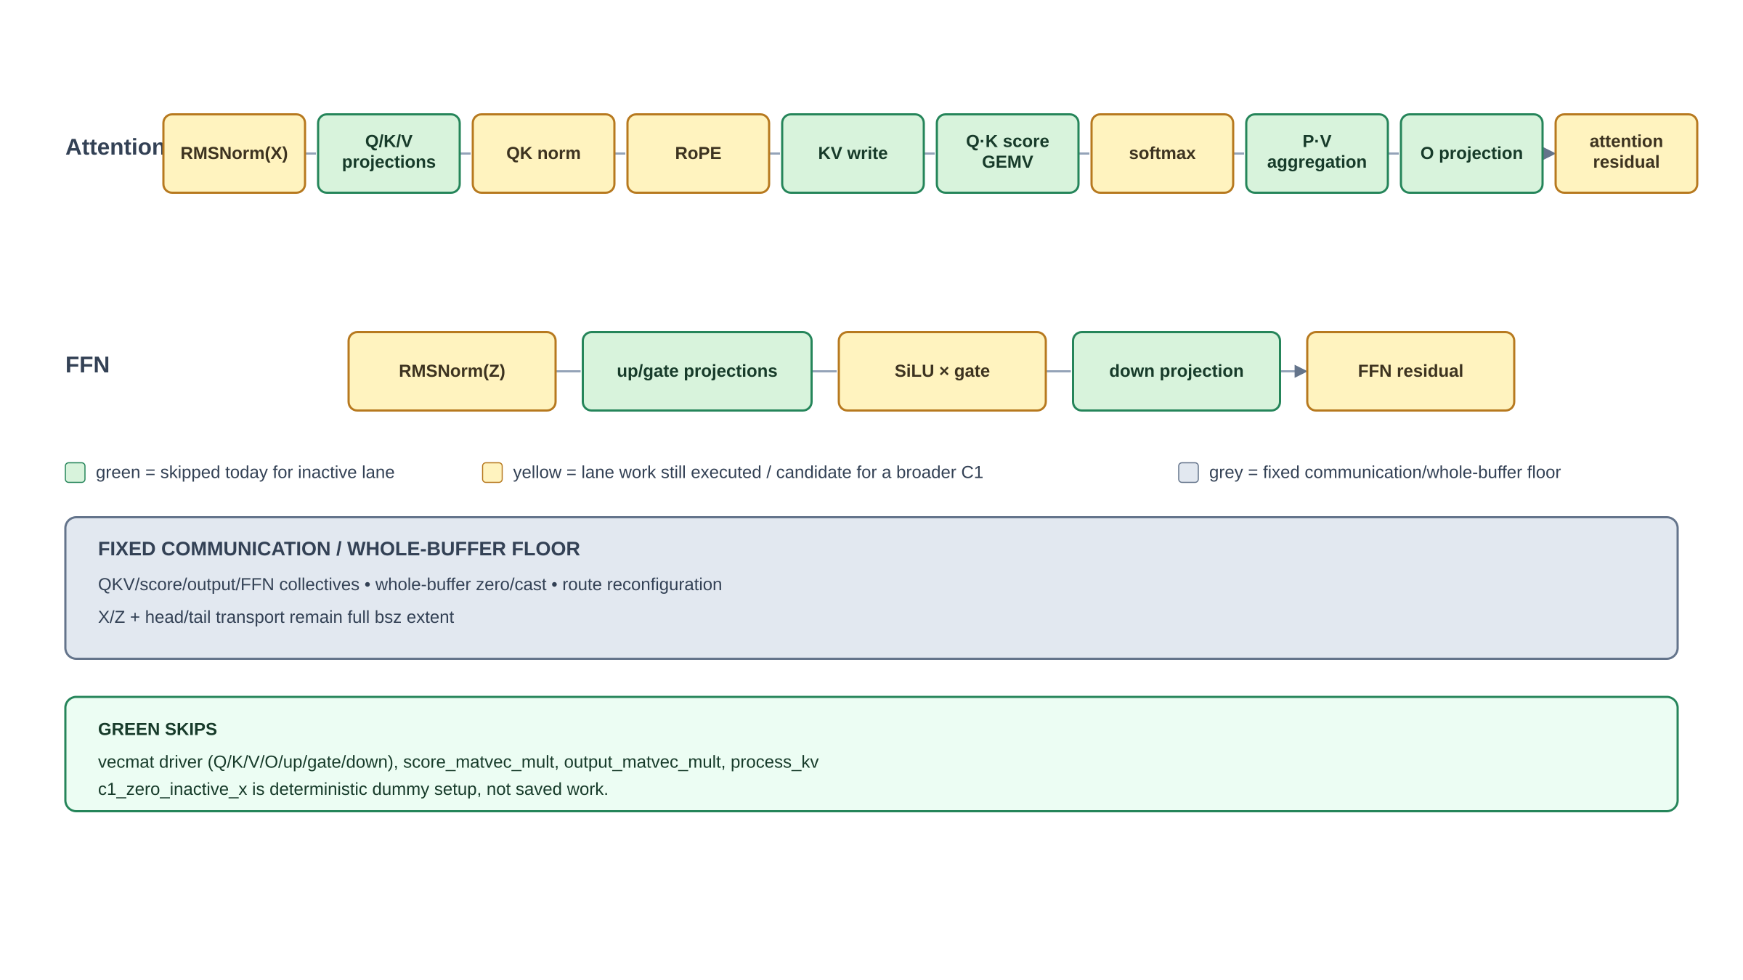
BENCHMARK-ONLY C1-M CHANGE
We skipped lane-sliced compute; the fixed batch floor stayed
Green is predicated while step < Rᵢ − min(R); yellow still executes for the inactive lane; grey remains full-bsz communication or whole-buffer work.
Notes:
Exact implemented skip surface: vecmat_computation_f32 avoids Q/K/V/O/up/gate/down GEMV maps; score_matvec_mult skips Q·K cache traversal; output_matvec_mult skips P·V cache aggregation; process_kv preserves resident KV. c1_zero_inactive_x establishes deterministic dummy state and is not saved work. RMSNorm, QK norm, RoPE, softmax, SiLU/SwiGLU, residuals, whole-buffer zero/cast, every collective, route reconfiguration, X/Z transport and head/tail remain active at fixed extent. One global token position remains; this is C1, not C2 independent progress.

Slide 3
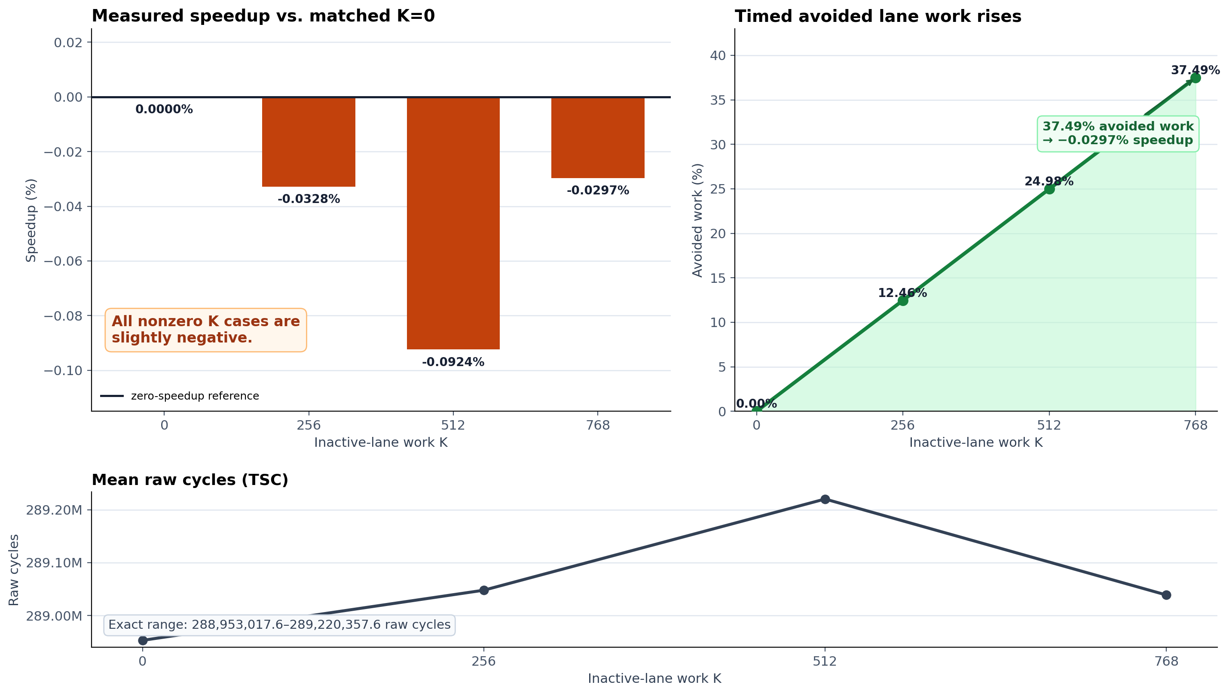
REAL CS-3 RESULT · 20/20 ACCEPTED
37.49% less lane-step work produced no critical-path speedup
Full Qwen3-1.7B, bsz=2, S/N/F/G=256/1024/769/255, five repetitions per case, raw TSC cycles. At K=768, mean speedup is −0.0297%.
Notes:
Construction-matched manual K0 is the only baseline used here. Mean speedups for K=256/512/768 are -0.0328%, -0.0924%, and -0.0297%; the response is non-monotonic and no break-even appears. A descriptive K=768 Welch sensitivity has an approximate +0.106% speedup upper edge, but serial case blocks make it non-universal. The automatic Experiment-A K0 is 12.2363% faster than this manual construction and must not be mixed into the ratio. Decision boundary: NO-GO for C1-M as a throughput mechanism at this point; operation reduction is real, end-to-end throughput/fairness/energy remain separate or unknown.

Slide 4
NEXT DECISION
Pin the fixed floor—or move to independent lane progress
A · Profile the C1 fixed floor
B · Design C2 / continuous batching
—
Time or ablate collectives, whole-buffer ops and transport by phase
—
Independent per-lane start, cursor and completion state
—
Identify the single largest remaining critical-path item
—
Price added SRAM, protocol, admission and scheduler complexity
—
Broaden masking only if that removable term can change the <0.1% result
—
Only credit gains that survive a serving-like schedule replay
Notes:
No recommendation is implied yet. Option A is one bounded profiling gate to explain the fixed floor. Option B targets the final mechanism in which a long-hit request can advance without waiting for another lane's missing prefix, but crosses into C2 and O1 continuous-batching scope. The realistic workload projection remains necessary before either path receives a serving-level gain.

