Slide 1
WaferEngine · CS-3
WEEKLY COLLABORATOR DISCUSSION
On-Chip KV Offload as a Storage Tier
Two multi-row storage designs measured on real WSE-3; the on-chip tier now sits under both prior resume options.
MODEL
EVIDENCE
SCOPE
DATE
Qwen3-1.7B geometry
81 CS-3 runs, 0-cycle spread
M3 idle-PE tier
2026-08-24
Notes:
This week closes the M3 multi-row storage question with device data: both candidate designs (v4 GO-chain, v5 cascade) ran on real CS-3, both are modeled to <1%, and the combined result upgrades the M2 resume tradeoff from a two-way A/B to a three-tier hierarchy.

Slide 2
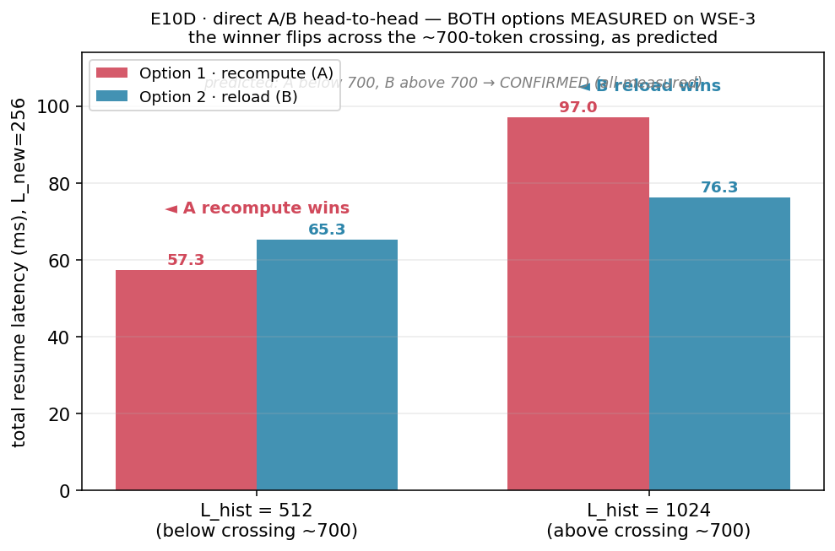
GOAL · WHERE WE ARE IN THE MILESTONES
M2 ended at recompute-vs-host with a 744-token crossing; M3 asks if idle PEs beat both
Last time (M2 E10/E10D, all device-measured): below H*=744 recompute wins, above it host reload wins — but reload rides shared edge IO and the host. M3's question: can idle on-chip PEs hold parked KV as a middle tier? This week: build the multi-row storage strip both candidate ways, measure both end-to-end, and price the tier.
Notes:
Position: M1 in-PE reuse is done (tier 0). M2 priced recompute (A, 77.4 us/token) vs host reload (B, E5 ingress 46-338 ms) and found the crossing at 744 tokens. M3 (idle-PE tier) needs multi-row storage because one storage PE holds ~11K words: L=1024 already needs R=2 rows, L=8192 needs ~12. The single-row protocol was device-proven earlier (51 runs); the open question was HOW to coordinate R rows — and at what cost.

Slide 3
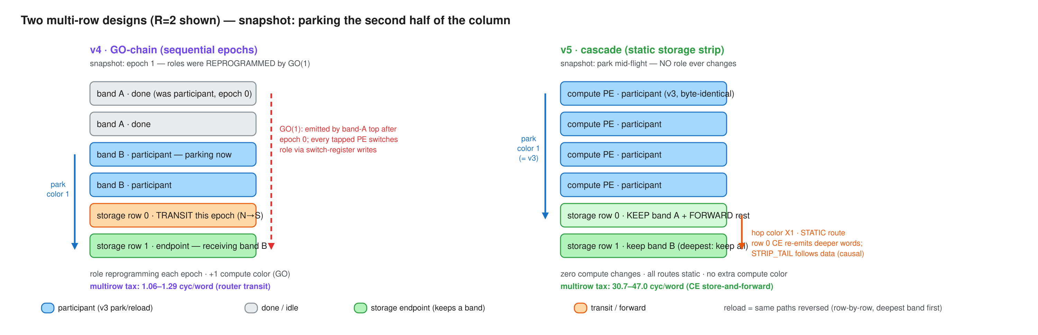
IMPLEMENTATION · TWO COORDINATION DESIGNS
v4 reprograms compute roles per epoch; v5 keeps compute byte-identical and cascades inside the strip
Both share the proven single-row protocol on one borrowed color. v4: bands park in sequential epochs, chained fully on-chip by a GO color; every tapped PE rewrites its switch positions per epoch. v5: row 0 keeps the nearest band and store-and-forwards deeper words on static per-hop colors; a STRIP_TAIL word rides behind the data as the causal end-of-stream. Reload returns over the same paths reversed.
Notes:
v4 needed direct switch-position byte writes (the tile_config library writes the wrong tx bit for RAMP - register-dump proven; byte = in_sel<<5|out_bits, S->RAMP=0x50). First-ever v4 silicon this week: GO chain, role reprogramming, and the byte writes all work at 256 PEs. v5's compute column is cmp-verified byte-identical to the single-row demo; every strip route is static so cross-color ordering hazards are impossible by construction. Editable source: docs/diagrams/m3-multirow-v4-vs-v5.excalidraw.

Slide 4
CAPACITY · NOMINAL 42 KIB/STORAGE PE = 672 KV-TOKEN EQUIVALENTS PER 1×256 ROW/BLOCK
Each row adds 672-token capacity; v4 wins every multi-row setting
KV MOVED
ROWS · CAPACITY
V3 SINGLE-ROW
V4 GO-CHAIN
V5 CASCADE
task · 1,024 tok
1 · 672 tok (under)
1,388,470
1,535,920
1,420,244
task · 1,024 tok
2 · 1,344 tok (fits)
—
1,544,946
1,675,327
task · 1,024 tok
4 · 2,688 tok (fits)
—
1,550,855
1,812,526
DSD · 8,192 tok
1 · 672 tok (under)
7,350,234
8,542,434
7,482,812
DSD · 8,192 tok
2 · 1,344 tok (under)
—
8,619,349
10,669,498
DSD · 8,192 tok
4 · 2,688 tok (under)
—
8,675,026
12,343,610
Notes:
EPCC CS-3, distance=1, n=3 per cell, zero infrastructure failures across 81 runs; every cell reproduced to the cycle. Visible payload labels replace benchmark notation: with compute-column height N=256 and lpb=4, E=64 u32 words/compute PE maps to 1,024 KV tokens and E=512 maps to 8,192. R is the number of 1×256 storage rows. Capacity is nominal analytical sizing, not compile-fit: 42 KiB/storage PE gives 672 KV-token equivalents per row/block, so R=1/2/4 gives 672/1,344/2,688 tokens. The demo verifies movement rather than retaining the full payload; therefore the 8,192-token rows shown are intentionally capacity-undersized measurements (about 13 rows are needed nominally). v4 metric = sum of per-band spans (excludes inter-epoch GO gaps, ~2*bh cycles each). DSD = owner-side bulk fabin-DSD reload receive. v4 wins every measured R>=2 cell; DSD 8,192-token payload at R=4 is 30% faster than v5.

Slide 5
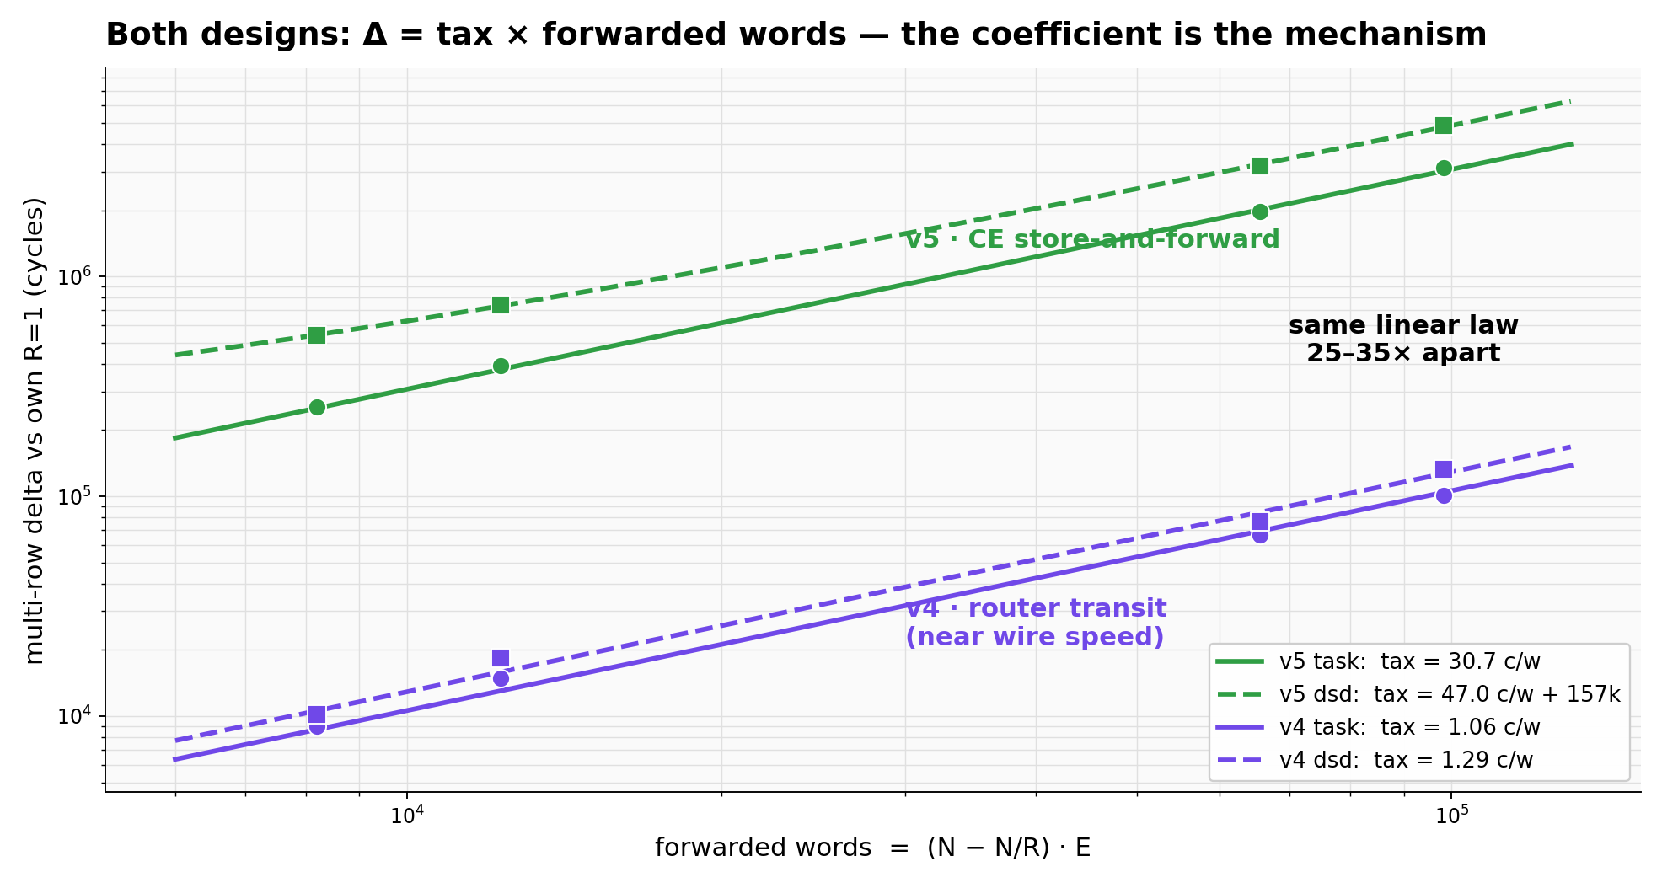
MODEL · ONE LAW, TWO COEFFICIENTS
Both designs obey delta = tax x forwarded words — the tax is the mechanism, 25-35x apart
Delta vs each design's own R=1 baseline collapses on the same axis, fwd_words = (N - N/R)·E. v4's tax is router-level transit (1.06/1.29 cyc/word, near wire speed); v5's is a CE data-task per forwarded word (30.7/47.0). The v5 dsd fit needs one extra constant (~157k cycles): strip rows emit their own block before relaying, which fast owners expose.
Notes:
The preregistered hypotheses were productively falsified: H1 (v5 R=1 reproduces v3 anchors) failed at +0.7-2.3% - the cascade's per-word branches do not compile out, so every implementation carries its own baseline. H2 (v4 overhead = per-epoch constant) failed in form - v4's delta is also per-forwarded-word, just router-priced. H3 (linearity in fwd_words) confirmed for E>=64 in both designs. Fitting: taxes from delta-vs-fwd slopes over (R,E) grid; c_fwd_word=75.4 from four independent park-span decompositions; c_relay_word~28.8 from the dsd identity, cross-checked against task mode to 1.6%.

Slide 6
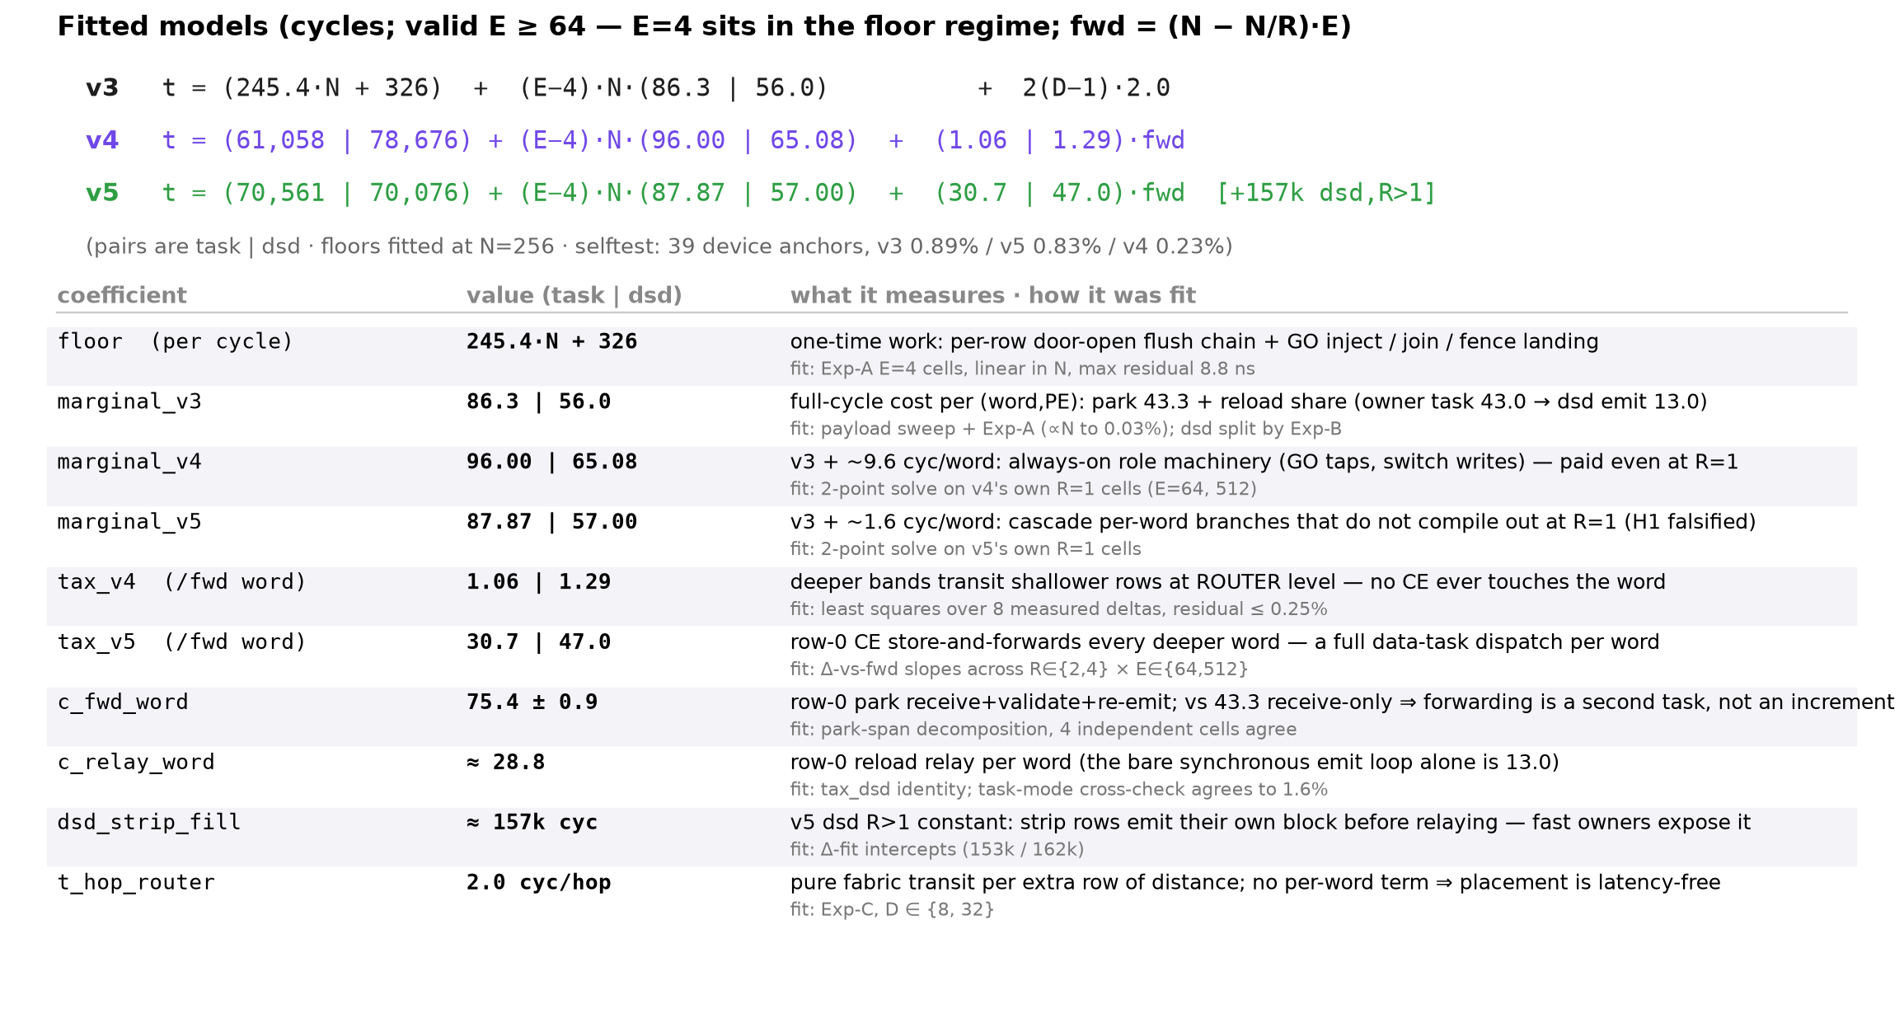
MODEL · EQUATIONS AND FITTED COEFFICIENTS
Three device-fit models, one coefficient table
Internal-discussion reference: the three fitted equations (task | dsd pairs) and every coefficient with its meaning and fit provenance. All values are real CS-3 measurements; selftest reproduces 39 device anchors under 1%.
Notes:
Replaces the earlier v4-equation slide per Le's request: full model view, modest typography. The v4-topology figure remains in figures/fig_v4_model_topology.png if wanted back. Deeper provenance: PREREGISTRATION-multirow.md consolidated record; perf_model.py --selftest.

Slide 7
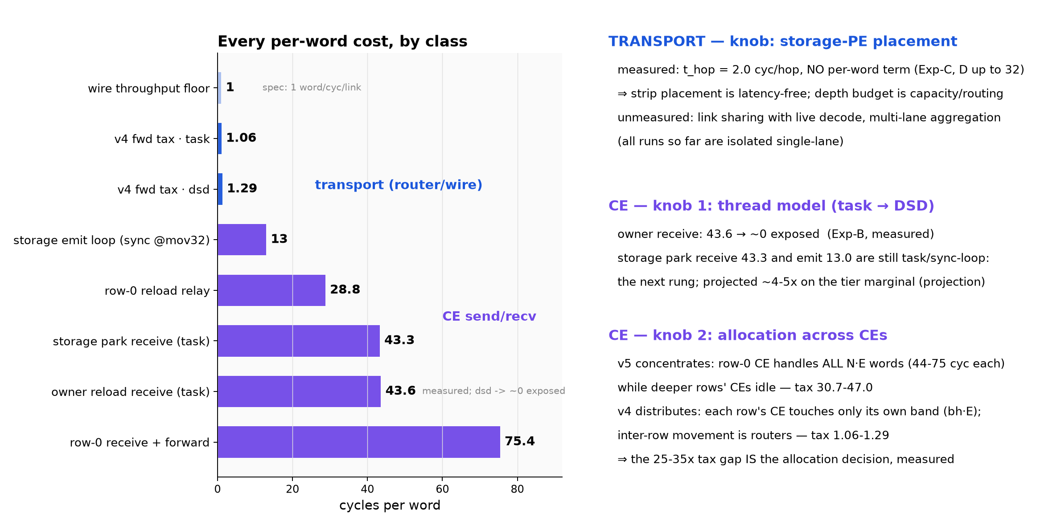
INSIGHT · TRANSPORT VS CE, AND THE KNOB FOR EACH
Pure transport is 1-2 cyc/word; CE send/recv is 13-75 — and each class has its own lever
Left: every measured per-word cost, colored by class — transport (router/wire) vs CE send/recv. Right: what moves each class. Transport depends on storage-PE placement, measured latency-free (2.0 cyc/hop, no per-word term). CE depends on the thread model (task -> DSD, measured on the owner side) and on how work is allocated across CEs: v5 concentrates all forwarding on row-0's CE (tax 30.7-47.0) while v4 leaves inter-row movement to routers (tax 1.06-1.29) — the 25-35x gap is the allocation decision itself, measured.
Notes:
The remaining CE items on the tier's critical path are storage park receive (43.3, task) and emit (13.0, sync loop) — the projected ~4-5x next rung (labeled projection). Transport-side open items are congestion-class, not latency-class: link sharing with live decode and multi-lane aggregation are unmeasured (all runs isolated single-lane). Wire floor 1 word/cyc/link is spec, not measured; everything else on the chart is a device fit.

Slide 8
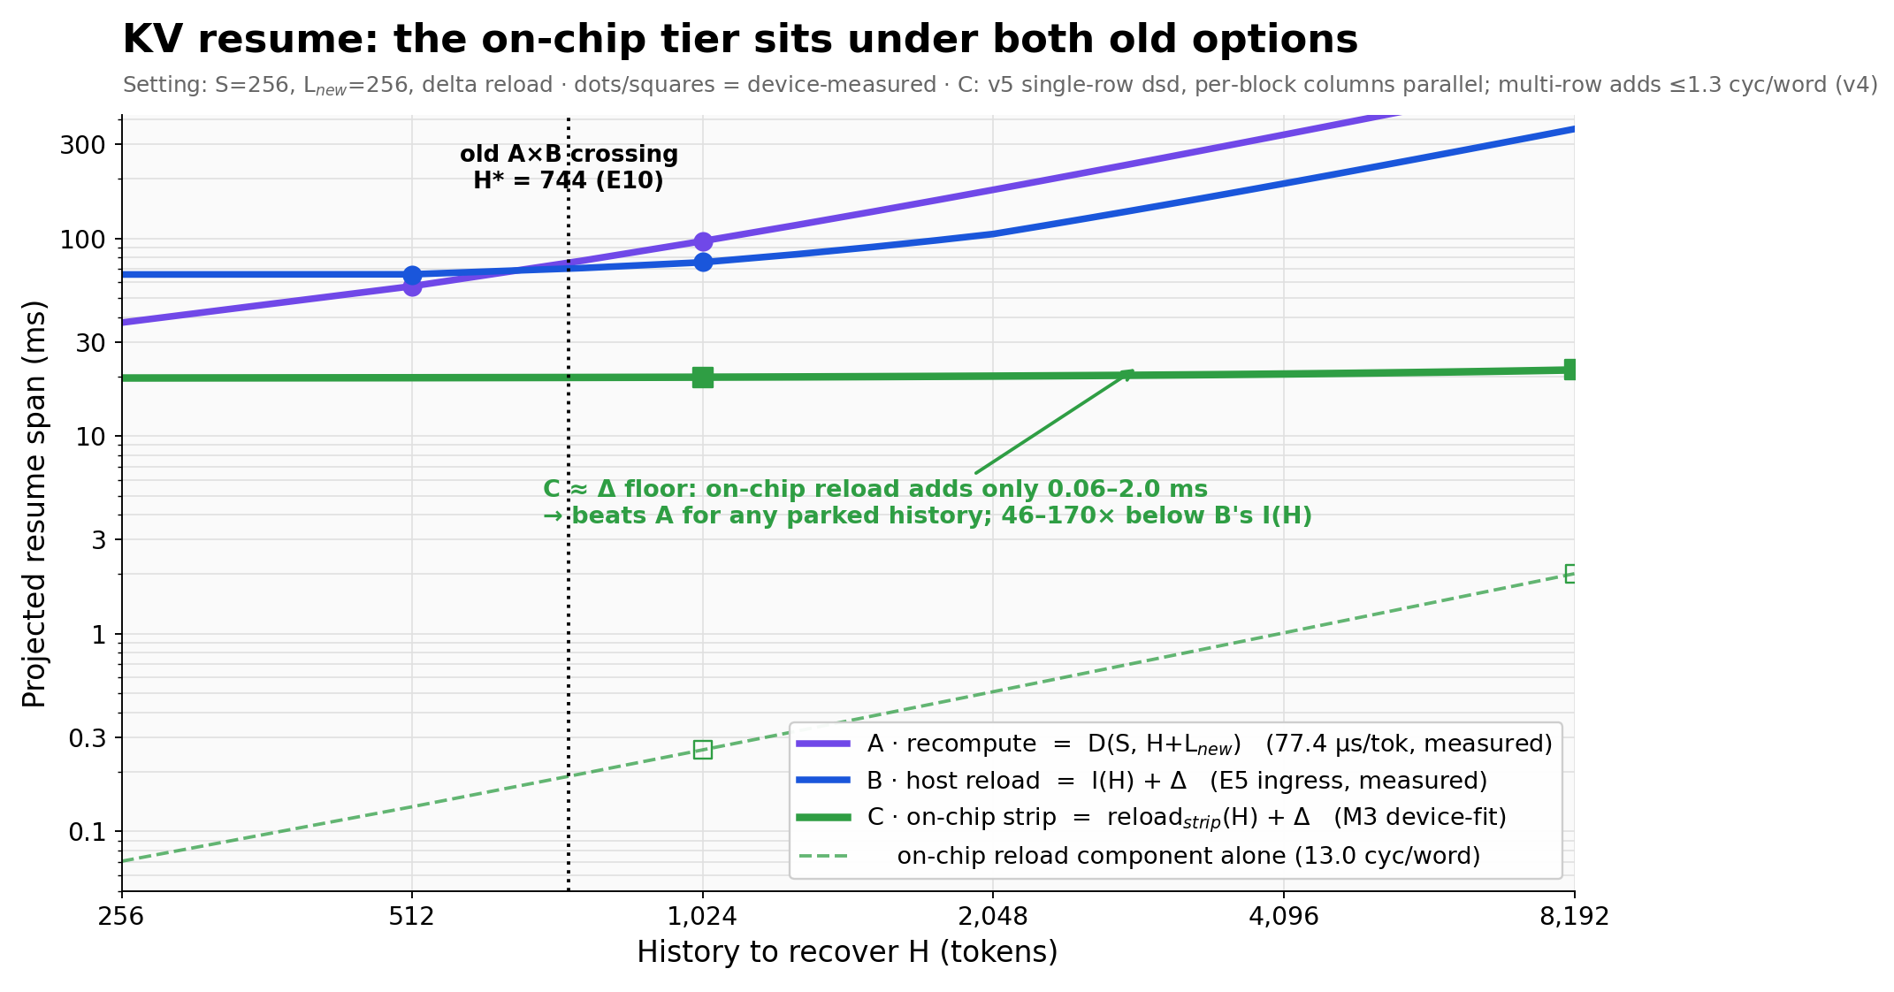
SO WHAT · THE TIER HOLDS
The on-chip tier sits under both old options: resume is now delta-dominated
Same axes and setting as the M2 boundary figure, plus measured tier C: on-chip strip reload adds only 0.06-2.0 ms (13.0 cyc/word), 46-170x below host ingress I(H), flattening resume onto the ~20 ms L_new delta floor. The old 744-token crossing becomes a fallback choice for un-parked history. Next lever for resume latency is the delta/restart path, not the transfer.
Notes:
Tier reading: T0 in-PE resident (free, scarcest SRAM) / T1 on-chip strip (swap ~ L/692 token-equivalents as-built; capacity R x ~11K words per column, columns parallel) / T2 recompute (only for tiny or un-parked history) / T2 DRAM (capacity overflow; shared edge IO, host in the loop). Caveats stated: delta floor is L_new=256 at 77.4 us/token - smaller L_new shrinks it; throughput view still wants the storage-DSD rung; concurrent-decode interference and round-gap fit are the remaining unmeasured items. Open design: a hybrid (v4 router transit + v5 static compute column) would dominate both at ~1.6 baseline + ~1.1 tax.

Slide 9
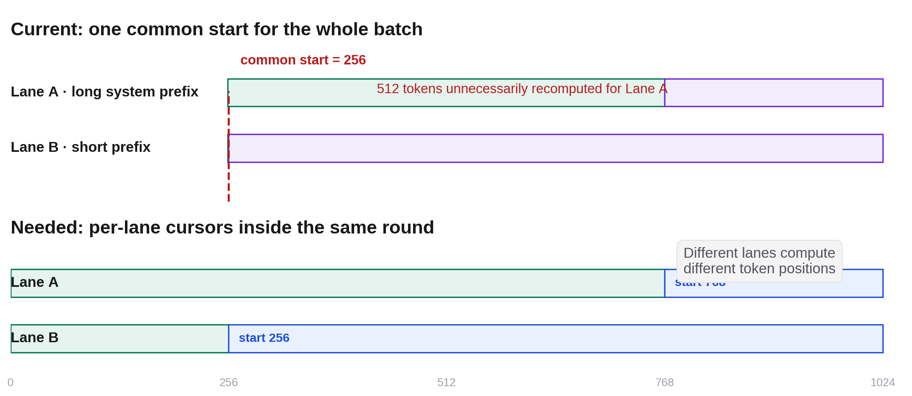
WHY THIS OPTIMIZATION · FOLLOW-UP TO AUG 11
Common-start is correct—but recomputes longer prefix hits
Lane A can reuse 768 tokens while Lane B can reuse only 256. The current batch starts both at 256, so Lane A re-executes 512 already-known token positions.
Notes:
This directly follows the Aug 11 ragged-execution limitation slide. Current common-start assignment is numerically correct; the open question was whether suppressing redundant lane work would shorten the lockstep batch critical path, or only reduce operation count and improve fairness/energy. Source figure: 2026-08-11 weekly collaborator deck, slide 7.

Slide 10
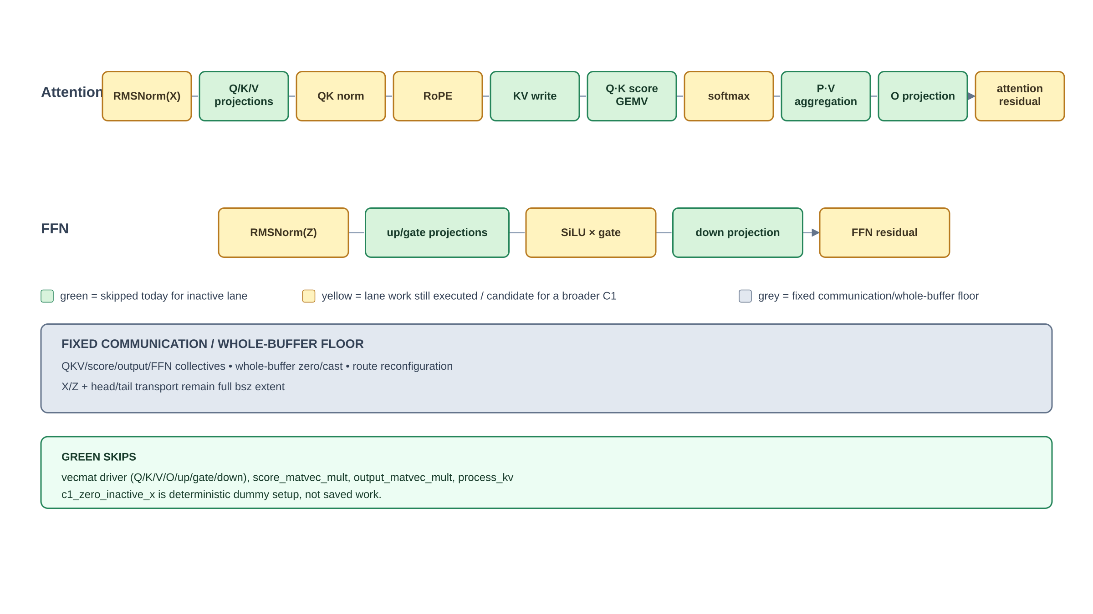
BENCHMARK-ONLY C1-M CHANGE
We skipped lane-sliced compute; the fixed batch floor stayed
Green is predicated while step < Rᵢ − min(R); yellow still executes for the inactive lane; grey remains full-bsz communication or whole-buffer work.
Notes:
Exact implemented skip surface: vecmat_computation_f32 avoids Q/K/V/O/up/gate/down GEMV maps; score_matvec_mult skips Q·K cache traversal; output_matvec_mult skips P·V cache aggregation; process_kv preserves resident KV. c1_zero_inactive_x establishes deterministic dummy state and is not saved work. RMSNorm, QK norm, RoPE, softmax, SiLU/SwiGLU, residuals, whole-buffer zero/cast, every collective, route reconfiguration, X/Z transport and head/tail remain active at fixed extent. One global token position remains; this is C1, not C2 independent progress.

Slide 11
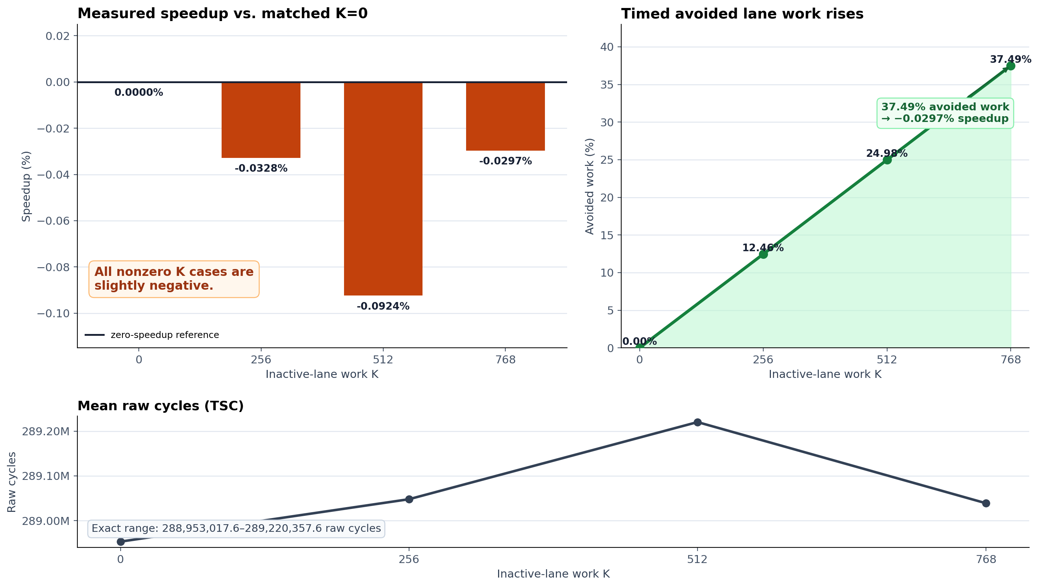
REAL CS-3 RESULT · 20/20 ACCEPTED
37.49% less lane-step work produced no critical-path speedup
Full Qwen3-1.7B, bsz=2, S/N/F/G=256/1024/769/255, five repetitions per case, raw TSC cycles. At K=768, mean speedup is −0.0297%.
Notes:
Construction-matched manual K0 is the only baseline used here. Mean speedups for K=256/512/768 are -0.0328%, -0.0924%, and -0.0297%; the response is non-monotonic and no break-even appears. A descriptive K=768 Welch sensitivity has an approximate +0.106% speedup upper edge, but serial case blocks make it non-universal. The automatic Experiment-A K0 is 12.2363% faster than this manual construction and must not be mixed into the ratio. Decision boundary: NO-GO for C1-M as a throughput mechanism at this point; operation reduction is real, end-to-end throughput/fairness/energy remain separate or unknown.

Slide 12
NEXT DECISION
Pin the fixed floor—or move to independent lane progress
A · Profile the C1 fixed floor
B · Design C2 / continuous batching
—
Time or ablate collectives, whole-buffer ops and transport by phase
—
Independent per-lane start, cursor and completion state
—
Identify the single largest remaining critical-path item
—
Price added SRAM, protocol, admission and scheduler complexity
—
Broaden masking only if that removable term can change the <0.1% result
—
Only credit gains that survive a serving-like schedule replay
Notes:
No recommendation is implied yet. Option A is one bounded profiling gate to explain the fixed floor. Option B targets the final mechanism in which a long-hit request can advance without waiting for another lane's missing prefix, but crosses into C2 and O1 continuous-batching scope. The realistic workload projection remains necessary before either path receives a serving-level gain.

