Slide 1
Scale up Vs. Scale out in Cloud Storage and Graph Processing Systems
Wenting Wang
Le Xu
Indranil Gupta
Department of Computer Science, University of Illinois, Urbana Champaign

Slide 2




Scale up VS. Scale out
A dilemma for cloud application users: scale up or scale out?
Scale up: one machine with high hardware configuration
Scale out: cluster composed by wimpy machines
Notes:
Todays cloud providers provide a variety of choices of instances.
It is challenging for the cloud users to figure out which instances are best for their applications.
They have to make decision between a scale up. A scale up node is a single server with powerful CPU and large memory and A scale out cluster is a cluster composed by wimpy servers that have relatively lower cpu power and memory size but also come with a cheaper price.
Question for the cloud users that 1. which should I choose base on my application and different constraints I have

Slide 3
Scale up VS. Scale out
Systems are designed in a scaling out way…
Scale-up vs Scale-out for Hadoop: Time to rethink?(2013)
“A single “scale-up” server can process each of these jobs and do as well or better than a cluster in terms of performance, cost, power, and server density”
What about other systems?
Question: Is scale out always better than scale up?
Notes:
It is well known that the industry rule of thumb of applying large cloud computing system is to distribute the computing unit over a cluster….
In fact many systems are designed in a way that has high scalability to keeps a good performance during cluster’s scales.
For example, hadoop speeds up computation by parallizing mr jobs over a large number of instances
So our question regarding this is…..
However, a recent research from MSR shows that a single scale up server can perform as well as or even better than a cluster running a Hadoop jobs in terms of performance, cost
This leads us to think whether the condition still holds for other systems such as storage/ graph processing

Slide 4
Contributions
Set up pricing models using public cloud pricing scheme
Linear Square fit on CPU, Memory and Storage
Estimation for arbitrary configuration
Provide deployment guidance for users with dollar budget caps or minimum throughput requirements in homogeneous environment
Apache Cassandra, the most popular open-source distributed key-value store
GraphLab, a popular open-source distributed graph processing system
Notes:
The main contribution of our work is:
Set up a pricing model using the pricing scheme provided by major public cloud providers: such as… This is due to the fact that even the public cloud providers have their own pricing scheme, for users to price arbitrary configuration on local machines or private cloud, such pricing model doesn’t exist
We provide a guidance for choosing between scale up or scale out instances for users who have dollar budget or min throughput requirements. In particular, we choose to explore storage system, Cassandra and graph processing system, graphlab. Both of these systems are popular and typical in their own areas
We explore users’ deployment options in heterogeneous environment for these systems. Heterogeneous environment is the environment that composed by both beefy and wimpy servers
In some cases, users have so much data so that a cluster with machines of same configurations doesn’t fit their needs, or the simply don’t have
For those users, we explore……in which machines have…
For the rest of the talk, im going to introduce the performance of these systems in
For the rest of the talk im going to discuss how we set up the pricing model and how Cassandra/graphlab perform under both homo/hetro enviroment

Slide 5
Scale up VS. Scale out - Storage
Cassandra Metrics
Throughput: ops per sec
Cost: $ per hour
Normalized Metric
Cost efficiency = Throughput / Cost
Notes:
For scale up and scale out metrics

Slide 6
Scale up VS. Scale out - Storage
YCSB workload
Yahoo Cloud Serving Benchmark: A database micro-benchmark tool
Read heavy, write heavy workload on Zipf Distribution
1 Million operations on 1GB database
Metrics: Performance(Ops/s), Cost($/hour) and Cost efficiency
Homogeneous Experiment Settings:
Scale out cluster: 4, 8, 16 machines (0.09$/hour)
Scale up machine(3.34$/hour)
Heterogeneous Experiment Settings:
A mixture of beefy and wimpy machines
Cost(beefy) = Cost(wimpy) X 4
Notes:
Let’s start with the performance comparision of a storage, in this case cassandra, on a beefy node and a wimpy cluster
For our experiment on storage system, we use Yahoo…
We perform both read heavy / write heavy workload… in this slide..
All experimets are done…
The main metric we use to evaluate different deployment choices are cost (cost per hour), performance (throughput), cost efficiency (throughput you gain over each dollar you spent)
For the homo experiment we use a sinlgle scale up beefy server and cluster with 4, 8, 16 wimpy machines.
For the heteo experiment we use a cluster composed by a mixture of beefy and wimpy nodes. In this experiment the beefy node is almost 4 times as powerful as wimpy node thus the cost ratio between these two machines is 4:1

Slide 7
Homogeneous - Cassandra
 | Budget-constrained | Min throughput requirement
Light workloads | Scale out with small number of nodes | If throughput low Scale out Else Scale up
Heavy workloads | If $ constraint low Scale out is only option Else Scale up | Scale up
Notes:
Here is the recommendations we provided for the storage users choosing beefy node and wimpy cluster based on our experiment results.
I’m going to introduce each of them…

Slide 8
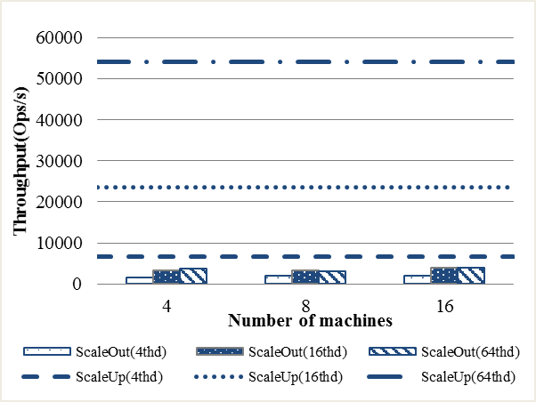
Homogeneous - Cassandra
Performance(Ops/s)
Main variable tuned: Workload intensity, scale out cluster size
- With a high threshold of throughput requirement, scale up is preferable
Notes:
Let’s start with the throughput performance…
In this experiment, the major params we tuned are workload intensity in terms of the number of client threads and scale out cluster size.
In our plot, the dash lines stand for the data we collected for the scale up machine and the bars are for the scale out cluster of different sizes.
1. Under any workload intensity scale up always generate much higher throughput than scale out cluster of any sizes.
2. Under a certain workload intensity scale out throughput increases as the cluster size increases.
From this plot we could see that with ….

Slide 9
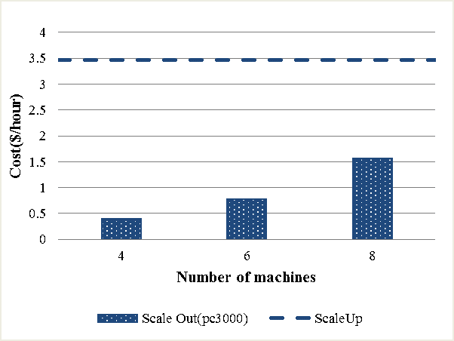
Homogeneous - Cassandra
Cost
4 8 16
Notes:
In this plot, we show the unit time cost…
Since we’re using a linear..when the wimpy cluster double its size, the cost also doubles.

Slide 10
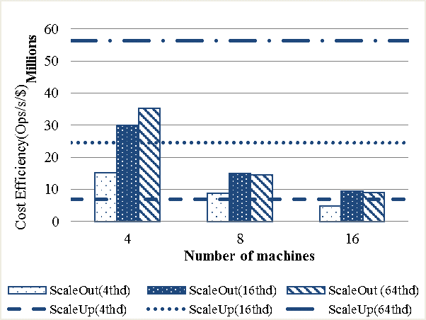
Homogeneous - Cassandra
Cost Efficiency
Main variable tuned: Workload intensity, scale out cluster size
Notes:
Finally we show cost efficiency of this workload in these two environments,
Cost ef is computed by.
Intuitively, cost ef means..
As its turned out, unlike throughput, cost efficiency of wimpy cluster is higher than beefy server under light workload
Under heavy workload

Slide 11
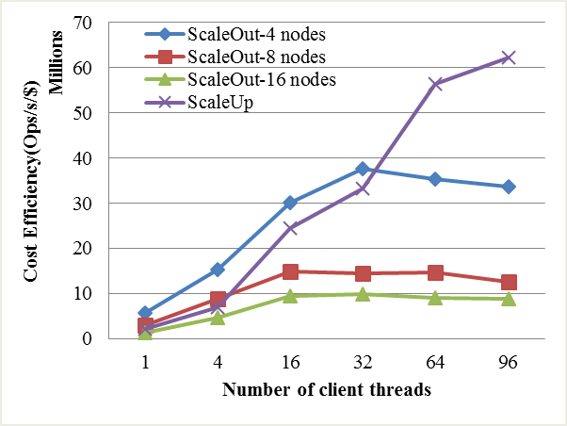
Homogeneous - Cassandra
Light workload: Scale out cluster has a better cost efficiency comparing to scale up while cluster size is small.
Heavy workload: scale up is always better in terms of cost efficiency
In terms of scale out size, small is always better
Scale up & Scale out under different workload intensity
Notes:
We run a few more experiments to further show this observations:
in this plot, we focus on the impact of workload intensity to the cost efficiency of these settings
Similar to the previous plot
1. While workload is light (number of users is small), scale out with small number of machines (4, 8) has better cost efficiency than scale up
2. Under heavy workload, the c/e of the wimpy cluster start to go down, beeft is always better in terms of throughput /dollar
3. In terms of scale out size, small is better under any workload. Because the cost of the cluster grows faster than the throughput

Slide 12

Homogeneous - Cassandra
 | Budget-constrained | Min throughput requirement
Light workloads | Scale out with small number of nodes | If throughput low Scale out Else Scale up
Heavy workloads | If $ constraint low Scale out is only option Else Scale up | Scale up
Notes:
Users care about the performance generated by each dollar

Slide 13
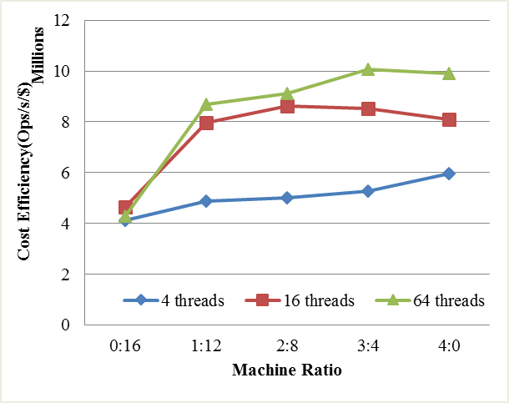
Heterogeneous - Cassandra
Main variable tuned: machine ratio, workload intensity
Adding one beefy node to the cluster significantly improves throughput, as the node serves as a contact point
Lower marginal benefits while the number of beefy nodes increases
Machine Ratio (# of beefy nodes : # of wimpy nodes) VS. Cost Efficiency under different workload intensity
Notes:
In our next section, we explore the deployment options for the users who want to use machines with mixed configurations in their cluster….
In the first experiment here, we start with 16 wimpy nodes, then…
For the heterogeneous environment, the main variables we tuned are the machine ratio, vnode ratio and workload intensity. The machine ratio stands for the ratio of beefy nodes versus the number of wimpy nodes, the vnode ratio shows the ratio of the number of virtual nodes we set on each wimpy node versus that number of beefy node. In Cassandra, this ratio implies the ratio of size of data being stored on each machine.
For the first plot we tune the change the machine ratio under vnode ratio of 1:4: from left to right we gradually increase the number of beefy nodes in the system and reduce the number of wimpy nodes in the system and keep the cluster cost unchanged.
It is clear that with the cluster cost unchanged, adding one beefy node to the cluster significantly improves the throughput as we presume that the beefy node serve as a contact.
As the number of beefy nodes increases, we gain less marginal benfit in terms of cost efficiency because the most requests still have to be passed through the network.

Slide 14
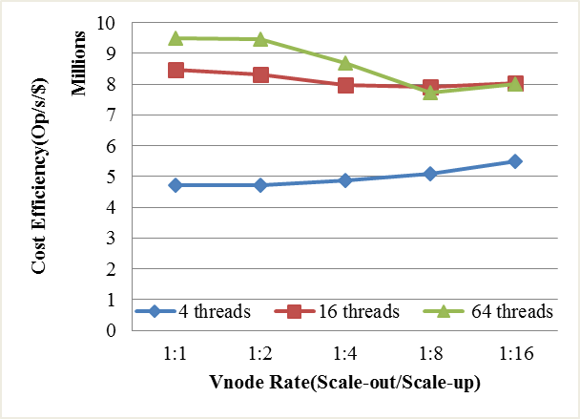
Heterogeneous - Cassandra
Main variable tuned: vnode ratio, workload intensity
Under light workload, performance increases as the beefy node partition grows
Under intense workload, beefy node becomes the bottleneck for the entire system.
Vnode Rate (# of wimpy nodes Vnode : # of beefy nodes Vnode) VS. Cost Efficiency under different workload intensity (machine ratio 1:12)
Notes:
In the second experiment we tune the vnode ratio between wimpy server and beefy server.
The vnode stands for virtual nodes on Cassandra’s ring.
The vnode ratio between wimpy server and beefy server is the ratio between the size of data partition on these two nodes.
In this plot we tune the ratio of vnodes (which is the ratio of data size assigned on wimpy nodes versus beefy node)
From left to right we increase the partition size we assigned to the beefy node with machine ratio of 1:12.
We found that under light workload intensity, storing more data on beefy node can be beneficial,
but as the workload gets intense, beefy node can become the bottleneck of the system while storing too much data. We also perform the similar experiments on the clusters with different machine ratio and getting the similar results.

Slide 15
Scale up VS. Scale out - GraphLab
GraphLab Metrics
Throughput: MB per sec
Cost: Total $ for a workload
since batch processing system
Normalized metric
Cost efficiency = Throughput / Cost
Notes:
Next we move on to graph processing system…

Slide 16
Experimental Settings
Page Rank
Homogeneous Settings
One scale up machine(3.34$/hour)
Two scale out clusters with 4, 8, 16 machines
Weak configuration (1 core/machine) – pc3000 (0.09$/hour)
Strong configuration (4 cores/machine) – d710 (0.34$/hour)
Heterogeneous Settings
A mixture of beefy and wimpy machines
Job | Data set | Input | |V| | |E|
Small | Live Journal | 1G | 4.8M | 68M
Large | Twitter | 6G | 41.6M | 1.5G
Notes:
Next we move on to graph processing system…
For graph processing system, the data we presented here is generated by running pagerank on two graphes, a small Live Journal social graph and a large twitter one. Same as Cassandra experiments, we have the three metrics: performance, cost and throughput per dollar.
For homogeneous experiments, we choose one scale up machine, and two scale out clusters, one is a weaker configuration where each machine has only one core, the other is a strong configuration where each node has 4 cores.
For the heteo experiment we use a cluster composed by a mixture of beefy and wimpy nodes.

Slide 17
Homogeneous - GraphLab
 | Budget-constrained | Min throughput requirement
Small Jobs | Scale out with small number of nodes (allow parallelization) | Scale out with small number of nodes
Large jobs | Scale up | Scale out with large number of nodes
Notes:
Here is the recommendations we provided for the graph processing users choosing beefy node and wimpy cluster based on our experiment results.
I’m going to introduce each of them…

Slide 18
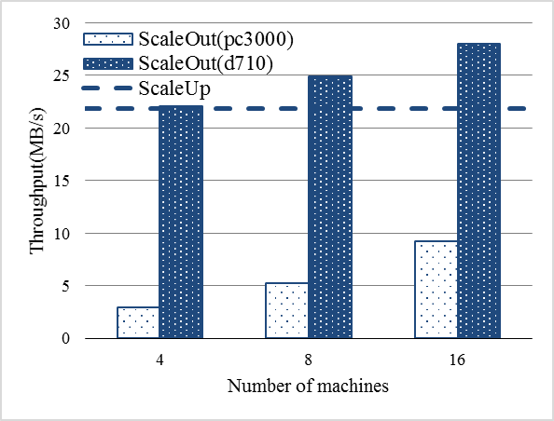
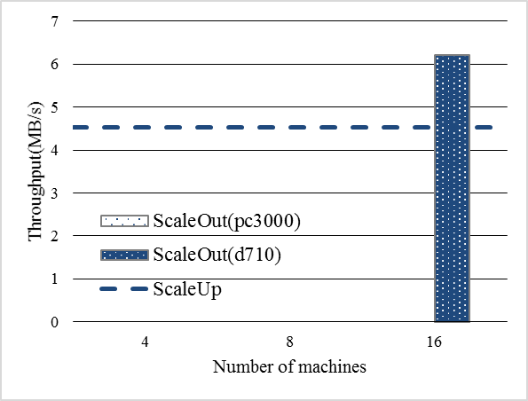
Homogeneous - GraphLab
Performance(MB/s)
Small job
Large job
Minimum requirement for the quality of scale out cluster
Scale out performs better than scale up
Notes:
Here we first present the throughput performance result for small graph and large graph.
One interesting observation is that graph processing system has some minimum requirement for hardware configuration and cluster size. for small graph on the left, the weak scale out cluster perform worst. This is because under this configuration, each machine only has one core which is not optimal for GraphLab. For large graph on the right side, GraphLab could only load graph to a strong scale out cluster with larger size. The reason for this is that a scale out cluster with a small number of machines may suffer out-of-memory when loading graph.
Compared scale out vs scale up, we found that scale out has better throughput than scale up machine.
Since scale out cluster which parses data in parallel is faster than scale up.

Slide 19
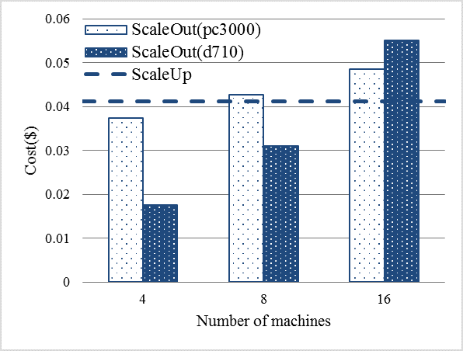
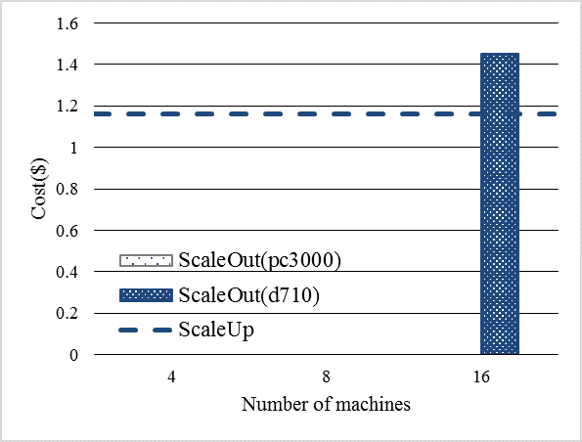
Homogeneous - GraphLab
Cost= completion time * cluster/ scale up machine unit price
Small job
Large job
Beefy machine is sometimes the cheapest choice
Notes:
, different from our Cassandra experiment, here we compute cost by unit time price * the time we complete each job.
Surprisingly, in our experiment, wimpy node cluster is not the cheaper choice. The experiment shows that renting beefy nodes for GraphLab can even be cheaper. This is caused by the fact that
For small graph, even though the weak scale out cluster has lower unit price, it generates a longer completion time while running the same job. It ended up cost more than both scale up and stronger scale out cluster.
For large graph, scale up machine becomes a cheaper choice because of its lower unit price
=======
Next lets look at the cost we rent such cluster or single machine. Here we calculate the job completion time multiplying the unit price of each setting)
Our key insight here is that, in contrast to the traditional view that a cluster consists a bunch of wimpy nodes is cheaper to rent, our experiment result shows that renting beefy nodes for graph processing is actually cheaper. The meaning of this is two folds:
First, for small graph, strong scale out cluster is in general cheaper than weak configuration. Although the weak cluster that has the lowest unit price, however, has a longer job completion time which generates a higher total cost.
Second, compared scale up vs scale out cluster for large graph, scale up is cheaper since its unit price is cheaper than scale out cluster.

Slide 20
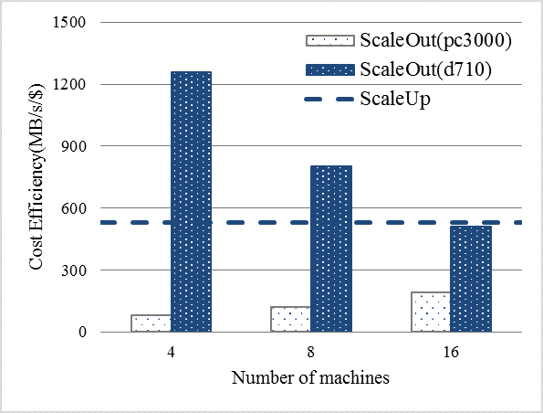
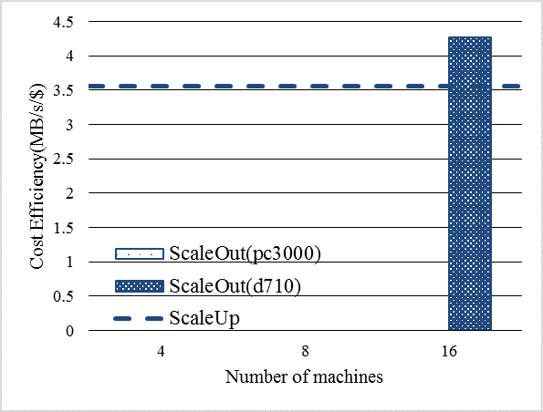
Homogeneous - GraphLab
Cost Efficiency (Throughput/$)
Small job
Large job
Scale out cluster in small size achieves best cost efficiency
Notes:
Finally we show the results for cost efficiency for GraphLab under in both scenarios
In both cases, a strong scale out cluster satisfying minimum configuration requirements has the best cost efficiency., scale up machine is less cost efficient
For the small jobs running on scale up machine doesn’t fully utilize the powerful CPU and large SSD storage.
For the large jobs, scale out machine achieves better cost efficiency by further parallelizing the computation.
===
And finally we calculate the cost efficiency for GraphLab
Our conclusion for cost efficiency is scale out cluster which satisfy the minimum quantity and quality requirement has the best cost efficiency. Scale up machine in both cases, small graph and large graph is less cost efficient. One reason is that for small job running on the scale up machine does not make the best use of powerful and expensive CPUs. For large graph, Although the scale out cluster is more expensive than the scale up machine, it achieves a better performance on the large graph by parallelizing the computation

Slide 21
Homogeneous - GraphLab
 | Budget-constrained | Min throughput requirement
Small Jobs | Scale out with small number of nodes (allow parallelization) | Scale out with small number of nodes
Large jobs | Scale up | Scale out with large number of nodes
Notes:
Here is the recommendations we provided for the graph processing users choosing beefy node and wimpy cluster based on our experiment results.
I’m going to introduce each of them…

Slide 22
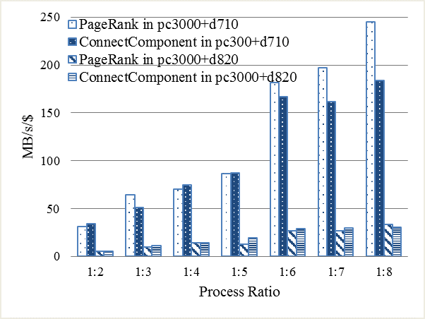
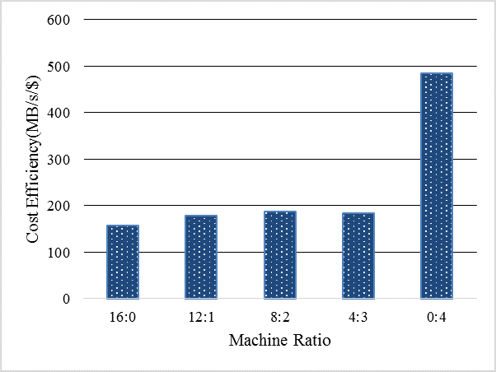

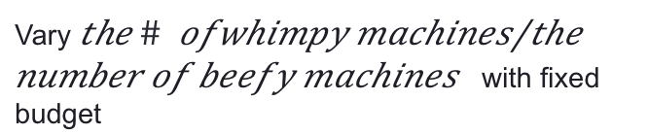
Heterogeneous - GraphLab
Vary $\frac{the \# of processes in whimpy machine}{the number of processes in beefy machine}$
Vary $\frac{the \# ofwhimpy machines}{the number of beefy machines}$ with fixed budget
Better cost efficiency can be achieved by
More processes running on beefy machine
Fewer wimpy machines(stragglers)
Notes:
In the heterogeneous environment, the main variables we tuned are the process ratio and the machine ratio. The machine ratio, similar to the experiments before, is the ratio of the number of wimpy machines versus the number of beefy machines. The process ratio, in this case, is the ratio of processes we allocate on wimpy machines versus the processes we allocate on beefy machine.
On the left side, we gradually increase the number of processes we allocate on beefy machine. As we can see, the cost efficiency increases as the number of beefy nodes increases.
On the right side, we replace the wimpy machines in the cluster by beefy machine and keep the cluster cost on changed. Apparently, the cost efficiency only increases while all the wimpy machines are replaced by the beefy machine. This is because as a graph processing system, the performance of GraphLab heavily depends on the parallization level. Wimpy nodes can easily become the straggler of the system to slow down the job.
We also investigate how graph processing system perform in a heterogenerous cluster.
The goal for this part is to give a guidance for application deployers who wants to run graph processing system in a heterogeneous cluster.
By experiment we show that, a better cost efficiency can be achieved in either way: 1) running more process on the beefy mahine in the cluster and 2) having fewer wimpy mahcines participate in the computation.
The 1st experiment we vary process ratio. By process ratio, we mean the number of processes running on wimpy/weak machine by the number of processes on a beefy machines. AS we run more computation processes in the powerful machine, the costefficiency is improved because the beefy node in the cluster is better utilized.
The 2nd experiment we vary the machine ratio with a fixed budget. In out settings, a beefy machine is four times as expensive as wimpy machine. With a fixed budget , we could rent a weak cluster with 16 weak machines, or a cluster with 4 beefy machines, or a heterogeneous cluster with a mix of these two type. So in this way we vary the machine ratio. The experimental result shows that a cluster with all strong machines provides the best cost efficiency. The reason is similar as previously mentioned. That is, weak machine in a heterogeneous cluster become stragglers which slow down the whole computation process.

Slide 23
To sum up…
What have we done:
Pricing model based on major cloud providers
General guidance between scale up vs. scale out
The choice is sensitive to workload intensity, job size, dollar budget, and throughput requirements
Explore implications when using heterogeneous mix of machines
Future work
A quantitative way to map hardware configuration to cost efficiency
Latency, network usage, resource utilization/profiling, fault tolerance
And many more…
Find our work at http://dprg.cs.uiuc.edu
Notes:
Base on the work we have now, We think it would be interesting to develop a quantitative way to map hardware configuration to cost efficiency level, that weill involves a more detailed resource profiling
Also we think it will make our work more complete to include more factors in to consideration
To sum it up: For this work we provide a general guidance between choosing scale up and scale out for storage / graph processing users, using the pricing model we derived from major cloud providers. We also explore some possible deployment plans for these systems in heterogeneous cluster. There are many more directions where this work can be extend to such as resource utilization, fault tolerance and quantitative way to map hardware configurations to cost efficiency.

Slide 24
Back up

Slide 25
How do we set up the pricing model
From AWS pricing March -2014
Linear least square fit, using three variables: CPU, memory, storage
VCPU count | Memory Size (GiB) | SSD Storage Size (GiB) | Price per hour ($)
7 | 3.75 | 32 | 0.15
14 | 7.5 | 80 | 0.3
28 | 15 | 160 | 0.6
55 | 30 | 320 | 1.2
Notes:
To price an instance of an arbitrary configuration, we derive pricing schemes from major cloud providers. Here is an example of Amazon’s AWS pricing on March 2014. The total price scales linearly with the hardware configurations. It became intuitive for us that the linear model will be a good fit in this situation. As a result, we use linear least square fit algorithm to construct a model to estimate machine cost based on CPU power, memory and storage size.

Slide 26
Linear Pricing Model
AWS instance pricing model
VCPU in SSD model ($/count) | Memory in SSD model ($/GiB) | SSD Storage ($/GiB) | VCPU in non SSD model ($/count) | Memory in non SSD model ($/GiB) | Non SSD Storage ($/GiB)
0.0094 | 0.0208 | 0.002 | 0.0155 | 0.0106 | 0.0001
VCPU count | Memory Size (GiB) | SSD Storage Size (GiB) | Price per hour ($) | Linear model estimation ($) | Error ($)
7 | 3.75 | 32 | 0.15 | 0.1504 | +0.004
6.5 | 7.5 | 32 | 0.225 | 0.2237 | -0.0013
13 | 15 | 80 | 0.45 | 0.4507 | +0.007
108 | 60 | 640 | 2.4 | 2.3940 | -0.006
VCPU count | Memory Size (GiB) | Non SSD Storage Size (GiB) | Price per hour ($) | Linear model estimation ($) | Error ($)
2 | 3.75 | 410 | 0.12 | 0.1190 | -0.001
20 | 7 | 1680 | 0.58 | 0.5817 | +0.0017
88 | 60.5 | 3360 | 2.4 | 2.4001 | +0.001
Notes:
On the top we have the pricing model we constructed

Slide 27
Contribution of our work
Setting up pricing model
Storage (Cassandra)
Homogeneous: Scale out using a small cluster only when there is a dollar budget cap and low throughput requirements, scale up in any other cases.
Heterogeneous: beefy node is preferable, assigning larger data partition to the beefy node without overwhelms it.
Graph processing
GraphLab performance and cost efficiency under homogeneous environment
GraphLab performance and cost efficiency under heterogeneous environment
Notes:
Even the public cloud providers have their own pricing scheme, for users to price arbitrary configuration on local machines or private cloud, such pricing model doesn’t exist

