Slide 1
Stela: Enabling Stream Processing Systems to Scale-in and Scale-out On-demand
Le Xu∗, Boyang Peng†, Indranil Gupta∗ ∗Department of Computer Science, University of Illinois, Urbana Champaign, †Yahoo! Inc.,
DPRG UIUC: http://dprg.cs.uiuc.edu

Slide 2
Elasticity:
What is elasticity?
System’s ability to scale out and scale in to adapt its workload change.
Important for real time stream processing systems
Existing Elasticity support in adaptive elasticity in stream processing systems
System S, Stormy, SEEP, etc.
What if the resource change is determined by users (on-demand)

Slide 3
Scale-out And Scale-in On-demand:
Why is it important?
Current systems, such as Storm, handles this inefficiently
Our two goals:
The post-scaling throughput (tuples per sec) should be optimized.
The interruption to the ongoing computation (while the scaling operation is being carried out) should be minimized.

Slide 4
Contributions of System Stela:
Development of novel metric ETP (Effective Throughput Percentage)
First work to describe and implement on-demand elasticity within Storm
It requires neither hardware profiling nor knowledge of application code.
We believe our solution can be applied to many other systems as well.
Evaluation of our system on micro-benchmark applications as well as on applications used in production

Slide 5
Data Processing Model
Directed acyclic graph of operators
Operators are stateless
Each operator is run by one or multiple instances (executors) at the same time

Slide 6
Effective Throughput Percentage (ETP)
2000
3000
4
The percentage impact that an operator has towards the application throughput.
Effective throughput of operator o is the throughput of uncongested subcomponent of this operator
3000
2
1000
1
1000
7
1000
5
1000
3
8
500
200
9
6
10
300
An example of congested topology.
(All execution rate in tuples/sec)

Slide 7
Find ETP For Each Operator
2000
3000
4
2
ETP of operator 3:
(1000+1000)/4500=4/9
3000
1000
1
1000
7
Output: 1000 tuples/s
1000
5
1000
3
8
Output: 1000 tuples/s
500
200
9
6
Component # | ETP
1 | 0
3 | 0.44
4 | 0.44
6 | 0.11
Uncongested Subcomponent:
A collection of uncongested paths leads to outputs.
10
300
An example of congested topology.
(All execution rate in tuples/sec)

Slide 8

Stela Scale-out
Component # | ETP
1 | 0
3 | 0.44
4 | 0.44
6 | 0.11
2000
3000
4
3000
2
1000
1
1000
7
1000
5
1000
3
8
500
200
9
6
10
300

Slide 9
Stela Scale-out: Step 1
Number of Instance slots:
10/5 = 2
+
1
3
5
7
9
?
2
4
6
8
10
?
1. compute N: # of instances being added on new machines
N = # of new machines * current instance count / current machine count

Slide 10
Stela Scale-out: Step 2
Component # | ETP
1 | 0
3 | 0.44
4 | 0.44
6 | 0.11
+
1
3
5
7
9
?
2
4
6
8
10
?
2. For each instance slot:
Pick component C with highest ETP

Slide 11
Stela Scale-out: Step 2
Component # | ETP
1 | 0
3 | 0.44
4 | 0.44
6 | 0.11
+
1
3
5
7
9
3
2
4
6
8
10
?
2. For each instance slot:
Pick component C with highest ETP

Slide 12
Stela Scale-out: Step 4
Component # | ETP
1 | 0
3 | 0.44->0
4 | 0.44
5 | 0.44
6 | 0.11
Component # | ETP
1 | 0
3 | 0.44
4 | 0.44
6 | 0.11
2000
3000
4
3000
2
1000
1
1000
7
5
2000
5
1000
1000
3
8
3
500
200
9
6
3
10
300
?
For each instance slot:
3. Update C’s execution rate assuming new instance assigned.

Slide 13
Stela Scale-out: Step 4
Component # | ETP
1 | 0
3 | 0.44->0
4 | 0.44
5 | 0.44
6 | 0.11
+
1
3
5
7
9
?
3
2
4
6
8
10
4
4. Update all components’ ETPs and repeat from 1.

Slide 14
Stela Scale-in: Step 1
ETP: 0
ETP: 0.88
ETP: 0.55
ETP: 0.44
ETP: 0.11
Which machine to remove?
1
3
5
7
9
0
0.44
0.44
0.22
0.04
2
4
6
8
10
0
0.44
0.11
0.22
0.07
1. Find ETPSum for all machines

Slide 15
Stela Scale-in: Step 2
ETP: 0
ETP: 0.88
ETP: 0.55
ETP: 0.44
ETP: 0.11
1
3
5
7
9
0
0.44
0.44
0.22
0.04
2
4
6
8
10
0
0.44
0.11
0.22
0.07
2. Remove machine with lowest ETP Sum

Slide 16
Stela Scale-in: Step 3
ETP: 0.88
ETP: 0.55
ETP: 0.44
ETP: 0.11
Ranked machine by ETPSum:
0.11<0.44<0.55<0.88
1
3
5
7
9
0
0.44
0.44
0.22
0.04
2
4
6
8
10
0
0.44
0.11
0.22
0.07
3. Round Robin schedule instances on removed machine starting with machine with lowest ETPSum.

Slide 17
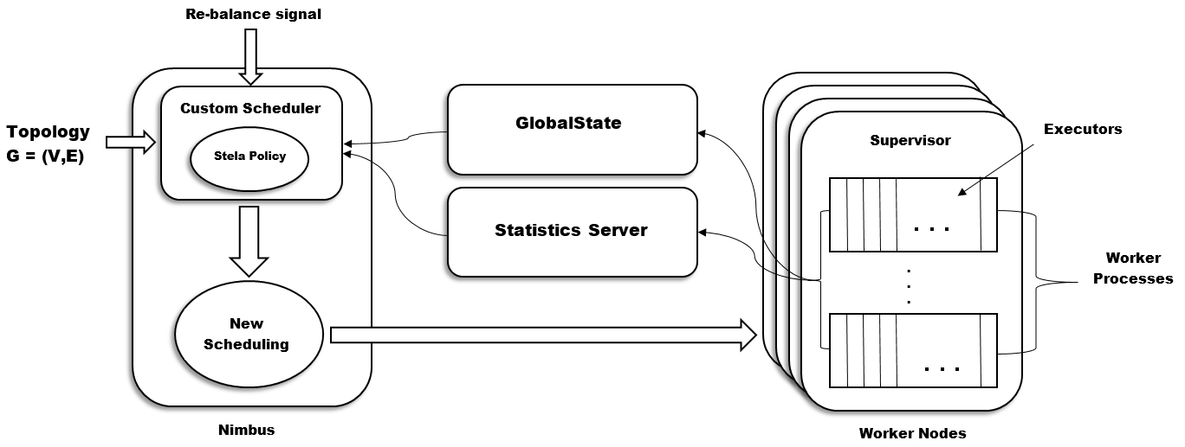
Stela Architecture

Slide 18
Evaluation
Experimental Setup (Emulab)
4-6 machines for micro-benchmark, 8 to 9 machines for real-world workload
Scaling strategy:
Storm Default
Stela
Linkedbase Load [1]
 | PC3000 | D710
Processor | 3 GHZ dual core processor | 2.4 GHz 64-bit Quad Core
Memory | 2GB | 12GB
Storage | 146 GB SCSI disks | 750 GB SATA disks
[1] L. Aniello, R. Baldoni, and L. Querzoni, “Adaptive online scheduling in Storm,” in Proceedings of the 7th ACM International Conference on Distributed Event-based Systems. ACM, 2013, pp. 207–218.

Slide 19
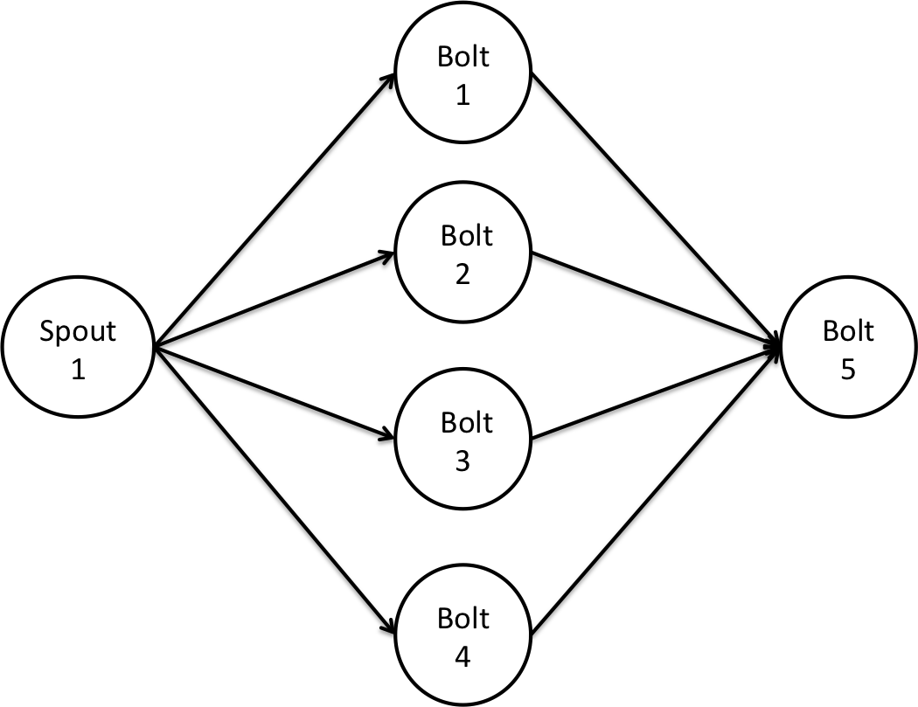
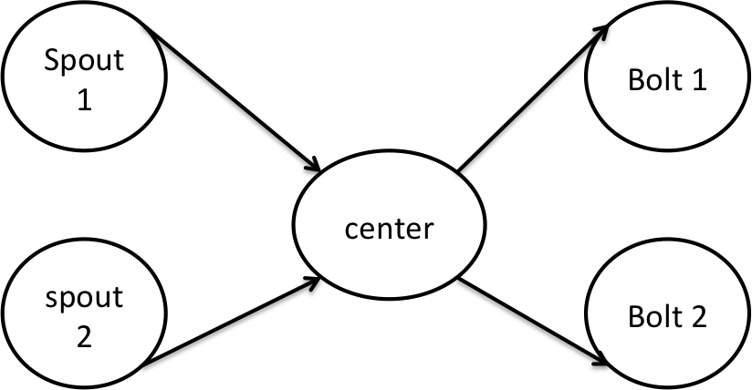
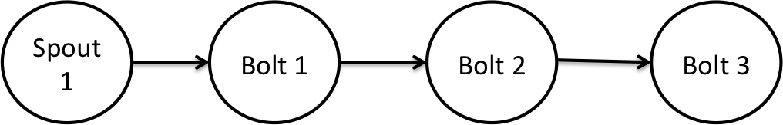
Micro-Benchmark Topologies
Star Topology
Linear Topology
Diamond Processing Topology

Slide 20
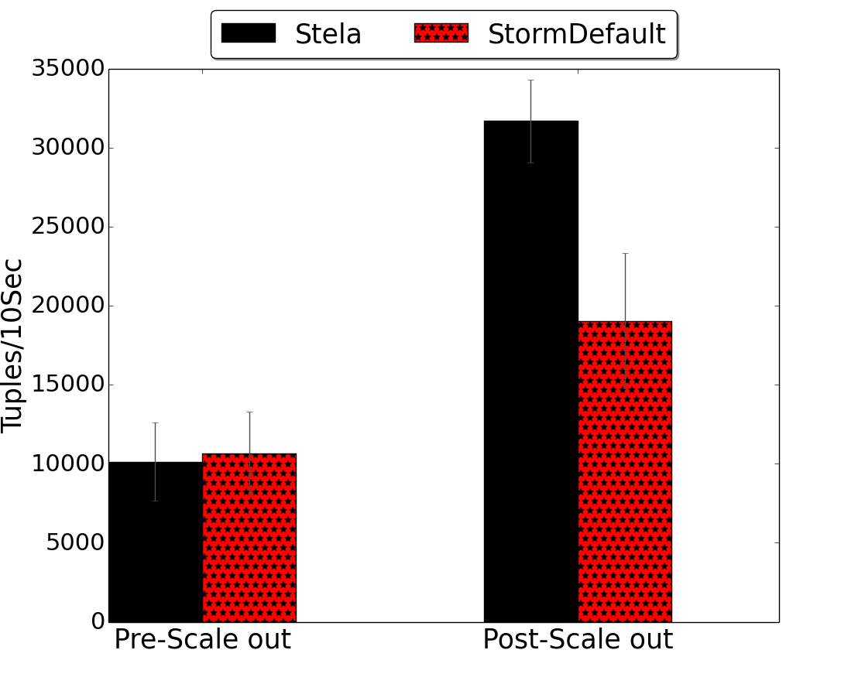
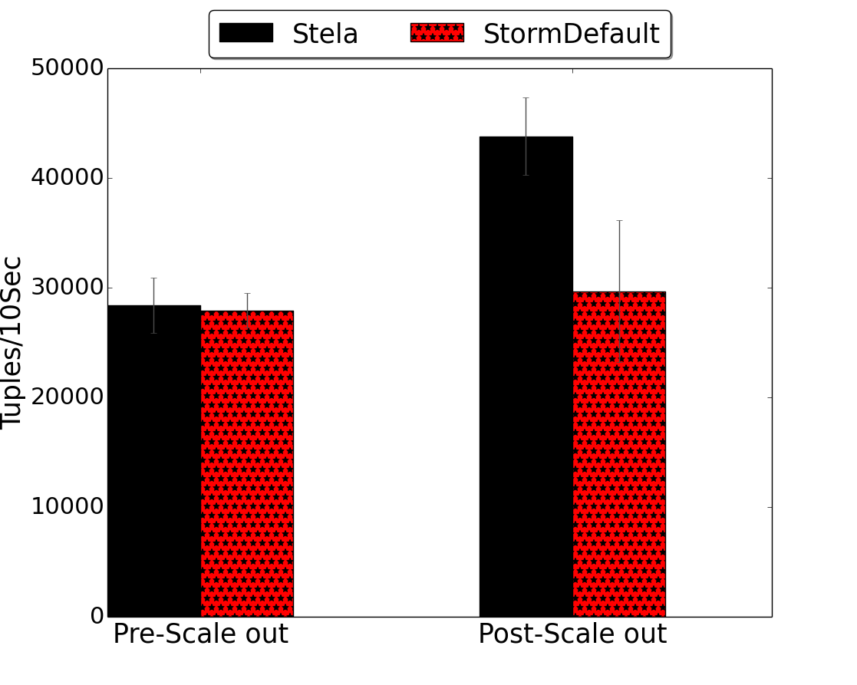
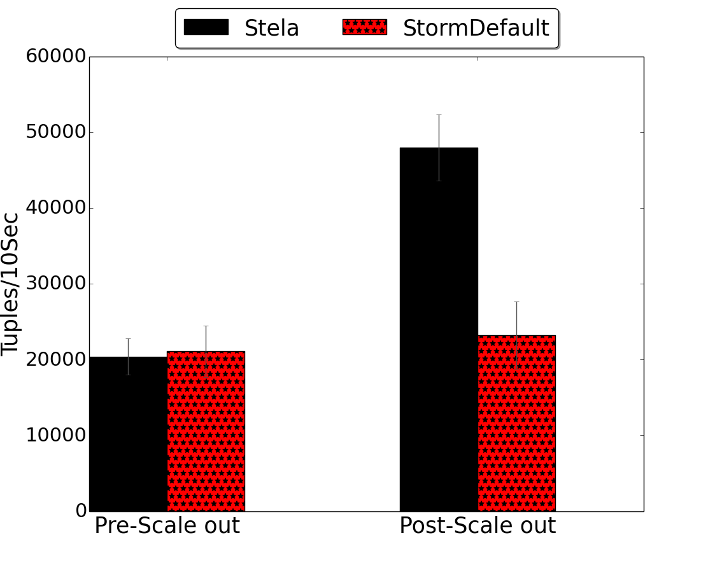
Micro-Benchmark Experimental Results
+65%
+45%
+120%
Star: Cluster size 4 -> 5
Executor size 20 -> 25
Linear: Cluster size 6 -> 7
Executor size 20 -> 23
Diamond: Cluster size 6 -> 7
Executor size 36 -> 42

Slide 21
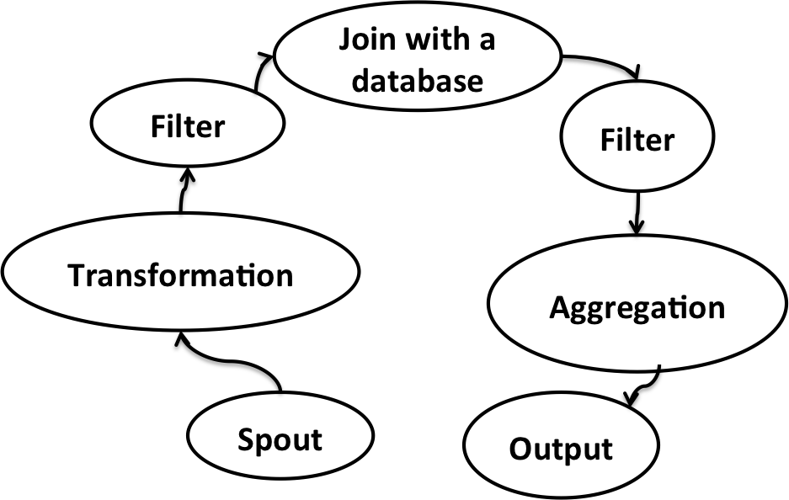
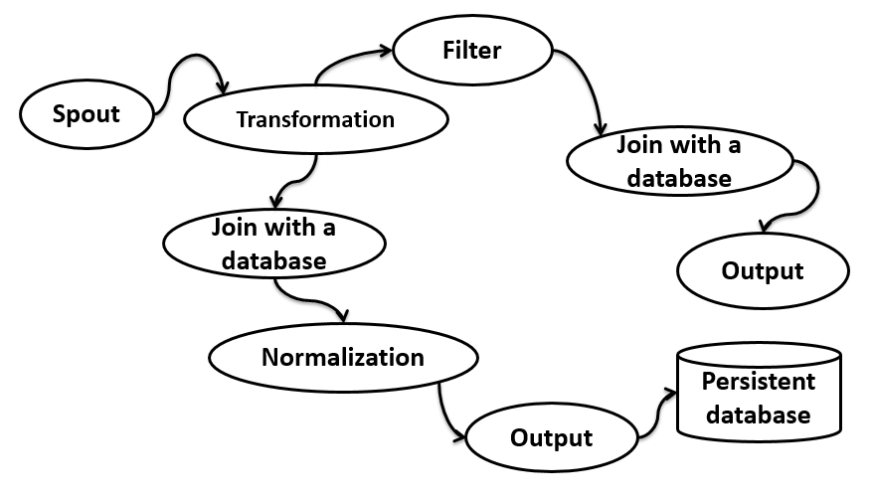
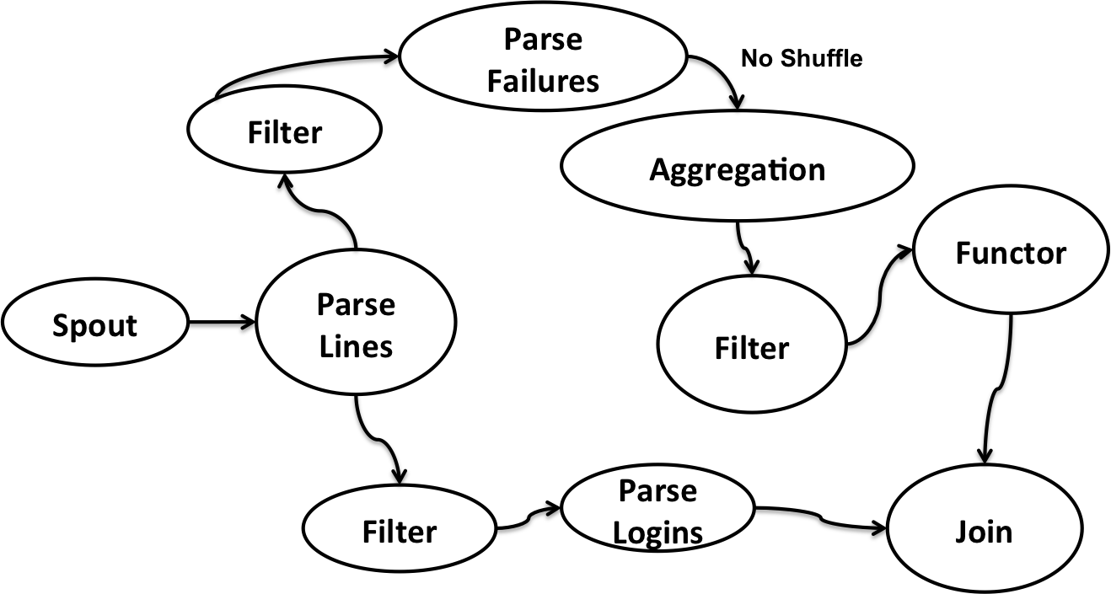
Real-world Topologies
Yahoo PageLoad Topology
Yahoo Processing Topology
IBM Network Topology

Slide 22
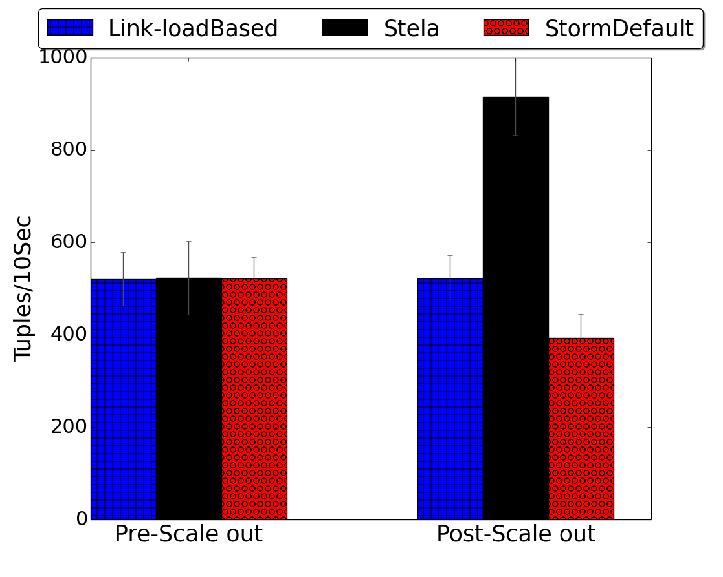
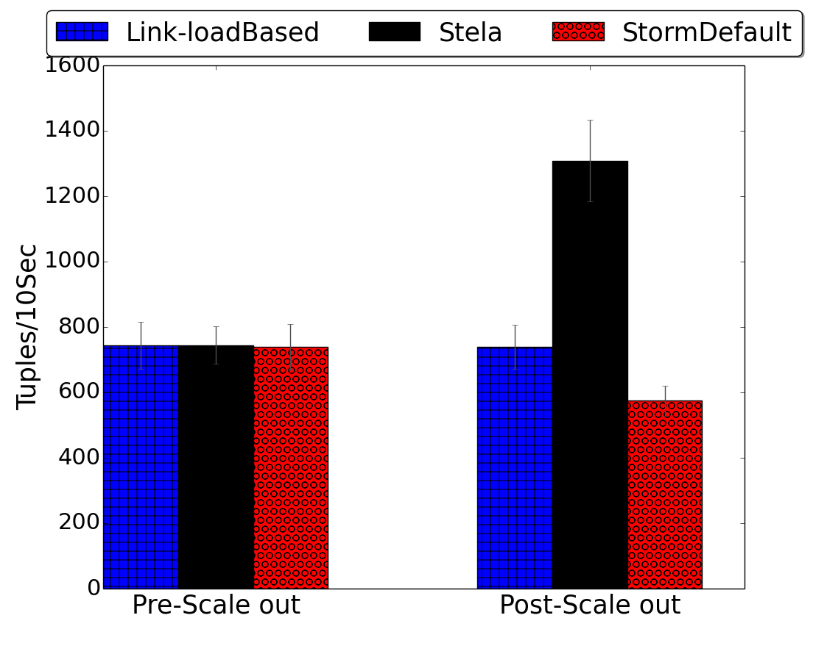
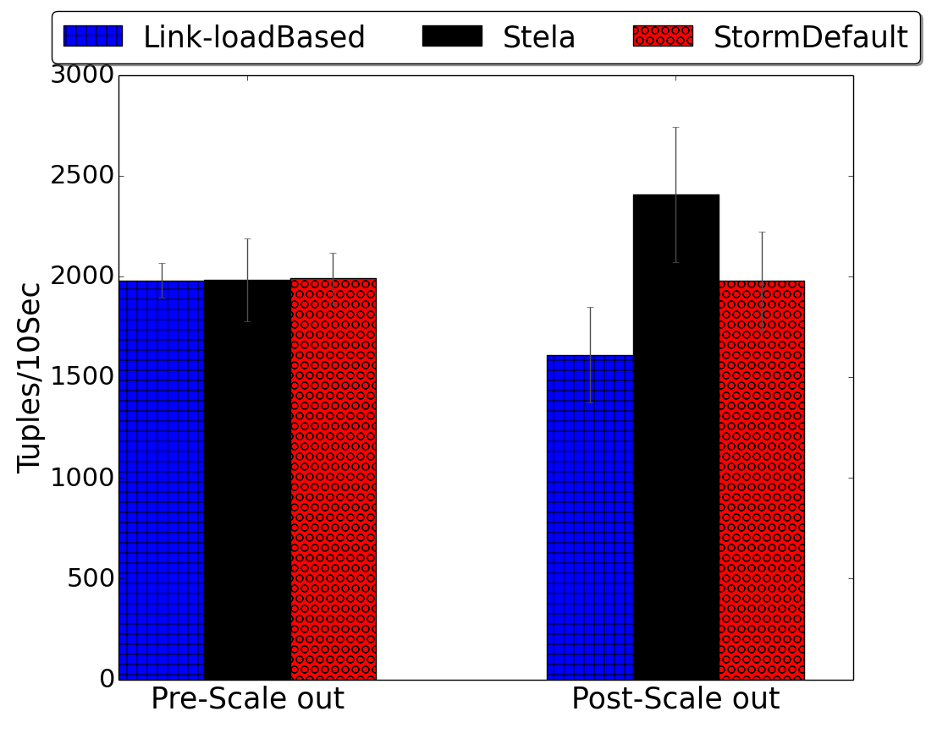
Real-world Topologies Experimental Results
+80%
+20%
+80%
PageLoad Topology:
Cluster size 7 -> 8
Executor size 28 -> 36
Processing Topology
Cluster size 8 -> 9
Executor size 32 -> 36
Network Topology
Cluster size 8 -> 9
Executor size 32 -> 36

Slide 23
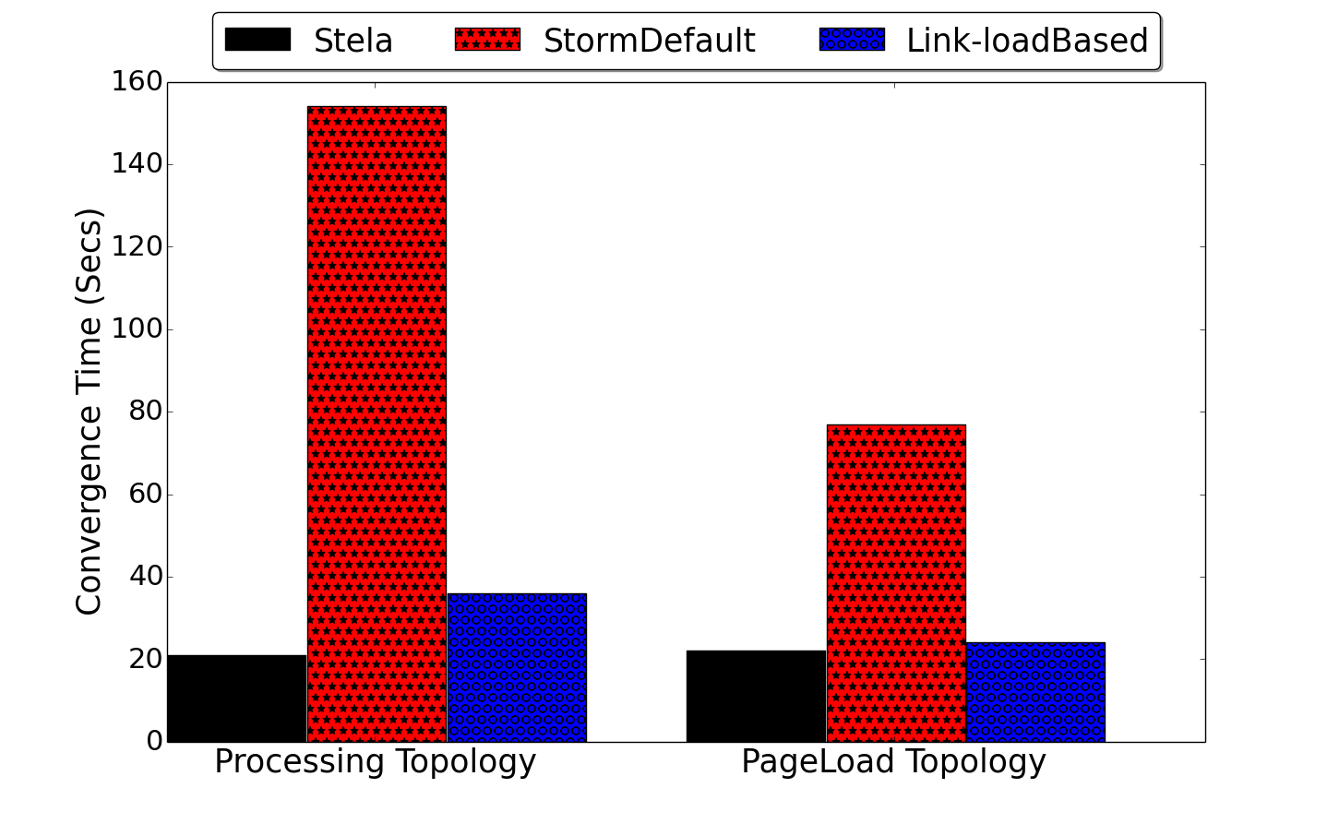
Convergence Time
Convergence time: the time it takes for the topology to reach its average post scale throughput.
Stela achieves shorter convergence time due to smart choice of executors restarted.
Yahoo Topology

Slide 24
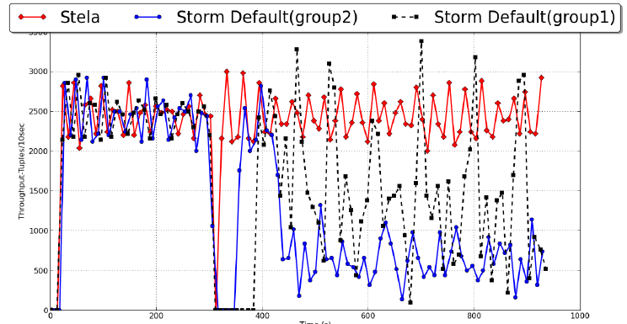
Scale-in Experiments
Selecting the correct machine to remove is important
Chance of Storm to pick the right set of machine(s) to remove is small (21% in this case)
Stela achieves 87.5% and 75% less down time

Slide 25
Summary
First work to describe and implement on-demand elasticity within Storm
Takeaway: Development of novel metric ETP, which can be generally applied to most stream processing systems.
For scale-out, Stela achieves throughput that is 22-120% higher than Storm’s
reduces interruption to 12.5%
For scale-in, Stela performs 40-500% better
Ongoing work: Multi-tenant adaptive stream processing

Slide 26
Thank you!
DPRG: http://dprg.cs.uiuc.edu
http://web.engr.illinois.edu/~lexu1/
lexu1@illinois.edu

