Slide 1

Getafix: Using Popularity to Curtail Memory Costs in Interactive Analytics Engines
Mainak Ghosh*, Ashwini Raina*, Le Xu*, Xiaoyao
Qian*, Indranil Gupta*, Himanshu Gupta#
*University of Illinois at Urbana Champaign, #Oath Inc.
Distributed Protocols Research Group
http://dprg.cs.uiuc.edu/
Notes:
Thanks <session chair> for the introduction. Today we will talk about our system Getafix which minimizes memory required in interactive analytics engines

Slide 2








Real-Time Analytics
Streaming Analytics
Distributed OLAP
Interactive Analytics Engine
Worth 13.7 billion dollars by 2021^{[1]}
[1] Research and Markets. 2015. Streaming Analytics Market by Verticals –Worldwide Market Forecast & Analysis (2015 - 2020). Report. (June 2015).
Notes:
Before diving into the solution, we will briefly describe the space and the motivation. The real time analytics space can be divided into two verticals – streaming analytics and distributed OLAP. Systems like Samza, Heron fall into the streaming space while Apache Kylin, SQL Server are some examples of OLAP systems. In the intersection lies interactive analytics engine. Some popular systems in this space are Druid, Presto. This area is expected to grow to 13.7 billion dollars by 2021

Slide 3





Interactive Analytics Engines
Data Ingestion
Handles petabytes of data and millions of queries per day
Query Compute
Prefetched, Cached
Replicated
Router
Batch Data
Real-time Data
Requires large amount of memory
Segments
Compute Nodes
Deep Storage
Less replication => less memory
Notes:
I will introduce the different modules in interactive analytics engine next. A typical use-case is ad clicks pipeline. Historical ad data and real time ad click events are collected, batched by time and stored in a deep storage like Amazon S3. The individual blocks are called segments and they are immutable. Queries are computed by a separate set of machines, typically VMs from Amazon EC2. They have powerful processors and large amount of memory. To reduce query response time, data is prefetched from the backend data store and cached in memory. Further segments are also replicated to better load balance query load to popular segments. We will primarily focus on replication in this talk as that is critical to reducing memory. A typical production deployment can handle petabytes of data and millions of queries per day. This means the front end VMs require hundreds of gigabytes in memory capacity.

Slide 4



Memory is not cheap …
Managing data is important in these systems
Notes:
We all know memory is a precious resource. The cost of memory has seen a steady increase in the last 2 years because of high demand. This has been observed in multiple online marketplaces and holds true for multiple products. This makes managing data in memory intensive systems like interactive analytics engines an extremely important problem to curtail costs.

Slide 5
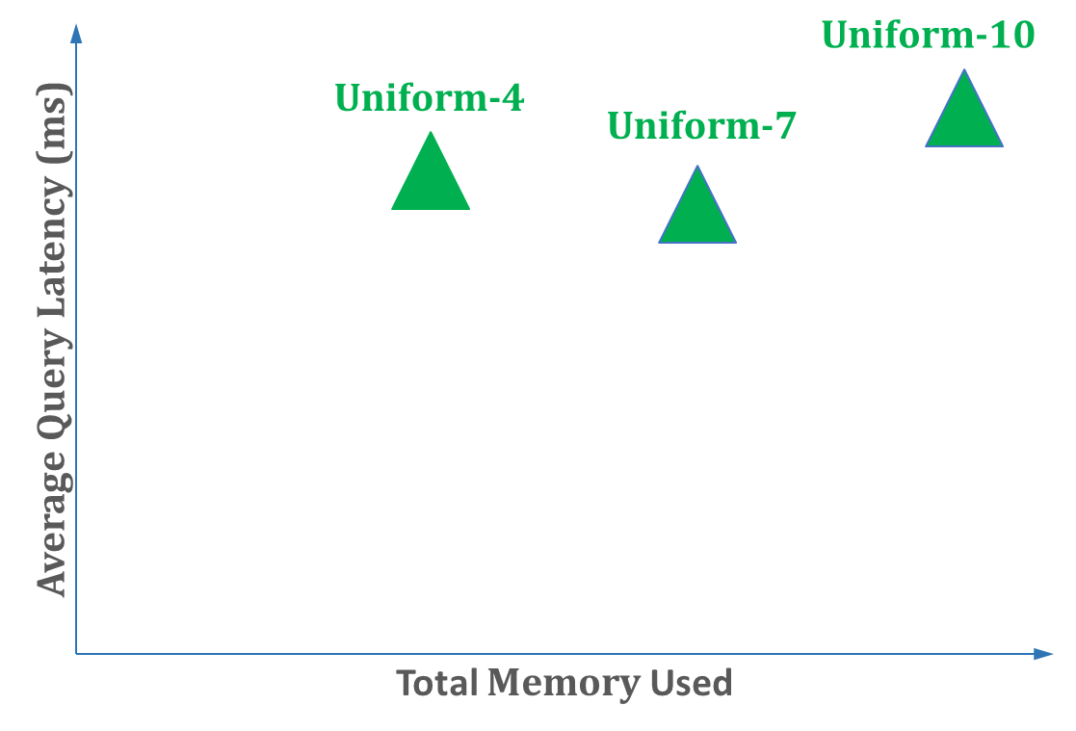
Memory Performance Tradeoff
Uniform Replication Strategy
Difficult to determine the knee offline
Can we do better?
Observed Knee
Notes:
Reducing memory in these systems will impact performance. We try to understand this tradeoff next. We start with a simple replication strategy where all segments are replicated uniformly. We ran experiments on a fixed cluster size of 20 frontend nodes with replication factors 4, 7 and 10. We measure total memory used on the x-axis and average query latency observed on the y-axis. The curve has a knee when all segments are replicated 7 times. We do not observe a steady improvement in performance because over-replication often leads to query hotspots because of data colocation. We have two observations here: Finding the knee of this curve depends on cluster size and query rate and cannot be intuitively determined offline. Second, is this the best that we can do?

Slide 6
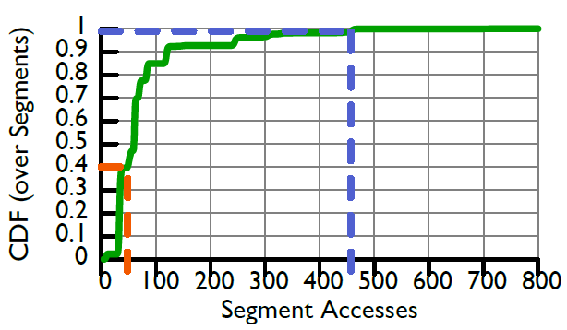
Skewed Access Pattern
Top 1% segments
43% of query accesses
Notes:
Actually, we can do better by exploiting the fact that segment access patterns are skewed. This is a CDF over the segment accesses collected from a production trace in Yahoo!. We observe that top 1% of segments get 43% of the query accesses. Also they see an order of magnitude more access than the bottom 40%.

Slide 7
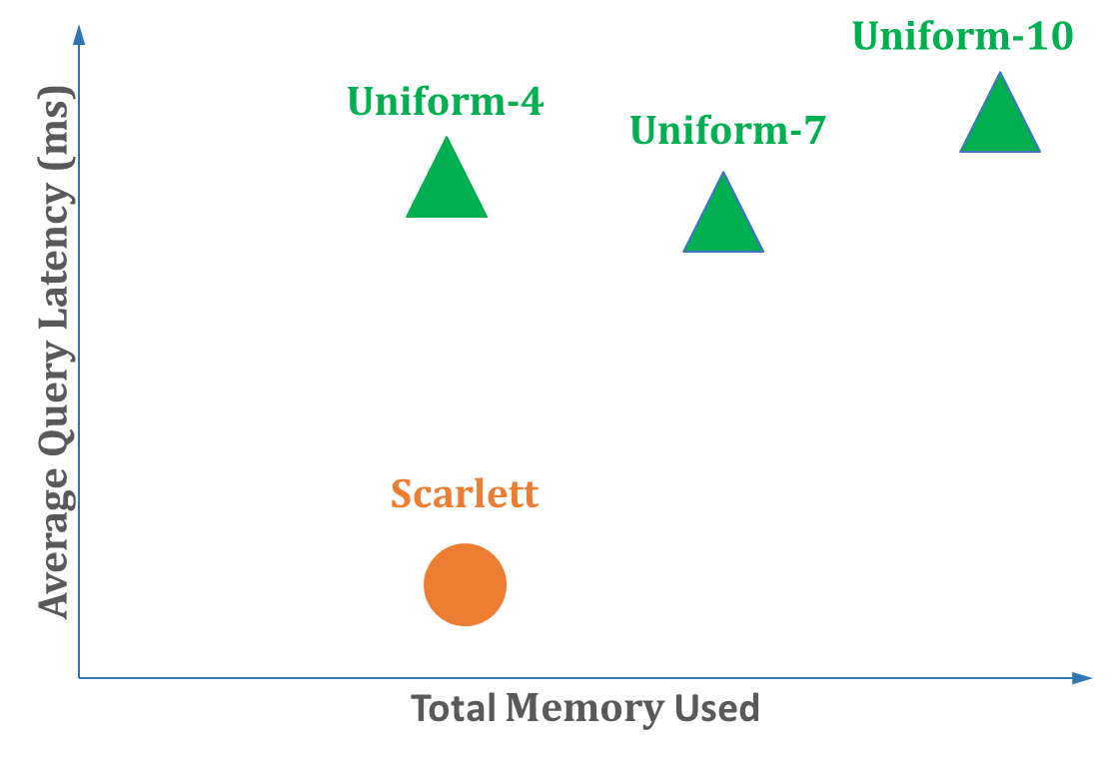
Reducing Memory
Selective Replication
Scarlett [Ananthanarayanan’11]
Data Compression
Blowfish [Khandelwal’16]
EC-Cache[Rashmi’16]
Selective Replication
Notes:
These access patterns have also been observed in batch processing systems and they have used selective replication schemes to significantly reduce memory. Scarlett is a system in this space which replicates blocks in HDFS files based on the number of concurrent accesses it sees. We implemented a version of this algorithm and ran an experiment. We observed a 2.15x reduction in query performance with 1.75x less memory. The improvement in query performance comes from the fact that popular segments now have more replicas to divide the query load. Other than selective replication, compressing unpopular data has also been explored as a technique to reduce memory. We consider this to be orthogonal to our work and focus on finding better selective replication schemes in the rest of the talk.

Slide 8
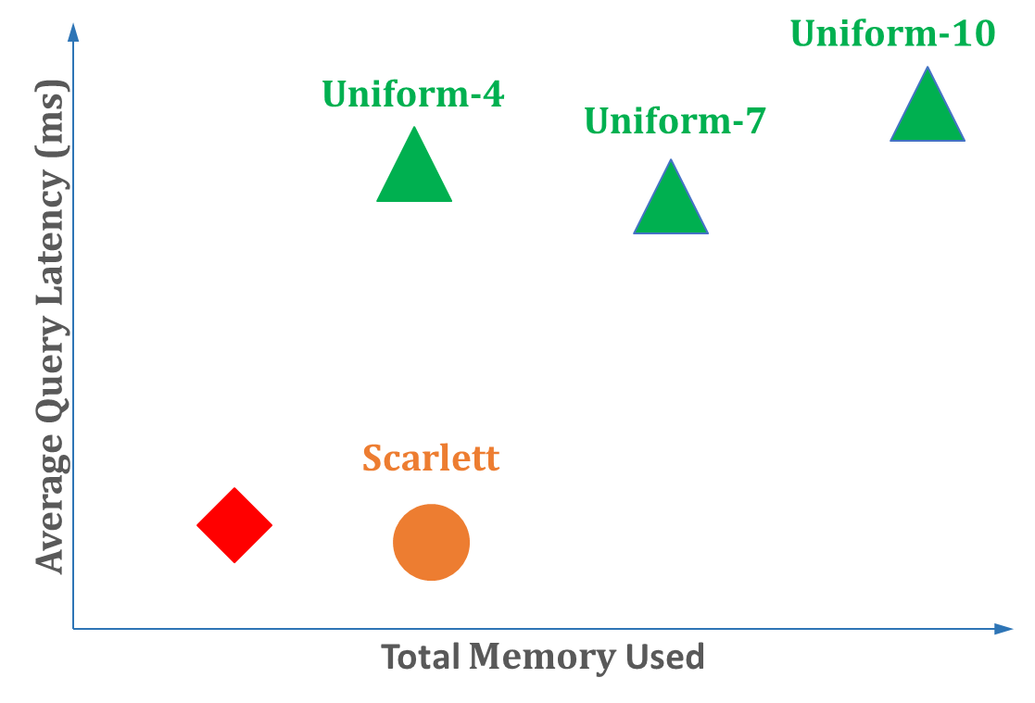
Getafix: Goals
Minimize memory required
Reduce cost of cluster provisioning
Minimize Makespan
Small impact on average query latency
Selective Replication
Goal
Notes:
Concretely, the goals of our system Getafix is to occupy this portion of the tradeoff space. To break it down even further, we want to minimize memory required with small impact on average query latency. We want to minimize makespan. Lastly, by minimizing memory, we want to reduce cost of cluster provisioning.

Slide 9
Agenda
Motivation
Problem Formulation
System Design
Evaluation
Takeaway
Notes:
In the rest of the talk, I will first describe the algorithm that powers Getafix. Next, I will briefly talk about some of the design components. Finally, I will show how Getafix does on the goals.

Slide 10
Colored Blocks and Bins …
Segments
Q1(Count) Q2(Top 10) Q3(GroupBy) Q4(Average)
S1 (5 AM – 6 AM)
S2 (6 AM – 7 AM)
Goal is to provide a load balanced assignment with the least amount of replication
S3 (7 AM – 8 AM)
CN1
CN1
CN2
CN3
CN4
Compute Nodes
Notes:
A typical query in an interactive analytics engine can touch multiple segments. In this example we show 4 queries. Query 1 computes on segment S1 to S3 and they can be executed in parallel as long as the segments are present in 3 different compute nodes. We consider this query segment pair as colored blocks. They represent a unit of computation. Their size stands for the time it will take to run the query on that segment. Here, all the blocks have the same size or they take unit time. The color stands for the segment it is being executed on, blue stands for segment S1 and so on. Compute nodes are bins. You create a replica of a segment when you have two compute nodes with a ball of the same color. Remember our goal is to minimize the memory required while minimizing Makespan. This means we want to load balance the blocks with the least amount of replication.

Slide 11
An arbitrary mapping ...
Segments
Q1(Count) Q2(Top 10) Q3(GroupBy) Q4(Average)
S1 (5 AM – 6 AM)
S2 (6 AM – 7 AM)
S3 (7 AM – 8 AM)
CN1
CN1
CN2
CN3
CN4
Load Balanced Assignment. Number of Replicas: 7
2
1
2
2
Compute Nodes
Notes:
This is an arbitrary load balanced solution. Each compute nodes has this many number of replicas. Total number of replicas required in this mapping is 7.

Slide 12
Solution which minimizes number of replicas …
Segments
Q1(Count) Q2(Top 10) Q3(GroupBy) Q4(Average)
S1 (5 AM – 6 AM)
S2 (6 AM – 7 AM)
S3 (7 AM – 8 AM)
CN1
CN1
CN2
CN3
CN4
Load Balanced Assignment. Number of Replicas: 5
1
1
1
2
Compute Nodes
Notes:
The mapping which minimizes the number of replicas is this one. Here the number of replicas is 5.

Slide 13
Static Problem: Assumptions (Relaxed later)
Blocks are of uniform size.
All queries take same time to execute on segments
The number of blocks and bins are static.
All queries and segments have arrived.
Bins are of uniform capacity.
Compute nodes are homogeneous in computation power.
Notes:
To make the problem tractable we make the following 3 assumptions. We relax all of these assumptions while designing the system. We expect that blocks are of uniform size. We solve for the static version of the problem first where all blocks and bins are known upfront. Finally, bins have uniform capacity.

Slide 14
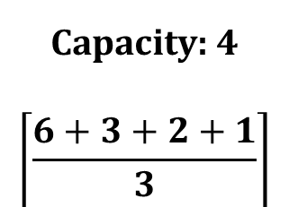
Segment Placement Algorithm
Assign bin capacity as total number of query segment pairs by number of compute nodes
Create a priority queue on segments by access count
S1 | S2 | S3 | S4
6 | 3 | 2 | 1
CN1
CN2
CN3
Capacity: 4
$$\left\lceil \frac{6+3+2+1}{3}\right\rceil$$
Notes:
Next we will describe our algorithm. We use a different example for this. The table here lists the segments in the system and the number represents popularity which is the number of queries accessing it. We have 3 compute nodes. A balanced allocation means each bin will have a capacity of 4. Note that this ensures that we minimize Makespan. We assign this capacity to each bin. Next, we create a priority queue with segments ordered by descending order of popularity.

Slide 15
Segment Placement Algorithm
Assign bin capacity as total number of query segment pairs by number of compute nodes
Create a priority queue on segments by access count
Pick from the head, assign to compute node based on a policy and return the rest
S1 | S2 | S3 | S4
6 | 3 | 2 | 1
CN1
CN2
CN3
Capacity: 4
Notes:
The algorithm runs in iterations. In each iteration, it picks the most popular segment and assigns it to a compute node based on some pre-defined policy. If the node does not have sufficient capacity to fit all the blocks, then the rest is returned to the queue.

Slide 16
Compute Node Selection Policy
Bin Packing heuristics like First Fit, Largest Fit and Best Fit applicable here
In our running example, we use First Fit
We choose the next CN (lowest CN id) that is not yet full.
Notes:
We use bin packing heuristics for compute node selection. In this example, we are going to use first fit, i.e, we will choose the compute node with the lowest id that is empty.

Slide 17
Segment Placement Algorithm
Assign bin capacity as total number of query segment pairs by number of compute nodes
Create a priority queue on segments by access count
Pick from the head, assign to compute node based on a policy and return the rest
S1 | S2 | S3 | S4
6 | 3 | 2 | 1
CN1
CN2
CN3
Capacity: 4

Slide 18
Segment Placement Algorithm
Assign bin capacity as total number of query segment pairs by number of compute nodes
Create a priority queue on segments by access count
Pick from the head, assign to compute node based on a policy and return the rest
S2 | S1 | S3 | S4
3 | 2 | 2 | 1
CN1
CN2
CN3
Capacity: 4
Notes:
We pick the blue blocks, fit 4 of the queries and return the other 2. Note its position changes in the priority queue

Slide 19
Segment Placement Algorithm
Assign bin capacity as total number of query segment pairs by number of compute nodes
Create a priority queue on segments by access count
Pick from the head, assign to compute node based on a policy and return the rest
Continue till the queue is empty
S2 | S1 | S3 | S4
3 | 2 | 2 | 1
CN1
CN2
CN3
Capacity: 4
Notes:
We continue iterating till the queue is empty

Slide 20
Segment Placement Algorithm
Assign bin capacity as total number of query segment pairs by number of compute nodes
Create a priority queue on segments by access count
Pick from the head, assign to compute node based on a policy and return the rest
Continue till the queue is empty
S1 | S3 | S4 | S2
2 | 2 | 1 | 0
CN1
CN2
CN3
Capacity: 4
Notes:
Next we select the orange blocks. They all fit in CN2

Slide 21
Segment Placement Algorithm
Assign bin capacity as total number of query segment pairs by number of compute nodes
Create a priority queue on segments by access count
Pick from the head, assign to compute node based on a policy and return the rest
Continue till the queue is empty
S3 | S1 | S4 | S2
2 | 1 | 1 | 0
CN1
CN2
CN3
Capacity: 4
Notes:
We pick blue again, fit 1 of the balss

Slide 22
Segment Placement Algorithm
Assign bin capacity as total number of query segment pairs by number of compute nodes
Create a priority queue on segments by access count
Pick from the head, assign to compute node based on a policy and return the rest
Continue till the queue is empty
S1 | S4 | S2 | S3
1 | 1 | 0 | 0
S1 | S4 | S2 | S3
1 | 1 | 0 | 0
S1 | S4 | S2 | S3
1 | 1 | 0 | 0
S1 | S4 | S2 | S3
1 | 1 | 0 | 0
CN1
CN2
CN3
Capacity: 4
Notes:
Next we fit the yellow blocks

Slide 23
Segment Placement Algorithm
Assign bin capacity as total number of query segment pairs by number of compute nodes
Create a priority queue on segments by access count
Pick from the head, assign to compute node based on a policy and return the rest
Continue till the queue is empty
S1 | S2 | S3 | S4
0 | 0 | 0 | 0
CN1
CN2
CN3
Capacity: 4
Load Balanced but not optimal in replica count
1
2
3
Notes:
Finally the last two available slots get filled by the left blue and green blocks. The total number of replicas in this assignment is 6. If you look closely, this is not an assignment with the least replication. You can reduce replication by 1 if you swap the blue ball in CN2 with the green ball in CN3

Slide 24
Segment Placement Algorithm
Assign bin capacity as total number of query segment pairs by number of compute nodes
Create a priority queue on segments by access count
Pick from the head, assign to compute node based on a policy and return the rest
Continue till the queue is empty
S1 | S2 | S3 | S4
0 | 0 | 0 | 0
CN1
CN2
CN3
Capacity: 4
Best Fit provably achieves this minimal replica count
1
2
2
Notes:
The final allocation looks like this. It can be shown that best fit will provably achieve the minimum replication count in this algorithm. We refer the audience to the paper for the formal proof.

Slide 25
Agenda
Motivation
Problem Formulation
System Design
Evaluation
Takeaway
Notes:
While designing Getafix, we relaxed the assumptions of the last section. We will talk about it next

Slide 26
Algorithm Execution
Coordinator
Best Fit Algorithm
Executes in periodic rounds
Small interval length
Tracks total access time
Total time all queries spend accessing a particular segment
Segment Access (CN1):
S1: 1, S2: 2
CN1
S1 (5 AM – 6 AM)
Queries
S2 (6 AM – 7 AM)
Access Logger
Notes:
The segment replication algorithm is run inside a coordinator node which is tasked with running and enforcing data management policies. It executes the algorithm in periodic rounds. We implemented an access logger module in compute nodes to track popularity of each segment and send it to the coordinator. It then runs the algorithm to calculate the segment placement plan. In a round, while the new placement is being planned and executed, the old placement pattern can still be used for ongoing queries, i.e., queries are not stopped. We chose to react to popularity changes to eliminate the overhead of batching in the fast path. Additionally, we use a small interval length between algorithm execution to catch popularity changes early. This ensures we can smoothly handle increased query load on a particular segment. Finally, access logger in Getafix tracks total access time instead of number of queries. In the last section we assumed that all blocks have the same size. In reality, queries can have different execution profile based on semantics, filter parameters, etc. As a result, counting the number of queries is not an accurate representation of popularity.

Slide 27
Segment Management
Coordinator
Best Fit Algorithm
Aggressively removes replicas of unpopular segments except one
One replica avoids network fetch on access
Single replica garbage collected under resource constraint
Bootstrap loads new segments
Avoids segment loads in fast path
Garbage Collection
Bootstrap Loader
CN1:
Insert S3
Remove S1
CN1
Deep Storage
Fetch S3
S1 (5 AM – 6 AM)
S2 (6 AM – 7 AM)
Access Logger
Notes:
Based on the generated segment placement plan, the coordinator instructs the compute nodes to load or remove segments for the next round. To load a new segment, compute nodes fetches it from deep storage. To keep memory utilization high, Getafix aggressively removes unpopular segment replicas. All but one replicas can be potentially removed. One replica for each segment is maintained in the frontend cluster to avoid demand fetch on access. Coordinator can instruct a compute node to remove even this single replica under resource constraint. For freshly minted segments, which have not seen queries yet, Getafix bootstrap loads these segments. This is done to avoid demand loading the segment during query execution.

Slide 28
Cluster Heterogeneity
Production clusters are tiered – hot, warm and cold data
Unexpected slowdowns (stragglers)
Bins are assigned unequal capacities in the algorithm
Auto-Tiering: Match popular segments to powerful nodes.
Done manually today by sys-admin.
Notes:
We relax our last assumption about homogeneous compute nodes here. Production clusters are typically tiered. Hot data is stored in VMs having sufficiently large memory to fit the full data size. They also have higher compute capacity. Warm data is stored in VMs where 30-40% data can fit in memory and rest resides on faster disks like SSDs and so on. Additionally, stragglers can be a problem too. To handle this heterogeneity, we assign capacities to the compute nodes based on the amount of query load it has taken in the past. The rest of the algorithm works as is. At the end, we further match the popular segments to more powerful nodes. This is called Auto-Tiering. This represents a better management alternative to the manual auto-tiering done today by sys admins

Slide 29
Other Details …
Query Routing
Segment Load Balancer
Minimizing Network Transfer
Fault Tolerance
Notes:
There are several other design components for which we refer the audience to our paper

Slide 30
Agenda
Motivation
Problem Formulation
System Design
Evaluation
Takeaway
Notes:
Next we evaluate Getafix against some of the goals that we had set out earlier

Slide 31
Memory Latency Tradeoff
Getafix uses ~50% less memory compared to Scarlett
Small impact on average latency
Getafix
Notes:
First, we want to revisit the tradeoff plot and see how Getafix does compared to the goals. We observe a 50% reduction in memory usage with 5% increase in average latency compared to scarlett. Getafix performs better at the tail. You will find the plot in paper.

Slide 32
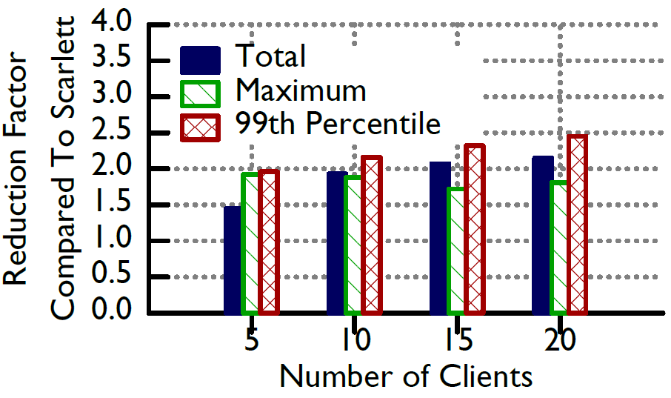
Memory Savings -- Scalability
Baseline: Scarlett^{[2]}
Total memory savings increases with client load
Notes:
Next, we want to quantify how the memory saving scales with increase in query load. We fix the number of compute nodes to 20. We vary the query load by adding more clients plotted on the x-axis. On the y-axis, we plot the memory used by Scarlett divided by Getafix. It is a ratio and higher is better. We observe a 1.45 – 2.15X reduction in total memory for Getafix and it increases as the number of clients grow. Scarlett alleviates query hotspots by creating more replicas of popular segments, while Getafix carefully balances replicas of popular and unpopular segments to keep overall replication (and memory usage) low.

Slide 33
Dollar Cost Savings
Memory Cost Model
Working Set Data Size x Replication Factor x Cost of Memory
Cost Saving Compared to Scarlett
= 100 TB x (4.2 – 1.9) x $0.005 per GB per hour (EC2)
= $1150 per hour
= $10 million annually
Notes:
Finally, we do some back-of-the-envelope calculations to estimate cost savings. We calculate memory costs as a product of working set data size, effective replication factor and memory cost. We use numbers for the first and the last parameters from data publicly available. We know EC2 couples memory and processing core costs, but for the purposes of back of the envelope calculation we talk about only memory. For effective replication factor, we use our observed numbers from the evaluation. Compared to Scarlett, we estimate a cost saving of 10 millions dollars annually.

Slide 34
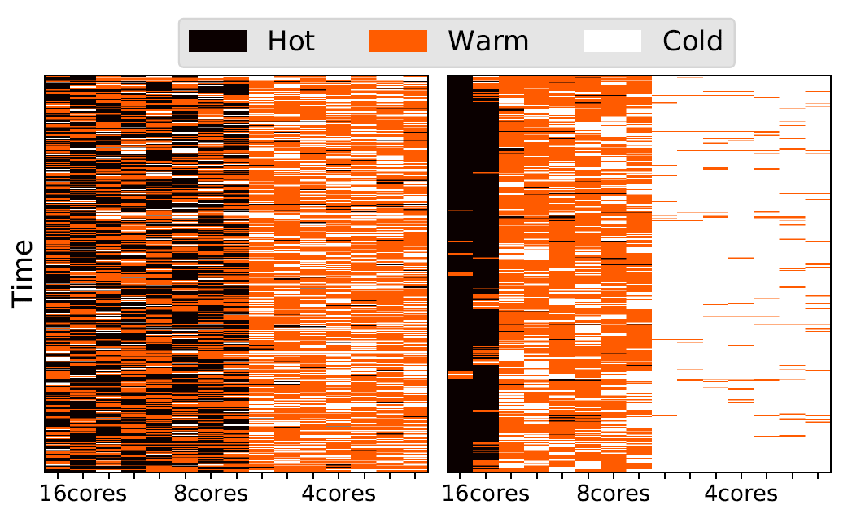
Tiering Accuracy
Query Processing Volume (CPU Time)
High
Moderate
Low
Getafix achieves 75% tiering accuracy compared to 42% for Getafix-B
Rounds
`
`
16
4
16
4
8
8
Getafix-B Getafix
Notes:
In this last plot, we measure how good our auto-tiering implementation is. We ran our experiment on Cluster-1. It has 3 hot, 6 warm and 6 cold tier nodes. We represent them on the x-axis. On the y-axis we plot rounds. We classify each compute node as high, moderate and low based on the query processing volume it sees. Each division is color coded. For vanilla Getafix we observe lot of hot tier nodes getting moderate and low query volume. This is because they do not have popular segments assigned to them. With our auto-tiering optimizations, we observe a much better tiering.

Slide 35

Takeaway
Data management in interactive analytics engine – an important problem
Best fit based segment replication algorithm minimizes replica count under assumptions
Our system, Getafix built on top of Druid relaxes these assumptions
Getafix out-performs known baselines by reducing memory and cost
Notes:
To summarize, today we talked about the data management problem in interactive analytics engine. I hope I have been able to convince you that it is an important problem today. We showed an algorithm that can provably reduce the memory requirements under some simplifying assumptions. We built our system Getafix which relaxes these assumptions. Through multiple evaluations, we show that Getafix can reduce memory in practice with little impact on performance. Lastly, I would like to leave you with this adage: Has rising provisioning costs put you in a fix, you can solve it all by using Getafix ☺ . Thanks you and I am now happy to take questions.

Slide 36
Evaluation Summary
Getafix minimizes memory and cost with little impact on performance
Getafix adapts well to heterogeneity in clusters by effectively auto-tiering
Notes:
To summarize, Getafix performs well on all the goals that we had set for it. We have more evaluation in the paper and we highly encourage the audience to take a look.

Slide 37
Memory Savings -- Scalability
Baseline: Scarlett^{[2]}
Total memory savings increases with client load
1.72x – 1.92x reduction in maximum memory
[2] Ganesh Ananthanarayanan, et.al. Scarlett: Coping with Skewed Content Popularity in Mapreduce Clusters. (EuroSys ’11).
Notes:
Reduction in maximum memory required in a single compute node is also significant and reduces slightly as the number of client grows. The maximum memory provides an estimate of how much VM memory to provision. Thus, this saving has a direct correlation to cost.

Slide 38
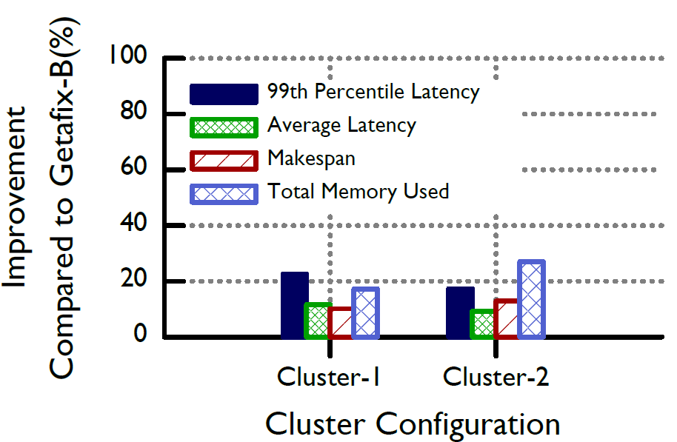
Heterogeneity Improvements
Baseline: (Getafix-B) Getafix w/o Heterogeneity
Improves on all metrics
Total Memory Savings improves 20 – 30%
Notes:
For these experiments, we use 3 different types of VMs with different core count and memory to create a tiered cluster. We ran our experiments with 2 such clusters configurations. Cluster-1 has larger fraction of hot tier i.e more powerful nodes compared to Cluster-2. We compare to vanilla Getafix without the optimizations. Getafix improves on all the metrics we measured for. We saw 20% reduction in memory and it increased from Cluster-1 to Cluster-2

Slide 39
Heterogeneity Improvements
Baseline: Vanilla Getafix (Getafix-B)
Improves on all metrics
Total Memory Savings improves 20 – 30%
~20% improvement in tail latency observed
Notes:
Our optimizations improves observed tail latency by 20%

Slide 40
Evaluation Goals
Memory and Cost Savings
Effectiveness of Auto-Tiering
Notes:
In today’s talk, we are going to see how much memory and cost saving Getafix can provide. Additionally, we will see how Getafix adapts to heterogeneity in cluster

Slide 41
Setup
Cluster: m4.4xlarge instances, Amazon S3 as deep storage, Amazon EBS General Purpose SSD (gp2) volumes as node local disks
Workloads: Synthetically generated derived from Yahoo! production trace.
Baselines: Scarlett and Uniform
Metrics: 1) Total and Maximum Memory, 2) Effective Replication Factor, 3) Average Query Latency, 4) Dollar Cost Savings

Slide 42
Setup
Cluster:
Baselines: Getafix without Heterogeneity Optimizations (Getafix-B)
Metrics: 1) Total Memory, 2) Average and Tail (99th) Query Latency, 3) Makespan 4) Tiering Accuracy
Tier | Node config (core / memory) | Cluster-1 | Cluster-2
Hot | m4.4xlarge (16 / 64 GB) | 3 | 4
Warm | m4.2xlarge (8 / 32 GB) | 6 | 6
Cold | m4.xlarge (4 / 16 GB) | 6 | 10

Slide 43
Assumptions
Each query takes unit time to process each segment it accesses.
Queries can have different execution profile based on semantic, time range queried etc.
Segment placement decisions are done after all queries have arrived.
System is dynamic with both queries and segments arriving in real time.
Compute nodes are homogeneous in computation power.

Slide 44
Related Work
Similar to data allocation problem in databases.
Optimize for query performance while we try to reduce memory
Work on saving memory and storage has focused on compression
Complimentary to our approach
Presto represent another class of interactive analytics engines which focus on query optimization
Limited details on memory management. Getafix can be implemented in the storage substrate.

Slide 45
Getafix: Goals
Minimize memory required
Minimize cost of cluster provisioning
Minimize makespan
Minimal impact on average query latency
Notes:
This brings us to the goals of our system Getafix. Our primary goal is to minimize the amount of memory required. By reducing memory used, we intent to minimize costs. We want to achieve this while minimizing Makespan or maximizing query throughput. We also want to have minimal impact on average query latency

Slide 46
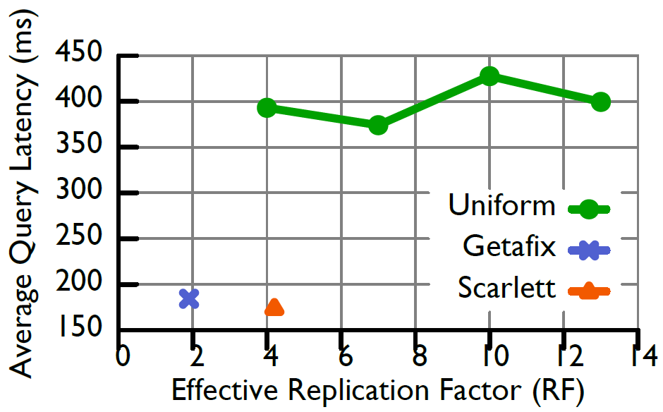
Memory Latency Tradeoff
Baseline: Uniform and Scarlett
2.15X worse query performance for Uniform
Notes:
We study the tradeoff between amount of memory and query performance. The goal of the experiment is to see where Getafix lies in the tradeoff space. We compare Getafix to Scarlett and Uniform replication. In uniform replication, you replicate all segments some pre-defined number of times. We ran 4 experiments for Uniform with replication factors 4, 7, 10, 13. On the x-axis we plot the effective replication for the strategies which directly relates to memory used. On the y axis we plot performance as average query latency. Non uniform schemes out-perform by 2.15x because it either over-replicates unpopular segments or under-replicates popular segments leading to hotspots.

Slide 47
Memory Latency Tradeoff
Baseline: Uniform and Scarlett
2.15X worse query performance for Uniform
Getafix uses least memory
Notes:
Getafix has the least effective replication factor

Slide 48


Evaluation Goals
Getafix minimizes memory and cost with little impact on performance
Support for Heterogeneity
Notes:
In the next set of experiments, we evaluate the heterogeneity optimizations for Getafix.

Slide 49
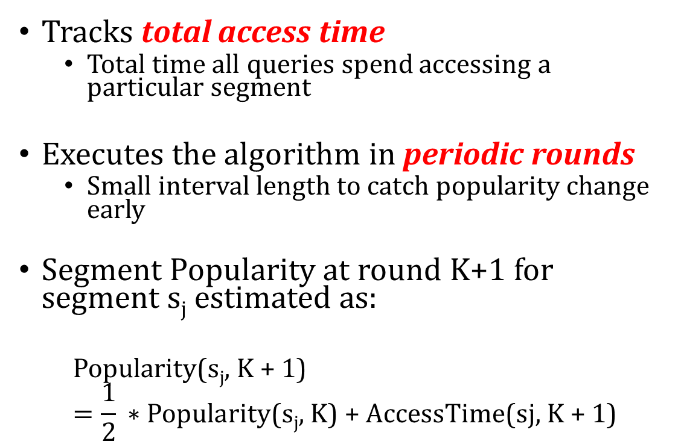
Implementation
Tracks total access time
Total time all queries spend accessing a particular segment
Executes the algorithm in periodic rounds
Small interval length to catch popularity change early
Segment Popularity at round K+1 for segment s_{j} estimated as:
$$\text{Popularity}\text{(}\text{s}\text{j}\text{, }\text{K}\text{ + 1)}=\frac{1}{2}\text{ ∗ }\text{Popularity}\text{(}\text{s}\text{j}\text{, }\text{K}\text{) + }\text{AccessTime}\text{(}\text{sj}\text{, }\text{K}\text{ + 1)}$$
Notes:
In the last section we assumed that all blocks have the same size. In reality, queries can have different execution profile based on semantics, filter parameters, etc. Counting the number of queries is not accurate representation of popularity. Instead, we look at the total time all queries spent accessing a particular segment. In a production system, queries and segments arrive continuously. We run the algorithm in periodic rounds. We keep the interval small enough to catch changes early. The popularity of a segment is calculated by maintaining a weighted average of popularity values collected in the past round. Latest popularity numbers are given more priority than older ones.

Slide 50
Segment Management
Getafix follows the segment placement plan
Segments are bootstrap loaded
Avoids segment loads in fast path
Aggressively removes replicas of unpopular segments except one
One replica avoids network fetch on access
Single replica garbage collected under resource constraint
Notes:
In each round, Getafix follows the segment placement plan generated by the algorithm. Segments replicas are inserted, moved and removed based on the plan. For freshly minted segments, which have not seen queries yet, Getafix bootstrap loads these segments. This is done to avoid demand loading the segment during query execution. To keep memory utilization high, Getafix aggressively removes unpopular segment replicas. All but one replicas can be potentially removed. One replica for each segment is maintained in the frontend cluster to avoid demand fetch on access. This single replica can also be garbage collected under resource constraint

Slide 51
Getafix uses well-known algorithms to minimize the amount of memory needed (thereby provisioning cost) with little impact on performance
Our implementation reduces memory by ~2X compared to state-of-the-art and can have million dollars in annual cost savings

