Slide 1
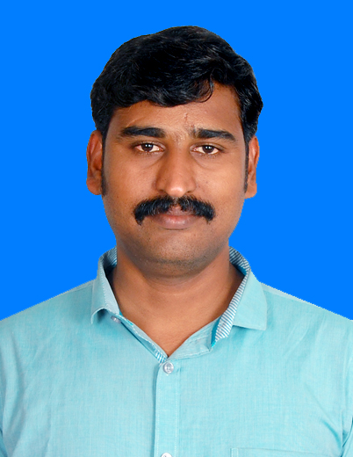



veeraskarthik@gmail.com
+91 9962980364
Chennai.
Veerapandiyan K
Techinical Arcihtect
Overview
A Tech Lead carry over almost 12 years of experience on IT industry wherein a fruitful 5 years with RPA domain. Was been a part of 10 successful RPA Project delivery using UiPath.
Strong experience in .Net / SQL / MSBI development framework.
Designed & developed bots using UiPath RPA Platform.
Have created Technical Design document, analyzed multiple processes & proposed technical & automation feasibility, RPA tool installation, code review, provided technical solutions, supported Client IT team in resolving environmental issues over the RPA Life Cycle
Experience in managing and leading a team of RPA developers
Conducted 10 training programs for internal & external stakeholders
Areas of Expertise :
RPA – UiPath, Automation Anywhere, VB Scripts and Macro.
Other Skills - C# .Net, ASP.net, SQL, MSBI (SSRS,SSIS) and IIS
Tools – Visual studio, Oracle sql developer, Flexiicap, UiPath and Automation Anywhere
Experience
RPA (2016-2022)
Education
Anna University of Chennai(2003-2006)

