Slide 1
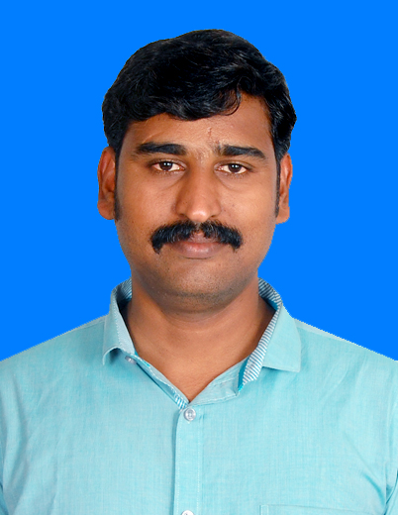



veeraskarthik@gmail.com
+91 9962980364
Chennai.
Veerapandiyan K
Techinical Arcihtect
Overview
A Tech Lead carry over almost 12 years of experience on IT industry wherein a fruitful 5 years with RPA domain. Was been a part of 10 successful RPA Project delivery using UiPath.
Strong experience in .Net / SQL / MSBI development framework.
Designed & developed bots using UiPath RPA Platform.
Have created Technical Design document, analyzed multiple processes & proposed technical & automation feasibility, RPA tool installation, code review, provided technical solutions, supported Client IT team in resolving environmental issues over the RPA Life Cycle
Experience in managing and leading a team of RPA developers
Conducted 10 training programs for internal & external stakeholders
Areas of Expertise :
RPA – UiPath, Automation Anywhere, VB Scripts and Macro.
Other Skills - C# .Net, ASP.net, SQL, MSBI (SSRS,SSIS) and IIS
Tools – Visual studio, Oracle sql developer, Flexiicap, UiPath and Automation Anywhere
Experience
RPA (2016-2022)
Education
Anna University of Chennai(2003-2006)

Slide 2
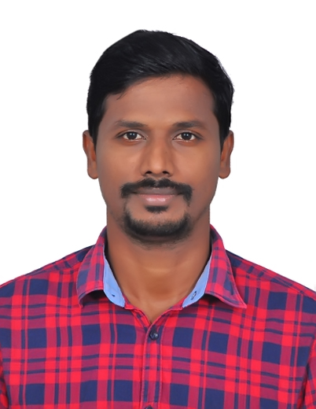
Baskaran.chidambaram07@gmail.com
+91 8939087721
Chennai
Baskaran Chidambaram
RPA Specialist
Overview
A Senior Developer in RPA with overall experience of 5.5 years. Was been a part of 5 successful RPA Project delivery using UiPath.
Strong experience in Uipath, AA, Power Automate & SQL Server.
Designed & Delivered bots using UiPath both in Waterfall & Agile Methodology.
Involved in end to end product setups for Uipath & AA.
Member of Centre of Excellence Team
Conducted 3 training programs for internal stakeholders and two session for freshers
Areas of Expertise :
RPA – UiPath, Automation Anywhere, Java Script, VB Scripts and Macro.
Other Skills – Python, Intelligent Document Processing, Abby Flexi Capture
Tools –UiPath, Automation Anywhere
Experience
RPA (2016-2022)
Education
S.A. Engineering College(2012-2016)

