Slide 1

Vel Tech Rangarajan Dr. Sagunthala R&D Institute of Science and Technology
School of Computing
Department of Computer Science and Engineering
10211CS224 / FULL STACK APPLICATION DEVELOPMENT (JAVA)
PROJECT REVIEW : MILESTONE PROJECT – 1
Date: 25-03-2026
Full-Stack Skill Learning Academy Marketplace with Secure Authentication
SDG: SDG No – SDG Title(SDG 4 – Quality Education)
Presented By:
Mohamed Ghouse Zuhair A – VTU24667 – 23UECS0365
Courses Handling Faculty:
Dr. S Hemamalini – M.E., PhD.
Assistant Professor (Senior Grade)

Slide 2
INTRODUCTION
1
In today’s digital world, online skill learning platforms are rapidly growing. However, many platforms lack personalization and secure access.
This project focuses on building a full-stack web application that allows users to learn and sell skills in one place. It provides a marketplace where instructors can upload courses and learners can enroll easily.
Secure authentication ensures user data protection and safe access. The system integrates frontend, backend, and database technologies. It aims to simplify skill sharing and learning. The platform is user-friendly and scalable.
2
3
4
5
6
7
8
9

Slide 3
PROBLEM STATEMENT
Many existing learning platforms either focus only on learning or only on selling courses, not both.
Some systems lack proper security, making user data vulnerable.
Manual handling of course management leads to inefficiency. There is no unified platform for both learners and instructors.
Users face difficulty in accessing personalized content. Payment and authentication systems are often not secure.
Hence, there is a need for a reliable, secure, and integrated learning marketplace system
1
2
3
4
5
6
7
8
9

Slide 4
OBJECTIVE(S)
To design and develop a full-stack marketplace platform for skill learning and course selling.
To implement secure authentication and efficient data management for users and courses.
1
2
3
4
5
6
7
8
9

Slide 5
PROPOSED SYSTEM
Develop a web-based platform for learners and instructors
Provide user registration and login with secure authentication
Allow instructors to upload and manage courses
Enable users to browse and enroll in courses
Store and manage data using a database system
Provide a simple and user-friendly interface
Ensure data privacy and security
Improve efficiency compared to manual systems
1
2
3
4
5
6
7
8
9

Slide 6
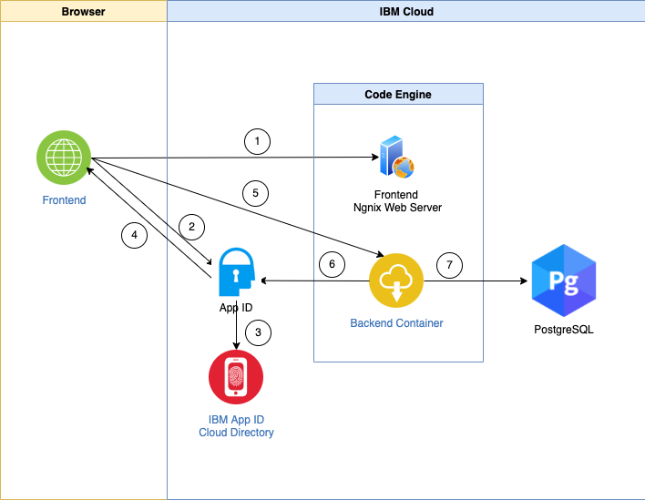
PROPOSED SYSTEM ARCHITECTURE
1
2
3
4
5
6
7
Input: User data (registration, login, course details)
Processing: Authentication, course management, user requests handling
Database: Stores user details, courses, enrollments
Output: User dashboard, course listings, confirmation messages
8
9

Slide 7
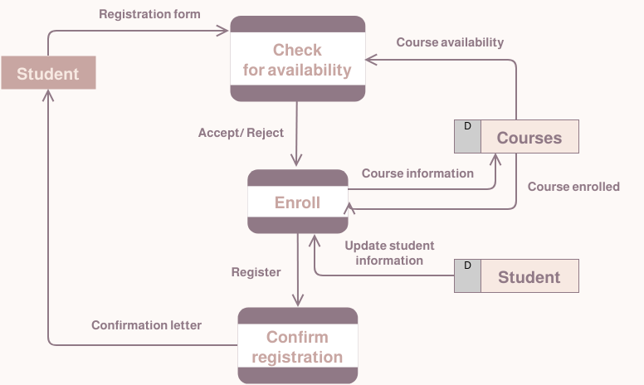
WORKFLOW
1
2
3
4
5
6
7
8
9

Slide 8
TECHNOLOGIES USED
1
Frontend: HTML, CSS, JavaScript.
Backend: Node.js
Database: MySQL
Tools: VS Code, Git, Postman
Hardware/Software Requirements: Basic computer system, internet, modern web browser
2
3
4
5
6
7
8
9

Slide 9
MODULE DESCRIPTION
1
Module 1: User Authentication Handles secure registration and login using authentication techniques.
Module 2: Course Management Allows instructors to create, update, and delete courses.
Module 3: User Dashboard Displays enrolled courses and user activity.
Module 4: Database Management Stores and retrieves user and course data efficiently.
2
3
4
5
6
7
8
9

Slide 10
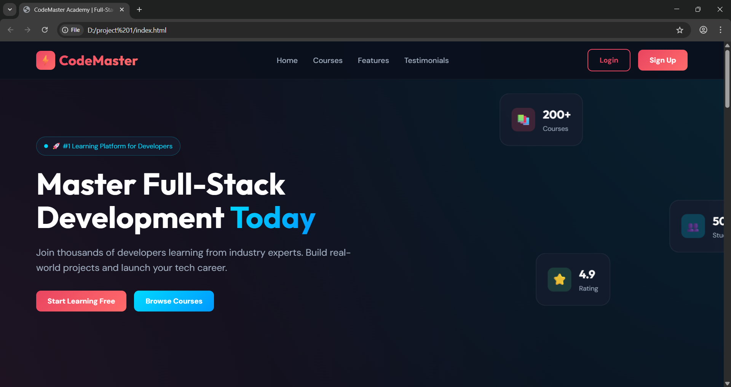
IMPLEMENTATION SCREENSHOTS
1
2
3
4
5
6
7
8
9
Displays the platform overview with navigation options for users to explore courses and features.

Slide 11
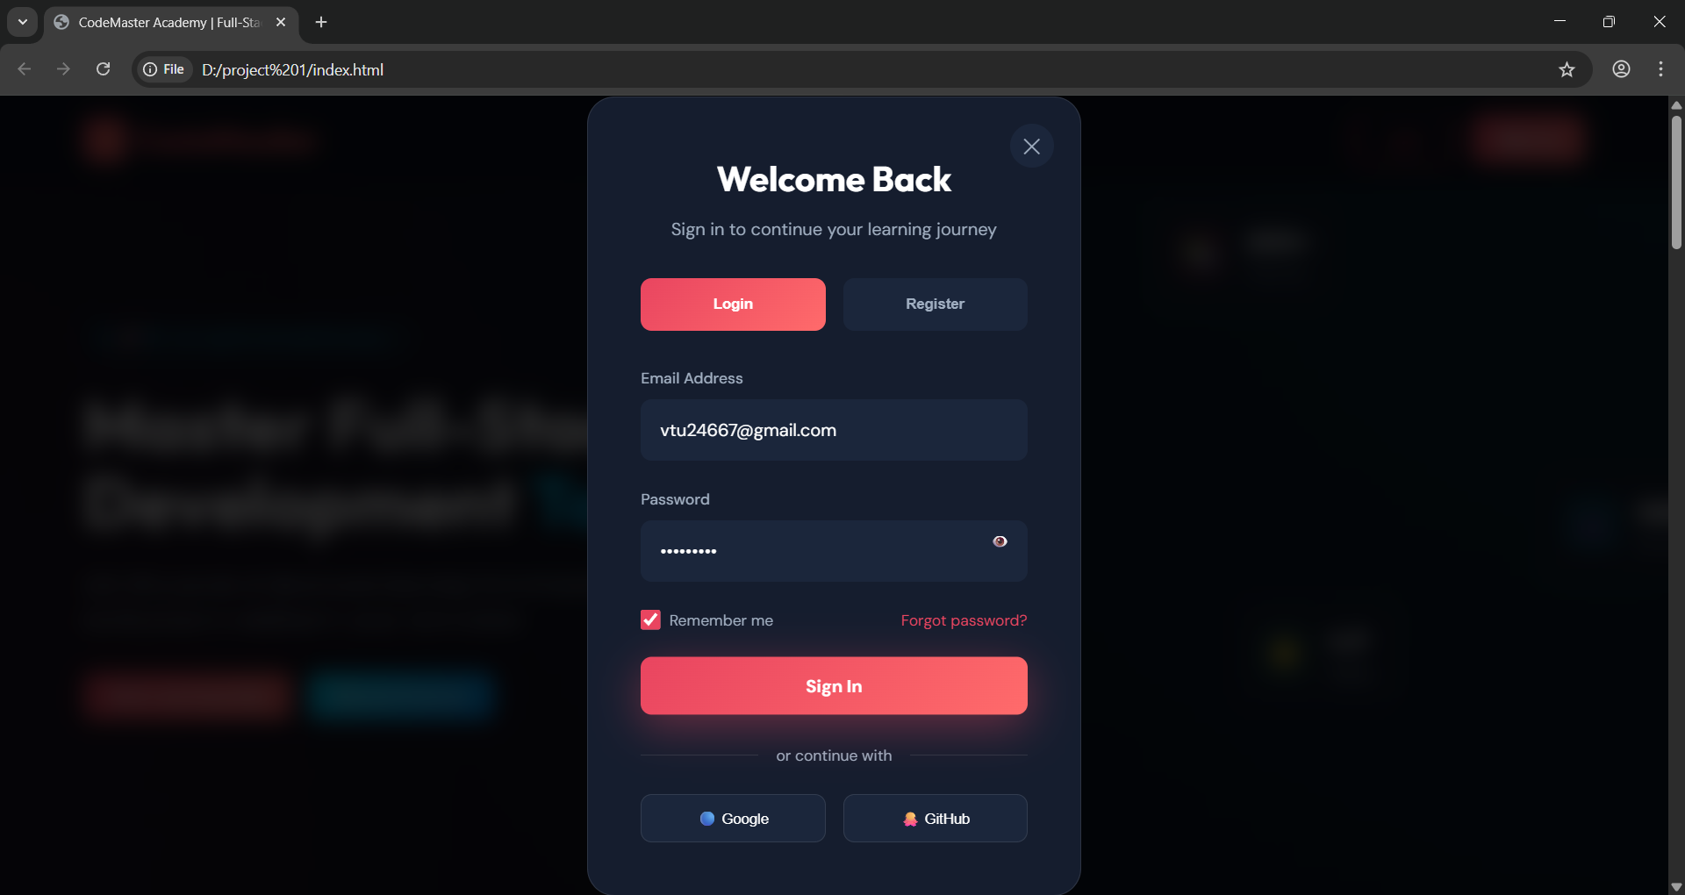
IMPLEMENTATION SCREENSHOTS
1
2
3
4
5
6
7
8(A)
9
Provides secure user authentication by allowing users to log in using their credentials.

Slide 12
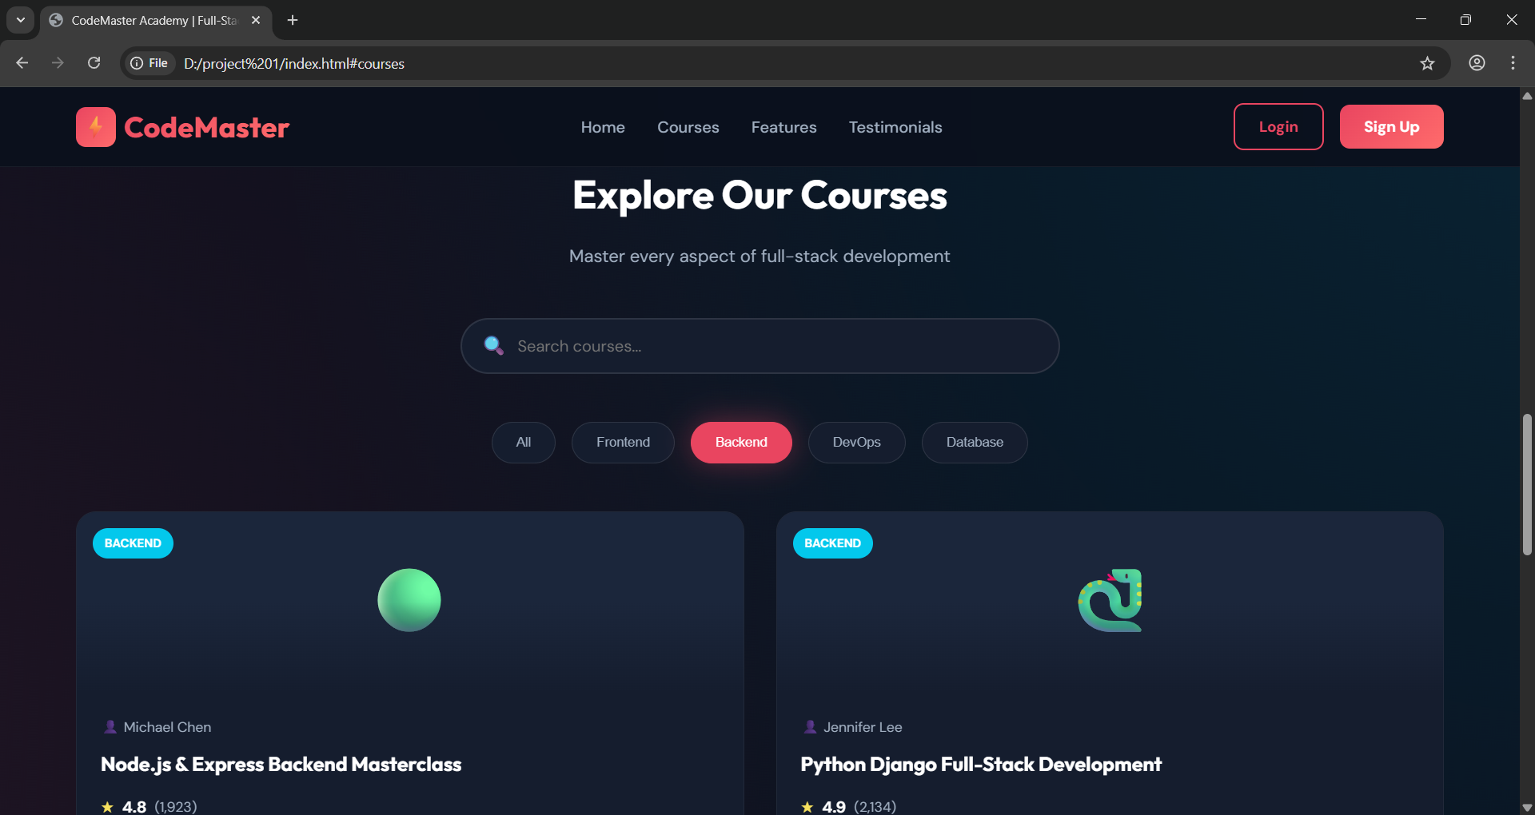
IMPLEMENTATION SCREENSHOTS
1
2
3
4
5
6
7
8(B)
9
Shows user-specific content including available courses, enrolled courses, and key functionalities.

Slide 13
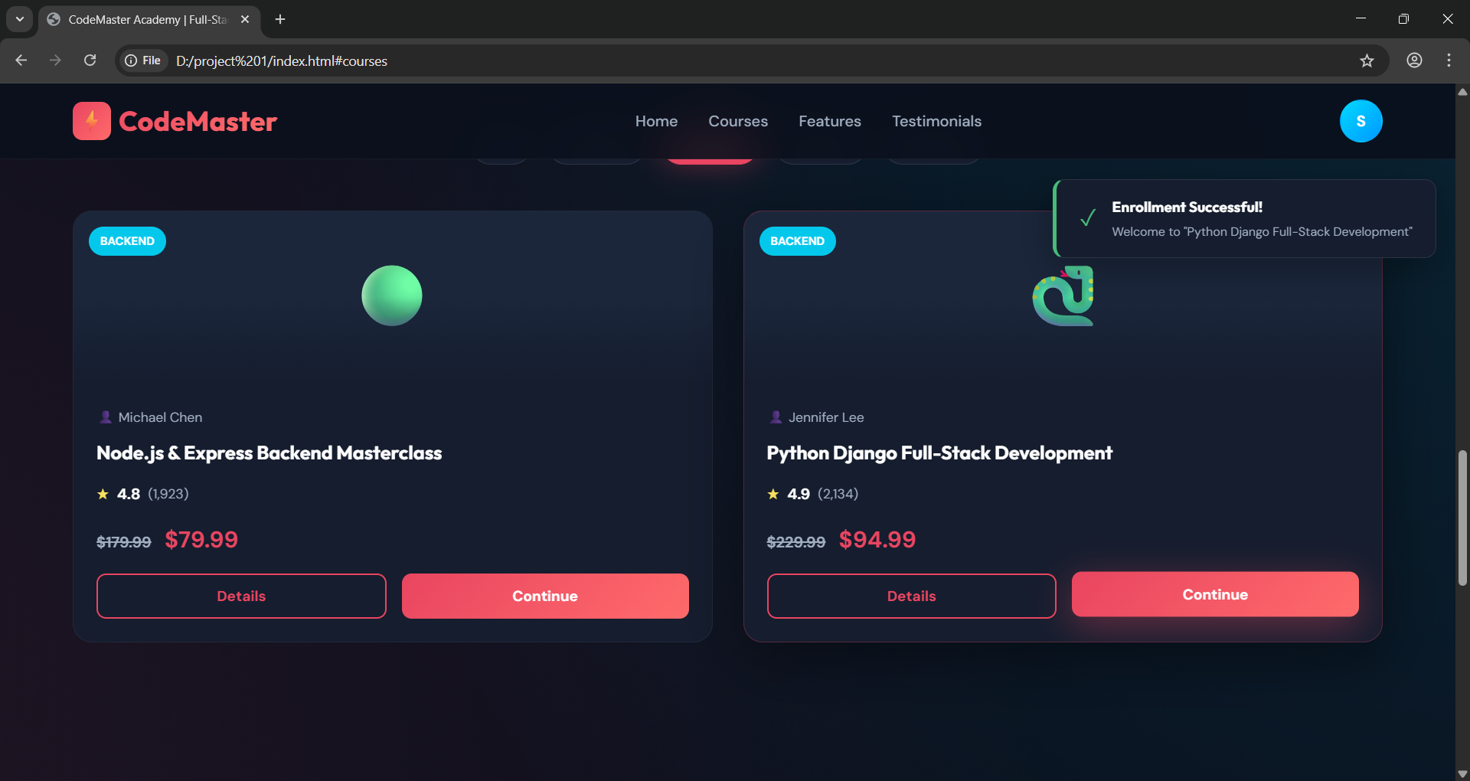
IMPLEMENTATION SCREENSHOTS
1
2
3
4
5
6
7
8(C)
9
Displays the final result such as course enrollment confirmation or processed user actions.

Slide 14
ADVANTAGES & LIMITATIONS
1
Advantages:
Secure user authentication
Easy access to learning materials
Supports both learners and instructors
Centralized platform
Scalable and efficient
Limitations:
Requires internet connection
Initial setup complexity
May need regular updates and maintenance
2
3
4
5
6
7
8
9

Slide 15
Thank you

