Slide 1

Public doamin
Designed by Luis Prado

Slide 2

Public doamin
Designed by Carlos Andujar

Slide 3

CCL License
Snail by aLf from The Noun Project

Slide 4

Creative Commons – Attribution (CC BY 3.0)
Cheeta designed by kesaryvamshi
from the Noun Project

Slide 5

Creative Commons – Attribution (CC BY 3.0)
City by Joel McKinney
from The Noun Project

Slide 6
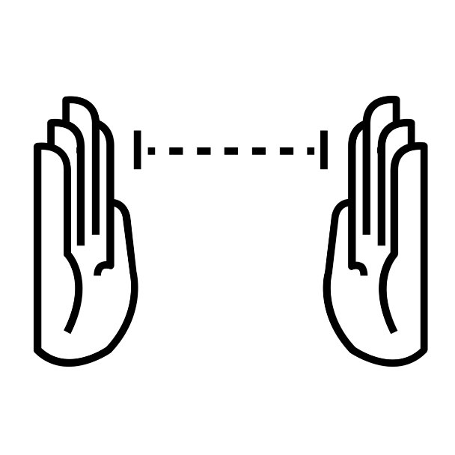
Measure by Ryan Beck from
The Noun Project

Slide 7
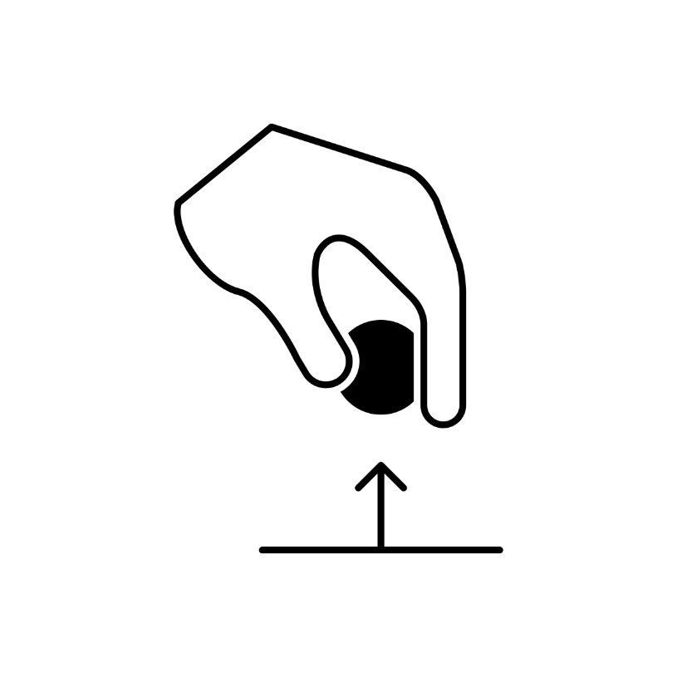
to pick by athanagore x
from The Noun Project

Slide 8
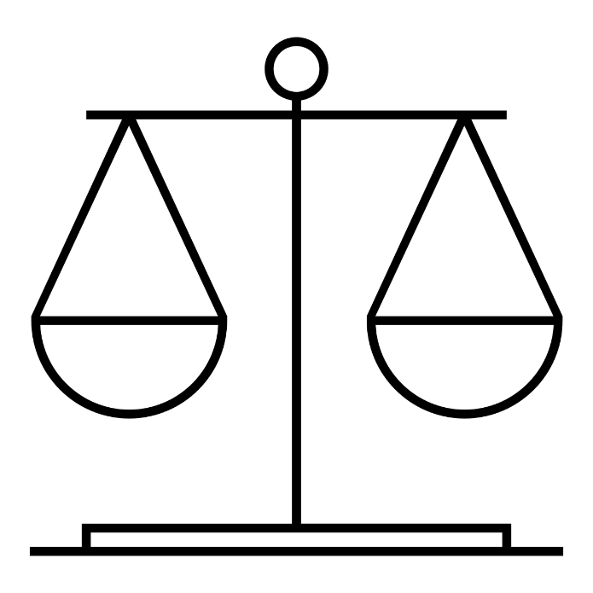
Balance by Juan Pablo Bravo
from The Noun Project

Slide 9
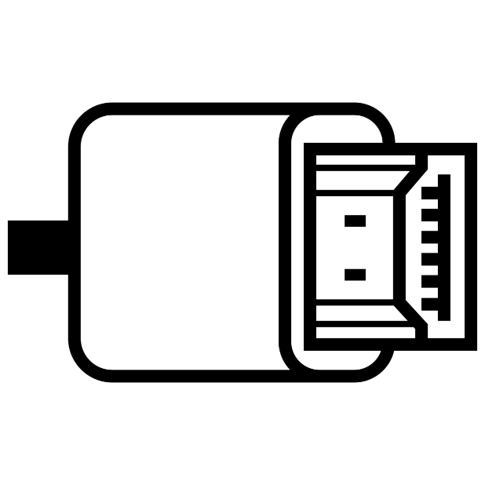
Hdmi Cable designed by Dan Hetteix
from the Noun Project

Slide 10

Created by Catherine Please

Slide 11

Created by Cris Dobbins

Slide 12

Created by Sofia Pramaggiore

Slide 13
Created by libberry

Slide 14

Created by Ahmed Elzahra

Slide 15

Created by Dimitry Sunseifer

Slide 16
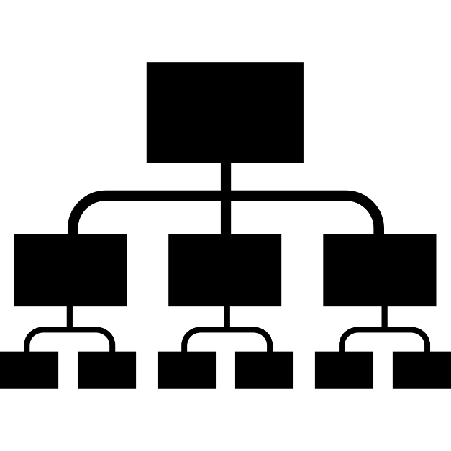
Created by Juan Pablo Bravo

Slide 17

Created by Ecem Afacan

Slide 18
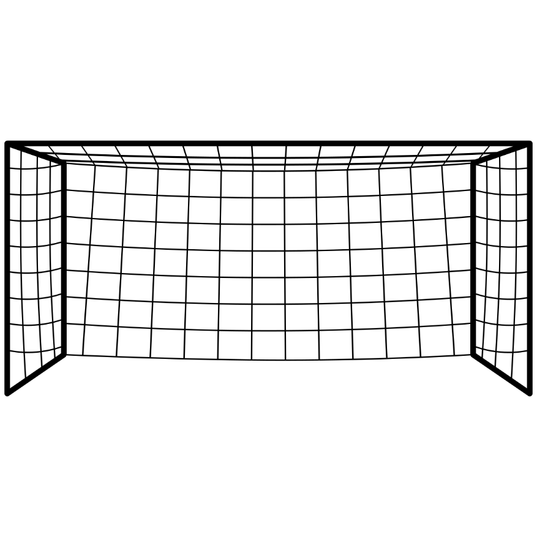
Created by Uriel Sosa

Slide 19
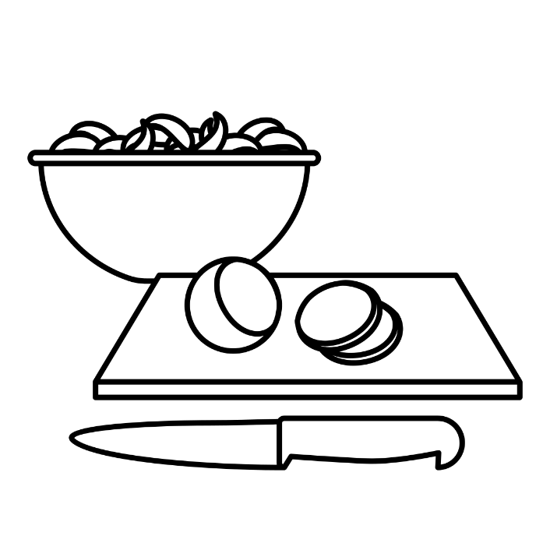
Created by Claire Jones

Slide 20
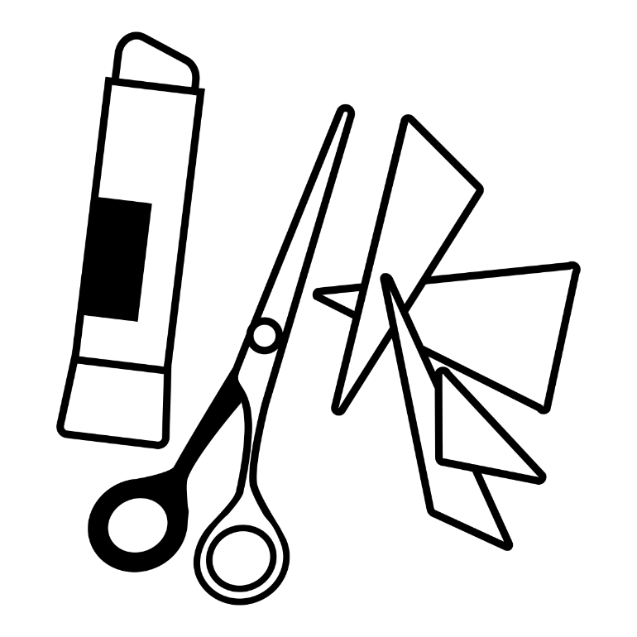
Created by Claire Jones

Slide 21

Created by Wilson Joseph

Slide 22
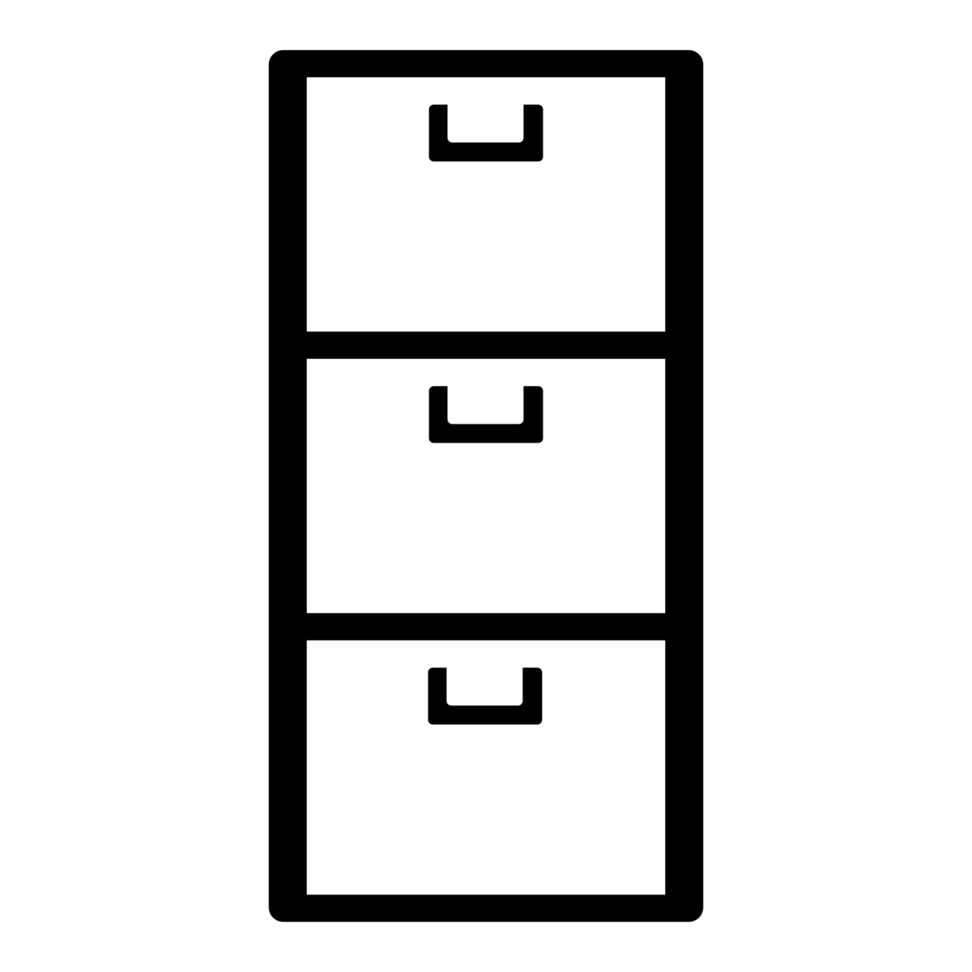
Created by Vincent Lynch

Slide 23

Created by Tim Jager

Slide 24

by iconsmind.com

Slide 25
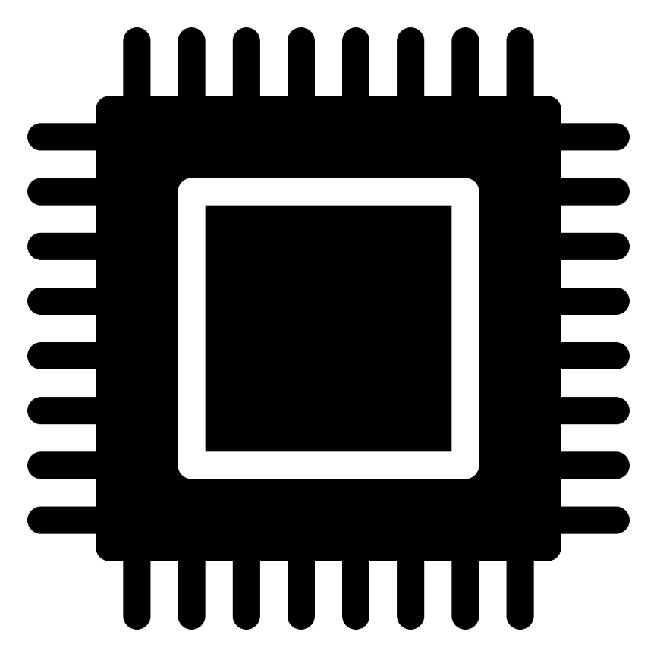
by iconsmind.com

Slide 26

by iconsmind.com

Slide 27
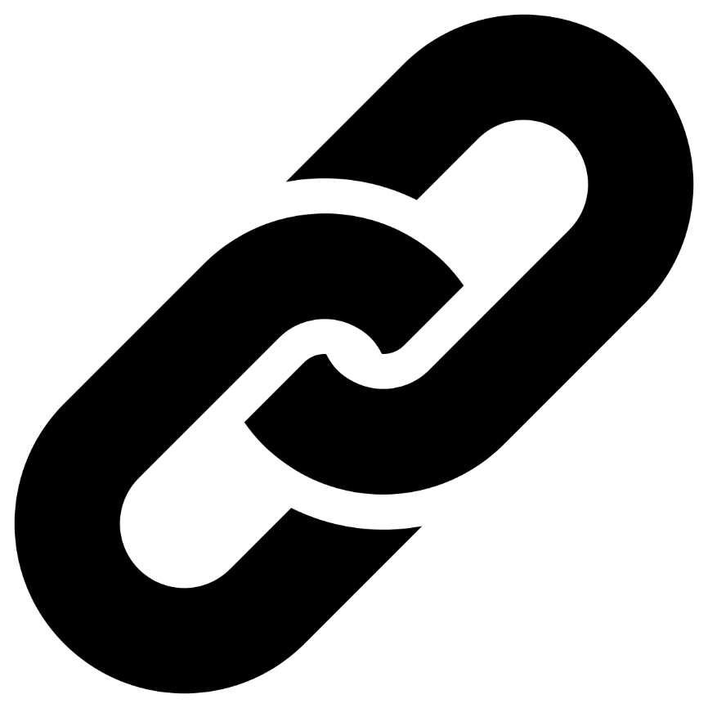
icon by Diego Naive

Slide 28

by Juan Pablo Bravo

Slide 29

Created by Nicole Regan

Slide 30
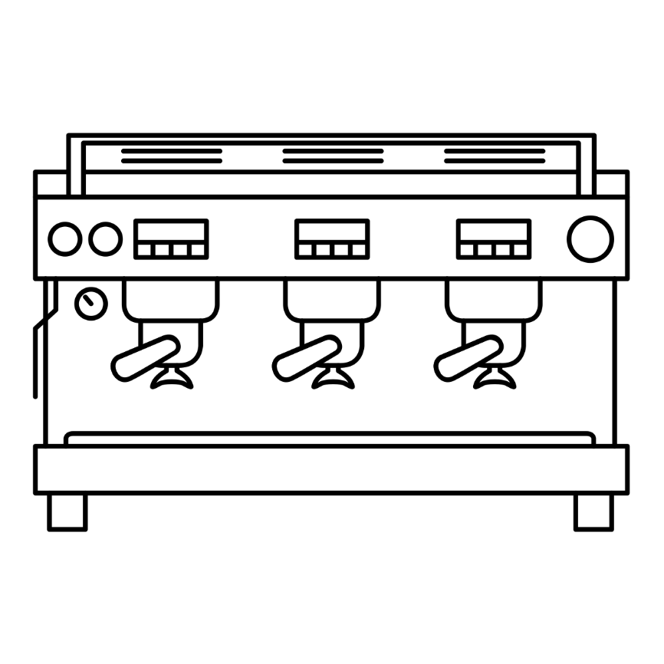
by Gabriela Muñiz

Slide 31
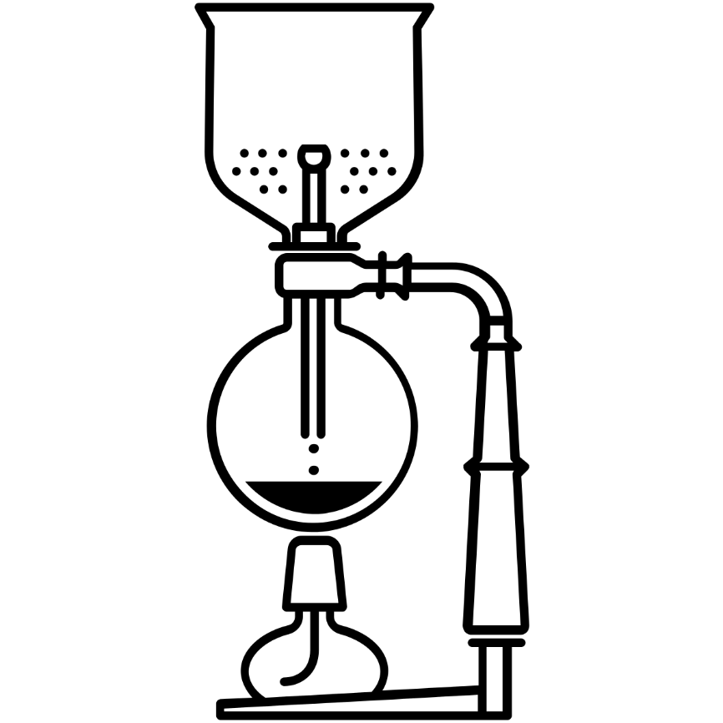
icon by Eric M. Ellis

Slide 32

by shaheen

