Slide 1
JAVA Array List 구현방법

Slide 2

Create
생성

Slide 3
ArrayList.java
package ot.ds.list.arraylist.implementation;
class ArrayList{
}
package ot.ds.list.arraylist.implementation;
public class Main {
public static void main(String[] args) {
ArrayList numbers = new ArrayList();
}
}
Main.java

Slide 4

Insert
추가

Slide 5
numbers.add(10);
numbers.add(20);
numbers.add(30);
numbers.add(40);

Slide 6
10
20
30
40
0
1
2
3

Slide 7
public boolean add(Object element){
elementData[size++] = element;
return true;
}

Slide 8
numbers.add(1, 50);

Slide 9
3
2
1
10
20
30
40
0
1
2
3

Slide 10
3
2
1
10
20
30
40
0
1
2
3
elementData[4] = elementData[3];
elementData[3] = elementData[2];
elementData[2] = elementData[1];

Slide 11
3
2
1
10
20
30
40
0
1
2
3
elementData[4] = elementData[3];
elementData[3] = elementData[2];
elementData[2] = elementData[1];
size-1
index

Slide 12
3
2
1
10
20
30
40
0
1
2
3
반복끝
index
반복시작
Size -1
반복
for( int i = ; i >= ; ){
elementData[i+1] = elementData[i];
}
size-1
index
i--

Slide 13
10
50
20
30
40
0
1
2
3
4
elementData[index] = element;

Slide 14
size++;

Slide 15

Remove
삭제

Slide 16
numbers.remove(1);

Slide 17
1
2
3
10
20
30
40
0
2
3
4
반복시작
index+1
반복끝
size -1
반복
for( int i = ; i <= ; ){
elementData[i-1] = elementData[i];
}
index + 1
size-1
i++

Slide 18
size--;

Slide 19
10
20
30
40
40
0
2
3
4
4
elementData[index] = null;

Slide 20
Get
가져오기

Slide 21
numbers.get(2)

Slide 22
10
50
30
40
0
1
2
3
public Object get(int index) {
return elementData[index];
}

Slide 23
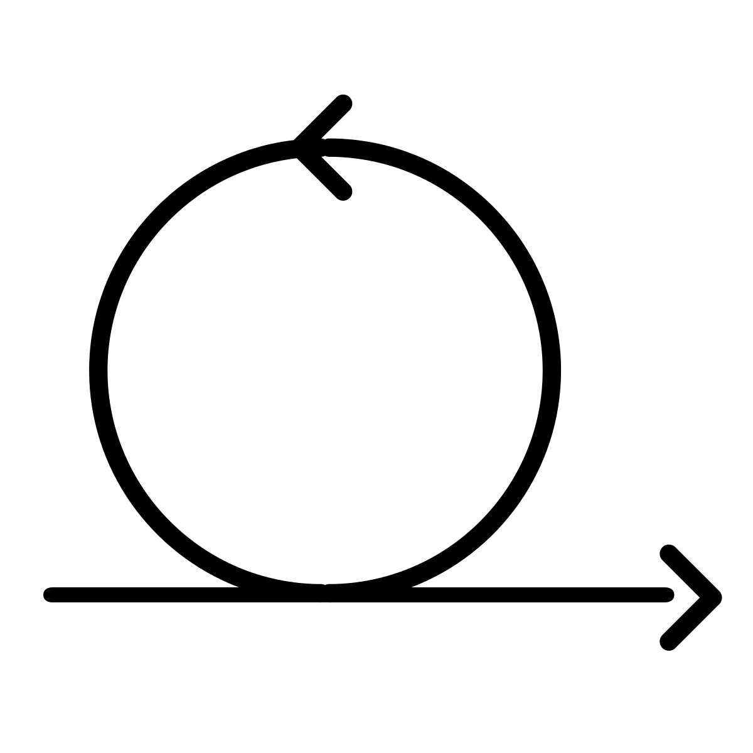
Iteration
반 복

Slide 24
cursor
10
50
30
40
0
1
2
3

Slide 25
class Ite implements Iterator {
int cursor = 0;
}

Slide 26
next()
10
50
30
40
Error
elementData[cursor++];
hasNext()
true
true
true
true
false
size != cursor
cursor
10
50
30
40
0
1
2
3
4
size
4
4
4
4
4

Slide 27
interface Iterator {
public boolean hasNext();
public Object next();
}

Slide 28
class Ite implements Iterator {
int cursor = 0;
public boolean hasNext() {
return size != cursor;
}
public Object next() {
return elementData[cursor++];
}
}

