Slide 1

Af-twin devops
Mylyn Integrated task management
Murat artim, escsa

Slide 2
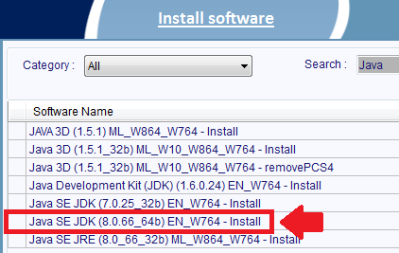
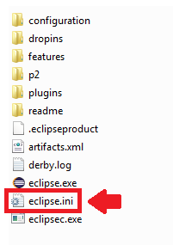
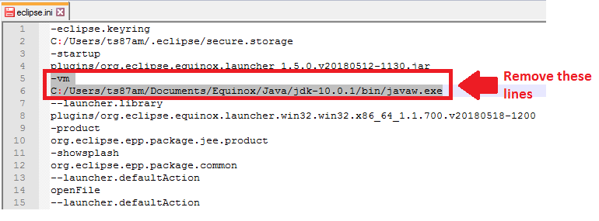
Install jdk from pc services
Mylyn Integrated task management
1
In order to integrate Eclipse IDE Mylyn task management with GitHub, we have to install PC Services JDK and set Eclipse to run with it.
First, install the latest available JDK (8.0.66) from PC Services (see figure 1).
Then open the ‘eclipse.ini’ file under you eclipse installation folder (see figure 2)
If exists, remove the 2 lines pointing to a JDK that eclipse should run (see figure 3). Now, eclipse will run with the officially installed PC Services JDK.
2
3

Slide 3
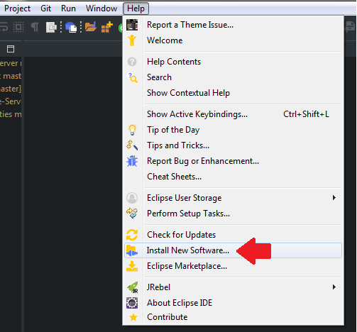
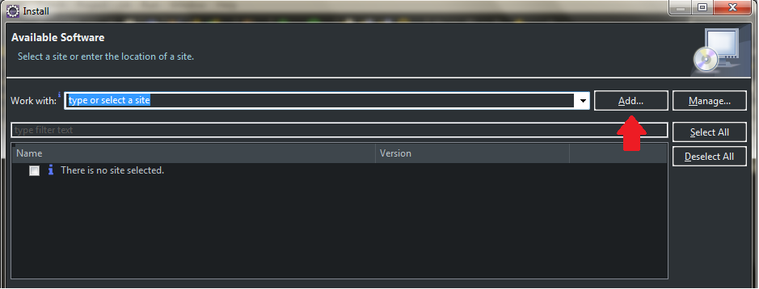
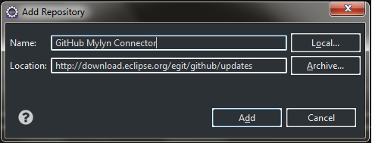
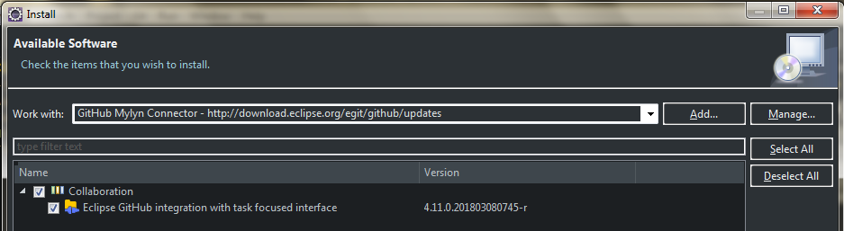
Install GitHub mylyn connector to eclipse
Mylyn Integrated task management
1
We will have to install the “GitHub Mylyn Connector” plugin to Eclipse. The plugin is not available through the marketplace therefore we have to do it the manual way.
Go to Help -> Install New Software (see figure 1). Click Add button in Install screen (see figure 2).
Fill the name and location as shown in figure 3, and click Add.
After the repository is checked out, you will see a list of items to install. Click the Collaboration item which is the root element (see figure 4).
2
3
4

Slide 4
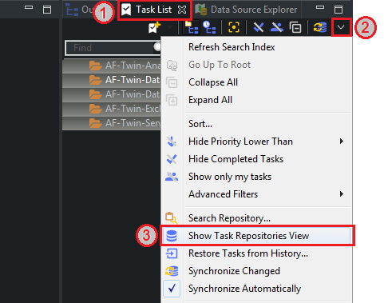
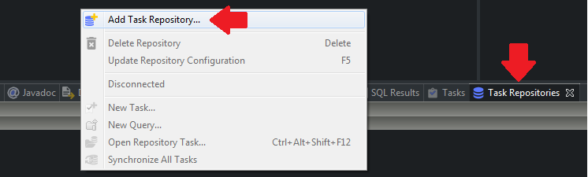
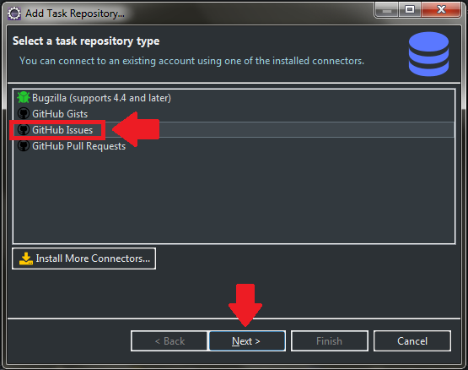
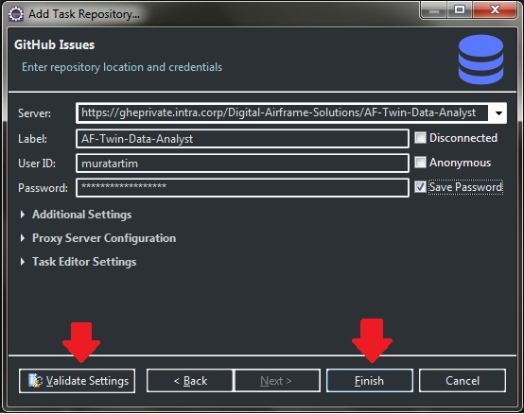
Add task repositories from GitHub
Mylyn Integrated task management
1
After the connector plugin installation is complete and Eclipse is restarted, we will add the task repositories from AF-Twin GitHub repos.
Go the Task List View (figure 1.1), click the drop-down button (figure 1.2) and select “Show Task Repositories View” (figure 1.3).
In the Task Repositories view, right-click and select “Add Task Repository” (figure 2). Then double-click “GitHub Issues” (figure 3).
Now fill the server, label, user id and password fields as shown in figure 4. Click Validate, and when validated click Finish. Repeat this for all AF-Twin GitHub repositories.
2
3
4

Slide 5
Mylyn Task management
Mylyn Integrated task management
1
After all task repositories are added, now we can start using Mylyn task management in Eclipse. Everything we do related to task management will be in sync with GitHub repos.
First, create categories for each project (see figure 1.1).
Query/get tasks from GitHub repositories and add them to created categories (figure 1.2).
Create new tasks in selected GitHub repositories (don’t forget to add them to a category during creation).
Synchronize tasks with GitHub repositories.
2
3
4

