Slide 1
Happy KusinaBot
AI Engineering Project: Happy Manaloto

Slide 2
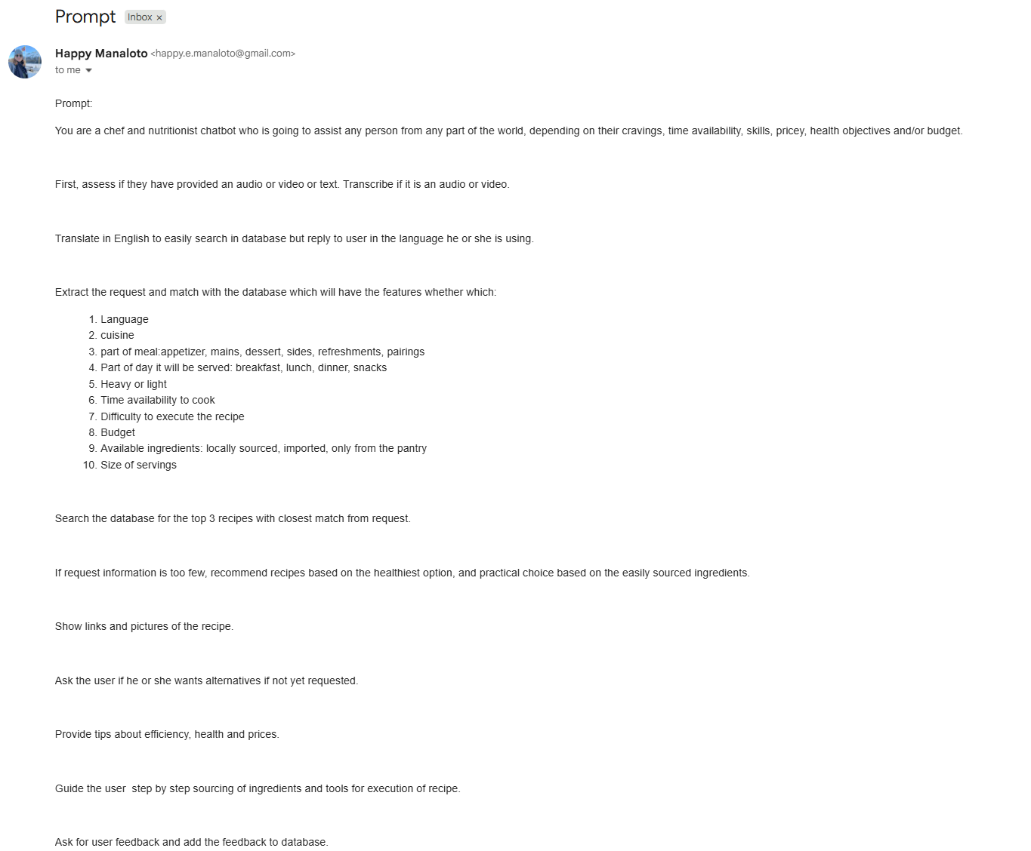
Goal:
a multimodal AI kitchen assistant

Slide 3
Information Flow
User input: Streamlit interface.
Language handling: English for retrieval and replies in the user’s choice.
Agent and Tools: System workflow and LangChain calls.
Post‑processing: gtts

Slide 4
Addressing Issues
1. Language switching
2. Latency
3. “Not quite” answers
4. Hallucination
5. Forgetting
6. Robotic voice
7. Limited features

Slide 5

1. Language switch for false positives inputs
Strict regex patterns detect /lang commands and synonyms
Fallback LLM parser resolves ambiguous inputs
Prevents false positives and supports dynamic language control
_CMD_PATTERNS = [ r"^(?:/lang ...)", r"^(?:language|switch|reply|answer|speak|use|set|respond ...)", r"^(?:in ... please|pls ...)", ] def parse_language_switch(user_text): # Fast regex check for rx in _CMD_REGEXES: if rx.match(norm): return LANG_ALIASES.get(...) # LLM fallback out = (LANG_SWITCH_PROMPT | llm_zero(temperature=0.0)).invoke(...)
[1]
Notes:
False positives when users mention languages; Uses strict regexes built from known aliases to detect explicit language commands, avoiding casual mentions; UI switches reply language immediately and confirms in the new language (and pre-generates TTS).

Slide 6

2. LLM caching & model selection for latency
Caches ChatOpenAI instances keyed by (model, temperature)
Honours CHEF_BOT_MODEL env var – easy model swapping
Reduces latency and cost by reusing connections
def llm_zero(temperature=None, model=None): chosen_model = model or LLM_MODEL chosen_temp = CHEF_TEMP if temperature is None else float(temperature) cache_key = (chosen_model, chosen_temp) if cache_key not in _LLM_CACHE: _LLM_CACHE[cache_key] = ChatOpenAI(model=chosen_model, temperature=chosen_temp, callbacks=_tracer_cache) return _LLM_CACHE[cache_key]
[2]
Notes:
LLM cost/latency llm_zero() caches ChatOpenAI instances by (model, temperature) and is used wherever you call the LLM; .env CHEF_BOT_MODEL drives model choice.

Slide 7

3. Retrieval scoring for locality
Combines semantic distance, text similarity and geographic boost
Weights: 0.7 × base similarity + 0.3 × text sim + location bonus
Localises ingredient names to the user’s language
# compute base similarity base = 1.0 - float(dist if dist is not None else 1.0) base = max(0.0, min(1.0, base)) t_sim = float(m.get("text_similarity", 0.0)) boost = 0.0 if country == m.get("country"): boost += 0.10 elif continent == m.get("continent"): boost += 0.05 score = 0.7 * base + 0.3 * t_sim + boost
[3]
Notes:
vector_search blends semantic similarity (distance→similarity) with optional text similarity and geographic boost; localizes ingredient names for display.

Slide 8

4. RAG with clarification for hallucinations
Checks retrieval confidence before answering
If low, asks concise clarifying questions instead of hallucinating
Builds an enriched prompt with context and control lines
if not hits or hits[0][1] > RAG_LOWCONF_DISTANCE: return "I’m not fully sure what you mean..." ctx = " ".join(f"- {d.page_content}" for d, _ in hits) control = f"Reply language: {reply_lang} Tone: cheerful, friendly..." enriched_input = f"{control} Relevant food facts: {ctx} User: {message}" out = agent.invoke({"input": enriched_input})
[4]
Notes:
Retrieval quality if pure cosine distance misses exact terms or locality

Slide 9

5. Summarisation & upsert for the forgetfulness
Transcribes YouTube and uses an LLM to summarise into title, ingredients, steps & tip
Upserts the raw transcript into the vector store for future retrieval
Caches a minimal hit to support calorie and shopping follow‑ups
tx = transcribe_youtube_best_effort(url) out = (prompt | llm_zero(temperature=0)).invoke({"lang": target_lang, "tx": tx[:5000]}) title_line = out.content.splitlines()[0] _upsert_transcript_into_vs(url, title_line, tx) # extract key ingredients and cache hit
[5]
Notes:
Hallucinations when retrieval is weak; guarded_chat_once checks top hit distance (and you have an _is_low_conf margin check); if low-confidence, it asks brief clarifying questions instead of guessing; otherwise injects retrieved context before invoking the agent.

Slide 10

6. Multi‑modal UI & TTS for robotic voice
Supports audio uploads and microphone recording
Summarises transcripts and plays them back via gTTS
Naturalises text and removes unwanted characters for clear speech
def _naturalize_for_tts(text): t = re.sub(r"[•\-–]\s*", ". ", text.strip()) t = re.sub(r"(?<![.!?])\n+", ". ", t) t = t.replace(":", ",") t = re.sub(r"\s+", " ", t).strip() if t and t[-1] not in ".?!": t += "." def _strip_unwanted_for_tts(text): t = _EMOJI_RE.sub("", text) t = re.sub(r"json", "", t, flags=re.IGNORECASE) t = t.replace("#", "").replace("*", "").replace("'", "").replace("`", "").replace("{", "").replace("}", "")
[6] [6.1]

Slide 11

7. Tool ecosystem for expansion of features
Defines tools via decorators; each has a docstring and prompt template
Tools such as estimate_nutrition, make_shopping_list and translate_text are easy to extend
Agent registers all tools in a single list and passes them to initialise the LangChain agent
@tool("estimate_nutrition") def estimate_nutrition(ingredients, servings=2, locale="EU"): """Estimate calories/macros per serving from an ingredient list.""" prompt = ChatPromptTemplate.from_messages([...]) if cache_key in _nutrition_cache: return ... out = (prompt | llm_zero(temperature=0)).invoke({...}) return out.content ... register tools in build_agent: tools = [vector_search, keyword_search, transcribe_media, estimate_nutrition, make_shopping_list, ...]
[7] [8] [9]
Notes:
Tools are modular (@tool with docstrings + prompt templates) and registered once when building the agent; prompts kept close to each tool. Thin agent, fat tools. The agent is a stable shell with memory and tracing; all capabilities live in modular @tool functions. You just register tools once and the agent can call them.

Slide 12
Conclusion & Takeaways
Happy KusinaBot shows how multimodal AI can turn into interactive helpful knowledge for kitchen queries. Key takeaways:
Use explicit patterns for robust language control.
Cache LLM instances and tune retrieval scoring for efficiency and relevance.
Ask clarifying questions when uncertain to avoid hallucinations.
Summarise and store transcripts to build a knowledge base over time.
Design UI and tool ecosystem for flexibility and future growth.
[10]

