Slide 1
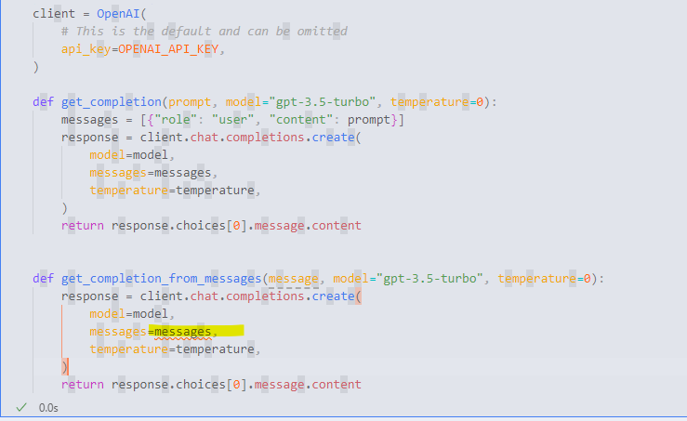
Use Panel widgets, user interface elements for interactive input.
Test the chatbot with different combinations and check its consistency.
I’ve tried few shots, and I thought it was working until I keep sending same input, it started to be confused.
Be explicit to GPT. COT in combination with few shots worked well in clearly telling the model
how to assess the type of input and respond accordingly.
Ensure that prompting and feedback circle back to GPT to incorrect responses.
I had to call GPT API in the chatbot codes

