Slide 1
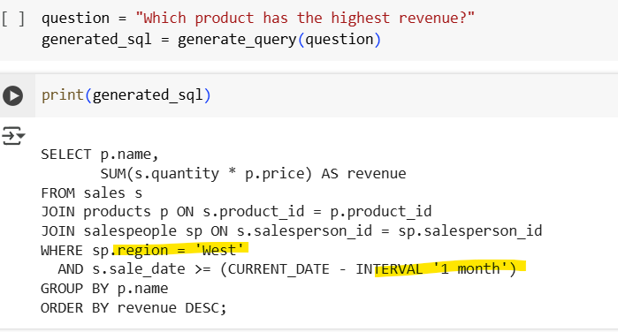
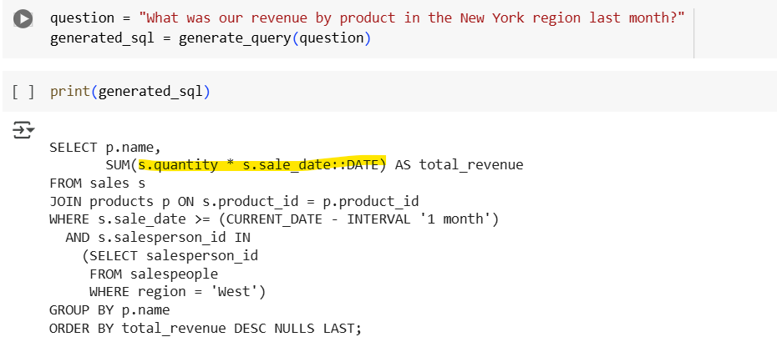
When question is not clear, filters were assumed. Example, region='West' even if not mentioned. Even with CoT
Zero-shot prompting confused columns.
Prompt can still be improved: make clearer identification of question from reasoning and a general reminder: "Only use filters if explicitly mentioned in the user question"

