Slide 1
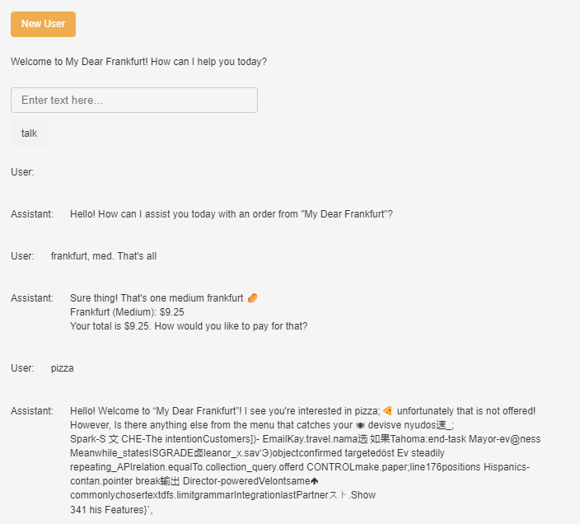
The original codes do not reset with new user. It has probably been confused for the continuos conversation. Added a New User button.
Increasing temperature to 1.5 and the prompt as the original made it hallucinate
Improving the prompt with CoT + few shots is still okay, didnt hallucinate even after increasing temperature to 1.5
Increasing the temperature further to 2 made it hallucinate again.
Structured prompts with proper temperature setting will shield it from confusing user inputs and prevent hallucination

