Slide 1


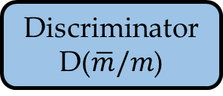






Incomplete MR data
Relative coordinate space
Transformed vectors: $\hat{m},m$
Pre-processing
Adversarial learning
noise vector
binary vector
$$z$$
$$\hat{m}$$
$$b$$
Generator
G($z,\hat{m},b$)
$$\overline{m}$$
MSE
loss
Forward
Backward
Real/completed samples
$$m$$
Discriminator
D($\overline{m}/m$)
Localizer
L($\overline{m}/m$,$l$)
Cross Entropy loss
Localization loss

