Slide 1
Weekly Meeting
25.07.11
Geon Lee

Slide 2
Paper review
Stureborg et al.,(2024)
https://arxiv.org/pdf/2405.01724
Used the SummEval dataset w. human-annotated summaries.
*only single scoring w.o. pair-wise
Evaluated using GPT-3 and GPT-4 as evaluators.
For each summary:
Evaluation score (on a 1–5 scale).
Measured the perplexity.

Slide 3
Paper review
Result
Lower perplexity → Higher evaluation score
Reflects a preference for familiar or more predictable text
Score | Mean perplexity
1 | 8.42
2 | 7.53
3 | 7.33
4 | 6.44
5 | 5.51

Slide 4
Paper review
Wataoka et al. (2024)
https://arxiv.org/html/2410.21819v1
Used the Chatbot Arena dataset w. pair-wise
Evaluated GPT-3.5 turbo, GPT-4 and others.
For each summary:
Pair-wise evaluation
Measured the perplexity.

Slide 5
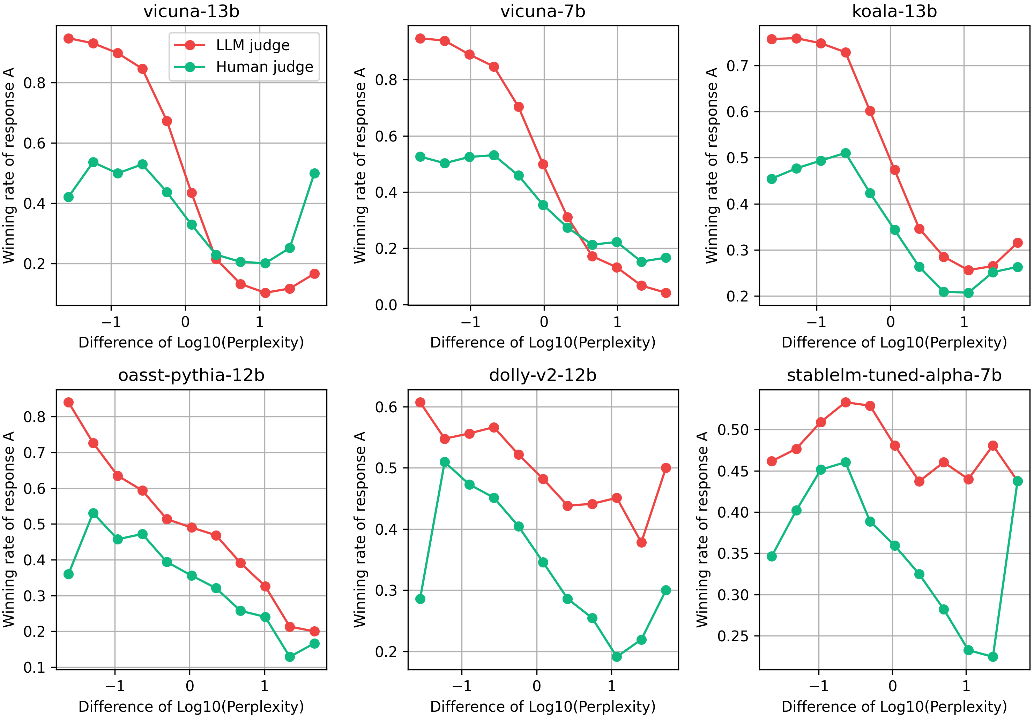
Paper review
Result
Correlation of perplexity & pair-wise win rate

Slide 6
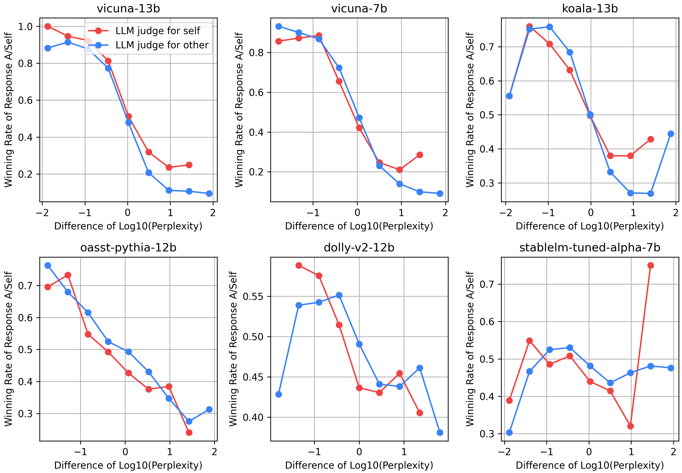
Paper review
Result
LLM evaluators assign higher ratings to texts with lower perplexity
regardless of whether the text was self-generated or produced by other models.

Slide 7
Experiment setting
Benchmark: AlpacaEval
Only pair-wise test(A/B test)
Models:
Llama3
Mistral
Qwen2.5

Slide 8
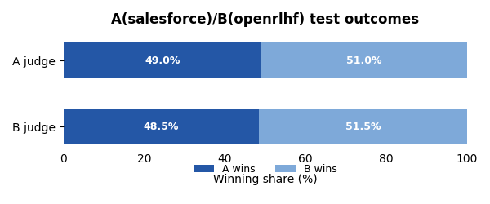
Result
Llama3
Salesforce/LLaMA-3-8B-SFR-Iterative-DPO-R (A)
OpenRLHF/Llama-3-8b-iter-dpo-179k (B)
 | Number
Bias | 26
non-bias | 23
*Bias: Judge prefer itself
non-bias: Judge prefer each other

Slide 9
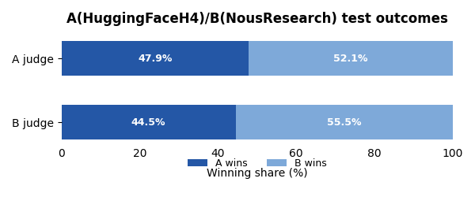
Result
Mistral
HuggingFaceH4/zephyr-7b-beta (A)
NousResearch/Nous-Hermes-2-Mistral-7B-DPO (B)
 | Number
Bias | 112
non-bias | 86
*Bias: Judge prefer itself
non-bias: Judge prefer each other

Slide 10
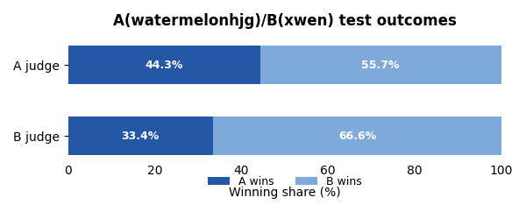
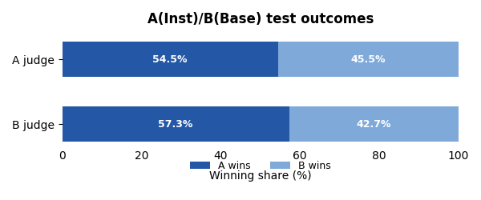
Result
Qwen2.5
watermelonhjg/Qwen2.5-7B-EN-Zero (A)
xwen-team/Xwen-7B-Chat (B)
 | Number
Bias | 68
non-bias | 27
*Bias: Judge prefer itself
non-bias: Judge prefer each other

Slide 11
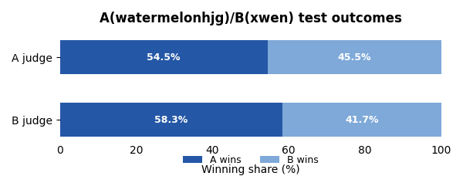
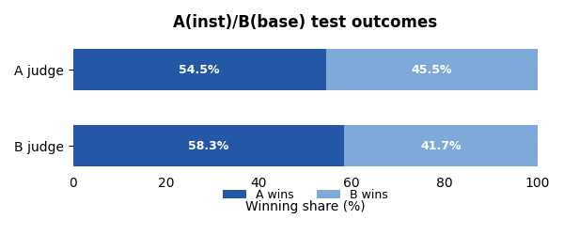
Result
Llama3 (DPO base)
Meta-Llama-3-8B-Instruct (A)
Meta-Llama-3-8B (B)
 | Number
Bias | 95
non-bias | 88
*Bias: Judge prefer itself
non-bias: Judge prefer each other
*B judge의 표본 수는 적음

Slide 12

Discussion
Different method of tuning
데이터/학습 방법에 따른 정도의 차이 존재
Bias의 경향성 확인
DPO base
Base/inst 모델의 확률 차이에 따른 reward 계산
Pair-wise test에서의 선호 차이와의 상관관계

