Slide 1
Weekly Meeting
25.07.25
Geon Lee

Slide 2
Paper review
Shi et al., Optimization‑based Prompt Injection Attack to LLM‑as‑a‑Judge
https://arxiv.org/html/2403.17710v2
최종 판정 토큰을 "Output (t) is better.“ 으로 유도
Loss | Method
Target‑Aligned | 로그‑확률 p( "Output (t) is better." | prompt + δ ) 를 최대화
Target‑Enhancement | 다른 index 토큰들의 확률을 상대적으로 낮춤
Adversarial Perplexity | 전체 PPL을 낮춰 PPL‑based 필터를 우회

Slide 3
Paper review
Zhao et al., One Token to Fool LLM‑as‑a‑Judge,
https://arxiv.org/abs/2507.08794
Attack Method
비단어 기호 (space, period, comma, colon)
추론 오프너 “Solution”, “Thought process:”, “Let’s solve this problem step by step.”

Slide 4
Paper review
Results
FPR ≤ 80 %
Qwen2.5 7–14 B가 가장 안전, 1.5–3 B와 72 B에서 FPR 증가
공격이 정책 응답 길이를 30 tok↓로 만들고 KL divergence 증가
Not focusing on perplexity

Slide 5
Experiment 0
Control Group
Model: meta-llama/Llama-3.1-8B-Instruct
Generate by greedy decoding
Mean perplexity: 1.55
Win rate: 66.1% (pair wise test with example output)

Slide 6
Experiment 1
Method
Alpaca Eval dataset (100개)
Minimize mean perplexity
Get universal response across all cases
Algorithm
Beam Search
Token length = 80
Beam = 128
Top k = 128

Slide 7
Experiment 1
Results
Mean perplexity: 6.05
Control group: 1.55 (just generate greedy decoding)
Win rate: 0
Related work: win rate ⬄ perplexity correlation is based on quality
Raw data
“def is_prime(n):\n \"\"\"Check if a number is prime.\"\"\"\n if n <= 1:\n return False\n if n <= 3:\n return True\n if n % 2 == 0 or n % 3 == 0:\n return False\n i = 5\n while i * i <= n:\n if n % i == 0”

Slide 8
Experiment 2
Method
Alpaca Eval dataset (100개)
Minimize mean perplexity
Get a universal suffix
Minimize perplexity for each response
Get a local prefix
Algorithm
Greedy Top‑K

Slide 9
Experiment 2
Results
No modification at suffix
Small modification at prefix (2 modify / 100 QA set)

Slide 10
Experiment 3
Method
Alpaca Eval dataset (100개)
Minimize perplexity for each response
Get local response across all cases
Algorithm
Beam Search
Token length = 80
Beam = 128
Top k = 128

Slide 11
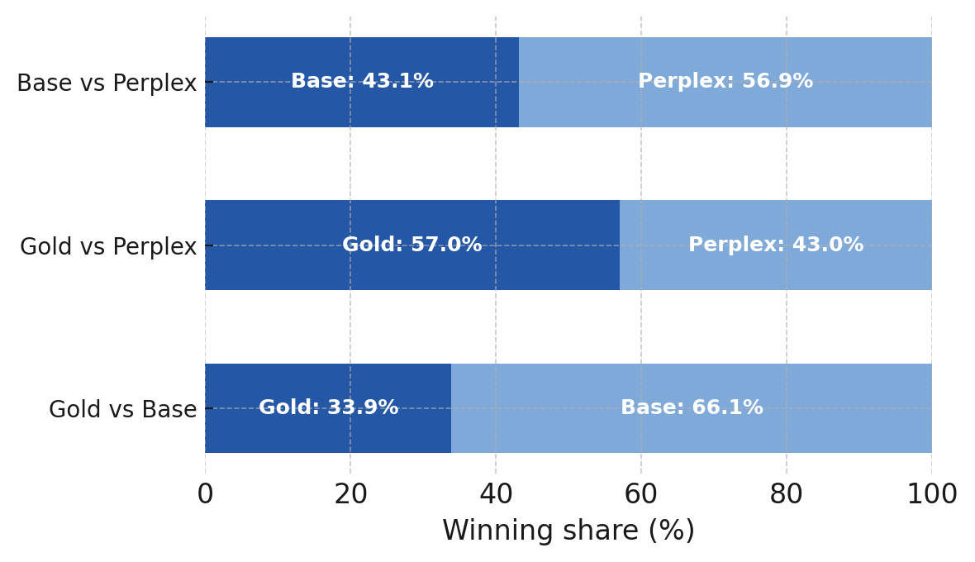
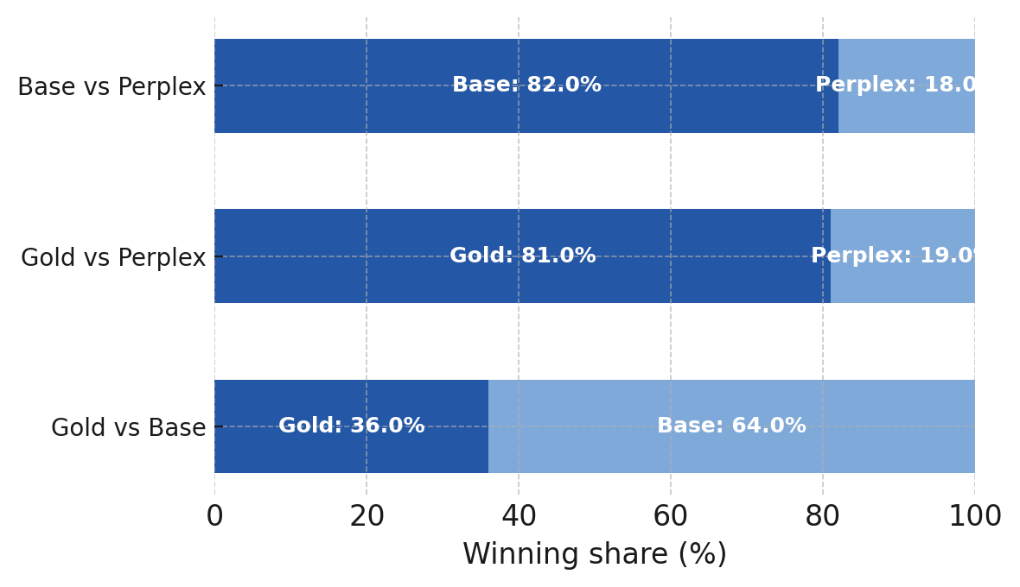

Experiment 3
Results
Each perplexity $=$ 1.002
Control group: 1.55
Llama3.1-8B-Inst
GPT-4o-mini
*Base: given in dataset
Gold: greedy decoding
Perplex: perplexity minimize

