Slide 1
Weekly Meeting
25.08.15
Geon Lee

Slide 2


Alpha-value tuning
Generate w. trained MLP
s_{i}: MLP output from last hidden layer & next-token embedding
Using the original model
8192 → 8 → 1
Dataset: alpaca eval

Slide 3
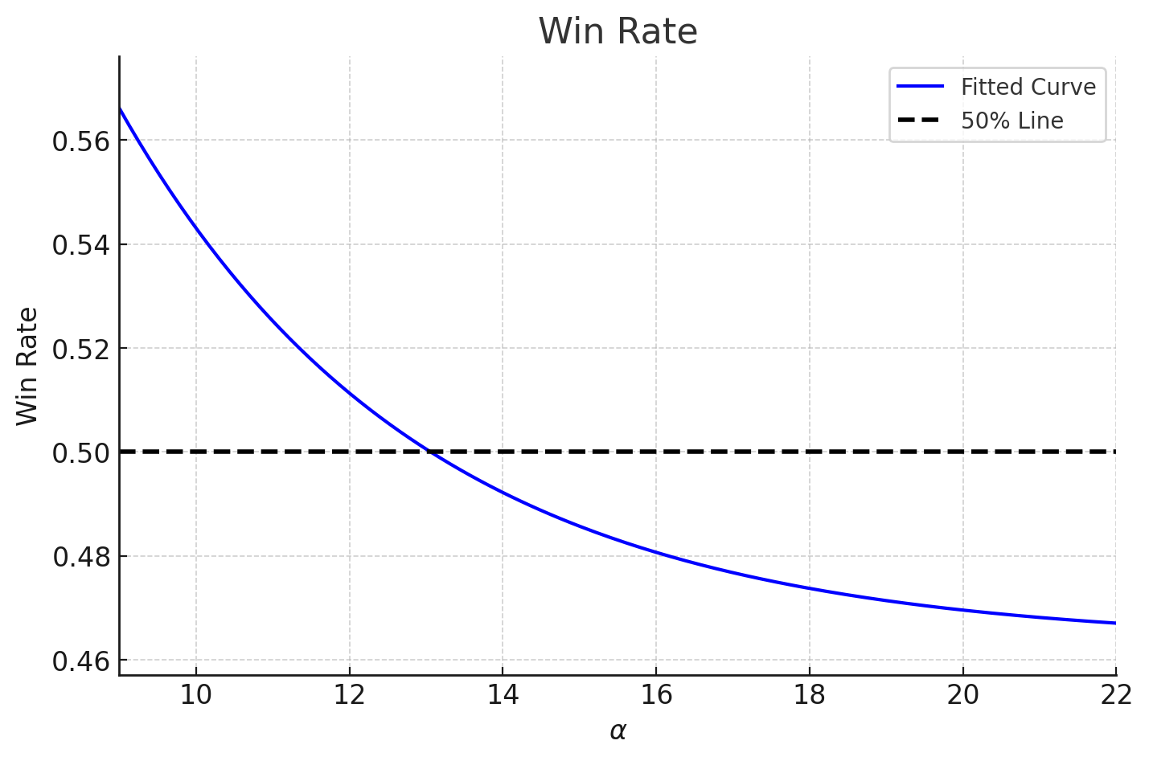

Alpha-value tuning
Alpha value:
α≈1: No significant difference from baseline
α≥10: Significant change
α$≫$10: Large α → lower win rates

Slide 4
Dataset Expansion
Chatbot Arena
lmsys/chatbot_arena_conversations
Randomly sample 2000 queries
(only English, one-turn conversation)
Other candidates
Consider OpenHermes or others
Dataset contains a lot of noise
Not similar to AlpacaEval dataset

Slide 5
Dataset Expansion
Chatbot arena:
3498 pair-wise dataset (Exclude cycles. i.e. a>b>c>a)
3298 train / 200 valid / 283 test
Total (Alpaca eval + Chatbot arena):
4914 pair-wise dataset (2457 instruction)
4156 train / 484 valid / 484 test

Slide 6
Dataset Expansion
Pair-wise test:
Generate: llama3.1, gpt-4o-mini (same setting as before)
Llama vs gpt win rate:
587:1412
572:1427
Detect preference bias (Include quality bias)
Llama vs Llama:
1021:978

Slide 7
MLP train - 1
Hyper-Parameters
Optimizer: SGD
Momentum: 0.9
Learning rate: 1 × 10⁻⁴
Weight decay: 1 × 10⁻⁴
Epochs: 50
Dropout: 0.25
Hidden width: 8
Input dimension: 8192
(8192, 8) → GELU → (8, 1)

Slide 8
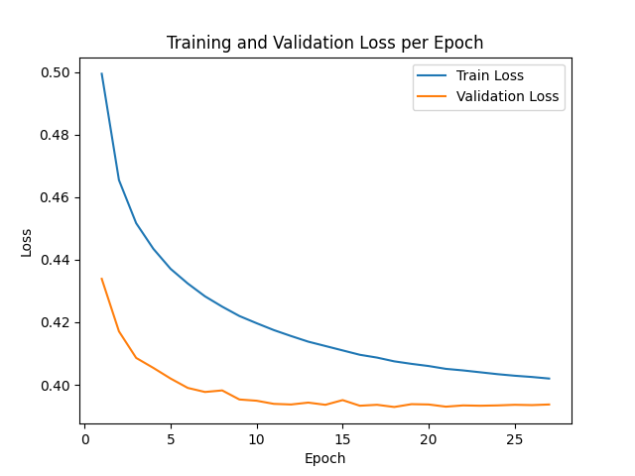

MLP train - 1
Results
Improvement in accuracy
No dramatic performance improvement

Slide 9
MLP train - 2
Hyper-Parameters
Optimizer: SGD
Momentum: 0.9
Learning rate: 1 × 10⁻⁴
Weight decay: 1 × 10⁻⁴
Epochs: 50
Dropout: 0.2
Hidden width: 256 - 128
Input dimension: 8192
(8192, 256) → GELU → (256, 128) → GELU → (128, 1)

Slide 10
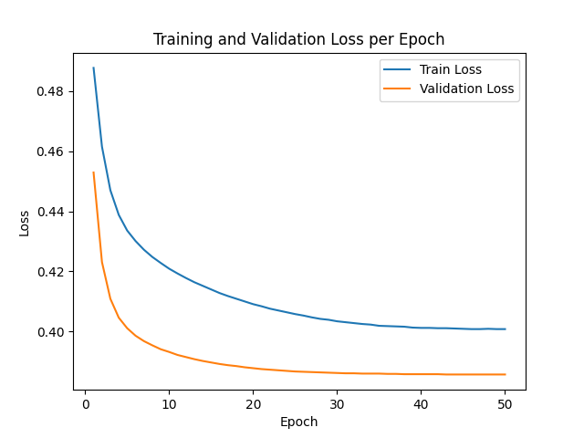

MLP train - 2
Results
Improvement in accuracy
No dramatic performance improvement
Parameter↑ → No change in accuracy

Slide 11
Discussion & TODO
Hyper parameter tuning
In progress
Increase layers & width
Num of parameters ↔ accuracy
Why performance is similar?
Num of train datasets ↔ accuracy
Training dataset: nearly 4× larger
Why performance increases only slightly?

