Slide 1
Weekly Meeting
25.08.15
Geon Lee

Slide 2


Alpha-value tuning
Generate w. trained MLP
s_{i}: MLP output from last hidden layer & next-token embedding
Using the original model
8192 → 8 → 1
Dataset: alpaca eval

Slide 3
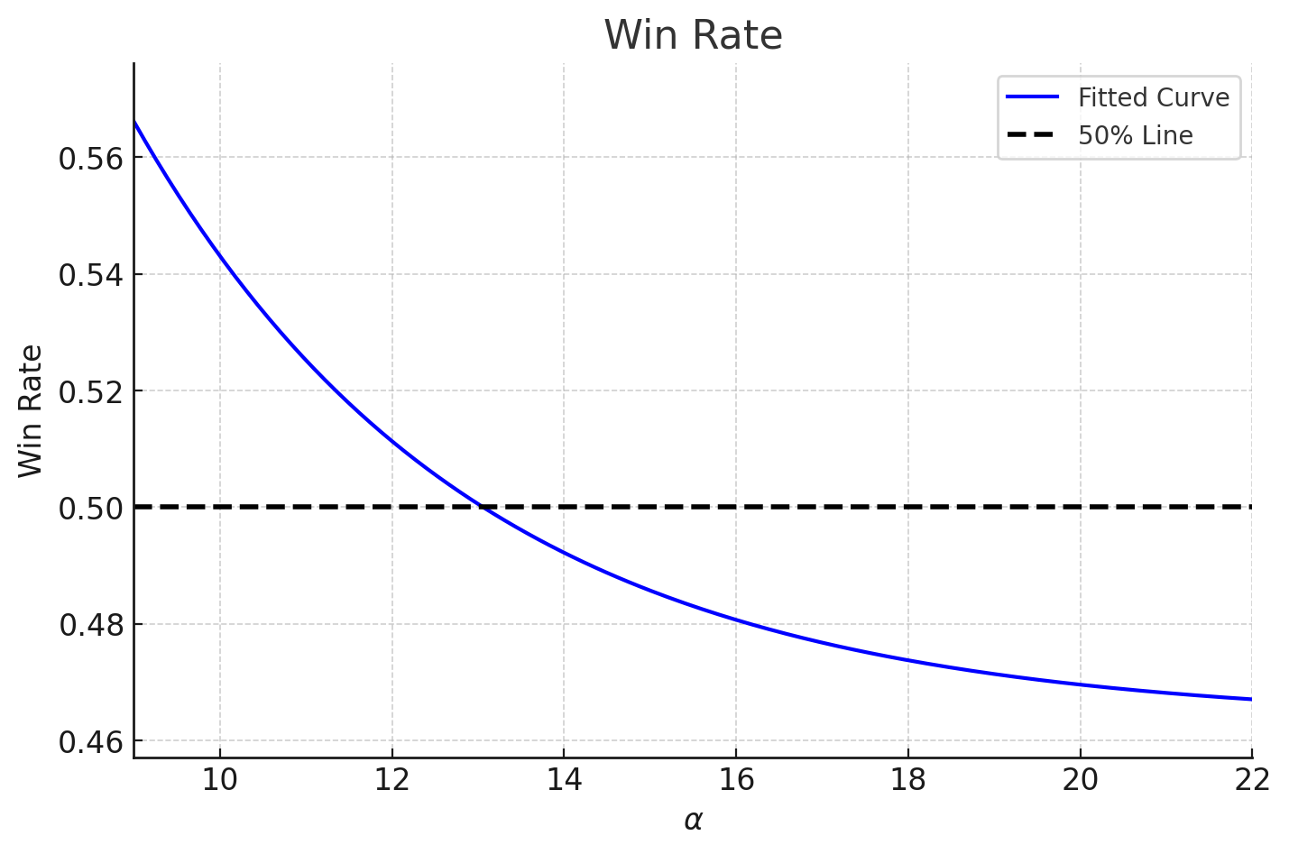

Alpha-value tuning
Alpha value:
α≈1: No significant difference from baseline
α≥10: Significant change
α$≫$10: Large α → lower win rates

Slide 4
Dataset Expansion
Chatbot Arena
lmsys/chatbot_arena_conversations
Randomly sample 2000 queries
(only English, one-turn conversation)
Other candidates
Consider OpenHermes or others
Dataset contains a lot of noise
Not similar to AlpacaEval dataset

Slide 5
Dataset Expansion
Chatbot arena:
3498 pair-wise dataset (Exclude cycles. i.e. a>b>c>a)
3298 train / 200 valid / 283 test
Total (Alpaca eval + Chatbot arena):
4914 pair-wise dataset (2457 instruction)
4156 train / 484 valid / 484 test

Slide 6
Dataset Expansion
Pair-wise test:
Generate: llama3.1, gpt-4o-mini (same setting as before)
Llama vs gpt win rate:
587:1412
572:1427
Detect preference bias (Include quality bias)
Llama vs Llama:
1021:978

Slide 7
MLP train - 1
Hyper-Parameters
Optimizer: SGD
Momentum: 0.9
Learning rate: 1 × 10⁻⁴
Weight decay: 1 × 10⁻⁴
Epochs: 50
Dropout: 0.25
Hidden width: 8
Input dimension: 8192
(8192, 8) → GELU → (8, 1)

Slide 8
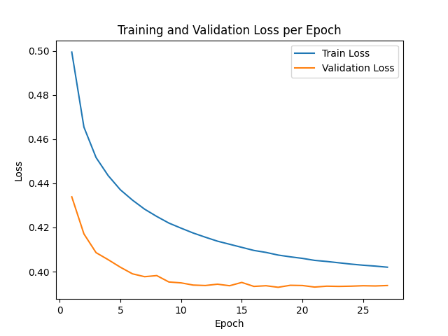

MLP train - 1
Results
Improvement in accuracy
No dramatic performance improvement

Slide 9
MLP train - 2
Hyper-Parameters
Optimizer: SGD
Momentum: 0.9
Learning rate: 1 × 10⁻⁴
Weight decay: 1 × 10⁻⁴
Epochs: 50
Dropout: 0.2
Hidden width: 256 - 128
Input dimension: 8192
(8192, 256) → GELU → (256, 128) → GELU → (128, 1)

Slide 10
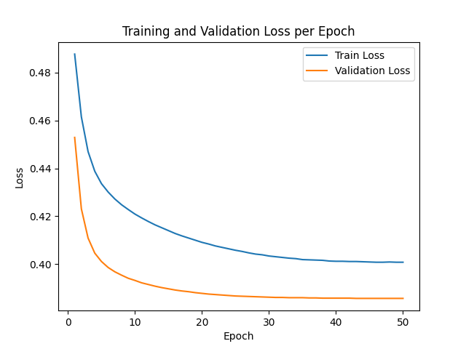

MLP train - 2
Results
Improvement in accuracy
No dramatic performance improvement
Parameter↑ → No change in accuracy

Slide 11
Discussion & TODO
Hyper parameter tuning
In progress
Increase layers & width
Num of parameters ↔ accuracy
Why performance is similar?
Num of train datasets ↔ accuracy
Training dataset: nearly 4× larger
Why performance increases only slightly?

Slide 12
Weekly Meeting
25.08.22
Geon Lee

Slide 13
Experiment setting
Train set
3956 pair
3,073,005 tokens
Valid set
484 pair
392,835 tokens
Test set
484 pair
382,193 tokens

Slide 14
Increase parameter
3layer
8192 → 1024 → 512 → 256 → 1
8192 → 512 → 256 → 128 → 1
etc
Skip connection
8192 → last layer
Optimizer
AdamW
SGD

Slide 15
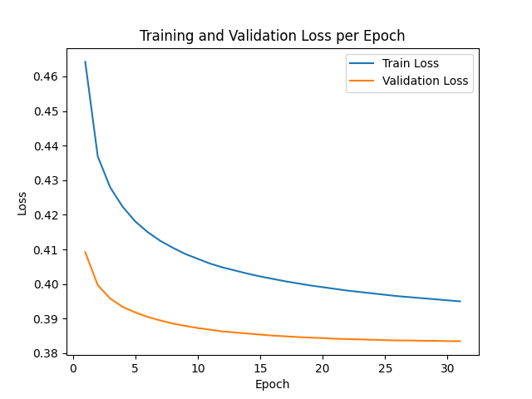
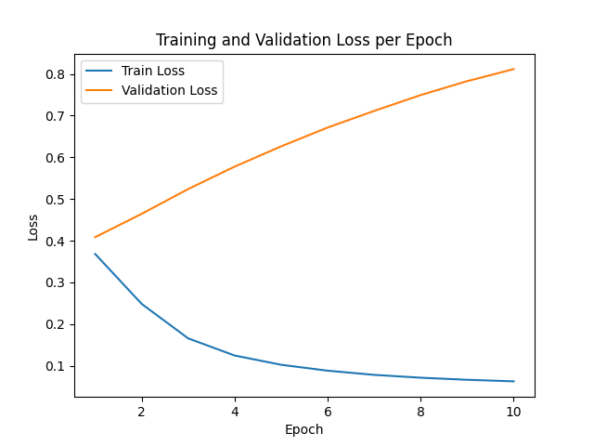




Increase parameter
Results
Still no dramatic changes
Accuracy 69%: maybe outlier
*512 → 256 → 128
*1024 → 512 → 256
*last saved
*last saved

Slide 16
Another hidden layer
Llama3.1-8B-inst
32 attention layer
Input dimension:
30th layer (4096)
24th layer (4096)
Next token embedding (4096)

Slide 17
Another hidden layer
Architecture
3 layer
SGD, AdamW
Width:
512 → 256 → 128
256 → 128 → 64
64 → 32 → 16
32 → 16 → 8
Skip connection:
12288 → last layer
Input dimension: 12288

Slide 18
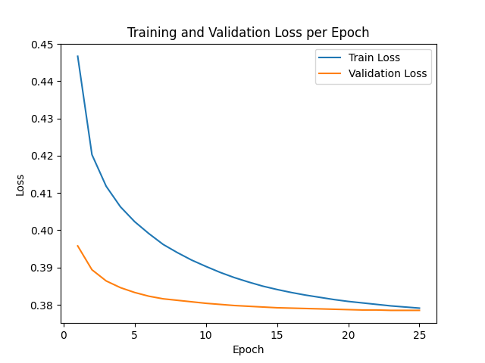


Another hidden layer
Results
Architecture
12288 → 64 → 32 → 16 → 1
12288 → 16 → 1
Optimizer
SGD
Still no changes in test set

Slide 19
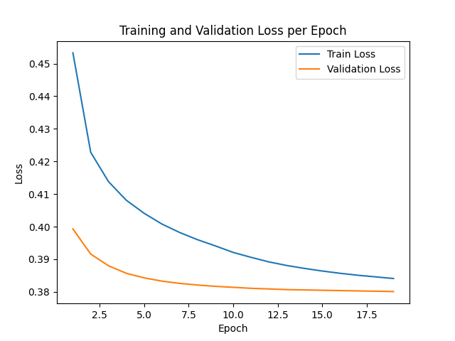

Another hidden layer
Results
Architecture
12288 → 32 → 16 → 8 → 1
12288 → 8 → 1
Optimizer
SGD

Slide 20
Discussion
Same token → low accuracy
Generalize
Increase input dimension → dataset size / parameter
Params: 789,121
Train tokens: 3,073,005 (but 7,912 win-lose set)
Another hidden layer

