Slide 1
Weekly Meeting
25.08.07
Geon Lee

Slide 2
Experiment Setting
Dataset
Alpaca Eval QA set (805)
GPT-4o-mini (w. temperature 0.7)
Llama-3.1-8B-Inst (w. temperature 1.0)x2
Llama-3.1-8B-Inst (w. greedy decoding)
*max_length = 512
Pair-wise test
GPT-4o-mini (w. greedy decoding)

Slide 3
Experiment Setting
Dataset
Total:
1416 pair-wise dataset
858 train / 284 valid / 284 test

Slide 4
Experiment Setting
Preprocess
Delete cycle (a>b>c>a)
Get two dataset for each query (a>b, a>c)
Response token → get final last hidden layer for each token(R⁴⁰⁹⁶)
Next token embedding* → (R⁴⁰⁹⁶)

Slide 5
Experiment Setting
Input Format
JSONL row
{ "q": prompt, "win": preferred answer, "lose": dispreferred answer }
Token limits : q ≤ 128 tokens, win/lose ≤ 512 tokens
For each time-step t (1…512)
sequence = (q_ids + answer_ids[:t+1])[-512:]
Loss : BCEWithLogits( s_win − s_lose , 1 )
Accuracy : mean( s_win > s_lose )

Slide 6
Experiment Setting
Hyper-Parameters
Optimizer: AdamW
Learning rate: 1 × 10⁻⁴
Weight decay: 1 × 10⁻⁴
Epochs: 32
Max sequence length: unlimited
Dropout: 0.25
Hidden width: 2, 4, 8, 16, 32
Input dimension: 4096 (only hidden layer)

Slide 7
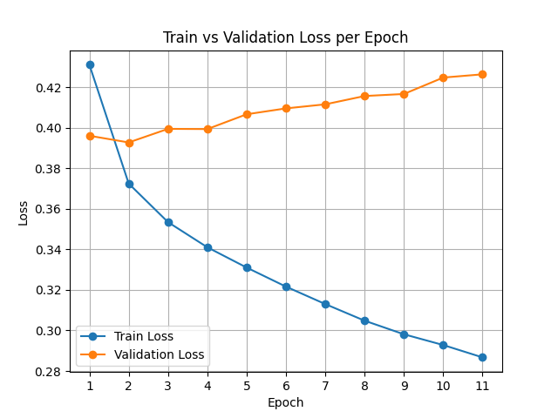
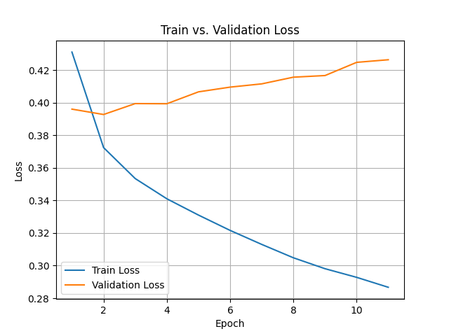
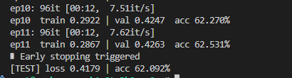
Experiment Setting
Results
Not generalizing
Overfitting detected
Similar pattern regardless of width
Accuracy ≈ 62%

Slide 8
Experiment Setting
Hyper-Parameters
Optimizer: AdamW, SGD
Momentum: 0.9(SGD)
Learning rate: 1 × 10⁻⁴
Weight decay: 1 × 10⁻⁴
Epochs: 32
Max sequence length: unlimited
Dropout: 0.25
Hidden width: 1, 2, 4, 8, 16, 32
Input dimension: 8192 (hidden layer + embedding)

Slide 9
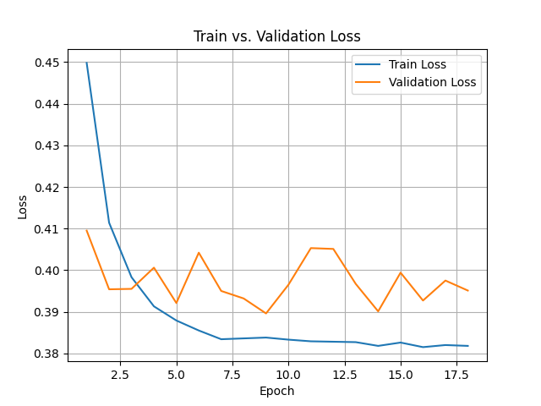
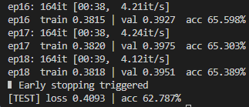
Experiment Setting
Results(AdamW)
Not generalizing
Overfitting detected
Similar pattern regardless of width
Accuracy ≈ 62%

Slide 10
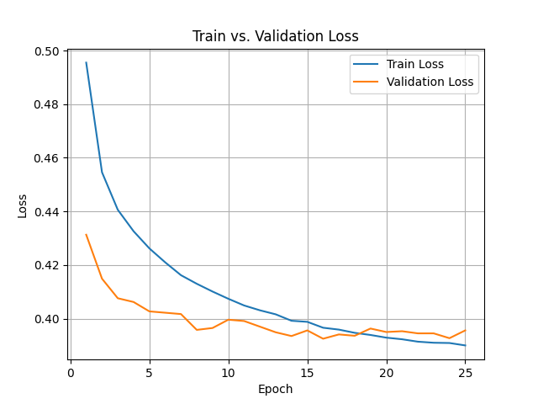
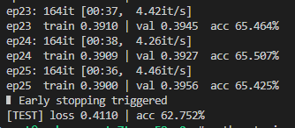
Experiment Setting
Results(SGD, width=1)
Not generalizing
Overfitting detected
Similar pattern regardless of width
Accuracy ≈ 62%

Slide 11
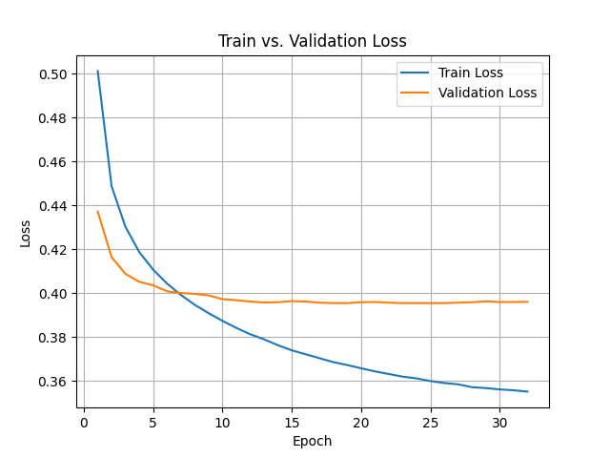
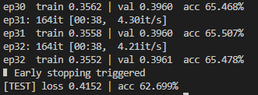
Experiment Setting
Results(SGD, width=8)
Not generalizing
Overfitting detected
Similar pattern regardless of width
Accuracy ≈ 62%

Slide 12
TODO
Discussion
Increased accuracy: data preprocessing
Increasing dataset size
Other loss function
Generation & pair-wise test
Generate w. trained model
Pair-wise test w. greedy decoding response

