Slide 1
PROGRESS PRESENTATION 2 · DATA & EDA
Building & Exploring the Dataset
Seven official Eurostat series → one clean, leakage-free quarterly panel
78 supervised quarters · 20 features · 2005Q1 – 2025Q4 (HPI is the binding constraint)

Slide 2

The dataset at a glance
78
20
7
supervised quarters
engineered features
official source series
2005–25
23
0
quarterly window
out-of-sample test quarters
target gaps after cleaning
The official German House Price Index begins only in 2005Q1, which sets the sample. The window spans the low-rate boom, COVID, and the 2022–23 rate-shock correction — a demanding test period.
German Housing & Rents · Data & EDA
2

Slide 3

Cleaning & missing-value treatment
Resample to quarters
Forward-fill macro only
Monthly series → quarterly mean; population interpolated
Slow prints (population, rates) carried at most one step
Trim to common window
Never impute targets
Keep quarters where every input exists (HPI from 2005)
House price and rent series left untouched
Derive YoY inflation & growth
Integrity asserts
From HICP and population before trimming
Pipeline fails loudly if any target gap remains
German Housing & Rents · Data & EDA
3

Slide 4

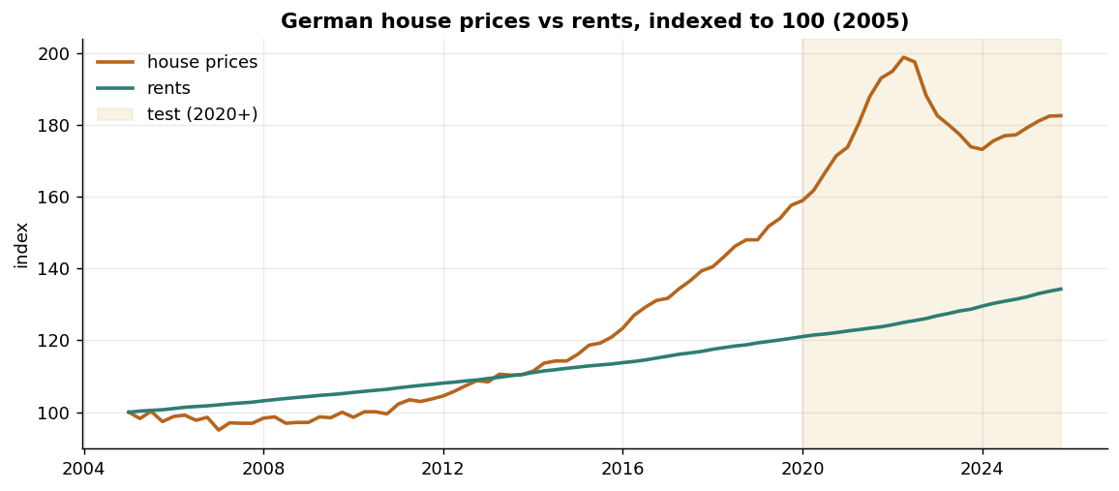
Prices boom & correct; rents drift
What we see
2010–22 price boom
2022 peak
Sharp 2022–23 correction
Rents rise smoothly throughout
Two market segments, two completely different dynamics
4

Slide 5

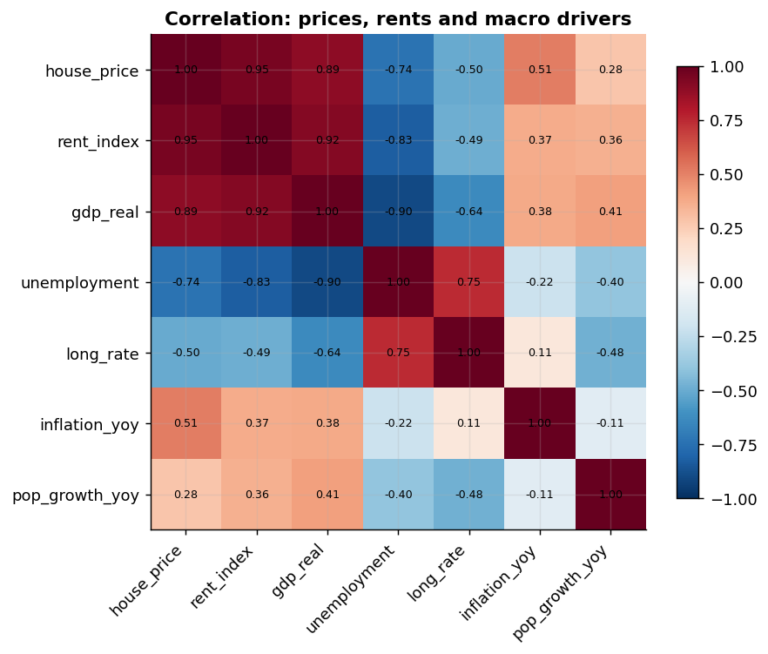
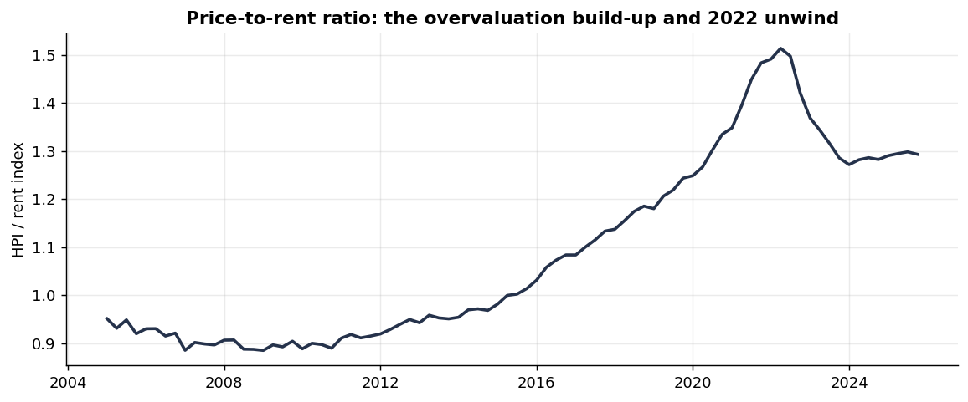
Correlations & valuation
Drivers correlation
Price-to-rent ratio
The price-to-rent ratio shows the overvaluation build-up and its 2022 unwind
5

Slide 6
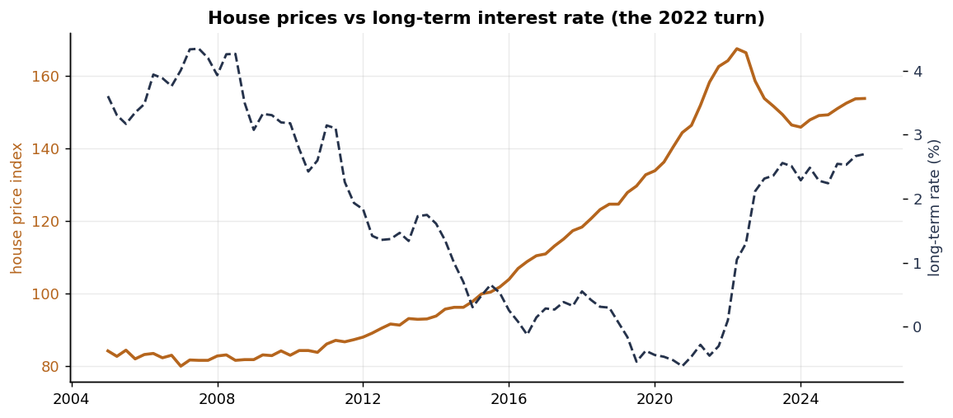
The interest-rate driver
Key signal
As the long-term rate fell toward zero, prices boomed. The 2022 rate spike marks the peak and correction — the relationship the models exploit.
German Housing & Rents · Data & EDA
6

Slide 7

CHALLENGES & NEXT STEPS
What to watch going into modelling
Small sample
Only 78 quarters; 20 features invite overfitting — regularise hard
Strong baseline
Quarterly index levels are close to a random walk
Degenerate rents
Rents rose every quarter — direction is trivial
National scope
District dynamics need commercial micro-data

