Slide 1
PROGRESS PRESENTATION 3 · RESULTS
Model Results & Critical Evaluation
ML beats the random walk for prices — but the margin is small and the sample tiny
Out-of-sample test: 23 quarters, 2020Q1 – 2025Q3

Slide 2

Models tested & methodology
Five model families per target on a strictly chronological split — train ≤ 2019Q4, test ≥ 2020Q1. No shuffling; ARIMA refit one step at a time.
Naive random walk
Linear Regression
Ridge
Random Forest
XGBoost
ARIMA
Quarter-t features only
Targets built last
Lags shift forward; rolling windows end at t
Next-quarter return via shift(-1)
Chronological split
Walk-forward ARIMA
No random shuffling of a time series
Refit each step; never fit on the future
Leakage controls are the backbone of a defensible result
2

Slide 3

House-price out-of-sample results
Model | MAE | RMSE | MAPE | R-sq | Dir. acc
XGBoost | 2.22 | 3.08 | 1.45% | 0.841 | 0.70
Random Forest | 2.34 | 3.29 | 1.52% | 0.819 | 0.70
Linear Regression | 2.53 | 3.38 | 1.65% | 0.810 | 0.74
Ridge | 2.53 | 3.58 | 1.65% | 0.786 | 0.70
Naive (random walk) | 2.74 | 3.37 | 1.80% | 0.810 | —
ARIMA (walk-forward) | 4.12 | 5.61 | 2.70% | 0.474 | —
Every ML/linear model beats the naive random walk — interest-rate and labour features let them anticipate the 2022 correction. A real but fragile edge (23 test points).
German Housing & Rents · Results
3

Slide 4

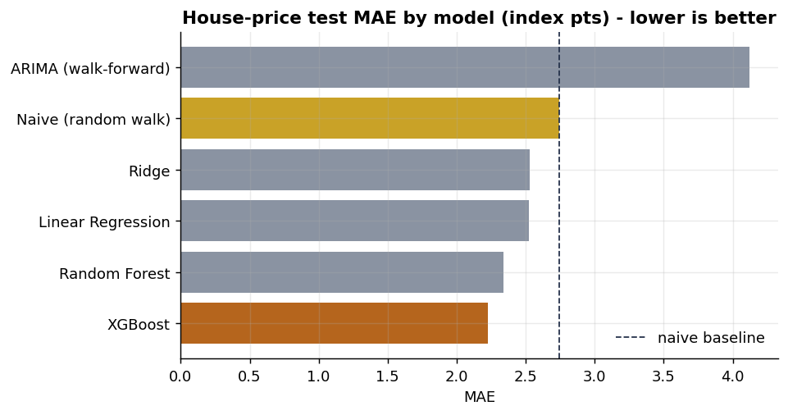
Beating the baseline (this time)
2.22
XGBoost MAE (index pts)
≈ 19% below the random walk's 2.74. Unusual for asset prices — the rate shock was partly legible.
Only ARIMA loses to persistence; all ML/linear models beat it here
4

Slide 5
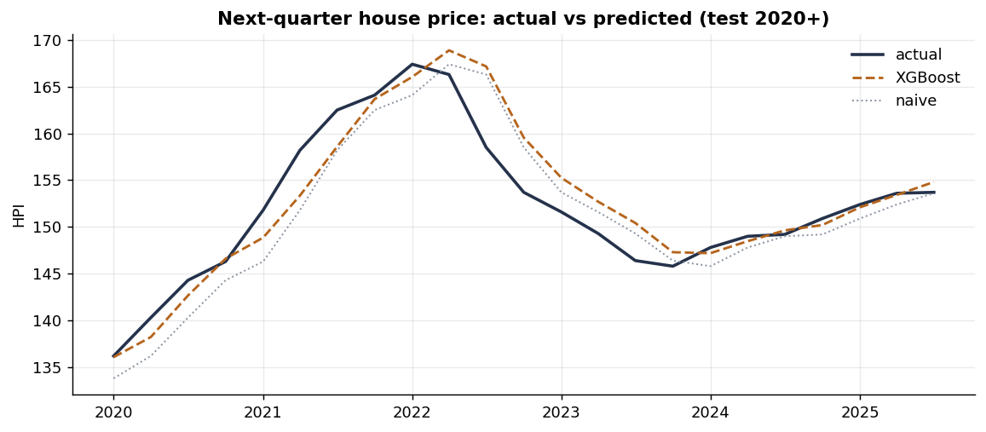
Forecast vs reality (house prices)
XGBoost tracks the 2022 peak and correction more closely than the naive forecast, which always lags the turn by one quarter — the source of its edge.
German Housing & Rents · Results
5

Slide 6

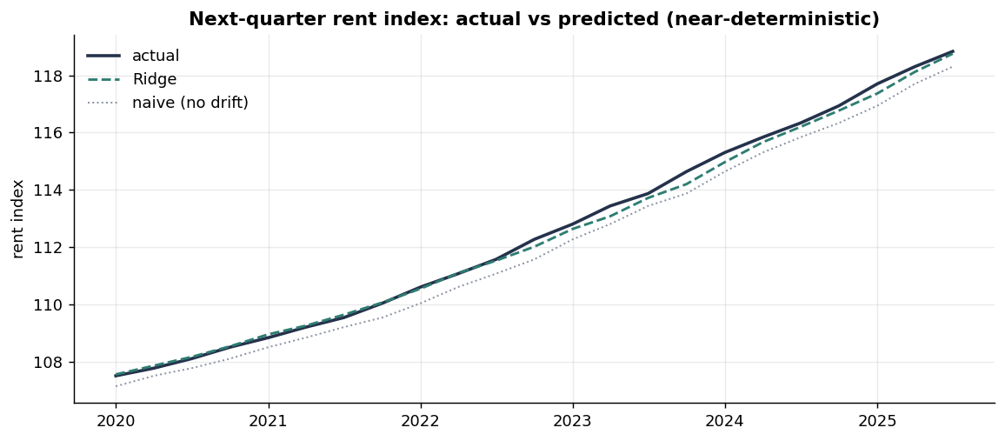
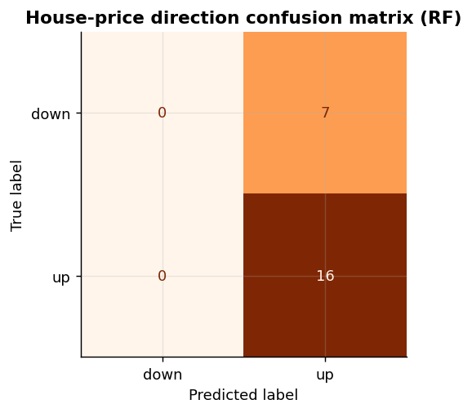
The two segments diverge
Rents: near-deterministic
Prices: direction is hard
Rents rose every quarter → R-sq ≈ 0.997, direction trivial
No model beats the naive 'always up' (0.70)
Segmentation that the data supports: prices vs rents behave nothing alike
6

Slide 7

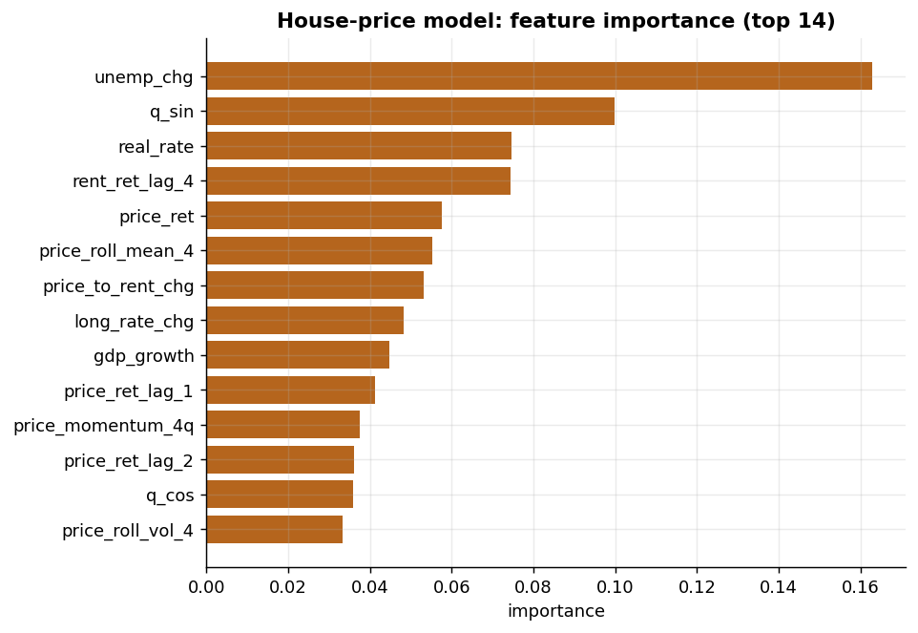
What drives house prices
Top drivers
Unemployment change
Real interest rate
Recent price momentum
Long-rate change
Price-to-rent change
Rate and labour-market variables carry most of the signal
7

Slide 8
CRITICAL EVALUATION & REPORT PLAN
Read the result with appropriate humility
LIMITATIONS
NEXT
Small sample (78 q); 20 features overfit-prone
One unusual rate-shock test window
National only; districts need micro-data
Permits / transport left as extensions
Rolling-origin evaluation
Diebold–Mariano significance test
Add a licensed city panel via the hook
Under-3000-word report, Harvard refs

