Slide 1
Two-peak Localization && Defects and Disorders
Wang Kun
3/15/2016

Slide 2
Two-peak Localization

Slide 3
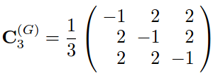
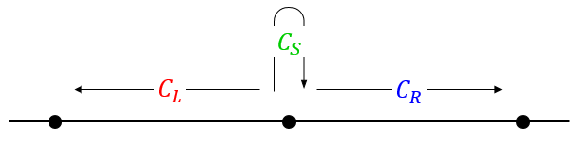
Localization in 3-state quantum walks
Configuration
Walker state: |0>
Coin state: |R>
Coin operator: Grover operator

Slide 4
Conclusions on the localization probabilities
Localization probability at 0
0.202 - PhysRevA.90.012307, 2014
Probabilities at other positions
exponentially decay with the distance from the origin - PhysRevA.90.012342, 2014
My observation: The “exponentially decay” does not hold for all cases!

Slide 5
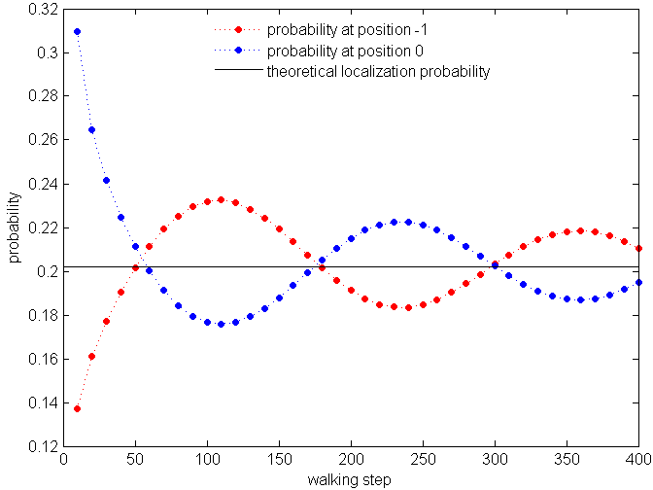
My observations - Two-peak localization
Probabilities at position -1 and 0 for different walking steps
Probability at position -1
Theoretical localization probability
Probability at position 0

Slide 6
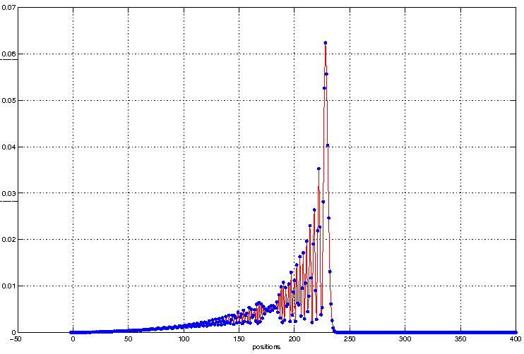
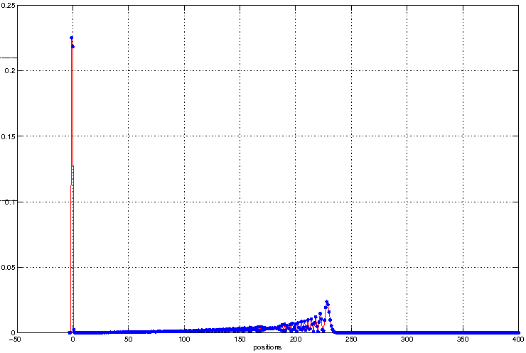
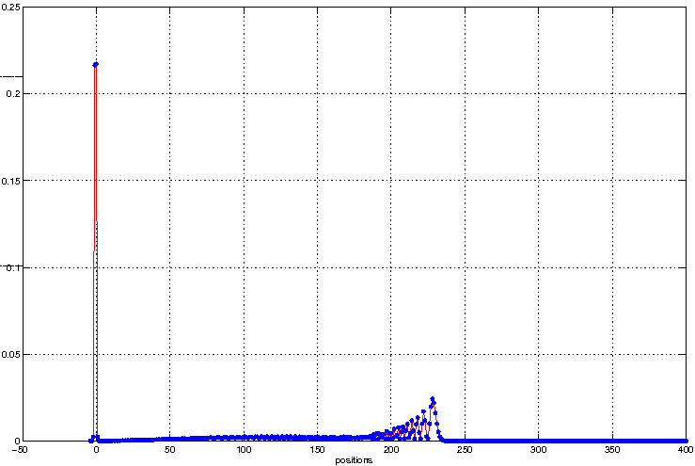
3-state quantum walk with one boundary
boundary: -1
absorbing probability: 0.6693
position -1: 0.0
position 0: 0.0
boundary: -2
absorbing probability: 0.0941
position -1: 0.2253
position 0: 0.2185
boundary: -3
absorbing probability: 0.0685
position -1: 0.2164
position 0: 0.2173

Slide 7
Evolutions of different 3-state quantum walks
Grover walk with no boundary
Grover walk with one boundary at -2

Slide 8
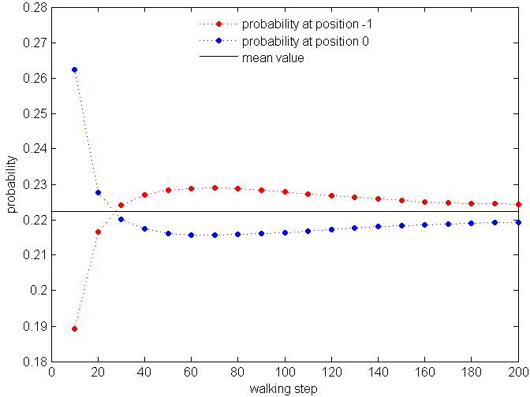
Two-peak localization in the one boundary case
The boundary is at -2
Probabilities at position -1 and 0 for different walking steps
Probability at position -1
Mean value
Probability at position 0

Slide 9
My questions
How is the localization generated in 3-state quantum walks on earth?
Two-peak localization in 3-state quantum walks with no boundary, with one boundary and with two boundaries

Slide 10
Defects and Disorders

Slide 11

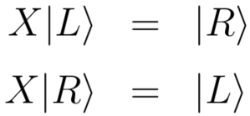


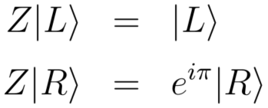
Different evolutions
Hadamard evolution
Bit-flip evolution: defect, or node percolation, or reflection
Phase-flip evolution: disorder

Slide 12

Defect model and disorder model
Bit-flip evolution
Quantum walk with percolation
Hadamard evolution
Quantum walk what?
Quantum walk with disorders
Phase-flip evolution

Slide 13
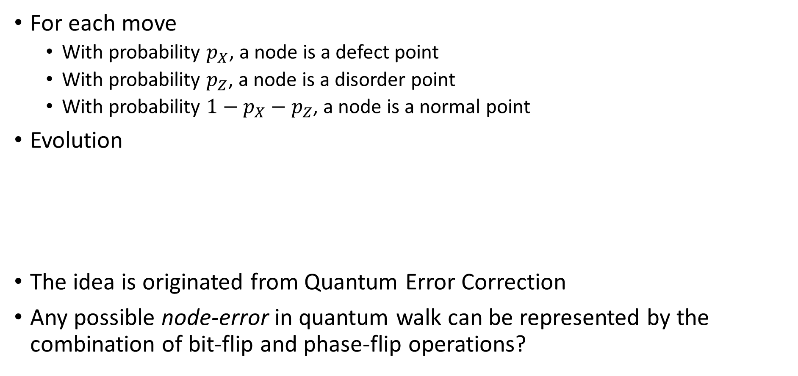
Combine bit-flip and phase-flip operations
For each move
With probability $p_{X}$, a node is a defect point
With probability $p_{Z}$, a node is a disorder point
With probability $1−p_{X}−p_{Z}$, a node is a normal point
Evolution
The idea is originated from Quantum Error Correction
Any possible node-error in quantum walk can be represented by the combination of bit-flip and phase-flip operations?
Hadamard evolution
Bit-flip evolution
Phase-flip evolution

Slide 14
My questions
Is the evolution correctly formalized?
Can this model shed light on any physical phenomenon?
Any possible node-error in quantum walk be represented by the combination of bit-flip and phase-flip operations
Hadamard evolution
Bit-flip evolution
Phase-flip evolution

Slide 15
Thank you!

