Slide 1
Quantum Walk with Restart
Wang Kun
Department of Computer Science and Technology
12/2/2015

Slide 2
Motivation
Should we recommend Alice to Bob?
YES if Alice and Bob are close enough
How to measure closeness/proximity?
Alice
i
i
Bob
i

Slide 3
Closeness measure
Two nodes should be close, if they have
many, short, heavy paths.
Random walk with restart (RWR) is a good measure
…

Slide 4
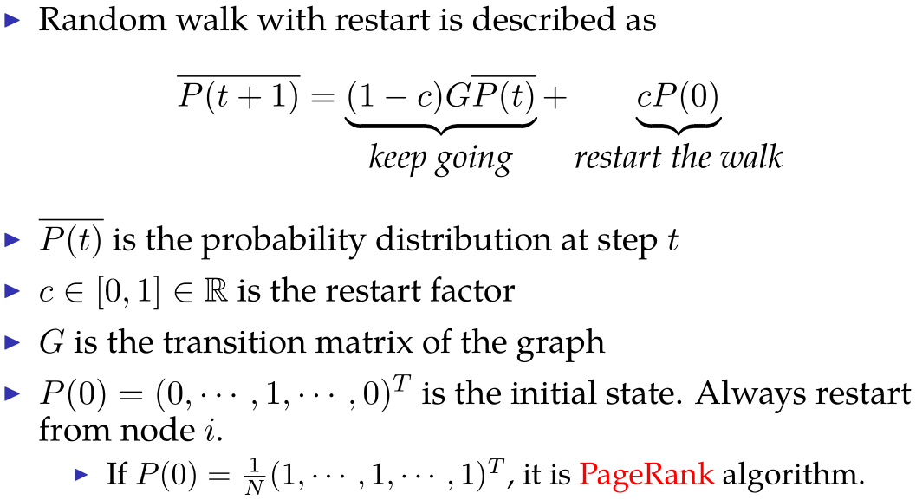
Random walk with restart

Slide 5



An example
10
9
12
2
1
8
3
11
4
6
5
7

Slide 6
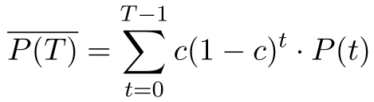




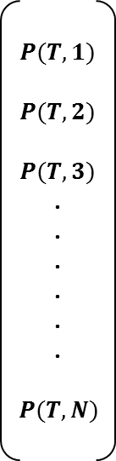
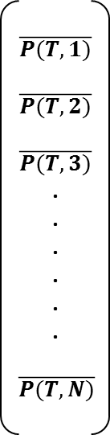


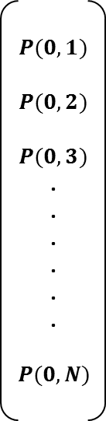
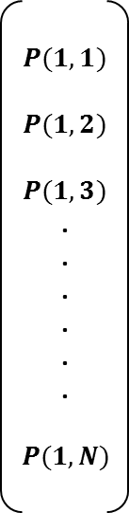

Random walk with restart (cont.)
Weighted sum of probabilities
$$\overline{P(T,1)}$$
$$\overline{P(T,2)}$$
$$\overline{P(T,3)}$$
.
.
.
.
.
.
$$\overline{P(T,N)}$$
$$P(0,1)$$
$$P(0,2)$$
$$P(0,3)$$
.
.
.
.
.
.
$$P(0,N)$$
$$P(1,1)$$
$$P(1,2)$$
$$P(1,3)$$
.
.
.
.
.
.
$$P(1,N)$$
$$P(T,1)$$
$$P(T,2)$$
$$P(T,3)$$
.
.
.
.
.
.
$$P(T,N)$$
$$c$$
$$c(1−c)$$
$$c{(1−c)}^{T−1}$$
· · · · · ·
limit
distribution
random walk after 0 step
random walk after 1 step
random walk after T steps

Slide 7
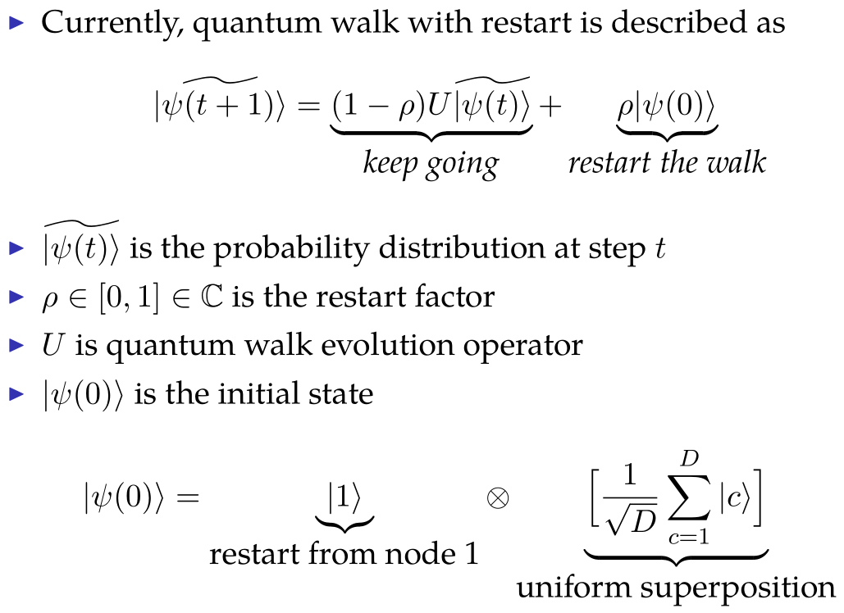
Quantum walk with restart

Slide 8
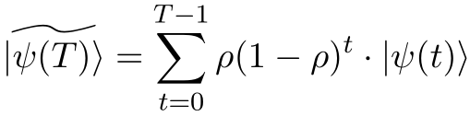





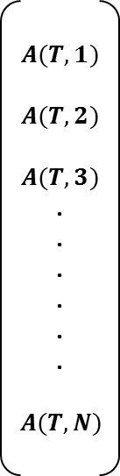
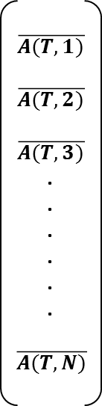


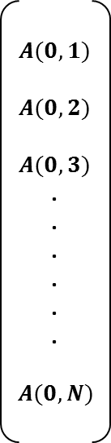
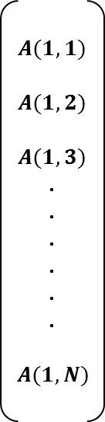
Quantum walk with restart
Weighted sum of probability amplitudes
$$\overline{A(T,1)}$$
$$\overline{A(T,2)}$$
$$\overline{A(T,3)}$$
.
.
.
.
.
.
$$\overline{A(T,N)}$$
$$A(0,1)$$
$$A(0,2)$$
$$A(0,3)$$
.
.
.
.
.
.
$$A(0,N)$$
$$A(1,1)$$
$$A(1,2)$$
$$A(1,3)$$
.
.
.
.
.
.
$$A(1,N)$$
$$A(T,1)$$
$$A(T,2)$$
$$A(T,3)$$
.
.
.
.
.
.
$$A(T,N)$$
$$ρ$$
$$ρ(1−ρ)$$
$$ρ{(1−ρ)}^{T−1}$$
· · · · · ·
interference
limit
probability amplitudes
quantum walk after 0 step
quantum walk after 1 step
quantum walk after T steps

Slide 9
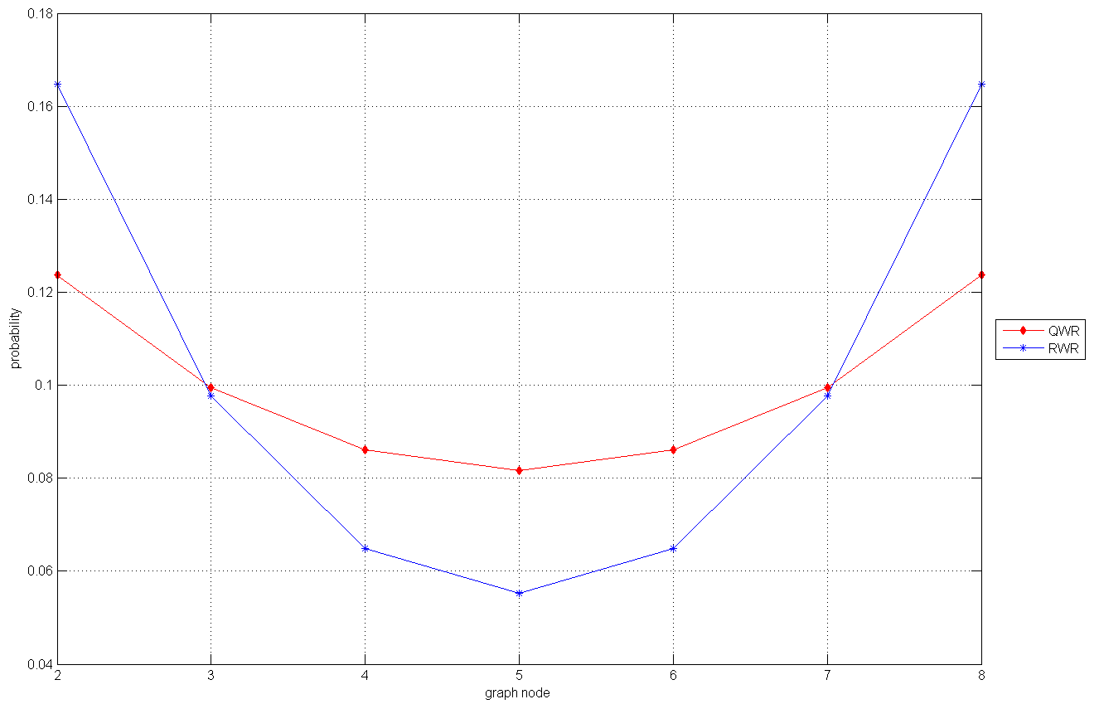
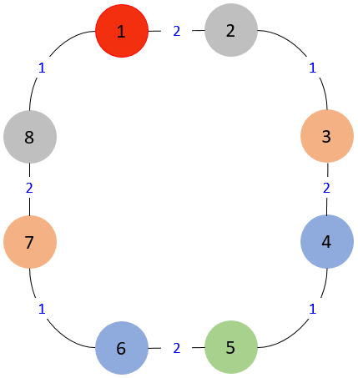
RWR/QRW on cycle

Slide 10
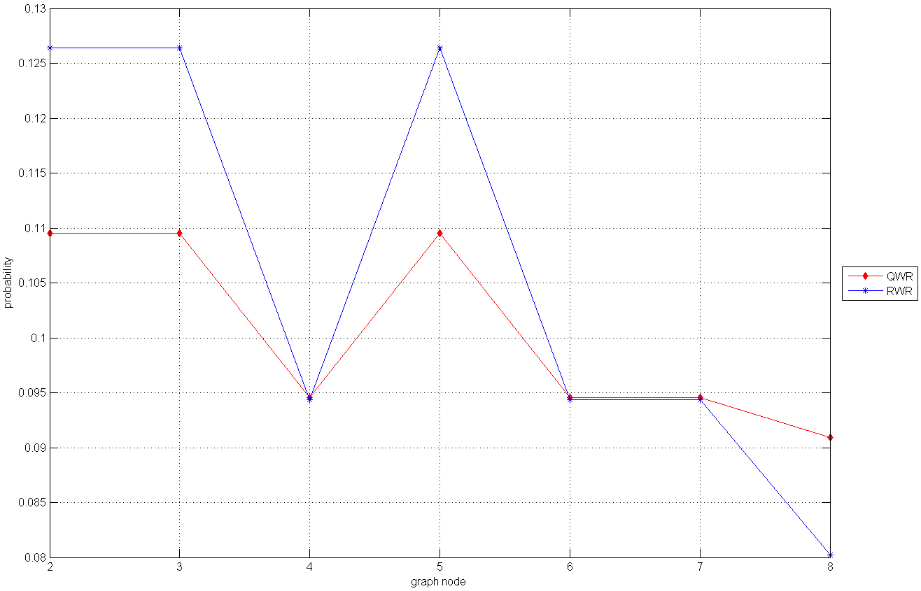
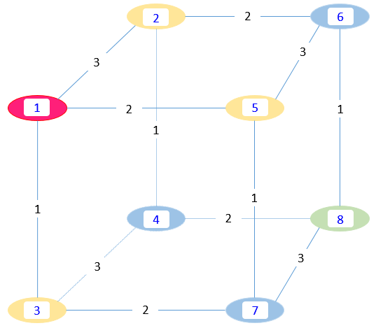
RWR/QRW on cube

Slide 11
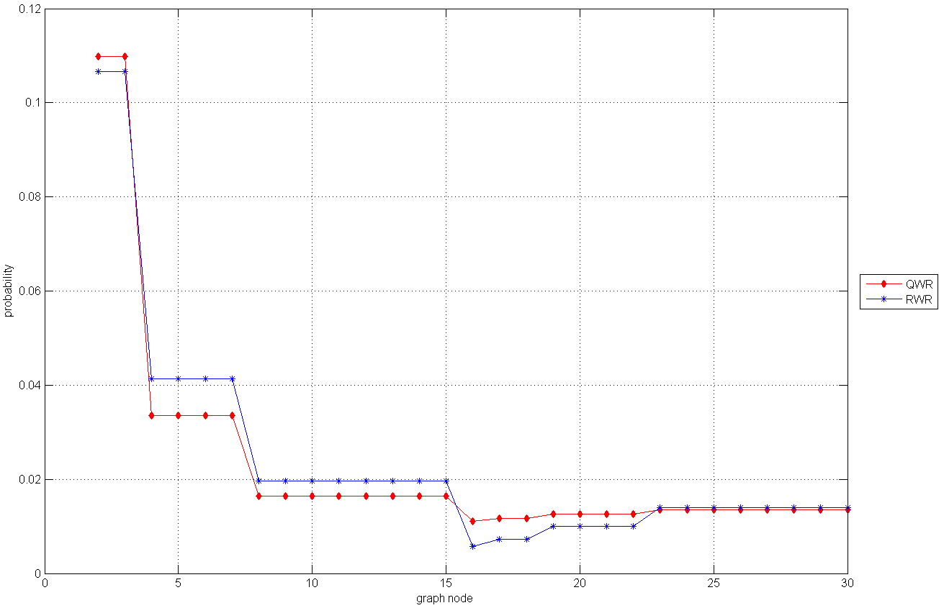
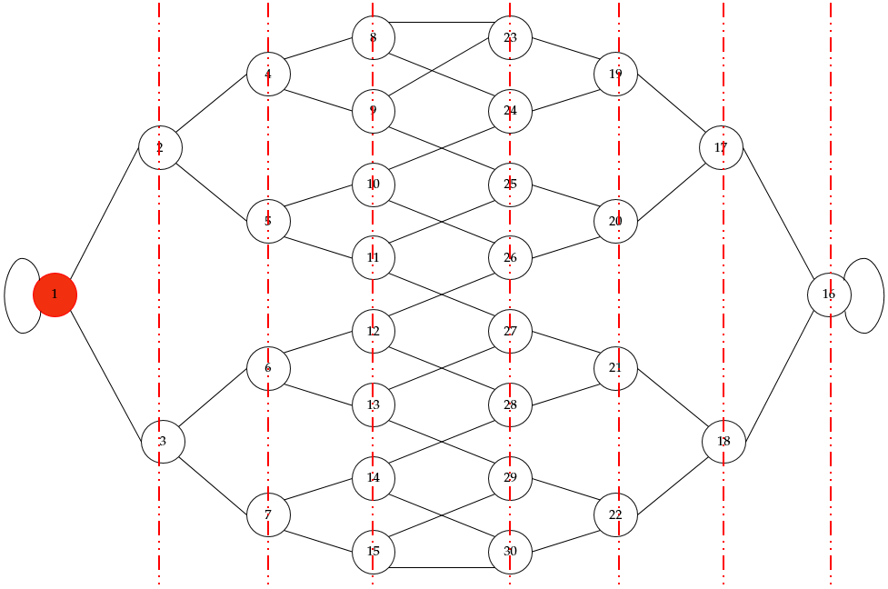
RWR/QRW on glued-tree

Slide 12
RWR V.S. QWR
They have similar distributions as proximity measure
Both can depict the hierarchy of a graph from a node’s point of view
They are different in relative proximity value
Given a node, its proximities to all other nodes in the graph are different in RWR and QRW
Which one is better as a proximity measure?
There are interferences (constructive and destructive) in QWR
Why are they still similar in the limiting distributions?

Slide 13
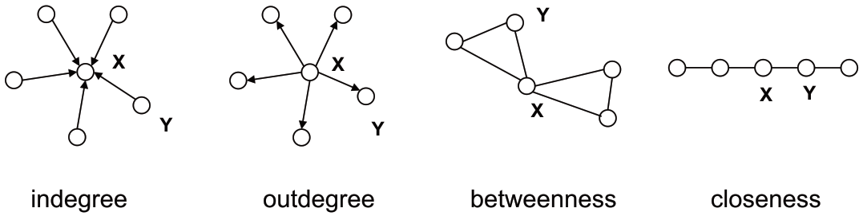
QWR and centrality
Lots of measure for graph centrality
Degree centrality, betweenness centrality, closeness centrality, etc.
QWR as a measure for graph centrality
A kind of closeness centrality (proximity between nodes)
Current definition only suits for regular undirected graph...

Slide 14
Thank you!

