Slide 1
Quantum Walk with Disorders
Wang Kun
1/14/2016

Slide 2
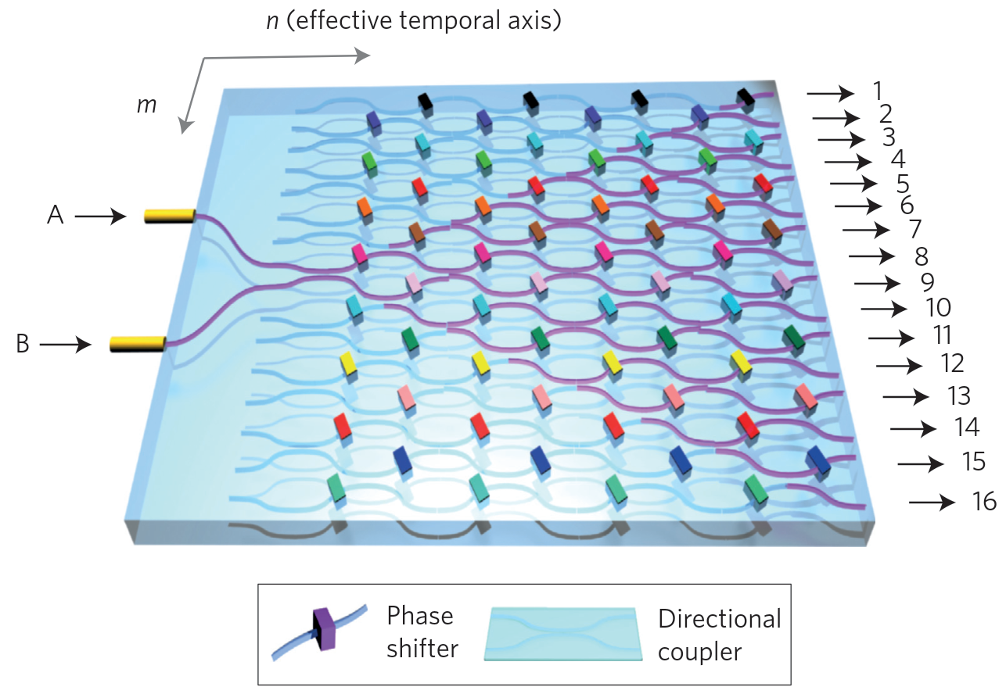
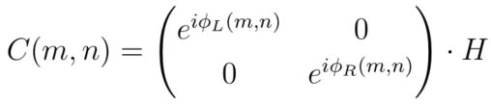
Discrete quantum walk with disorder
References:
10.1103/PhysRevLett.106.180403, 2011
10.1038/nphoton.2013.26, 2013
10.1103/PhysRevA.89.032322, 2014
Notes:
Keywords:
Optical networks.
H is the Hadamard gate.
Coin operators with disorder are still unitary.

Slide 3
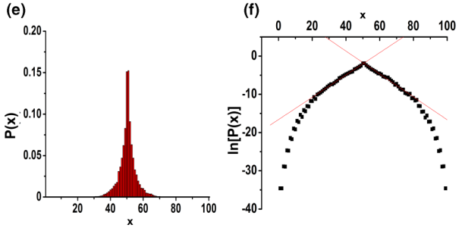

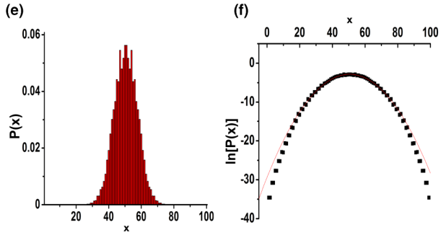

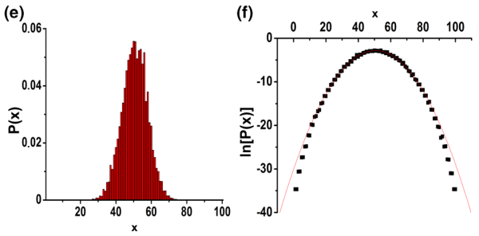
Classification of disorders
static (position-dependent)
Localization
dynamic
(time-dependent,
space correlated)
disorder
Decoherence
fluctuating
(both position and time dependent, space uncorrelated)
Decoherence
Notes:
Keywords:
In Anderson localization, probability is exponentially decay, thus Log(P(t)) is linear dependent in position.
In normal random walk, probability is not exponentially decay, Log(P(t)) is parabolic dependent in position.
Decoherence by unitary operations.
In the fluctuating model, dynamic disorders beat static disorder and result in decoherence.

Slide 4
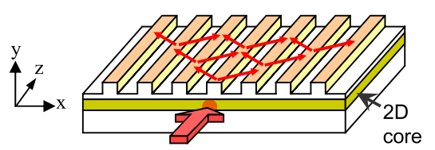
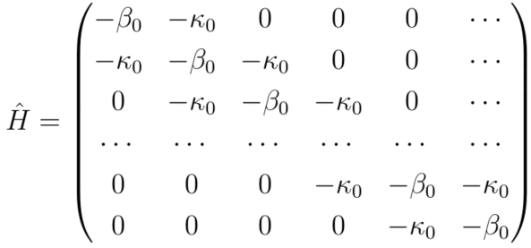
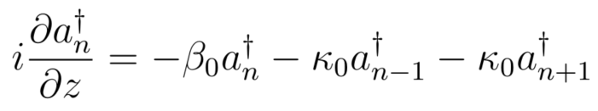

Continuous quantum walk with disorder
References:
10.1103/PhysRevLett.100.170506, 2008
10.1103/PhysRevLett.100.013906, 2008
10.1103/PhysRevLett.105.163905, 2010
10.1364/oe.19.013636, 2011
10.1103/PhysRevA.88.042334, 2013
10.1063/1.4871401, 2014
10.1103/PhysRevLett.115.133602, 2015

Slide 5

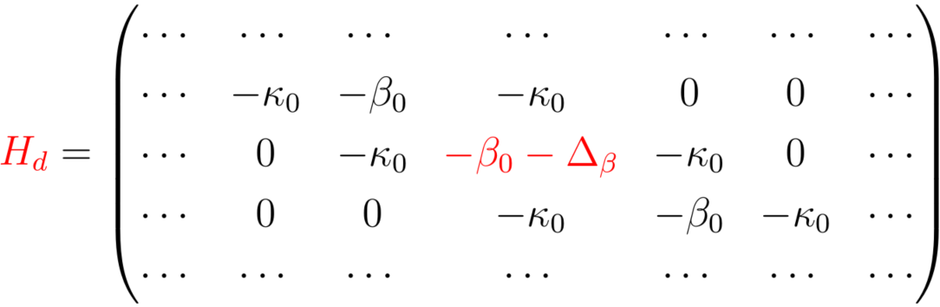
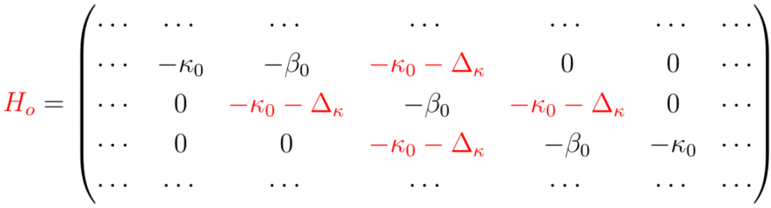
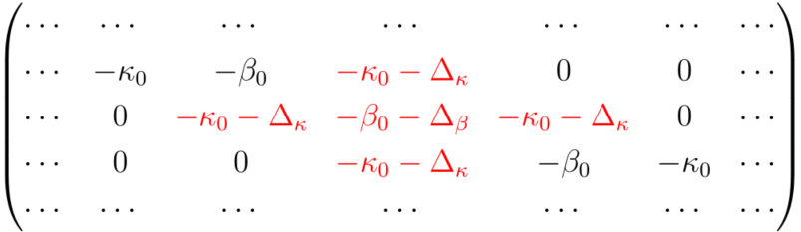
Classification of disorders
diagonal
-2
-1
0
1
2
disorder
off-diagonal
-2
-1
0
1
2
mixed?
-2
-1
0
1
2

Slide 6
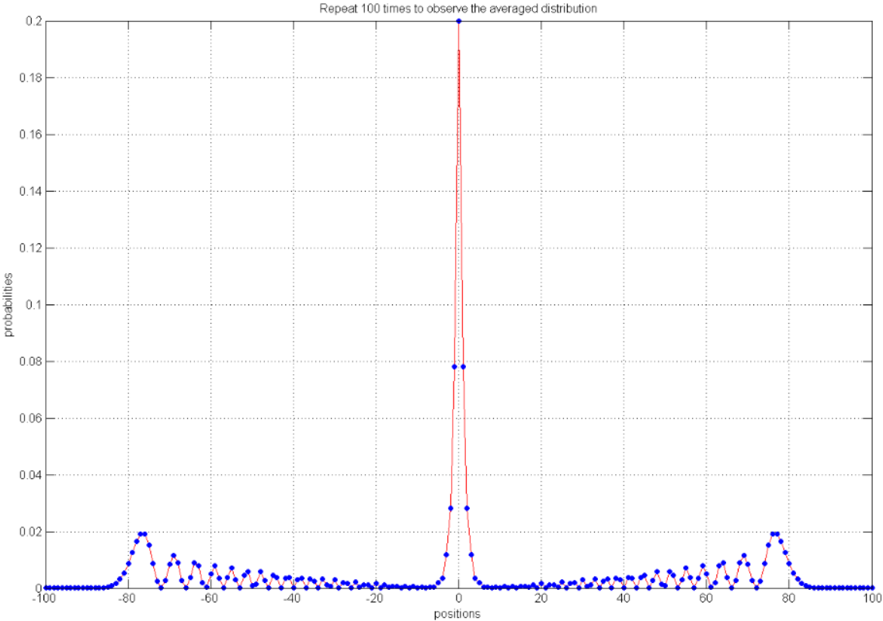


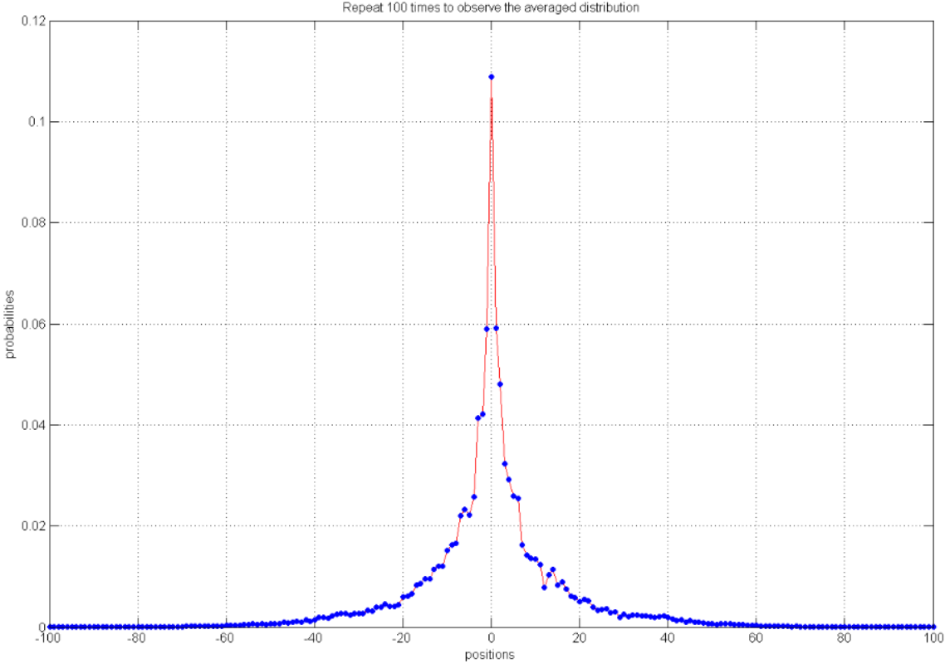

Diagonal disorders
repulsive
Indistinguishable between these two effects, only attractive case is studied
single-point
point 0
diagonal
disorder
attractive
multi-points
mixed

Slide 7
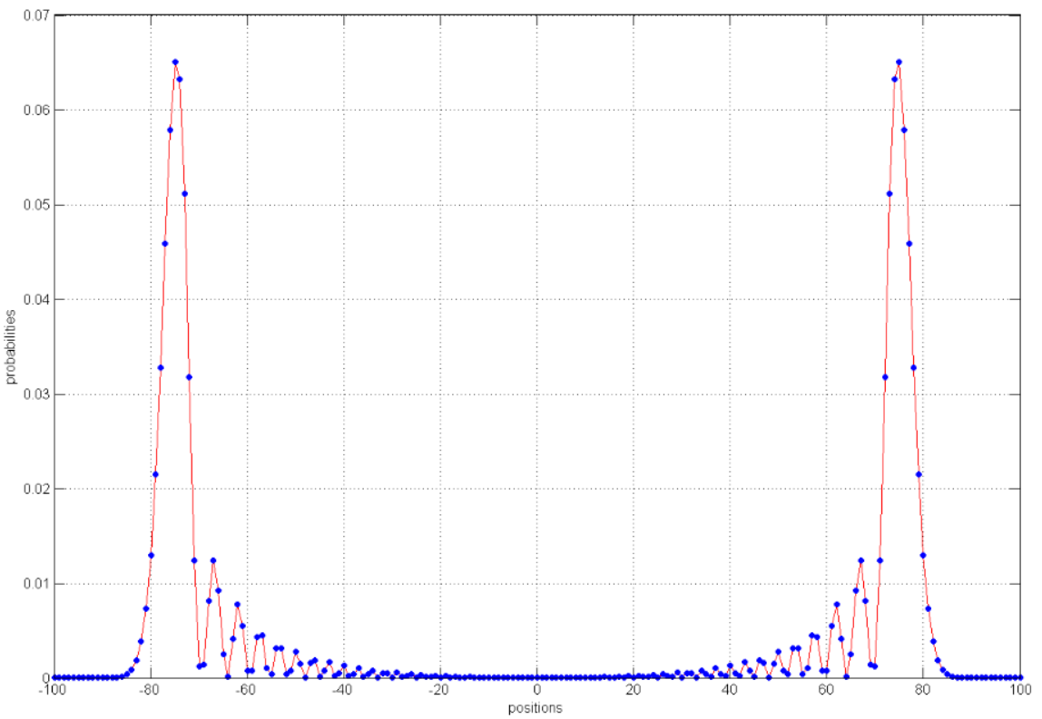
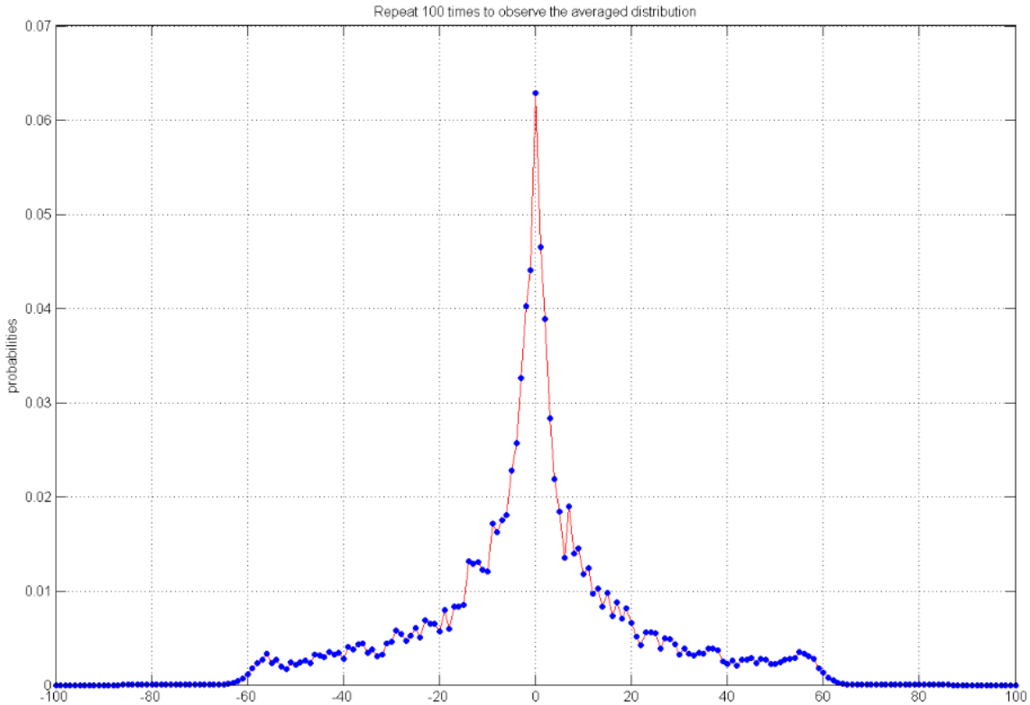

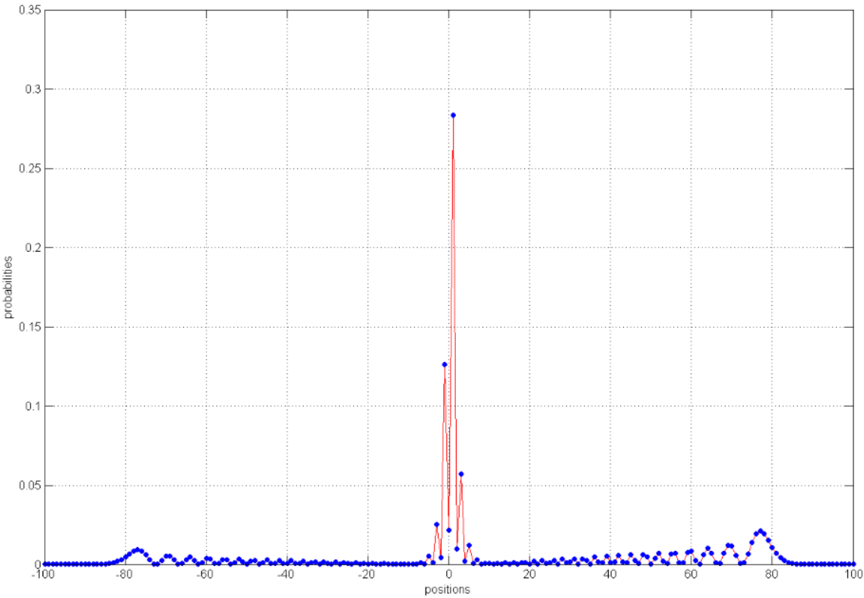

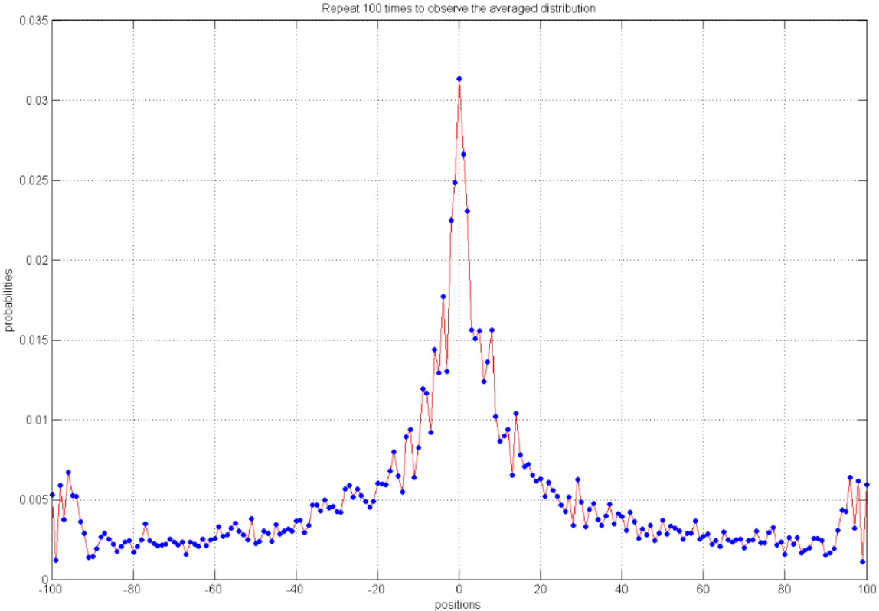
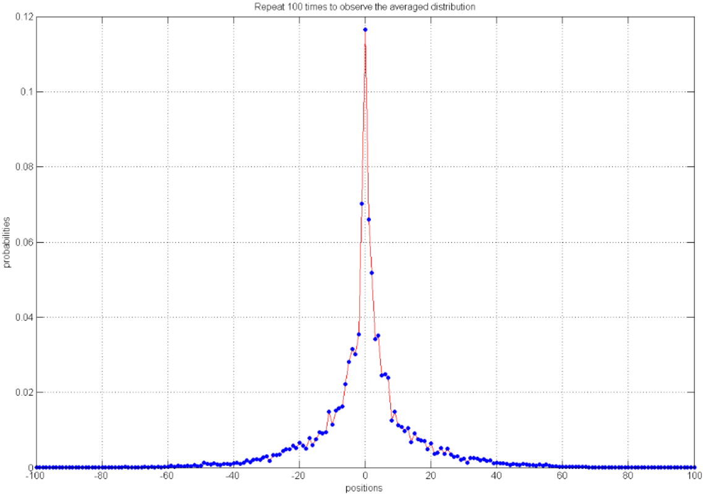

Off-diagonal disorders
single-point
point 0
repulsive
0.0628
multi-points
single-point
point 0
off-diagonal
disorder
attractive
0.0296
multi-points
0.1228
mixed
Notes:
Keywords:
The sum of two models (repulsive, attractive) enhanced the Anderson localization.

Slide 8
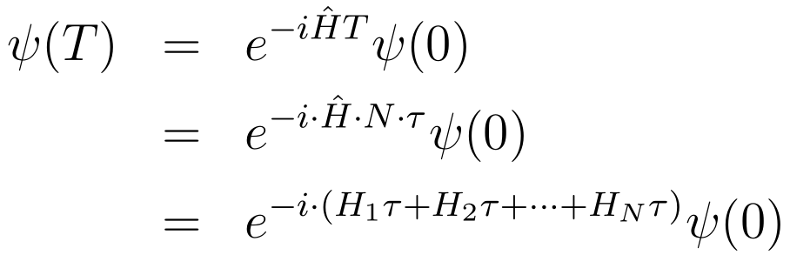
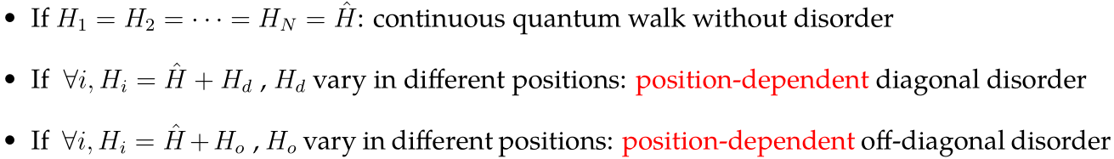
Formalization
Nτ
HN
...
...
...
...
3τ
H3
2τ
time
H2
τ
H1
0
-2
-1
0
1
2
position
Localization

Slide 9

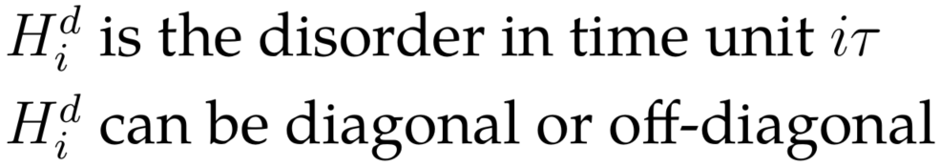
Time-dependent disorders
The disorders are randomly generated in each unit time, but is position independent
Nτ
HN
...
...
...
...
3τ
H3
2τ
time
H2
τ
Decoherence?
H1
0
...
...
-2
-1
0
1
2
position

Slide 10

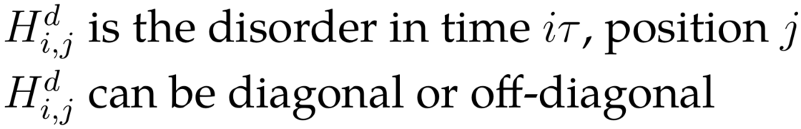
Fluctuating disorders
The disorders are randomly generated:
In each position and
In each unit time
Nτ
HN
...
...
...
...
3τ
H3
2τ
time
H2
τ
Decoherence?
H1
0
...
...
-2
-1
0
1
2
position

Slide 11
Beyond one dimension and one particle
Discrete (optical network)
One dimension, one particle
Continuous (waveguide)
One dimension, one particle
One dimension, two particles
Two dimension, one particle
Two dimension, two particles
One dimension, two particles
Two dimension, one particle
Two dimension, two particles
attractive/repulsive disorders, single-point disorders
time-dependent disorder, fluctuating disorder
what’s left?
10.1038/nature05623, 2007
10.1103/PhysRevA.84.041807, 2011

Slide 12
Thank you!

