Slide 1

Quantum Walk
Name: WANG Kun
Email: nju.wangkun@gmail.com
Date: December 5, 2013

Slide 2
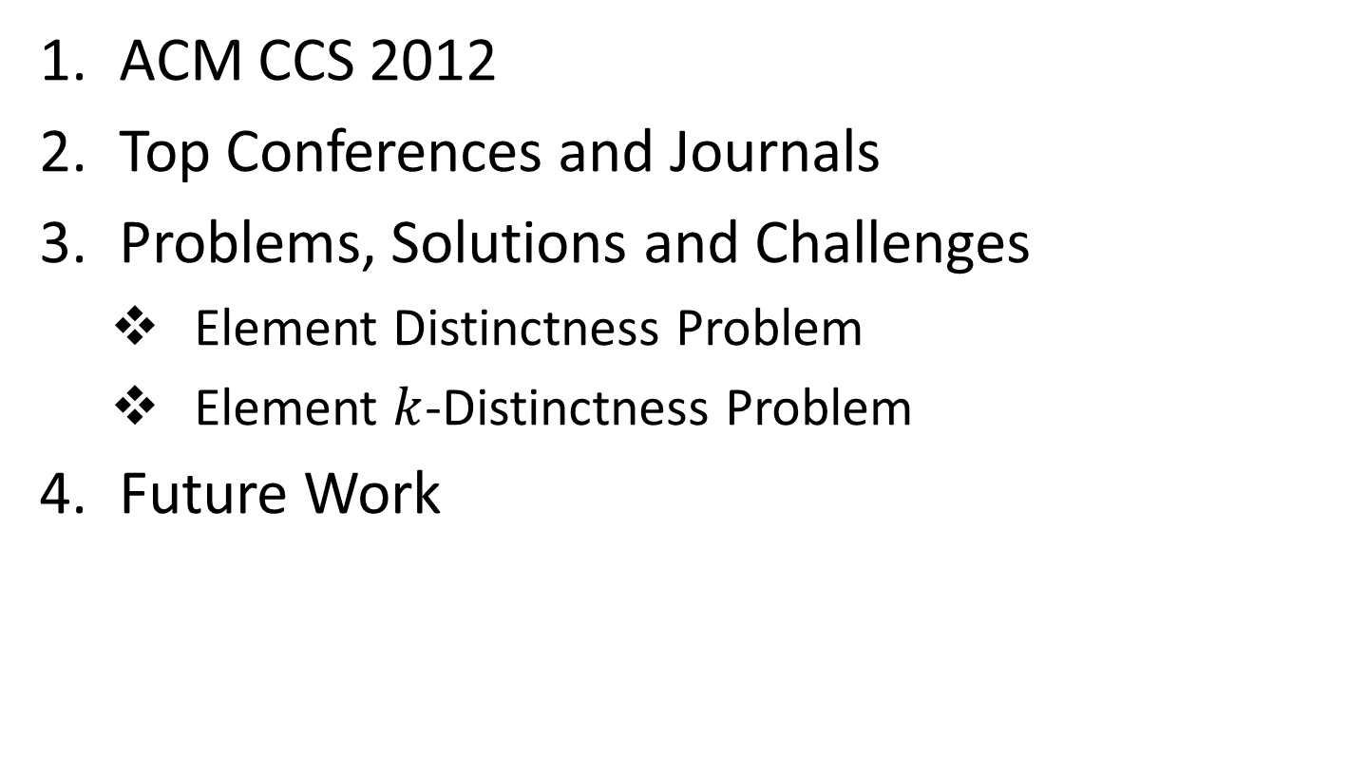
Outline
ACM CCS 2012
Top Conferences and Journals
Problems, Solutions and Challenges
Element Distinctness Problem
Element $k$-Distinctness Problem
Future Work

Slide 3
ACM CCS 2012
Theory of computation
Models of Computation
Quantum Computation Theory
Quantum Walk
Computational Complexity and Cryptography
Quantum Complexity Theory
Hardware
Emerging Technologies
Quantum Technologies
Computer Systems Organization
Architectures
Quantum Computing

Slide 4
Top Conferences
Top Conferences
STOC (ACM Symposium on Theory of Computing)
FOCS (Symposium on Foundations of Computer Science)
LICS (IEEE Symposium on Logic in Computer Science)
SODA (ACM-SIAM Symposium on Discrete Algorithms)
CCC (IEEE Conference on Computational Complexity)
Popular Conferences
AQIS (Asian Quantum Information Science Conference)
ICQFT (International Conference on Quantum Foundation and Technology)
QIP (Quantum Information Processing)
QCMC (Quantum Communication, Measurement and Computing)

Slide 5
Top Journals
Top Journals
IANDC (Information and Computation)
SICOPM (SIAM Journal on Computing)
Algorithmica
Computational Complexity
PRL (Physical Review Letters), PRA (Physical Review A), PRB (Physical Review B), ……
Popular Journals
QIC (Quantum Information and Computation)
IJQI (International Journal of Quantum Information)
Quantum Physics

Slide 6
Where is Quantum Walk
STOC 2014
algorithms and data structures
computational complexity
algorithmic coding theory
algorithmic graph theory
approximation algorithms
computational geometry
computational learning theory
quantum computing
randomness in computing
information retrieval
databases
……
AQIS 2014
Quantum computation, algorithms and complexity
Quantum information theory
Quantum decoherence fighting concepts, methods and tools
Quantum cryptography
Quantum communications experiments and theory
Quantum technologies
Quantum processor and computer design
Quantum programming languages and semantics
…...

Slide 7
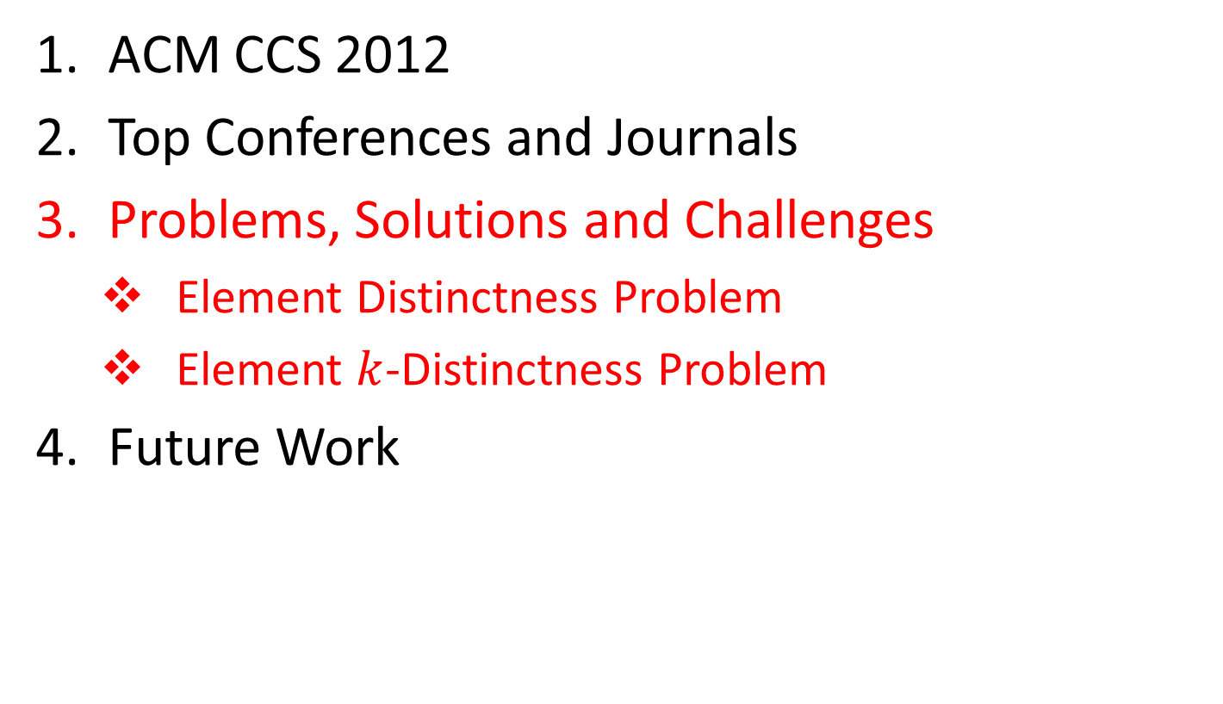
Outline
ACM CCS 2012
Top Conferences and Journals
Problems, Solutions and Challenges
Element Distinctness Problem
Element $k$-Distinctness Problem
Future Work

Slide 8

Element Distinctness Problem
Comparison-based model
Only comparisons between elements are allowed
Complexity measure is the number of comparisons
Classical comparisons
GKadHS@STOC’96
Notes:
Given a list of numbers x0, x1, …, xn in [M], are they all distinct?

Slide 9





Solution
complexity
1999
2001
2002
2004
2007
year

Slide 10
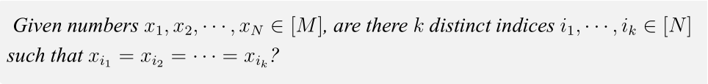
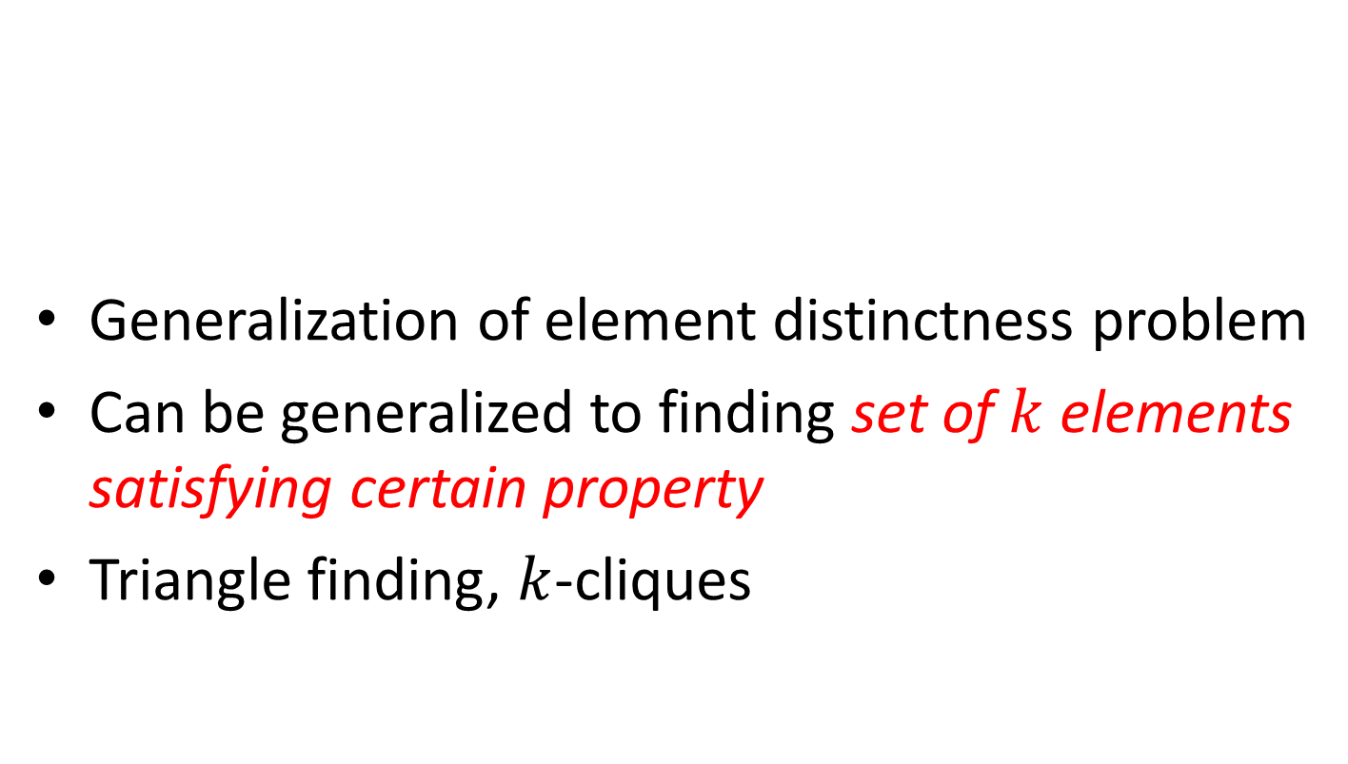

Element $k$-Distinctness Problem
Generalization of element distinctness problem
Can be generalized to finding set of $k$ elements satisfying certain property
Triangle finding, $k$-cliques

Slide 11



Current Solution
complexity
2007
2012
year

Slide 12

Challenges
Better algorithms for element 𝑘-distinctness
Lower bound for element 𝑘-distinctness
complexity
2007
2012
present
year

Slide 13
Future Work
Classical solutions to the problems
Read the references in detail
Learn new methods
Quantum walk on graphs
Learning graphs
Adversary bound
……

Slide 14
Acknowledgement
Thank you!
Q & A

